Slide 1
Simple vs. Complex Medical Opinions
Briefed by: Anthony Politelli & Stephanie Beck
Date: August 2020

Slide 2
Objectives
Identify references for medical opinions
Identify types of medical opinions
Identify who is authorized to request a medical opinion
Identify a simple versus complex medical opinion
Identify and bookmark evidence

Slide 3
Medical Opinion References
38 CFR §3.159(c)(4) - Providing medical examinations or obtaining medical opinions
38 CFR 3.306 - Aggravation of Preservice Disability
38 CFR §3.326 - Examinations
38 CFR §3.327 - Reexaminations
38 CFR §4.125 - Diagnosis of Mental Disorders
M21-1, Part I, Chapter 1, Section C - Requesting Records
M21-1, Part I, Chapter 1, Section C, Topic 3 - Assisting With Medical Opinions or Examination Requests
M21-1, Part III, Subpart iv, Chapter 3, Section A - Examination Requests Overview
M21-1, Part III, Subpart iv, Chapter 3, Section A, Topic 7 - Medical Opinions
M21-1, Part III, Subpart iv, Chapter 3, Section D - Examination Reports
M21-1, Part III, Subpart i, Chapter 2, Section D, Topic 6 - Requesting Examinations for IDES Participants
M21-1, Part IV. Subpart ii Chapter 2, Section G, Topic 5.g - Requesting Medical Opinions in 1151 Claims
McLendon v. Nicholson - No. 04-0185, June 5, 2006

Slide 4
Types of Medical Opinions
Types of Medical Opinions (MO):
Direct Service-Connection
Secondary Service-Connection
Aggravation of Preexisting Condition
Aggravation of Nonservice-Connected Disability
Reconciliation of Conflicting Medical Evidence

Slide 5
Who May Request Medical opinions
VSRs and MSCs who have completed training specified by Central Office (CO) may prepare basic or straightforward medical opinion requests without RVSR or DRO review
Medical opinion requests of a complex nature, must be prepared by the rating activity

Slide 6
Simple Medical Opinions
Simple Medical Opinions Include:
direct/nexus
example: HL/tinnitus due to military noise exposure
Non-AD example: claim for lower back pain with lumbar strain noted in STRs or on LOD
basic aggravation
example: pes planus preexisting service
basic secondary
example: right knee condition due to left knee injury

Slide 7
Complex Medical Opinions
Complex Medical Opinions Include:
compensation under 38 U.S.C. 1151
diagnostic variation or conflicting medical evidence
questions of credibility of evidence presented to the examiner, or
any other matters specified by the VSCM such as
rare disorders/rare etiologies, or
sensitive or high priority claims

Slide 8
Handling Complex Medical Opinions
If a complex medical opinion is required, MSCs must send an email to the appropriate DRAS and state:
a complex medical opinion is necessary
the condition which requires a complex medical opinion, and
the reason a complex medical opinion is required

Slide 9
Opinion Requests
Maintaining Objectivity in Medical Opinion Requests
When requesting medical opinions, RO employees should identify all relevant evidence for the examiner’s review, both favorable and unfavorable. However, maintain objectivity when preparing medical opinion requests.
Use a neutral and unbiased tone
Do not slant the facts
Do not communicate that VA prefers one answer or outcome over another

Slide 10
Opinion Requests
Avoid Asking For Legal Conclusions In
Medical Opinions
Do not request a medical authority to make conclusions of law, which is a responsibility inherent to the rating activity. To prevent confusion, avoid using the word “opinion” when asking the examiner a question about any issue that does not require a formal medical opinion.

Slide 11
Aggravation Example 1
Foot Findings on Enlistment Exam:

Slide 12
Aggravation Example 2
Wrist Findings on Enlistment Exam:

Slide 13
Other Aggravation Examples
Other Items Often Seen On Enlistment Exam:
asthma
knee/shoulder/joint injuries
prior surgeries
scars, especially prior surgical scars

Slide 14
Evidence in the Claim File
Ensure all pertinent records are uploaded into VBMS
All relevant records should be annotated and/or bookmarked in the eFolder

Slide 15
Pertinent Evidence in the Claim File
Identify all evidence which is related to claimed and referred conditions such as:
Competent lay evidence which describes persistent or recurrent symptoms of disability, and/or
Competent medical evidence which provides a current diagnosis of the claimed disability, and
The evidence of an in-service event, injury or disease related to the claimed disability.
Recommendation: Complete the Evaluating Lay Evidence Course, TMS 3879907

Slide 16
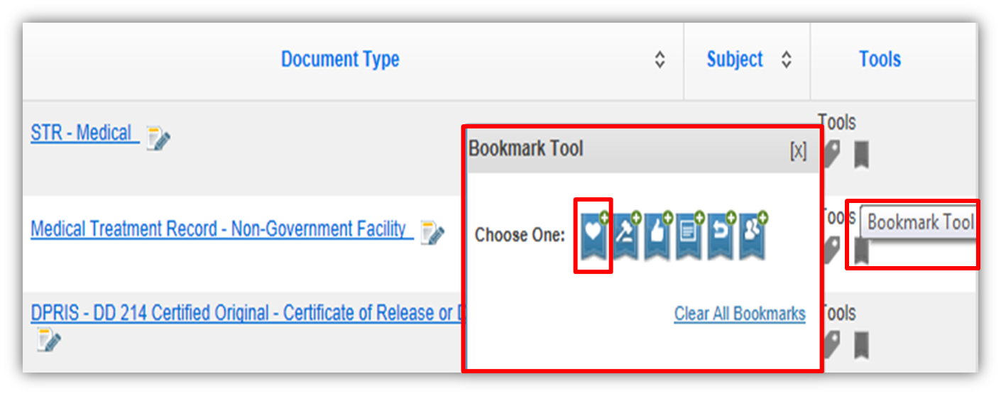
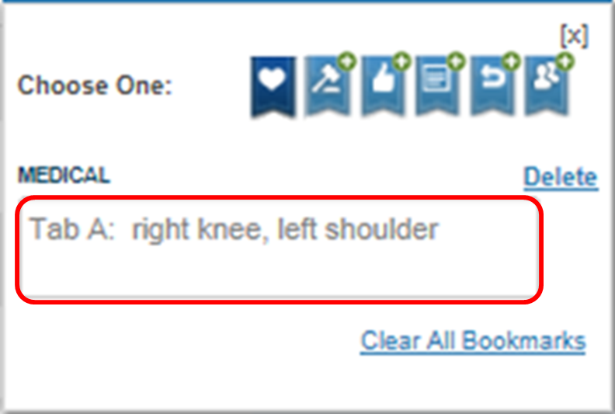
Bookmarking Documents
While there are multiple bookmark types available in VBMS, when bookmarking evidence for an examiner’s review, ROs must use the medical bookmark
The bookmark steps are found in M21-1 III.iv.3.A.15.a

Slide 17
Examples of Ideal IDES Direct Opinion
Exam Location: (Fill in VAMC Location)
The SM was diagnosed with (Fill in Condition). (Fill in Condition) was noted on the SM's entrance exam. Please answer the following opinion:
Was the SM’s (Fill in Condition), which clearly and unmistakably existed prior to service, aggravated beyond its natural progression during service? Rationale must be provided in the appropriate section below. Your review is not limited to the evidence identified on this request form, or tabbed in the claims folder.
Potentially Relevant Evidence
Tab A: Entrance Exam
Tab B: (Fill in Relevant DBQ)
Tab C: (Fill in Relevant Additional DBQ if Applicable)
Tab D: (Fill in Medical Record with Date of Treatment if Applicable)
Tabbing Instructions in VBMS (DO NOT INCLUDE THESE INSTRUCTIONS IN YOUR OPINION REQUEST):
1. Tab the entrance exam and cite the page number inside the medical bookmark. Example (TAB A: Entrance Exam pg. 300)
2. Tab the Relevant DBQ(s). Example (TAB B: Knee DBQ, TAB C: Back DBQ, etc.)
3. Tab any other relevant medical records and cite the page numbers inside the medical bookmark. Example (TAB D: Knee Injury pg. 400)

Slide 18
Questions?

