Slide 1
Integrated Disability Evaluation System (IDES) Topics
Briefed by: Compensation Service (212A)
Date: August 2020

Slide 2
IDES Topics Overview
Duty Status and Service Verification in NG/R IDES cases
Multi-Disciplinary Brief
IDES Exit Interviews
Exit Interview Updates in VTA

Slide 3
Duty Status (DS) and Service Verification in IDES Cases Involving Members of the National Guard (NG) and Reserve (R)
Briefed by: Dave Kesselman
Date: August 2020

Slide 4
DS and Service Verification in NG/R IDES Cases
Overview
Duty Status v. Component
Review of MSC Responsibilities
Use of Veterans Information Solution (VIS) Reporting
“Active Service” Defined
Active Duty v. ADT/IADT
Updating Military Service Tab in VBMS

Slide 5
Duty Status v. Component
Duty Status
Active Duty (AD)
Non-Active Duty (NAD)
Component
Active Component (AC)
Reserve Component (RC)
Includes members of both NG and Reserve
Can have NAD or AD duty status

Slide 6
MSC Responsibilities
In IDES cases involving members of the NG/R, the MSC must:
Confirm current duty status
Ensure Line of Duty (LOD) Determination was provided with all NAD referrals
Update VBMS to reflect all prior periods of active service
Obtain verification of all prior periods of active service
Additionally, if a NG/R participant is currently serving on AD, the MSC must:
Obtain current orders
Update VBMS with date of entry of current Period of Service (POS)
Initiate action for award adjustment (if the participant is in receipt of VA Compensation)
References: M21-1 III.i.2.D.3.d and f

Slide 7
Using VIS to Verify Service
Veterans Information Solution (VIS) is a tool at your disposal to confirm military service data
VIS Report Builder
Include “Education Tab”
Generate VIS report and upload to VBMS eFolder for all NG/R cases
Determine periods of Active Service
Ensure all periods of Active Service are indicated and verified on Military Service screen in VBMS

Slide 8
“Active Service” Defined
Rule of Thumb:
Active duty service, that is not considered active duty for training (neither ADT or IADT), is always considered “Active Service”
ADT or IADT can sometimes be considered active service (when such service involves a service-connected disability)

Slide 9
“Active Service” Defined (cont.)
Active Service includes:
Full time duty in Armed Services--that is not active duty for training purposes (ADT, IADT)
Full-time service by member of active component
Federal Active Service by a member of RC (NG/R)
Activation under Title 10--not active duty for training (ADT, IADT)
Full-time service by a Reservist (not for training)
Reservists serving in the AGR and ADS
Important: Full-time service in the National Guard (AGR or ADS) is always considered active duty for training (ADT)

Slide 10
“Active Service” Defined (cont.)
“Active Service” includes:
ADT and/or IADT, only if
During the period of active duty for training (ADT) the servicemember was disabled or died from a disease or injury incurred or aggravated in the line of duty, or
During the period of inactive duty for training (IADT) the servicemember was disabled or died from any of the following conditions:
acute myocardial infarction
cardiac arrest, or
a cerebrovascular accident

Slide 11
Entering ADT/IADT in VBMS
Periods of ADT or IADT must be not be entered into VBMS until a rating decision is completed establishing SC (per M21-1 III.ii.3.C.7.a.)
As such, MSCs should not enter or verify any period (neither current or previous) of ADT/IADT in VBMS (unless SC was previously granted for a condition relating to that PoS)

Slide 12
Updating Service Info in VBMS
M21-1 III.ii.3.C.7.a: “All periods of Active Service must be verified and updated in VBMS”
For NG/R, “Active Service” will generally be limited to
Federal Active Service under Title 10--not for training.
Full-time AGR/ADS Service (Reserves only)
All “Active Service” dates must be entered and marked verified on Military Service Tab in VBMS
VBMS must show “Yes” in VADS or User entry of “Yes” in VERIFIED
VIS Report is sufficient to verify Service Information
Do not duplicate POS in VBMS
Do not enter periods of ADT/IADT in VBMS (unless SC has been established by rating for the period)

Slide 13
Multi-Disciplinary Brief (MDB)
Briefed by: Alex Plowman
Date: August 2020

Slide 14
Multi-Disciplinary Brief (MDB)
Strategic Objective
In support of the National Defense Strategy effort to build a more lethal force and improve organizational efficiency, the Disability Evaluation Systems Optimization Working Group created the Multi-Disciplinary Brief (MDB)
The Department of Defense, Health Service Policy memorandum does not eliminate or modify other one-to-one briefings, meetings, or case requirements established
Service members should complete an MDB prior to the Service member meeting individually with the MSC or within 10 days of referral into the Legacy DES (LDES)

Slide 15
Multi-Disciplinary Brief (MDB) continued
Functions of the MDB
The MDB will include content from:
Physical Evaluation Board Liaison Officer (PEBLO)
Military Legal Counsel (DES Attorney)
Department of Veterans Affairs Military Service Coordinator (MSC)
Goals of the MDB:
Establish Service members expectations
Prepare Service members for the initial interview and each stage of the IDES process
Inform Service members of what is expected of them during the IDES process

Slide 16
Multi-Disciplinary Brief (MDB) continued
VA Information Provided at MDB
Overview of VA’s role in the IDES Process
Explanation of VA Benefits (specifically, VA Compensation)
Explanation of “service-connection” including the evidence needed to support a claim
All VA Forms necessary to bring to the Initial Interview
Explanation of VA Form 21-526EZ
Steps Participants can take to prepare for the initial interview
Anticipated Benefits:
By providing the information above, the MDB will:
Ensure consistency in the VA information provided to IDES participants
Ensure participants come to initial interviews prepared and informed
Reduce the time/effort MSCs must spend providing general/standard VA information at individual initial interviews

Slide 17
Multi-Disciplinary Brief (MDB) video recording
Current Status of the MDB
The Department Of Defense has been working towards a video recording of the MDB. This will allow for extended outreach to places in which all required briefers are not physically available
The script that was prepared was developed to be broadly applicable for use across all Military Services, and is intended to standardize the VA information provided in all MDB’s

Slide 18
IDES Exit Interview
Briefed by: Michelle Collins
Date: August 2020

Slide 19
IDES Exit Interviews and Related Requirements
MSCs are encouraged to review M21-1 III.i.2.E.6 for details regarding IDES Exit Interviews.
The timeframe for Exit Interviews has changed from 10 to 14 calendar days.
M21-1 III.i.2.E.6 was updated to include:
IDES participants who were found fit and Return To Duty (RTD), or disenrolled from IDES for any other reason (to include administrative and other non-medical discharges)
indicate the requirement for the MSC to enter the RTD Letter Date in VTA (when applicable)

Slide 20
MSC Responsibilities for Exit Interviews
MSCs must run the Pending Exit Interview Report in VTA to identify IDES cases requiring exit interviews
Contact all IDES participants to offer an exit interview
All required actions related to the exit interview must be completed within 14 days of the date entered in the EXIT INTERVIEW START DATE field in VTA

Slide 21
Exit Interviews by Telephone
MSCs must take the actions described in M21-1 III i.2.E.6.f. for exit interview by telephone.
Attempt to contact the participant by telephone to schedule the interview. If the participant cannot be reached by telephone, attempt to contact the participant by e-mail
After scheduling the appointment, send a follow-up e-mail to the participant that confirms the date and time of the interview
Document the telephone interview on VA Form 27-0820, and ensure it is associated with the participant’s eFolder

Slide 22
Exit Interviews With IDES Participants That a PEB Determined Are Unfit for Duty
MSCs must follow the instructions described in M21-1 III.i.2.E.6 e
Document the exit interview by completing VA Form 21-0820, and uploading it to the participant’s eFolder, or entering a detailed note in VBMS

Slide 23
Required Action in Return to Duty (RTD)/Disenrolled IDES Cases
M21-1 III.i.2.E.2.a outlines the required VA actions in cases involving participants who are found fit and RTD or are disenrolled from IDES for any other reason (to include administrative and other non-medical discharges)
Previously (before the recent manual update), these procedures indicated that this action would be taken by either the MSC or the DRAS, based on which office had current jurisdiction of the Veteran’s file
M21-1 III.i.2.E.2.a now shows this as the MSC’s responsibility in all cases

Slide 24
Required Action in Return to Duty (RTD)/Disenrolled IDES Cases (cont.)
The MSC actions required in these instances are summarized as follows:
prepare the appropriate letter
complete the exit interview
clear the pending EP 689, and
establish a rating EP (if the participant is a NAD Veteran, who has not received a final rating)

Slide 25
EXIT INTERVIEW QUESTION
All required actions related to the exit interview must be completed within ___days of the date entered in the ____field in VTA.

Slide 26
Exit Interview Answer
All required actions related to the exit interview must be completed within 14 days of the date entered in the EXIT INTERVIEW START DATE field in VTA.

Slide 27
Exit Interview Updates in the
Veterans Tracking Application (VTA)
Briefed by: Andy Reese
Date: August 2020

Slide 28
Exit Interview Guidelines for VTA
Exit Interviews are discussed in M21-1, Part III, Subpart i, Chapter 2, Section E, Topic 6
MSCs should run the Pending Exit Interview Report daily in VTA to see their cases pending an Exit Interview
Exit Interviews should be completed within 14 days of exit interview start date

Slide 29
Exit Interview Data Fields when Service member is Found Unfit by PEB
The Exit Interview Start Date will automatically populate with the date the Final Disposition Date is entered by the PEB.
Completion of the following data fields in VTA is required
8/10/2020
Not Required, but update if data available/task completed
DoS (DD214 or Separation/Retirement Order/Letter):?

Slide 30
Exit Interview Data Fields when Service member is Returned to Duty (RTD)
If RTD by the MEB, the Exit Interview Start Date will populate with the date the PEBLO enters the IPEB Referral (MEB Results)
If RTD by the PEB, the Exit Interview Start Date will populate with the date the PEB enters the Final Disposition Date
8/10/2020
**RTD Letter Date has to be populated for
Exit Interview Fields to become active.
Note: Complete the RTD Letter, provide to Service member and upload to VBMS.

Slide 31
Questions
Notes:
====

Slide 32
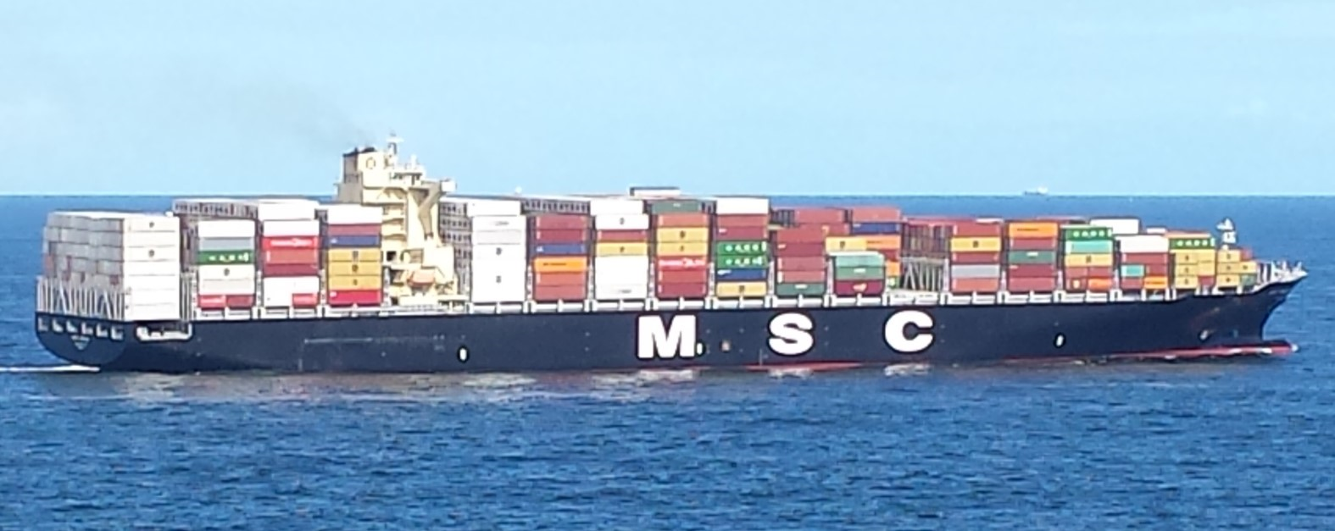
MSCs: Carrying the Load. Thanks for All You Do!!
Notes:
====

