Slide 1
Disappearance Of A Veteran
Compensation Service
July 2020

Slide 2
Objectives
Identify the procedures for obtaining a Veteran’s address
Apply the final actions to take if a current address is unobtainable
Identify the actions a claims processor must taken when processing 810 work items associated with the disappearance of a Veteran
Recognize the principles of paying benefits to the dependents of a Veteran whose whereabouts are unknown
Identify the steps to take upon the reappearance of a Veteran

Slide 3
References
38 CFR 3.158 – Abandoned Claims
38 CFR 3.656 – Disappearance of Veteran
M21-1 III.ii.1.B.6 – Handling Returned Undeliverable Mail
M21-1 III.vi.8 – Miscellaneous Authorization Issues
M21-5 7.E – Filling a Substantive Appeal

Slide 4
Overview
Veteran does not provide VA with a valid address
Essential mail is returned as undeliverable
The Intake Processing Center (IPC) takes steps to find a new address
If IPC’s efforts are unsuccessful, IPC establishes an EP 290 – Disappearance of Veteran and assigns it to the non-rating lane
If the Veteran has a running award, VA may suspend or discontinue benefit payments if all efforts to update the address have been exhausted

Slide 5
First Steps for Obtaining a Correct Address
When VA receives essential mail returned as undeliverable, the IPC undertakes the first steps towards obtaining a valid mailing address.
  The IPC follows return mail procedures under M21-1 III.ii.1.B.6.d
  If the IPC exhausts all efforts under the above reference, they establish EP 290 – Disappearance of Veteran for non-rating review
  Important: Utilize telephone development whenever possible to obtain a corrected address.

Slide 6
Final Attempts to Obtain an Updated Address
If direct deposit information is available, send a Bank Letter to the Veteran’s financial institution and set a 30-day suspense
If an address is identified within 30 days, then resend the returned mail and clear EP 290
If direct deposit information is NOT available, or there was no response to the Bank Letter, follow the guidance under M21-1 III.ii.1.B.6.i

Slide 7
Taking Final Action When a Correct Address is Unobtainable
If no award is running, take no further action and clear EP 290
If no award is running and a claim is pending:
  Deny the claim under the Basic Eligibility Tab in VBMS-A for the reason Whereabouts Unknown
  Send decision notice to the claimant’s last known address
  Clear the pending EP 290 and any EPs associated with pending claims
  Consider the claim abandoned one year following the date of request (38 CFR 3.158(a))

Slide 8
Taking Final Action When a Correct Address is Unobtainable (Cont.)
If an award is running:
  Clear the EP 290 and any EP(s) associated with pending claims
  Establish EP 600 with a suspense date of 65 days
  Send notice of proposed adverse action to discontinue benefits to the last address of record
  Suspend benefits effective LAST PAID DATE in Share if the beneficiary does not respond within that timeframe
  Send a decision notice to the last address of record
  Cite applicable laws and regulations for the notification letter: 38 CFR 3.158, 38 CFR 3.656

Slide 9
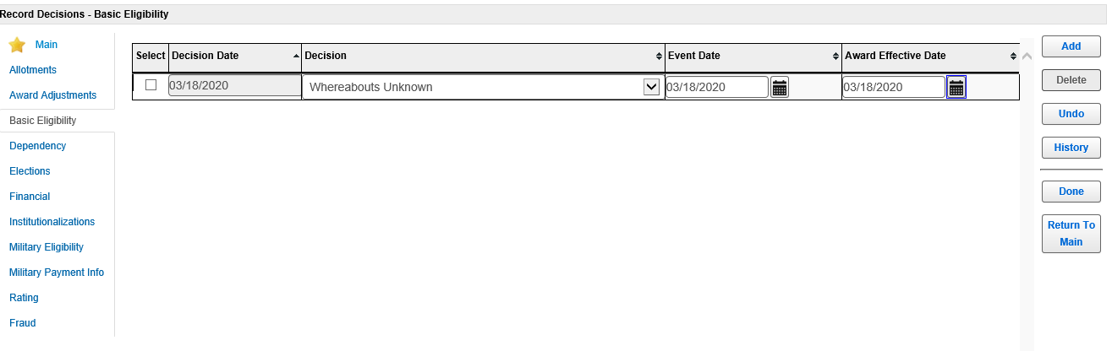
Denial of Pending Claim – No Running Award

Slide 10
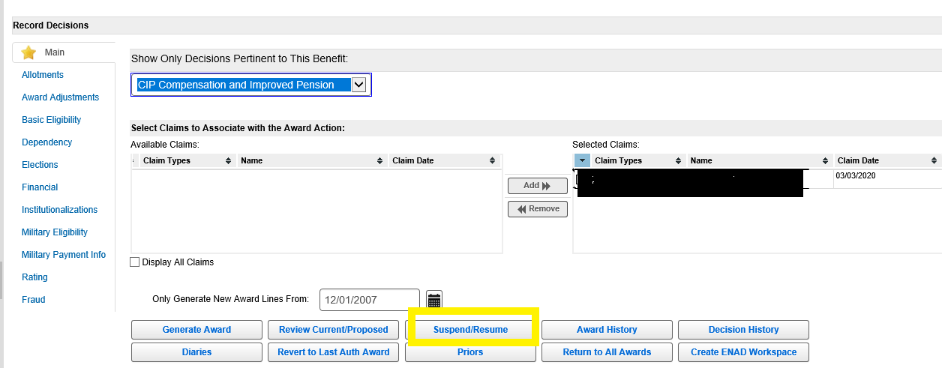
Suspending a Running Award
To begin suspending an award, click on Suspend/Resume in the Record Decisions screen.

Slide 11
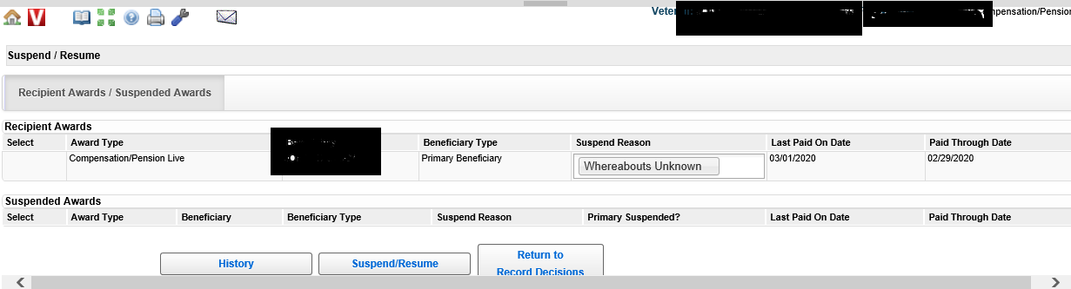
Suspending a Running Award (Cont.)
Choose Whereabouts Unknown for Suspend Reason. Benefits should be suspended Last Date on Paid. Click on the Suspend/Resume button to go to the next screen.

Slide 12
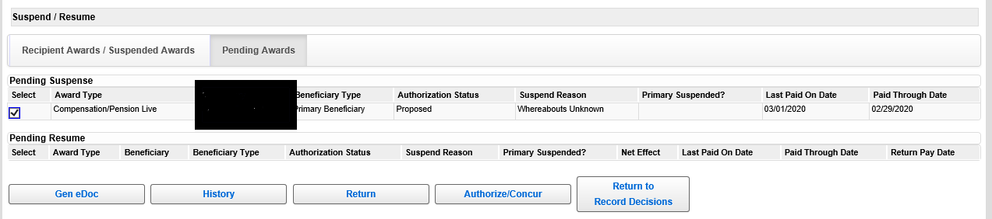
Suspending a Running Award (Cont.)
The suspense action should now be pending in VBMS-A. This action must be authorized by a Senior Veteran’s Service Representative (SVSR), or other authorizing employee, in the Suspend/Resume screen.

Slide 13
Generation of 810 WIs Associated With a Veteran’s Disappearance
When two consecutive checks to a Veteran are returned indicating Whereabouts Unknown or Moved Left No Address, payments are automatically suspended during processing of the returned check. An 810 Work Item, Notice of Benefit Payment Transaction (810WI) is then generated with message code 612, Account Suspended – Undeliverable Payment.

Slide 14
Processing an 810 Work Item
If no award action is required, allow the suspension to continue and cancel the work item
If a valid address is received, restart the award effective date last paid per the Award Information tab in Share
If there is a deduction for payment of life insurance or insurance loan payments, take award action to continue the insurance deduction
See M21-1 III.vi.8.1.b for a list of the life insurance programs for which there may be a deduction

Slide 15
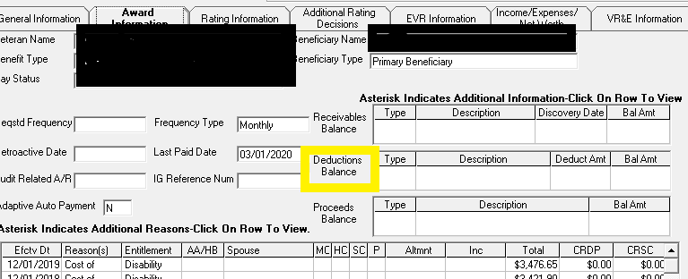
Finding Deductions in Share
Information about deductions can be found in Share under the Award Information tab. Last Paid Date information can be found to the left of Deductions Balance.

Slide 16
Six-Month Follow-Up Notice on an 810 Work Item
Upon receipt of a six-month follow-up notice:
  Attempt to contact the Veteran by phone for a valid address
  Follow steps 1-6 in M21-1 III.ii.1.B.6.d (return mail procedures)
  Leave a note in VBMS detailing what actions were taken to obtain a correct address
  Stop the Veteran’s award effective Last Paid Date, using Whereabouts Unknown in the Decision field on the Basic Eligibility tab in VBMS-A
  Note: If successful at any point in obtaining a correct address, update the corporate record and resume the Veteran’s award effective date last paid.

Slide 17
Payments to Dependents
Per 38 CFR 3.656, a Veteran receiving compensation whose whereabouts remain unknown for 90 days or more can have their benefits paid to or for:
  a spouse
  children, or
  parents.

Slide 18
Eligibility Criteria
The dependent, or person on their behalf, must submit the request using VA Form 21-0788, Information Regarding Apportionment of Beneficiary’s Award.
If the legal relationship to the Veteran is not already established, the claimant must also submit VA Form 21-686c, Application Request to Add and/or Remove Dependents and any required documentation
If VA Form 21-0788 is received within one year of the date VA last paid benefits to the Veteran, benefits can be paid to the dependent that same date. Otherwise benefits are paid the first of the month following the date VA received the form.

Slide 19
Payment Rates to Dependents
In compensation cases, the rate payable to the dependent(s) is either the current Dependency and Indemnity Compensation (DIC) rate or the rate of compensation payable to the Veteran, whichever is less.
Please refer to M21-1 III.vi.8.2 for additional information regarding payments to dependents.

Slide 20
When VA Obtains a Current Address or Reappearance of a Veteran
When a valid address is received for a Veteran who has disappeared:
  Resume the Veteran’s award effective the Last Paid Date
  Notify the Veteran of the decision made
  Applicable laws and regulations for the notification letter: 38 CFR 3.158 and 38 CFR 3.656
  Note: Per 38 CFR 3.158(c), payments can be resumed effective the date VA last paid benefits to the Veteran, regardless of how much time has passed since the Veteran’s award was suspended or stopped (only applies to awards not paid to a dependent based on disappearance of the Veteran).

Slide 21
When VA Obtains a Current Address or Reappearance of a Veteran (Cont.)
If the Veteran’s award is being paid to dependents:
  Discontinue any awards to dependents effective Last Paid Date per the Award Information tab in Share
  Inform the dependent(s) via notification letter the reason the award was discontinued, and
  Resume the Veteran’s award in accordance with the facts found, send notification letter

Slide 22
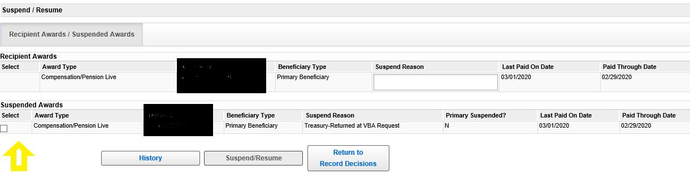
Resuming the Veteran’s Award if Suspended
Benefits are resumed using the Suspend/Resume screen in VBMS-A. Select the box under the Suspended Awards heading and then click Suspend/Resume.

Slide 23
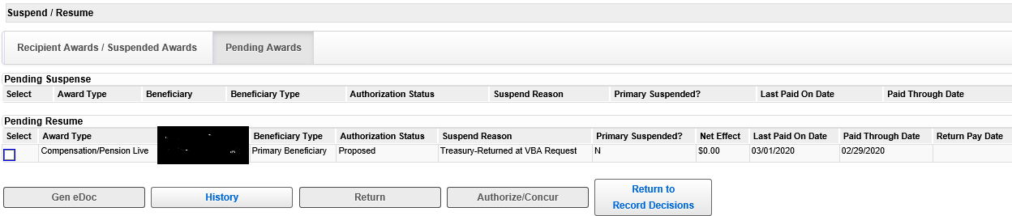
Resuming the Veteran’s Award if
Suspended (Cont.)
The award should now be pending resumption. An SVSR will need to authorize the action. To authorize, check the box under the Pending Resume heading and then click the Authorize/Concur button.

Slide 24
Awards Stopped Due to Whereabouts Unknown
If the Veteran’s award has been discontinued due to Whereabouts Unknown:
  Go to the Basic Eligibility tab in Share
  Delete the previous Whereabouts Unknown Decision
  Generate award
  Note: Make sure to resume the award if also suspended.

Slide 25
Questions

