Slide 1
Generate Award Override (GAO) and
Gross and Net Rate Adjustments
Compensation Service
July 2020

Slide 2
Lesson Objectives
Define the function of the Generate Award Override (GAO) process
Demonstrate how to process an award using the GAO function in VBMS-A
Explain the five GAO processing actions and identify the correct use of each action to adjust a Veterans award
Understand the other adjustment options that may be needed when adjusting an award
Demonstrate the location and functionality of the other adjustment options within VBMS-A

Slide 3
References
M21-1, Part III, Subpart v, 8.B Paying Pension to the Dependents of an Incarcerated Veteran
M21-1, Part III, Subpart vi, 4.D Awards and Payments for Benefits due to Philippine Service
M21-1, Part V, Subpart iii, 1.C Section 306 Pension & Old-Law Pension
M21-1, Part V, Subpart iii, 1.D Parent’s DIC
VBMS-A User Guide (Log in to VBMS-A & click “Awards Help”)
VETSNET Awards User Guide

Slide 4
Generate Award Override (GAO)
The GAO function is used to bypass system edits and modify a proposed generated award that is incorrect.
The GAO function should only be used after verifying all award data entry and decision input is correct.
Awards generated using the GAO function always require a third signature before the award is finalized.

Slide 5
Possible Reasons to use the GAO Function
There are very few specific circumstances where the GAO function must be used to achieve the desired award adjustment.
Additional circumstances may arise on a case-by-case basis necessitating use of the GAO function to modify an incorrect award.
Both VBMS-A and VETSNET Awards have GAO functionality, however VBMS-A should be used whenever possible.

Slide 6
Caution when using GAO Function
The GAO function should only be used when no other option exists for correcting an incorrect award because:
The GAO function overrides the system and can cause issues with the award,
The GAO function must be used again in each subsequent award action, and
If an authorizer returns the award, the GAO award lines will not be saved and must be recreated.

Slide 7
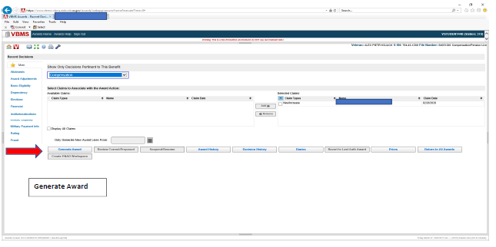
Processing an Award using GAO
Log-in to VBMS-A. Begin by recording all necessary decisions and select "Generate Award."

Slide 8
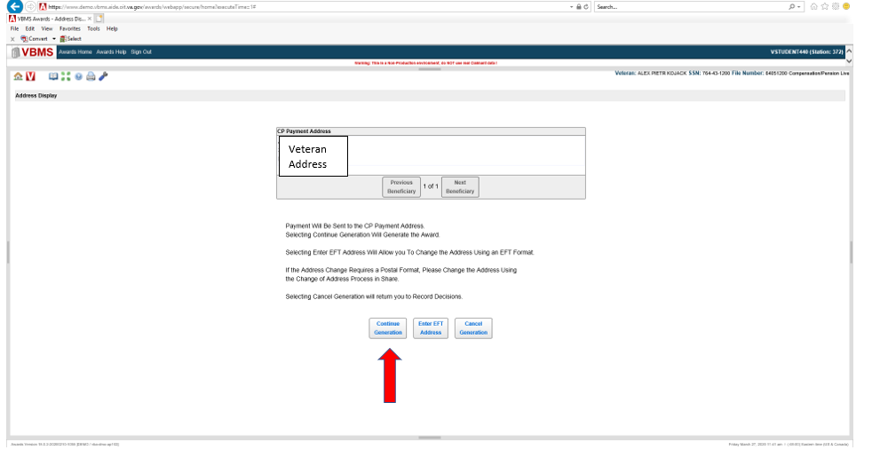
Processing an Award using GAO (cont.)
Select "Continue Generation."

Slide 9
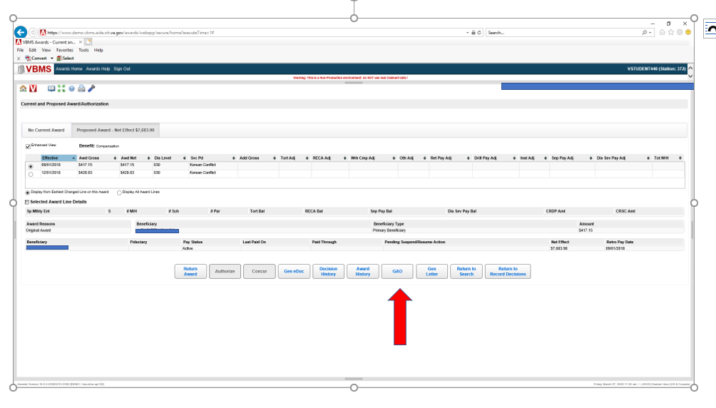
Processing an Award using GAO (cont.)
Select "GAO."

Slide 10
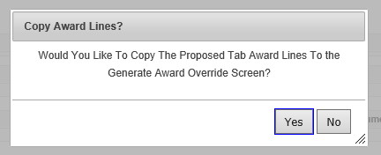
Copy Award Lines in GAO
A message will display offering the option to copy the proposed award lines. Selecting “No” will open a blank GAO screen where all the lines must be manually constructed. Selecting “Yes” will open the GAO screen with all the proposed award lines displayed and available for adjustment.

Slide 11
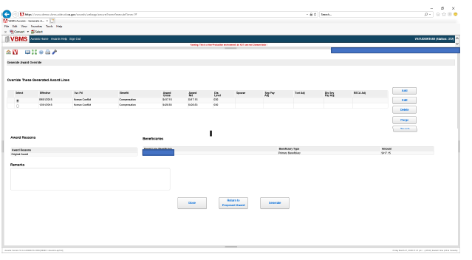
GAO Actions Function
The actions that can be taken on this screen are: “Add, Edit, Delete, Purge, Revert and/or Generate.”

Slide 12
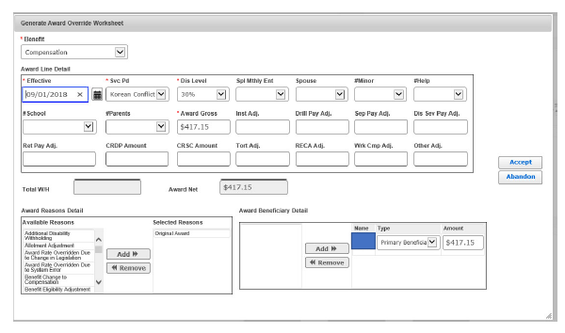
GAO Worksheet
The GAO Worksheet is accessed by selecting “Add” or “Edit”. The information populated in the worksheet fields will be from the award line that was highlighted at the time the “add” button was selected.

Slide 13
Adding an Award Line in GAO
All fields with an asterisk (Benefit, Effective, Svc Pd, dis Level, Award Gross) are required, but can be edited.

Slide 14
Adding an Award Line in GAO (cont.)
Benefit – Select the benefit type of award
Enter the award “Effective” date for the new award line
Update all other fields requiring a change
Select “Accept” to save the data, close the screen and return to the GAO screen which will be displayed with the newly added award line
1
3
2
4
3
3

Slide 15
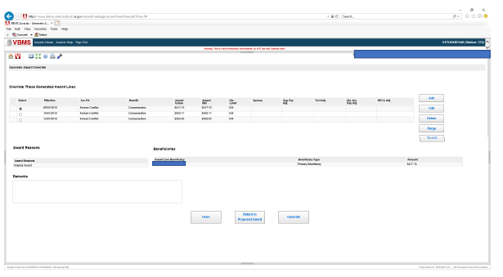
Adding an Award Line in GAO (cont.)
5. Record the justification for overriding the system in the “Remarks” block
6. Select “Generate” to generate the award
5
6

Slide 16
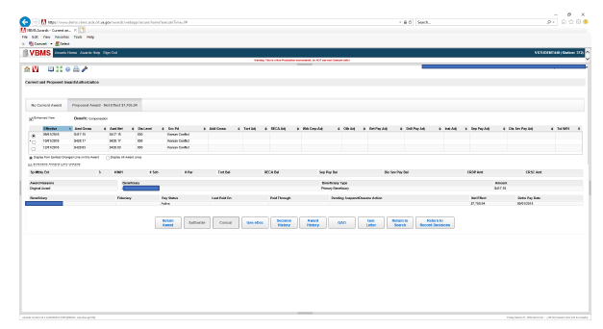
Proposed Award Screen
On the proposed award tab, an asterisk will be displayed next to the award line that was created using the GAO function.

Slide 17
Deleting Award Lines and Purging GAO Worksheets
Delete Record – Click the award line to delete, Select “Delete”, Click “Accept,” the dialog box appears.
Purging all GAO Worksheets – Click on one line, Select “Purge,” Dialog box will appear.
Selecting “Yes” will purge all prior payment information since the last authorized award event. When finished, click the “Done” button.

Slide 18
Reverting GAO Worksheets
Reverting GAO Worksheet Changes – Click on one line any time after using the Add, Edit or Delete functions, then click the “Revert” button. The dialog box appears.
By selecting “Yes” all of the prior payment information will be restored back to the stored values as they existed when the page was first accessed. Click the “Done” button when finished.

Slide 19
Other Adjustments in VBMS-A
VBMS-A has other functionalities that allow the VSR to manually adjust a system-generated rate or create a new payment line that the system could not generate on its own.
Functions:
Add to Gross Rate
Replace Gross Rate
Preserve Net Rate
Important: Unlike GAO, these functions do not require a third signature.

Slide 20
Add to Gross Rate
Add to Gross Rate allows the VSR to:
Add an additional amount to the system-generated payment line, effectively increasing the payment by the adjusted amount entered for the period of time specified.
Example of Use:
Eliminating the overpayment created due to an administrative error (M21-1 III.vi.2.B.3.e)

Slide 21
Replace Gross Rate
Replace Gross Rate allows the VSR to:
Replace the gross rate amount generated by the system with the amount entered on that screen for the indicated period of time.
Example of Use:
Generating an award that pays benefits back prior to October 1, 1982 (Vetsnet User Guide)
Note: At this time, there are no manual procedures that require the use of Replace Gross Rate.

Slide 22
Preserve Net Rate
Preserve Net Rate allows the VSR to:
Prevent other actions that might withhold the payable benefits, such as withholding due to receipt of separate benefits.
Examples of Use:
Preparing an award where the Veteran was in receipt of VSP benefits from the Air Force (M21-1 III.v.4.B.4.b)
Processing a request for the adjustment of separation benefits withholding due to extreme financial hardship (M21-1 III.v.4.B.7.a)

Slide 23
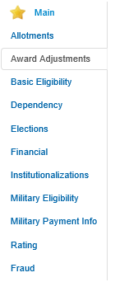
Location Within VBMS-A
Like GAO, these functions are also located in VBMS-A. However, they are housed in a different area within VBMS-A.
Once logged into VBMS-A with Veteran’s file number and having selected the appropriate EP, the VSR would need to select Award Adjustments.
This is the same selection the VSR would make if adjusting the award for retired pay or severance/separation pay.

Slide 24
Location Within VBMS-A (cont.)
On the Award Adjustments screen, the VSR is given several tab options.
By selecting “Other Adjustments,” the VSR will be taken to the a new screen which will allow them to enter the needed information.

Slide 25
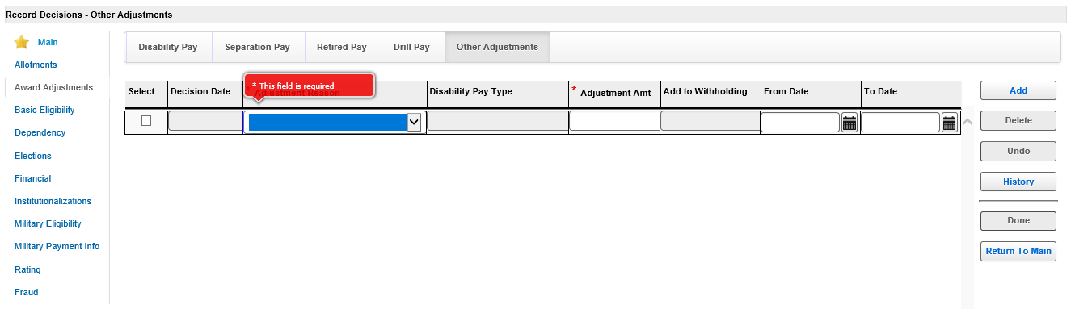
Location Within VBMS-A (cont.)
The Other Adjustments screen will prompt the VSR to enter the type of adjustment they need.
Remember, the different adjustments perform different actions, so the VSR must select the appropriate one needed.

Slide 26
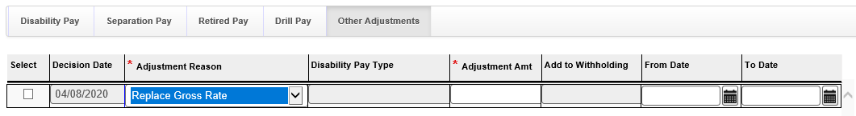
Location Within VBMS-A (cont.)
Once the type of adjustment is selected, the remaining information needs to be entered, including:
Adjustment Amount
From Date (starting date of adjustment)
To Date (end date of adjustment)

Slide 27
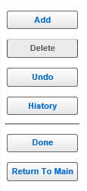
Location Within VBMS-A (cont.)
After all information has been entered for the adjustment, the VSR must remember to select the Done button in order to save the data.
The VSR will need to complete all other actions to create the award:
Enter any other decisions needed
Generate award and include explanatory notes including reasons for adjustment
Review notification to ensure letter is correct and sufficient per the manual
Route to authorizer for review and finalization

Slide 28
Summary
Define GAO and when to use the GAO function
The GAO function should only be used when necessary and completed in VBMS-A
Use of GAOs requires a third signature regardless of retro amount
A detailed note is required in the “remarks” box explaining the details of what and why the GAO function was used
GAO’s have to be duplicated with each subsequent award
Other Adjustments: Add to Gross Rate, Replace Gross Rate, Preserve Net Rate
These are located in VBMS-A>Award Adjustments>Other Adjustments tab

Slide 29
Review
Questions

