Slide 1
Determining Parental Dependency for Disability Compensation
Compensation Service
April 2020

Slide 2
Lesson Objectives
Comprehend the laws, terms, and regulations that guide the determination of parental dependency for disability compensation
Recognize the forms that must be completed in order to accurately process a claim for a dependent parent
Recall the types of eligible parental relationship VA may consider, the specific requirements for establishing parental relationships, and the development process to obtain the required evidence
Understand the specific financial requirements for establishing parental dependency including the circumstances under which dependency can be established or must be denied

Slide 3
Lesson Objectives (cont.)
Distinguish the circumstances where an administrative decision for parental dependency must be completed, and the required elements that must be addressed in an administrative decision
Know the process for generating an award for parental dependency and the requirements for notification that must be sent to the Veteran
Discuss the circumstances under which parental dependency should be reevaluated and/or discontinued

Slide 4
References
38 CFR 3.4(b)(2), Compensation. Disability Compensation. An additional amount
38 CFR 3.59, Definitions, parent
38 CFR 3.250, Dependency of Parent
38 CFR 3.209, Establishing relationship
38 CFR 3.401(b), Veterans, Additional compensation or pension for dependent
M21-1, Part III, Subpart iii, Chapter 1, Section B – Evidence Requested from the Claimant

Slide 5
References (cont.)
M21-1, Part III, Subpart iii, Chapter 5, Section I – Establishing Parental Relationship
M21-1, Part III, Subpart iii, Chapter 5, Section J – Establishing Parental Dependency
M21-1, Part III, Subpart iii, Chapter 5, Section L – Adjusting Awards for Dependents
M21-1, Part III, Subpart v, Chapter 1, Section A – General Information on Administrative Decisions
M21-1, Part III, Subpart v, Chapter 2, Section B – Decision Notices
VBMS Core User Guide
VBMS Awards User Guide

Slide 6
Overview of Parental Dependency and Eligibility
Veteran must have overall combined disability evaluation of 30% or more to be eligible for dependents.
Eligible dependents include:
Spouse
Child (minor, school, helpless)
Parent
Eligibility of parent(s) differs from most other types of dependents – entitlement determinations must consider both relationship and financial dependency of the parent.

Slide 7
Definitions
Per 38 CFR 3.59, a parent is defined as:
a biological parent,
an adoptive parent, and
a foster parent
The term dependent parent does not necessarily mean that the parent is not self-supporting. Rather it means that either:
the parent’s income and net worth are minimal, or
a parent with substantial income and assets has correspondingly high expenses

Slide 8
Distinction Between Relationship and Dependency
The term relationship concerns an individual’s legal status with respect to the Veteran: biological, adopted, and foster parents.
Stepparents, grandparents, and other family members might not be excluded if:
they formally adopted the Veteran, or
stood in the place of a Veteran’s parent (foster)
Ineligible parental relationships:
Parents of Veteran’s spouse (in-laws)

Slide 9
Distinction Between Relationship and Dependency (cont.)
The term dependency relates to the income, assets, and expenses of the parent and their financial dependence upon the Veteran.
In all parental dependency claims, the financial situation of the parent(s) is a factor in establishing entitlement.
Although two distinct requirements, both parental relationship and parental dependency, must be established in order to pay additional benefits for a parent.

Slide 10
Required Forms
After March 24, 2015, claims for parental dependency must be submitted on a prescribed claim form:
VA Form 21P-509, Statement of Dependency of Parent(s)
Other acceptable forms to initiate a claim for parental dependency include:
VA Form 21-686c, Application Request to Add and/or Remove Dependents
VA Form 21-0538, Mandatory Status of Dependents
In all cases, VA Form 21P-509 is needed as this specific form requests the financial information needed for determining parental dependency.

Slide 11
Establishing Parental Relationship
There are three eligible parental relationships under the law:
Biological parent
Adoptive parent
Foster parent
Unlike other claims for dependency in which evidentiary documents may not be required, documentary evidence is required to establish the legal relationship between the Veteran and their parent(s).
The type of documentary evidence needed depends on the type of parental relationship claimed.

Slide 12
Establishing Parental Relationship – Biological
A Veteran’s relationship with their biological parent(s) must be established by documentary evidence:
Birth certificate showing biological parent(s), or
Acceptable additional evidence (M21-1 III.iii.5.F.4.c):
Certified statement – physician or midwife present at birth
Service department records establishing relationship
Hospital, school, baptismal/church records
Insurance policies
Additional evidence may be needed to support the claim, especially in cases where the biological father is not listed on the birth certificate.

Slide 13
Establishing Parental Relationship – Adoption
A Veteran’s relationship to their Adoptive parent must be established through documentary evidence as well:
Final adoption decree showing relationship
Secondary evidence:
A copy of Veteran’s revised birth certificate, and
Statements of at least two disinterested parties who have personal knowledge of the adoption
Evidence that is not sufficient to establish an adoptive relationship for parental dependency:
Interlocutory adoption decree
Adoptive placement agreement

Slide 14
Establishing Parental Relationship – Foster
The term foster parent is defined by VA as a person who stands in place of a Veteran’s parent (in loco parentis) for a continuous period of at least one year.
The one year period must:
start before the Veteran’s 21st birthday, and
continue for one year before the Veteran entered active duty
The one year period may end after the Veteran’s 21st birthday, as long as the requirements set forth in the previous bullet are met.
Note: The term “foster parent” could apply to anyone, related or unrelated to the Veteran.

Slide 15
Establishing Parental Relationship – Foster (cont.)
The term relinquishment of parental control means:
The parent has ceased to provide for the child, and
The normal parent-child relationship has been broken
This does not mean or imply:
The court has terminated parental rights
Abandonment on the part of the biological or adoptive parent
If the claimed parent is a foster parent, the VSR will request completion of VA Form 21P-524, Statement of Person Claiming to Have Stood in Relation of Parent, as long as the parent is considered financially “dependent” on the Veteran (M21-1 III.iii.5.I.6.h)

Slide 16
Development Actions for Establishing Parental Relationship
When documentary evidence is needed to establish parental relationship, prepare a development letter in VBMS Core:
Developing under EP 130
Requesting appropriate evidence – “free text” needed
Allow 30 days for a response
Established a tracked item in VBMS
Important: Do not develop for evidence of a parental relationship if the financial information provided shows the parent is not “dependent” on the Veteran.

Slide 17
Denial Decisions Based on Relationship
Deny the claim based on the absence of a recognized parental relationship under the following circumstances:
The relationship is not eligible under the law (i.e. other than biological, adoptive, or foster parent)
The Veteran does not provide the requested evidence – deny the claim for “Failure to Furnish Requested Evidence”
VA must fulfill our duty to assist the Veteran by requesting the required information or evidence to support the claim. However, the Veteran has the initial burden of proof and must provide the supporting evidence – otherwise VA must deny their claim.

Slide 18
Establishing Parental Dependency
VA uses the financial information the Veteran provides on a completed VA Form 21P-509 to determine whether their parent(s) is financially dependent on the Veteran.
Two types of dependency:
Conclusive dependency – domestic cases, parental income does not exceed the income limitations
Factual dependency – all foreign cases and any domestic cases where parental income exceeds the income limitations, but it is insufficient to reasonably maintain themselves and their family members

Slide 19
Conclusive Dependency
Conclusive Dependency – when the monthly income of the parent(s) does not exceed established limitations.
Monthly Income Limitations:
$400 – mother or father alone
$660 – for a:
mother and father, or
remarried parent and spouse living together
If the parent is within income limitations, net worth is not a factor unless it is substantial.

Slide 20
Conclusive Dependency (cont.)
An additional $185 is added to the income limitation for each member of the family that the parent is under legal or moral obligation to support.
Members of the family, for parental dependency considerations, includes relatives:
Under age 21 who are supported by a parent under legal or moral obligation, and
Over age 21 who are dependent on the parent because of physical or mental incapacity
Note: Legal dependents of the Veteran’s parent(s) are considered for income limitation purposes in determining conclusive dependency, but may not be added to the Veteran’s award as the Veteran’s dependents.

Slide 21
Conclusive Dependency (cont.)
Example of conclusive dependency established:
The Veteran, rated 30% disabled due to service-connected disability, claims their biological mother as a dependent, and the income information provided on VA Form 21P-509 shows that the mother does not have any income.
Because she receives less than the $400 monthly income limitation, conclusive dependency is established.
Question: Are those who exceed the income limits automatically denied?

Slide 22
Factual Dependency
Factual Dependency – in all foreign cases, and those domestic cases where income exceeds limitations, VA will use the following standard:
Does the parent have sufficient income and/or net worth to provide reasonable maintenance for himself/herself and for members of his/her family?
In other words, the VA can consider income, expenses, and net worth to establish dependency even when the parent’s income exceeds the income limits for conclusive dependency.
Note: This is a discretionary determination based on specifics of each case.

Slide 23
Factual Dependency (cont.)
A few more terms to define in understanding factual dependency based on CFR 3.250:
Our basic rule states that “dependency will be held to exist if [the parent] of the Veteran does not have an income sufficient to provide reasonable maintenance” for themselves and family.
Reasonable Maintenance “includes not only housing, food, clothing, and medical care sufficient to sustain life, but such items beyond the bare necessities…to provide those conveniences and comforts of living suitable to and consistent with the parent’s reasonable mode of life.”

Slide 24
Factual Dependency (cont.)
Compare the available income of the parent(s) to their expenses and determine if factual dependency exists:
Many potential variables exist depending on the income and expenses listed
Very few rules guide what types of income and expenses can be considered or not
Consideration is on a case-by-case basis
When determining factual dependency, and the parent’s income is not sufficient to provide their “reasonable maintenance,” the VA must also consider the parent’s net worth, or financial assets, and the potential to subsidize their income.

Slide 25
Net Worth
When determining whether factual dependency exists, always consider the parent’s net worth:
If assets could be used to provide additional financial support
If parents hold separate assets, the net worth for each parent should be considered separately
If parents hold assets jointly, only consider half of the joint or community property when considering the dependency of each parent
M21-1 III.iii.5.J.3.b provides a table that describes considerations with regard to net worth and establishing factual dependency.

Slide 26
Development Actions for Establishing Parental Dependency
If the Veteran has not provided VA Form 21P-509, Statement of Dependency of Parent(s), the VSR must request its completion using a subsequent development letter.
If additional financial information or clarification is needed, the VSR must undertake development by telephone:
Efficient means for obtaining information
Document on VA Form 27-0820, Report of General Information

Slide 27
Development Actions for Establishing Parental Dependency (cont.)
If telephone development is unsuccessful, send a subsequent development letter:
Clearly identify and describe the information or clarification needed – use the “free text” feature
Provide VA Form 21-4138, Statement in Support of Claim, for Veteran to respond
Develop under EP 130
Allow 30 days or a response
Establish a tracked item in VBMS
Once financial information required to determine dependency is obtained, an administrative decision may be required.

Slide 28
Administrative Decisions for Parental Dependency Claims
Administrative decisions are not required for every parental dependency claim.
Administrative decisions must be completed when:
The decision is unfavorable (i.e. a denial)
Factual dependency exists and a parent’s estate is $80,000 or more
Administrative decisions are either prepared using either:
Format discussed in M21-1 III.v.1.A.3.c
Denials (except for excessive net worth)
VA Form 21P-5427, Corpus of Estate Determination
Denials due to excessive net worth and grants with an estate of $80,000 or more

Slide 29
Administrative Decision for Parental Dependency Claims (cont.)
Per M21-1 III.v.1.A.3.c, an administrative decision must include the following elements:
Identification of the issue(s) adjudicated
Summary of the
Evidence considered, and
Laws and regulations applicable to the claim
A list of findings that are favorable to the claimant, if any, and
Identification of the element(s) required to grant the claim that were not met
Note: M21-1 III.v.1.A.3.g provides sample formatting for an administrative decision.

Slide 30
VA Form 21P-5427, Corpus of Estate Determination
VA Form 21P-5427, Corpus of Estate Determination
When denial or discontinuation is due to excessive net worth
When factual dependency exists and parent’s estate is $80,000 or more
This form helps to clearly delineate:
Assets: stocks, bonds, real estate, other personal property
Monthly income types
Monthly expenses

Slide 31
Administrative Decision for Parental Dependency Claims
Whether creating an administrative decision from the format in the manual, or using the VA Form 21P-5427, the VSR should remember the following:
Documents will be:
Reviewed by an authorizer,
Provided to the Veteran and their representative (once approved)
Uploaded to the Veteran’s eFolder (once approved)
Decisions should be:
Well-written with valid reasons and bases
Written in clear, simple terms
Conclusion should be obvious to the reader

Slide 32
Awards for Parental Dependency Claims
An award transaction is required for all parental dependency decisions, whether establishing the parent as a dependent (grants) or denying the claim.
Two tasks must be completed to record the decision in VBMS-A:
Dependent information must first be added in VBMS Core
Dependency decision to grant or deny the claim must then be added in VBMS-A

Slide 33
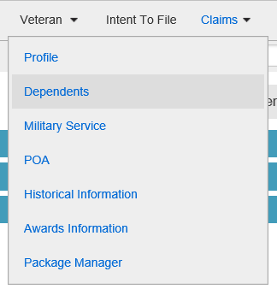
Awards for Parental Dependency Claims (cont.)
Adding dependent information in VBMS Core:
Enter the parent as a potential Dependent in VBMS Core first so they become an option to select when entering the decision in VBMS-A
The above action does NOT add the parent to the actual award

Slide 34
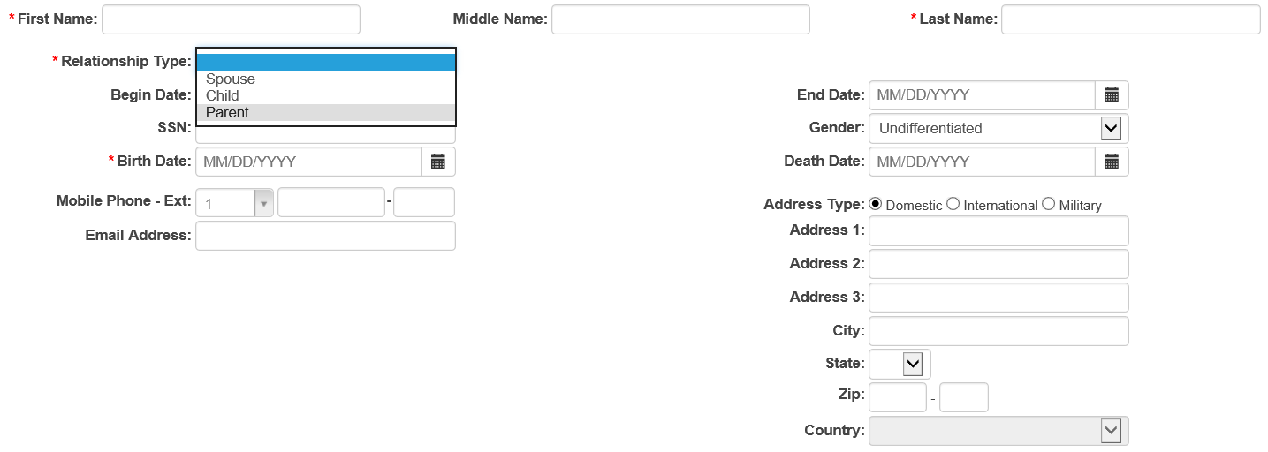
Awards for Parental Dependency Claims (cont.)
Adding dependent to the system in VBMS Core:
Complete all selections marked with an asterisk
Remember to select the correct relationship type so the dependent is listed as a parent rather than another type of dependent
Once completed, remember to save

Slide 35
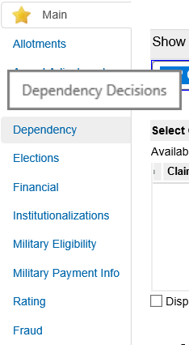
Awards for Parental Dependency Claims (cont.)
Once the dependent profile is entered in VBMS Core, the decision can be entered into VBMS-A:
After selecting the EP 130, the VSR should select Dependency from the left hand column.
The VSR should fill in all pertinent information for the decision including the person (drop-down menu), relationship type (parent), event date (effective date), award status (established or not), decision, and award effective date (payment date).
If denied, favorable findings should be entered.

Slide 36
Decision Notices
Once the award is generated, the VSR is also required to prepare a decision notice to inform the Veteran of the decision made.
Some of the elements of the decision notice are the same as the elements for the administrative decision. However, the decision notice also provides the Veteran with:
Review options, should the Veteran disagree with the decision
Instructions for obtaining or accessing evidence used in making the decision

Slide 37
Decision Notices (cont.)
The decision notice also covers information concerning any changes in the Veteran’s payments as a result of the decision made.
If VA granted the Veteran’s claim or otherwise adjusted their award, include:
The new monthly rate of payment
The effective dates of entitlement and payment
The amount of any benefits VA is withholding and the reason for the withholding
If an overpayment of benefits was created, the letter must also include the Veteran’s right to request:
A waiver of the overpayment, and/or
A repayment plan

Slide 38
Decision Notices (cont.)
A decision notice generated in VBMS-A is referred to as a Redesigned Automated Decision Letter (RADL).
To ensure that all decision notice requirements are met, the VSR may need to add free text to the letter.
When the RADL is deemed insufficient and cannot be adequately amended using free text, the VSR may revert to using a Personal Computer Generated Letter (PCGL).

Slide 39
Reevaluate a Parent’s Dependency
There are instances where the VSR will have to re-evaluate the dependency of a parent that is already on a Veteran’s award.
These instances include:
Any significant change in the parent’s income or net worth
Change in the parent’s marital status (which may affect the parent’s finances)
Death of the parent – remove as soon as possible to minimize the overpayment of benefits
Remember: It may be necessary to provide due process before removing a parent from a Veteran’s award.

Slide 40
Review
Questions

