Slide 1
Exam Liaison Call
Medical Disability Examination Program Office (217)
Briefed by: Medical Disability Examination Program Office Staff
Date: August 13, 2020
TMS Number: 4557428
Notes:
Ken

Slide 2
Agenda
TMS Number for Exam Liaison Call - 4557428
Use of the ERRA Tool
VHA Cancellation Comments
VBA In-person Exams
Allowable Mileage
Exam Status Requests
Vendor Scheduling Requests
Vendor Cancellation of Appointments
Requesting BDD/IDES During Pandemic
Special Instructions
Clarification Requests
Adding DBQ’s to CR responses
ESR Cloning Functionality
ESR Status
Extra Schedular Consideration
Reminders
Contract Exam Resources
Notes:
Ken

Slide 3
TMS Number for EL Call
A TMS number will be assigned to EL calls
A recording of the call, slide deck and attachments will be available
Questions typed into the chat box will be shown along with the answer that was provided
Will be available during the week following the call
This is not considered mandatory training
A new Exam Liaison site to replace Pulse will be online in the near future
Notes:
Tim

Slide 4
ERRA Tool
ERRA reflects VHA facilities that are doing ACE and Tele C&P exams only
78 VHA locations across all VISN’s supporting C&P
VHA has not yet officially resumed in-person C&P examinations at this time
All eligible exams should be sent to VHA unless specifically excluded from ACE/Tele C&P process
If the necessary DBQ is showing as disabled at the closest VAMC send the request to MDE Vendors
VHA will cancel the request if they determine an in-person exam is required, must be re-requested with a vendor
ALL BDD/IDES exams must be request through EMS
ERRA use not applicable to BDD/IDES only
Notes:
Tim

Slide 5
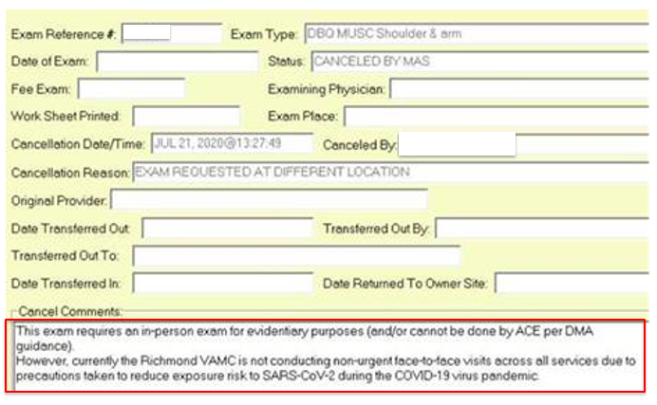
VHA Cancellation Comments
Notes:
Tim

Slide 6
VBA In-Person Exams
96% of vendor locations now scheduling in-person exams
Specific requirements must be met prior to in-person exams taking place
Exams requiring the removal of PPE by Veteran or examiner now permissible in 69 CONUS and 1 OCONUS locations, as of 8/11/20
Veterans and Service Members within 50/100 miles of these areas eligible for In-person exams
Notes:
Tim

Slide 7
VBA In-person Exams (cont.)
Currently, most “open” areas still in Phase I
VBA will continue work with VHA to assess move to Phase 2 and Phase 3 in all areas
Move to Phase 2/3 only permitted when there is sustained reduction in COVID-19 cases and is based on VHA recommendations
Phase 1 – Out-patient C&P examinations can be completed that do not require the removal of PPE
Phase 2 – Out-patient and in-patient C&P examinations can be completed that do not require the removal of PPE
Phase 3 – All C&P examinations can be completed
Notes:
Tim

Slide 8
VBA In-person Exams (cont.)
https://benefits.va.gov/compensation/claimexam.asp
Notes:
Tim

Slide 9
Allowable Mileage for Contract Examinations
Veterans/Service members can be scheduled to travel up to 50 miles for general examinations and up to 100 miles one way for a specialty examination
Veteran must agree to travel any distances in excess of 50/100
Vendors not currently allowed to schedule exams in excess of 50/100, even with Veteran consent, unless approved in advance by VBA
Vendors must contact VBA for this approval
Regional Offices should not discuss, and are not authorized to approve, excess mileage requests with vendors
Refer these requests to MDEPO
Notes:
Chris

Slide 10
Exam Status Requests
MDEPO requires the following to complete an exam status request:
Date of “Appointed Completed” message(s)
Date of “Results Available: Received” message(s)
What is shown in the vendor portal
Confirmation the EL has contacted vendor and unable to resolve the status
Attachment #1
Notes:
Chris

Slide 11
Vendor Scheduling Requests
Do not contact Vendors requesting appointment or scheduling updates
Guidance released by NWQ/OFO July 29, 2020 states:
“As specific areas begin to reopen, the exam vendors have been diligently working to schedule examinations in a timely manner. Regional Offices should refrain from contacting the exam vendors regarding the scheduling of specific claims, until further notice…”
Attachment #2
Notes:
Dan

Slide 12
Vendor Cancellation of Appointments
If a Veteran refuses to attend an in-person examination due to COVID19 concerns, the Vendor will:
Cancel the scheduled appointment
Cite “Veteran concerns/risks associated with pandemic”
Hold ESR until Veteran can be scheduled and appointment completed
Vendor will not send a request to cancel the ESR
Notes:
Dan

Slide 13
Vendor Cancellation of Appointments (cont.)
If a Veteran fails to attend an in-person examination, Tele C&P exam or ACE phone call for any reason, the Vendor will:
Cancel the scheduled appointment
Cite “Veteran concerns/risks associated with pandemic”
Hold ESR until Veteran can be rescheduled and appointment completed
Vendors will not send a request to cancel the ESR
Notes:
Dan

Slide 14
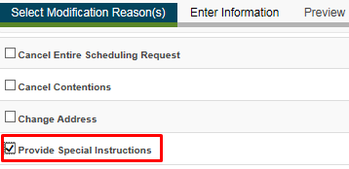
Special Instructions Needed
Should not be used to add new DBQ’s or medical opinions
Vendors have been instructed to ignore DBQ and medical opinion changes
Should be used for: Non-exam changes that have occurred since submission of the ESR
Notes:
Linsay

Slide 15
Clarification Requests
Clarification Requests (CR) citing “Force Majeure” have been resolved
Done by an automated IT process
This caused a “Locked” status as they were being resolved
If you see any that remain in a locked status, or a CR that still cites Force Majeure contact MDEPO
Attachment #3
Notes:
Linsay

Slide 16
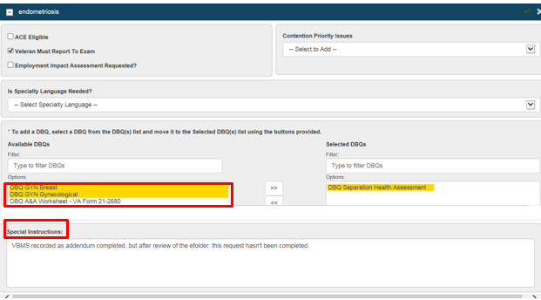
Adding DBQs when Responding to CRs
If necessary, the user will make any changes to the DBQ(s) in the original ESR. The user should only make changes based on the questions (if necessary) from the clarification request. Only the question that is asked by the inquiry should be answered.
https://vbaw.vba.va.gov/bl/21/contractexams/docs/ESR%20Clarification_Job%20Aid_Concur.docx
Notes:
Linsay

Slide 17
ESR “Cloning” Functionality
Users will now be able to clone the data and narrative previously captured from an ESR on a closed or canceled EP, and generate a new or Rework ESR associated to the source ESR under the new EP.
Users can regenerate Rework and/or copy an ESR without manually re-keying all the previous information from a previously closed/canceled EP.
Users will now be able to clone ESR contention information and narratives under a different EP.
The data and narrative from the selected contention(s), from the source ESR, populates in a 'Draft' Rework ESR.
This process will reduce potential errors due to manual data entry and will improve accuracy of data used for contract Exam performance oversight.
Note: The previous ESR must be in a completed/canceled state.
https://vbaw.vba.va.gov/bl/21/contractexams/docs/ESR%20Cloning%20Functionality_Job%20Aid_Concur.docx
Notes:
Linsay

Slide 18
ESR “Cloning” Functionality (cont.)
Notes:
Linsay

Slide 19
ESR Status: In-Person/ACE/Tele C&P Exams
If a vendor can schedule and complete any portion of an ESR via an In-person, ACE or Tele C&P exams:
Contentions with appointments will show “Scheduled” and the ESR status will be “Open”
When appointments are completed (prior to RAP being rec’d), these contentions will show “Pending Results” and the ESR status will remain “Open”
When appointments are completed (all RAP’s rec’d) for ALL contentions on an ESR, the contentions will show “Completed” and the ESR status will be “Completed”
Contentions that can’t be completed will remain in “Triage” status and the ESR will remain “Open”
For any ESR where the vendor is unable to schedule any appointments, the ESR will remain in “Triage” status
Attachment #4
Notes:
Chris

Slide 20
Extra Schedular Consideration
Under 38 CFR 3.321 (b)(1) entitlement to an extra-schedular evaluation should be considered when:
The issue is expressly raised by the Veteran or
There is evidence of exceptional or unusual circumstances indicating that the rating schedule may be inadequate to compensate for the average impairment of earning capacity due to disability
Under 38 CFR 4.16(b) entitlement to an extra-schedular evaluation should be considered when:
There is evidence that the Veteran may be unable to secure substantially gainful occupation because of an SC disability
Only the Director of the Compensation Service (214D) may approve extra-schedular evaluations in compensation claims
SOURCE: M21-1 Part III, Subpart iv , Chapter 6, Section B
Notes:
Chris

Slide 21
Reminders
Rework Requests
Are for instances where the examination results are missing information that was included/requested on the original ESR (Inadequate/insufficient)
If not on original ESR a new DBQ/medical opinion is required
Do not contact Vendors for appointment or scheduling information
Do not add DBQ’s or medical opinions to the Special Instructions block after an ESR is submitted
Any missed appointments, ACE telephone calls or Tele C&P exams should be attributed to COVID19 and NOT be rated as a “No Show”
Notes:
Tim

Slide 22
Contract Exam Resources
Your VA Claim Exam
VA claim (C&p) exam
Exam FAQ’s
Mandatory Contract Exam Staff FAQS
COVID-19 Information Page
Novel Coronavirus Disease (COVID-19) Operational Information Page
VBMS EMS
VBMS EMS Information
Decision Tree for Examination Clarification and Correction
Contract Exam Inquiries
Contract Exam Inquiry Protocol Job Aid
Notes:
Ken

Slide 23
Questions
Notes:
Team

