Slide 1
Quality Management System (QMS) Error Notification & Correction
Office of Administrative Review
July 2020

Slide 2
Lesson Objectives
Recognize notification of an error correction
Access QMS
Identify and understand information on the “Error Correction Detail” page
Understand the function of action commands on the “Error Correction Detail” page
Identify and understand information on “My Error Correction Records”
Notes:
Instructor Notes:
At the end of this training, learners will be able to:
Recognize notification of an error correction
Access QMS
Identify and understand information on the “Error Correction Detail” page
Understand the function of action commands on the “Error Correction Detail” page
Identify and understand information on “My Error Correction Records”

Slide 3
References
QMS User Guide
M21-5, Chapter 3, Decision Review Operations Center (DROC) Quality Review Team (QRT)
M21-4, Chapter 6, Quality Review Team
Notes:
References:
Instructor Notes:
QMS User Guide
M21-5, Chapter 3, Decision Review Operations Center (DROC) Quality Review Team (QRT)
M21-4, Chapter 6, Quality Review Team

Slide 4
DRO Quality Reviews: ASPEN to QMS

Slide 5
DRO Quality Reviews: ASPEN to QMS
Quality reviews for DROs are currently conducted using ASPEN.
Continued utilization of ASPEN presents the following challenges:
Quality reviews performed in multiple systems
No single database of quality information
Extensive programming changes required to modify quality checklists and the reporting process
Updates were made to the Quality Management System (QMS) that allows for a smooth transition for all DRO quality reviews from ASPEN to QMS.
Notes:
Instructor Notes:
Quality reviews for Decision Review Officers (DROs) are currently conducted using the Automated Standardized Performance Elements Nationwide system, or ASPEN.
Continued utilization of ASPEN presents the following challenges:
Quality reviews of employees are conducted in multiple systems, to include ASPEN and the Quality Management System (QMS)
No single database of quality information
Extensive programming changes required to modify quality review checklists and the reporting process
Updates were made to the Quality Management System (QMS) that allows for a smooth transition for all DROs from ASPEN to QMS.

Slide 6
Benefits of DRO Quality Reviews in QMS
Minimal training for Quality Review Team (QRT) personnel who are trained and comfortable with conducting quality reviews in QMS.
Eliminates required use of ASPEN by Rating Quality Review Specialists (RQRS) for conducting reviews, allowing RQRS to operate in one quality system.
Improves quality review process and analysis of quality-related data.
All quality review information available in one database for analysis
Enhanced and consistent data tracking and reporting
Automated notification and tracking of errors
Notes:
Instructor Notes:
Quality Review Team (QRT) personnel are trained and comfortable with conducting quality reviews in QMS.
Conducting DRO quality reviews in QMS allows for the elimination of ASPEN as a system Rating Quality Review Specialists (RQRS) are required to use, thereby allowing RQRS to operate in one quality system instead of two systems.
In addition, conducting DRO quality reviews in QMS allows for improvement to the quality review process and enhanced analysis of quality-related data.
All quality review information available in one database for analysis
Enhanced and consistent data tracking and reporting
Automated notification and tracking of errors

Slide 7
Use of QMS for DRO Reviews by Position
DROs – Will use QMS to review quality errors, submit reconsideration requests, and log corrective actions
RQRS – Will continue to conduct quality reviews in QMS to now include all quality reviews for DROs
Supervisors – Will now track DRO quality in QMS
Notes:
DROs – Will use QMS to review quality errors, submit rebuttals, and log corrective actions
RQRS – Will continue to conduct quality reviews in QMS to now include all quality reviews for DROs
Supervisors – Will now track DRO quality in QMS

Slide 8
Access QMS

Slide 9
How to Access QMS
Single Sign-On Method in Salesforce
Via Start VBAPPS Salesforce
https://va.my.salesforce.com/
Notes:
Instructor Notes:
Employees must log into QMS every 90 days or your salesforce account will be deactivated.
Employees can also access the “Error Correction Detail” page by logging into Salesforce and QMS.
The Single Sign-On method is used to access Salesforce.
Navigate to your Start menu, then VBAPPS and click Salesforce.
QMS is part of the Salesforce site.

Slide 10
How to Access QMS, cont.
QMS is only available in the Salesforce Classic platform at this time.
The cloud icon identifies that you are logged into the Salesforce Lightning platform.
Notes:
Instructor Notes:
QMS is only available in the Salesforce Classic platform at this time.
The cloud icon at the top left corner of the screen identifies that you are logged into Salesforce Lightning platform.

Slide 11
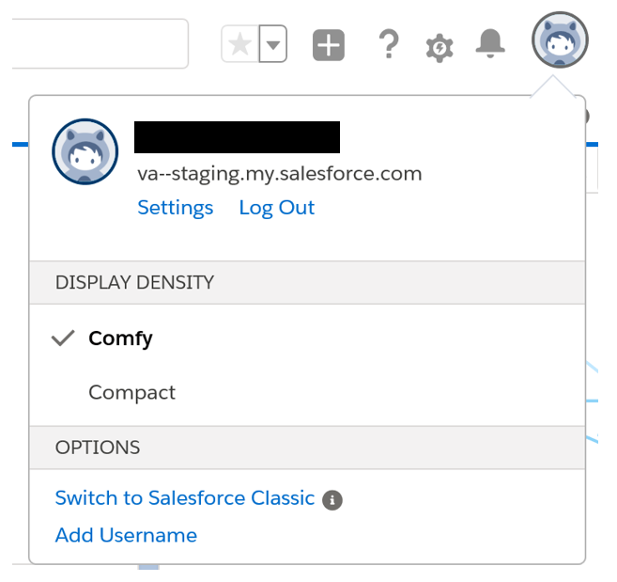
How to Access QMS, cont.
Switch from the Lightning platform to the Salesforce Classic platform.
Notes:
Instructor Notes:
Click on the icon at the top right corner of the screen to switch from the Salesforce Lightning view to Salesforce Classic view.

Slide 12
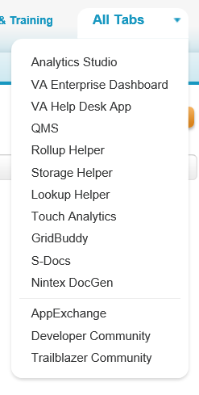
How to Access QMS, cont.
Select “QMS” from the drop-down menu at the top right of the screen.
Notes:
Instructor Notes:
Select “QMS” from the drop-down menu at the top right of the screen.

Slide 13
How to Access QMS, cont.
The VA emblem at the top left corner of the screen confirms you are logged into the Salesforce Classic platform.
QMS displays at the top right of the screen.
Notes:
Instructor Notes:
The VA emblem at the top left corner of the screen confirms you are logged into the Salesforce Classic platform.
QMS displays at the top right of the screen.

Slide 14
QMS Error Notification

Slide 15
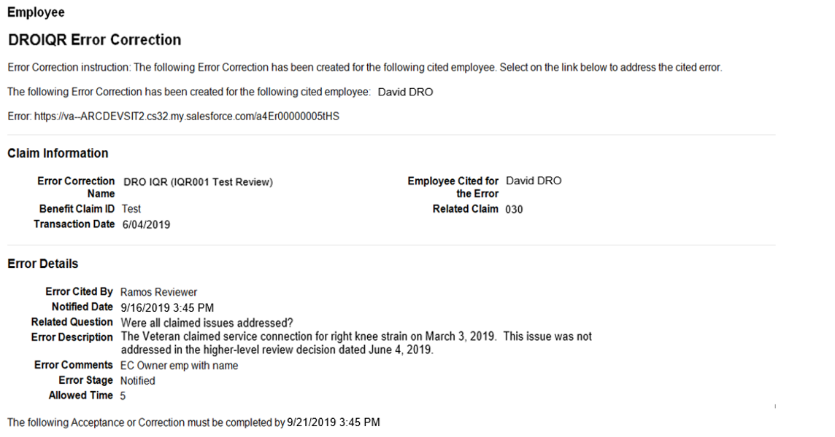
QMS Email Notification
Notes:
Instructor Notes:
Upon receipt of a quality review error cited in the Quality Management System (QMS), the Decision Review Officer (DRO) will receive an email notification that includes a hyperlink to the “Error Correction Detail” page of the cited error.
Email notification of an error is also sent to the employee’s Coach.
Each error on a review will receive its own email notification.
If two errors are called for one review, there will be two notification emails.
Allowed Time
Displays the number of business days, after the initial notification date, the employee is allotted to make a decision on the error correction.
An employee has the option to agree or disagree with the error, and he/she can submit a request for reconsideration on the cited error.
The content of the email does not contain all of the details related to an individual cited error from a quality review.
Employees should rely on the “Error Correction Detail” page for full details of the cited error.

Slide 16
QMS Error Correction

Slide 17
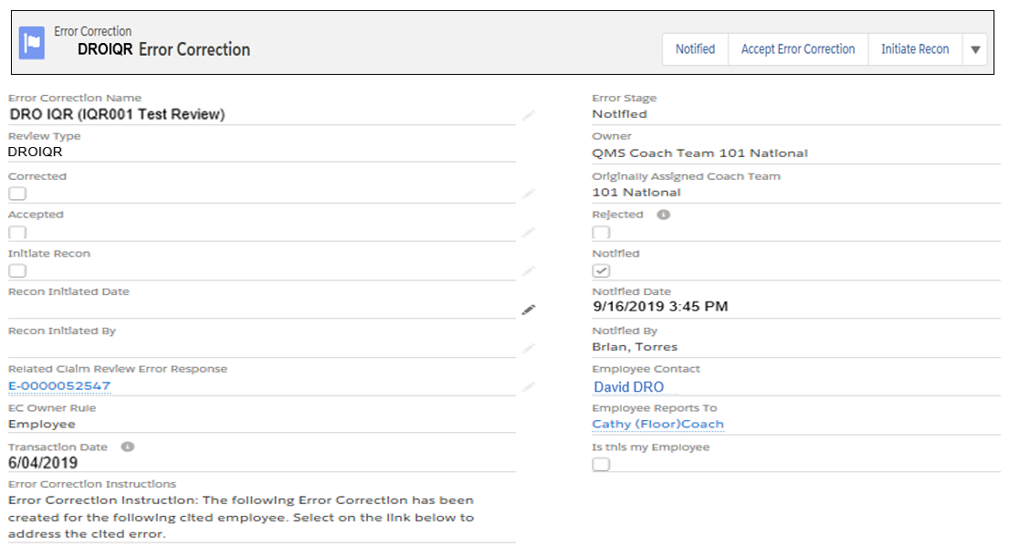
QMS Employee Error Correction
Notes:
Instructor Notes:
The “Error Correction Detail” page is a universal page for all quality review components.
This page is used by the employees, Management, and national Quality Assurance.
DROs will use the “Accept Error Correction” and “Initiate Recon” buttons on this page.
The “Error Correction Detail” page is the location in QMS where the DRO will indicate if they agree or disagree with the error cited.
If the employee agrees with the cited error, he/she will click “Accept Error Correction.”
If the employee disagrees with the error, he/she can click “Initiate Recon” to submit a reconsideration request.

Slide 18
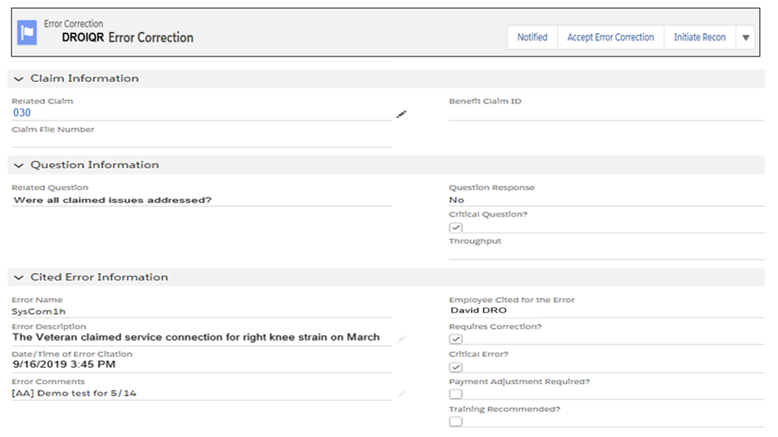
QMS Employee Error Correction, cont.
Notes:
Instructor Notes:
On the “Error Correction Detail” page in QMS, employees can see the Error Name, Related Question, Error Description and any Error Comments.

Slide 19
QMS Employee Accepts/Corrects Error
The DRO can accept the error and correct the error independent of one another or simultaneously.
The DRO is required to provide a comment.
Notes:
Instructor Notes:
The DRO can accept the error and correct the error independent of one another or simultaneously.
The employee should select “Error Accepted” when he/she agrees to the cited error and correction is needed but pending.
The employee should select “Error Accepted” and “Error Corrected” when he/she agrees to the cited error and corrective action has been taken.
The DRO is required to provide a comment.
Comments should include the action required and completed, as well as the employee’s action plan and when he/she corrected the error.

Slide 20
QMS Employee Initiates Reconsideration
The DRO types the narrative for the requested reconsideration into the text box displayed in QMS.
The Error will automatically route to the QRT Coach for local processing of the reconsideration decision.
Notes:
Instructor Notes:
If the DRO disagrees with the error cited and chooses to submit a reconsideration request, he/she should provide their narrative in the Comments text box.
It is recommended that employees include the following information with the reconsideration request:
Statement disagreeing with cited error
Reason(s) for disagreeing with the cited error
References to support the reason(s) for disagreeing with the cited error
Upon submission of the reconsideration request narrative, the error will automatically route to the QRT Coach for local processing of the reconsideration decision.
The employee is responsible for managing and monitoring the error correction until the error correction has been resolved.

Slide 21
Questions?
Recognize notification of an error correction
Access QMS
Identify and understand information on the “Error Correction Detail” page
Understand the function of action commands on the “Error Correction Detail” page
Identify and understand information on “My Error Correction Records”
Notes:
Instructor Notes:
As stated in the beginning of the training, the lesson objectives were to:
Recognize notification of an error correction
Access QMS
Identify and understand information on the “Error Correction Detail” page
Understand the function of action commands on the “Error Correction Detail” page
Identify and understand information on “My Error Correction Records”
We discussed each of these objectives through the following topics in each slide today:
DRO Quality Reviews: ASPEN to QMS
Benefits of DRO Quality Reviews in QMS
QMS Email Notification
How to Access QMS
QMS Employee Error Correction
QMS Employee Accepts/Corrects Error
QMS Employee Initiates Reconsideration

Slide 22
Next Steps
An assessment and satisfaction survey have been assigned to you in TMS
Be sure to complete the survey and assessment to receive credit for this training
Notes:
Instructor Notes:
An assessment and satisfaction survey have been assigned to you in TMS. Completing both will allow you to receive credit for this training.

