Slide 1
For TMS Training Credit
To obtain training credit in TMS, there is no need to review these slides at this time – immediately close this box by using your mouse to select the “X” in the upper right-hand corner; select “Return to Content Structure” button; and, select the next link (Video) to view the audio recording of the Quality Call along with the Quality Call Bulletin
  These slides are included here only in case you want to use them later for training purposes or reference
    These are the exact same slides that are shown in the audio recording

Slide 2
Compensation Service Quality Call
July 2020

Slide 3
Welcome to the July 2020 Quality Call
Bonnie Kirby
Senior Quality Review Specialist
Quality Review Team
Quality Assurance

Slide 4
Agenda
What’s New in the M21-1
MST Updates/Reminders
When an RFE Diary is Necessary
ALS Claims Part IV: Common Site Visit Findings
Common Advisory Review Reminders
STAR and QRT Functions
Q-Tips: Acceptable Forms of Evidence of Qualifying Active Service
Final Notification vs. Final Attempt Letter
Correspondence Reminders
Closing Comments

Slide 5
What’s New in the M21-1
Dustin Williams
Lead Program Analyst
Procedures Maintenance Staff
Policy and Procedures

Slide 6
M21-1 III.iv.3.A
On June 19, 2020, Compensation Service announced that the Examination Request Routing Assistant (ERRA) tool had been updated with historical search functionality
On June 30, 2020, M21-1 III.iv.3.A.1.d was updated to remove the procedural requirement for eFolder upload of ERRA inquiry results
Important: This does not nullify the requirement to use ERRA in determining examination request routing destinations

Slide 7
Military Sexual Trauma (MST)
Processing Reminders
Esther Adefope
Chief
STAR Program Review Staff
Quality Assurance

Slide 8
Military Sexual Trauma (MST)
Processing Reminders
Attitudes regarding personal assault/MST
  Sexual trauma during service is an extremely sensitive and personal topic
  The decision process is non-adversarial
The VA has a special obligation/heightened duty to assist a Veteran in obtaining corroborating or alternate evidence

Slide 9
Military Sexual Trauma (MST)
Processing Reminders
All development actions on claims involving MST must be completed by individuals that have:
  Completed the required MST training
  AND
  Been designated by the RO as an MST claims processor
“Grant if you can; deny only if you must”
M21-1 IV.ii.1.D.5.l

Slide 10
Military Sexual Trauma (MST)
Processing Reminders
The following checklists must be completed and uploaded to VBMS:
  MST Outreach Coordinator Checklist
  Personal Trauma Development Checklist
  Personal Trauma Incident/ Marker Worksheet
M21-1 IV.ii.1.D.5.l

Slide 11
Military Sexual Trauma (MST)
Processing Reminders
Markers
  Evidentiary signs, events, or circumstances
  Indicative of a possibility that the claimed stressor occurred
  Reports, lay statements, or behavioral changes
  Associated with the approximate timeframe
M21-1 III.iv.4.O.3.d

Slide 12
Military Sexual Trauma (MST)
Processing Reminders
Often necessary to seek alternative evidence to review for markers:
  Rape crisis centers
  Domestic abuse centers
  Counseling facilities
  Civilian medical records
  Police reports
  Personal statements from:
    Family members
    Fellow service members
    Chaplains or Clergy
M21-1 III.iv.4.O.3.c

Slide 13
Military Sexual Trauma (MST)
Processing Reminders
Requesting VA exams in MST cases
  Low threshold for requesting exams in MST cases
  Request an exam for PTSD based on MST when there is:
    A current medical diagnosis of PTSD or a Veteran’s lay statement describing PTSD symptoms
    AND
    Credible evidence of the personal trauma event or circumstantial evidence of a marker (can be in-service or post-service regarding the in-service trauma event)
38 CFR 3.159(c)(4)
M21-1 IV.ii.1.D.6.c

Slide 14
Military Sexual Trauma (MST)
Processing Reminders
Exam and medical opinion are almost always needed
The examiner must provide an opinion to confirm the presence of the in-service stressor based on the marker(s)
The examiner also provides the link between the claimed stressor and a current diagnosis of PTSD

Slide 15
Military Sexual Trauma (MST)
Processing Reminders
Grant PTSD due to MST when the following are present:
  Current diagnosis
  Credible evidence the claimed stressor occurred
  AND
  Medical opinion that relates the diagnosis to the in-service stressor

Slide 16
Military Sexual Trauma (MST)
Processing Reminders
Antoinette Rivera
Program Manager
MST and Suicide Prevention
Office of Field Operations

Slide 17
MST Outreach Coordinator vs. MST Claims Coordinator
MST Outreach Coordinator
MST Claims
Coordinator
May be male or female
Collateral duty in Public Contact
May be assigned one or more special emphasis programs
Also known as an MST claims processor
Has VSR experience
Completed specialized MST training
Assigned to the development activity at RO
Completed specialized MST training

Slide 18
MST Outreach Coordinator Role
Provides assistance and instructions associated with filing a claim based on MST
Shares and receives information with the Veteran
Provides claim updates based on MST, if requested

Slide 19
RFE Diary Reminders
Jessica Flannery
Operations Analyst
Program Operations Staff
Quality Assurance

Slide 20
Routine Future Exam (RFE) Diary Reminders
The rating activity should exercise prudent judgment and refer to 38 CFR 3.327(b) when determining the need for a review exam
It is VBA’s policy to request future examinations only when absolutely necessary, and every effort should be made to limit cases where future exams are requested
M21-1 III.iv.3.B.2.a

Slide 21
Routine Future Exam (RFE) Diary Reminders
Do not establish RFE diaries when
  The disability is static, without material improvement over five years
  The disability is permanent in character and of such nature that there is no likelihood of improvement
  The Veteran is over 55 years of age (except unusual circumstances or required by regulation)
  The evaluation is the prescribed schedular minimum within its diagnostic code
  The evaluation is 10% or less, or
  The combined evaluation would not change even if the reexamination resulted in a reduced evaluation for one or more disabilities
Note: This guidance applies to initial RFEs and reexaminations requested in the interest of substantiating sustained improvement
M21-1 III.iv.3.B.2.d

Slide 22
ALS – Common Site Visit Findings
Part #4 of 4-Part Series
Jessica Flannery
Operations Analyst
Program Operations Staff
Quality Assurance

Slide 23

ALS – Common Site Visit Findings
Part #4 of 4-Part Series
Fact: If a single disability is evaluated as 100-percent disabling, consider entitlement to A&A or the housebound rate as an inferred issue if the evidence shows that the benefit may be awarded
  *M21-1 IV.ii.2.H.8.e

Slide 24
ALS – Common Site Visit Findings
Part #4 of 4-Part Series
Best Practice: Utilize the checklist that you previously created to also note the need for A&A (or other levels of SMC) based upon the list of complications you have identified throughout the medical evidence

Slide 25
ALS – Common Site Visit Findings
Part #4 of 4-Part Series
Scenario: The Veteran is SC for ALS and complications as follows:
  8017-6520 @ 100% – Permanent tracheostomy
  5109 @ 100% – LOU of the BL hands
  8520 @ 40% - Weakness of the L lower extremity
  8520 @ 60% - Weakness of the R lower extremity
  7542 @ 40% - Voiding Dysfunction
  Medical evidence demonstrates need for A&A due to assistance with tracheostomy, eating, bathing, and dressing
Question: What level of SMC should be granted?

Slide 26
ALS – Common Site Visit Findings
Part #4 of 4-Part Series
Answer:
  8017-6520 100% – Permanent tracheostomy = L for A&A
  5109 100% – LOU of the BL hands = M for LOU
  8520 40% - Weakness of the L lower extremity = SMC not warranted
  8520 60% - Weakness of the R lower extremity = SMC not warranted
  7542 40% - Voiding Dysfunction = SMC not warranted
  L + M = O
  O + need for A&A = R1
  *38 CFR 3.350; M21-1 IV.ii.2.H (specifically topic 2.b-c)

Slide 27
ALS – Common Site Visit Findings
Part #4 of 4-Part Series
Question: For the same scenario, what are the SMC codes that should be displayed on the codesheet?
  8017-6520 @ 100% – trach = L for A&A
  5109 @ 100% LOU of the BL hands = M for LOU
  L + M = O
  O + need for A&A = R1

Slide 28
ALS – Common Site Visit Findings
Part #4 of 4-Part Series
Answer:
*M21-1 Part I, Appendix A, Sections VII-VIII

Slide 29
ALS Review
Part #1:
Missing ALS special issue and/or flash – this ensures ALS claims are properly expedited. (M21-1, III.iii.1.F.1 and 2 and M21-4, App C.2 and 3)
Medical evidence confirming a diagnosis of ALS alone is sufficient to support an evaluation of 100%. (M21-1, III.iv.4.N.6.c)
Part #2
If there is no individual complication warranting a single 100-percent, assign a single 100-percent evaluation using DC 8017 and include all complications in the diagnosis. (M21-1, III.iv.4.N.6.d)
When a single 100-percent evaluation is warranted for a complication of ALS, assign a 100-percent evaluation for that complication with a hyphenated DC (Ex: 8017-5110, loss of use of both feet due to ALS) and assign separate evaluations for all other complications. (M21-1, III.iv.4.N.6.d)
Part #3
ALS can be established on the basis of presumption under 38 CFR 3.318, if manifested at any time after discharge or release from active military, naval, or air service. (38 CFR 3.318; M21-1, III.iv.4.N.6.b; and III.iv.6.C.5.a)
Award SC for disabilities that are proximately due to, or the result of, an SC condition under 38 CFR 3.310. (38 CFR 3.318; M21-1, III.iv.4.N.6.b; and III.iv.6.C.5.a)
Part #4
If a single disability is evaluated as 100% disabling, consider entitlement to A&A or the housebound rate as an inferred issue if the evidence shows that the benefit may be awarded. (M21-1, IV.ii.2.H.8.e)

Slide 30
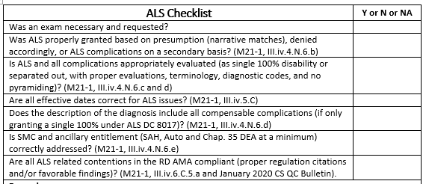
ALS Checklist

Slide 31
Common Advisory Review Reminders
Philip Bramlage
Lead Consultant
Advisory and Special Review Team
Quality Assurance

Slide 32
Common Review Reminders for RVSRs/DROs
38 CFR §4.14 and 38 CFR §4.96 – ratings for certain respiratory conditions should not be combined
38 CFR §4.126 (evaluation of mental disorders) – notes “the rating agency shall assign an evaluation based on all the evidence of record that bears on occupational and social impairment rather than solely on the examiner's assessment of the level of disability at the moment of the examination”

Slide 33
General NWQ Routing Reminders for Advisory Requests
Ensure the appropriate “Compensation Service Review” Special Issue is attached to a contention, e.g., “Compensation Service Review – Extraschedular”
When referring claims to Compensation Service (whether auto-routed or manually), ensure there is a tracked item as directed in the M21-1 and the claim is in “Open” Status
Claims not auto-routed in VBMS, must be manually brokered to Compensation Service for review, i.e., RO 388 in VBMS

Slide 34
STAR and QRT Functions
David Hannigan
Quality Assurance Officer
Quality Assurance

Slide 35
STAR and QRT Functions
STAR
QRT
National method for measuring compensation claims processing accuracy:
  Claims that require a rating
  Claims that do not require a rating
Issue based accuracy
Special Focused Reviews
Monthly Individual Quality Reviews (IQRs)
  VSR, RVSRs, DROs, and RQRSs
Task based accuracy
Mentoring & Feedback
Training on Quality Trends

Slide 36
Q-Tips
David Hannigan

Slide 37

Q-Tips
Fun way to share ideas in a simple tip format
Your Q-Tips are welcome and requested
We will help each other by sharing knowledge
Send your ideas to David Hannigan
  david.hannigan@va.gov

Slide 38
Q-Tip #1: Acceptable Forms of Evidence of Qualifying Active Service
In addition to original, carbon copies, and certified copies of separation documents, consider acceptance of a digitally signed copy of DD Form 214 or 215
  Contains a 10-digit number that follows the certifying official’s name
  Acceptable in place of a certifying official’s signature if:
    The form appears genuine and unaltered
    AND
    The Veteran was discharged on or after 8/1/08 under other than dishonorable conditions
M21-1 III.ii.6.B.3.a

Slide 39
Q-Tip #2
Amy Austin
Consultant
STAR Program Review Staff
Quality Assurance

Slide 40
Q-Tip #2: Final Notification Letter
No longer final-attempt letter/Do not use Final Attempt Letter available in VBMS
No longer a 10 day response period
If efforts to obtain records from a Federal entity are unsuccessful, ROs must
  prepare a final notification letter using Letter Creator tool, or prepare an equivalent notice using PCGL, and
  send the letter to the claimant
  Do not add a tracked item to control
Exceptions: If the unavailable Federal records are
  STRs, first attempt to locate the records in JLV
  VAMC or VR&E records
  Fire-related records and the Veteran fails to provide enough information to reconstruct the records via PIES
M21-1 III.iii.1.C.1.e and Letter Creator User Guide; M21-1 III.iii.1.B.2.g

Slide 41
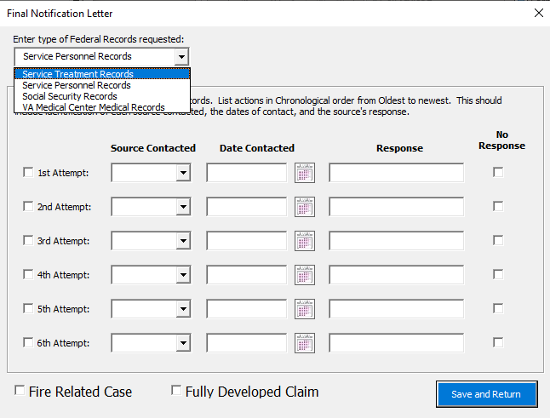
Q-Tip #2: Final Notification Letter

Slide 42
Correspondence Reminders
Devin Johnston
Program Analyst
Outbound Services & Standardization
Office of Business Process Integration (OBPI)

Slide 43
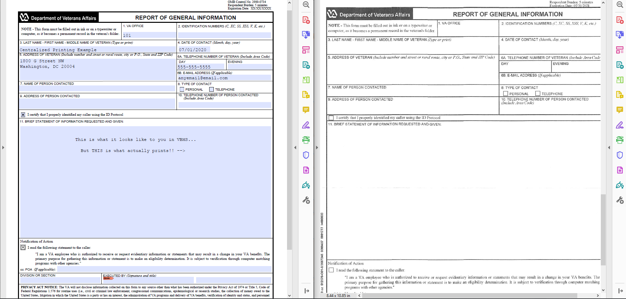
Centralized Printing Reminders
DO NOT add Fillable PDF Forms
They print blank

Slide 44
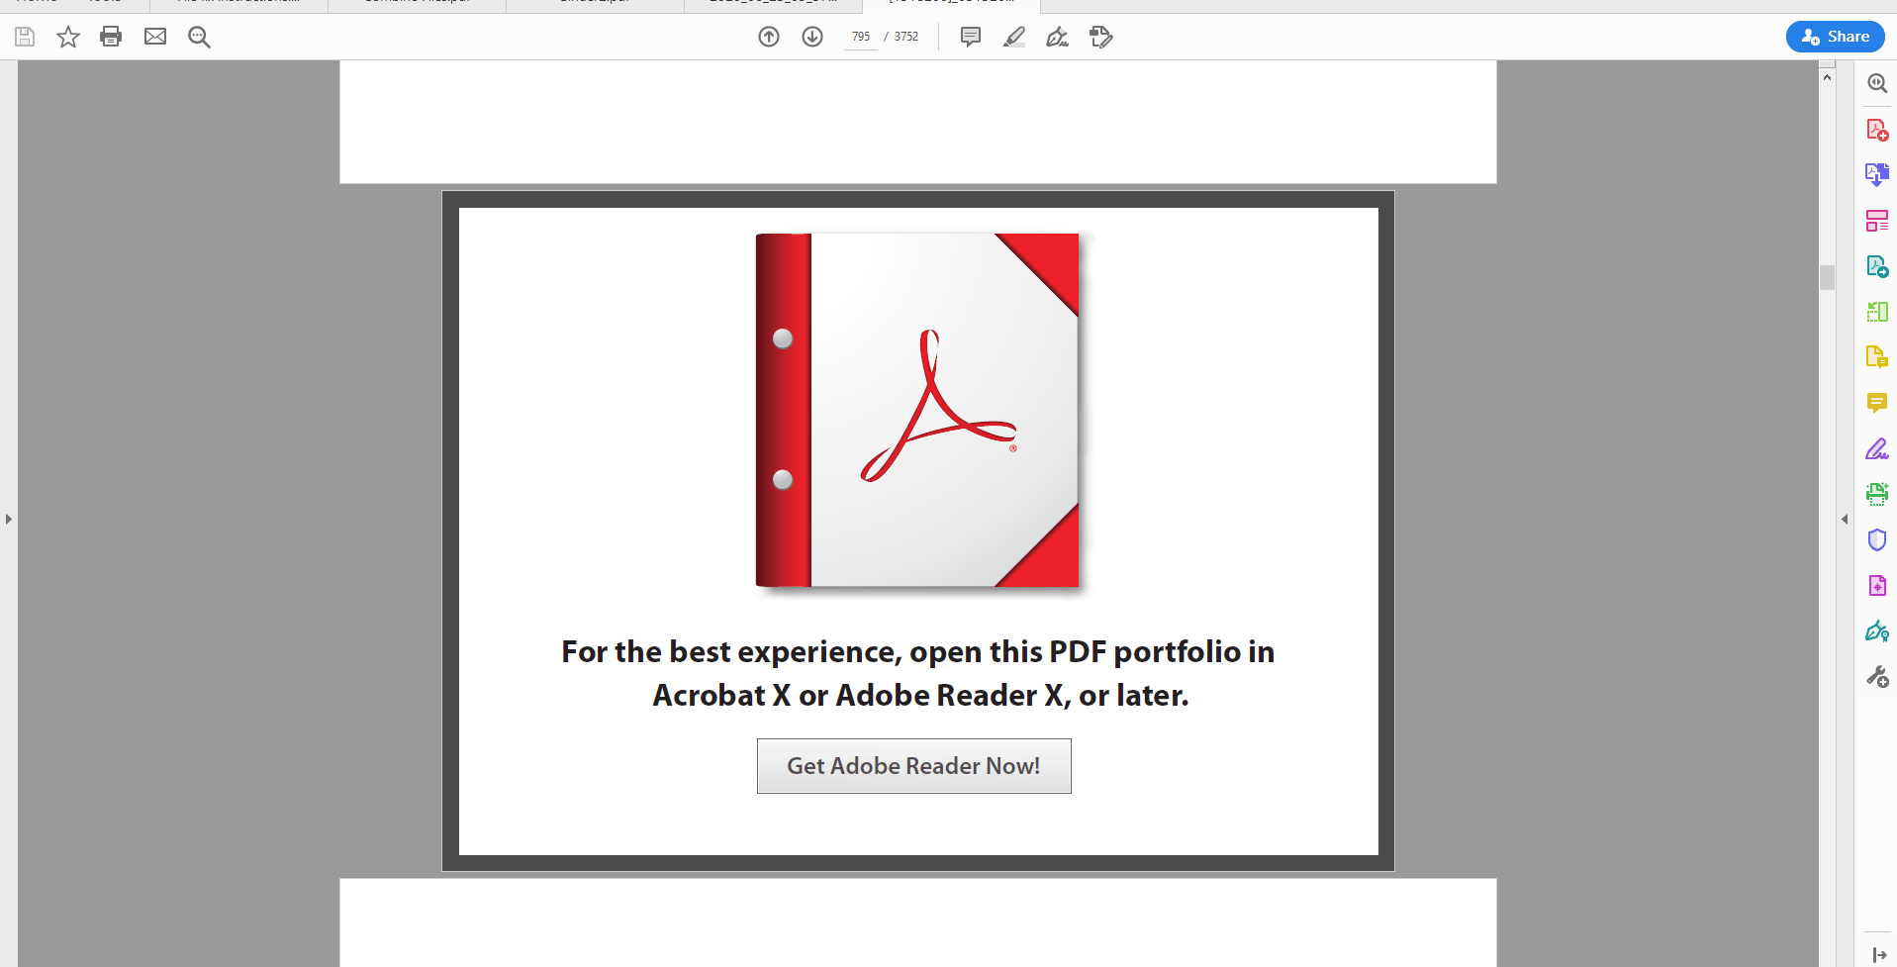
Centralized Printing Reminders
DO NOT use Adobe Portfolio
The letter does not print; this is all that is sent to print

Slide 45
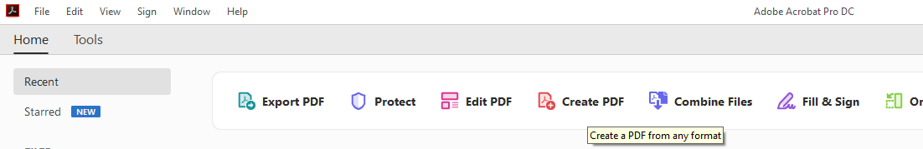
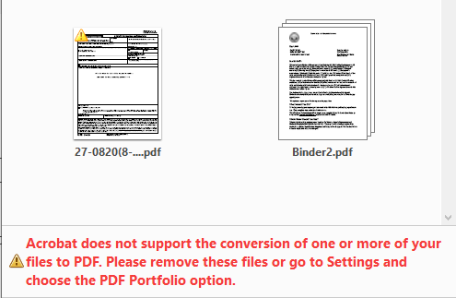
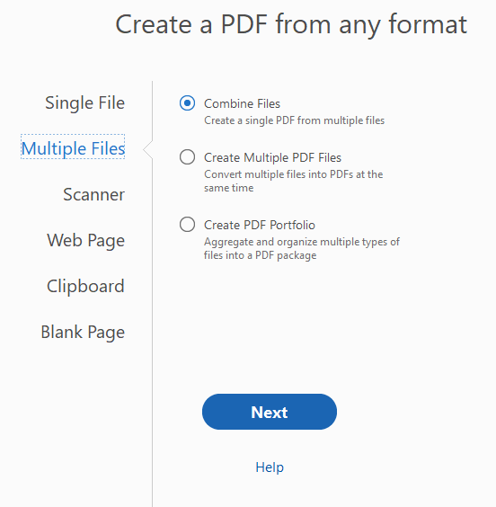
Best Practices for Combining Files

Slide 46
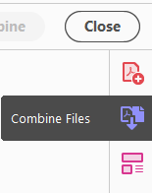
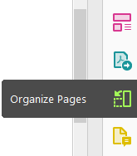
Best Practices for Combining Files
Do not use “Combine Files” use “Organize Pages”

Slide 47
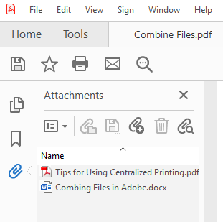
Best Practices for Combining Files
Do not use the paperclip to attach files within the PDF

Slide 48
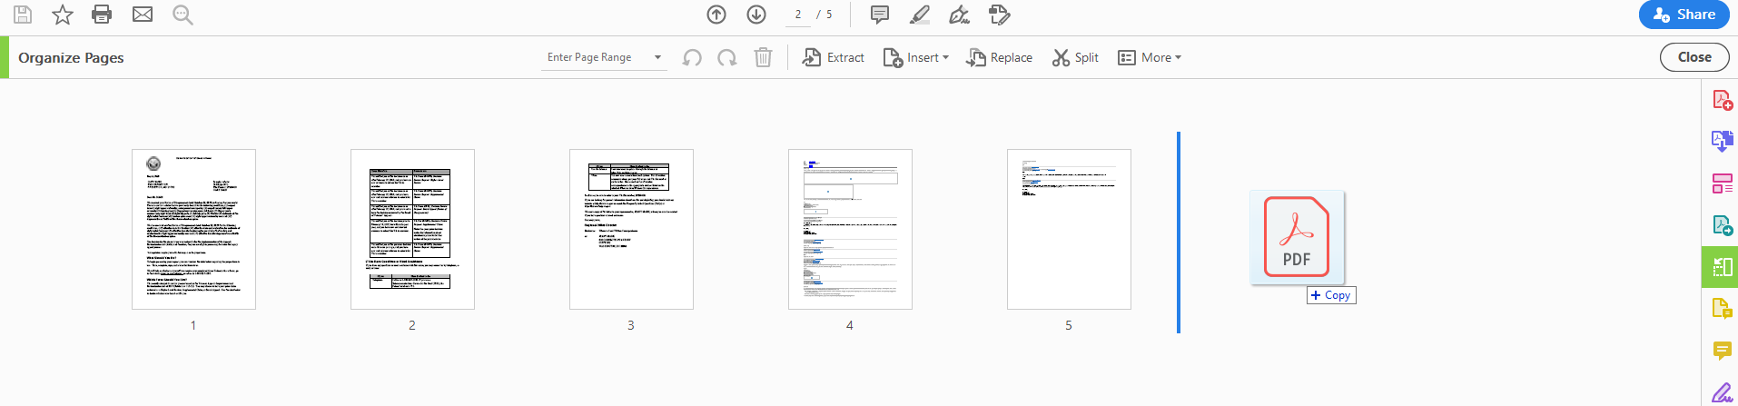
Best Practices for Combining Files
In “Organize Pages,” drag & drop the PDF file(s), or specific pages from another PDF where you would like them to be added to your letter
Print the PDF, rather than “Save as PDF,” with appropriate printer settings

Slide 49
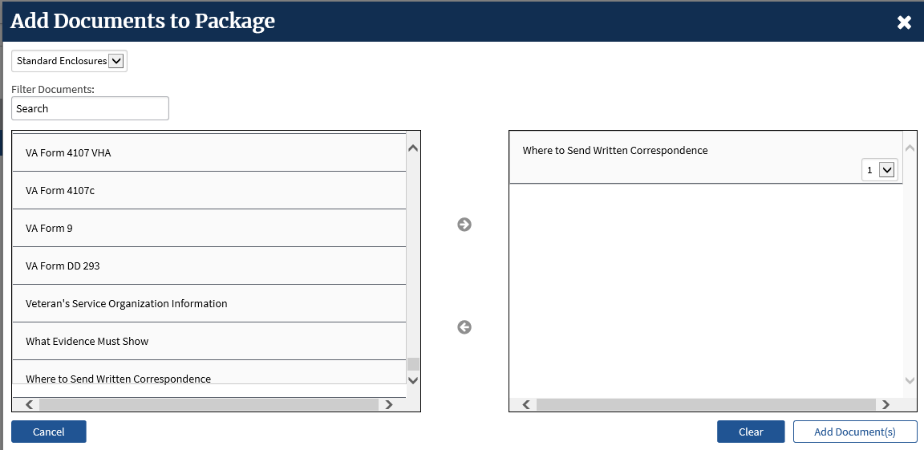
Final Reminders
Use the Standard Enclosures provided in Package Manager whenever possible

Slide 50
Final Reminders
Open and view the document in VBMS before you add it to a letter in Package Manager
Use the “Subject” in document properties to add details for documents with a common “Document Type”
Do not send an attachment without a letter associated with it
Do not send attachments as separate mail packages

Slide 51
Suggestions – Next Quality Call
Presented by: Bonnie Kirby
We are offering opportunities for RO SMEs to present topics during a Compensation Service Quality Call recording session
  Peer-to-peer communication is optimum
Are you interested in presenting a topic?
  Talk to your coach or other RO management team member
  If approved, have management send your name and topic to:
    VAVBAWAS/CO/InternalQRS

Slide 52
Do you have Suggestions for Topics?
Please email your topic suggestions to the Quality Call Leads at VAVBAWAS/CO/InternalQRS
  In your email, please include:
    CC to your coach or other RO management
    Name of topic
    Intended audience (VSR, RVSR, DRO, AQRS, RQRS, etc.)
    Applicable 38 CFR and/ or M21-1 references
Quality Call Bulletins can be found on the STAR Home Page on the Compensation Service Intranet site, TMS, and VBA Learning Catalog
Audio recordings of the Quality Calls with separate copies of the PowerPoint slides can be found in both TMS and the VBA Learning Catalog

Slide 53

Next Quality Call
A Compensation Service Quality Call is usually recorded each month
Final Quality Call for FY20 will be recorded in August

