Slide 1
For TMS Training Credit
To obtain training credit in TMS, there is no need to review these slides at this time – immediately close this box by using your mouse to select the “X” in the upper right-hand corner; select “Return to Content Structure” button; and, select the next link (Video) to view the audio recording of the Quality Call along with the Quality Call Bulletin
These slides are included here only in case you want to use them later for training purposes or reference
These are the exact same slides that are shown in the audio recording

Slide 2
Compensation Service Quality Call
June 2020

Slide 3
Welcome to the June 2020 Compensation Service Quality Call
Robert Johnson
Senior Quality Review Specialist
Quality Review Team; Quality Assurance

Slide 4
Agenda
ALS – Common Site Visit Findings / Part 3 of 4-Part Series
Homeless & Traumatic Brain Injury (TBI) Claims
Blue Water Navy (BWN) Quality
Discontinuance of Public-Use DBQs
Hospital Adjustments: Rating Reminders
VBMS-A User Tips for Correcting CUEs
Centralized Printing Requirements
Q-Tips
Package Manager
Evaluating Finger Disabilities
AMA Applicable Laws/ Regulations: Cross Referencing
What’s New in the M21-1

Slide 5
ALS – Common Site Visit Findings Part 3 of 4-Part Series
Jessica Flannery
Operations Analyst
Program Operations Staff; Quality Assurance

Slide 6
ALS – Common Site Visit Findings
Fact: ALS can be established on the basis of presumption under 38 CFR 3.318, if manifested at any time after discharge or release from active military, naval, or air service
38 CFR 3.318; M21-1 III.iv.4.N.6.b; and, M21-1 III.iv.6.C.5.a

Slide 7
Common Site Visit Findings (Cont’d)
Fact: Award SC for disabilities that are proximately due to, or the result of, an SC condition under 38 CFR 3.310
38 CFR 3.318; M21-1 III.iv.4.N.6.b; and, M21-1 III.iv.6.C.5.a

Slide 8
Common Site Visit Findings (Cont’d)
Best Practice: Review your rating decision narrative to ensure the proper legal basis and proper laws/ regulations are appended to the decision
The narrative must reference
Basis of presumption or secondary rather than direct (incurred) basis
38 CFR 3.318 or 3.310 not 3.307 and 3.309
Example
Service connection may be granted for specific diseases or conditions which are presumed to have been caused by service if manifested to a compensable degree following military discharge. Although not shown in service, service connection for ALS has been granted on the basis of presumption. (38 CFR 3.318)

Slide 9
Quiz # 1
The RVSR must ensure the legal basis and laws/ regulations are applicable in the rating decision narrative. If granting SC for ALS on the basis of presumption, which example best represents the correct narrative:
Service connection for ALS has been established as directly related to military service. (38 CFR 3.303, 38 CFR 3.304)
Service connection may be granted for specific diseases or conditions which are presumed to have been caused by service if manifested to a compensable degree following military discharge. Although not shown in service, service connection for ALS has been granted on the basis of presumption. (38 CFR 3.307, 38 CFR 3.309)
Service connection may be granted for specific diseases or conditions which are presumed to have been caused by service if manifested to a compensable degree following military discharge. Although not shown in service, service connection for ALS has been granted on the basis of presumption. (38 CFR 3.318)

Slide 10
Answer # 1
Service connection may be granted for specific diseases or conditions which are presumed to have been caused by service if manifested to a compensable degree following military discharge. Although not shown in service, service connection for ALS has been granted on the basis of presumption. (38 CFR 3.318)

Slide 11
Quiz # 2
If the RVSR is granting LOU of bilateral feet secondary to SC ALS, which example best represents the correct narrative:
Service connection for LOU of bilateral feet has been established as directly related to military service. (38 CFR 3.303, 38 CFR 3.304)
Service connection may be granted for specific diseases or conditions which are presumed to have been caused by service if manifested to a compensable degree following military discharge. Although not shown in service, service connection for LOU of bilateral feet has been granted on the basis of presumption. (38 CFR 3.307, 38 CFR 3.309)
Service connection for LOU of bilateral feet has been established as related to the service-connected disability of ALS. (38 CFR 3.310)

Slide 12
Answer # 2
Service connection for LOU of bilateral feet has been established as related to the service-connected disability of ALS. (38 CFR 3.310)

Slide 13
Homeless & TBI Claims – Special Quality Review –
David Hannigan
Quality Assurance Officer
Quality Assurance

Slide 14
Homeless & TBI Special Quality Review
FY19 – 25 Homeless Cases Identified / 22 Included TBI or Mental Disability
Rating Issue-Based Accuracy = 98.6%
Cited Benefit Entitlement Errors
Failure to grant service connection for lower extremity radiculopathy
Failure to request VAE/ MO for PTSD/ MST case
Cited Non-Benefit Entitlement Errors
Favorable finding for PTSD missing
Incorrect evaluation noted in decision narrative
New claim needed to be placed under EP control
Failing to list the claimant’s contention(s) when denying the claim
Takeaway: This challenged population of Veterans was served well, but always room for improvement

Slide 15
Blue Water Navy (BWN) Quality
Vanessa Carr
Consultant
BWN STAR Program Review Staff; Quality Assurance

Slide 16
STAR BWN Team & BWN SFR
Quality Assurance Program Review (QA) has a specific group of Consultants assigned to the BWN QA Team
BWN Special Focused Review (SFR) was completed in March 2020
BWN-specific issue-based accuracy = 96.4%
16 of 452 issues with BWN-specific errors
Overall SFR issue-based accuracy = 85.6%
65 of 452 issues with critical errors

Slide 17
Monthly STAR BWN Quality Reviews
A monthly sample of 10 cases from each of the 8 Centralized Stations are selected for quality review each month
This is a separate quality sample from the STAR sample, and the BWN sample is not included in RO station accuracy
February 2020 BWN accuracy has been released to the 8 Centralized Stations
BWN QA Team has met with each station to review & discuss their individual findings

Slide 18
February 2020 BWN Accuracy
Issue-based (IB) Accuracy Findings----All 8 stations (average)
BWN Specific IB Accuracy = 96.2%
Overall IB Accuracy = 85.3%

Slide 19
BWN Quality Reports
BWN Quality Reports can be found on the Compensation Service Intranet Home Page
https://vbaw.vba.va.gov/bl/21/data/quality/consis/consis_focus.htm
The BWN Quality Reports will be posted monthly for your review

Slide 20
Discontinuance of Public-Use DBQs
Tina Skelly
Management Analyst
Medical Disability Exam Quality & Program Management Office

Slide 21
Discontinuance of Public Use DBQs
Public Use DBQs discontinued April 2020
Modernized
Increased capacity to conduct C&P examinations
Safeguarding against fraud
Adjudication Procedures Manual Updates
III.iv.3.D.2.e – Discontinuance of Publicly Available DBQs
III.iv.3.D.2.f – Authenticity of DBQs
III.ii.1.C.8.e – Handling Discontinued Forms

Slide 22
Hospital Adjustments – Rating Reminders –
Andrew Gray
Lead Operational Innovation Strategist
Office of the Deputy Executive Director for Operations; Operational Innovation Team

Slide 23
Statutory Housebound (HB) Resolution

Slide 24
Statutory HB Resolution (Cont’d)

Slide 25
Requirements to Address Competency
Competency must be addressed in cases where a mental condition is initially evaluated as totally disabling or when the total evaluation is continued in a rating decision
This includes when assigning or continuing a temporary total evaluation for a mental disorder under 38 CFR 4.29
M21-1 III.iv.8.A.2.a

Slide 26
VBMS-R Text for Competency
Include the following text in the rating narrative, either generated based on decision points or added using the VA COMPETENT glossary selection within VBMS-Rating for these cases
There is no evidence of record that shows that you are unable to manage your financial affairs. (38 CFR 3.353)

Slide 27
Important Reminder
When granting paragraph 29 and staging the rating to reduce benefits, VBMS-Rating does not prompt employees to consider competency

Slide 28
VBMS-A User Tips – Correcting CUEs –
Erin Hawkins
Consultant
Advisory and Special Review Team; Quality Assurance

Slide 29
VBMS-A User Tips for Correcting CUEs
The March 2020 Compensation Service Quality Call discussed updates to the M21-1 that clarified procedures for correction of the record in CUE scenarios associated with administrative errors
M21-1 III.iv.8.B
M21-1 III.iv.8.E
M21-1 IV.ii.3.A
One of the changes requires that the codesheet be modified so that it appears how it should have appeared if no error been made
This change impacts promulgation VSRs and the steps required in VBMS-A to prevent overpayments and premature reductions in running awards

Slide 30
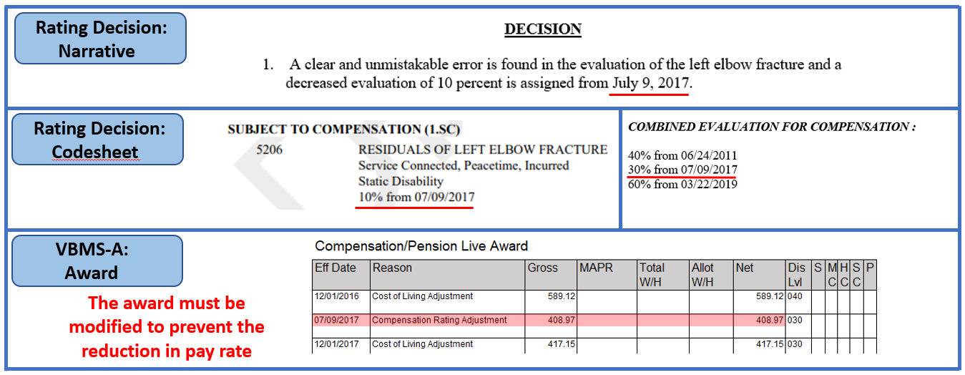
CUE Decision and Award Interaction

Slide 31
Steps in VBMS-A to Prevent an Overpayment
M21-1 III.vi.2.B.3.e – Eliminating an Overpayment Resulting From Correction of an Administrative Error provides instructions on how to modify VBMS-A to prevent an overpayment from being created

Slide 32
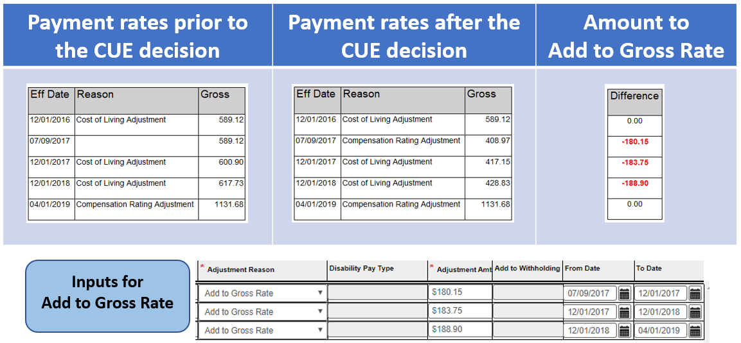
Steps To Prevent an Overpayment (Cont’d)

Slide 33
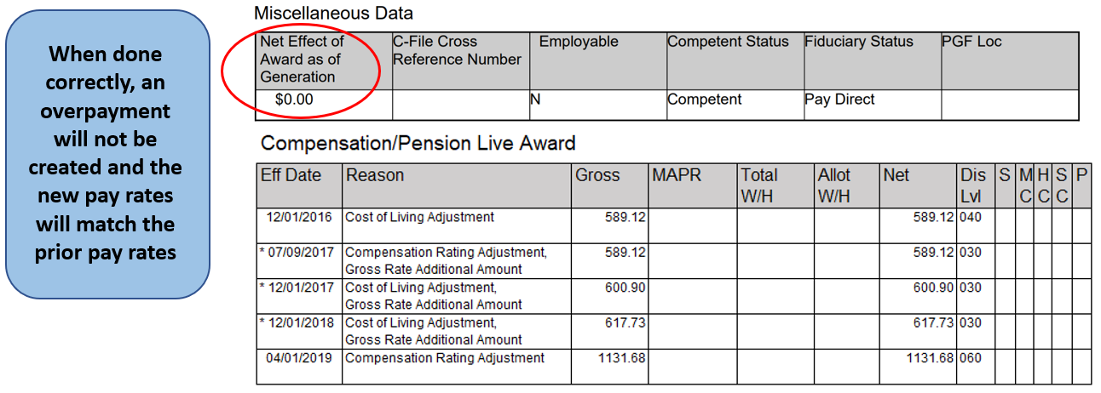
Steps To Prevent an Overpayment (Cont’d)

Slide 34
Reminder for Reductions to Running Awards
If a CUE decision results in a reduction in the running award, the beneficiary must continue to receive his/ her current rate of payment until the first day of the month following a 60-day period that begins the date of the notice of the final rating decision
38 CFR 3.105(e)
M21-1 IV.ii.3.A.2.a

Slide 35
Reductions To Running Awards (Cont’d)
Example: A Veteran is evaluated at the 70% rate effective 1/6/2020, with a payment effective date of 2/1/2020. A CUE is discovered and Due Process issued. Rating Decision dated 5/29/2020 finalizes the CUE decision, and the Veteran’s combined rating is corrected to reflect 50% effective 1/6/2020. Action is being taken on 6/3/2020 to promulgate the Rating. The award must be adjusted (Add to Gross Rate used) to continue paying at the 70% rate from 2/1/2020 to 9/1/2020.

Slide 36
Steps in VBMS-A to Prevent an Overpayment During Periods of Non-Entitlement
Some CUE Rating Decisions result in eliminating periods of entitlement fully, for these cases the ‘Add to Gross Rate’ feature cannot be used to prevent an overpayment benefits because VBMS-A will not allow new award payment lines during periods of non-entitlement to benefits
Example: A Veteran’s original claim for PTSD was granted at 50% effective 9/23/2016, with a payment effective date of 10/1/2016. A CUE is discovered in the effective date of the grant. Due process is issued proposing to correct the effective date from 9/23/2016 to 10/6/2017.
When the final CUE decision is made, the ‘Add to Gross Rate’ feature cannot be used to force VBMS-A to pay at the 50% rate for the period of 10/1/2016 to 11/1/2017 because VBMS-A will not generate any award payment lines prior to 11/1/2017 since entitlement to benefits is not established until 11/1/2017.

Slide 37
Steps To Prevent an Overpayment During Periods of Non-Entitlement (Cont’d)
The Priors screen in VBMS-A must be used to prevent the overpayment during past periods of non-entitlement
Priors screen functionality allows users to
Add award lines prior to the first converted award line
Override prior converted award lines or prior award lines established by normal Awards processing
Adjust the Veteran’s record to reflect when an out-of-system payment was made

Slide 38
Steps To Prevent an Overpayment During Periods of Non-Entitlement (Cont’d)
Example: A Veteran’s original claim for PTSD was granted at 50% effective 9/23/2016, with a payment effective date of 10/1/2016. A CUE was discovered, and a final Rating Decision is prepared that corrects the effective date of the PTSD grant from 9/23/2016 to 10/6/2017, with a payment effective date of 11/1/2017.

Slide 39
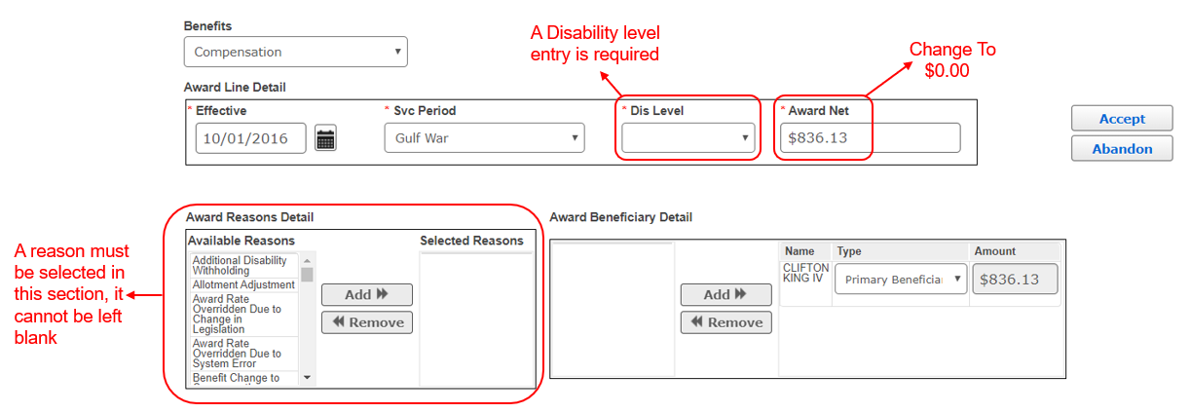
Steps To Prevent an Overpayment During Periods of Non-Entitlement (Cont’d)
Edit the 10/1/2016 and 12/1/2016 lines to change the “Award Net” to $0.00. Entries must also be made in “Dis Level” and “Awards Reasons Detail” fields

Slide 40
Steps To Prevent an Overpayment During Periods of Non-Entitlement (Cont’d)
The Priors screen now reflects that the Veteran was paid $0.00 until 11/1/2017 (the period prior to the Veteran’s entitlement to benefits)

Slide 41
Steps To Prevent an Overpayment During Periods of Non-Entitlement (Cont’d)
VBMS-A will not recognize any award payment lines during periods of non-entitlement to benefits
If a CUE decision results in eliminating benefits completely, authorization activity cannot manipulate the award to ensure both the overpayment is prevented and the Veteran continues to receive payment until the first day following 60 days after notice of final decision
Example: A Veteran is only service connected for asthma at 30%. A CUE is discovered and the condition is severed by Rating Decision dated 3/2/2020. Since the Veteran has no entitlement to benefits, VBMS-A will not generate any payment lines in order to continue paying at the 30% rate until 6/1/2020.

Slide 42
Assistance for VBMS-A CUE Awards
In situations where VBMS-A cannot be correctly manipulated to prevent the overpayment and/ or continue to pay the Veteran correctly until the first day following 60 days after notice of final decision, users should e-mail Compensation Service Business Management Staff for assistance
VAVBAWAS/CO/215A

Slide 43
Centralized Printing Requirements
Devin Johnston
Program Analyst
Outbound Services & Standardization Staff; Office of Business Process Integration

Slide 44
Centralized Printing Requirements
Black and White documents only
Portrait Orientation only
No Fillable PDF Forms
DO not use Adobe PDF Portfolio
M21-1 III.v.2.B.1.m
TMS # 4415957

Slide 45
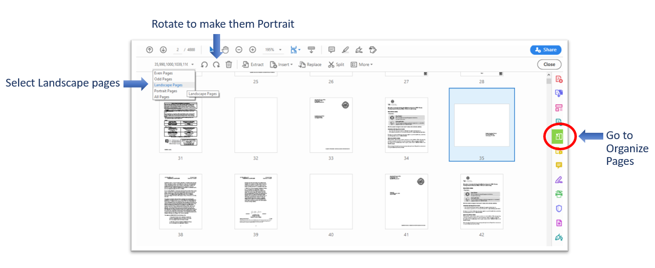
How to Fix a File to Print

Slide 46
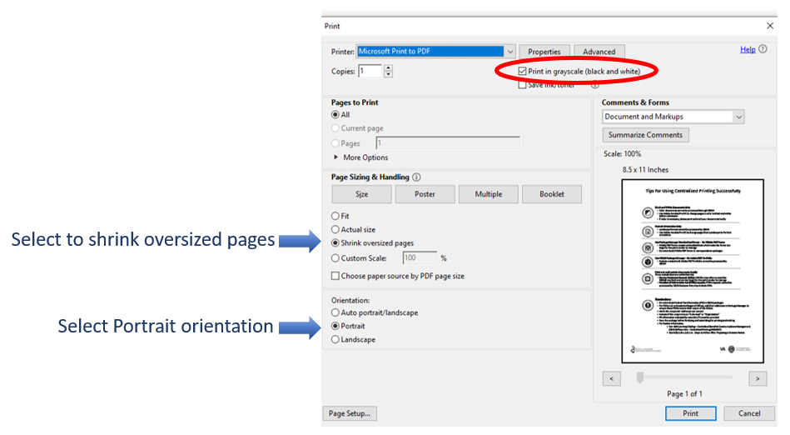
How to Fix a File to Print (Cont’d)

Slide 47
Q-Tips
Robert Johnson & Bonnie Kirby
Senior Quality Review Specialists
Quality Review Team; Quality Assurance

Slide 48
Q-Tips
Fun way to share ideas in a simple tip format
Your Q-Tips are welcome and requested
We will help each other by sharing knowledge
Send your ideas to David Hannigan
david.hannigan@va.gov

Slide 49
Q-Tip # 1
Robert Johnson

Slide 50
Package Manager
M21-1 III.ii.1.B.4.b – Procedures for Handling Outgoing Mail
For outgoing mail you will prepare packages using VBMS Package Manager for centralized printing and mailing
M21-1 III.v.2.B.1.m – Steps to Follow After Preparing a Decision Notice
Ensure the documents created in VBMS Package Manager are transmitted for centralized printing and mailing, and confirm that a copy of the decision notice has been included in the eFolder

Slide 51
Package Manager (Cont’d)
Example
VSRs will review the Package Manager to ensure a necessary 5103 notice was successfully sent to the claimant before marking the claim Ready for Decision
M21-1 I.1.B.1.d
Example
RVSRs will review the Package Manger to ensure a proposed adverse action letter was successfully sent to the claimant before taking final action
M21-1 I.2.B
TMS # 4415957 – Using Package Manger for Centralized Printing/ Distribution

Slide 52
Q-Tip # 2
Bonnie Kirby

Slide 53
Workaround for Finger Evaluations
Reminder: The Evaluation Builder does not generate the proper evaluations when evaluating disabilities of the fingers
Refer to M21-1 III.iv.4.A.4 for guidelines on evaluating disabilities of the hands
Refer to M21-1 III.iv.4.A.1.t for the workaround for painful motion of the fingers
38 CFR 4.71a DCs 5216-5230
May 2018 Compensation Service Quality Call

Slide 54
AMA Applicable Laws/ Regulations: Cross Referencing
Bonnie Kirby
Senior Quality Review Specialist
Quality Review Team; Quality Assurance

Slide 55
AMA Applicable Laws/ Regulations – Cross Referencing –
AMA requires inclusion of applicable laws and regulations in decisions
Failure to include applicable laws and regulations
Task 10 error on the VSR Task Based Quality Review Checklist
Task 9 error on the RVSR Task Based Quality Review Checklist
How should the listing of applicable laws/ regulations that cross-reference other applicable laws/ regulations be handled from an IQR perspective?

Slide 56
IQR Application
If a decisionmaker includes an applicable law/ regulation that cross references another applicable law/ regulation (that is not included in the decision),
A critical error should not be cited
Instead, a comment/ non-critical error requiring correction should be cited
Although all applicable laws/ regulations should be included for AMA sufficient notification, the above scenario does not rise to the level of a critical error

Slide 57
Examples
An ITF was used to grant an effective date, and the decisionmaker cites only 38 CFR 3.155. A correctable comment/ non-critical error should be cited since 3.155 cross references 3.400.
An ITF was used to grant an effective date, and the decisionmaker cites only 38 CFR 3.400. A critical error should be cited. Since both 3.400 and 3.155 are required, and 3.400 does not cross reference 3.155, this rises to the level of a critical error.

Slide 58
What’s New in the M21-1
Matthew Hof
Analyst / Manual Editor
Procedures Maintenance Staff; Policy and Procedures

Slide 59
Erroneous Development Response Period
M21-1, Part III, Subpart iii, Chapter 1, Section B was updated May 19, 2020, to clearly identify claims processor’s authority to proceed with claims work if a request was made to the claimant in error
Added new Block 2.g that indicates we can nullify the response period provided to a claimant if it was erroneously given
Claimant must be made aware that the period was nullified in the rating decision/ decision notice
We are not dictating standard language to allow flexibility to fix the scenario
Used two clear examples of when its appropriate
VA Form 21-686c example was the result of a study of common errors/ issues/ delays in non-rating claims
Intent is to allow next actions to be taken upon recognition of the error

Slide 60
Document Translation by Pittsburgh RO
M21-1, Part III, Subpart iii, Chapter 1, Section E was updated May 19, 2020, to include process improvements for handling of document translation requests and response
Require the eFolder document name(s) and corresponding receipt date(s) when notifying the Pittsburgh RO that document translation is needed
Pittsburgh RO will close out the tracked item upon completion, facilitating claim movement in NWQ

Slide 61
* Present a Topic * Suggestions * Next Call
Robert Johnson
Senior Quality Review Specialist
Quality Review Team; Quality Assurance

Slide 62
Would You Like to Present a Topic?
We are offering opportunities for RO SMEs to present topics during Compensation Service Quality Call recording sessions
Peer-to-Peer communication is optimum
If YOU are interested in presenting a topic in a future Quality Call
Talk to your Coach or other RO management team member
If okay, have management send your name and topic to
VAVBAWAS/CO/InternalQRS

Slide 63
Do You Have Suggestions for Topics?
If you have topic suggestions for a future Quality Call, please email the Quality Call Leads (Robert Johnson & Bonnie Kirby) at VAVBAWAS/CO/InternalQRS
In your email, please include
Cc to your Coach or other RO management
Name of topic
Intended audience (VSR Pre or Post, RVSR, AQRS, RQRS, etc.)
Applicable 38 CFR and/ or M21-1 references
Quality Call Bulletins can be found on the STAR Home Page on the Compensation Service Intranet site, TMS, and VBA Learning Catalog
Audio recordings of the Quality Calls with separate copies of the PowerPoint slides can be found in both TMS and the VBA Learning Catalog

Slide 64
When is the Next Quality Call?
A Compensation Service Quality Call is usually recorded each month
Next Quality Call will be recorded in July

