Slide 1
(VSR VIP Pre-D & Post-D) Systems Compliance
Compensation Service
August
2020

Slide 2
Introduction to Systems Compliance
Purpose:
To learn the how to accurately update VA systems during the claims process or refresh your memory if you are already familiar with this topic.
Motivation:
Reducing the number of Task 11 errors will help achieve the following:
Better claims processing accuracy
Less rework of claims
Allows resources to be allocated where they are truly needed
Improve timeliness in the processing of Veteran’s claims

Slide 3
Objectives
At the end of this course, you should be able to:
Identify all systems compliance elements that must be reviewed on a case
Recognize errors associated with each systems compliance element

Slide 4
References
M21-1, Part III, Subpart ii, Chapter 2, B.2.c, Determining the Proper DOC for Claims Establishment Purposes
M21-1, Part III, Subpart ii, Chapter 3, C, System Updates
M21-1, Part III, Subpart iii, Chapter 1, F, Record Maintenance During the Development Process
M21-4, Appendix B, End Product Codes
M21-4, Appendix C, Index of Claim Attributes
M21-4, Chapter 6, Appendix A, VSR Task Based Quality Review Checklist

Slide 5
Topic 1: Systems Compliance

Slide 6
Date of Claim (DOC)
Most claims (generally) – the earliest date a VA Facility received the claim, or RAD+1 for BDD
Matching programs and Work Items – date shown on the message or date of the review if no date is shown
Due process – date the EP is established for the proposed adverse action
EP 930 – same date of claim of the underlying EP prematurely cleared or incorrectly processed

Slide 7
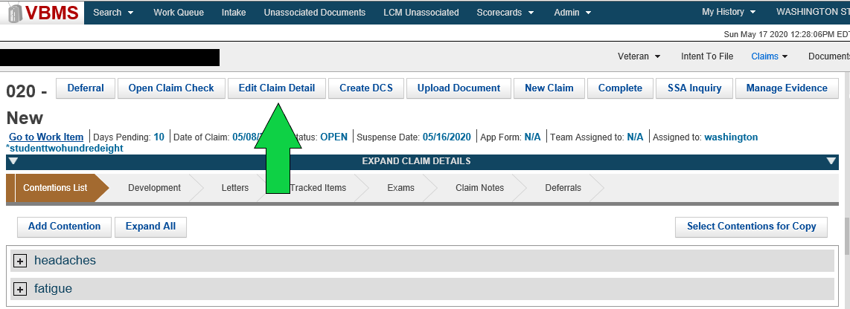
End Product (EP)
The correct EP and associated claim label should be selected for each claim, based on claim type and number of contentions. To change the claim information, click “Edit Claim Detail,” on the claim information screen.
Note: Third digit modifiers and incorrect claim labels are comments, not systems compliance errors.

Slide 8
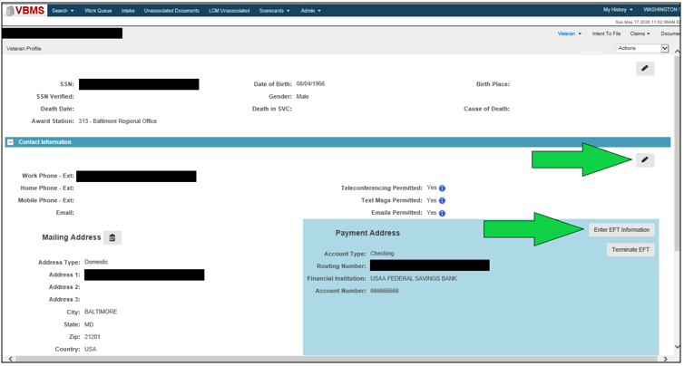
Payee’s Address & Direct Deposit Information
Ensure the following are up-to-date:
Mailing address
Direct deposit info
Temporary address, if applicable
Note: Incorrect direct deposit not an error unless there is a running award.

Slide 9
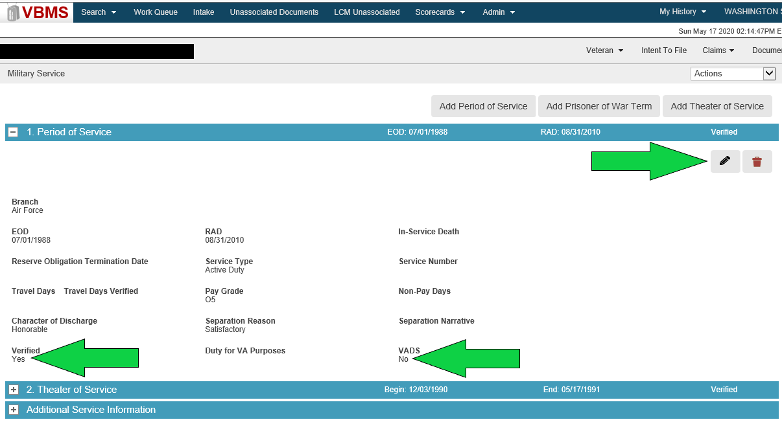
Veteran’s Service
Ensure the following:
Veteran’s service information is verified and updated in VBMS (“Yes” in VADS and/or Verified)
All required service periods are shown
Note: Additional specific entry requirements for non-active duty are discussed in the M21-1, Part III, Subpart ii, 3.C.

Slide 10
Power of Attorney (POA)
Designation of POA received on an acceptable and complete form:
VA Form 21-22, Appointment of Veterans Service Organization as Claimants Representative, or
VA Form 21-22a, Appointment of Individual as Claimant’s Representative
Correct POA and accesses are reflected in VBMS
Proper revocations of POAs, if applicable

Slide 11
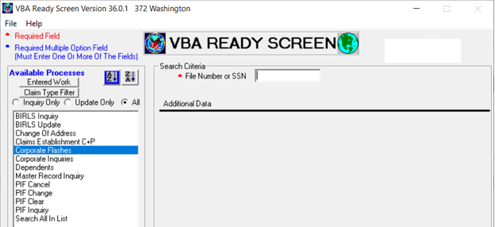
Corporate Flashes
Corporate flashes:
Claimant-specific indicators
Entered in the corporate record in Share
Common flashes – POW, Homeless, Attorney Fee, Restricted Access
Note: Only designated corporate flashes are errors.

Slide 12
Special Issues
Special Issues are claim-specific or issue-specific indicators:
Represent a certain:
claim type
disability or disease, or
another special notation relevant to a particular claim or issue.
Mandatory for all claims/issues, where applicable
Applied to contentions (see screen shot on “Contentions” slide)
Example: Agent Orange, Fully Developed Claim, Potential Under/Overpayment
Note: Only designated special issues are errors.

Slide 13
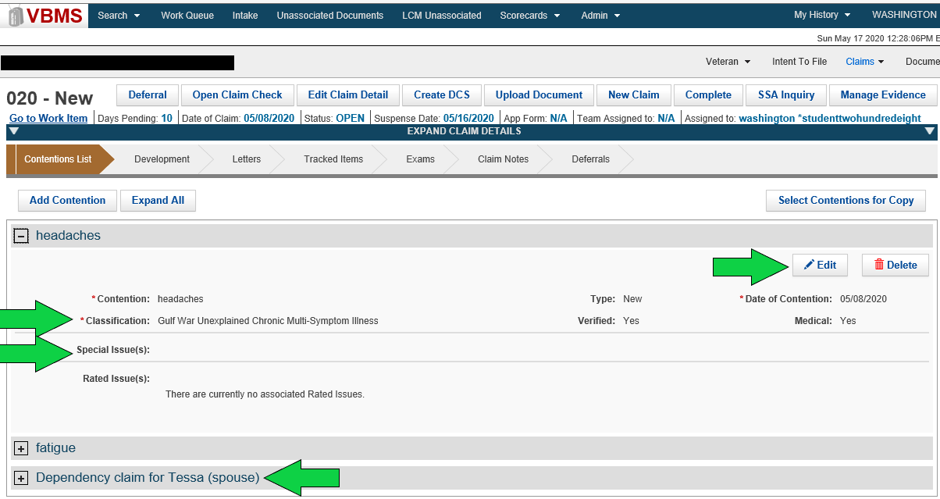
Contentions
Identify and confirm each claimed issue
Each claimed dependent is a separate contention
Contentions must be verified to show in eBenefits
Important: The contention classification must be correct to aid with correct DBQ selection in EMS.

Slide 14
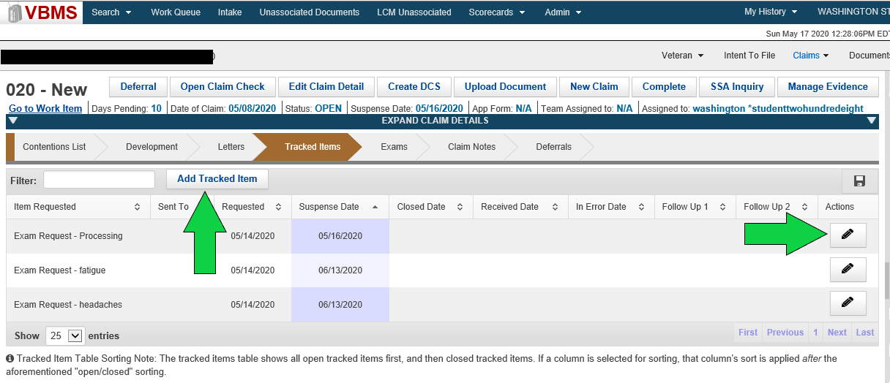
Tracked Items
Required to control requested evidence
Tracked item errors:
Incorrect use of custom tracked items
Unnecessary tracked items
Follow-up vs. extending suspense when done incorrectly
Note: Tracked items not required if tracking is no longer warranted.
Example: The records have been received or are unnecessary.

Slide 15
Summary
Now that you have completed this course, you should be able to:
Identify all systems compliance elements that must be reviewed on a case
Recognize errors associated with each systems compliance element

Slide 16
Questions?

