Slide 1
FOR TMS TRAINING CREDIT
To obtain training credit in TMS, there is no need to review these slides at this time – immediately close this box by using your mouse to select the “X” in the upper right-hand corner; select the “Return to Content Structure” button; and, select the next link (Video) to view the edited audio-video recording of the Quality Call along with the Call Bulletin
These slides are included here only in case you want to use them later for training purposes or reference
These are the same slides that are shown in the audio-video recording

Slide 2
Compensation Service Quality Call
May 2020

Slide 3
Welcome to the May 2020 Quality Call
Bonnie Kirby
Senior Quality Review Specialist
Quality Review Team
Quality Assurance

Slide 4
Agenda
Decommissioning of the Navy and Coast Guard Ship List
What’s New in the M21-1
COVID-19 Impact on Compensation Operations
Q-Tips: Scheduling Exams Amid Covid-19
Including Laws & Regulations in C&C Evaluation Decisions
Calculating Past-Due Benefits on Attorney Fee Cases
ALS Claims Part II: Common Site Visit Findings
Vietnam Visual Order of Battle
The Package Manager
Closing Comments

Slide 5
Decommissioning of Ships List
Melissa Milenkovic
Program Analyst
Procedures Maintenance Staff (211C)
Policy and Procedures

Slide 6
Decommissioning of Ships List
On January 1, 2020, VBA restricted use of the Navy and Coast Guard Ships Associated with Service in Vietnam and Exposure to Herbicide Agents, a.k.a., the ships list, to Records Research Team members designated to work blue water Navy claims.
Beginning May 1, VBA discontinued updating the ships list.
Link to the ships list removed from VBA sites
Training materials are being updated
M21-1, Part IV, Subpart ii, Chapter 2, Section C will contain the historical policy for use of the ships list (M21-1, IV.ii.2.C.3.q)
Comms with all VA and external stakeholders

Slide 7
What’s New in the M21-1
Kim Tibbitts
Program Analyst
Procedures Maintenance Staff (211C)
Policy and Procedures

Slide 8
Overhaul of M21-1, Part III, Subpart v, Chapter 3 Apportionments
Changes to M21-1, Part III, Subpart v, Chapter 3, reflect a course correction in the way claims processors
decide apportionment claims, and
manage running apportionments

Slide 9
Change in the Approach to Determining Entitlement
38 CFR 3.450 and 3.451 govern most decisions regarding a dependent’s entitlement to a portion of a Veteran’s disability compensation (apportionment)
BAD: Conflating the provisions of 38 CFR 3.450 and 3.451 when deciding apportionment claims
GOOD: Considering the provisions of 38 CFR 3.450 and 3.451 separately when deciding apportionment claims

Slide 10
Change in the Approach to Determining Entitlement (cont.)
38 CFR 3.451 prohibits the apportionment of a Veteran’s benefits if the apportionment would cause undue hardship to the Veteran. No such provision exists in 38 CFR 3.450.
What This Means: VA may grant an apportionment claim under 38 CFR 3.450, even if doing so will create a hardship on the Veteran.

Slide 11
Change in the Approach to Determining Entitlement (cont.)
38 CFR 3.450 prohibits the apportionment of a Veteran’s benefits to his/her dependents if the Veteran is contributing to their support. No such provision exists in 38 CFR 3.451.
What This Means: VA may grant an apportionment claim under 38 CFR 3.451, even if the Veteran is contributing to the support of the claimant.

Slide 12
Change in the Approach to Determining Entitlement (cont.)
When deciding entitlement to an apportionment, decision makers must first determine whether they may grant entitlement under the provisions of 38 CFR 3.450. If they cannot, decision makers must determine whether they may grant entitlement to a special apportionment under the provisions of 38 CFR 3.451.
Note: See M21-1, Part III, Subpart v, 3.A.1.d for exceptions.

Slide 13
Change in the Development Process
Eliminated the requirement to undertake development with the claimant after he/she submits a completed VA Form 21-0788, Information Regarding Apportionment of Beneficiary’s Award
Claims processors may still undertake development with the claimant if they require
clarification regarding entries the claimant made on the form, or
evidence or information beyond what the form requires in order to make an equitable decision

Slide 14
Determining the Amount of an Apportionment
The regulation under which a decision maker grants an apportionment typically dictates the amount of the apportionment.
There are exceptions, one of them being the apportionment of disability compensation.

Slide 15
Determining the Amount of an Apportionment – Disability Compensation
If VA decides to apportion disability compensation to a Veteran’s dependent(s) under either 38 CFR 3.450 or 3.451, the latter regulation – 38 CFR 3.451 – dictates the amount of disability compensation VA may apportion.

Slide 16
Treasury-Listed Countries and Enemy Territory
Recent changes to M21-1, Part III, Subpart vi, 3.B clarified the following:
Restrictions regarding the development of claims from and the authorization of awards to claimants that reside in a listed country apply only if the claimant is not a U.S. citizen
Restrictions regarding the payment of benefits to beneficiaries that reside in enemy territory apply only if the beneficiary is not a U.S. citizen

Slide 17
Treasury-Listed Countries and Enemy Territory (cont.)
A “listed country” and “enemy territory” are not always one and the same.
At the present time, there is no location the U.S. identifies as “enemy territory.”

Slide 18
COVID-19 Impact on Compensation Operations
Sian Roussel
Program Analyst
Program Implementation
Policy and Procedures

Slide 19
Novel Coronavirus Disease (COVID-19) Operational Information Page
VBA continues to identify and implement measures to assist Veterans and other claimants in the processing of benefits claims during the pandemic.
Guidance related to compensation and pension benefit claims and appeals may be found on the Compensation Service Novel Coronavirus (COVID-19) Operational Information Page.
Regional offices should routinely check here for updated guidance and processing instructions.

Slide 20
COVID-19 and Impacts on Private Medical Record (PMR) Requests
In some cases, private healthcare providers are not responding to record requests due to unavoidable issues from COVID-19 pandemic.
Where PMR contractor is unable to obtain records, VA is instituting temporary procedures to ensure that Veterans are not adversely impacted by delayed records.
Contractor will provide claimant additional notice of ability to request extensions for providing and obtaining private medical records.

Slide 21
COVID-19 and Impacts on PMR Requests
Claimants may independently provide PMRs or request claims proceed without them. However, adjudicators should not issue a final decision on claims for 15 calendar days following the date of the PMR Retrieval Program letter to allow for submission of an extension request.

Slide 22
COVID-19 and Impacts on PMR Requests
If a case needs to be held for 15 calendar days for submission of an extension request, claims processors should add a custom tracked item labeled “COVID PMR Delay.”
Tracked item covers 15-calendar-day response period after notification letter is sent by PMR Retrieval Program contractor (if it has not already expired).
If extension request based on COVID-19 is received, claim processors will follow guidance in Policy Letter (PL) 20-02, Novel Coronavirus (COVID-19) Claims and Appeals Processing Guidance.

Slide 23
COVID-19 Impact on Compensation Operations
Dustin Williams
Lead Program Analyst
Procedures Maintenance
Policy and Procedures

Slide 24
COVID-19 Impact on NPRC Requests
Due to COVID-19, NPRC has reduced capacity, resulting in significant response delays.
Effective immediately, and until further notice, accept uncertified service verification documents as valid proof of service.
Take appropriate claim actions, including examination ordering and favorable claim decisions, based on uncertified service verification documents.
Issues dependent on receipt of service records will be deferred, and end product kept open.

Slide 25
COVID-19 and School Children
Due to COVID-19, schools may suspend or cancel classes, or elect to instruct virtually.
In such instances, do not remove a dependent school child from a beneficiary’s award.

Slide 26
COVID-19 and Impact on Hearings
During COVID-19 pandemic, formal hearings may be conducted via Skype for Business.
Veteran/claimant must waive the right to appear in person.
If Veteran, claimant, or representative is not comfortable with a virtual hearing option, no action may be taken to decide the claim/appeal until in-person hearing can be conducted.

Slide 27
Q-Tips
Bonnie Kirby

Slide 28
Q-Tips
Fun way to share ideas in a simple tip format
Your Q-Tips are welcome and requested
We will help each other by sharing knowledge
Send your ideas to David Hannigan
david.hannigan@va.gov

Slide 29
Q-Tip #1: Scheduling Exams Amid Covid-19
Compensation Service has a COVID-19 Operational Information Page:
https://vbaw.vba.va.gov/bl/21/corona.htm
Exam information found on this page:
Field guidance, including Q&A
Medical Disability Exam Program Office guidance
“VBA has directed MDE vendors not to cancel exam requests due to COVID-19.”
Guidance for routing exams
March 2020 Contract Examinations Tip Sheet
Up-to-date information on handling examinations

Slide 30
Tip #2: Including Laws & Regulations in Confirmed & Continued Evaluations
RVSR Task Based Quality Review Checklist Task # 9: The laws and regulations applicable to the claim were not provided
50% of a sample reviewed were missing Part 4 regulations when confirming and continuing a disability evaluation
Use of the Evaluation Builder (EB) is mandatory
M21-1 III.iv.6.C.5.c
Proofread!
Ensure a law for each component of the decision is included
M21-1 III.iv.6.C.5.a

Slide 31
Q-Tip #3
Amy Wintrow
Consultant
Program Review – STAR Staff
Quality Assurance

Slide 32
Q-Tip #3: Calculating Past-Due Benefits on Attorney Fee Cases
The regulation states that in calculating the past-due benefit, total the payments that accrued during the period
from the effective date of the award
to the date of the decision awarding benefits
Do NOT use the:
date of the notification letter, or
last day of the month in which the decision awarding benefits was made
38 CFR 14.636(h) and M21-1 I.3.C.5.c

Slide 33
Q-Tip #3: Calculating Past-Due Benefits on Attorney Fee Cases
How does this apply to downstream dependency issues/subsequent grant of dependent?
1. Dependency evidence is of record when the grant is completed – use effective date of the award through the date of the disability rating decision
2. Dependency evidence is received within one year after the rating decision (favorable) – use effective date of the award through the generation date of the award
3. Dependency evidence is received after period covered by 3.156(b) - dependency issue is separate from that claim and there are no fees to withhold
38 CFR 3.156(b) and Instructions found on Attorney Fee Audit Standard Calculator

Slide 34
ALS – Common Site Visit Findings Part 2 of 4-part Series
Jessica Flannery
Operations Analyst
Program Operations Staff
Quality Assurance

Slide 35
ALS – Common Site Visit Findings Part 2 of 4-part series
Fact: If there is no individual complication warranting a single 100-percent, assign a single 100-percent evaluation using DC 8017 and include all complications in the diagnosis
Ex: ALS with dysphagia and mild bilateral lower extremity nerve involvement
M21-1, III.iv.4.N.6.d

Slide 36
ALS – Common Site Visit Findings Part 2 of 4-part series
Fact: When a single 100-percent evaluation is warranted for a complication of ALS:
Assign a 100-percent evaluation for that complication with a hyphenated DC (Ex: 8017-5110, loss of use of both feet due to ALS)
Assign separate evaluations for all complications
Note: Do not assign a separate evaluation under 38 CFR 4.124a, DC 8017 alone; this would be pyramiding under 38 CFR 4.14.
M21-1, III.iv.4.N.6.d

Slide 37
ALS – Common Site Visit Findings Part 2 of 4-part series
Best Practice: As you go through the DBQ (or other medical evidence), make a list of every complication and see if any rise to the level of 100%. List serves a two-fold purpose:
#1 – helps identify if any complication reaches 100% level
If a complication does rise to the 100% level, you know that you must break out every complication separately
If there are no complications that warrant a separate 100% evaluation, then you need to include your list of complications in the description of the ALS diagnosis under DC 8017
#2 – serves as a check-off list to ensure you have included every complication in the rating decision

Slide 38
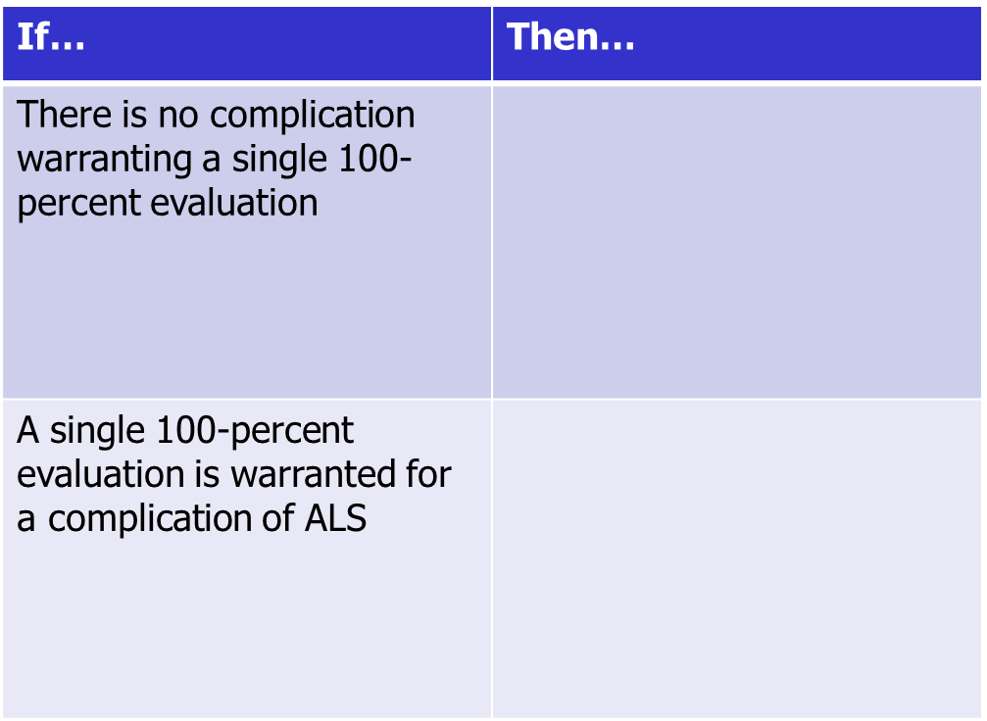
ALS – Common Site Visit Findings Part 2 of 4-part series
For reference, this is clearly defined in M21-1, III.iv.4.N.6.d.

Slide 39
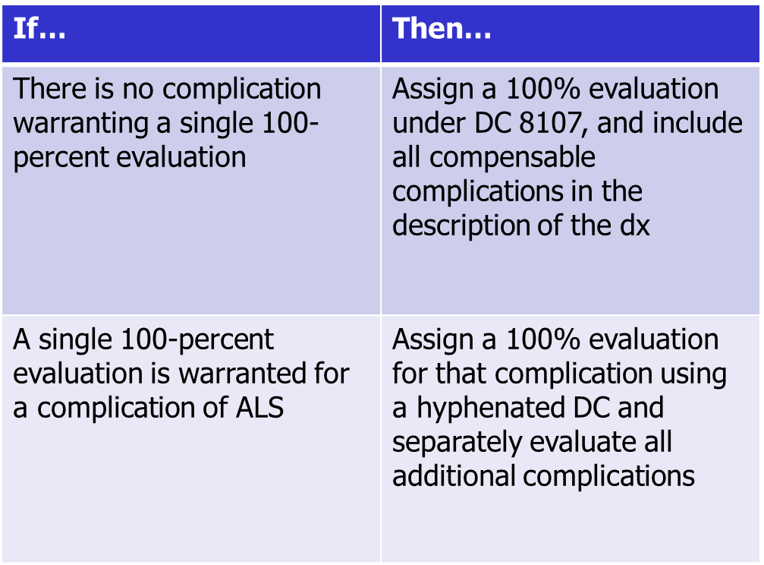
ALS – Common Site Visit Findings Part 2 of 4-part series
For reference, this is clearly defined in M21-1, III.iv.4.N.6.d.

Slide 40
ALS – Common Site Visit Findings Part 2 of 4-part series
Scenario: Veteran submits a private DBQ showing a diagnosis of ALS, mild bilateral upper extremity weakness, mild dysphagia, and sleep apnea-like respiratory condition requiring use of CPAP.
What is/ are the proper diagnostic code(s) and evaluation(s) for this scenario?

Slide 41
ALS – Common Site Visit Findings Part 2 of 4-part series
DC 8017 @ 100% ALS with mild bilateral upper extremity weakness, mild dysphagia, and sleep apnea-like respiratory condition
Since no complication warrants a 100% evaluation on its own merit, all complications should be rated together with ALS under DC 8017.

Slide 42
ALS – Common Site Visit Findings Part 2 of 4-part series
Scenario: Veteran submits a private DBQ showing a diagnosis of ALS and sleep apnea-like respiratory condition with a tracheostomy.
What is/ are the proper diagnostic code(s) and evaluation(s) for this scenario?

Slide 43
ALS – Common Site Visit Findings Part 2 of 4-part series
DC 8017 – 6847 @ 100% Sleep apnea-like respiratory condition with tracheostomy due to ALS
Since there is a complication that warrants a 100% evaluation on its own merit, it is appropriate to assign a 100% evaluation for that complication using a hyphenated DC.
Any additional complications that come up in the future will also be rated separately.

Slide 44
Vietnam Visual Order of Battle
Andrew Gray
Lead Operational Innovation Strategist
Office of the Deputy Executive Director for Operations
Operational Innovation Team

Slide 45
What is the Vietnam Visual Order of Battle?
A new stressor verification tool to quickly and accurately verify stressor statements from Vietnam Veterans
Created out of a need that was identified by employees in the field
Tableau Workbook with data from 1.6 million combat, incident, and operation summary reports
Over 919,000 verified events from January 1, 1965 through April 21, 1975
The data was obtained through the National Archives and Records Administration and Texas Tech University

Slide 46
What are the Sources of Information?
Primary data sources include:
Republic of Vietnam incident files
Records about combat incidents in Cambodia during the Vietnam War
Viet Cong initiated incidents files
Records about the ground combat operations by the Army during war
Enemy base area file
Southeast Asia friendly forces file
Ground operations reporting system files for the Army of the Republic of South Vietnam
Naval gunfire support during the Vietnam War

Slide 47
Vietnam Visual Order of Battle Tool
Allows employees to find the location of landing zones, hills, fire bases, and other military site locations
If a stressor cannot be verified using the VVOB, then development is required to JSRRC/MCASC for stressor verification

Slide 48
The Package Manager
George Boyd
Consultant
Advisory and Special Review Team
Quality Assurance

Slide 49
Package Manager Trends
Package Manager (PM) Trends from QMS VSR IQRs
 | FY19 | FY20
# of Pre Errors Cited | 12 | 3
# of Post Errors Cited | 122 | 114
Total Errors Cited | 134 | 117

Slide 50
Package Manager Trends
Package Manager (PM) Trends from QMS VSR IQRs (continued)
 | FY19 | FY20
Rating Decisions Not Received | 18 | 16
Letters Not Sent (PM in Draft Status) | 28 | 25
PM Not Used | 14 | 37

Slide 51
The Package Manager
Erin Hawkins
Consultant
Advisory and Special Review Team
Quality Assurance

Slide 52
Package Manager References and Resources
M21-1 III.ii.1.B.4.b. Procedures for Handling Outgoing Mail
For other outgoing regular/routine mail (such as development letters or award letters to claimants, beneficiaries, and representatives) prepare packages using VBMS Package Manager for centralized printing and mailing as provided in the CBCM program whenever possible, unless the type of communication may not be centrally printed.

Slide 53
Package Manager References and Resources
M21-1 III.v.2.B.1.m. Steps to Follow After Preparing a Decision Notice
Ensure that the notice and any other associated documents that must be provided to the claimant or beneficiary
comply with the rules in the document titled Tips for Using Centralized Printing Successfully
are included in a package, created in VBMS Package Manager, and
are transmitted for centralized printing and mailing
Centralized Benefits Communications Management (CBCM) Phase One - Centralized Printing (TMS #4415957)
Provides training on creating packages in Package Manager

Slide 54
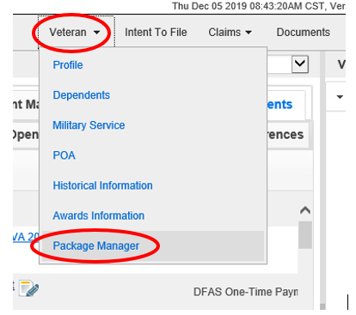
Accessing Package Manager in VBMS
To access Package Manager in VBMS:
Select “Veteran”
From the drop-down menu, select “Package Manager”

Slide 55
Package Manager Reminders
Ensure each package is sent for each recipient. Many packages are sent to the Veteran and the POA, so the package has two recipients. “Send Package” has to be selected for each recipient.

Slide 56
Package Manager Reminders
Example of when the POA package was sent, but “Send Package” was not selected for the Veteran’s copy

Slide 57
Reviewing Package Manager Status
Package Manager displays the history of packages prepared and sent for Centralized Print.
Package Manager also displays when a package is not successfully sent.
Users should take this information into account when processing claims.
Example: Due Process is prepared on 2/3/2020. The Due Process letter dated 2/4/2020 is available in VBMS documents, however a review of Package Manager shows the Due Process package is still in “Draft” status. This means that even though the Due Process letter is present in VBMS documents, the Veteran never received the correspondence.

Slide 58
Package Manager Status on the Distributions Tab
Draft, circle; The package is not finalized. This status means the user must finalize the package to be sent.
In Progress, envelope; The package is finalized and sent to Centralized Printing. No action is needed.
Success, checkmark; Centralized Printing received and accepted the package. No action is needed.
Fail, exclamation point; Centralized Printing received the package, but unable to print it. User should contact VAVBAWAS/CO/VCIP

Slide 59
Suggestions – Next Quality Call
Presented by: Bonnie Kirby
We are offering opportunities for RO SMEs to present topics during a Compensation Service Quality Call recording session
Peer-to-peer communication is optimum
Are you interested in presenting a topic?
Talk to your coach or other RO management team member
If approved, have management send your name and topic to:
VAVBAWAS/CO/InternalQRS

Slide 60
Do you have Suggestions for Topics?
Please email your topic suggestions to the Quality Call Leads at VAVBAWAS/CO/InternalQRS
In your email, please include:
CC to your coach or other RO management
Name of topic
Intended audience (VSR, RVSR, DRO, AQRS, RQRS, etc)
Applicable 38 CFR and/ or M21-1 references
Quality Call Bulletins can be found on the STAR Home Page on the Compensation Service Intranet site, TMS, and VBA Learning Catalog
Audio recordings of the Quality Calls with separate copies of the PowerPoint slides can be found in both TMS and the VBA Learning Catalog

Slide 61
Next Quality Call
A Compensation Service Quality Call is usually recorded each month
Next Quality Call will be recorded in June

