Slide 1
VR&E Operational Excellence Training
Click here to view the recording
Recording Password: VREoet2020!
Strategic Performance Management:
The Theory of Change
Briefed by:
Pamela Salazar, VR&E Service and Jon Desenberg, MITRE June 16, 2020

Slide 2
Kick-Off Question
What’s the synonym that comes to mind when you hear the word “Strategy”?
Use the Chat Box

Slide 3



Contact Information
Jon Desenberg
Strategic Management
JDesenberg@MITRE.org
202-210-1541

Slide 4

Learning Objectives
What’s one thing you want to learn in the next two hours?
Use the Chat Box

Slide 5
Training Objectives
  Provide overview of team’s functions and benefits
  Understand Effective Performance Management
  Focus on interim results
  Knowledge of current Performance Monitoring reports and discussion

Slide 6

Learning Objectives
How does The Theory of Change improve execution and engagement?
Why is change an effective focal point for strategic management?
What important step in the Theory of Change do most organizations struggle with and why?
Why are performance measures misused and what can we do about it?

Slide 7
Training Connection
Connecting to The Rest of the Week’s Trainings:
Unity in Goal-based Change
Not Every idea will work and that’s ok.
Strategy is everyone’s business
Foresight is increasingly important
Disney’s use of foresight
Advent Health Value statements, appearance, love – Why value is important
Use of Stories to compliment data
Asking Questions matters – Advent Health
Supply Chain Management – Products and impact on customer

Slide 8

Workshop Objectives
Strategies
| 8 |
Moving away from compliance;
How do we support the use of strategic thinking?
Enhance your skills
in effectively creating, testing and using
Strategies
Notes:
Instructor notes:
This is an “application” workshop, so the primary objective is helping you effectively use MVCs
The secondary objective is helping PLs create effective MVCs (that is, create MVCs that have high utility)
It may seem like we are focused on creating ”perfect” MVCs, but this is not the case
We provide guidance on creating MVCs so that we all create them in a consistent manner
Consistent w.r.t. what each MVC component means, not the form in which the MVC is documented
In this workshop, we will talk about ways in which MVCs can be used and offer utility, but much of that practice will need to occur on the job (outside this workshop)

Slide 9
Strategic Experience Gallery Walk
  Think of any Strategy or Planning Session, work or non-work.
  1) What worked
  2) What didn’t work
  3) What did you learn / How would you improve?
Use the Chat Box

Slide 10

“Crossing The River By Feeling The Stones”
摸着石头过河
Is this how we plan and manage today?

Slide 11
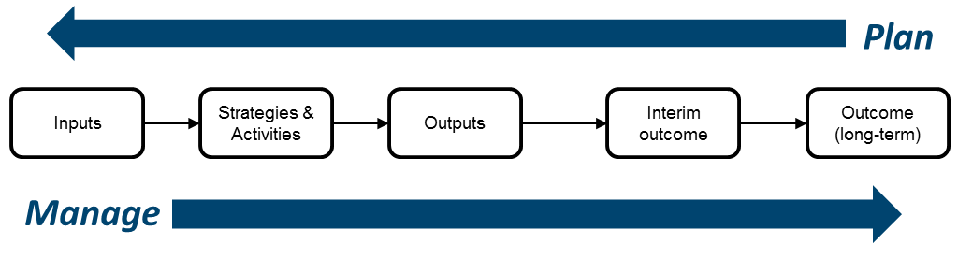
Performance Logic Model
Focusing on Interim Outcomes:
Measurable Change – Not Milestones
Force Field - What is pushing for & against the long-term outcome?
Center of Gravity – Who or What is the focus for creating change?
Attitudes, Behaviors, Conditions – Can we measure these in a key group?

Slide 12
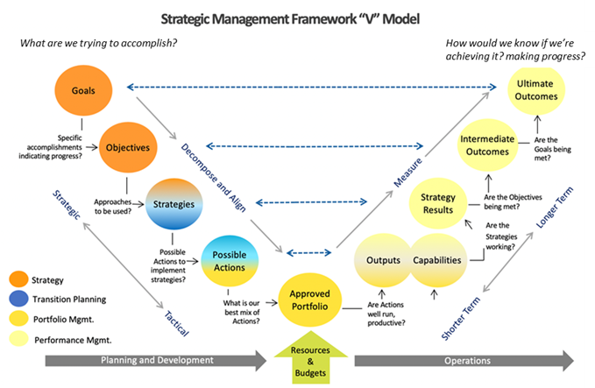
How do we connect planning and results?

Slide 13
Field Performance Monitoring Roadmap
Performance Monitoring Objective
The intent of this new performance monitoring function is to provide the field with additional support and resources to maximize the number of Veteran positive outcomes and program participation growth.
Reasons for Establishing the Performance Monitoring Function
The intent of the new performance monitoring function is to enhance the linkage between VR&E Central Office and Field operations to achieve the following: Leverage data to build on the strengths of the highest performing stations Identify areas of concern at a station level where performance indicators are slipping so that immediate action can be taken Have a better sense of who is in trouble and who needs assistance Provide additional support to the Field to allow them to better serve Veterans Ensure modernization initiatives are being implement and leverage to their full potential
13

Slide 14
Goals and Objectives
Monitor performance against national and local performance standards and support building stronger local capacity for self-monitoring and achieving outcomes
Assesses the effectiveness of national performance standards and identify opportunities for improvement.
Work with District Analysts to ensure that VR&E related measures/issues are being tracked and triaged for additional focus and remediation of solutions.
Provide data-driven insights into risks and opportunities at a national and local level.
Assess benefits realized from improvement initiatives.
Strategic Performance Monitoring
Align improvement efforts with VR&E priorities and performance outcomes
Partner with district/RO analysts to identify actionable recommendations and implement solutions in response to identified challenge areas at a national and local level.
Identify areas to leverage and promote the use of leading practices throughout the field
Create opportunities to facilitate dialogue and identify best practices.
Conduct ongoing analysis of market conditions and trends (e.g., Veteran pipeline) to support performance improvement efforts
Performance Improvement Support
Modernization Adoption
Monitor compliance with new modernization initiatives.
Identify and reduce barriers for adoption of new technology.
Ensure compliance with appropriate policy and procedures
Address field questions and concerns related to policy and procedures.
Policy Compliance

Slide 15
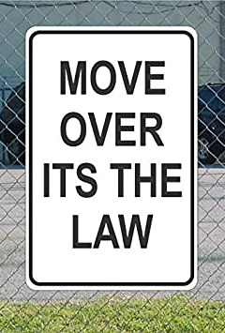
Evidence-Based Strategic Framework in the Law
The Government Performance and Results Act of 1993 (GPRA)
The GPRA Modernization Act of 2010 (GPRAMA)
Recovery Accountability and Transparency Board of 2009 (RAT Board)
Digital Accountability and Transparency Act of 2014 (DATA Act)
Evidence-Based Policymaking Act of 2019

Slide 16


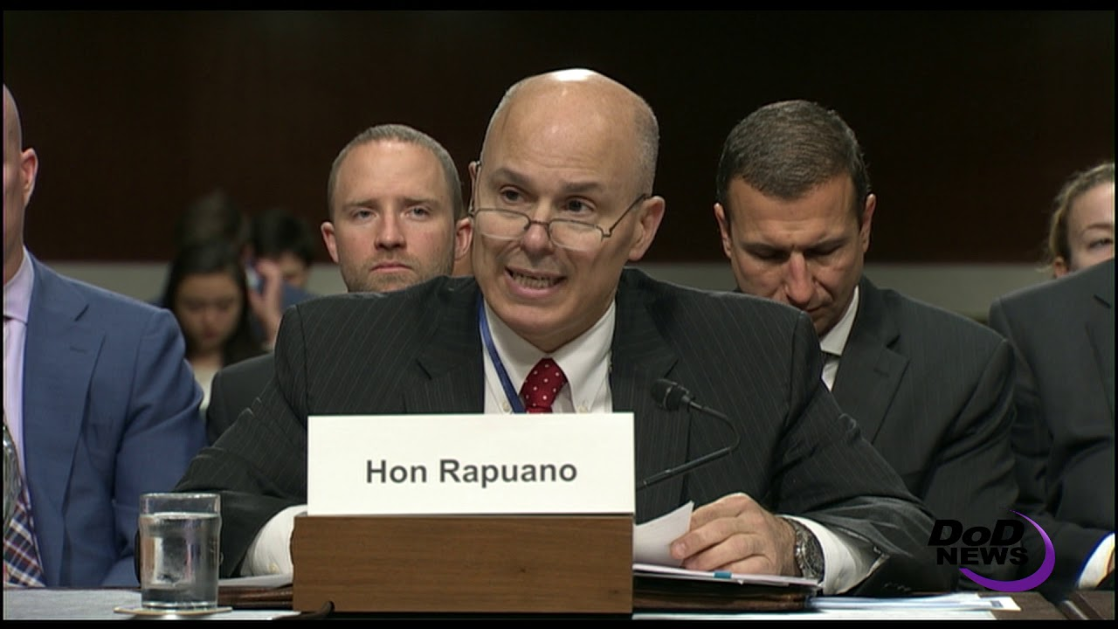
The Real World: Why Shifting to Outcomes Matters

Slide 17

What’s the First Question you hear from a Doctor?
Question:
What’s the First Question Your Doctor asks you?
Fill In Your Reply in the Chat Box:
A Diagnostic Approach to Outcomes

Slide 18

Using the Logic Model:
The Doctor Analogy – What is the First Question?
Start with a Question
Outcome Goal (End Outcome):
Achieve and Maintain Proper Health and Quality of Life
  Measures: Dozens…Pulse, Years Lived; Satisfaction Survey, etc.
Objective Goals (Intermediate Outcomes):
-Achieve Appropriate Fitness for Age, Gender
-Stop Pain in Y
-Restore Function of X
  Measures: Thousands: Weight, Blood Analyses, Scans, etc.

Slide 19
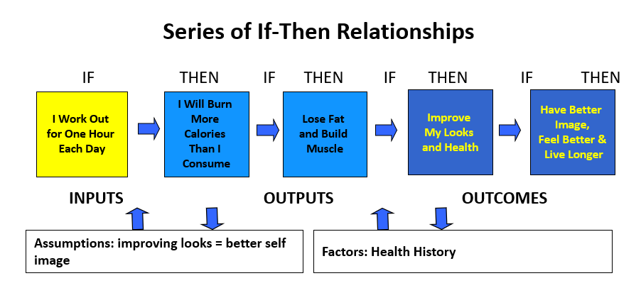
Sample Logic Model: My Work Out Routine and defining linkages between what we do and why we do it .
Logic Model
Series of If-Then Relationships
IF THEN IF THEN IF THEN IF THEN
I Work Out
for One Hour
Each Day
I Will Burn
More
Calories
Than I
Consume
Lose Fat
and Build
Muscle
Improve
My Looks
and Health
Have Better
Image,
Feel Better &
Live Longer
INPUTS OUTPUTS OUTCOMES
Assumptions: improving looks = better self image
Factors: Health History
Notes:
Fundamental to logic model is notion of if-then relationships; causal connections; not direct cause-effect but ASSOCIATIONS - logical connections
Simple example
Where have sound research, if-then relationships are clear. Often, don’t

Slide 20
Clarifying the terms
Definitions
Inputs
People and resources required to achieve outcomes
Activities/
Outputs
What the inputs produce
Immediate and Intermediate Outcomes
Changes required to achieve end outcome
End Outcome
End goal or ultimate benefit
Assumptions: beliefs or evidence that supports your IF-THEN logic
Factors: external influences beyond control that effect IF-THEN relationships

Slide 21

Dental Check Up
Fill in the Boxes in numerical order from right to left.
The Time frame for this Model is One Year.
Think of Results, Changes, and What you, the dental patient should do or NOT DO.

Slide 22
Activity Worksheet: The Dental Check-Up Logic Model
IF THEN IF THEN IF THEN
8)
9)
6)
7)
4)
5)
3)
INPUTS OUTPUTS OUTCOMES
Assumptions:1)
External Factors:2)

Slide 23

Training Break

Slide 24
Separating Early and Later Activities
Global Logic Model: Childhood Lead Poisoning Program
Early Activities
Later Activities
Early Outcomes
Later Outcomes
If we do…
Outreach
Screening
ID of elevated kids
And we do…
Case mgmt of EBLL kids
Refer EBLL kids for medical treatment
Train family in in-home detection techniques
Assess environment of EBLL child
Refer environment for clean-up
Then….
EBLL kids get medical treatment
Family performs in-home techniques
Lead source identified
Environment gets cleaned up
Lead source removed
And then…
EBLL reduced
Developmental slide stopped
Quality of life improves
Definition:
EBLL – Elevated Blood Lead Levels
Module Three: Using Logic Models

Slide 25
Most logic models incorporate the following
Emphasis on Intermediate Outcomes
CONTROL
EFFECT
Inputs
Activities
Outputs
Intermediate
Outcomes
Attitudes Behaviors Conditions
End
Outcomes
HOW
WHY?

Slide 26
Outcomes vs. Outputs
Drivers
Inputs
Activities
Outputs
Intermediate
Outcomes
End
Outcomes
Appreciating outcomes vs. outputs
Appreciating outcomes vs. outputs
Outputs | Outcomes
Number of housing units rehabilitated | Increases in equity (property value) of rehabilitated houses for low-income families as a results of targeted assistance
Number of businesses assisted through loans and training | Percent of businesses that remain viable 3 years after assistance
Number of people served by water/sewer projects | Increased percent of people with access to clean drinking water
Number of acres of agricultural lands with conservation plans | Percent improvement in soil quality; dollars saved in flood mitigation

Slide 27
Control and Influence
Drivers
Inputs
Activities
Outputs
Intermediate
Outcomes
End
Outcomes
Typical Program
Focus
Typical Agency Focus
Suggested Agency Focus

Slide 28
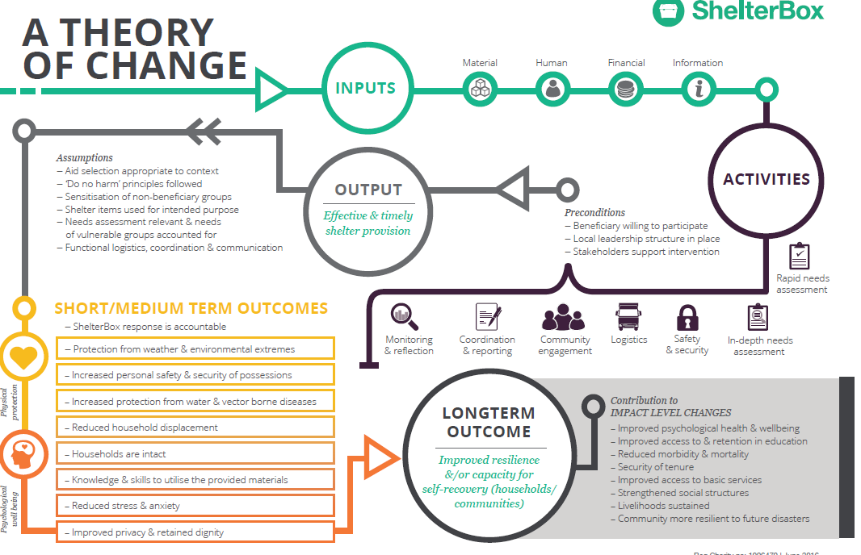
Theory of Change

Slide 29

Theory of Change
Myths:
Developing a Theory of Change to Guide Planning is complicated and controlled by a few senior leaders.
Outcome Based Planning is just another box to check.
Facts:
This framework relies on stakeholders challenging unexplained or illogical assumptions, resourcing and activities. It should be clear, specific and measurable.
Strategically engaging employees and partners and their creativity is increasingly important.

Slide 30

WHY?
But Why Are We Doing This?
But Why Are We Doing This?
Resiliency
Results
Monitoring and evaluation
Communication and Engagement
Learning
Why Else?

Slide 31
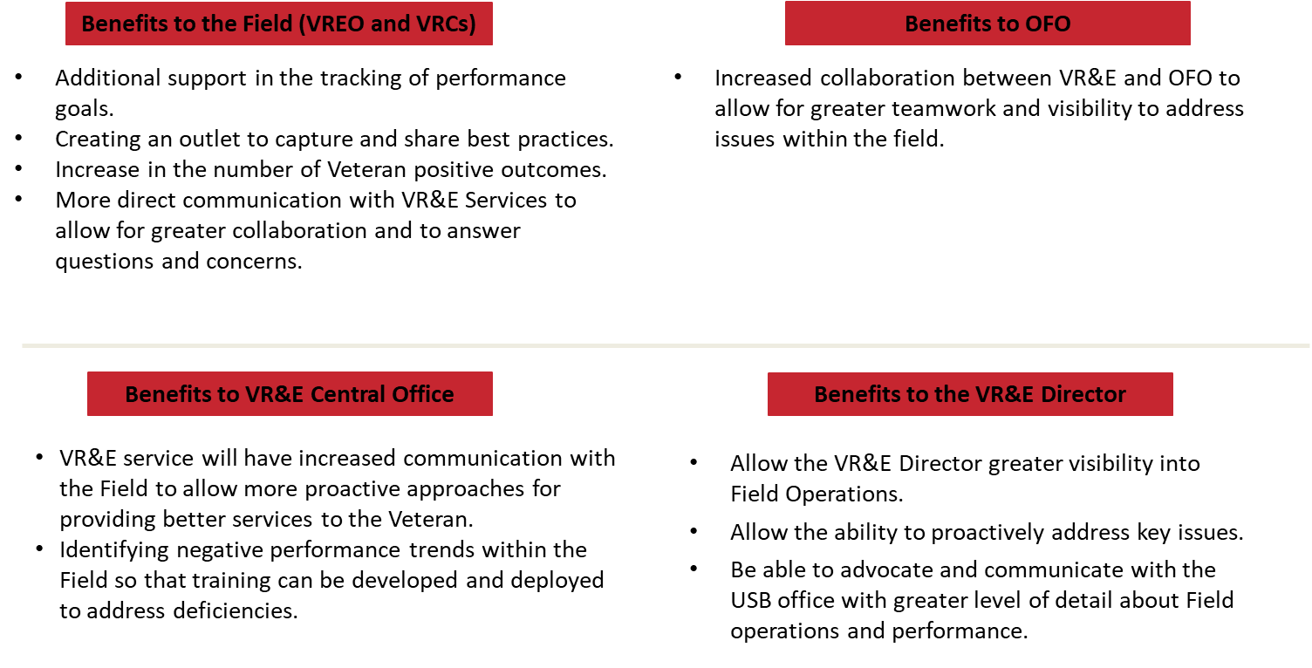
Benefits for Key Stakeholders

Slide 32
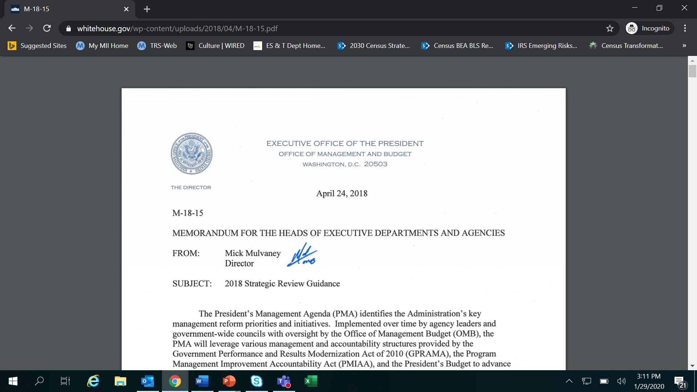
Integrating Foresight and Contextual Indicators into Strategic Management
1. Mission Assessment, which includes an assessment of progress being made
2. Risk Assessment, which includes the use of Foresight and External Indicators
3. Management Priorities, which includes updates in key management areas

Slide 33

Identifying intermediate outcomes through Center of Gravity Analysis
Center of Gravity Analysis
What attitude, behavior or condition needs to change to achieve the end outcomes? (Target)
2. Identify who possesses the critical capability to cause the change or achieve the end outcomes. What must they do? (Who & What)
3. How can you get them to do that? (How?)

Slide 34

Identifying Intermediate Outcomes
  Intermediate outcomes measure the results of strategies deployed to achieve the end outcome. Intermediate outcomes target the “center of gravity” of a particular problem to cause a change in the direction of the end outcome.
  Attitudes Behaviors Conditions

Slide 35
Identifying Intermediate Outcomes
If your organization were successful, what would you SEE, HEAR, FEEL and DO?
More | See | Hear | Feel | Do
Less
Notes:
Ask participants to think about the question in the context of their programs or organizations.
Give participants 10-15 minutes to generate responses.
Once participants have generated responses, ask, “Which of these things are you currently measuring?”

Slide 36
Measuring is Just the Scorecard: Not How you Win the Game
Selecting Your Measures
The Program Performance Assessment Window™
Attention Needed
Proven
Success
I
M
P
O
R
T
A
N
C
E
Factors
a = I4, P2
b = I3, P3
c = I2, P1
d = I1, P4
4
a
3
b
Exit
Opportunity
Resources
Available
2
c
1
d
1
2
3
4
PERFORMANCE

Slide 37

Case Study
Case Study: Using Improved Outcome Metrics to Fundamentally Change Course and Improve
As the food safety environment changed, measures and strategies needed to improve to meet different challenges.
Strategic focus on meat inspection no longer as relevant.
Improper cooking temperature, cross contamination and more diverse food sources and products were new drivers of foodborne illness.
FSIS used the logic model shift and change to adapt.

Slide 38
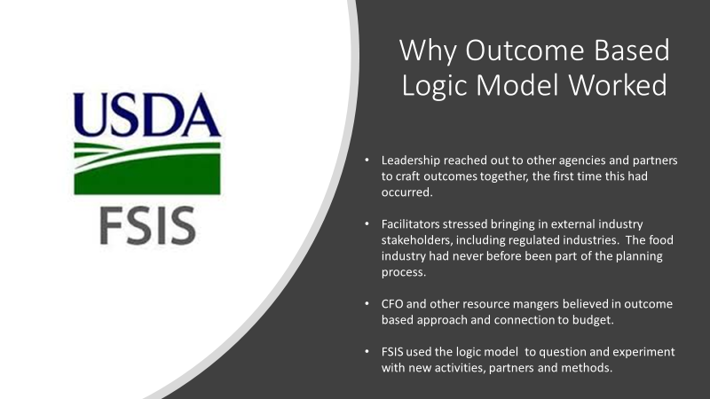
Case Study
CFO and other resource managers believed in outcome based approach and connection to budget.

Slide 39
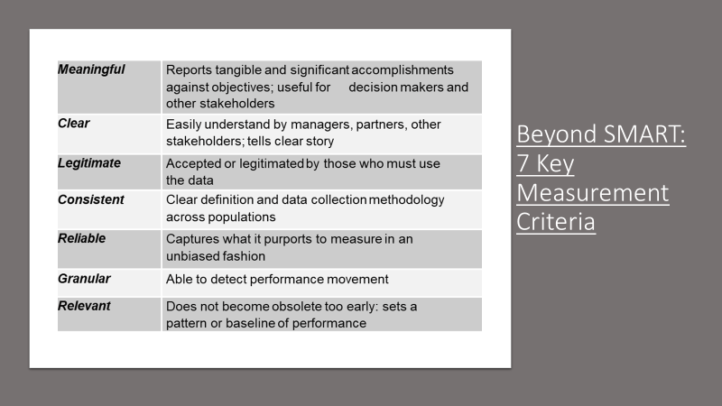
Measurement Criteria
Reports tangible and significant accomplishments against objectives; useful for decision makers and other stakeholders

Slide 40

Two Revolutions in Public Service
Business Intelligence, Analytics and Decision-making
Behavioral Science and Insights

Slide 41
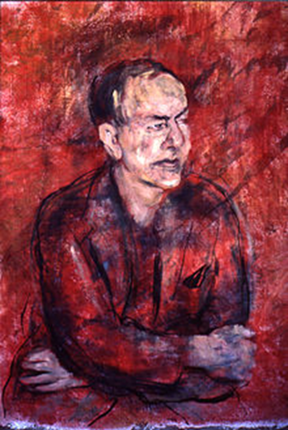
Nobel Prize Winner Herbert Simon
Ambiguity – Difficult to make decisions in large organizations
Longitudinal context, meaning that participants in organizational decision-making are a part of ongoing processes. Even if they don't take on active roles in all phases of decision-making, they are part of the Decision Process and its consequences
Incentives and penalties, which are pervasive, long-term, short-term
Repeated / rules-based decisions
Conflict / authority /politics

Slide 42
Effective Performance Management
Be aware of yearly targets and individual monthly targets
Determine where your station should be at the end of every quarter to ensure you meet your targets by end of FY
Review and staff cases in your station to assist in moving them, as appropriate
Take advantage of weekly performance reports provided
Communicate with CO Field Liaison to share concerns/issues, request resources, share best practices

Slide 43
Performance Monitoring Reports
Performance Data:
Field Liaisons meet with leadership to provide updates on the following:
Review of targets and where individual stations and districts are at
Prediction of how stations will continue to work on their targets based on feedback
Review of workload management report – oldest cases, new plan developed
Gather information from the station on the usage of new modernization/IT initiatives.
At this time, we are also monitoring the following:
COVID Impact on PP and PPR
IPPS Outstanding Invoices
Update on contracted and brokered cases

Slide 44

1. The Theory of Change improve execution and engagement by setting clear outcomes and testing evidence-based theories on the best way to achieve those outcomes.
2. Change is an effective focal point in strategic management in order to emphasize specificity, measurability and true outcomes.
3. Many organizations struggle with intermediate outcomes, an area that connects are work and products with our long-term goals.
4. Federal Performance Measures have been largely used for accountability and transparency, deterring organizations from using them in evidence-based pilots and experiments that will not always be successful.
Learning Objective Review and Questions

