Slide 1
Organizational Change, Growth Mindset and Psychological Safety
Click here to view the recording
Recording Password: VREoet2020!
Thriving in a Performance Driven Organization
Briefed by:
Dr. Craig Petrun
June 2020

Slide 2
Objectives
Define the process and factors that influence the organizational adoption of change
  Reflect on where VR&E is in the change process and explore the alignment of change factors to your modernization efforts
Explore the individual and organizational benefits of a growth mindset
  Apply “growth mindset” to the VR&E modernization and transformation initiatives
Review the importance and organizational benefits of “psychological safety”
  Reflect on what you have changed or will change to increase the “psychological safety” in your office

Slide 3
Change: In its simplest form change requires moving from the present to the future state
Present
State
Transition
State
Future
State
BEGINNING NEUTRAL ZONE ENDING
Change is the act of letting go of existing behaviors / attitudes and moving to and establishing new behaviors and attitudes that achieve and sustain desired business outcomes.
Kurt Lewin, Frontiers of Group Dynamics, 1947, 1(1), pgs 5-41.
William Bridges, Managing Transitions, Making the Most of Change.

Slide 4
Understanding the role of individual change
The Spiral of Individual Change
(Future State)
(Future State)
  Maintenance: Sustaining behavior change until integrated into lifestyle
  Action: Making the change
Pros vs. Cons
  Preparation: Getting ready to make change
  Pre-contemplation: Not aware of need for change
  Contemplation: Thinking about change
(Current State)
Prochaska, Norcross & DiClemente, Changing for Good, Harper-Collins Publishers, 1994.

Slide 5
Reflection and Learning
In your experience, where do individuals in your organization tend to get stuck?
  Pre-Contemplation
  Contemplation
  Preparation
  Action
  Maintenance

Slide 6

Navigating the Change Process: Successful implementation requires commitment to the entire process
Establish Urgency & Scope
Create & Communicate the Vision
Drive
Commitment,
Empowerment
Establish
Change
Infrastructure, Plans & Wins
Sustain & Refine the
Change
Measure progress, demonstrate value, communicate success, take corrective action
if needed.
Introduce new tools, technology, reward systems, training.
Engage workforce in planning the change; validate costs & benefits.
Engage leadership; communicate the compelling need for change.
Identify
stakeholders,
costs, and benefits of the change.
J. Kotter, Leading Change, 1996.

Slide 7
Navigating the Change Process: Successful implementation requires an understanding of the key organizational factors
Input
Open Systems Model of Change
External Environment
Most organizational change is driven by environmental impact.
Boxes indicate primary variables affecting organizational performance.
Arrows indicate critical linkages.
A change in any variable will ultimately affect every other variable.
Higher level variables have greater weight in effecting organizational change.
Leadership
Mission & Strategy
Organizational Culture
Throughput
Management Practices
Structure
Systems (Policies & Procedures)
Work Unit Climate
Task & Individual Skills
Motivation
Individual Needs & Values
Individual & Organizational Performance
Source: Burke, W. W. (1992). Organization development: A process of learning and changing, 2nd edition, Addison-Wesley Publishing Company.
W.Warner Burke & George H. Litwin, “A Causal Model of Organizational Performance and Change,” Journal of Management, vol. 18, 1992.
Outcomes

Slide 8
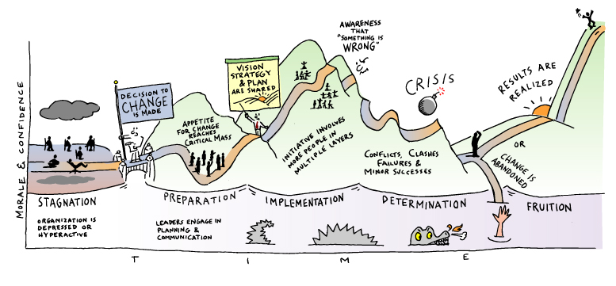
The path to change for both individuals and organizations is non-linear
The Change Road Map – “The road ahead is full of landmines.”
The nature of change unfolds in a series of dynamic but manageable phases that require preparation.
Jeanie Daniel Duck, The Change Monster, Crown Business, 2001 (Illustration by Gene Mackles).

Slide 9
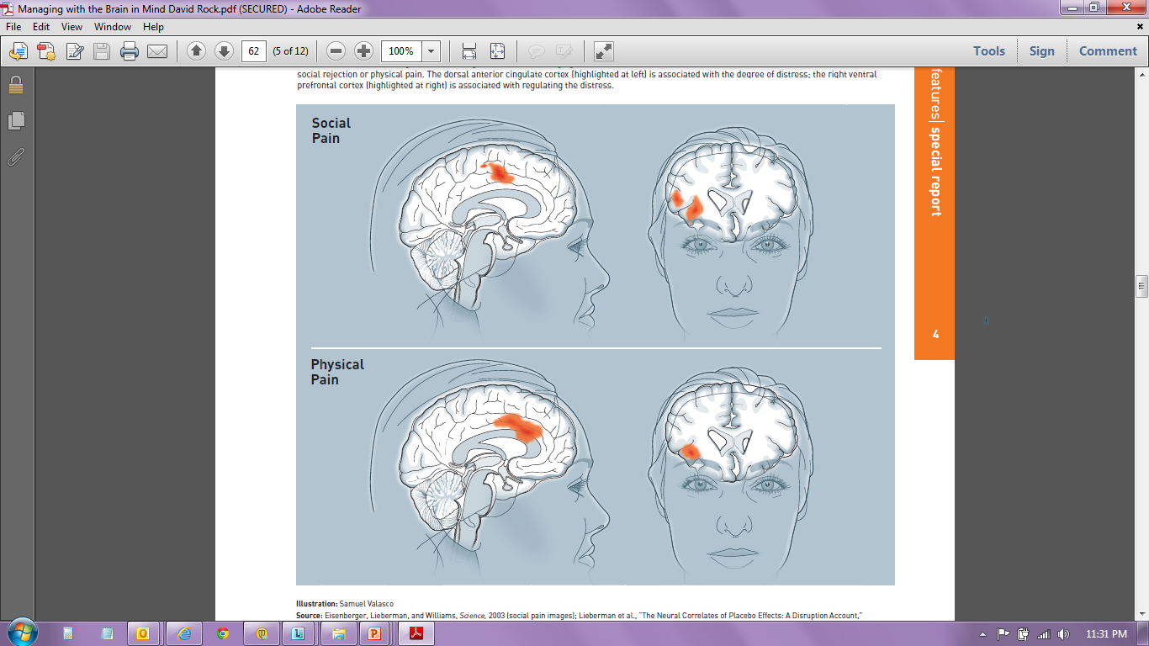
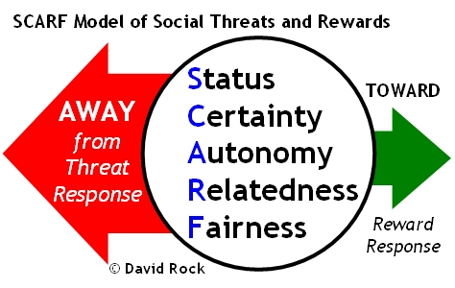
Neuroscience and organizational change
The brain cannot tell the difference between physical and social [emotional] pain
When emotions are triggered by a new situation, the brain automatically categorizes the change as threat or reward
Source: Rock, D. (2008). SCARF: a brain-based model for collaborating with and influencing others, NeuroLeadership Journal, pp. 1-10.

Slide 10
Reflection and Learning
Take a few moments to think about the VR&E Modernization initiatives/process and then answer the following questions:
  Where are you in the individual change process?
  What open systems change factors need more attention?
  Which SCARF factors are in play?

Slide 11
Growth Mindset

Slide 12
Growth Mindset vs. Fixed Mindset
Growth Mindset
Is the belief that skills and abilities can be improved and that the development of skills and abilities is the goal of the work you do
Students who believed their intelligence (IQ) could be developed outperformed those who believed their IQ was fixed
Fixed Mindset
A “fixed mindset” is when individuals believe their talents, and abilities cannot be improved by any means necessary. They feel as if they’re born with a certain amount of everything, and do not wish to challenge themselves because they are scared of failure
People believe their basic qualities, like their intelligence or talent, are simply fixed traits. They believe that talent alone creates success.
The Power of Yet | Carol Dweck | TEDx

Slide 13
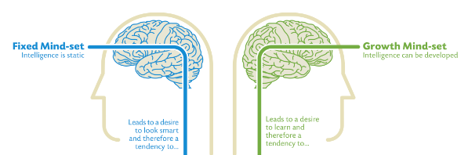
Growth vs. Fixed Mindset
Focus is on proving, doing better than others
Focus is on getting better, developing, improving,
Difficult Problem = Threat
What if I am not good?
Maybe I don’t have the skills
I could make mistakes
Others may do it better
Difficult Problem = Challenge
I can get better
I can always improve
A great chance to develop skills
A year ago, I wouldn't have done this well
The Power of Yet | Carol Dweck | TEDx
Source: Dweck, Carol. (2008). Mindset: The New Psychology of Success
Source, Illustration: Nigel Holmes

Slide 14
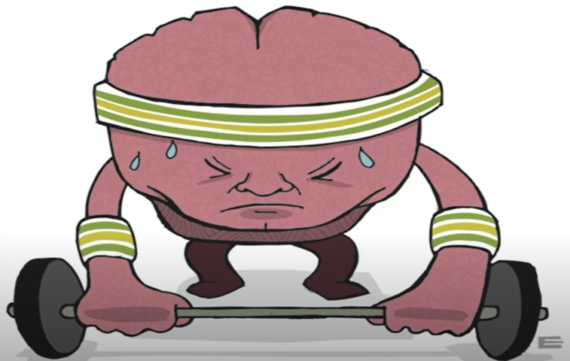
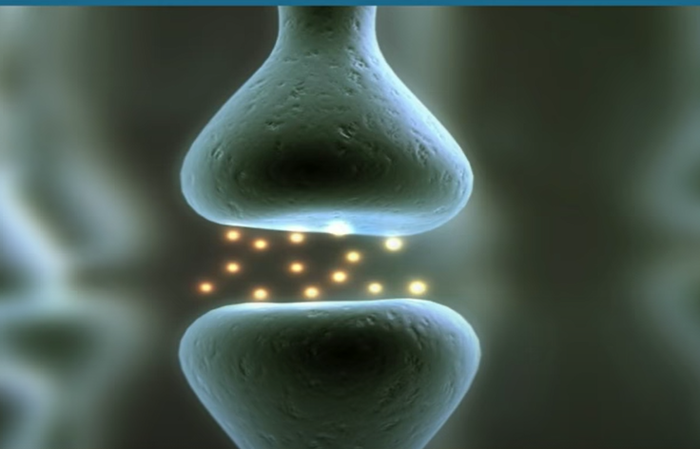
Teaching Children Their Minds Gan Grow Leads to Higher Performance
The Power of Yet

Slide 15
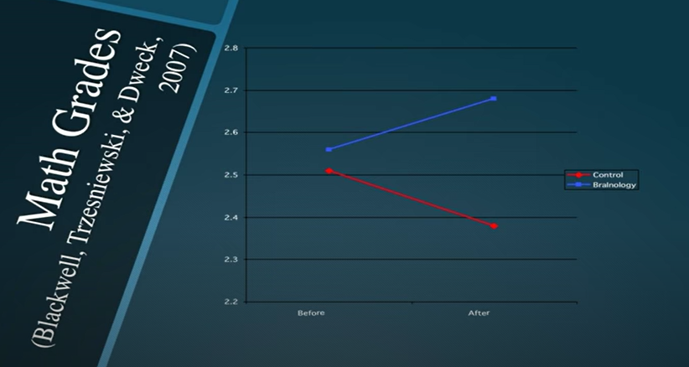
Growth Mindset Students Exhibit Higher Performance
Notes:
When she taught children that everytime they pushed themselves outside their comfort zone they can from new

Slide 16
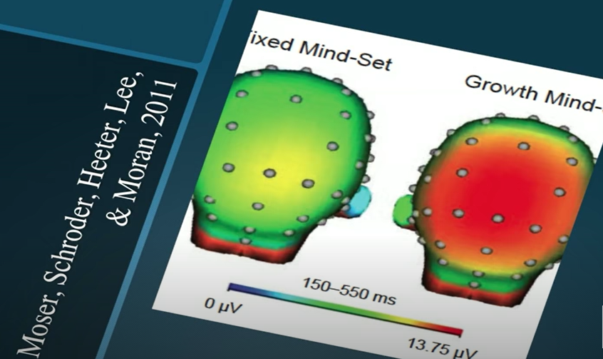
Growth Mindset Students Learn from Difficult Problems

Slide 17
“The path to a Growth Mindset is a Journey, not a Proclamation.” – Carol Dweck
Acknowledge we are all a mix of fixed and growth mindset.
Watch for your triggers and reactions when you have a setback or staff aren’t listening or performing well:
  Do you hear a voice inside you becoming defensive, angry, blaming
  Do you feel crushed by feedback instead of learning from it?
  Do you feel envious / threatened or eager to learn?
  Do you look for excuses?
Have a different conversation with yourself and others. “What have I tried, and what can I try next?”

Slide 18
Reflection and Learning
Individual Exercise
Identify 2-3 “fixed mindset” belief you have about yourself that does not serve you well
  Example:
    “I’m not good at showing empathy”
Find alternative beliefs that would move you to a “growth mindset”
  Example:
    “I am learning to ask questions to better understand other perspectives”
Brainstorm strategies to help you move towards a “growth mindset”
  Example:
    Right down a question before every meeting that would invite others to share their perspectives

Slide 19
Growth Mindset Individual Worksheet
Belief
Belief
Strategies
1
2
3

Slide 20
Psychological Safety

Slide 21
Psychological Safety
What happens when psychological safety is missing?
  Team members will refrain from admitting a mistake, asking a question, or offering a new idea
  Organizational performance and innovation take a hit
What is Psychological Safety?
  A shared belief that the environment is safe for interpersonal risk-taking
  Confidence that you will not be embarrassed, rejected or punished for speaking up
The behaviors that create psychological safety are part of the same unwritten rules we often turn to, as individuals, when we need to establish a bond.
Those human bonds matter as much at work as anywhere else.
- Amy Edmonson, HBR
Building a psychologically safe workplace | Amy Edmondson | TEDxHGSE
Source: Edmonson, A (2014). Teaming: How Organizations Learn, Innovate, and Compete in the new Knowledge Economy
Notes:
Two Dimensions you have to focus on… talking about
Free people up and not be afraid of each other…
If you have uncertainty and Interdependence

Slide 22
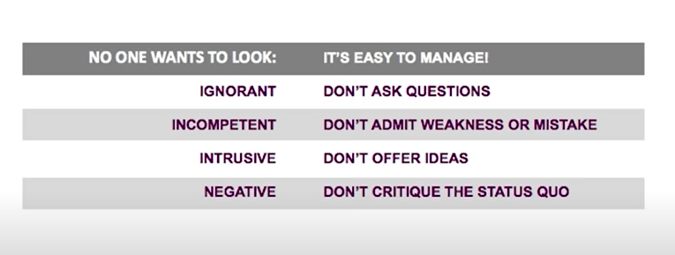
Why do people fail to speak up?
Impression Management
Notes:
We are quite good about this… learn this in school and early in life. But every time we withhold in the workplace we do not produce new ideas.
Good news it that not all workplaces are this way. Ones that have psychological safety.
Joined a team of Doctors and Nurses – wanted to find the true rate of drug errors, human related. She was going to find out if better teams make fewer mistakes. Trained investigator

Slide 23
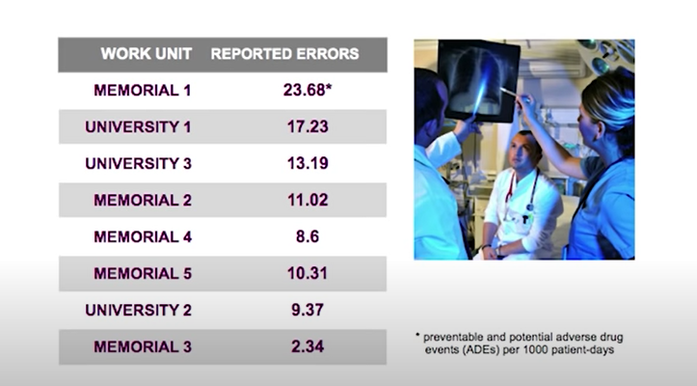
Do better teams make less errors?

Slide 24
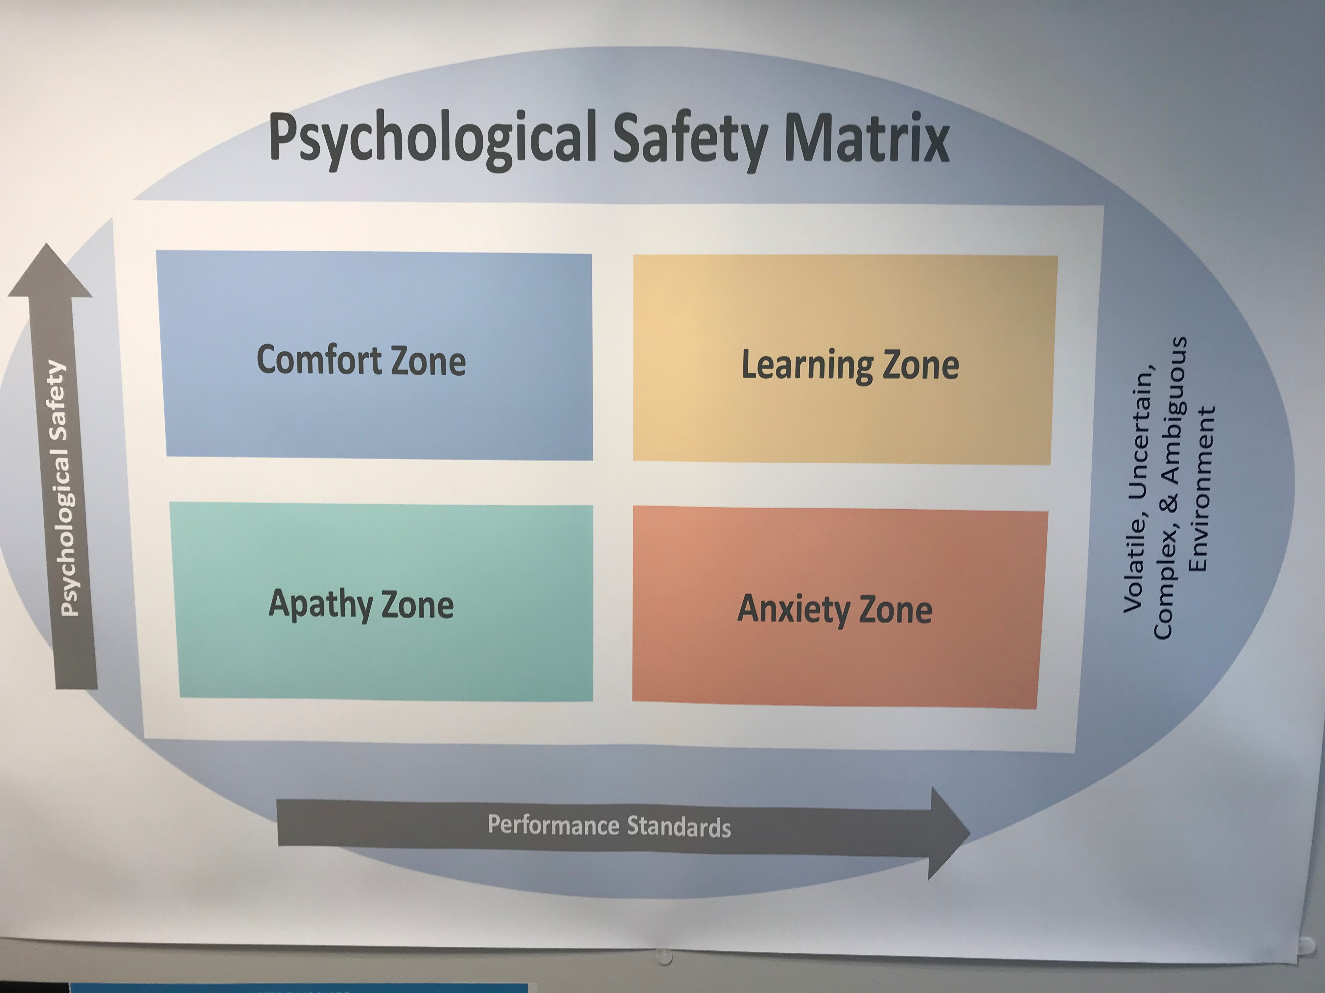
Psychological Safety vs. Accountability

Slide 25
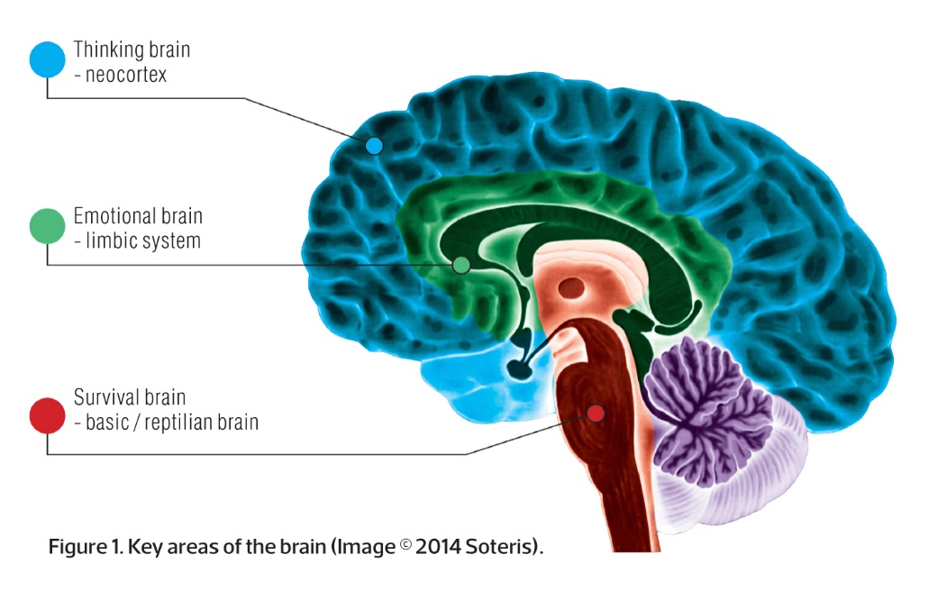
When your threat response is triggered, your reasoning brain is temporarily overpowered
Our brain evolved from
  a reptilian (400 million years) to
  a limbic brain (250,000 million years) to
  a Neocortex (500,000 years) brain
Our reptilian and limbic systems control threat responses. The amygdala is always scanning for threats.
It takes 8 milliseconds for a signal to get to the limbic system and send out a threat response.
It takes the same signal 40 milliseconds to get to the reasoning and thinking part of the brain.
When the brain has triggered a threat response, neurotransmitters flood your body.
These chemicals affect our ability to perceive, judge, think and relate.

Slide 26
Leadership Behaviors and Psychological Safety
Be accessible – Leaders encourage team members to learn together by being accessible and personally involved
Acknowledge limits – When leaders admit that they don’t know something, their genuine display of humility encourages other team members to follow suit.
Display fallibility – To create a psychologically safety, team leaders must demonstrate a tolerance of failure by acknowledging their own fallibility
Invite participation – When people believe their leaders value their input, they’re more engaged and responsive
Frame failure as learning opportunity – Instead of punishing people for well-intentioned risks that backfire, leaders encourage team members to embrace error and deal with failure in a productive manner
Use direct language – Using direct, actionable language instigates the type of straightforward blunt discussion that enable learning
Set boundaries – When leaders are as clear as possible about what is acceptable, people feel psychologically safer than when boundaries are vague or unpredictable

Slide 27
Leadership Behaviors and Psychological Safety
 | Setting the Stage | Inviting Participation | Responding Productively
Accomplishes | Shared expectations and meaning | Confidence that voice is welcome | Orientation toward continuous learning
Leadership Tasks | Frame the Work Set expectations about failure, uncertainty, and interdependence to clarify the need for voice Emphasize purpose Identify what’s at stake, why it matters, and for whom it matters | Demonstrate situational humility Acknowledge gaps Practice inquiry Ask good questions Model intense listening Set up Structure and Processes Create forums for input Provide guidelines for discussion | Express Appreciation Listen Acknowledge and thank Destigmatize Failure Look forward Offer help Discuss, consider, and brainstorm next steps Sanction Clear Violations

Slide 28
Reflection and Learning
DO THIS
How can you increase “psychological safety” during your organizational transformation?
AVOID THIS
How might you threaten “psychological safety” as part of your organizational transformation?
MESSAGES | BEHAVIORS
MESSAGES | BEHAVIORS

Slide 29

Questions

Slide 30
Appendix

Slide 31
The Change Process Crosswalk to Individuals
Establish Urgency & Scope
Create & Communicate the Vision
Drive
Commitment,
Empowerment
Establish
Change
Infrastructure, Plans & Wins
Sustain & Refine the
Change
Pre-Contemplation
Contemplation
Measure progress, demonstrate value, communicate success, take corrective action
if needed.
Introduce new tools, technology, reward systems, training.
Engage workforce in planning the change; validate costs & benefits.
Engage leadership; communicate the compelling need for change.
Identify
stakeholders,
costs, and benefits of the change.
Maintenance
Action
Preparation
J. Kotter, Leading Change, 1996.

Slide 32
Individual Change Crosswalk to Organizations
The Spiral of Individual Change in Organizations
  Maintenance
(Future State)
Choice, Training, Success
Performance Management
Resources
(Time, Dollars, Friends)
  Action
Cascading Leadership
Performance Planning
Quick Wins
  Preparation
Org. Transition Plan
Training, SCARF, Involvement
  Contemplation:
  Pre-contemplation
Vision/Strategy
Stakeholder
Analysis
Communications
Env. Assessment
External Changes
(Current State)
Prochaska, Norcross & DiClemente, Changing for Good, Harper-Collins Publishers, 1994.

Slide 33
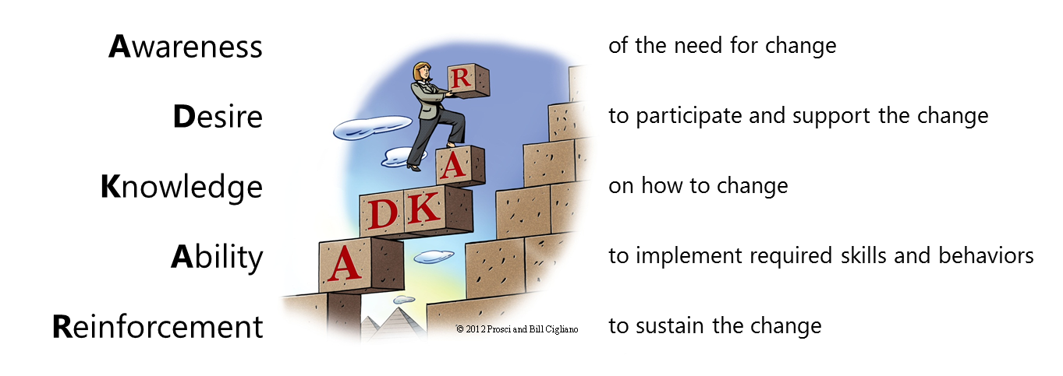
ADKAR Individual Change Model (PROSCI)
ADKAR describes the key building blocks for successful change
  personal or professional
Success with change requires all elements of the ADKAR model to be present

