Slide 1

Click here to view the recording
Recording Password: VREoet2020!
Creating a thriving culture of excellence to empower exceptional healthcare service delivery

Slide 2
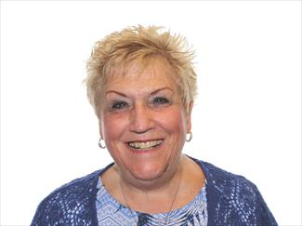

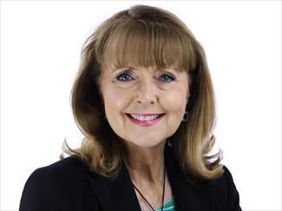

Presenters from AdventHealth Central Florida Division—South
AdventHealth Celebration
Deborah Laughon, MSN-ED DBA CCRN CENP
Nursing Director, Professional Development/Clinical Excellence
Leah Crescenti, BSN RN PCCN
Senior Manager, Clinical Experience
Connie Brink, MPH
Concierge Services Manager

Slide 3
Objectives
Describe an example of an Industry “change” using health care story
Identify critical elements of “change” that support success
Associate current “experience” with described critical elements

Slide 4

Overview
1973
AdventHealth was established
50
● Hospital campuses operated in nine states
80,000
Employees and physicians
5 million +
Patients served annually
12
● Skilled nursing facilities
18
● Home health and hospice agencies
Notes:
With a sacred mission of Extending the Healing Ministry of Christ, AdventHealth is a connected system of care for every stage of life and health.
More than 80,000 skilled and compassionate caregivers in physician practices, hospitals, outpatient clinics, skilled nursing facilities, home health agencies and hospice centers provide individualized, wholistic care.
A shared vision, common values, focus on whole-person health and commitment to making communities healthier unify the system's 50 hospital campuses and hundreds of care sites in diverse markets throughout almost a dozen states.

Slide 5
AdventHealth History
Largest Protestant-denomination hospital system in U.S.
Roots from mid-1800’s with faith and health pioneers such as Ellen & James White, Dr. Kelllog in Battle Creek, MI
In Florida, the movement began in 1908 with the opening of a sanitarium in Winter Park, FL
Corporate headquarters in Orlando, FL
Central Florida Division-South is Largest Medicare provider in US

Slide 6
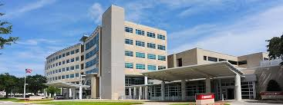
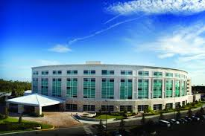
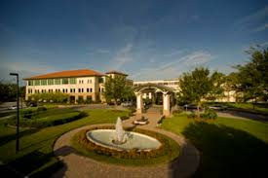
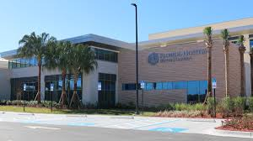





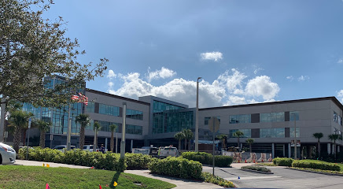
AdventHealth Campuses
Central Florida Division--South
Notes:
We are speaking today because we have gone through major change
Hope that it will help you as you go through your changes
Due to competitive marketplace, consumer driven demands that changed healthcare,
Needed to rebrand and regroup – show FL Hospital logo to AdventHealth logo
Journey – years of work and growth

Slide 7
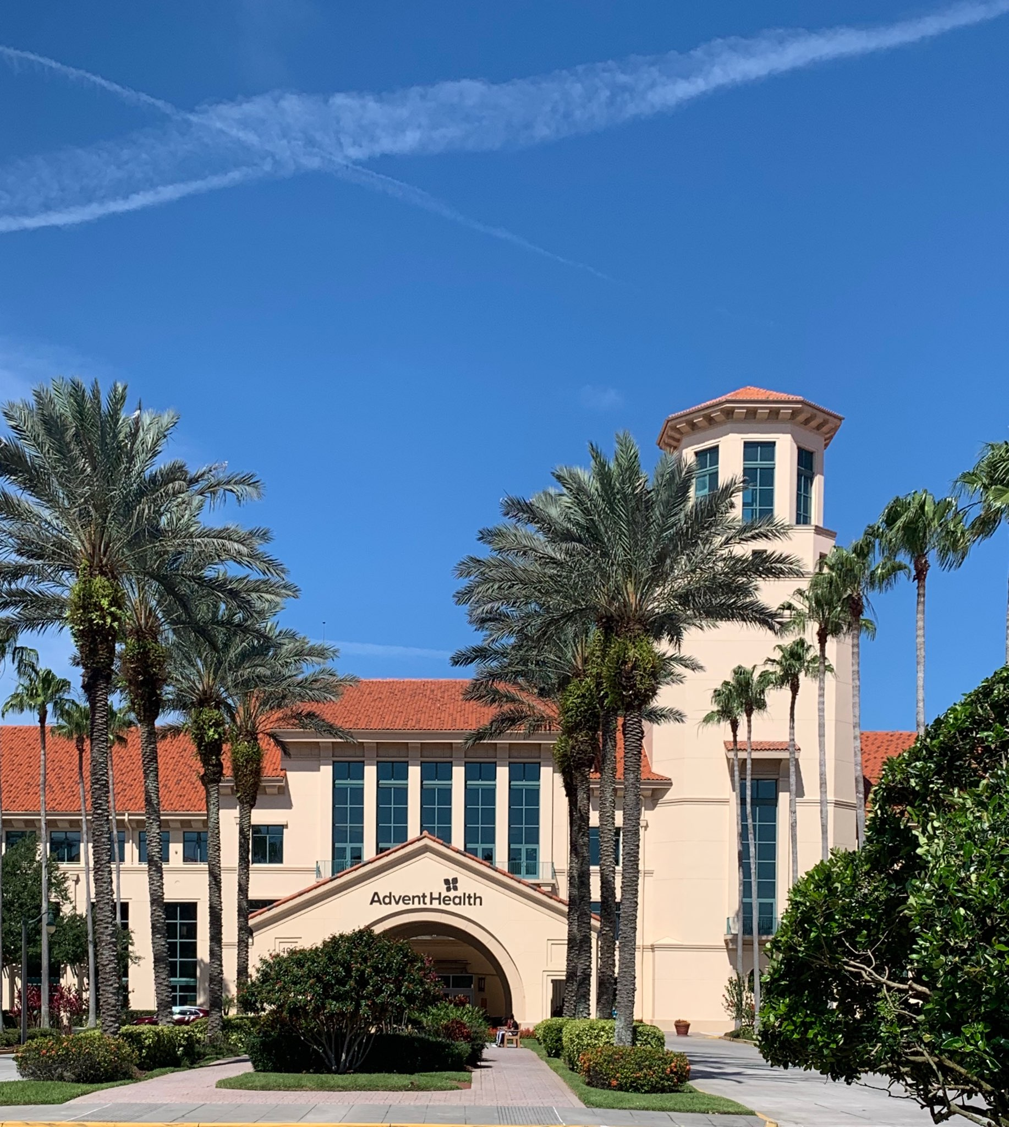
AdventHealth Celebration
Notes:
Added to the network of greater Orlando campus in November, 1997
Unique partnership with the community of Celebration and the Walt Disney Company
Focus on excellence in community hospital setting
Destination healthcare
Living laboratory
Maintaining faith-based roots of whole-person care—mind, body and spirit

Slide 8
Interactive Question
What changes are you going through?
How do these changes impact your role?
Notes:
Many businesses and industries are facing changes in operations, employment practices and leadership responsibilities. Take a moment to share with us the changes you may be experiencing within your organization. (Read the questions.)

Slide 9
2018—Year of Significant Change
Intentional effort to rebrand from Adventist Health System to AdventHealth on a national scale
Align our Mission, Vision, Values and Service Standards across all states for consistency of team culture and guest experience
“The Whole Care Experience” training on new alignment to all employees and medical staff
Four-hour sessions led by all levels of AdventHealth leadership and champions of the organization over four-month period

Slide 10
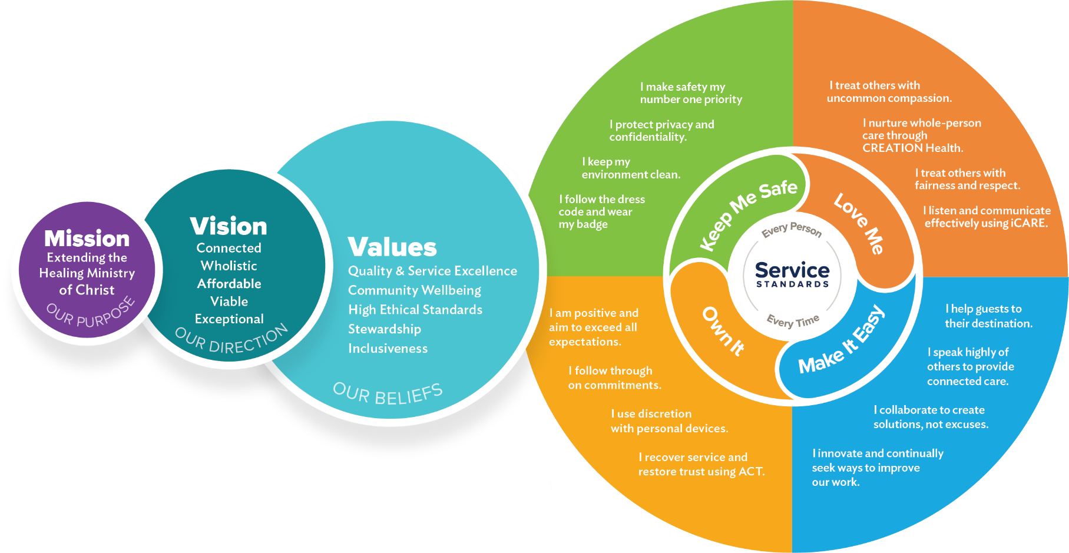
Greater as a Whole

Slide 11

Interactive Question
In leading change, what communication methods are working for you?
Notes:
Change is challenging and realizing it is important to get a clear message to all: we want to know what communication methods are working for you?
Read over comments and share some of the examples.
Summarize with the importance of assessing what is effective, consistent structure and timing.
I want to share part of our story to support effective communication during change.

Slide 12
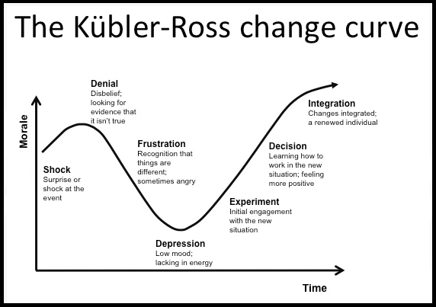
Change
Notes:
Talk about this model and the change evolution

Slide 13
Communication Cascade
Vision
Communication
Action
Notes:
Executive: Communication of the Vision and how it supports the Mission. Communicated to Leaders. For us this is Chiefs, VP’s, AVP’s, Directors, Managers, and supervisors.
Communication is Active with a variety of forums but the same message. Videos. Town Halls. Written Messages, huddles, social media. (Many ways: One Message: One Plan) We used a communication cascade to deliver the message to leaders, leaders to Managers, Managers To Staff. We used a structured consistent time and format called Connection Central. The content is delivered with a narrative and then a Key Word that is then used to deliver concise focus message. Too many words can be opportunity for confusion. Repeat and repeat. Consistency in messaging builds trust.
Action: Take the message to an actionable

Slide 14
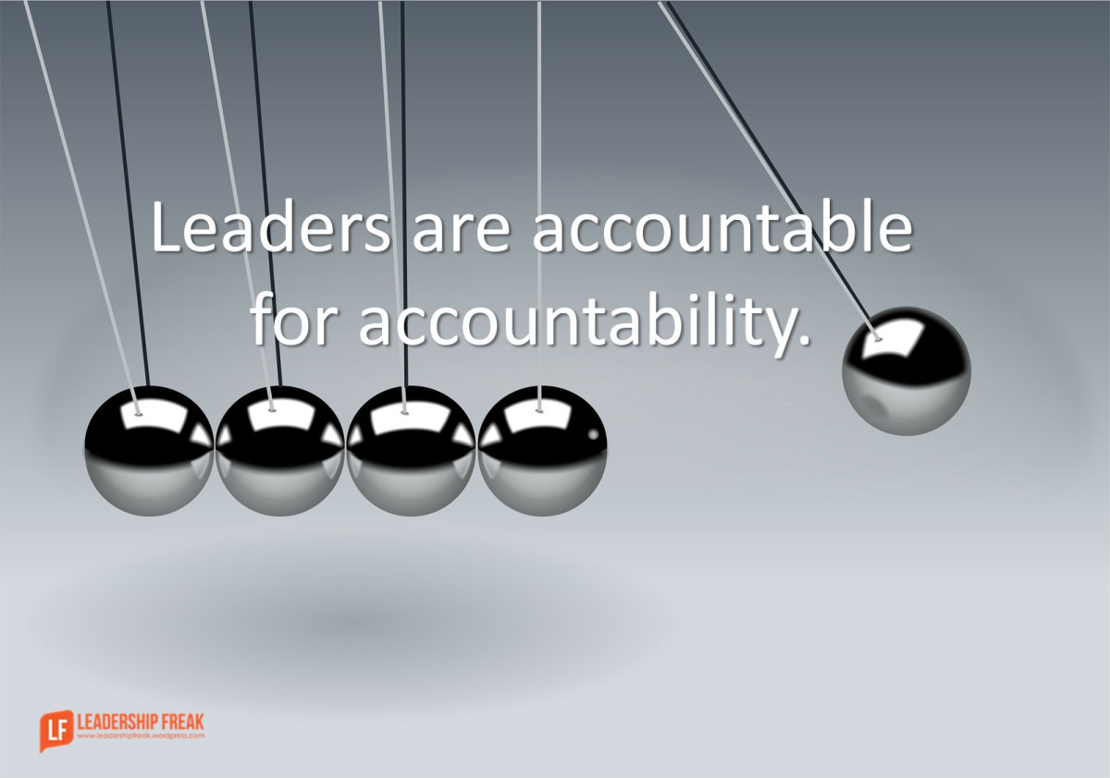
Accountability
Clear Expectations
Continual Observation
Communication
Consequences
Recognition
Notes:
Starts with leadership… (trust, but verify)

Slide 15
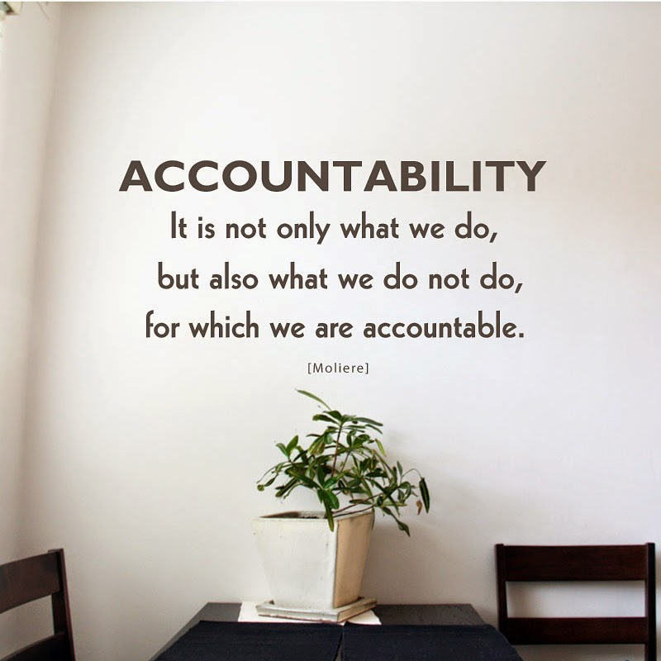
Interactive Question
What tools/processes do you find effective to ensure accountability?
Notes:
Look for consistency, methodology to ensure structure and process, observations, dialog, 1:1’s, report out

Slide 16
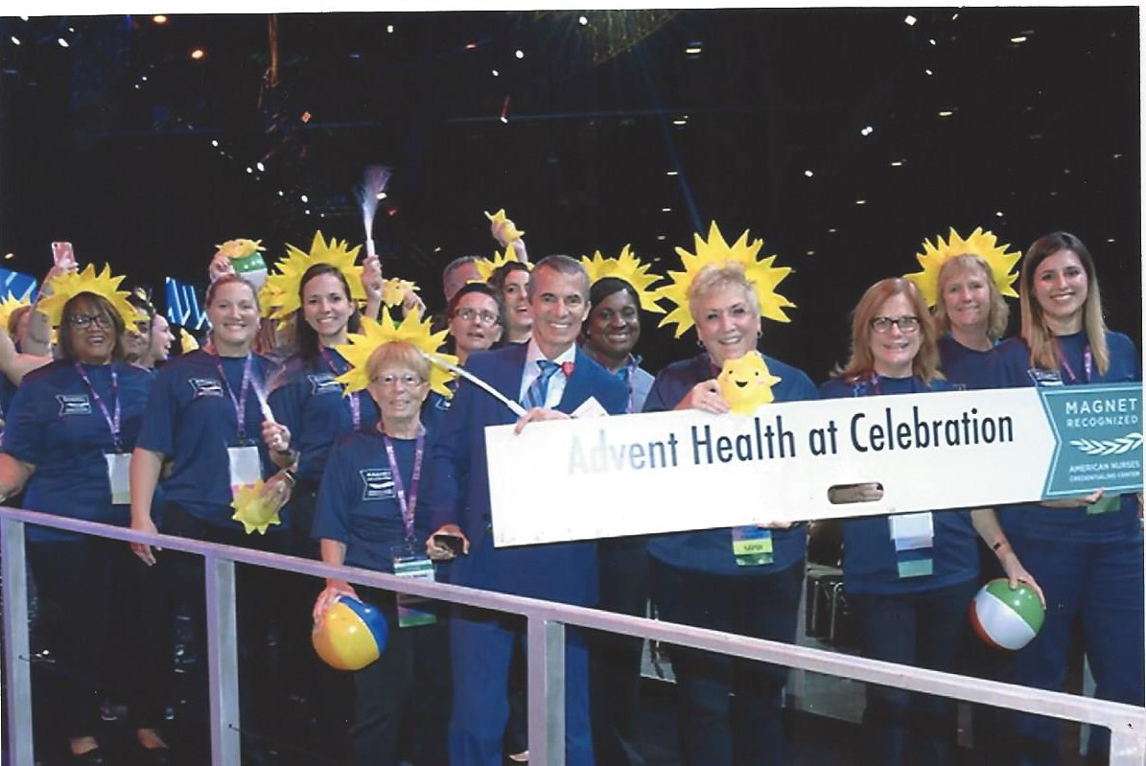
Journey to Magnet - Commitment to Excellence
Commitment
Executive Leadership
Ownership at all levels
Structures and Processes
Notes:
Photo from ANCC National Convention. Examples of employee, patient and community presentation…

Slide 17
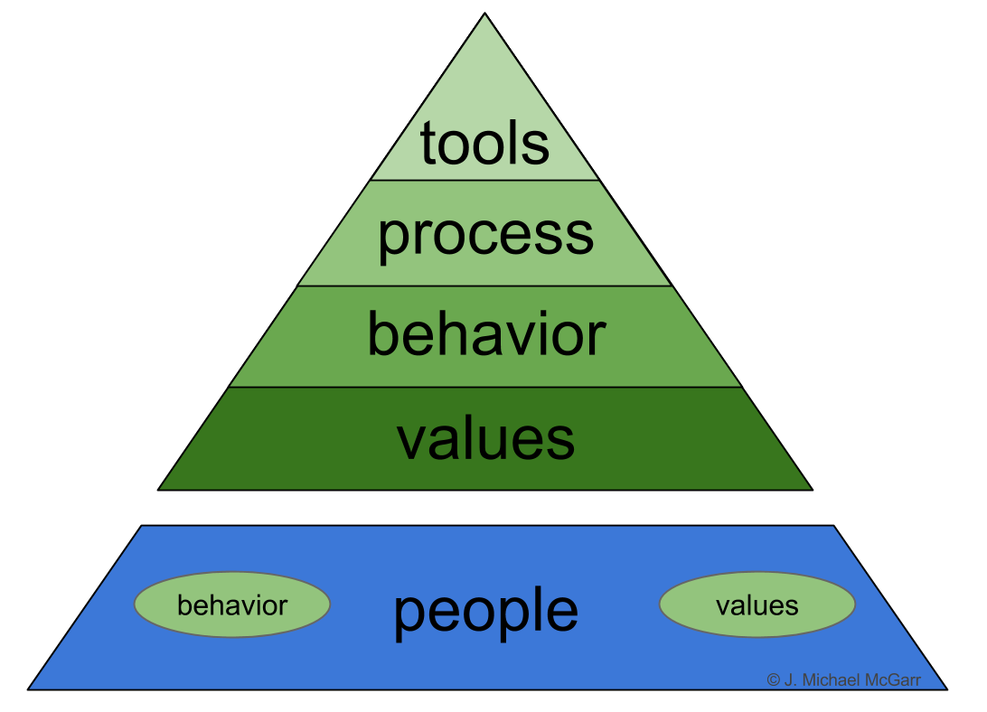
Interactive question
What examples do you have that showcase the change in culture that you are building?
Notes:
Since our stories are different, let’s hear some of the outcomes you hope to see during this change process?

Slide 19
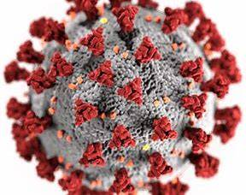
Let’s talk about COVID-19
Rapid change - positive or negative?
COVID-19 has been a challenge bringing many changes to everyone.
Has this been a positive or negative experience for you?
Notes:
Let’s talk about a recent global issue that lead to an environment of rapid change. The COVID-19 pandemic!
Think about the following question.
Feel free to share your thoughts in the chat area.
Do you naturally see change as a positive or negative? Do you dive in or are you hesitant?

Slide 20
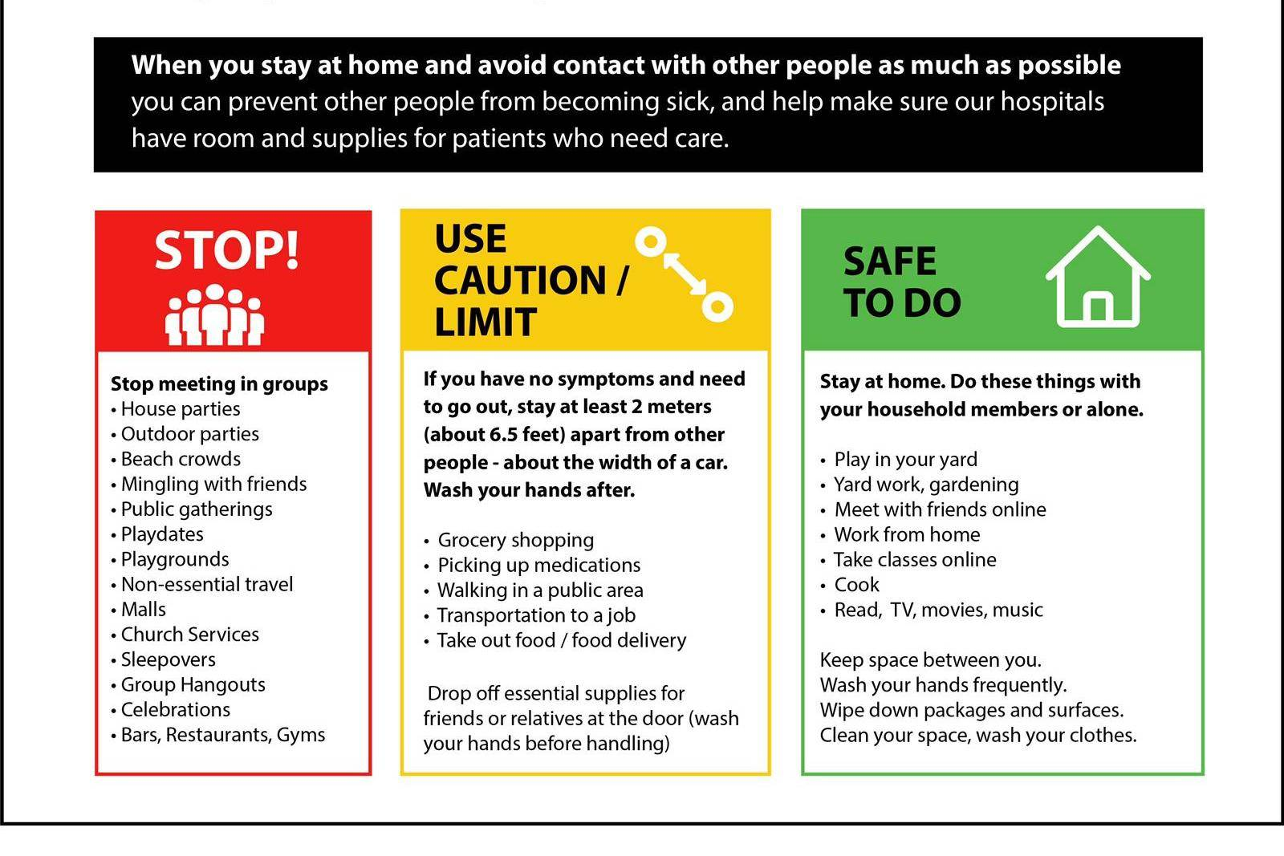
Let’s talk about COVID-19
What actually changed?
What things changed for you as the COVID-19 crisis spread?
Working remotely
Homeschooling
Social distancing in public
Staying away from friends and family
Vacation cancelled
Loss of employment/income
Stopped/started watching the news
Increase in mental health concerns
Increase/decrease in fitness activities
Other
Notes:
Think about the following question.
Feel free to share your answer in the chat area.
How did you lead your co workers and/or family through all of these changes? Did you help them to see the positive? Did you get stuck in the negative/ things you were missing out on?

Slide 21
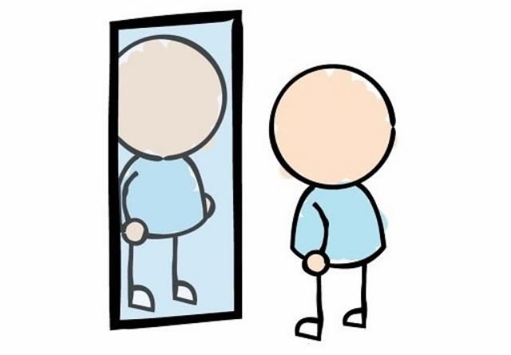
Let’s talk about COVID-19
Self Reflection during change
What did you learn about yourself while being under quarantine?
How did I react to all the changes?
What did I do well?
What could I have done better?
As an employee?
As a family?
Notes:
Think about the following question.
Feel free to share your thoughts in the chat area
It is important to reflect on what your natural tendencies as a response to change are.
As a leader, your role is to guide others through change.

Slide 22

Let’s talk about COVID-19
Notes:
You just reflected on how the changes that came with COVID-19 affected you and your family
There are some very valuable lessons to be learned from the COVID-19 pandemic on many levels
Next, we will discuss some of the lessons we learned/ were reminded of here at AdventHealth Celebration

Slide 23
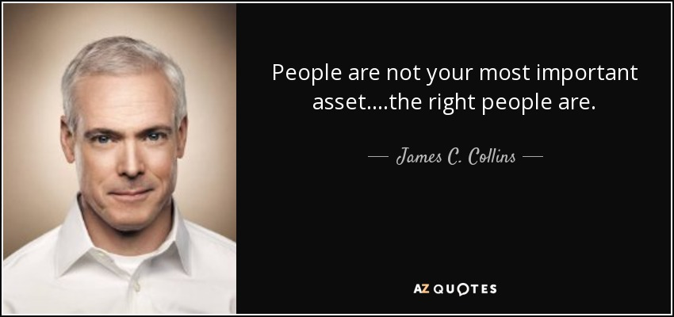
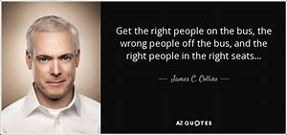
Your people are your most important assets
“You can design and create, and build the most wonderful place in the world. But it takes people to make the dream a reality.” – Walt Disney
-James C Collins – author of Good to Great and Built to Last
“As leaders, our job is to hire, develop, coach, and nurture people who are a good fit for the organizational culture.”
– Jake Poore- author of 99 Lessons Learned From Disney to Improve the Patient Experience
“A good rule of thumb is to treat your employees exactly as you would like them to treat their patients.”
– Jake Poore- author of 99 Lessons Learned From Disney to Improve the Patient Experience
Notes:
There are several wonderful books available for you to read about leadership, but a common theme will always be “taking care of your people”
Examples, our CEO went unit to unit asking employees what they needed – what was important to them – what was weighing on their minds. Nail salon example
Leadership classes – don’t teach how to complete tasks, teach your people to celebrate, train and develop others.
Get the right people in the right jobs.
Internal and external customer.

Slide 24
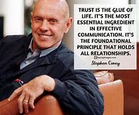
If your financial house is in order, you weather change, like the COVID-19 pandemic, more easily
From the book, The 7 Habits of Highly Effective People
An Emotional Bank Account is a metaphor that describes the amount of trust that’s been built up in a relationship. It’s the feeling of safeness you have with another human being.
– Stephen Covey
DEPOSITS
Seek first to understand
Listen to understand
Empathy, kindness, courtesy
Keep commitments
Clarifying expectations
Attend to the little things
Show personal integrity
Open to feedback
Sincerely apologize when you make a withdrawal
WITHDRAWALS
Seek first to be understood
Listen to respond
Unkind words or deeds
Breaking promises
Violating expectations
Being disrespectful
Disloyalty, duplicity
Rejecting feedback
Pride, conceit or arrogance
Notes:
On a personal level, if you had some savings in the bank, the threat of layoffs and pay cuts that came with COVID – 19 seemed less daunting than for those who had no savings available.
Think of the example of an ATM machine – you have to put money into it if you ever need to take money out of it. You can’t withdraw money you never deposited.
In terms of managing change as an organization, a company who has always placed their employees first will weather the storm created by constant fast paced change well.
Employees must trust their leaders. (Read quote from above)
Think of each person you work with as an ATM machine. With every interaction, you are either making a deposit or a withdrawal based on your behaviors. When the environment becomes one of rapid change, you will be stretching people, making them uncomfortable, asking them to do more or to do things differently. This can be a sort of withdrawal. If you have always focused on making deposits, these withdrawals will be understandable/ forgiven. If you haven’t deposited enough into the employee, when change comes, these withdrawals won’t be so easily understood or forgiven.
You can see above some examples of deposit and withdrawal behaviors

Slide 25
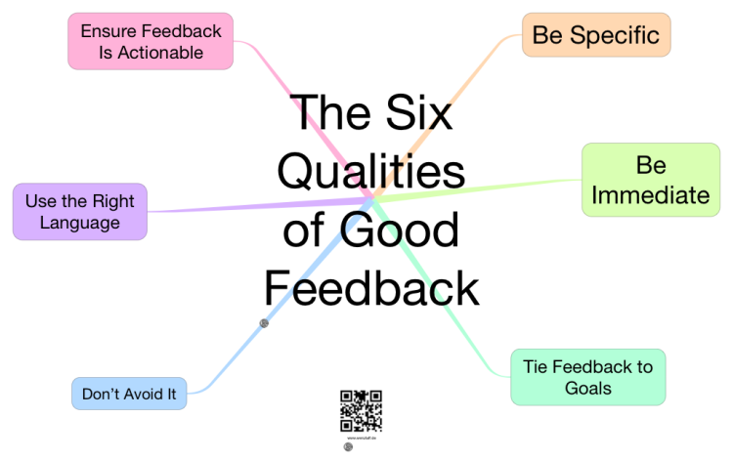

Feedback is a gift, however, it must be balanced for it to be effective
Feedback is a gift
It is important to provide recognition and coaching
“By celebrating the intent and coaching the behavior, employees will have the confidence and motivation to put their best foot forward on behalf of the patient.”
-Jake Poore- author of 99 Lessons Learned From Disney to Improve the Patient Experience
Notes:
As a leader, your job is not to do an increasingly complicated series of tasks – it is to develop your team. Imagine your performance being rated based on the performance of your team. You look good, when they look good.
In order to develop your team and to lead them through change you MUST provide recognition for what you want to see repeated and provide coaching for anything that is not meeting expectation.
Sometimes coaching conversations are “tough” conversations, but tough conversations don’t have to be mean conversations. Think of these conversations as you helping someone to grow and develop. You are making a “deposit” every time you provide someone with the gift of feedback. Feedback is an investment in a person. Sometimes, you may find that despite recognition, feedback and coaching a person is not growing in their role. That is ok. They may be “on the wrong bus”. Or, if they are a good organizational fit, they “are on the right bus” – your next move may be to help them find the “right seat on the bus”.

Slide 26

Let’s talk about COVID-19
Adjusting to a major change
How long did it take you to settle into a “new normal” routine?
1 week
2 weeks
1 month
Different amounts of time for different things
Other
Notes:
Think about the following question.
Feel free to share your answer in the chat area.
At what point did you “settle” into the fact that life was going to be different and just “get on with it”?
How long does it take to develop a new habit and make it stick? 21-28 days. You have to be relentless for a bit before you can step back a bit when you are trying to make a change stick.

Slide 27
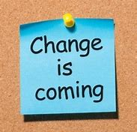
Organizations have the ability to create change VERY quickly when they are aligned to a common need / goal
Figure it out
Not doing anything is a decision, too… But this inaction will not move you forward
“All my experience suggests that individuals will eagerly embrace change when given a chance to have their share of voice in inventing the future of their company…to create a unique and exciting future in which they can share.” Gary Hamel
“Authorship leads to ownership.” – Jake Poore
Notes:
When COVID-19 hit, we had no choice. We had to make drastic, sweeping, quick changes to our practice. And, WE DID!

Slide 28
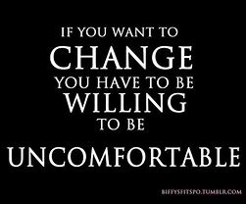
Rapid change can be uncomfortable and it can feel risky
Give everyone a voice
Reward ideas, this prompts others to start thinking in a different way
Embrace mistakes as learning opportunities
Stress management and resilience are critical
Notes:
Resilience room, stretch zone, treats, visit from upper mgmt., etc.

Slide 29
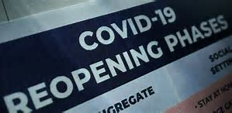
Let’s talk about COVID-19
Adjusting to yet another change
What is helping you to adjust to the change of “re-opening”?
Notes:
Please reflect on the following question.
Feel free to share your answer in the chat area.

Slide 30

Notes:
We’ve shared some of our journey and learnings from our rebranding to our response to COVID. Change is always a journey, not a destination. And change is inevitable, so embrace change and enjoy the journey…

Slide 31
As VR&E moves forward…
Today’s rapid economic, technologic and social changes have significant operational implication for all business and industry, including government
Creating change is cascaded from executive level down and must be transparent, reliable and consistently reinforced based on mission, vision and values
Leaders working with direct reports play a vital role by being a proactive “champion” of change to gain buy-in by allowing input/ideas
Change impacts everyone at all levels in many different ways

Slide 32


