Slide 1
The Budget Process
General Operating Expenses
(GOE)
Click here to view the recording
Recording Password: VREoet2020!
Ursula Sneed
Director, Discretionary Budget Staff
Office of Financial Management

Slide 2
Who We Are and What We Do
Roles of the Discretionary Budget Staff:
  Experts on all aspects of the VBA budgetary process for the formulation and execution of the GOE budget
  Advisors to the VBA Business Lines and Staff Offices on the efficient and fiscally sound use of appropriated funding
  Interpreters of fiscal and budgetary guidance into actionable tasks, processes and deliverables
Responsibilities of the Discretionary Budget Staff:
  Ensure compliance to the “Golden Rules” of Fiscal Law – Purpose, Time and Amount
    Purpose – Necessary Expense
    Time – Bona Fide Needs Rule
    Amount – Antideficiency Act Violation
  Formulate a defensible annual budget to OMB and Congress that articulates the budget year funding required to support and execute the VBA mission
  Create an outyear resource framework to articulate funding requirements and priorities in the 5 year planning period
2

Slide 3
FY2020 GOE Appropriation
FY2020 began under a Continuing Resolution
  Short term resolution passed by Congress to keep the government open
  Provides funding for a limited time
  Gives lawmakers additional time to enact appropriation bills
Public Law 116-94, the Further Consolidated Appropriations Act, 2020 signed into law on December 20, 2019 provides $3.1B in Budget Authority
FY 2020 VBA budget also includes $2B in reimbursements and $60M in carryover – total funding $5.2B
The Coronavirus Aid, Relief, and Economic Security (CARES) Act provided VBA with $13M in supplemental funding for COVID-19 requirements
3

Slide 4
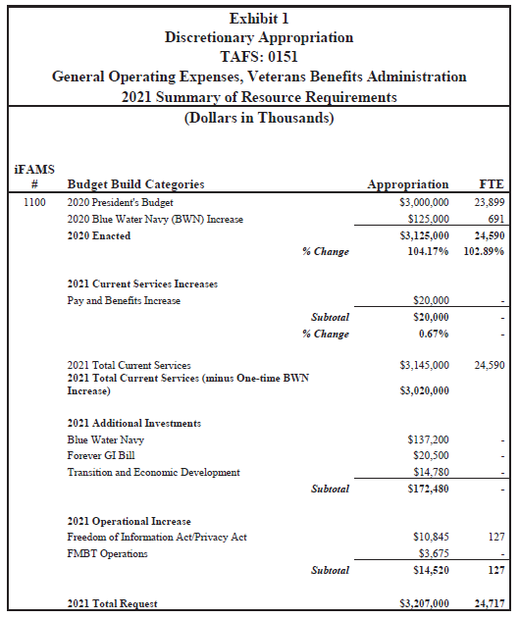
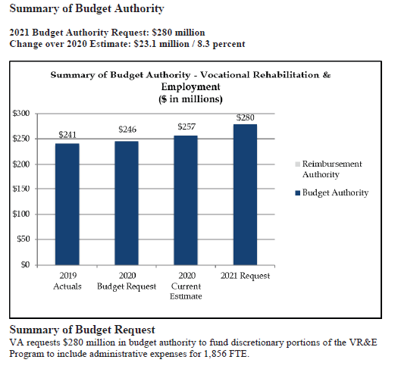
FY2021 GOE Budget Request
4

Slide 5
So, how do we get there….
5

Slide 6
Phases of the Budget Process
Planning
  Assess capabilities (Review laws, policy, vision, mission, goals and directives)
  Develop strategy and guidance
Programming
  Build Five-Year Program
  Turn strategy and guidance into achievable, affordable packages
Budgeting
  Prepare defensible budget Submission
  Scrub budget years
  Test for efficient funds execution
Execution
  Execute the current fiscal year budget
  Adjust resources to achieve desired performance
  Assess actual output against planned performance
  Develop Performance Metrics
Programming
Formulation
Budget Execution

Slide 7
Budget Phase Timeframes
Current
Year
Formulation
Prior Years
Planning
15
16
17
18
19
20
21
22
23
24
25
26
27
28
29
30
31
32
33
34
35
36
Budget Execution
Programming
Budget Execution Years
  prior years and current fiscal year
Formulation Years(FY21 PB to Congress Feb 2020)
  Congress review, authorization and appropriation
Programming Years
  Five-year period for resource allocation
Planning Years
  Horizon for planning force structure and recapitalization

Slide 8
Budget Phase - Programming
A systematic approach to developing VBA’s resource needs to achieve our mission and goals
  Balancing and integrating resources among the various Services, Staff Offices and programs according to VA and VBA priorities
  Provides long term planning and programming that aligns with VBA’s goals and objectives, by identifying outyear requirements
Core Functions:
Prioritize, analyze and strategic planning of GOE financial resources and requirements to comply with VA/VBA Strategic Goals, Objectives and Strategies
Define, validate, and prioritize requirements that will be recommended to USB for future budget cycles
Integrate the fiscal resources, human resources, facilities, and information technology
5 Year Program Plan Development
8

Slide 9
Budget Phase - Formulation
Internal Budget
OFM issues internal guidance – April
  LOBs/offices submit requirements in BRIT – May
  LOBs/offices brief Budget Director – May
  OFM hosts Congressional Justifications (narratives) kickoff – June
  VBA submits Budget Request to VA Office of Management (OM) – June
Office of Management & Budget (OMB) Budget
  OFM receives OMB Guidance, Circular A-11 – July
  LOBs submit narratives to OFM – Late June
  OFM submits narratives to OM – August
  OM submits narratives to OMB - September
  Brief OMB
  Receive OMB Passback – late November
  Receive OMB Passback settlement – early December
President’s Budget
  OFM works with LOBs to update budget exhibits/narratives– December/January
  OFM submits final narratives to OM – December/January
  OMB reviews narratives. LOBs work with OFM to revise narratives. - January
  President’s Budget submitted to Congress – February
9

Slide 10
Budget Phase - Execution
Appropriation
Congressionally designated budget authority provided to a government agency for specified purposes
Apportionment
The action by which OMB distributes amounts available for obligation in an appropriation
Allotment/Sub Allotment
Authorizes recipients to incur obligations for a specified amount and purpose
Allowance Memos
Distribution of funding available to each VBA business line and staff office for the obligation of GOE funding
Obligation
Legally binding agreement to pay for goods and services
10

Slide 11
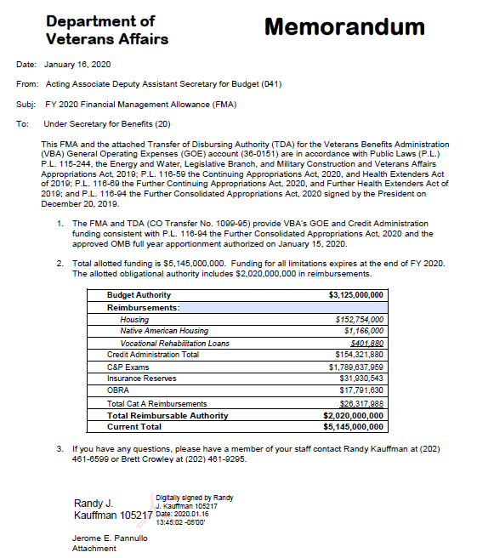
Transfer of Disbursing Authority (TDA)
This Memo and attached TDA provides funding consistent with the 2020 appropriation
VBA GOE Budget Authority $3.1 Billion
Reimbursable Authority: $2 Billion
11

Slide 12
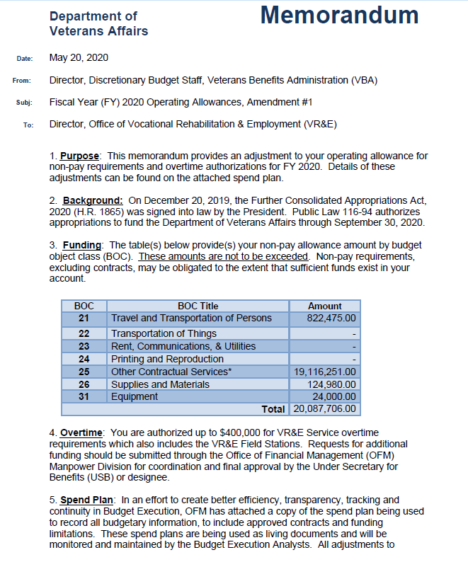
Allowance Memorandum
Allowance Memo distributes funding to each business line and staff office at the Budget Obligation Code (BOC) level
Establishes the annual budget for each office based on approved requirements and past execution
Authorizes the spending limit for Overtime
Source for the development of office spend plans
12

Slide 13
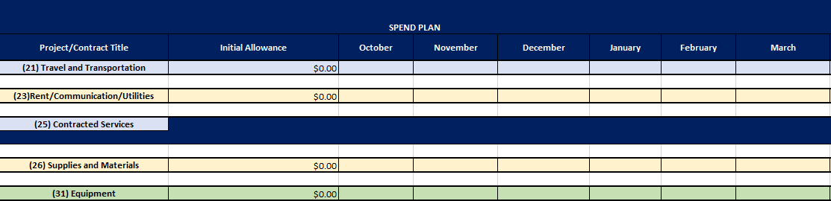
Spend Plans
Spend plans are developed by each office to reflect their monthly plan for obligating funded requirements
Adjustments are made to plans during the fiscal year to reflect the reallocation of funding due to changing requirements during the FY
Unfunded requirements (UFRs) are captured separately and evaluated quarterly unless otherwise directed by the PDUSB
UFRs are submitted to the PDUSB and COS for final review, prioritization and approval
13

Slide 14
End-of-Year Close-Out
  At the end of the fiscal year all obligations must be finalized before the fund expires on September 30th
  During the 4th quarter, the Discretionary Budget Execution team will begin “sweeping” unexecutable funding for VBA-managed reallocation
  Comply with acquisition activities in accordance with submission dates and guidance administered by the Office of Mission Support’s Acquisition Division

Slide 15
GOE BUDGET CYCLE
Execution Deliverables:
- Allowance Memos
Spend Plans
IAAs/SLAs
Reimbursements
FY2020
Formulation Budget Deliverables:
- Cost Estimates
Budget Exhibits
Congressional Justifications
Reimbursements
Execute FY20 Appropriation
Formulate FY22 Budget
Submit FY21 Budget Request
Program FY23-FY27 Framework
Formulation Submission Deliverables:
- Budget Hearing Prep
OMB and Congressional Inquiries
Appropriation Analysis
Execution Hand-Off
Programming Deliverables:
- Requirements Analysis
Funding Strategy
Cost-Benefit Analysis
Formulation Hand-Off
15

Slide 16

Why should you care??
16

Slide 17
Why You Should Care
It’s important for all VBA leaders to understand the budget process, inputs, and how money works
Understand when decisions are made that affect resources for your programs and operational objectives (short and long term)
Identify your best opportunities to influence financial decisions
Better development, articulation and justification of your resource requirements throughout the budget process
17

Slide 18

Questions
Questions
18

