Slide 1
Compensation Service Benefits Delivery at Discharge (BDD) and Integrated Disability Evaluation System (IDES) Conference Call
Briefed by: 212A
Name/Title: 212A Staff
Date: April 14, 2020

Slide 2
Admin Items
See Call-in Info in Read Ahead intro for call/mute info
Ask questions IRT the topic(s) being discussed, all other questions should be asked during Open Floor
Scenario/Case Specific questions will not be answered on the call. Send an email with details to the appropriate staff email box
Skype Chat is turned off

Slide 3
Agenda
Introduction
COVID-19 Topics for Discussion
General Topics for Discussion
IDES Specific Topics
VTA Reminders
BDD Specific Topics
Miscellaneous and Open Floor

Slide 4
Reminder: Slides are used to show the Topic, and start discussion, however, slides do not show all the information associated with the topic. The Read Ahead is the official document.

Slide 5
COVID-19
This is a very difficult time, things are very fluid, and some changes/decisions are happening as we speak. We know you might have many questions and we hope the information in this Read Ahead answers most of them. Please read the topics/write-ups and ask any questions (at the appropriate time) as needed.
COVID-19 Topics for Discussion

Slide 6
Requesting BDD/IDES Exams During the COVID-19 Pandemic Memo (1 of 2)
Comp Service IDES/BDD Program Office published this memo dated April 1 to provide BDD and IDES personnel information on exams as a result of COVID-19
Most recent information since the distribution of the memo.
No new exam requests should be submitted to VHA. Point forward, all exam requests should be submitted in EMS to contract vendors.
Exams requests that were previously submitted to VHA will be cancelled by VHA except where the exam has been initiated, or where VHA determines the exams can be accomplished via Telehealth. Any exams that are cancelled by VHA should be submitted via EMS. Clarifications needed from VHA should still be requested in CAPRI.
Exams submitted to VBA vendors should NOT be cancelled due to reasons associated with COVID-19. Examiners should not cancel ESRs for COVID-19 related issues. MSCs must not cancel any ESRs (neither in part or in full) at the request or direction of the exam provider.
Contract providers may cancel scheduled appointments for reasons relating to COVID-19, but they should not cancel the pending ESR. When appointments are cancelled, the status will be shown as OPEN in EMS. In these instances, the provider will contact the participant to reschedule the appointment at an appropriate time—no further action is required by the MSC
QTC is sending text messages to SMs about their exams being postponed, not cancelled. Exams will be re-scheduled ASAP. The text will read something like “Due to the CV-19, and per the VA, QTC is postponing all in-clinic exams until further notice. We are working with the VA for expansion of alternative methods for completing exams.”

Slide 7
Requesting BDD/IDES Exams During the COVID-19 Pandemic Memo (2 of 2)
5. If an ESR, or a specific contention is erroneously cancelled by the exam provider, the MSC must resubmit the ESR.
If the entire ESR shows a CANCELLED status, the MSC must re-submit the entire request, to include the SHA DBQ
If a contention is showing a CANCELLED status, the MSC must submit another ESR and request only the specific DBQ relating to that condition—DO NOT request another SHA DBQ unless the SHA DBQ was not completed
If the ESR or contention exam is cancelled, contact Contract Exams and cc: the BDD or IDES mailbox with claim number and details
See Read Ahead for 2 example screen shots

Slide 8
Impact of the COVID-19 Pandemic on the IDES Processing Memo
Comp Service IDES/BDD Program Office published this memo dated March 27 to provide IDES personnel information on IDES processing as a result of COVID-19

Slide 9
General Topics for Discussion

Slide 10
MSC Conference
The MSC Conference scheduled for May 2020 has been postponed with a tentative date of August. Further info will be provided as it becomes available

Slide 11
IDES Specific Topics

Slide 12
Intake Analyst Role in VBMS for IDES MSCs
It is highly recommended that all MSCs who work in support of the IDES program have the ability to assign cases to themselves
The VBMS user roll, Intake Analyst, provides this capability
The ability to assign claims to themselves:
allows MSC to avoid delays associated with coordinating with a supervisor or another employee to have IDES cases assigned to the MSC
ensure that IDES cases are brokered properly and timely,
ensures MSCs can access status information in EMS regarding exams they have requested
allows MSCs to utilize the eBenefits workaround (Method 2) discussed below
MSCs who are currently unable to assign cases to themselves should coordinate with their supervisor to submit a VA Form 20-8824e to their ISO
IDES MSCs VBMS User Profiles should reflect both the Intake Analyst and Developer VSR roles

Slide 13
Transmission of IDES Applications/Documents via eBenefits
In accordance with social distancing requirements, MSCs are encouraged to complete IDES Initial Interviews telephonically (as described in M21-1 III.i.2.D.4.d) to the fullest extent possible
M21-1 III.i.2.D.4.f discusses three means for participants to return documents to the MSC: SAFE, encrypted email, and secure fax
It is recognized that each of these means have limitations and present challenges which may complicate and/or delay document transmission
Alternative procedures (using eBenefits) will now be allowed in limited circumstances to facilitate transmission of applications and supporting documents from IDES participants

Slide 14
Transmission of IDES Applications/Documents via eBenefits
Method 1: Uploading Supporting Documents via eBenefits
Method 2. Completing and Submitting VA Compensation Applications via eBenefits
These processes are temporary workarounds intended to mitigate complications associated with the COVID-19 Pandemic, and address challenges associated with telephone interviews. The guidance does not represent a permanent change to IDES application procedures; these workarounds will remain allowable until further notice

Slide 15
Transmission of IDES Documents (continued)
Method 1: Uploading Supporting Documents via eBenefits )
In addition to the means to return documents identified in M21-1 III.i.2.D.4.f, MSCs may now advise IDES SMs that they can return documents (including the completed VA Form 21-526EZ) using the Upload Supporting Documents functionality in eBenefits
To upload documents in eBenefits, the SM must have a pending EP 689, (which should have been established by the MSC in advance of the initial interview)
Additionally, the MSC must advise the participant to:
• Complete and sign the 21-526EZ in hard copy or via fillable PDF
• Log in (or register for) eBenefits
• Follow prompts to Upload Supporting Documents
• Notify the MSC that the documents have been successfully uploaded
After the participant takes the actions described above, the MSC must:
• Review the documents in the participant’s eFolder
• Ensure that the 21-526EZ is completed and signed
• Enter the conditions indicated on the 21-526EZ as contentions under the EP 689
• Continue routine IDES processing

Slide 16
Transmission of IDES Documents (continued)
Method 2: Completing/Submitting Claims via eBens
Important: Only MSCs who have the capability to assign cases to themselves are permitted to use this method. MSCs who lack this capability must continue to advise participants to return documents in the manner described in M21-1 III.i.2.D.4.f or via the manner described in Method 1
Like the process described in Method 1, this method will also ensure documents submitted by the participant are automatically included in the participant’s eFolder. Additionally, this method:
eliminates the need for MSC to manually enter claimed conditions as contentions in VBMS, which removes a time consuming MSC task and the potential for data entry errors
serves to resolve challenges associated the applicant affixing his or her electronic signature to PDF applications

Slide 17
Transmission of IDES Documents (continued)
Method 2: Completing/Submitting Claims via eBens
Establish 689
Conduct telephone interview
Advise the participant to submit his or her application for VA Compensation (along with any additional documentation) via eBenefits; the participant will need to
visit https://www.ebenefits.va.gov/ebenefits/homepage
log on (or register for an account)
click Apply; then Compensation
follow system prompts to complete application
When prompted for service dates, the participant should enter the current date as their release date from active duty. (explain that this entry is necessary to execute the document transfer; participants should not enter a future/projected/estimated separation date)
upload any additional evidence (including dependency applications/information)

Slide 18
Transmission of IDES Documents (continued)
Method 2: Completing/Submitting Claims via eBens
Advise the participant to contact the MSC immediately upon submission of the application/documents into eBenefits
Identify the rating EP that was established as a result of the eBenefits application.
Assign the Rating EP established via eBenefits to yourself.
Open the rating EP in VBMS, and copy the contentions from the rating EP to the EP 689 per the instructions on page 211 of the VBMS Users Guide.
Review the EP 689 in VBMS to ensure it reflects all contentions the participant has claimed, as well as all referred conditions (indicated on the VA Form 21-0819).

Slide 19
Transmission of IDES Documents (continued)
Method 2: Completing/Submitting Claims via eBens
9. Cancel the Pending Rating EP associated with the application submitted via eBenefits. The IDES claim and all associated issues will remain controlled under the EP 689 as typical in routine IDES processing.
Important: it is absolutely critical that the MSC promptly cancel the rating EP. If this EP remains pending overnight, NWQ will route the claim to a VSC for processing, where it will likely create problems and confusion, resulting in unnecessary work for VSC employees and may complicate or delay IDES processing.

Slide 20
All Conditions must be Addressed in IDES Exams
IDES exams must not be considered complete until all examinations (claimed and referred conditions and the SHA DBQ) have been completed
Cases must remain in the Medical Evaluation Stage, and not pushed forward to the PEBLO or DRAS until examinations for all conditions have been completed
VA and DoD may consider some changes to IDES policy that may potentially allow for some cases to move forward before all exams can be accomplished; however, at this time no such change has been approved, and at this time, all standard IDES requirements (including the requirement for the SHA and exams for all claimed and referred conditions) remain in place

Slide 21
Current IDES Program Timeliness
As outreach specialists and VA’s frontline contact with SMs and Veterans, it is vital that we are realistic in our communications regarding claims processing times. Below is the current IDES timeliness data (ADC) for March 2020
Stage/Phase | IDES Goal (AD/NAD) | March 2020 (AD/NAD)
Claim Dev | 5/11 | 7/9
Medical Stage | 32 | 42/36
Proposed Ratings | 20 | 21/31
Recon Ratings | 4 | 8/7
Exit Interviews | 14 | 8/7
Final Ratings | 20/na | 34/na
Source: VTA Completed Reports April 7, 2020 (8am ET)
Note: VA using the goals from the 230-day process

Slide 22
VTA Reminders

Slide 23
VTA v. 2.4.7
VTA v.2.4.7 was released on March 30, 2020
A Vocational Rehabilitation and Employment (VR&E) Tab was added in order for Vocational Rehabilitation Counselors (VRCs) to update data fields in reference to a VR&E Interview and VR&E Plan. A VR&E Pending and Completed Report has also been added
The VRCs should be contacting the SMs after the MSC Interview. Please advise your SMs of this during your interviews, and that the VRC is not associated with the duties of the MSC and the info MSCs provide
VRC inputs have no bearing on the MSC or other tabs/goals

Slide 24
BDD Specific Topics

Slide 25
BDD Promotional Fliers
There are now two BDD promotional fliers on the Pre-Discharge Intranet Site under the heading, “Additional Pre-Discharge Links and Materials” and below are links to both of the fliers. A link to the BDD Promotional YouTube Video is also located under “Additional Pre-Discharge Links and Materials”
The BDD program is the fastest way to receive VA benefits for transitioning SMs. However, with an estimated over 200,000 SMs transitioning each fiscal year (FY), the BDD program has been severely underutilized. In FY19, VA received a total of 35,815 BDD claims, which only represents 18 percent of the estimated transitioning population. VA has received 16,465 BDD claims so far in FY20 which only represents eight percent of the of the estimated transitioning Servicemember population. MSCs are encouraged to distribute these promotional materials and the BDD Promotional YouTube Video as much as possible. Once MSCs are back on military installations, MSCs should work with the Transition Assistance Program (TAP) Benefit Advisors to provide BDD information and the MSCs information to SMs including all TAP classes
BDD Promotional Flier #1
BDD Promotional Flier #2

Slide 26
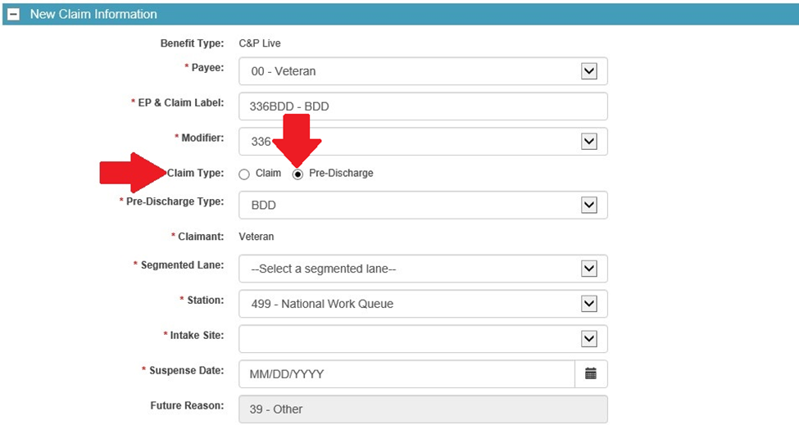
Pre-Discharge Claim Type
MSCs are reminded when establishing a BDD or BDD-Excluded claim in VBMS, the MSC must select “Pre-Discharge” as the claim type as shown below
Selecting “Pre-Discharge” as the claim type is the only way to establish the claim as a diary claim

Slide 27
Teleworking and Servicemember Assistance
Recently, there have been reports of military installations incorrectly informing Servicemembers to wait until after discharge to submit a claim, because the MSC is not at the installation due to the COVID-19 pandemic
When teleworking, MSCs should ensure their contact information is posted at their installation office to allow Servicemembers to contact the MSC

Slide 28
Current Program Timeliness
As outreach specialists and VA’s frontline contact with SMs and
Veterans, it is vital that we are realistic in our communications regarding claims processing times. Below is the current program timeliness data as of April 13, 2020.
Data Points | Goal | April 13, 2020
Completed FYTD |  | 17,536
Receipts FYTD |  | 16,804
Pending |  | 3,376
# Completed w/in 30 Days of Discharge |  | 10,934
% Completed w/in 30 Days of Discharge | 100% | 62.3%
Avg. Days to Complete FYTD | 30 | 44
Source: Tableau BDD History Report

Slide 29
Misc and Open Floor
TMS # VA 4553631
Next BDD/IDES MSC Teleconference Call: May 12, 2020
Next BDD/IDES Coaches Call June 4, 2020
Open Floor/Questions
Notes:
====

