Slide 1
VR&E Centralized Mail will begin momentarily
A facilitator is currently talking. If you cannot hear, please place a ‘sad face’ emoticon in the chat box.
*Reminder – Please do not use the Instant Message window for general discussion or commentary as it can be distracting to the audience and presenter.
All attendees will be muted or placed on lecture mode, in order to ensure that we are able to cover all of the training content.
Please post questions at the end of the call during the Q&A portion. Questions will be answered in the order they are received, within the remaining time of the training event.
To go into full screen mode, please click the Full Screen View Icon as indicated here
Notes:
Narrator – Dale Sagotsky
(15 / 7 mins)
Slide Instructions –
Open Skype/slide 15 minutes before call begins
Start Video when call begins (office start time of call)
Place all participants microphones in lecture mode by going to Participant Actions and choosing Mute Audience
Slide Notes – Copy text “A facilitator is currently talking. If you cannot hear, please place a ‘sad face’ emoticon in the chat box.”
Slide Narration –
Hello, Welcome . The call will begin in (15 /7 start time) minutes.
Please remember to mute your microphones when you are not speaking.
If you are calling in by phone, please ensure your microphone and speaker on your computer is muted. This will prevent feedback
Please do not use the Instant Message window for general discussion or commentary as it can be distracting to the audience and presenter.
Please post questions at the end of the call during the Q&A portion. Questions will be answered in the order they are received, within the remaining time of the Hotline call.
In formulating questions, please keep the subject content to the walk-on items or topics in this month’s bulletin as these areas will be the only focus of the question and answer segment.
VANTS will not be used or monitored during today’s call.

Slide 2
Vocational Rehabilitation and Employment Centralized Mail
TMS #: VA 4553097
National Training
**This event is being recorded for training and historical purposes**
Notes:
Hello everyone, thank you for joining our Centralized Mail Training. The purpose of this overview is to assist VR&E Staff in the next step of our transition towards being paperless by digitizing our current labor intensive, physical processing of mail, with a more efficient, streamlined, and paperless mail delivery and receipt system.
Centralized Mail already exists and several business lines have been working in the Centralized Mail portal for about five years now. The implementation of Centralized Mail for VR&E will include a PO Box dedicated to VR&E, creating and enabling mail queues and user roles for our business line on the existing platform.
I would like to mention that this call is being recorded for historical and training purposes and that the TMS # for this training is 4553097. CRC Continuing Education Units are also being provided for this training. This training is for all VR&E Staff however Supervisors and Super Users are identified for this training and they are to ensure that all other staff complete this training in TMS by April 6th. This training and additions manuals will be uploaded in TMS by this Wednesday.
With that being said lets move into our agenda for today.

Slide 3
Agenda
Introduction
Overview
Benefits
Workflows
Deployment Overview
Forwarding Mail
Demonstration
Access
User Roles and General User Interface
Mail Packet User Interface
Ongoing Support
Questions
Notes:
This is our agenda for today, we will try our best to move through these items rather quickly today. As a reminder, you are currently on lecture mode to ensure that we go over all of this material with you. Please use the chat box for questions that you may have and we will address your questions towards the end of call. Thanks for your flexibility.

Slide 4
Overview
Notes:
Centralized Mail or CM is a centralized, virtual mail process that will replace the current labor-intensive physical processing of mail, with a more efficient, streamlined, and effective paperless mail receipt and delivery system.
CM for VR&E will expand and enhance available features of the current centralized mail process to develop a separate digital portal specifically for VR&E mail, essentially removing all paper mail from the current mail process and enabling staff to manage incoming mail virtually.
CM specifically aims to virtually deliver mail to each VR&E Office, in a manner that accommodates minimal maintenance and human effort, while remaining agile enough to accommodate changes in routing, delivery and integration.
As you can see from our roadmap, the Centralized Mail initiative was slated to begin around the third quarter of FY20, this initiative was planned to roll out nationally just before Active Folder Scanning. Due to our current circumstances with Covid-19, Centralized Mail was deployed on March 29, 2020, along with Active Folder Scanning.

Slide 5
Benefits
Eliminates all paper mail sorting and processing
Minimizes instances or lost or misplaced mail
Simplifies locating and processing prioritized mail
Virtual notification of new documents in the eFolder
Eliminates need for shipping physical mail between offices
Improves document management and processing
Notes:
Now let’s review some of the key benefits of Centralized Mail.
CM will eliminate physical mail sorting and processing at the RO.
Minimizes the instances mail getting lost.
Simplifies locating and processing of prioritized mail.
Eliminates the need for shipping mail between Regional and out based offices.
And it improves document management and processing.
In the future state, CM will be integrated with the Case Management Solution.
This will allow VR&E staff to quickly find new mail, review, work documents that require action, and upload into the Veteran’s eFolder.

Slide 6
Workflow Comparison “As-Is”/Current State
Notes:
Now we would like to take the time to review our previous state vs. our current state w CM. Life before CM included, external mail being provided to the ROs and then sent to the local mailrooms for clerks to open, sort and distribute to the appropriate departments within the VA. Mail is then further sorted from the VR&E Office to the specific local staff and sent to any additional satellite offices. Local and Satellite staff then collect the physical mail from their various mailboxes and then they process the mail. Dependent on the mail types, staff will place the documents in the folder and or send financial documents to the Finance Dept (SSD) for further processing.

Slide 7
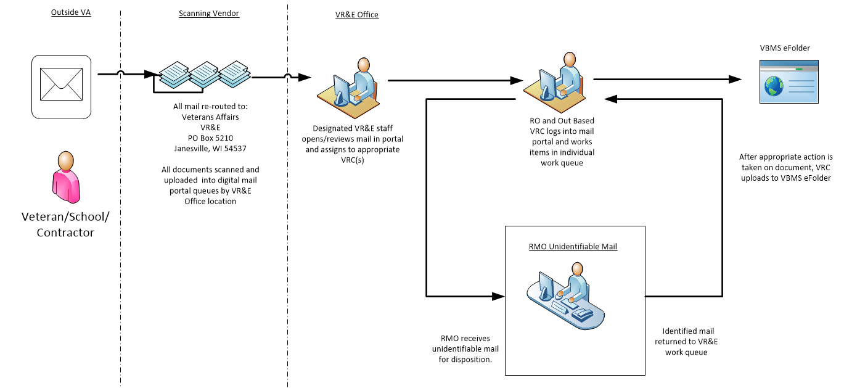
Workflow Comparison Future State (CM)
Notes:
Now via CM, mail will be received externally and sent immediately to a scanning vendor. The mail will then be scanned and uploaded into digital mail queues to specific VR&E Regional Offices. Then designated VR&E Staff will log into CM to assign the various digitized mail also known as mail packets to the appropriate VRCs. Staff will then log into CM to work the various mail packets by either uploading them into VBMS as completed packets or sending them for review as unidentifiable mail packets. Unidentifiable mail packets will be routed to the supervisor, Super User and/or RMO for further screening processes.

Slide 8
Deployment Overview
Centralized Mail VR&E deployment plan:
Deployed to all Regional Offices
All Regional Offices will have a queue to receive CM packets
Overall Scope:
Create 56 VR&E mail queues in Centralized Mail (CM) Portal
VR&E has a designated PO Box to receive mail directly at the Janesville WI scan site
Additional “trigger” documents were also added into the Centralized Mail Portal to enable quick identification of specifically identified VR&E documents
Notes:
As we know centralized mail is currently deployed to all Regional Offices and all ROs will have a mail queue and are ready to receive mail packets.
Our overall scope that has been completed, included the following:
The creation of 56 VR&E mail queues in the CM portal
A designated VR&E PO Box to send mail for the scan vendor
The incorporation of trigger documents in the CM Portal. Trigger documents are documents that have succinct descriptors or nomenclature to identify the documents within the packet. Trigger documents also aids with the built in search features that our SME will demonstrate later.
We would like to state that at the present time, faxes are not available, but we will add this feature in a future state.

Slide 9
Forwarding Mail
CM Deployed on March 29, 2020
Forwarding mail is already taking place
Mail is opened and date stamped prior to shipping
Envelope needs to be stapled with the documents to ensure it is sent as one packet
Place all packets in an appropriate shipping box and send to the VR&E PO Box below:
Department of Veterans Affairs
Vocational Rehabilitation and Employment Intake Center
P.O. Box 5210
Janesville, WI, 53547-5210
VR&E Super Users/Supervisors should check the CM mail queue daily for mail packets to be assigned
Notes:
Now let’s go over the forwarding mail process. Thanks to the collaboration of VR&E, OBPI and OFO, the forwarding of VR&E mail is currently underway.
The mail is opened, date stamped and attached to the envelope it came in. This is called a "packet".
Note: typically the person responsible for shipping mail would be the designated individual who handles the physical mail today. This may vary from RO to RO. For example in some stations, SSD may be assisting with this task.
The packets are then shipped in an appropriate shipping box to the Post Office Box dedicated to VR&E at the Janesville location shown here on the screen. As stated earlier when the mail hits the scanning vendor it is usually scanned in and uploaded in the RO queue for assignment within approximately two days. VR&E Super Users and Supervisors should check the CM mail queue daily for mail packets that can be assigned to the Basic Users at the RO. Basic Users should also check their work queue daily to make the appropriate action to their assigned work packets, either approving the packet by uploading to VBMS or sending the packet back for further review. The Basic User function will be briefly reviewed towards the latter part of the demo after a comprehensive demo of the Supervisor Role.

Slide 10
Demonstration
Accessing CM Portal
Basic Graphic User Interface
Mail Packet Graphic User Interface
Notes:
Now we will pivot over to a demonstration of the Centralized Mail Portal. Today’s demo will be conducted by Irina Rossinkina, who is an Office of Business Process Integration (OBPI) Veteran Claims Intake Program (VCIP) Centralized Mail Subject Matter Expert. During her demonstration she will be doing an overview of the Supervisor’s Role. Note: the Supervisor’s Role is similar to the Super User’s Role except that Supervisor has the capability to perform the Unidentified Mail First action. She will explain this function later in the demo. But first she will be showing us how to:
Access the CM Portal
Navigate the General Graphic User Interface, which will include an explanation of the Queue Hierarchy, Task Bar, and Button Functionality
And a guided explanation of the Mail Packet Graphic User Interface, which will show us the Document Viewer, Document Information and additional Task Bar and Button Functionality.
Irina, you may now conduct your demonstration.

Slide 11
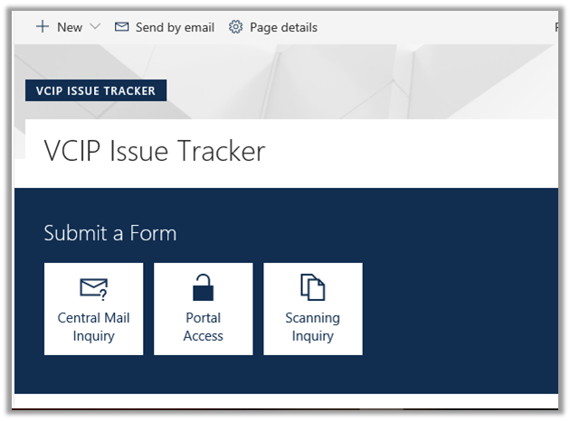
VCIP Issue Tracker
Notes:
For CM support regarding scanning, rescanning, and/or image issues, Users can go to the Veteran Claims Intake Program (VCIP) Issue Tracker Sharepoint site. To submit an inquiry, navigate to this Sharepoint site (it is linked here for your convenience) and click on the Central Mail Inquiry button to begin entering your specific CM issue.
CM VCIP SharePoint Site: https://dvagov.sharepoint.com/sites/VACOOBPI/VCIP/IT/SitePages/Default.aspx

Slide 12
Additional Support
CM Daily Forum – Jointly operated OBPI and VR&E – Starting Tuesday, March 31, 2020 at 12:00 noon ET
Questions regarding CM should be sent to the VR&E Field Liaisons Team:
Questions regarding Vendor related scanning/rescans/image issues, please send to the VCIP Mailbox: VCIP.VBACO@va.gov
Centralized Mail User Manual: Available in CM Portal and TMS
District | E-mail
Northeast | VAVBAWAS/CO/VRE/NE
Southeast | VAVBAWAS/CO/VRE/SE
Continental | VAVBAWAS/CO/VRE/CONT
Pacific | VAVBAWAS/CO/VRE/PA
Notes:
For VR&E Support, we are collaborating with OBPI, to provide a CM Daily Forum starting Tuesday, March 31, 2020 at Noon to 1:00pm ET. During these calls, we will be addressing questions regarding CM.
Additional specific VR&E Questions that you may have that are not addressed or occur outside of the hours of the CM Daily Forum, please forward these inquires to your VR&E Field Liaisons Team as indicated on the screen.
As mentioned earlier, issues or follow up questions specifically regarding Vendor scanning, rescans, and/or image issues can be sent to the VCIP Mailbox or the VCIP SharePoint site information on the previous slide.
The CM User Manual is available via the CM Portal as Irina has previously showed us. You may also access this Manual and the Super User, Supervisor and Basic User Manual in TMS after this call. Note the video and slide deck will be posted in TMS by Wednesday or Thursday.

Slide 13
Questions
TMS Training Information
TMS #: VA 4553097
Target Audience:
All VR&E Staff
Completion Date:
Monday, April 6th
Notes:
At this point we would like to address any questions that we have in the IM Chat Box and any other questions with the remaining time.
As a reminder, please go into TMS (VA 4553097) to complete the feedback survey to indicate the completion of this training. Additional content such as the slide deck and video will be added to this item by Wednesday/Thursday. Note all VR&E Users must complete this training by Monday April 6th.
With that being said, we would like to thank you for our attendance and participation in this training. We would like to wish you a good day and a great week. Stay safe good bye.

Slide 14
Vocational Rehabilitation and Employment Centralized Mail
User Roles and Work Queues

Slide 15
Queues
User Role | Queue | Description
Basic User Program | Hold | Contains packets placed on hold, which may require additional information to continue processing
 | Work | Contains packets assigned to a specific user at a specific location for processing
Notes:
CM Portal functionality access is governed by User Role and Location assignments from the System Administrator; therefore, you may not have access to all applications.
Note: The System Administrator is an external, non-assignable role (not a VA employee) that monitors the system environment to ensure continuous, optimal performance of CM Portal functions and support systems, including managing user access and permissions, system notifications, and system security.
The CM Portal supports six (6) User Roles:
• Basic User
The Basic User performs these functions at designated Locations:
• Assign Do Not Upload status to a packet
• Request a Re-scan of a packet
• Request a Split on a packet
• Request a Hold on a packet
• Request that a packet is designated as Unidentified/Unidentifiable Mail (UM)
• Route a packet to the Reassign Queue for a new location
• View assigned packets in the Centralized Mail Queue
• View all user packets in Centralized Mail Search results, if the location is not restricted
• Perform Basic User functions on packets assigned to any user in the Search results
• Upload a packet to the VBMS
• Add or view Notes
• Download a packet
• Review packet history
• Export as CSV by creating a comma-separated value (CSV) file to transfer data into a spreadsheet format using Search results

Slide 16
Queues
*Indicates additional queues
User Role | Queue | Description
Super User | *Authorization | Contains packets requested for Re-scan or split that require Supervisor or Super User authorization to continue
 | *Assignment | Contains packets pending assignment to a Work Queue
 | *Reassign | Contains packets that require rerouting to a different location or user for processing
 | Hold | Contains packets placed on hold, which may require additional information to continue processing
 | Work | Contains packets assigned to a specific user at a specific location for processing
Notes:
• Super User
The Super User performs the same functions as a Basic User at designated Locations plus these additional tasks:
• Process packets in the Authorization Queue (first-level Split and Re-scan requests)
• Assign packets to users for processing
Process packets in the Reassign Queue

Slide 17
Queues
*Indicates additional queues
User Role | Queue | Description
Supervisor | Authorization | Contains packets requested for Re-scan or split that require Supervisor or Super User authorization to continue
 | Assignment | Contains packets pending assignment to a Work Queue
 | Reassign | Contains packets that require rerouting to a different location or user for processing
 | Hold | Contains packets placed on hold, which may require additional information to continue processing
 | Work | Contains packets assigned to a specific user at a specific location for processing
 | *Unidentified Mail (UM) First | Contains packets that a Basic User or Super User has designated as Unidentified Mail
Notes:
• Supervisor
The Supervisor performs the same functions as a Super User at designated Locations plus these additional actions:
• Process packets in the Unidentified Mail First Queue

Slide 18
Queues
*Indicates additional queues
User Role | Queue | Description
Records Management Office (RMO) | Unidentified Mail (UM) Final | Contains packets that a Supervisor or Super User has authorized as Unidentified Mail
Notes:
• Records Management Officer (RMO)
The RMO performs these functions at designated Locations:
• Process packets in the Unidentified Mail Final Queue
• View packets
• Review packet history
• Download a packet to a local workstation
• Export as CSV using Centralized Mail Search results
• View and add notes to any packet using Search results

