Slide 1
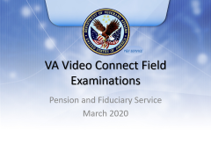
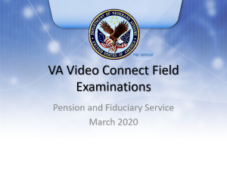
VA Video Connect Field Examinations
Pension and Fiduciary Service
March 2020
Notes:
Course Description:
This course teaches learners to….

Slide 2
Background
The intent is for field examiners to utilize video conferencing as the alternative to face-to-face field examinations during the pandemic.
In all instances where the manual requires a face-to-face field examination, field examiners should attempt to use the videoconferencing capability.
Field examiners should use their normal scheduling protocol – let the beneficiary or fiduciary know the purpose of the meeting, and ask them to prepare by having any documents ready for review (if necessary) during the meeting.
In addition, the field examiner will be required to set expectations for the individual on what to expect for video conference. It will be important that this is done to help the beneficiary and/or fiduciary know what to expect. This includes notifying that a computer, tablet, or smartphone with a camera is needed.
Important – the field examiner must inform the individual that the videoconference is a secure platform and will not be recorded.

Slide 3
Objectives
Upon completion of this topic, you will be able to
  Complete an audio and visual equipment check
  Complete a lighting and privacy check
  Schedule a field examination appointment in the VA Video Connect Scheduler
  Conduct a VA Video Connect field examination Session
Notes:
Instructor Notes:
At the end of this lesson, given the training and references, the learner will be able to do the following:
Upon completion of this topic, you will be able to
Complete an audio and visual equipment check
Complete a lighting and privacy check
Schedule a field examination appointment in the VA Video Connect Scheduler
Conduct a VA Video Connect field examination

Slide 4
When to Use Video Field Exams
Field Examiners (FEs) are to utilize VA Video-Connect to conduct all field examinations during times when face-to-face field examinations cannot be conducted.
Video field exams are to be utilized for all field exams until further notice
Will be conducted by Field Examiners and all external fiduciary customers (beneficiaries and fiduciaries)
When the beneficiary/fiduciary is not willing or able to use the VVC the FE must conduct the interview by telephone
Notes:
Field Examiners (FEs) are to utilize VA Video-Connect to conduct all field Examinations during times when face-to-face field examinations cannot be conducted.
Video field exams are to be utilized for all field exams until further notice
Will be conducted by Field Examiners and all external fiduciary customers (beneficiaries and fiduciaries)

Slide 5
Equipment Requirements
The following equipment is required for both the FE and the external customer to participate in Video Field Exams:
  Computer, tablet, mobile phone
  Webcam, laptop, or mobile phone with integrated camera
  High-speed Internet access
  Email address
  Integrated microphone
Notes:
Equipment that both the Field Examiner and the external customer will require for a successful video field exam appointment are a desktop computer with a webcam, a laptop, tablet or mobile phone with an embedded camera, high speed internet access and a valid email address.
And now, we will go into how to use the VA Video Connect Tele-counseling Scheduler.

Slide 6
Scheduling an Appointment
It is very important to select the correct Field Examiner when scheduling an appointment
Within the Scheduler, the dropdown box used to select the FE looks very much like the Outlook address book and it is easy to select the wrong person
When scheduling, take an extra moment and double check selection
Link to Scheduler: http://vrescheduler1.evn.va.gov/VREScheduler/calls/New.aspx
Request Access:
TELECOUNSELING.VBACO@VA.GOV
Notes:
Let’s go over a few points before going over the steps to schedule an appointment.
It is very important to select the correct Field Examiner when scheduling an appointment.
Within the Scheduler, the drop down box used to select the FE looks very much like the Outlook address book and it is easy to select the wrong person.
When scheduling, take an extra moment and double check selection.
Note that the Scheduler URL address has changed, so please re-save it to your browser favorites and delete the old link.
http://vrescheduler1.evn.va.gov/VREScheduler/calls/New.aspx.
If you do not have access to the scheduler, simply send an email to Telecounseling.vbaco@va.gov to request access.

Slide 7
The Video Field Exam Appointment
Once an appointment has been scheduled in the VR&E Tele-counseling Scheduler portal, the Field Examiner and external customer will receive an email confirmation for the appointment
Email will contain a link which will initiate the VA Video Connect web-based application in an internet browser when clicked
Appointments should not be scheduled with less than an hour’s notice in case the email confirmation does not arrive
It is recommended that the Field Examiner join the meeting a few minutes early to welcome the beneficiary or fiduciary when they join
Notes:
Field Examiner should ensure that they have received a confirmation email for the scheduled appointment
It is recommended that appointments be scheduled at least an hour before the appointment to ensure delivery and receipt of the confirmation emails
The Field Examiner should plan to join the meeting a few minutes prior to the scheduled start time

Slide 8
Documentation Requirements
For initial appointment, successor initial appointment, and scheduled follow-up field examinations, when verification of financial information is required, it is acceptable to review the information through VVC by having the individual hold the information in front of the camera. If the FE cannot visually verify through VVC, complete the interview and require that the information is mailed into the intake center. Establish a task in the field examination work item and allow 14-days for receipt of the information. Do not close the field examination work item until the information is received.
In the case of an unscheduled field examination due to non-receipt of an accounting, the fiduciary must submit the required documents to the hub, and visual verification would not be acceptable because the LIE cannot audit an accounting based on an FEs visual verification.

Slide 9
***IMPORTANT***
***IMPORTANT*** The VA Video Connect Telehealth system is a program used by VR&E to conduct tele-counseling sessions with Veterans in the Voc Rehab program. All of the internal elements of the video connect system will not conform to Fiduciary personnel information. We will show what this will look like on the next slide.
Notes:
***IMPORTANT*** The VA Video Connect Telehealth system is a program used by VR&E to conduct tele-counseling sessions with Veterans in the Voc Rehab program. All of the internal elements of the video connect system will not conform to Fiduciary personnel information. We will show what this will look like on the next slide.

Slide 10
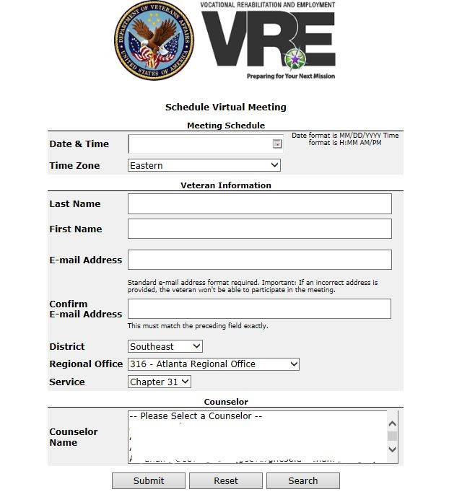
Scheduler Instructions
Select Date
& Time
Enter Veteran information
Select District, RO, & Service
Choose Name
Link to Scheduler: http://vrescheduler1.evn.va.gov/VREScheduler/calls/New.aspx
Notes:
Click calendar icon to Select the Date, Hour, Minute, AM or PM, (in the Veteran’s Time Zone) and save your date and time selections
Enter the beneficiary and/or fiduciary’s Name and Email
You must obtain the Veteran’s email address
Select the correct District and select the correct Regional Office. Then select the correct service that you will be providing
Start typing the Field Examiner’s name in the “Counselor Name” drop down – please double-check to ensure you have the correct Field Examiner before you select the Submit button. Select the Reset button to enter next customer appointment
The elements that refer to VR&E information will not change. However, they will still be utilized by Fiduciary personnel in the scheduler when scheduling a video connect appoint with an external customer. For example: The “Counselor Name” will be the Field Examiner. The Veteran could be either the Veteran, a beneficiary other than the Veteran, or the Fiduciary.

Slide 11
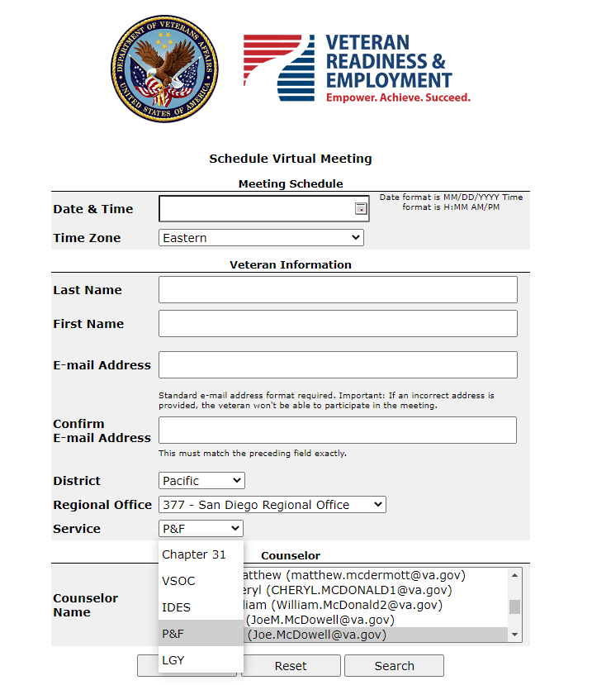
Scheduler Instructions
Be sure and select an item from the Service Drop-Down box.
P&F should select “P&F”
LGY should select “LGY”
VR&E should select Chapter 31, VSOC, or IDES

Slide 12
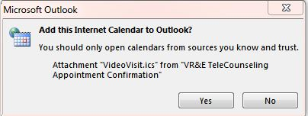
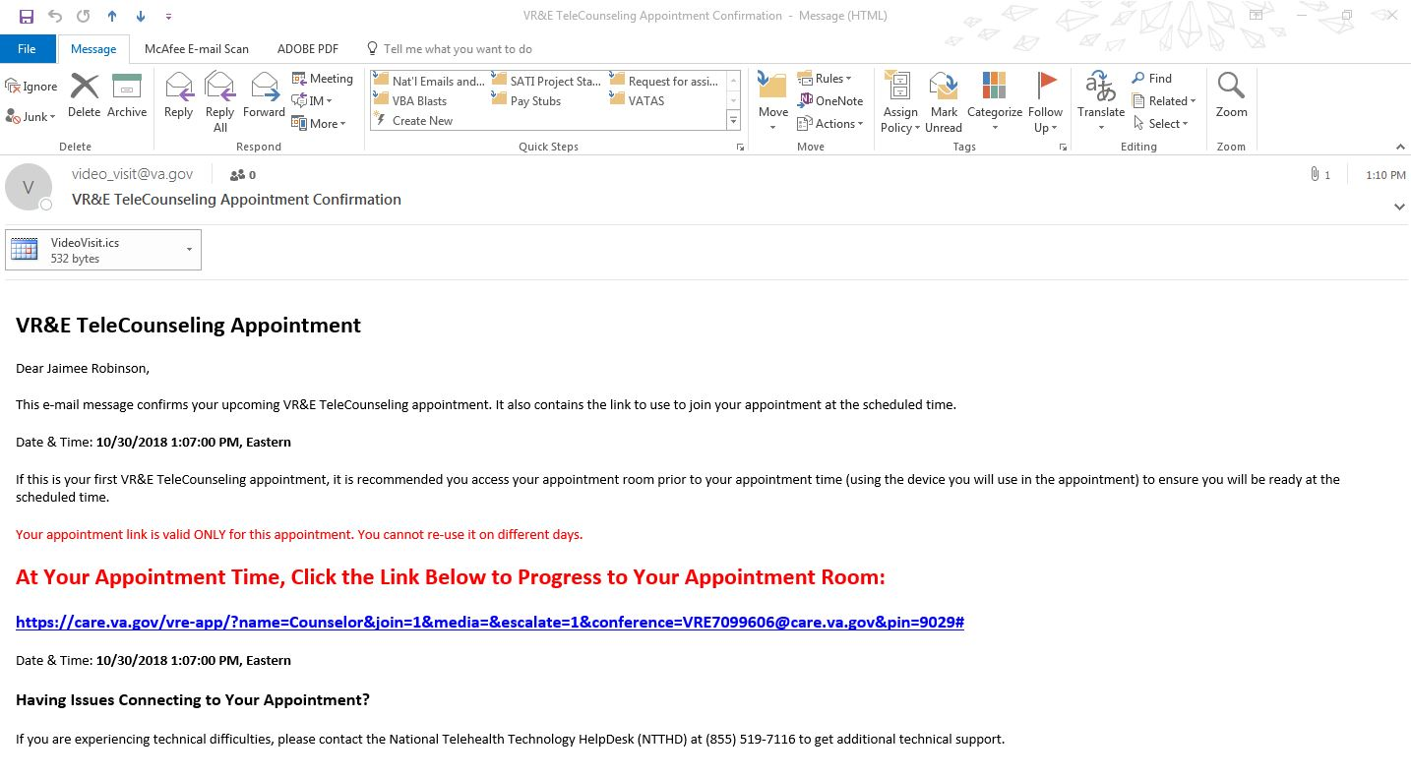
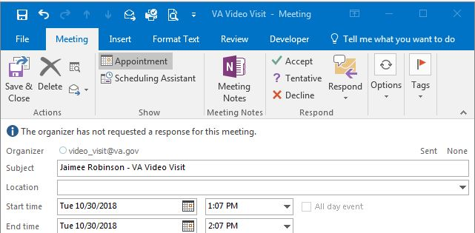
Adding Appointment to Calendar
Notes:
Here is an example of an email notification after an appointment is scheduled with an external customer in the Tele-counseling Scheduler. This email is the same one the external customer receives. These are the instructions on how to add the appointment to your calendar.
Note that a calendar invite is attached to the actual email. Double Click on the calendar invite, edit the subject line as you prefer. We suggest putting the Veteran’s name or initials so you can keep track of who is going to be joining you for that call. Once the meeting is accepted/saved, close it and it will appear in your Outlook calendar. It will not be a breach of PII with a name in the unencrypted calendar. You can be extra careful by entering a combination of names and initials in the subject line.
http://vrescheduler1.evn.va.gov/VREScheduler/calls/New.aspx

Slide 13
Pre-Call Reminders
Audio: Check settings on microphone and speaker
Visual: Ensure proper lighting and camera placement
PII: Ensure no CER folders or other PII are visible
Privacy: Closed door; no public places
Environment: Should be professional
13
Notes:
Prior to beginning a video field exam appointment:
Be sure to check all audio settings. This means checking all microphone and speaker options.
Ensure there is proper lighting and adjust as necessary
Ensure that no CER folders or other PII are visible
Ensure the door is closed during appointments, and do not conduct in public places. Also, please advise your Veterans not to be in a public place where sensitive information can be overheard, including at home if they want to ensure privacy
Environment: Should be professional; no political signs or anything that might be viewed as offensive - neutral in tone for someone on video

Slide 14
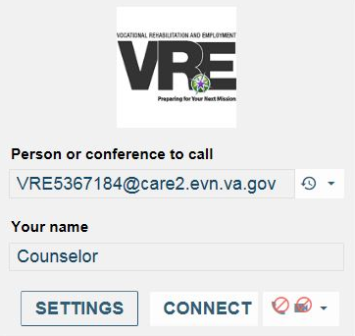
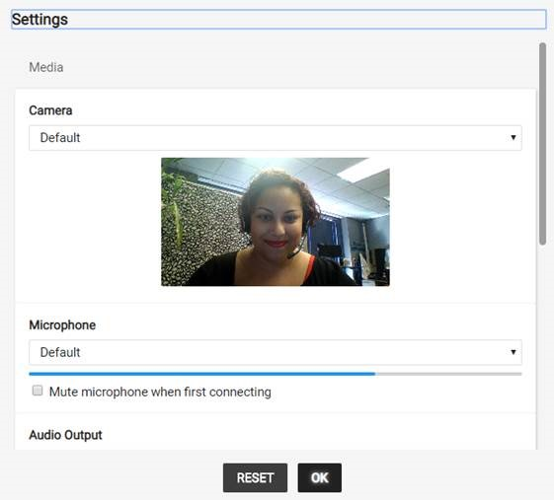
Connecting to a Windows ©Session
1
Choose the desired microphone and camera
2
Type in your name
Select CONNECT to join the call
Click OK to begin the call
Notes:
When connecting to the conference call:
The first screen will display a Person or Conference to Call (DO NOT change this field) EMAIL ADDRESS address and NAME. Enter your name and advise Veterans to enter their name before joining the session. They will see the same screens
Click connect to advance to the next screen
On the second screen:
You can adjust which microphone and camera to use in the event that you have multiple options
Click start to join the call.

Slide 15
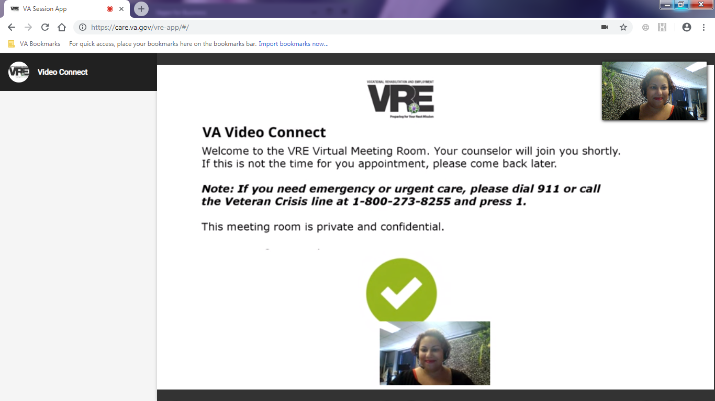
External Customer Initiates Windows Session
“Waiting for the host to join”
“Welcome to the meeting”
Notes:
In the event that a beneficiary or fiduciary is waiting for the Field Examiner, they will see this screen. They will also hear the following message: “Waiting for the host to join.”
The beneficiary or fiduciary will hear “Welcome to the meeting” once the Case Manager joins.
You as a Field Examiner, will hear a different message if you join before the Veteran. The Field Examiner should hear, “You are the only participant in the conference.”

Slide 16
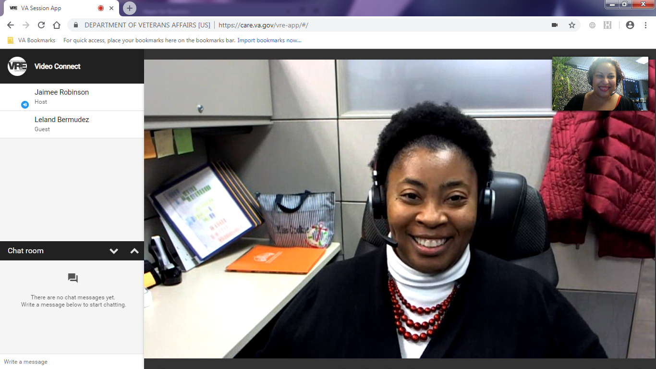
Live Desktop Video Session
Update Settings
Information
Full screen on/off
(L-R)
Chat On/Off
Ends the call
Screen share
Mute/Unmute microphone
Turns camera on/off
Notes:
On this slide, we are pointing out the different command buttons available to both parties.
After joining the call, the chat feature will become available. You can exchange written messages using this feature and/or minimize the chat window.
You have the option to end the call, mute the microphone, and/or toggle the camera on and off.
You can hide the self view when the camera is in use. Also, if either of you turns the camera off, you can still communicate by using the audio portion. The session remains active but the other person will not be seen. Next is what VA Video Connect looks like when both you and the Veteran are using an Apple iOS device.

Slide 17
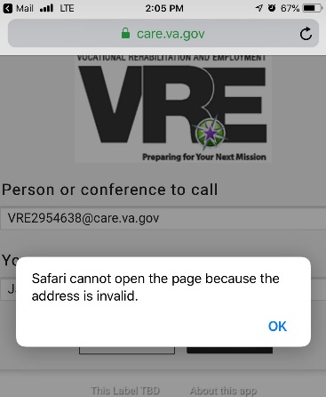
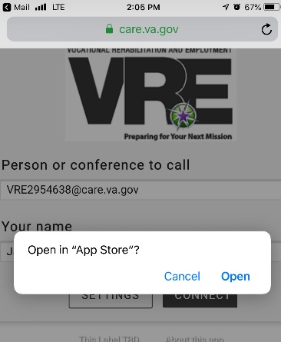
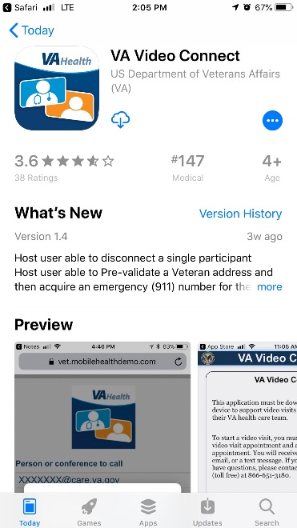
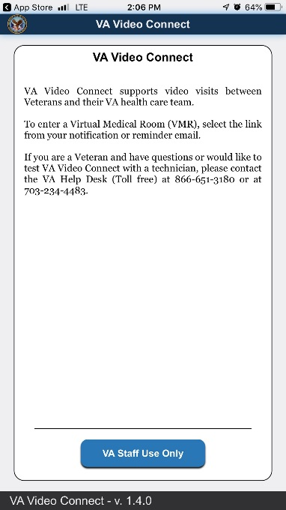
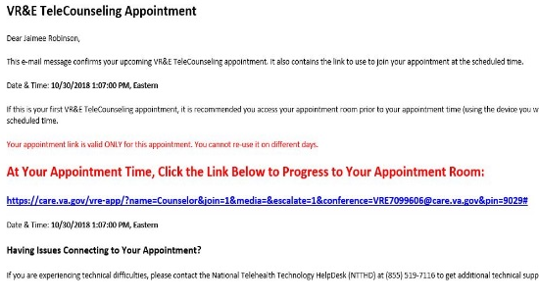
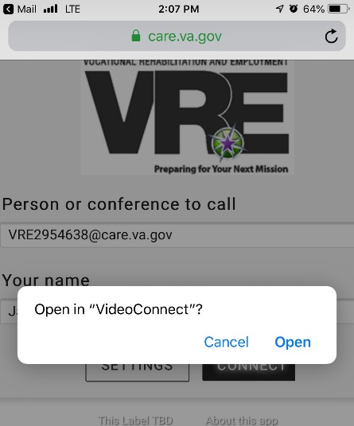

iOS© Device Pre-Session Steps
1
2
Download the VA Video Connect App from the App Store
Error message before downloading required app.
Click OK
Click Open
View of the opened VA Video Connect App
Exit and go to Step #3
3
Click Open to begin the session
Return to the email and re-click the video session link
Notes:
When using an Apple iOS device for video field exams, there are a few extra required steps needed when entering a VA Video Connect session for the first time.
User will receive an error message if attempting to enter the session before downloading the app. The error message will read, “Safari cannot open the page because the address is invalid.” User should click okay. The following prompt will ask, “Open in App Store”? User should click “Open”.
In the App store, user will have the option to download the app. Once downloaded, users will have the option to open the VA Video Connect app.
User should return to the original email that contains the link to the meeting and reinitiate. Upon re-clicking the link, the meeting should open in the VA Video Connect app. User will be asked, “Open in VideoConnect”? Select open.

Slide 18
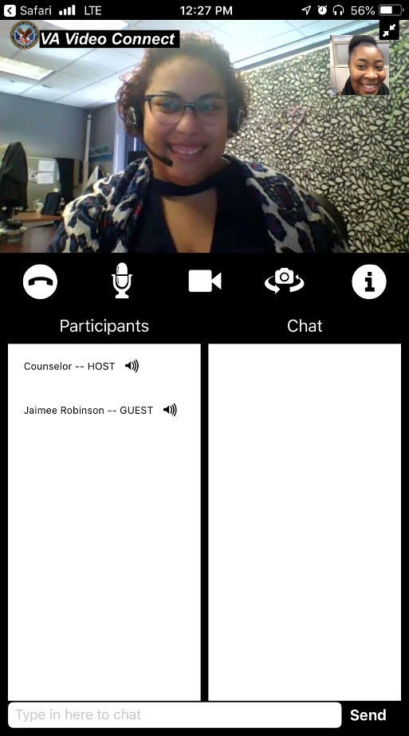
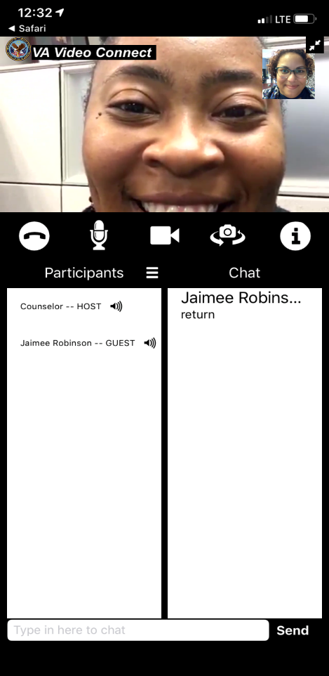
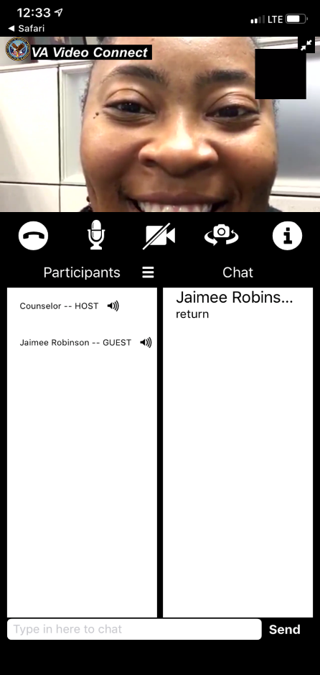
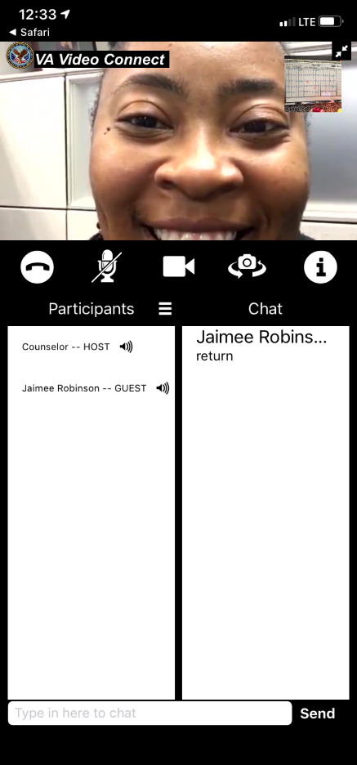
iOS© Device Live Video Session
Mute/Unmute
Rotate Camera View
Turns camera on/off
Case Manager View
Veteran View
Notes:
Once in the session, there is a slightly different view when using an Apple iOS device. However, the same features in a Windows session are also available while using an Apple iOS device. The Field Examiner and beneficiary and/or fiduciary views are identical. Notice that the controls are in a different location and the Chat window cannot be toggled on or off while in this portrait orientation view.

Slide 19
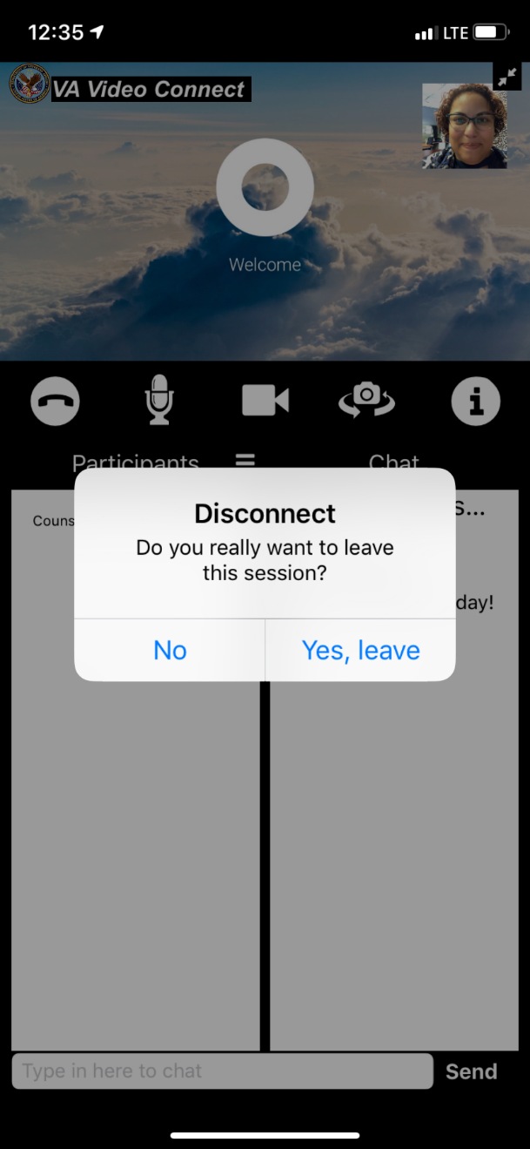
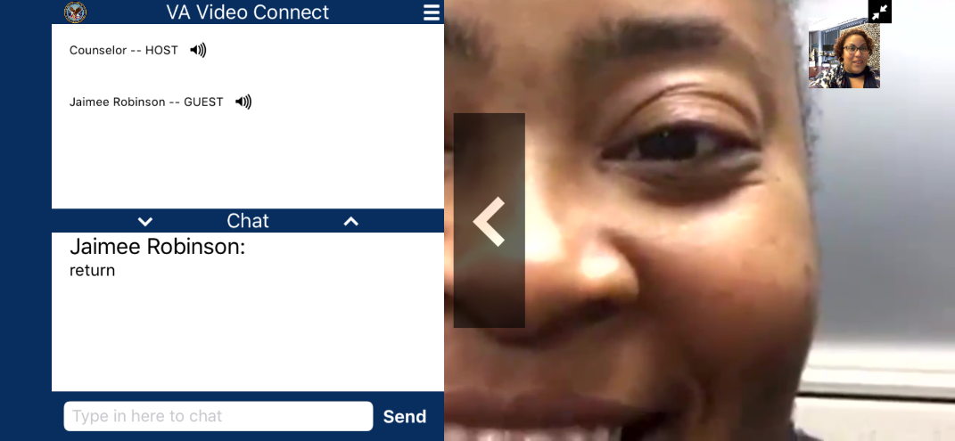
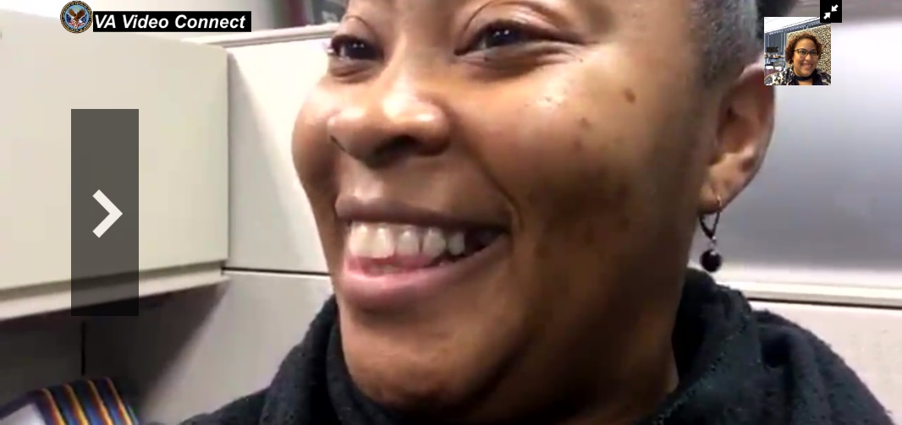
iOS© Device Live Video Session
Chat Off
Chat On
Notes:
However, if either of you changes the orientation of the device to a landscape view, then the chat feature can be shown or hidden.
Lastly, when the participant is ready to exit the call, he or she will click on the telephone handset icon on the far left hand side of the screen underneath the video screen. Then the following message will appear: “Disconnect, Do you really want to leave this session? No/Yes, leave.”

Slide 20
Troubleshooting
If you cannot hear the Veteran, beneficiary, or fiduciary, make sure your speakers or headphones are connected. Then check all volume controls
Your computer or device may have its own volume buttons or switches
Return to the email and re-click the video session link
Notes:
Now that we have covered participating in a session, here are a few troubleshooting tips.
Your headphones or speakers may have their own volume buttons or switches.
If you cannot hear the Veteran, make sure your speakers or headphones are connected. Then check all volume controls.
Your computer or device may have its own volume buttons or switches. Be sure to check those controls too.
A beneficiary or fiduciary may need to re-access an active session from within the application. They should return to the appointment email and re-click on the session link to regain access.

Slide 21
Troubleshooting cont’d
If the Veteran cannot hear, make sure the microphone is properly connected and not muted
If the Veteran is experiencing distorted sound, very low sound, or echoes:
  Check whether you or the Veteran have enabled microphone boost, echo cancellation, game control, noise reduction, digital effects or similar features on audio devices
  Turn all such audio device features off for VA Video Connect to work optimally
Notes:
If the Veteran cannot hear you, check your microphone connection and settings.
If the Veteran reports distorted or low sound, or echoes, check all other sound settings on your device as well as the Veteran’s device.

Slide 22
Field Support for Technical Problems
The Field Examiner should contact the National Telehealth Technology Help Desk (NTTHD) at (866) 651-3180 for technical issues
Veterans, beneficiaries and fiduciaries are allowed to listen in on a call between the NTTHD and the FE, but are not allowed to conduct the call independently, as the NTTHD is not allowed to provide support external to the VA.
FEs may send Video Field Exam email inquiries to VHA_NTTHD@va.gov (National Telehealth Technology Help Desk)
Notes:
In the event that you are still having difficulty, you as the Field Examiner should contact the National Telehealth Technology Help Desk (or NTTHD) for assistance with troubleshooting. Please note that Veterans are permitted to listen in on a call between the NTTHD and the Field Examiner, but they are not allowed to contact the NTTHD or conduct the call independently, as the NTTHD is not allowed to provide support directly to the Veteran.

Slide 23
Tips and Tricks!
Log in ahead of meeting to mitigate any connectivity issues
Funds under management can be verified visually on a VVC field exam
Please review FPM 2.D.3 for recent changes to verification requirements of income, expenses, and non-liquid assets
FE should log into meeting early – the external customer cannot log in until the FE is logged into the VVC exam
Notes:
Initial test users have experienced some lag issues with connectivity in VVC system. Best practice is to log in ahead of scheduled meeting time to ensure FE is able to connect to the meeting with no issues. Also, FEs should advise fiduciary that high speed internet access is required in order to use the system effectively.
When verifying funds under management, FEs can verify bank statements and financial statements through the secure VVC system. This is an acceptable means of verification when completing a VVC field examination
Recent changes to FPM 2.D.3 require the FE to identify income, expenses and non-liquid assets, however these no longer need to be verified at each field exam. This will help when completing an exam via the VVC system or by telephone. Liquid assets, for the purpose of verifying funds under management, still need to be verified using acceptable means outlined in 2.D.3
Plan ahead! Try not to schedule last minute exams. Connectivity issues can happen and it is best to prepare for this by logging into the VVC call 10-15 minutes prior to the external customer. Remember: The external customer cannot log into the call until the VA employee is logged in first.

Slide 24

31. Questions?
  Complete an audio and visual equipment check
  Complete a lighting and privacy check
  Schedule a field examination appointment in the VA Video Connect Scheduler
  Conduct a VA Video Connect field examination Session
Notes:
Instructor Notes:
(Recall) These are our learning objectives as stated from the beginning of the training:
Complete an audio and visual equipment check
Complete a lighting and privacy check
Schedule a field examination appointment in the VA Video Connect Scheduler
Conduct a VA Video Connect field examination Session
Are there any additional questions?

Slide 25
TMS Survey and Assessment
An assessment and satisfaction survey have been assigned to you in TMS.
You should be able to complete the survey and assessment within ten minutes.
Be sure to complete the survey and assessment to receive credit for this training.
Notes:
Instructor Notes:
An assessment and satisfaction survey have been assigned to you in TMS. You should be able to complete both within ten minutes.
Completing both will allow you to receive credit for this training.

