Slide 1
FOR TMS TRAINING CREDIT
To obtain training credit in TMS, there is no need to review these slides at this time – immediately close this box by using your mouse to select the “X” in the upper right-hand corner; select the “Return to Content Structure” button; and, select the next link (Video) to view the edited audio-video recording of the Quality Call along with the Call Bulletin
  These slides are included here only in case you want to use them later for training purposes or reference
    These are the same slides that are shown in the audio-video recording

Slide 2
March 2020
Compensation Service Quality Call

Slide 3
Welcome to the March 2020 Quality Call
Robert Johnson
Senior Quality Review Specialist
Quality Review Team
Quality Assurance

Slide 4
Agenda
  RVSR Task Based Quality Review Checklist: Favorable Findings
  Q-Tip: ALS & 38 CFR 3.318
  What’s New in the M21-1: Correcting CUEs
  Korean DMZ Expanded Dates & 38 CFR 3.114a
  Routine Future Examinations (RFEs)
  Development Reminders
  Kudos to VARO Huntington – QMS Error Record Management
  M21-5 Appeals and Reviews Migration

Slide 5
RVSR Task Based Quality Review Checklist
– Favorable Findings –
Robert Johnson
Senior Quality Review Specialist
Quality Review Team
Quality Assurance

Slide 6
Favorable Findings
– Critical Error –
Significant Change – RVSR Task Based Quality Review Checklist
  Descriptor “The decision maker did not identify and properly document applicable favorable findings”
    Will be changed from a non-critical to a critical error
      This change will be implemented sometime in 3rd Quarter of FY20
      Notice will be provided 30 days prior to implementation
        38 CFR 3.104(c)
        M21-1 III.iv.2.B.5
        M21-1 III.iv.5.A.1.f
        M21-1 III.iv.6.C.5.f

Slide 7
What Are Favorable Findings
An element that is met and conceded getting you one step closer to being able to grant the benefit sought
  Not predicated on scheduling a VAE, but at least one element is met if it was properly scheduled

Slide 8
Favorable Findings Helpful Hints – SC
Is the Veteran claiming SC for his/her condition based on military service
  Incurrence: Was there a qualifying event, injury or disease during service
    No: No favorable finding for this element
    Yes: Favorable finding: When and where did you find this information
  Diagnosis: Does the Veteran have a current diagnosis of the condition being denied
    No: No favorable finding for this element
    Yes: Favorable finding: What is the date of diagnosis, source & date are you using
  Nexus: Is there a positive opinion with rationale of record
    No: No favorable finding for this element
    Yes: Favorable finding: What source and date are you using

Slide 9
38 CFR 3.303 Example
Claim for direct SC for low back pain
STRs show in-service event: lumbar spine injury
Proper VAE/MO scheduled
VAE shows dx lumbar strain with MO not related to service
SC denied for lumbar strain (claimed as low back pain)
  What are the favorable findings?
    In-service event of lumbar spine injury jumping off a tank on June 1, 2002
    Current diagnosis of lumbar strain in VAE dated March 11, 2020

Slide 10
Documenting Favorable Findings
Favorable Findings Tab in VBMS-R must be used to document
  Excel document showing favorable finding drop-downs is exact duplicate of drop-downs in this Tab
  The finding must be specific by using a combination of the pre-populated VBMS-R text, supplemented with appropriate concise free text
      The evidence shows that a qualifying event, injury or disease had its onset during your service. On the DD214, your MOS of Infantryman confirms a high probability of noise exposure.
  Free text should be no more than one or two sentences, at most
    If you are typing more than two sentences, it is too much and/or not appropriate

Slide 11
Inappropriate Free Text Example
You have been diagnosed with a disability. VA examination dated 01/17/2019 shows left eye functional loss of vision. Medical opinion from Michael Monson, OD shows a diagnosis of central corneal opacity, left eye likely causing decrease visual acuity also vitral degeneration and corneal dystrophy. And opined corneal scar from metal in eye during service is more likely than not related to military service. Service treatment records show a piece of metal fell and hit your left eye and FB in left eye could not be gathered or swabbed and you were treated with antibiotic and a steroid and patch. Service treatment record dated 11/30/1962 shows you reported blurred vision in the left eye but it had cleared up. Vision testing done 12/31/1962 showed 20/25 normal vision in the left eye. Service treatment record dated 02/63 showed FB complaint, no damage to left eye was found. X-ray dated 08/09/63 for FB, none were found. Eye exam dated 10/14/65 was found to be normal.

Slide 12
What Isn’t a Favorable Finding
Favorable findings are NOT discussions of the facts of the case (even facts that appear favorable, such as a private medical opinion, if that fact is not accepted as a conceded element)
Favorable findings are NOT negative findings
Examples of what would NOT be a favorable finding:
  The STRs do not show evidence of your claimed condition
  The private medical opinion provided a nexus, but we are not accepting that nexus as it does not include rationale, and the VA medical opinion does

Slide 13
Correcting AMA Error Citations
The following verbiage will be used within the new rating decision and related notification letter:
  Providing missed laws and regulations: The purpose of this rating decision is to provide you with additional laws and regulations that are applicable to our decision on your claim but were not included in our previous decision of ____ (date).
  Providing favorable findings: The purpose of this rating decision is to explain the favorable findings associated with your claim for ____ (issue) but were not included in our previous decision of ___ (date).

Slide 14
Refresher Courses
AMA Improved Decision Notices - Rating Decisions: TMS # 4491280
Appeals Modernization Act 201: TMS # 4491236
Favorable Findings (VBMS-R) and Supplemental Claims: TMS # 4500202
AMA Supplemental Training in Adobe Prime: TMS # 4500996
    https://captivateprime.adobe.com/app/learner?accountId=27356#/course/1126260
AMA FAQs

Slide 15
Q-Tip
David Hannigan
Quality Assurance Officer
Quality Assurance

Slide 16


Fun way to share ideas in a simple tip format
Your Q-Tips are welcome and requested
We will help each other by sharing knowledge
Send your ideas to David Hannigan
  david.hannigan@va.gov

Slide 17
ALS & 38 CFR 3.318
Only 38 CFR 3.307 and 38 CFR 3.309 are automatically populated in VBMS-R when addressing ALS
  Reminder: You must also manually add 38 CFR 3.318
Action has been initiated to enhance VBMS-R to populate 3.318
  Plan is to have this added in a future VBMS Update

Slide 18
What’s New in the M21-1
Angela Moritz
Procedures Analyst/Manual Editor
Procedures Maintenance Staff
Policy and Procedures

Slide 19
VBMS-R User Tips for Correcting CUEs
Recent M21-1 updates have clarified procedures for correction of the record in CUE scenarios associated with administrative error
  M21-1 III.iv.8.B
  M21-1 III.iv.8.E
  M21-1 IV.ii.3.A
Two significant clarifications
  Update the codesheet so that it reads how it should have read had no error been made
  Provide due process for past reductions even if current payments are not affected

Slide 20
General Guidance
General best practice:
  Use VBMS-R to generate the issue and decision for the final rating
  THEN return to the master record to correct the codesheet
M21-1 III.iv.6.C.5.a requires explanation of effective dates
3 main scenarios
  Severance
  Reduction affecting current payment
  Past reduction not affecting current payment

Slide 21
Scenario 1
Severance
  Facts:
    SC was erroneously established for a right knee disability effective 04/16/2016
      Evidence did not establish service incurrence
    Rating decision and notification letter providing due process was completed 12/29/2019
    The claimant did not provide any evidence during the due process period
    Today we are rating the final reduction
    The rating has been completed in VBMS-R up to the point of completion of the decision entry and narrative creation

Slide 22
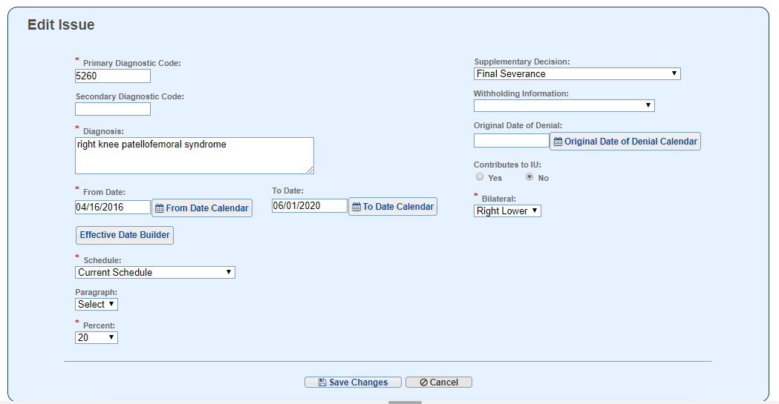
Issue Management
Diagnosis Information Screen:
  Enter effective date of severance in To Date
  Select Final Severance from the Supplementary Decision menu
  DO NOT change Decision Basis or other information at this point.

Slide 23
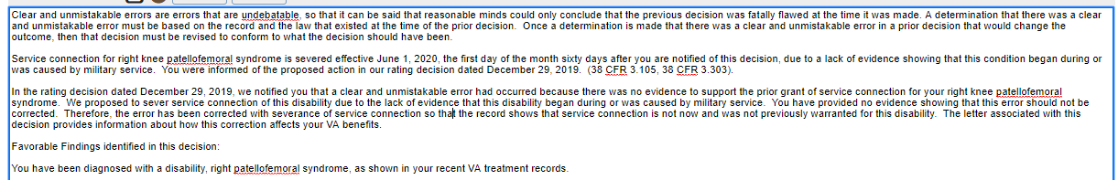
Issue Management
Complete rating narrative
Narrative text (supplement as necessary)
Favorable findings
Reference laws
Include explanation of effective date

Slide 24
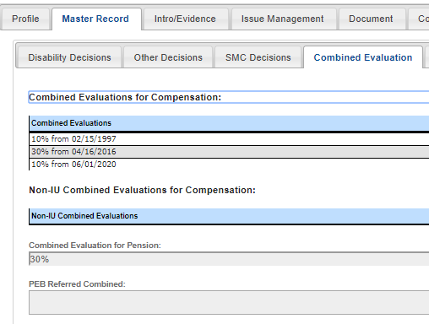
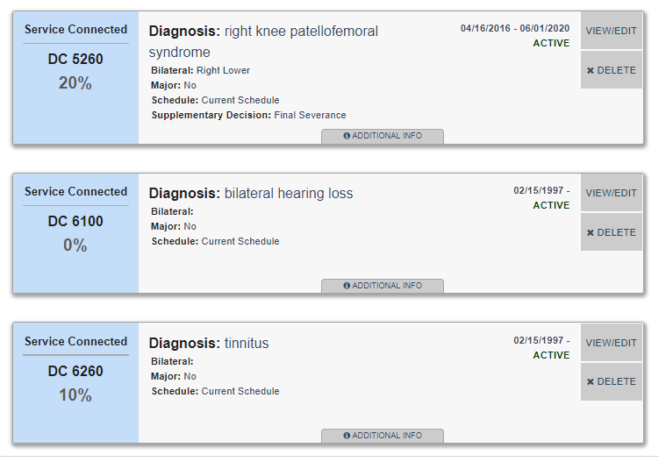
Current Master Record

Slide 25
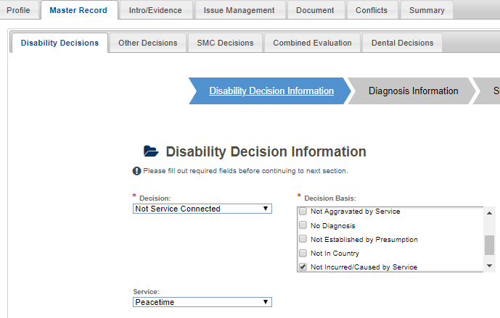
Correct the Master Record
Return to the Master Record
  Edit the severance issue on the Disability Decision Information screen
    Decision field: change to Not Service Connected
    Decision Basis field: change to Not Incurred/Caused by Service (or whatever basis is appropriate for the issue being addressed)
    Service field: re-enter appropriate service
  Save make no other changes

Slide 26
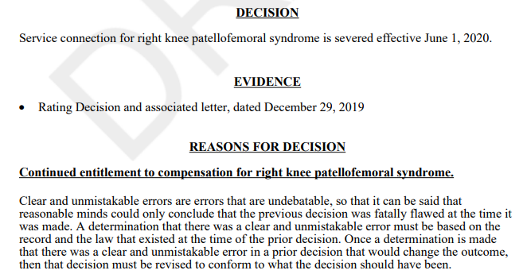
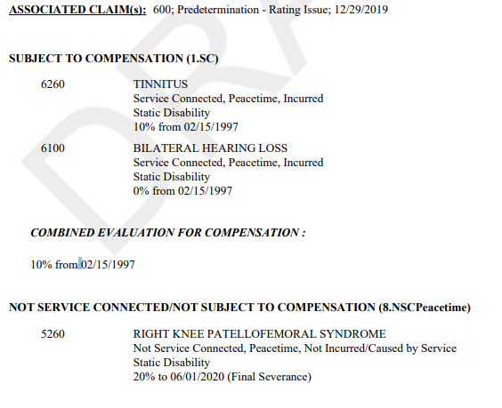
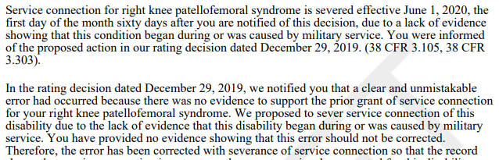
Severance Narrative & Codesheet

Slide 27
Scenario 2
Reduction affecting current payment
  Facts:
    Rating decision dated October 5, 2017, granted service connection for right knee patellofemoral syndrome at 20 percent effective January 12, 2017
    A rating decision dated December 23, 2019 (with due process letter on the same date), properly identified a CUE for assigning an incorrect evaluation of 20 percent and proposed to reduce the evaluation to 10 percent
      The current combined evaluation will be reduced from 20 to 10 percent
    Today we are rating the final reduction

Slide 28
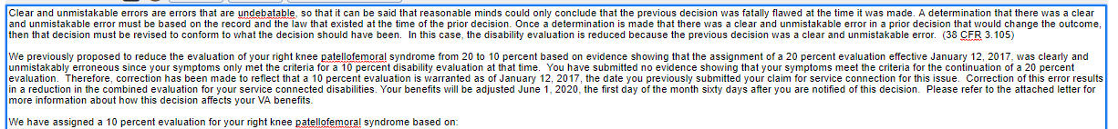
Generating Issue/Decision
Generate the final reduction in Issue Management in VBMS-R as normal, adding necessary effective date and reasons and basis information and applicable laws, as needed

Slide 29
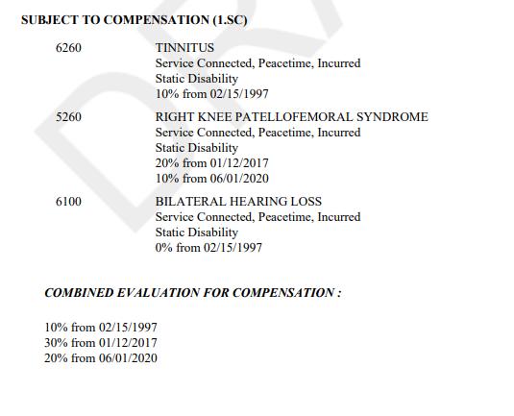
Why Must the Codesheet Be Corrected?
Without correction of the codesheet, the combined evaluation continues to be calculated as 30 percent from January 12, 2017, for this and future decisions
Incorrect Codesheet

Slide 30
Procedures to Correct the Codesheet
Return to the Master Record
Edit the Diagnosis Information screen to change the effective date of the 10 percent evaluation to reflect the correct effective date for the decision had the error not occurred (January 12, 2017)
Delete the information from the Supplementary Decision field
Delete the 20 percent evaluation information

Slide 31
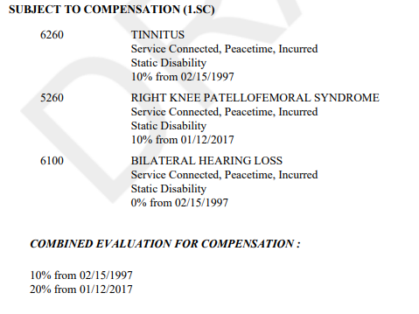
Corrected Codesheet
Following correction of
the Master Record
  the narrative will continue to generate with the proper notification for the Veteran, and
  the codesheet will generate with the CUE corrected and proper combined evaluation information

Slide 32
Scenario 3
Past reduction not affecting current payment
  Facts
    A prior rating decision granted service connection for residuals of left elbow fracture with a 20 percent evaluation assigned effective July 9, 2017
      This was the Veteran’s only service-connected disability at that time
      Thereafter, a rating decision dated June 15, 2019, granted service connection for PTSD with a 50 percent evaluation effective March 22, 2019
    A rating decision and due process notification dated December 15, 2019, properly proposed to reduce the elbow disability’s 20 percent evaluation to 10 percent
      If this reduction occurs, the combined evaluation will be 10 percent from July 9, 2017 to March 22, 2019
      Sixty percent will continue from March 22, 2019
    We are completing the final reduction rating today

Slide 33
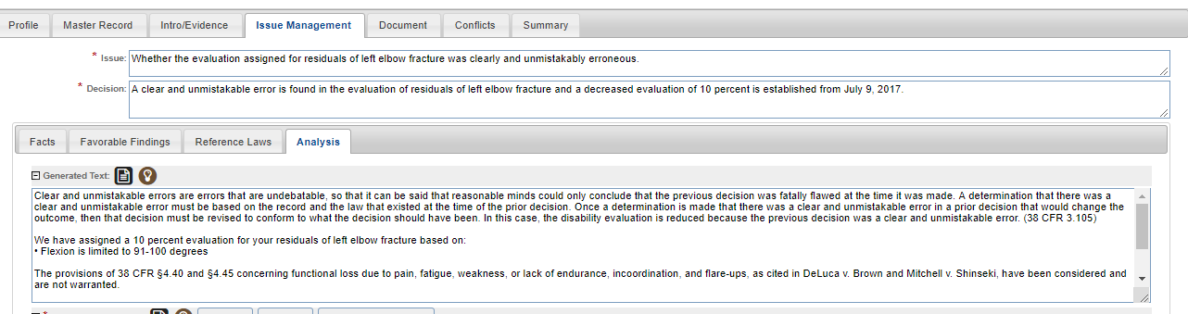
Edit Generated Language
There is no perfect way to enter this decision in VBMS-R
  Entered here as final reduction effective July 9, 2017, to generate CUE language
  Edit generated language to provide proper information

Slide 34
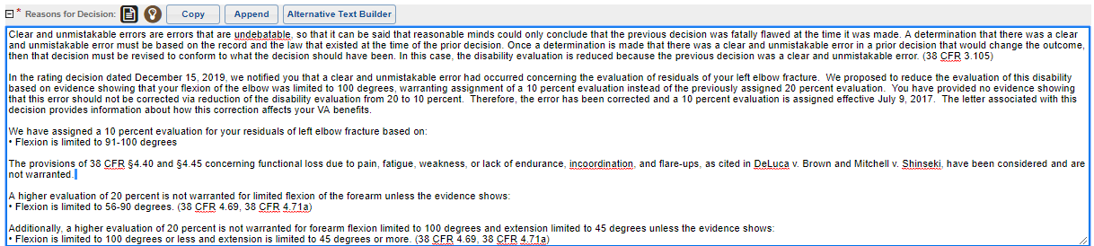
Provide Correct Information in the Narrative
Suggestions:
  Leave discussion of payments to the notification letter
  Provide the specifics of the error without extensive discussion (assuming that was provided in the proposal)

Slide 35
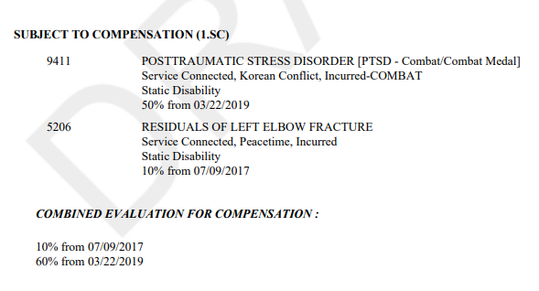
Correct the Codesheet
Update the codesheet so that it reads how it should have read had no error been made
For this example, correction involved removing the 20 percent evaluation for the elbow

Slide 36
Final Reminders
Leave discussion of payment details to authorization
  When current benefits change, use the effective date of the benefit change in the decision text and explain that date in the narrative
    Also explain how the record is corrected for the CUE
You may include a note on the codesheet annotating that this is a CUE due to administrative error and no O/P should be created
  This is discretionary, but if it is unclear that this is the situation, then the note may be helpful
Be clear and specific in your narrative
Review all generated text to ensure accuracy
Often, there is no single correct way to address a CUE in VBMS-R
  Use the system optimally for generation of situation-appropriate generated language

Slide 37
Korean DMZ Expanded Dates & 38 CFR 3.114a
Aimee Hawkins
Consultant
STAR Program Review Staff
Quality Assurance

Slide 38
Question
We would like clarification on effective dates of grants for Veterans who served in Korea and now meet the requirements for presumptive SC based on herbicide exposure in the Koran DMZ due to the expansion of dates in PL 116-23. If a claim or legacy appeal was pending on the date of the law change, can we grant prior to the date of the law change, or is the proper effective date of the grant January 1, 2020; the effective date of the law change as directed by 38 CFR 3.114?

Slide 39
Guidance
Decision makers should apply liberalizing legislation effective date rules [38 CFR 3.114(a)] to claims that are specifically being granted under the expanded Korean DMZ dates in the new law. As stated in that regulation, “The effective date of such award or increase shall be fixed in accordance with the facts found, but shall not be earlier than the effective date of the act or administrative issue."

Slide 40
Example
A Veteran was previously denied service connection for diabetes mellitus based on herbicide exposure. He submits a new claim in December 2019. Exposure to herbicides can now be established based on the expanded dates of Korean DMZ service effectuated by the new law. If all other requirements of service connection are met, the claim should be granted the date of law change, January 1, 2020.
  For more information on assigning an effective date based on liberalizing legislation, please refer to M21-1, Part III, Subpart iv, 5.C.8

Slide 41
Routine Future Examinations (RFEs)
Bonnie Kirby
Senior Quality Review Specialist
Quality Review Team
Quality Assurance

Slide 42
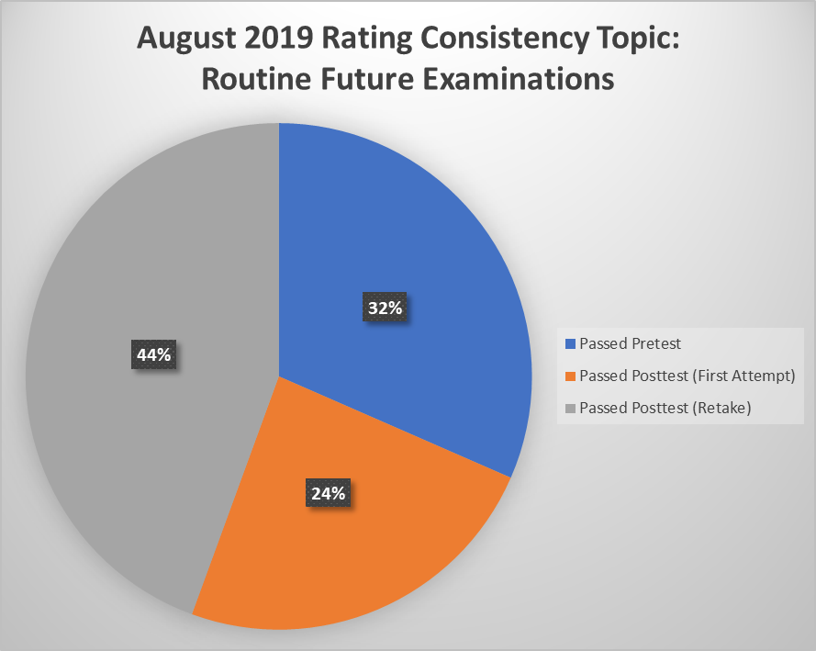
August 2019 Rating Consistency Study
Pass rates:
  Passed Pretest - 32%
    905 of 2868
  Passed Posttest first attempt following training - 24%
    689 of 2868
  Passed Posttest Retake (two or more attempts following training) – 44%
    1274 of 2868

Slide 43
Routine Future Examinations (RFEs)
August 2019 RFE Consistency Study demonstrated improvement since May 2018
Results showed the most disparity concerning when to schedule a future exam in the following scenarios:
  Veterans over 55 years of age
    38 CFR 3.327(b)(2)(iv)
  Where a combined disability evaluation would not be affected if the future examination results in a reduced evaluation
    38 CFR 3.327(b)(2)(vi)
  When the rating is a prescribed scheduled minimum rating
    38 CFR 3.327(b)(2)(v)

Slide 44
Routine Future Examinations (RFEs)
Veterans over 55 years of age
  How old is the Veteran?
  How old will the Veteran be when the RFE is scheduled?
  If either of the above exist, is this an unusual circumstance?
    38 CFR 3.327(b)(2)(iv)
    M21-1 III.iv.3.B.2.d-f

Slide 45
Routine Future Examinations (RFEs)
Where a combined disability evaluation would not be affected if the future examination results in a reduced evaluation
  What is the current combined evaluation?
  What would the combined evaluation be if the disability in question was reduced to the protected or prescribed minimum evaluation?
  Is entitlement to SMC predicated upon the disability in question?
    38 CFR 3.327(b)(2)(vi)
    M21-1 III.iv.3.B.2.d

Slide 46
Routine Future Examinations (RFEs)
When the rating is a prescribed scheduled minimum rating
  What are the current rules and regulations regarding the disability in question and its body system?
  Is the evaluation protected under historical evaluation criteria?
    38 CFR 3.327(b)(2)(v)
    M21-1 III.iv.3.B.2.d

Slide 47
Routine Future Examinations (RFEs)
Final RFE reminder regarding permanency of total evaluations:
  If receiving treatment,
    Is it likely that the disability will improve or is the treatment for amelioration of symptoms?
    Is the treatment likely to continue throughout the Veteran’s lifetime?
  Check to determine if the treatment records or examination results note “palliative,” “hospice,” or “respite” care
    38 CFR 3.327(b)(2)(iii)
    38 CFR 3.343
    M21-1 III.iv.8.D.3
    M21-1 III.iv.3.B.2.d

Slide 48
Development Reminders
Amy Wintrow
Consultant
STAR Program Review Staff
Quality Assurance

Slide 49
VAMC Record Reminders
VA medical records include records documenting
  Inpatient and outpatient treatment received
    At a Veterans Health Administration (VHA) facility, or
    By a contractor under the Veterans Choice Program (VCP) or the new Veteran Community Care Program, and
  Vet Center treatment
When relevant treatment is alleged at a VA facility, ROs must attempt to obtain the records unless the RO concludes that it is reasonably certain the records do not exist
    M21-1 III.iii.1.C.2.b

Slide 50
VAMC Record Reminders
When a Veteran does not identify treatment at a specific VA facility, ROs must
  Perform an enterprise search in CAPRI, and
  Associate any relevant records with the claims folder
If the search results do not show any VAMC treatment, add a permanent note to the appropriate claims processing system documenting the results
    M21-1 III.iii.1.C.2.g

Slide 51
VAMC Record Reminders
If medical evidence relevant to a pending issue is available electronically through CAPRI or JLV, the records must be added to the claims folder
Uploading records to VBMS is a necessary step so that the Veteran, POA, subsequent decisionmakers, and other stakeholders can see the specific evidence used in making a disability determination
    M21-1 III.iii.1.C.2.h

Slide 52
Examination/Medical Opinion Reminders
Highest STAR rating-related error categories from 8/1/19 to 3/4/20
  B2bb – VA exam was needed
  B2cc – VA medical opinion was needed
  B2f – Insufficient VA examination/ medical opinion
Body systems most commonly involved in error citations
  Musculoskeletal
  Hearing Loss/Tinnitus
  Mental

Slide 53
Examination/Medical Opinion Reminders
Avoid rating based on insufficient examinations by ensuring
    The DBQ and Medical Opinion are both internally consistent, as well as consistent with the evidence of record
    The examiner identifies all fingers affected by painful motion
    Competency is addressed in Mental DBQs
    Additional required DBQs are completed such as in cases of:
      Diabetes Mellitus
      Traumatic Brain Injury (TBI)
      Multiple Sclerosis (MS)
      Amyotrophic Lateral Sclerosis (ALS)

Slide 54
Kudos to Huntington VA Regional Office
– QMS Error Record Management –
Introduction
Christine Alford
Chief, Advisory and Special Review Team
Quality Assurance
Presentation
Jacqueline Hale
Coach, Quality Review Team
Huntington VA Regional Office

Slide 55
Huntington RO Kudos
Christine Alford
Chief
Advisory and Special Review Team
Quality Assurance

Slide 56
Kudos to a Regional Office:
Quality Improvement
Quality and Productivity Process Improvement Initiatives
User-Friendly and Effective Resources
Effective Communication Practices Regarding Procedural, Legislative, and Regulatory Changes
Wide Dissemination of Proven RO Best Practices

Slide 57
Huntington RO Quality Improvement
Redesigned QMS Error Record Management Process
July 2019 Compensation Service Site Visit
New Process Implemented December 1, 2019
Remarkable Results in Less Than Several Months

Slide 58
QMS Error Record Management
Jacqueline Hale
Coach
Quality Review Team
Huntington VA Regional Office

Slide 59
Redesigned QMS Error Record Management Process
Huntington redesigned its QMS Error Record Management Process effective December 1, 2019 (October rollout)
Prior average of 100 error records with 75% past the 5-day limit
Current average of 15-25 records with occasional past due records with extenuating circumstances
  And a lot less stress and confusion ☺

Slide 60
Key Elements
Our Team
Workload Management Plan
  Definitions/Terminology
  Areas of Responsibility
Training
Reporting/Communication
Huntington
VSC FTE Stats
VSRs: 87
RVSRs: 44

Slide 61
Resources
SharePoint Sites
  WMP Adjustments
  Error Notification PowerPoint (detail look at email)
  Rebuttal Procedures/ Info Sheet
  FAQs
M21-4, Appendix B, Topic 2
  EP 930 - Review, Referrals, Other
Other
  Local Process

Slide 62
What Does Success Look Like?
Success is having 0 Error Records open longer than 5 days without verifiable extenuating circumstances documented on the QMS record

Slide 63
The Great News!
The majority of our error record issues traced back to a misunderstanding the terminology for QMS
There is no need to keep an error record open while claims processing takes place
  The QMS error record has no control for claims processing, and it is not available to any other processors

Slide 64
QMS & VBMS
QMS is completely separated from VBMS when it comes to terminology and process
Applying commonly understood claims processing language to QMS Error Records results in conflict and confusion
Understanding the separation between QMS Error Records and Claims Processing enables us to meet our responsibilities within VBA’s Quality Assurance Program

Slide 65
Moving an Error Record to COMPLETE Status
Only 2 ways an Error Record gets to COMPLETE status:
  Error record marked “Accepted and “Corrected” = Complete
  Responsibility of employee cited for error
  Error overturned on rebuttal = Complete
  Responsibility of the QRT Coach
  All Error Records must be closed out using one of these two methods

Slide 66
Accepted
Error Record status obtained once an employee agrees that the error citation is accurate
OR
Status obtained once reconsideration and rebuttal options are exhausted

Slide 67
Corrected
Error Record status obtained once an employee has verified all claims processing tracking information is in place in the claims processing systems
OR
Status obtained once employee has verified that no tracking in Claims Processing system is required
  The process of determining if an EP 930 is needed IS the corrective action for a QMS Error Record

Slide 68
Responsibilities
Employee Responsibilities
  Daily reviews and prompt action on all error notifications
  Claims processing action verification
    determining if EP 930 is needed & completing
  Closure of all agreed to or upheld error records in 5 days
Floor Coach Responsibilities
  Daily monitoring of open error records for team
  Daily 6th Day report responses to VSC Front Office & QRT Coach

Slide 69
Responsibilities (Cont’d)
QRT Responsibilities
  Provide daily report to Front Office and QRT Coach of all error records that have exceeded timeliness limits
QRT Coach Responsibilities
  Assist employees in overcoming obstacles relating to error records and process
  Document all verified extenuating circumstances in the IQR record

Slide 70
Process
When employees receive notification that an error has been cited, they are expected to take prompt action on the notification
The 5-day timeframe is provided to allow adequate time for the employee to take all actions required to close out the error record, including all communications required to submit a formal rebuttal
In order for leave to be considered an extenuating circumstance and extend the 5-day window, an employee must be away from primary duties for 24 or more hours during the timeframe
Extenuating circumstances must be verified by a direct supervisor

Slide 71
Timeline

Slide 72
Who Is Responsible For Each Process?
Employee Cited for Error
Floor Coach
QRT Coach
Employee, Floor Coach & QRT Coach

Slide 73
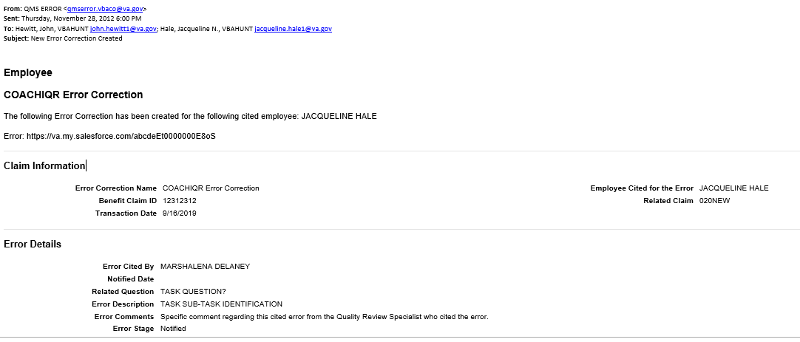
Example of Error Notification Email
Sent Date of Error Notification Starts the 5-Day Timeliness Clock
No PII
- fake notification -

Slide 74
Two Additional Processes
Correction Spot Checks
  Random sample, 15% of correction required records
Proxy Reviews
  An employee will be on extended leave or is no longer employed by the Department of Veterans Affairs

Slide 75
Conclusion
Compensation Service Site Visit – July 2019
Workload Management Plan updates provided workable definitions for claims processors to use for Error Record Management
Clear areas of responsibility
Identified the path, process, and assistance for employees
6th Day report facilitates clear, timely communication
We believe Huntington has not only achieved success with this process, but we also anticipate ongoing continued success

Slide 76
Huntington RO Kudos
Christine Alford

Slide 77
Quality Improvement at Your RO!
All offices are encouraged to utilize tools, such as Huntington RO’s QMS Error Record Management Process, to improve claims quality and service to Veterans and their Families
Does your office currently have a similar quality-focused practice?
  Please let us know so we can feature your best practice during an upcoming Quality Call for everyone’s benefit!
    VAVBA/WAS/CO/InternalQRS
    Christine.ALFORD1@va.gov

Slide 78
M21-5, Appeals and Reviews Migration
Fred Somers
Program Analyst
AMO Program Administration

Slide 79
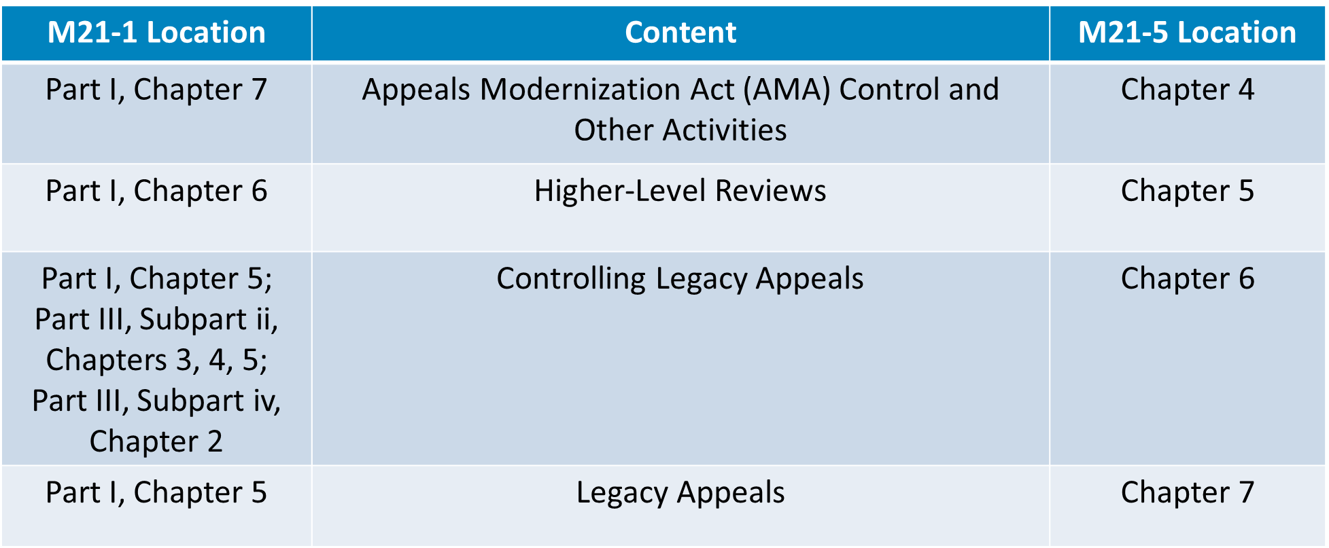
M21-5, Appeals and Reviews Migration
Migration of content from M21-1 to M21-5 completed March 2nd

Slide 80
M21-5, Appeals and Reviews Migration
Change Matrix available in M21-5 Resources
Note: Hyperlinks in M21-1 will be updated on a rolling basis

Slide 81
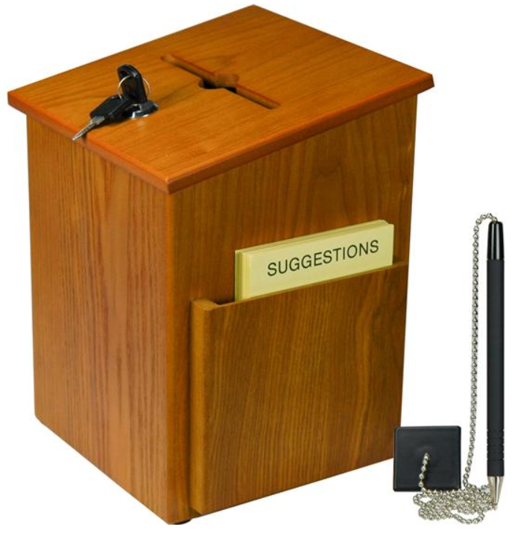

Suggestions – Next Quality Call
Presented by:
Robert Johnson

Slide 82
Would You Like to Present a Topic?
We are offering opportunities for RO SMEs to present topics during Compensation Service Quality Call recording sessions
  Peer-to-Peer communication is optimum
Are YOU interested in presenting a topic?
  Talk to your Coach or other RO management team member
  If okay, have management send your name and topic to:
    VAVBAWAS/CO/InternalQRS <InternalQRS.VBAVACO@va.gov>

Slide 83
Do You Have Suggestions for Topics?
Please feel free to email your topic suggestions to the Quality Call Leads at this mailbox VAVBAWAS/CO/InternalQRS
  In your email, be sure to include:
    Cc to your Coach or other RO management
    Name of the topic
    Intended audience (VSR – SVSR – RVSR – DRO – AQRS – RQRS)
    Applicable M21-1 and/or 38 CFR citations
Quality Call Bulletins can be found in the STAR Home Page on the Compensation Service Intranet site, TMS, and VBA Learning Catalog
Audio recordings of the Quality Calls with separate copies of the PowerPoint slides can be found in both TMS and VBA Learning Catalog

Slide 84

Next Quality Call
A Compensation Service Quality Call is usually recorded each month
Next Quality Call will be recorded in April

