Slide 1
VA Vocational Rehabilitation and Employment Introduction to the VR&E Electronic Virtual Assistant (e-VA)
e-VA (powered by SARA)
VR&E Training

Slide 2
INTRODUCTIONS
Participation is critical
Pilot lasts 30 days
Meet the e-VA Training Team:
VR&E Training
VR&E Implementation
The Career Index

Slide 3
Training Objectives
Upon completing this training, you will be able to
Identify the benefits of e-VA
Understand how e-VA and Corporate WINRS interact
Access and log in to e-VA
Edit user and claimant profiles
Identify assignments and tracks
Send and receive communications and alerts
Schedule events and appointments
Undertake bulk actions
Utilize the Staff Dashboard Report
Notes:
Understand what e-VA is and how it fits into VR&E’s larger modernization plan
Identify the benefits of using e-VA for VR&E staff and Claimants
Understand how e-VA connects to CWINRS
Understand the information and data that is exchanged between e-VA and CWINRS
Learn how to access and log into e-VA
Understand how to create and update User and Veteran profiles in e-VA
Learn how to manage the claimant’s record and contact information
Learn how e-VA schedules communication and follow up with Claimants
Understand the relationship between e-VA Tracks and a claimant’s case status
Understand how case statuses in CWINRS determine Tracks and Assignments in e-VA
Understand e-VA’s communication capabilities and features
Gain proficiency in sending and receiving messages and texts
Understand how to manage and respond to alerts
Understand how to use e-VA’s calendar functionality to make and manage appointments
Learn how claimants can reschedule appointments with e-VA
Learn how to save time by performing actions for multiple claimants at one time
Understand how the Staff Dashboard Report can help you manage your caseload

Slide 4
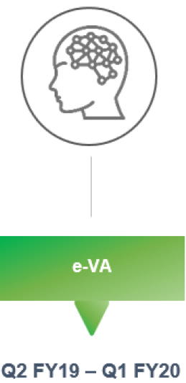
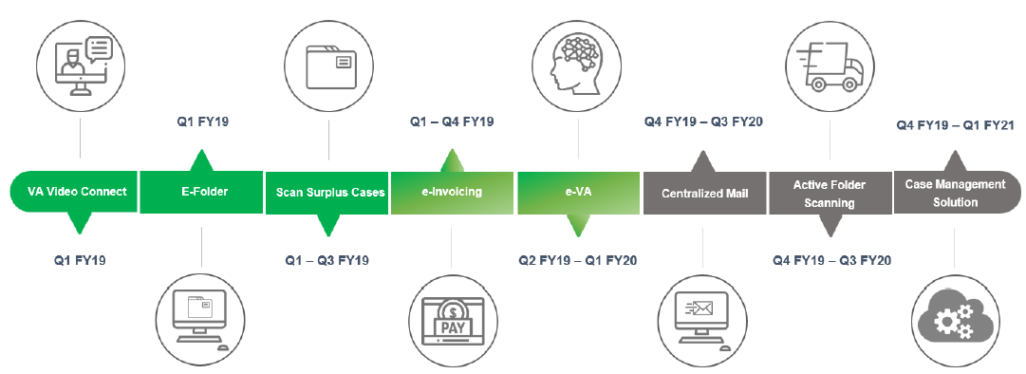
VR&E Service Modernization Roadmap
Detailed description of the VR&E service modernization roadmap is provided in the Notes section.
Notes:
eFolder access for document management
Scanning surplus cases to improve the quality of scanned documents
e-Invoicing to standardize and streamline the invoicing process
e-VA to reduce administrative burdens associated with scheduling, follow-ups, and other routine activities
Centralized Mail to streamline intake and handling of paper at ROs
Active Folder Scan to complete the transition to a paperless process
Case Management Solution Service to provide a modern case management system with enhanced workflow, automation, and tracking capabilities
Vocational Rehabilitation and Employment is making substantial modernization improvements to fully align with the VBA Secretary’s three priorities:
Provide Veterans with the benefits they have earned in a manner that honors their service.
Ensure we are strong fiscal stewards of the money entrusted to us.
Foster a culture of collaboration.
The ultimate modernization goals are to move VR&E into a digital and paperless environment and sunset any legacy information technology tools that are still being utilized. e-VA is a key step in achieving this goal. e-VA will help reduce time spent performing routine case management tasks by providing capabilities such as:

Slide 5
What is e-VA?
Notes:
Ctrl+Click image to play video.

Slide 6
What is e-VA? (cont.)
Vocational Rehabilitation and Employment is making substantial modernization improvements to fully align with the VBA Under Secretary’s three priorities:
Provide Veterans with the benefits they have earned in a manner that honors their service.
Ensure we are strong fiscal stewards of the money entrusted to us.
Foster a culture of collaboration.
The ultimate modernization goals are to move VR&E into a digital and paperless environment and sunset any legacy information technology tools that are still being utilized. e-VA is a key step in achieving this goal. e-VA will help reduce time spent performing routine case management tasks by providing capabilities such as:
Two-way electronic communication between staff and claimants through text message or e-mail
Online scheduling and automated alerts, follow-up messages, and appointment reminders
Case tracking and management support tools, such as caseload dashboards
Tools to extract and present data in charts, tables, and other visualizations to find useful information

Slide 7
Key Benefits
Automating follow-ups
with Claimants
Conduct required follow-ups via automated reminders and alerts
Receive updates regarding plan progression, i.e. job search, training, health, etc.
Exchange (upload/download) important documents
Engaging directly
with Claimants
Text directly from your computer
Send mass text and e-mail messages from e-VA’s Bulk Actions interface
Obtain documents and images from claimants (pay stubs, receipts, etc.)
Documenting Correspondence and Interactions
Correspondence within e-VA automatically converts into case notes on your behalf including:
Every contact attempt (successful or unsuccessful)
Any text or e-mail conversation
Appointments, including changes and cancellations
Connecting to CWINRS
e-VA sends and receives information to/from CWINRS (and will connect with the new case management system)
Case notes from e-VA will be sent automatically to CWINRS
A new claimant entered in CWINRS is automatically entered in e-VA
Claimant contact information updated in CWINRS updates e-VA
e-VA enhances the customer experience in a manner that honors the Veteran's service

Slide 8
How is e-VA Connected to CWINRS?
A new claimant enrolled in CWINRS is automatically enrolled in e-VA
Claimant contact information updated in CWINRS is automatically updated in e-VA
If a claimant is reassigned to a different VRC in CWINRS, the claimant is automatically reassigned to the new VRC in e-VA
When a claimant’s case status is changed in CWINRS, the claimant’s case status “Track” is changed in e-VA
Case notes generated in e-VA are automatically populated into CWINRS
Note: case notes from text message conversations in e-VA are built over an 8 hour period of time, prior to populating in CWINRS

Slide 9
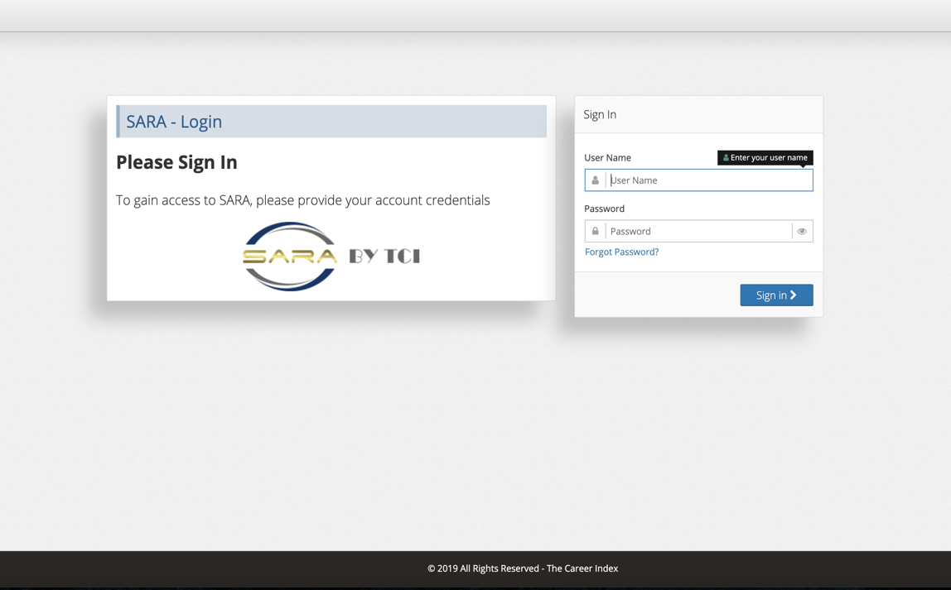
HANDS-ON TRAINING
With Training Exercise Guide
Notes:
Now that you know what e-VA is, we will show you how to use it!
We will now log into the system and walk you through e-VA’s features and functionality and perform hands-on practice activities in the e-VA training environment

Slide 10
Access e-VA
Open a browser and go to https://staging-staff.eva.va.gov
Credentials:
Example: User ID: john.smith – note the “dot” between your first and last name!
Password: password - you will be asked to create a new password for yourself

