Slide 1
U.S. Department of Veterans Affairs
Veterans Benefits Administration
Outreach, Transition and Economic Development (OTED)

Slide 2
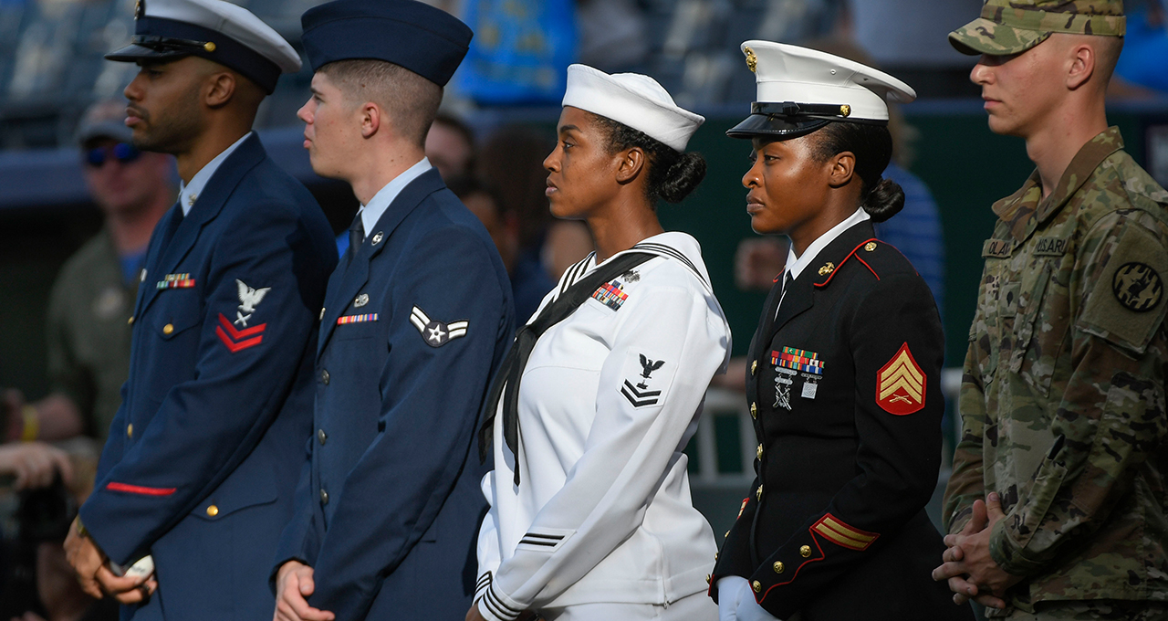
Outreach, Transition and Economic Development (OTED)
Mission- Collaborate, inform and advocate for Veterans, transitioning Servicemembers, survivors, family members, and all eligible beneficiaries by highlighting pathways to VA benefits and services to facilitate sustained successful connections.
Vision- Serve as a trusted leader to all Veterans, transitioning Service members, survivors, and eligible beneficiaries by increasing awareness of and access to VA benefits and services.
Reimagined in April 2021
7 divisions that deliver 14 workstreams/programs
Transition Assistance Program
Post-Separation/OSA
Quality and Compliance
Office of Client Relations
Outreach
Strategic Engagement
Executive Management Officer Office

Slide 3
Our Impact
Committees, Task Forces, and Working Groups
Interagency
TAP Interagency Executive Council
VA/DoD Joint Executive Committee
Financial Literacy and Education Commission
Elderly Justice Coordinating Council
Sexual Trauma Working Group
VA
VA Suicide Prevention Consortium
Advisory Committees; Homeless, Minority and Native American Veterans
VA’s Secretary Advisory Committee on Former Prisoners of War
Center for Women Veterans
Center for Minority Veterans
Sexual Harassment and Assault Prevention/Survivor Care and Support (SHAPSCS) Sub council
I-DEA Inclusion, Diversity Equity and Access Sub Council
Indo Pacific Working Group

Slide 4
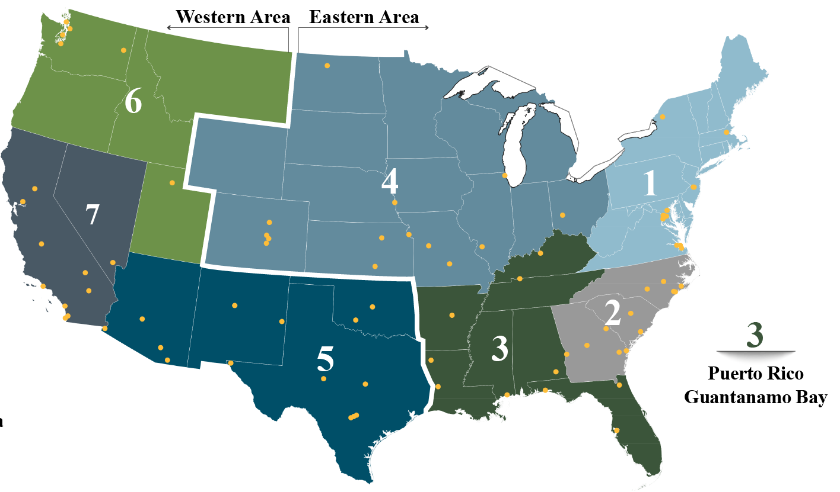
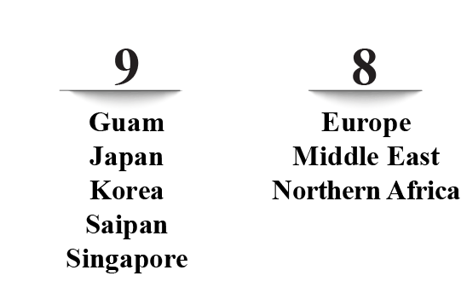
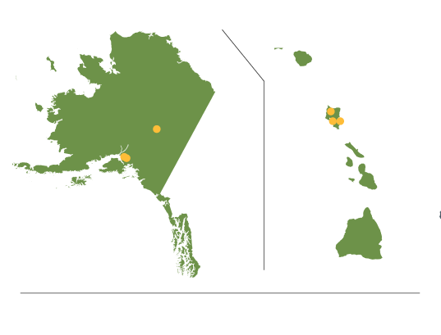
Transition Assistance Program (TAP)
VA currently supports more than 330 installations, CONUS and OCONUS, organized into nine operational regions.
Transition Leads coordinate with TAP Managers, so Benefit Advisors (BAs) have the support/space needed to conduct briefings for TSMs, their families and their caregivers. BAs facilitate multiple types of VA TAP events.
In a normal operating model, VA uses a regional hub-and-spoke model to deploy VA BAs globally to engage Service members, Veterans and their families and caregivers.
Goal: Support Service members and their families transitioning to civilian life through the Transition Assistance Program
300 installations worldwide
7.5 hours of orientation
Opportunity for one-on-one sessions

Slide 5
Transition Assistance Program (TAP) cont.
Accomplishments:
Achieved 97.5 TAP Customer Satisfaction
Provided 22,121 one-on-one benefit engagements FYTD
VA launched the Military Life Cycle (MLC) Learner Assessment Tool
Deployed Women’s Health
Transition Training
FY21 1,066 attendees
98% satisfaction
On the horizon:
Implementation of Public Law
No: 116-214-215
Isakson Roe Sections
Section 101, Network of Support
Section 4305,
Independent Assessment
of TAP
Section 4306, Longitudinal study
This Photo by Unknown Author is licensed under CC BY

Slide 6
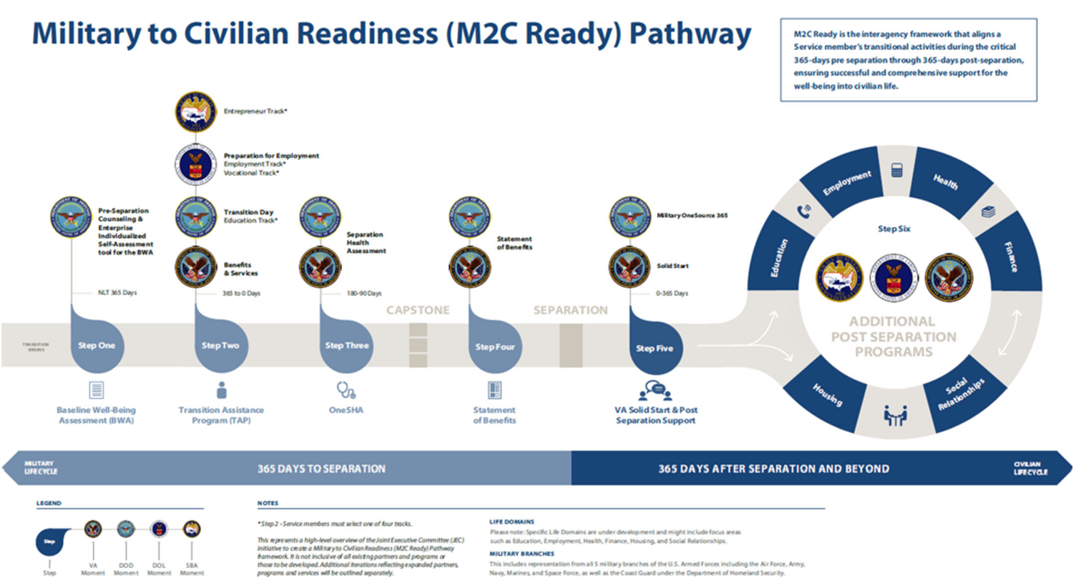
Post-Separation/Office of Survivors Assistance
Goals: Collaborate with DoD/Federal partners to chart the Military to Civilian Readiness Pathway and Lead VA’s Office for Survivor Assistance

Slide 7
Post Separation/Office of Survivors Assistance (cont.)
Accomplishments:
Released outcomes of the Post Separation TAP Assessment (PSTAP) Study
Created an African American Engagement Plan
Establish collaboration with Center for Minority Veterans
Implemented Personalized Career Planning and Guidance (PCPG)
Completed redesign of program
Processed over 7,800 applications in FY21
On the horizon:
Implementation of Public Law No: 116-215 Isakson Roe Sections
Section 4304, Implement Grant Office
Section 5303, Posting and reporting of VA Sexual Harassment policy
Implementation of Enhanced Statement of Benefits
This Photo by Unknown Author is licensed under CC BY-SA

Slide 8
Quality and Compliance
Goal: Provide centralized oversight on evaluation and technical assistance in VBA program management for VBA national call centers (NCCs) and public contact teams (PCTs) to drive consistent, high-quality interactions with VA stakeholders.
Completed PCT and NCC Site Visits | FY21 | FY22: Q1-2
Pacific | 6 | 3
Continental | 4 | 2
Northeast | 7 | 1
Southeast | 4 | 3
Total | 21 | 9
Main Functions:
Evaluate customer interactions and operational performance at NCCs and PCT locations through quality reviews and scheduled site visits.
Provide mentoring and issue impartial findings, trends, and recommendations that support improvements to VBA programs and services.

Slide 9
Quality and Compliance (cont.)
Accomplishments:
FY21 - Completed 5,000+ quality reviews on inbound NCC calls resulting in 92.19%, above the national quality target of 91%.
FYTD 22 (through 02/22) – Completed 2,000 reviews on NCC calls resulting in 92.27%.
FY21 - Completed 21 PCT and NCC site visits through conducting 365 interviews and 1,442 quality/operational reviews that identified 50 actionable items for improvements, 18 recommendations, 16 best practices, and one commendable item.
FYTD 22 (through 3/18/22) - Completed 9 PCT site visits, 69 interviews, and 886 reviews that identified 30 actionable items for improvements, 10 best practices, and 4 commendable items.
FY21 - Centralized the NCC evaluation scorecard,
allowing immediate updates and
improvements to one single scorecard.
On the horizon:
Implement an internal satisfaction
survey to obtain PCT/NCC feedback.
Transition from the NICE
to Calabrio call recording platform.
Implement an optional national
Public Contact Quality Management
Program for local use.
This Photo by Unknown Author is licensed under CC BY-NC

Slide 10
Client Relations
Goal: Quickly and accurately respond to and resolve inquiries from Veterans and beneficiaries who reach out to the White House, Secretary of Veterans Affairs and other senior VA officials
Accomplishments:
FYTD Receipts=9,984
62% more than the 6,090 FY21
Feb22 Receipts= 2,059
70% more than the 1,214 Feb21
FYTD Completed=6,887
17% improvement over 5,737 Feb21
Feb22 Completed=1,519
53% improvement over 993 Feb21
On the horizon: Implement feedback loop to regional offices
This Photo by Unknown Author is licensed under CC BY-NC

Slide 11
Outreach
Goal: Provide Veterans and their families with information on VA benefits and services through Veteran-specific Outreach programs, and economic development.
Authority: 38 U.S.C. 7703(5) directs that the Veterans Benefits Administration is statutorily responsible for the Department of Veterans Affairs' outreach efforts.
Scope:
Special Emphasis Programs (14): Women, Minority, Former Prisoner of War, Military Sexual Trauma, Tribal, Elderly, Faith-Based, LGBTQ+, Suicide Prevention, Survivors, ALS, Homeless, Justice-Involved, Casualty Assistance, and Rural
General Outreach-New VA benefits and programs, OMSC/International
Economic Development Initiatives
Financial Literacy Program (1 per month/Veterans and Employees)

Slide 12
Outreach (cont.)
Accomplishments:
Soft launch of a digital Customer Service Outreach Survey (Outreach V-Signals)
Transitioned Outreach special emphasis symposiums to Veteran public facing
Completed Women’s Veteran and Native American Journey Maps
Executed 29 Financial Literacy Programs, 7,643 participants
Piloted spousal benefit sessions during Economic Development Initiatives
On the horizon:
Pilot of the digital Customer Service Outreach Survey (Outreach V-Signals) in Field
Projected Implementation FY22, Q3
Target Military Sexual Trauma, Homeless and Women’s Outreach Events
Conduct virtual EDI events; Alameda County, California; Puget Sound, Washington; and Erie County, New York
 | Total Events Completed | Virtual Events Completed | Virtual Event % | Total Attendance
FY21 | 6,789 | 5,797 | 85% | 438,687
FY22 FYTD | 3,859 | 2,764 | 72% | 215,479

Slide 13
Strategic Engagement
Goal: Change the way VA talks to Veterans and the media, making sure that we deliver the right message to the right Veteran at the right time.
Focus on creative and innovative ways to connect with Veterans, the media and other stakeholders
Engage internal and external partners to ensure effective communication with Veterans and their advocates about the benefits and services they have earned.
Collaborate with business lines and Regional Offices to inform, engage, and support VBA beneficiaries, as well as internal and external partners through delivery of communications strategies, products and materials

Slide 14
Strategic Engagement (cont.)
Accomplishments:
Produced nearly 4,500 unique materials and reached more than 25 million people.
Launched National VBA Media Training Program, 4 sessions completed.
Published a new, no-cost Veterans Benefits Guide for Transitioning Servicemembers in collaboration with Stars and Stripes; provided ROs hard copies
Received 16 National Marketing and Communications (MarCom) Awards
Deployed two national Insurance Benefits and Military Exposure Basics Public Service Announcements with both being recognized by MarCom
Conducted monthly briefings with RO Public Affairs Officers (PAO), sharing the latest communications strategies and products
On the horizon:
Deploy an interactive platform,
VBA Communication Hub, designed
to provide real-time approved products
(Communications plans,
products, talking points, etc.)
Develop and deliver tailored
communications training to ROs
Conduct Communications Summit
for RO and HQ PAOs
This Photo by Unknown Author is licensed under CC BY-NC-ND

Slide 15
Questions

