Slide 1
VR&E e-VA and Case Management Solution
New Manager Training
Click Here to watch video:
NMT VR&E e-VA and CMS
March 2021
Presented by VR&E Service Training Team
This training is being recorded for training and historical purposes

Slide 2
e-VA Reports
New Manager Training
March 2021
Notes:
Hello everyone, special thank you to all of you for stepping up to be a new VR&E manager! Today’s e-VA discussion will be about its reports in the Electronic Virtual Assistant (e-VA). It is to assist you with exploring and utilizing the top five e-VA reports and to help manage e-VA utilization at your stations.

Slide 3
Agenda
Training Overview
Performance Time Series
Performance Summary
Alert Response Analysis
Nothing Scheduled Report
Summary Statistics
Questions/Comments/Concerns

Slide 4
1.) Performance Time Series (PTS) (Performance Tab)
Located on the default landing page for users with “Manager” level e-VA access
Links located within the legend provide access to detailed data report items within the PTS.
Provides correlation between employee logins and activities.
Staff could view their login, activities, idle percentage and alerts
Provides a snapshot of RO performance
Note: Selecting an empty heart in the report title will add it to the Favorites tab

Slide 5
DEMO

Slide 6
2.) Performance Summary (Performance Tab)
The [Performance Summary] is a follow-on report to the Performance Time Series. The Performance Summary reports provides a breakdown by staff member of the office metrics provided by the PTS
Management can view:
Idle %: Percent of case load where e-VA has nothing to do (should be below 5%) - These are the cases where there are no assignments or appointments scheduled
Alerts status for the following types of alerts:
Black alerts – Veterans actively asking questions and requesting information from their counselor
Yellow alerts – indicates e-VA is unable to gather additional information or if a Veteran has responded with important information
Red alerts – indicates information has been captured and is being sent to the counselor

Slide 7
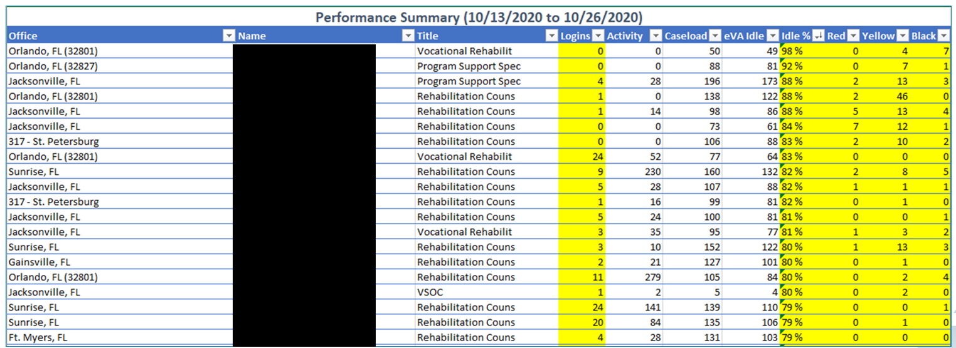
2.) Performance Summary
Note: The above is a Report Example of St. Petersburg 317. It is not an exhaustive list. Office totals and staff names have been removed.

Slide 8
2.) Performance Summary
Key Areas of Concern: (using example below)
Counselor has an idle percentage of 76
Counselor currently has 106 active Veterans assigned to their e-VA case list, but 81 of those Veterans are idle and do not have assignments or appointments scheduled for e-VA to execute
Counselor has 131 pending e-VA alerts that may contain important follow up information from the Veteran.
This Veteran is idle (red hourglass icon) and has chosen not yet decided (red thumbs down) to communicate through e-VA.
No red thumbs down and red hourglass symbol indicates this Veteran is not idle and has chosen to accept e-VA

Slide 9
DEMO

Slide 10
3.) Alert Response Analysis (Non-Viewed Alerts)
Just like a good assistant, e-VA uses an Alert System to keep you informed.
Alerts appear in your Dashboard and there is a legend at the bottom of the page for quick reference.
The color coding of the Alerts provides a visual representation of the communications coming in that guide you as you decide which communications (Alerts) to review first.
This Veteran is idle (red hourglass icon) and has chosen not yet decided (red thumbs down) to communicate through e-VA.
The lack of the red thumbs down and red hourglass symbol indicates this Veteran is not idle and has chosen to accept e-VA

Slide 11
3.) e-VA Icon Alerts in Detail
Red alerts – Are considered urgent . Action should be taken immediately. Red alerts are generated by e-VA when there is a need for manual intervention. The claimant may have told e-VA they found a job or lost the job or that they need help. Whatever the reason, you will want to manage your red alerts in a timely manner. Yellow alerts – Are considered potential problems that may need to be addressed period yellow alerts are notification from e-VA advising you There could be an issue that needs attention. e-VA may not be able to reach a claimant or the claimant may have said something e-VA does not know what to do with. Green alerts – Are generated when a claimant completes assignments or reports normal progress. No specific action may be necessary. Black alerts – Any incoming text message or email from my claimant generates a black alert usually the information contained in the black alert is critical to the claimant having a successful outcome so be sure to manage your black alerts in a timely manner. Purple alerts – Are generated when e-VA receives a document or image from a claim it. Many of the e-VA automated assignments contains sections where e-VA is asking for a copy of a transcript or credential. Anything e-VA receives from those requests will generate the purple alert.

Slide 12
DEMO

Slide 13
4.) Nothing Scheduled Report (Clients Tab)
The [Nothing Scheduled] Report shows active clients with no scheduled assignments or upcoming appointments for e-VA to execute.
Wait! What is an assignment?
An assignment is a directive to e-VA to undertake a certain follow-up task with your client(s). For example: All levels of case management require a face-to-face annual review. A counselor may want to create a “schedule an appointment” assignment for them to begin scheduling Veterans for their annual review appointments each year.
Annual Review Tip – Try scheduling annual reviews around the same time each year. This will help make sure that all your assigned claimants remain on a similar review schedule.
Office
Staff
Title
Client
Client ID
Track
Track Date
301 - Boston
Arroyo, Tia
Rehabilitation Counselor
Andrews, Marisella
14997012-1454296
Rehab to Employment - CH 31
08/11/2020
301 - Boston
Arroyo, Tia
Rehabilitation Counselor
Anselme, Jude
3861207-387798
Rehab to Employment - CH 31
01/23/2020
301 - Boston
Arroyo, Tia
Rehabilitation Counselor
Bevilacqua, Justin
37112698-1626151
Rehab to Employment - CH 31
03/05/2020
301 - Boston
Arroyo, Tia
Rehabilitation Counselor
Caraballo Rivera, Jose
41642389-1446883
Rehab to Employment - CH 31
04/08/2020
301 - Boston
Arroyo, Tia
Rehabilitation Counselor
Coppola, Thomas
32659712-1335764
Rehab to Employment - CH 31
08/25/2020
301 - Boston
Arroyo, Tia
Rehabilitation Counselor
Deshaw, Thomas
2866611-321993
Rehab to Employment - CH 31
06/14/2019
301 - Boston
Arroyo, Tia
Rehabilitation Counselor
Desir, Jean
17251514-1094725
Job Ready Services - CH 31
06/26/2020
301 - Boston
Arroyo, Tia
Rehabilitation Counselor
Dezso, Mark
29619386-1722779
Rehab to Employment - CH 31
08/12/2020
301 - Boston
Arroyo, Tia
Rehabilitation Counselor
Dockrey, Jessica
12170993-784416
Rehab to Employment - CH 31
08/02/2019
301 - Boston
Arroyo, Tia
Rehabilitation Counselor
Everett, Joshua
9772244-1191617
Rehab to Employment - CH 31
01/24/2020
301 - Boston
Arroyo, Tia
Rehabilitation Counselor
Farber, Bianca
10936789-1455916
Interrupted - CH 31
06/23/2020
301 - Boston
Arroyo, Tia
Rehabilitation Counselor
Flaherty, Matthew
32057753-1684188
Rehab to Employment - CH 31
07/02/2020
301 - Boston
Arroyo, Tia
Rehabilitation Counselor
Gilpatrick, Sara
22859791-985910
Employed
09/02/2020
Report Example

Slide 14
DEMO

Slide 15
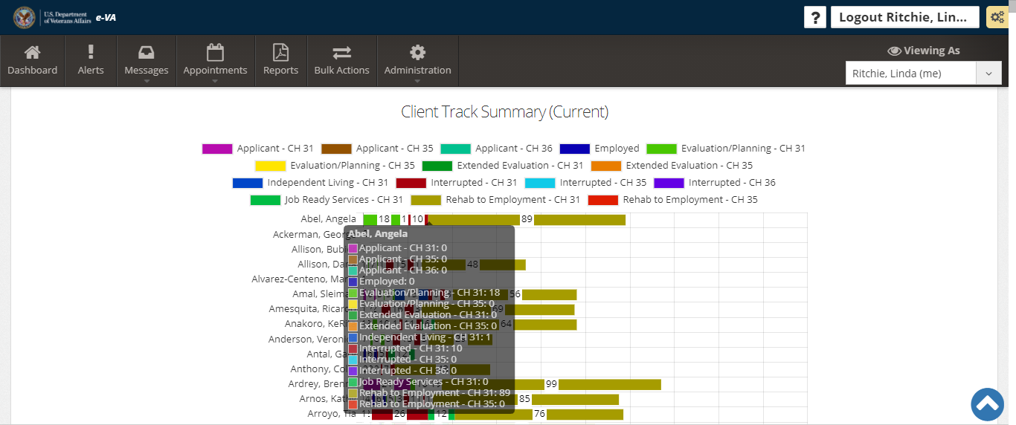
5.) Summary Statistics (Performance Tab)
The [Summary Statistics] Report is an easy way to evaluate the case status report of a counselor's caseload without having to utilize CWINRS to search case by case. Management is also able to see idle percentage, logins, cases that have been opened and closed, activity, and unviewed alerts.

Slide 16
DEMO

Slide 17
Questions/Comments/Concerns? Send us an email at: VRE_EVA.VBACO@va.gov We would love to hear from you!
Notes:
Thank you for attending today’s training. As a reminder, please log into TMS and complete this training assignment. This will ensure you receive credit for the training and as always provide the opportunity to give us your honest feedback. The TMS number is 4562160. For those who are CRC, you can access your verification form for continuing education units via TMS. After completing the training item in TMS, go to the” My History” Pod, click “View All,” locate and click on the hyperlinked training title, click on “View Details” and click “Print Accreditation Certificate.”
Again we would like to thank you for attending today’s training and have a good day/evening.

Slide 18
VR&E Case Management Solution
New Manager Training
March 2021
Presented by VR&E Service Training Team
This training is being recorded for training and historical purposes

Slide 19
What do you hope to gain from the new CMS?
Notes:
Let’s pause for a moment and think about where we have come from and where we are going. I must admit that there are many features of the current system CWINRS that will be greatly missed. It has gotten me through the good times and hard times. It has helped me to manage thousands of Veterans. It has been with me since I started my career with VR&E. We know that it is not always easy to say goodbye, but we are coming to a point in this organization, and for you, that we will begin our transition to a new system for case management, CMS. So, thinking ahead, from what you heard, what you experienced, what are some features or characteristics you are looking for in a new case management system? While you are taking a few moments to think about that, and placing your responses in the chat window, I’m going to share one of my personal anticipations for this new system. I can’t help to think back to the days that I was sitting behind my desk watching the pile of papers grow steadily. From a few papers, to a few inches and then sometimes a good stack of paper that is a foot high. If it wasn’t for the awesome hard working work studies, I’m sure it would have gotten much higher. I know that eventually this new system will lead us to a day where physical paper is pretty much a thing of the past. Most everything we do will be digital and there will no longer be the need to experience the trauma of having large piles of paper.
Let’s now take a look at some of the things that you are looking forward to. [Read the responses to the group]

Slide 20
CMS System Introduction - Highlights
Digital Record Keeping
Automation
Increased Transparency
Systems Integration
Cloud Based System
Alerts
Streamlined Workflows
Notes:
Having a great case management system makes good business sense. It addresses changing customer demands, increases the efficiency of knowledge employees, and ultimately optimizes business processes essential for business growth. Our investment of time, energy, and resources in this new case management system is well worth it. Once we get through the initial stages of introducing the new system, we know that your quality of service will improve, customer satisfaction will be greater, and the business of serving claimants will certainly soar. We have a lot to look forward to and I can’t wait to get there. Hopefully you are as excited as I am as we transition into a new, modern, system that serves the needs of us and our customers.
Let’s take a look at just some of the many great features available with CMS.
Digital record keeping. For many years VR&E has talked about going paperless. We know that with this new system we are going to eliminate the need for paper and instead focus our resources on the digital age. No longer the need to spend the non-value added time of filing paper, but instead records will be immediately available for you, and more so anyone in VA to quickly and easily access.
Increased Transparency. Times are changing and we know that through this past year the need to be transparent could not be greater. Why stop with such a good thing. As the needs of the VA change, our ability to manage claimants differently will change. This will allow for the ease of access of the cases from VRCs around the globe, QA, Supervisors and management to provide the necessary support for managing you and the organization.
Cloud Based System. Simply put, cloud computing is the delivery of computing services—including servers, storage, databases, networking, software, analytics, and intelligence—over the Internet (“the cloud”) to offer faster innovation, flexible resources, and economies of scale. That is the fancy definition of us leaping forward in technology.
Streamlined Workflows. Here we are just talking about making work easier. We all have personal experience of working with technology that makes are life easier. Just today I was able to easily log into this training using MS Teams, and not forget the reminder that came up when it was time to join which was easily set, and what about the beauty of being able to communicate seamlessly with email. All this technology is making our lives great. This new system will streamline, more make life easier for you and the Veterans.
Automation. You know it! How important is it to now have a system that can do some of the work for you. It is here. I must admit, just recently I discovered Amazon Prime. I think about something….and it is done. That is the same case here. With the automation of so many tasks such as working in conjunction with e-VA, alerts that are advantageous, the calculation of awards. There is no longer the need to dream about these things as they are already here and ready for your use.
Systems Integration. We may be One VA, however, there are many different systems that are available throughout the organization. Not to worry, we have worked into this new system the ability to integrate as many VA systems as possible.
Alerts. It is important to have reminders. We recently transitioned to e-VA, some may still lean on outlook, where others have to sharpen their pencil every morning to write down reminders in the paper calendar. We have worked with SBG to develop an alert system that is practical and usable. You can now work within CMS to receive the most important reminders as a VR&E employee.

Slide 21
Introductions
CMS
Staff
VR&E
SBG
Notes:
This pilot is only possible because of you, VR&E Service and our contractors, SBG working together to create the best possible system. You are going to be interacting with many people throughout the MVP deployment. Not to worry, you will not be tested on this! However, there are a lot of moving parts and we know that by us working together we will get the best possibly system.

Slide 22
Training Instructors
Tara Gordon, Senior Technical Trainer
Andre Manning, Technical Training Subject Matter Expert
Jordan Graves, Technical Training Subject Matter Expert
Notes:
With us today is also the training instructors that will be leading the training on CMS. The developers of the system, and instructors here with us today are from SBG Technology Solutions. Founded in 2004 as a premier small business government contractor servicing the U.S. Federal Government, SBG Technology Solutions, or SBG, leverages extensive governance and engineering expertise to offer customers comprehensive, enterprise-wide approaches and innovative technical solutions for critical mission execution. With a primary focus on clients’ strategic business needs, SBG continues to deliver best-in-class solutions that govern modernization, optimize operations, and secure vital IT infrastructure. Headquartered in Alexandria, Virginia our nationwide reach has expanded over the past 15 years, garnering a reputation for providing adaptive, scalable solutions that deliver customer-driven results. On the line with us today from SBG as the training instructors are Ms. Tara Gordon, Senior Technical Trainer, and Mr. Andre Manning and Jordan Graves, both technical training subject matter experts. They will be leading the training in the coming weeks.
They are part of the organization, SBG, that has developed CMS. You may not from them all today as they are attending to the other classes and activities that are occurring simultaneously with this training event. For this class, and the remainder of the week, you will be hearing from __________________. The other training staff with SBG include ________________________.

Slide 23
CMS Minimally Viable Product (MVP) Functionality
New Chapter 31 Applicants Only
Application Processing (Manual and Automation)
Automatic Eligibility Determination
Case Note Creation
Assignment of Claimants
Entitlement Extensions
Applicable Forms and Letters Generation
Entitlement documentation and months of remaining entitlement calculated
Functionality to Support Development of RTE/IWRP, IEEP & IILP Plans
Subsistence Allowance Awards – calculation, creation and process payments
Generation of Automatic Awards Letters
Notes:
CMS, as you can imagine, can do many things. We have big dreams with big plans. For the time being we are going to focus on the MVP. You have heard me use that term multiple times now and I want to ensure everyone is clear on what this means. MVP stands for Minimally Viable Product. An MVP is a version of a product with just enough features to be usable by early customers who can then provide feedback for future product development. So what does this mean to you? This means that we have put together the basic foundations of CMS and it is now ready for use by the selected pilot individuals. We know there is a lot to do in your job, but in order to get this off the ground without further delay, it was decided that the system would provided employees that ability to process cases from applicant through RTE, with some exceptions. There is a lot done in the initial stages of the case.
You can see from the list on the presentation that it will not do everything through these stages. Notice there is not IL, or Self-employment, or work study. You can also see there is not rapid access or employment services only. There are a few gaps in these areas with the system. Not to worry, in the future we will have all of this functionality. But for now, cases that only meet these requirements will be processed using CMS. That means there is going to be a period of time where CWINRS and CMS will be used for managing cases. Also think about that fact that not all stations have CMS, so the few that may be transferred to other stations will have to be routed via CWINRS. There will be ongoing meetings post deployment of CMS later this month to address the individual needs of each case that may go outside of the lanes of services shown here.
I am going to run down the list here to share some of the functionality.
New Chapter 31 applicants only will be processed using CMS. As some of you may recall, this was similar with the deployment of eFolder. This system too will only be for new applicants. No reapplicants, No returning program participants at this time.
Electronic and manual applications received from Claimants will be processed via CMS
You may have heard there is going to be much more automation available in CMS, and one of those is the automatic determination of eligibility. However, there will be some interaction managers and other support staff that interact with the system at this period of the case.
Record keeping and case note creation will be available
As new applicants apply for services, there will be a need to route the cases for management, and this will be a feature in CMS
Entitlement extensions
There are plenty of forms and letters used with all cases and this will be one of the features ready for use in the system
Plan development. Plans of extended evaluation, independent living and RTE plan types will be available in the initial release, or MVP, of CMS. Since the system is not ready for employment services, rapid access and other closely related plan types will be managed in CWINRS.
And the functionality that many of us are looking forward to is the processing of subsistence allowance. Not just subsistence allowance…but automated subsistence allowance.
If you haven’t gathered by now, there will continue to be changes and enhancements to the system as it is developed. We share these functionalities today, but there may be some minor adjustments along the journey.
I’m going to pause now just to let you absorb all these great features of the system in addition to responding to any questions or feedback.

Slide 24
CMS ROLE TYPES
Role Type | Overview
Vocational Rehabilitation Counselor (VRC) | Provides case management services to program participants.
Assistant Veteran Readiness & Employment Officer (AVREO) | The local assistant manager within the VR&E division overseeing daily operations of the employees and the program.
Regional Office Administrator (RO Admin) | Provides administrator functions for the regional office.
Program Support (PS) | Provides administrative support for VR&E.
Management Analyst (MA) | Provides administrative support for VR&E.
National Administrator National Admin | Provides administrator functions for all regional offices.
Read Only | Individuals needing access to the system to monitor, review and obtain reports of activities conducted in system.
VR&E Service Director | Oversees the entire VR&E program at a national level with providing support with local management and implementing and ensuring adherence to all policies, procedures, laws and regulations in place.
Veteran Readiness and Employment Officer (VREO) | Manger for the local VR&E division overseeing daily operations of the employees and the program.
Regional Officer Director (RO Director) | Oversees the local Regional Office and manages the local VREO.

Slide 25
System Integrations
VA System | Definition
VA.Gov​ | This integration will provide electronic applications to the CMS system.​
MPI (Claimant Search)​ | This integration will provide the SSN, PID, DOB, and VET360 ID​
VA Profile​ | This integration will provide address, email, and telephone numbers​
BGS Services​ | This integration uses SSN, PID, and VA File# as “call outs” to this Service and communicates back and forth updates for: Awards, Disability Rating Services.
VADIR​ | This integration will provide updates to Military Service and Transfer of Entitlement.​
E-VA​ | This integration will allow the Veteran to communicate with the counselor securely and create Case Notes.​
WEAMS​ | This integration will provide the repository of schools, providers, and partners.​
LTS​ | This integration communicates Chapter 33 Entitlement ONLY​
VA-ONCE​ | This integration communicates with Awards, Enrollment Certifications, and Periods in a Daily Job​
FAS (Financial Accounting System) | This integration will communicate with Payments, Awards Calculations, and Award Lines​

Slide 26
Pilot Overview
Application
Eligibility
Entitlement
Plan Development
Subsistence Allowance
Access and utilization of CMS for new cases post-training to be used to provide feedback on system functionality
Small-scale deployment of CMS used to investigate crucial elements
Primary: Cleveland Regional Office VR&E Staff
Support: NE Training Champions & CMAs
Pilot Training February 2020 followed by 2-3-month Pilot with regular meetings
What is a Pilot?
Elements
Participation
Expectations
Schedule
Notes:
Let’s talk a little bit about the pilot. From experience, I know that everyone here probably doesn't know how the pilot is connect to you, or CMS. I can’t help to think about some of the gadgets and programs that you use daily that went through rigorous testing. Think about Facebook. Did any of you in the past year get a notice from Facebook asking to test their new platform? I did. I accepted the offer and started using the new system. From there I was able to provide feedback and other information on my experience. It was different then what I was used to, but I know there were enhancements that would make my use of the program better. Think about all the major companies that are piloting equipment and software to make our experience the best. Google. Apple. Microsoft. Toyota. Veterans Affairs. Believe it or not, we have tested all of our software here in VR&E. Just last year we worked with some stations to test out e-VA and ensure it was in align with what you need as a counselor. Employees like you used the system for a period of time, provided us feedback, and we used their input to enhance the system and make it how it is today. Saying all this, that is the same thing that is happening with CMS. We have what we believe to be a great case management system that needs your feedback with using in in a live setting. We know the entire system is not available yet, so we are going to focus the pilot, or your user experience, on the application through RTE and Subsistence Allowance processes. We’ve carefully considered who we would use in this test and as introduced before, we are using Cleveland along with three other stations to test out the system. We are anticipating and expecting your assistance in providing honest feedback which will make this better for the entire nation. We plan to set up routine meetings to collect this feedback from you. We don’t yet have a set period for the length of this pilot considering we have to kick it off, see how the system initially functions, incorporate the other stations, and analyze the process going forward. Don’t worry….your job will only be to use the system. We’ve got plenty of people in the background that will do the rest.

Slide 27
MVP Pilot Training Deployment Schedule
District (Pilot Station) | Training Dates | Production Deployment
Northeast (Cleveland) | April 12 – 16, 2021 | April 19, 2021
Pacific (San Diego) | May 3 – 7, 2021 | May 10, 2021
Continental (Denver) | May 17 – 21, 2021 | May 24, 2021
Southeast (Columbia) | June 7 – 11, 2021 | June 14, 2021

Slide 28
Training Agenda
Day 1 | Day 2 | Day 3 | Day 4 | Day 5
Welcome Module 1: Introduction to CMS Module 2: Dashboard Module 3: Queues and Alerts Module 4: Search | Welcome Module 5: Applicant Module 6: Evaluation and Planning | Welcome Module 7: Rehabilitation to Employment | Welcome Module 7: Rehabilitation to Employment (Continued) | Welcome Module 8: Reports

Slide 29
Training Layers
Phase 1: Live Virtual Training
Phase 2: Topic Specific Training (Live & Recorded)
Phase 3: Refresher / Ongoing

Slide 30
Training Navigation Assistance
yourIT
Notes:
We are all in this together with you. As you have heard so far, there is a lot of support available to assist you get through the pilot process. I’m going to share with you the options available for continued support:
VR&E Modernization Program SharePoint. Hopefully you all have found this site helpful as the best community of practice page where you can go to ask questions and get information for modernization initiatives. As we get more involved with the deployment, we plan to start using this site more for a centralized location where all users can come to ask questions to your colleagues and others that are part of this group. We will be populating this site with training and other information that applies to training and the deployment of the system. I am going to put the address for this SharePoint in the chat now: VR&E Service Modernization Program - Home (sharepoint.com)
Another place to seek assistance is with the Modernization Operations Center or MOC. There are Officer’s available throughout the day to assist with information, questions and other inquiries related to modernization initiatives. They are joining us today. But if you haven’t yet had an opportunity to reach out to the MOC for assistance….I’m sure they love to hear from you. Go ahead and reach out as need and they will either have the information you need to direct you to where you need to go. Again, I will put the address in the chat now, but it is also available on the Modernization SharePoint I provided a moment ago… https://teams.microsoft.com/l/meetup-join/19:meeting_Zjc2YTkxNWMtNGQ5Ny00MWZkLTkwNzUtNjMyNzQzY2NiN2Jj%40thread.v2/0?context=%7b%22Tid%22:%22e95f1b23-abaf-45ee-821d-b7ab251ab3bf%22%2c%22Oid%22:%229abeae5b-959c-4c6e-ae08-d44646f4c3a1%22%7d
After the week long training, VR&E Service Training Team and Project Managers will host weekly meetings to ensure we address any immediate needs, discuss the system and your feedback, and determine and provide any additional training needs.
There is also the training resources which will be available in Teams. You will have access to the presentations, recordings, quick reference guides and any other information we determine necessary for the training event. That will be located in the area which I showed earlier today.
Finally, for technical assistance, there is yourIT. The same portal you use for other technical issues, you will be utilizing them. This is there for when the system doesn't operate as intended or you run into roadblocks with the VA IT computer infrastructure.

Slide 31
Training Champion Overview
Training Support
Communications
Marketing
VR&E Service
Training Champions
Pilot Station &
Future Users
Notes:
I am going to touch on today the vision we have for the Training Champions. We are joined today by one to three training champion per station for this district. We have used training champions in the past for modernization initiatives and it is our goal to continue to use them as a way to support the training, pilot and deployment of the system. As we gear up for national release, we need some employees from each station to start getting versed in the system to provide individualized station support. We don’t expect or want you to train your station. But we do want your assistance as we start delivering training to each and every station. We imagine that you will you will be included in communications, training and anything else related to CMS going forward so that you can become well versed, but also to share and demo the system as needed at your offices. You will also serve as a liaison between us and your station for future system and training needs. The training champions here today were nominated by your station and district and we hope that going forward you will be there to assist us as the need is there. There will be more information available as we move forward. But for now, please plan to attend and participate in the training and other activities that we determine necessary.

Slide 32
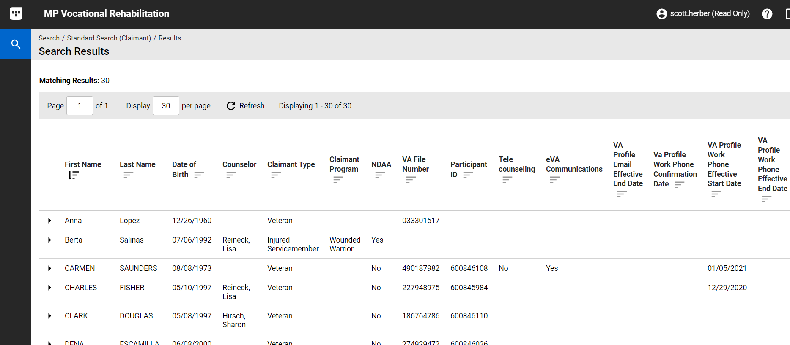
Training Environment

Slide 33
VR&E CMS Overview

Slide 34
PIV Single Sign-On Capability

Slide 35
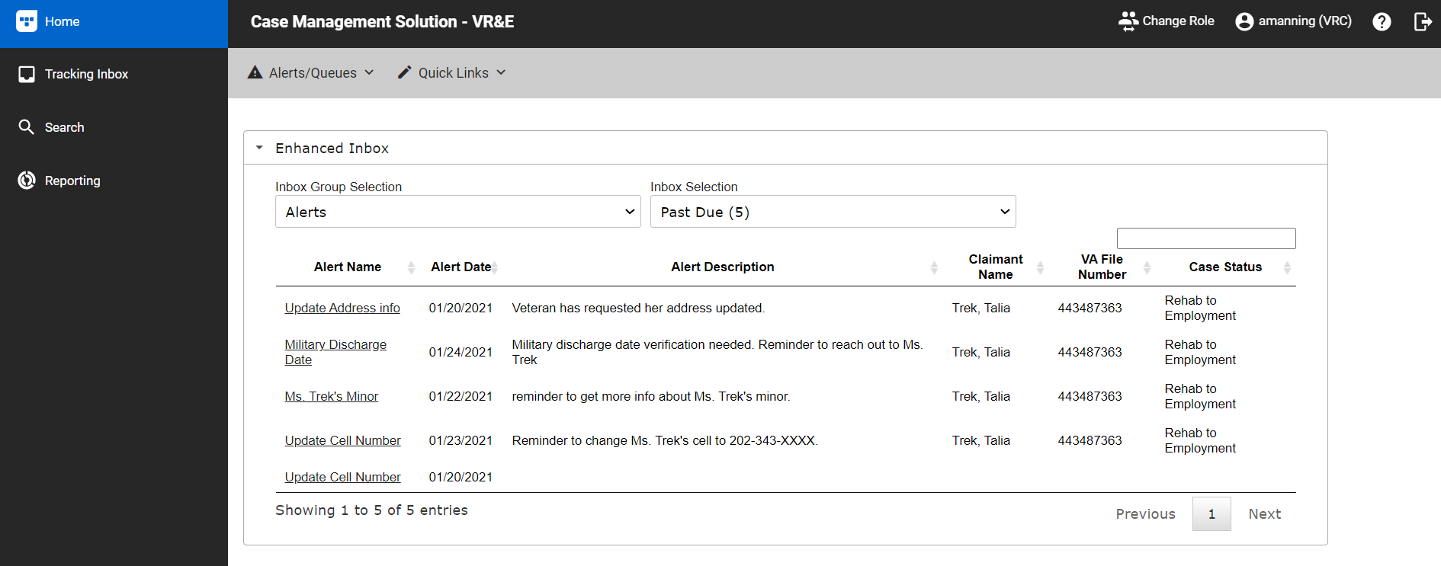
CMS Dashboard

Slide 36
Workflows
Blue = Previous Status
Gray = N/A
Green = Current Status
CMS comprises streamlined workflows and automations that allow the user to quickly find the status and locate the history of the current Case, Application, and Award. Each status is color-coded to indicate the current or past status.

Slide 37
Event
An Event is the action to transition between statuses within a Case.
Each page will have an Event Information Section in which you can create a New Event.

Slide 38
Event Listing
On the Event Listing page, you can view the history of all the actions that occurred on the various case statuses within CMS.
The information is sorted in chronological order by default for easy viewing. You can sort by the column headings (e.g., Event Category, Event) by ascending or descending order

Slide 39
Breadcrumbs

Slide 40
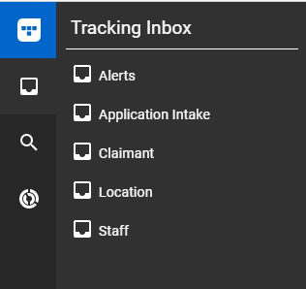
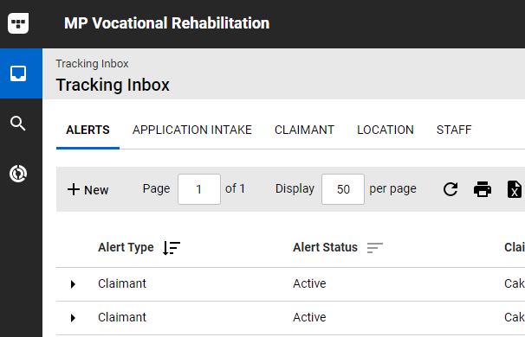
Tracking Inbox Menu
Tracking Inbox: Enables users (except Read Only) to quickly navigate to separate pages (i.e., Submenus) within the system to manage the following:
Claimants
Staff (self)
Tracking Inbox options are based on your role.

Slide 41
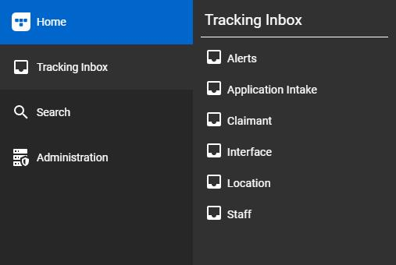
Alerts Submenu
The Alerts submenu will take you to the Alerts page that shows specific alerts associated with your account. The following alerts are available:
User Alerts
Claimant Alerts
System Alerts
You can also create Manual Alerts to find and identify specific information.

Slide 42
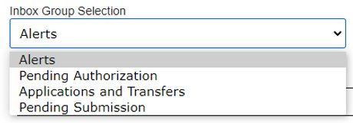
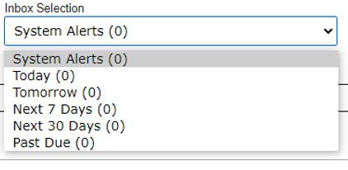
Alerts/Queues
Alerts are notifications or reminders of tasks that need to be completed in CMS.

Slide 43
Application Intake Submenu
The Application Intake submenu will take you to the Application Page. The application page displays:
All the applications for the assigned RO, electronic and manual
Options for creating new applications for manual entries

Slide 44
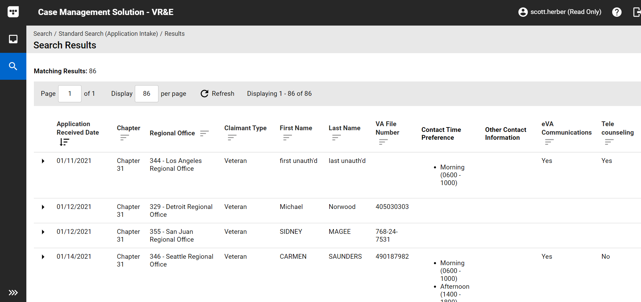
Application Intake (Results)

Slide 45
Application Intake (Processing)

Slide 46
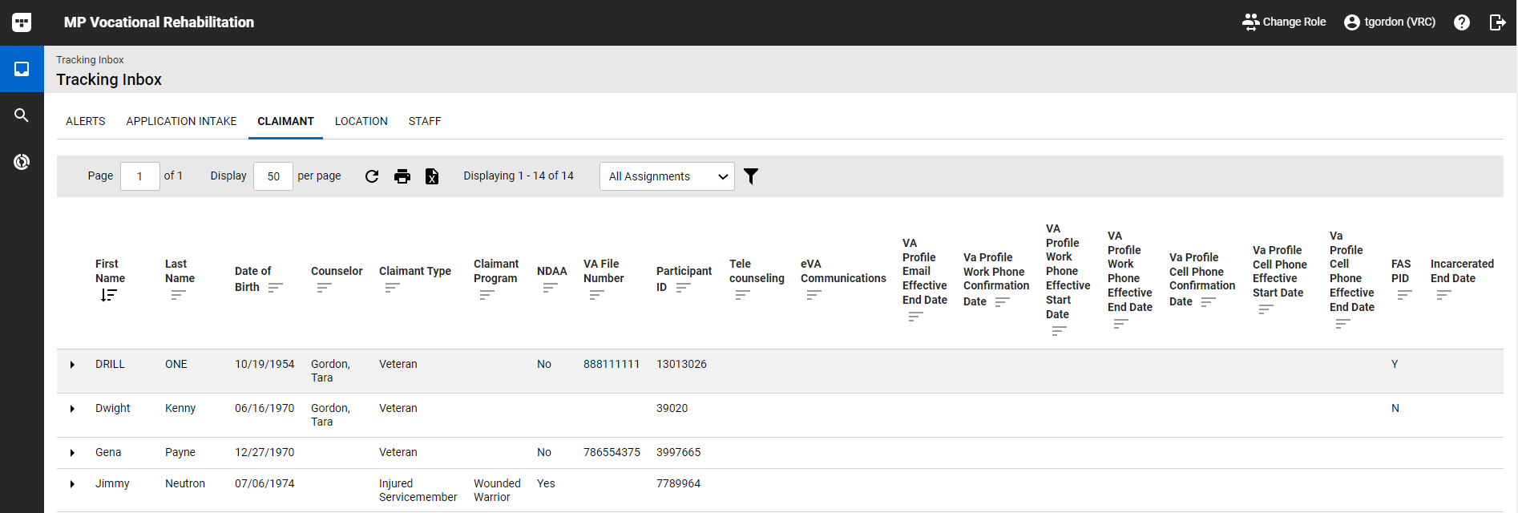
Claimant Submenu
The Claimant submenu will take you to the Claimant Page that will show all claimants assigned to you.

Slide 47
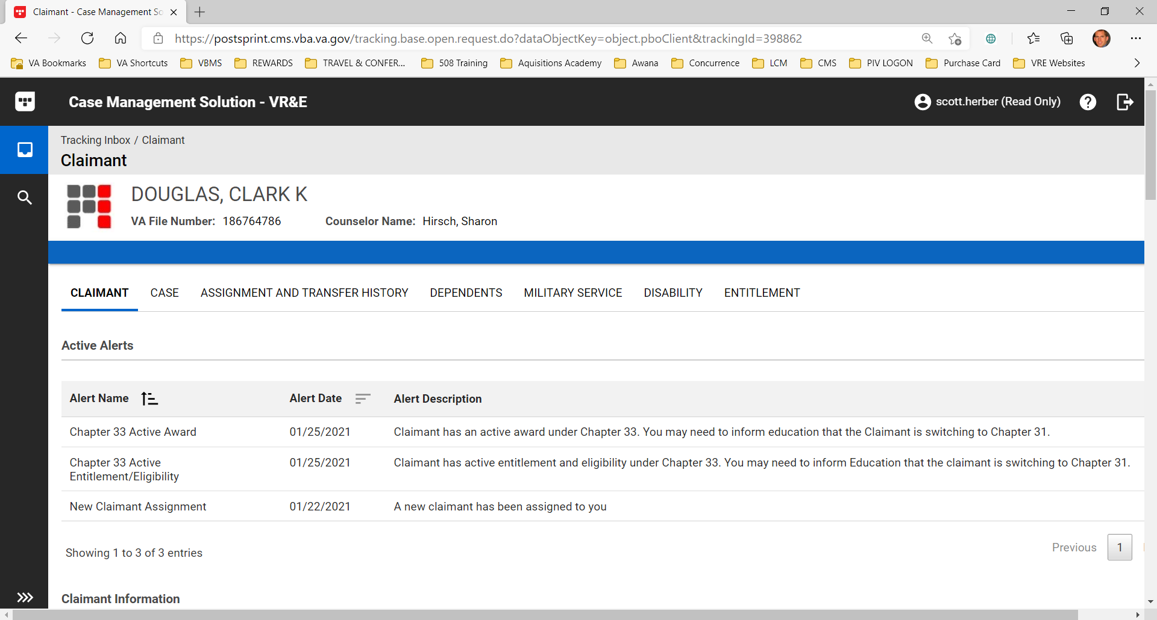
Claimant Submenu

Slide 48
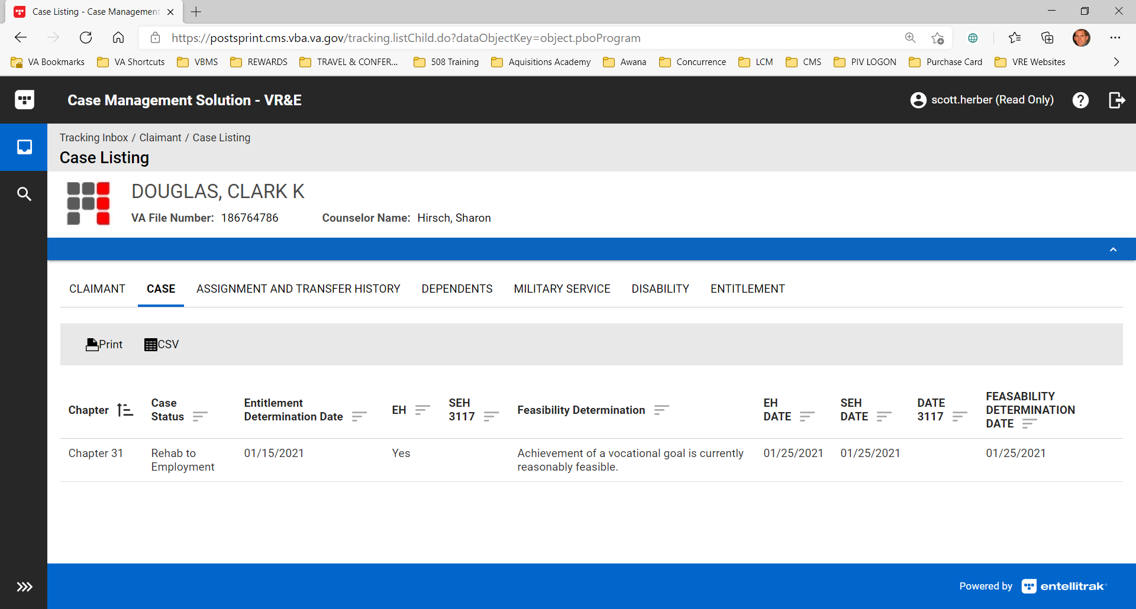
Claimant (Case)

Slide 49
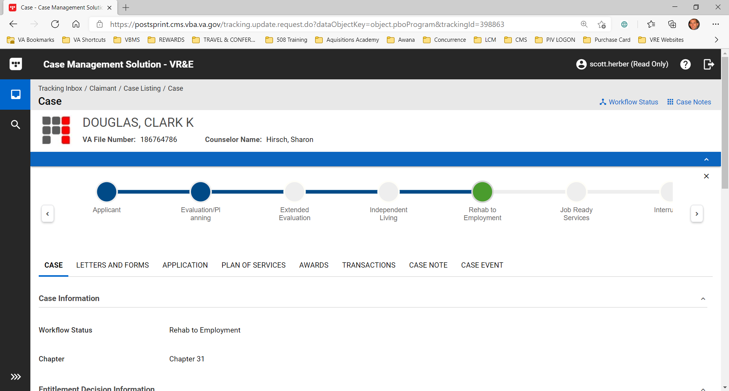
Claimant (Case)

Slide 50
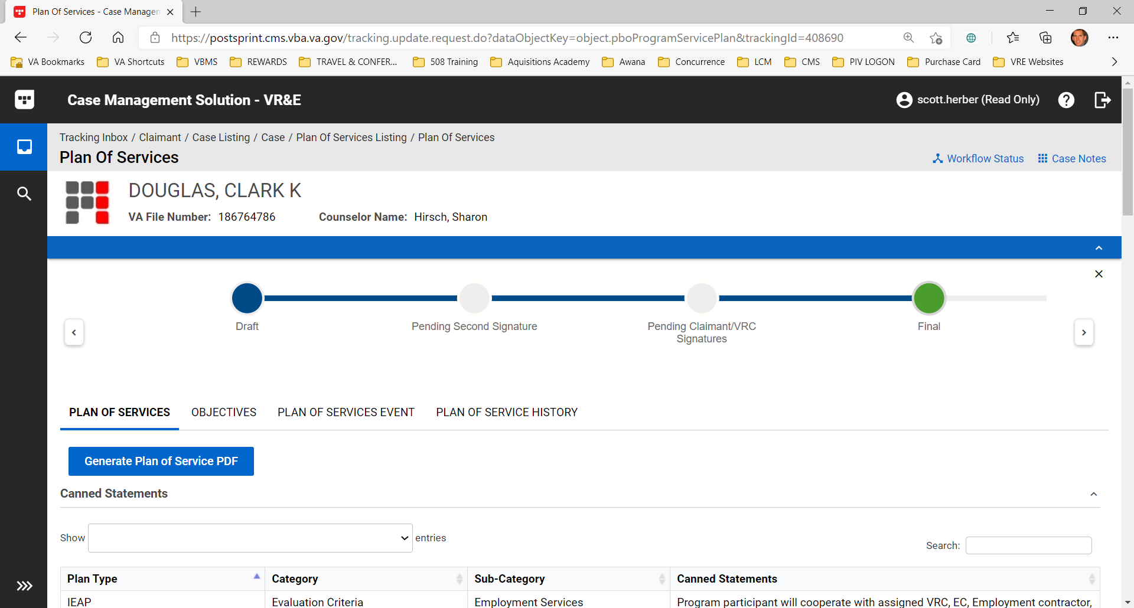
Claimant (Plan of Services)

Slide 51
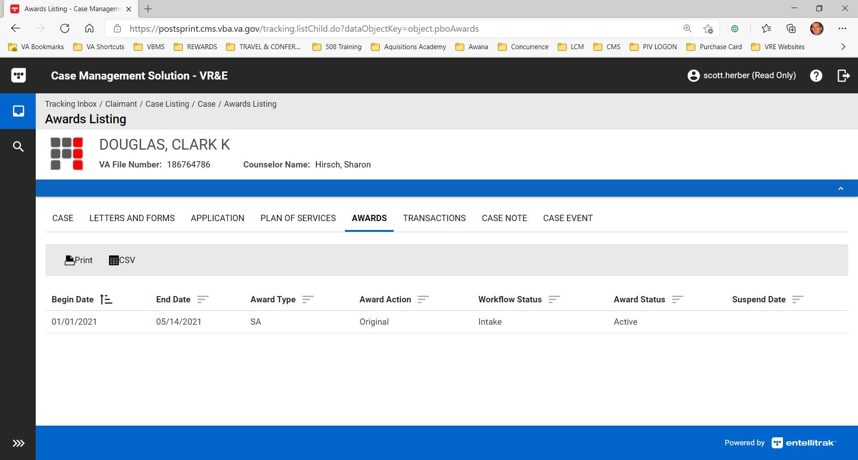
Claimant (Awards)

Slide 52
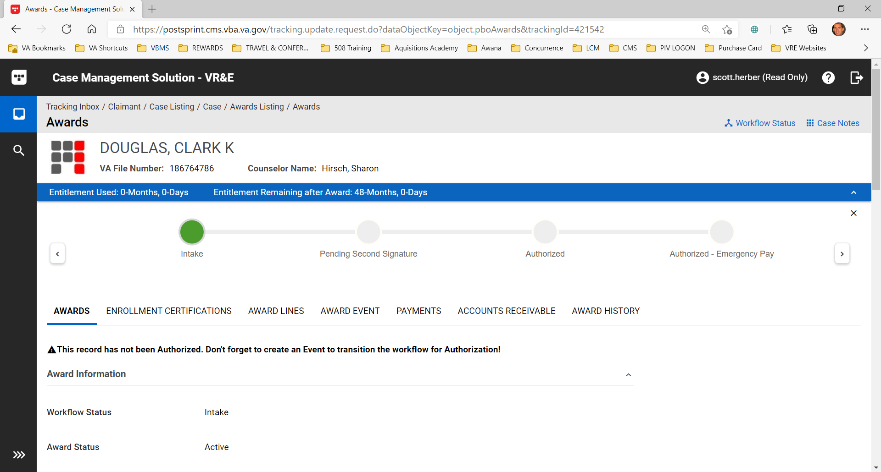
Claimant (Awards)

Slide 53
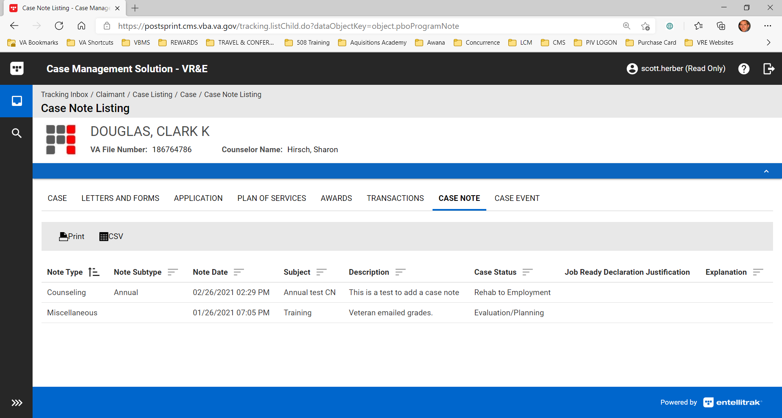
Claimant (Case Note)

Slide 54
VR&E CMS Demonstration

Slide 55
VR&E CMS POCs:
Scott Herber, Dale Sagotsky and Tyechia Brown
Training Specialists, VR&E Service
Notes:
The VR&E Service Training Team is here to answer your questions and provide any necessary assistance. Please consider reaching out to myself, Dale and Tyechia if you have any unmet training needs related to CMS. We also ask that if you require any special assistance or accommodations for this event, please let us know so that we can make the right arrangements.
I am going to pause now to allow time for you to ask your questions and to see if there are any items in the chat area that I may have not addressed.
We are all very excited to be part of this journey. It has been long coming…but know it was well worth the wait. CMS has so much to offer. Digital enhancements. Increased transparency. Cloud based. Streamlined workflows. Automation. Systems integration. Alerts. …and did I mention automation!! We are about to step out of that 1997 Honda Civic and into the 2021 Mercedes.
I can’t end the call without first thanking you again for your assistance with making this pilot, testing and deployment of the MVP possible. Thanks to the Cleveland RO. Thank you to all the CMAs that can join us. Thanks to the many District Training Champions. Thanks to all the VR&E Service employees. Thanks to our Executive Director and Assistant directors for helping to lead this endeavor. Thanks to the implementation team, and specifically Alison Rosen and Jessica Bland for leading the development of this system. On behalf of the entire VR&E Service office and all of us here in training headquarters, thanks for joining us today for today’s meeting and we look forward to the training and many years ahead of working together in this new system. Thank you and please have a good rest of your day.

Slide 56
Questions/Discussion
Next NMT Teams Sessions:
Global Perspectives: Education Service
Tuesday, March 16, 2021 @ 11-12:30 PM ET
Global Perspective: Compensation Service
Tuesday, March 23, 2021 @ 11-12:30 PM ET
Global Perspective: Transition and Economic Development
Tuesday, March 30, 2021 @ 11-12:30 PM ET
TMS #4551725
e-VA and CMS
Notes:
Any questions.
TMS Info: Please complete the feedback survey.

