Slide 1

Legacy Appeals:
DRO Review Process
Office of Administrative Review
December 2020
Notes:
Instructor Notes:
This course teaches learners about Decision Review Officers (DROs) and their authority to review, complete, and make decisions regarding appellate issues.

Slide 2
Lesson Objectives
Define the duties of the DRO
Identify issues under the jurisdiction of the DRO
Understand the DRO's decisional authority and limits of authority
Understand de novo review and what the review consists of
Describe the purpose and requirements of informal conferences
Detail the different DRO decisions made on appealed issues
Notes:
Instructor Notes:
At the end of this training, learners will be able to:
Define the duties of the DRO
Identify issues under the jurisdiction of the DRO
Understand the DRO's decisional authority and limits of authority
Understand de novo review and what the review consists of
Describe the purpose and requirements of informal conferences
Detail the different DRO decisions made on appealed issues

Slide 3
Appeals Modernization Act (AMA)
PL 115-55, Veterans Appeals Improvement and Modernization Act of 2017 went into effect on February 19, 2019
Claimants who received a decision notice
  PRIOR to the effective date may file a legacy appeal with the agency of original jurisdiction (AOJ)
  ON or AFTER the effective date may file an appeal directly with the Board of Veterans’ Appeals (Board) under the new appeal system
Notes:
Learning Objective: N/A
Instructor Notes:
VA amended its claims adjudication, appeals, and Board of Veterans’ Appeals (BVA, or Board) regulations with the final rule, Public Law (PL) 115-55, Veterans Appeals Improvement and Modernization Act of 2017, also called “AMA.” The President signed the law on August 23, 2017, and it became effective on February 19, 2019.
AMA contains numerous provisions including:
changes to decision notices
new decision review processes, including higher-level reviews and supplemental claims, and
new options available at the Board of Veterans’ Appeals.
Under this rule, VA amended the procedures for appeals of VA decisions on claims for benefits, creating a new, modernized review system. Disagreements with VA decisions on or after the effective date (February 19, 2019), or in situations in which a claimant elected to opt-in to the new review system, are processed in the modernized review system.

Slide 4
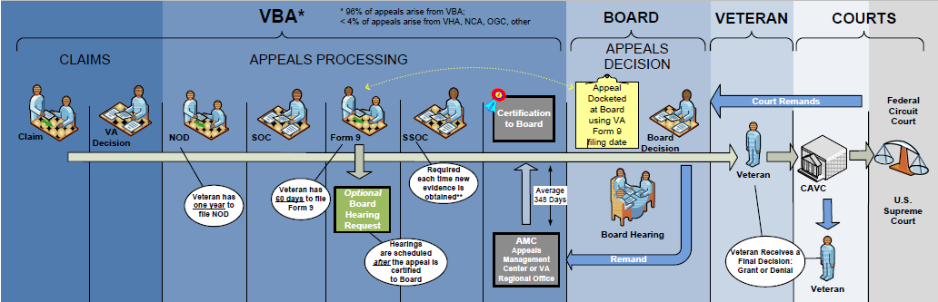
Legacy Appeal Process: DRO Jurisdiction
A DRO is a senior technical expert responsible for holding post-decisional hearings and processing appeals.
Notes:
Learning Objective: Define the duties of the DRO
Instructor Notes:
This graphic shows the entirety of the legacy appeals system. The red box identifies the appeals processing stages that a Decision Review Officer (DRO) has jurisdiction and authority to be involved in.
A DRO is a senior technical expert who is responsible for holding post-decisional hearings and processing appeals. The DRO may have jurisdiction of any legacy appeal.
*Note* - The graphic on this slide shows how the Appeals Management Center (AMC) or the VA Regional Office is responsible for conducting legacy appeals work and certifying appeals to the Board. Please note that effective January 4, 2017, VBA Letter 20-17-02, Realignment of Appeals Policy and Operational Control to the Appeals Management Office, realigned appeals and decision review activities to the newly established Appeals Management Office (AMO). Furthermore, effective October 1, 2018, AMO established three Decision Review Operations Centers (DROCs) under VBA Letter 20-18-05, Decision Review Operations Centers. Per this new guidance, the AMC was renamed to the Washington DC Decision Review Operations Center (DC DROC). Finally, effective July 2020, AMO was renamed to Office of Administrative Review (OAR).

Slide 5
DRO Duties, Jurisdiction and Authority

Slide 6
DRO Duties
Contacts appellants and representatives
Holds informal conferences and formal hearings
Evaluates evidence of record
Decides disagreements based on entire evidentiary record
Issues SOC/SSOCs
Certifies and transfers appeals to BVA
Participates in employee development
Notes:
Learning Objective: Define the duties of the DRO
Instructor Notes:
Makes direct contact with appellants and their representatives to include holding informal conferences and formal hearings
Evaluates the evidence of record, including the need for additional evidence as a result of information obtained during the conference or hearing
Decides disagreements based on the entire evidentiary record
Issues SOC/SSOCs, certifies, and coordinates the transfer of appeals to BVA
Plays a central role in employee development, including
mentoring new employees, such as appeals RVSRs
participating in the training of RVSRs
providing feedback to OAR, Compensation Service, or Pension and Fiduciary (P&F) Service managers at all levels

Slide 7
DRO Jurisdiction
De novo review
Limited jurisdiction of rating issues raised during informal conferences or formal hearings
Downstream issues raised from favorable appeal decisions
  Disability evaluation
  Effective date
  Any inferred or ancillary issues
Notes:
Learning Objective: Identify issues under the jurisdiction of the DRO
Instructor Notes:
The DRO has:
de novo review jurisdiction over only legacy appeals governed by 38 CFR Part 3 and 38 CFR Part 4
limited jurisdiction over a rating issue raised during an informal conference or formal hearing, provided the issue was part of the rating decision that is subject of the hearing
When a DRO issues a favorable decision on an appealed issue, the DRO assumes jurisdiction over and decides any downstream issues, including:
disability evaluation
effective date, and
any inferred or ancillary issues that are encompassed by that favorable decision.
Example of downstream issue: The appeal decision maker is reviewing medical evidence in support of the appeal on the Veteran’s SC neurological disability and discovers that it now causes loss of use. The appeal decision must include a decision on any ancillary benefits to which the Veteran is entitled, such as SMC and auto grant.

Slide 8
Issues Not Under DRO Jurisdiction
Appeals on rating decisions made by the DRO him/herself
Appeals filed after February 19, 2019 under modernized review system
Committee on Waivers and Compromises (COWC) issues
Loan guaranty
Insurance
Hearing requests concerning the denial of benefits from a medical determination rendered by a VA medical authority
Notes:
Learning Objective: Identify issues under the jurisdiction of the DRO
Instructor Notes:
The DRO does not have jurisdiction over:
an appeal on a rating decision made by the DRO him/herself
Disagreements filed on or after February 19, 2019, to which the modernized review system applies
Committee on Waivers and Compromises (COWC) issues
loan guaranty
insurance, and
hearing requests concerning the denial of benefits from a medical determination rendered by a VA medical activity for:
Clothing allowance
Automobile and adaptive equipment, and
Specially adapted housing.

Slide 9
DRO Decisional Authority
Amend, reverse, or uphold decision based on
  de novo review
  new evidence
Single signature of clear and unmistakable errors (CUEs) that are not adverse actions
DROs cannot
  participate in a hearing if he or she participated in the decision under appeal
  recommend a change based on de novo review of a BVA decision
  bargain to withdraw a claim or take action in exchange for the grant of a benefit
Notes:
Learning Objective: Understand the DRO's decisional authority and limits of authority
Instructor Notes:
The DRO may:
amend, reverse, or modify a decision based on de novo review, new evidence, or CUE, and
exercise single signature CUE authority on decisions that do not involve reduction of evaluation or severance of service connection.
The DRO may not:
participate in a formal hearing if he/she participated in the decision now under appeal
recommend based on de novo review of a BVA decision
Bargain with an appellant or their representative in exchange for withdrawal of an appeal

Slide 10
De Novo Review

Slide 11
Right to De Novo Review
Right to de novo review if NOD filed timely, and either requests review
  at time of NOD submission, or
  within 60 days of the date VA sends notice of right to de novo review
60-day time limit cannot be extended
Can only have one de novo review of an issue
Notes:
Learning Objective: Understand de novo review and what the review consists of
Instructor Notes:
An appellant has a right to de novo review of his/her claim if he/she files a timely NOD with the decision on a benefit claim, and either
requests de novo review at the time of submission of NOD, or
requests de novo review within 60 days of the date VA sends the notice of the right to de novo review.
Notes:
The 60-day time limit cannot be extended.
An appellant cannot have more than one de novo review of the issue on appeal.

Slide 12
Conducting the Review
Individual who did not participate in original decision
Conducted by DRO or higher (cannot be delegated lower):
  DROCM
  VSCM
  PMCM
Visiting DRO
Notes:
Learning Objective: Understand de novo review and what the review consists of
Instructor Notes:
Only an individual who did not participate in the original decision being appealed may conduct the de novo review.
At VA discretion, the de novo review is conducted by the DRO or by one of the following individuals with higher authority
DROCM
VSCM, or
PMCM.
The DROCM, VSCM, or PMCM at each RO/DROC has the authority to grant the issue on appeal based on a de novo review or CUE. They are not permitted to delegate this authority to anyone else, other than to a Visiting DRO.
If the DRO at the host RO participated in the decision being reviewed, a visiting DRO may be requested to hold hearings or conduct de novo review. The visiting DRO will render a decision in such claims, but not maintain jurisdiction of the appeal.

Slide 13
De Novo Review
New and complete review
No deference to decision being appealed
Result may be new decision or no change
Review only of decision that appellant has expressed disagreement with
Reverse or revise other decisions, even if disadvantageous (requires CUE)
Notes:
Learning Objective: Understand de novo review and what the review consists of
Instructor Notes:
The de novo review is a new and complete review of the appealed issue with no deference given to the decision being appealed. The review may lead to a new decision which may be a full grant, partial grant, CUE, or no change.
The review will encompass only the decision with which the appellant has expressed disagreement with the NOD.
During de novo review, the reviewer may also reverse or revise (even if disadvantageous to the claimant) prior decisions of an agency of original jurisdiction (including the decision being reviewed or any prior decision that has become final due to failure to timely appeal) on the grounds of CUE.

Slide 14
Informal Conference

Slide 15
Informal Conference
Scheduled and conducted at DRO discretion
All parties understand issues pending review
Clarify issues as needed
Provide explanations regarding decision
  rating
  which evidence was considered
  how evidence was considered
Identify additional information
Notes:
Learning Objective: Describe the purpose and requirements of informal conferences
Instructor Notes:
Informal conferences are scheduled and conducted at the discretion of the DRO.
The purpose of the informal conference is to:
ensure all parties understand the issues pending review
clarify the issues the appellant wishes to appeal
provide explanations regarding
The rating decision(s)
Which evidence was considered, and
How the evidence was considered
identify additional sources of pertinent information to include introduction of new evidence if available.

Slide 16
Conducting the Conference
Conference location
  in person
  by telephone
  videoconference
Attendance
  appellant
  his/her representative
Reminders for attorneys
Notes:
Learning Objective: Describe the purpose and requirements of informal conferences
Instructor Notes:
Conduct an informal conference
in person at a VA facility
of jurisdiction, or
nearest to the appellant’s residence
by telephone, or
by videoconference.
Informal conferences may be conducted in work areas as long as all participants agree on the location.
The appellant and his/her representative may attend an informal conference at their discretion.
Note: If the appellant’s representative is an attorney, emphasize
the informality of the conference
that rules of evidence do not apply, and
that leading questions are permissible.

Slide 17
Informal Conference Report
Document informal conference in report
Describe in the report
  all issues in detail
  specific additional evidence required
  summary of discussion during the conference
  course of action agreed upon
Retain in claims folder
Consider when making a new decision
Notes:
Learning Objective: Describe the purpose and requirements of informal conferences
Instructor Notes:
Use the informal conference report to:
document the informal conference
describe all the issues in detail
document specific additional evidence required, and
document the course of action agreed upon by the parties.
The informal conference report should be retained in the claims folder or electronic file. Consider the information recorded in the Informal Conference Report when making a new decision.

Slide 18
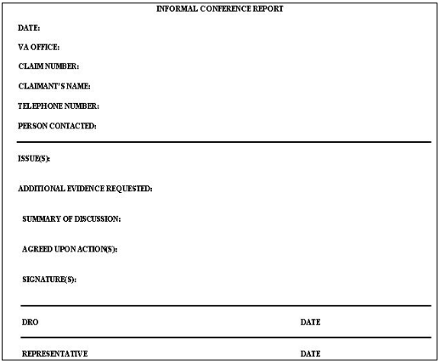
Report Example
Notes:
Learning Objective: Describe the purpose and requirements of informal conferences
Instructor Notes:
Review example displayed on screen.

Slide 19
Making a Decision

Slide 20
Awarding Full Benefits
If all benefits sought on appeal are awarded for entire period
  consider appeal resolved
  advise appellant and representative
  update VACOLS
“Full grant” depends on type of issue
  initial service-connection: full grant when disability granted
  increased evaluation: full grant when maximum allowed granted
Include statement in decision notice that the decision
  is an award of all benefits sought on appeal, and
  the appeal is considered satisfied in full
Notes:
Learning Objective: Detail the different DRO decisions made on appealed issues
Instructor Notes:
If all benefits sought are awarded for the entire period covered by the appeal
consider the appeal resolved for that issue
advise the appellant and representative, if applicable, that the appeal is considered resolved, and
update the Veterans Appeals Control and Locator System (VACOLS) record according to the table below.
“Full grant” is determined depending on the type of issue under appeal.
If the issue is initial service-connection (SC), then a full grant occurs when SC for the disability is granted.
If the issue is the evaluation of an already SC disability, a full grant occurs when the maximum benefit allowed by law and regulation for that specific issue is granted for the entire period under appeal.
The exception to this is when a Veteran submits an appeal for a specific disability evaluation other than the schedular maximum, an award of the specifically requested evaluation for the entire period under appeal is considered a full grant.
The decision notice for a full grant must be comprehensive and include a statement that the decision is an award of all benefits sought on appeal for that tissue, and the appeal is considered satisfied in full for that issue.

Slide 21
Awarding Partial Benefits
When maximum schedular benefit allowed is not granted for entire period
When awarding partial benefits, send the appellant
  the new rating decision
  statement of the case (SOC) or supplemental statement of the case (SSOC), or, development as needed
  appeals satisfaction notice
  notice of appeal rights
Notes:
Learning Objective: Detail the different DRO decisions made on appealed issues
Instructor Notes:
A partial grant of an issue on appeal occurs when the maximum schedular benefit allowed by law and regulation for the issue(s) under appeal is not granted for the entire period under appeal. *Remember, if the issue under appeal is initial SC, a partial grant cannot occur; the decision rendered must either involve a full grant or denial of the issue under appeal.
When awarding partial benefits, the DRO must send the appellant:
The new rating decision
A decision that partially awards the benefit sought requires a statement of the case (SOC) or supplemental statement of the case (SSOC) unless the appellant states they are satisfied with the partial award.
For any issues that cannot be fully granted or denied, the DRO should initiate required development action
Notice of appeals rights

Slide 22
Upholding Prior Decision
Confirm previous decision on NOD, send
  an SOC
  VA Form 9
  explanation of any applicable time limit to respond
Confirm previous decision on SOC, send
  an SSOC
  VA Form 9
  explanation of any applicable time limit to respond
Notes:
Learning Objective: Detail the different DRO decisions made on appealed issues
Instructor Notes:
If the DRO confirms the previous decision, he/she sends an SOC
confirming the decision on appeal, and
explaining the reasons and bases for the VA decision, and
provides VA Form 9, Appeal to Board of Veterans’ Appeals, to the appellant.
If confirming the previous decision on appeal after an SOC has been sent, send the appellant:
an SSOC
confirming the decision on appeal, and
discussing any changes and additions to the information provided in the prior SOC or SSOCs
a VA Form 9, if still required, and
an explanation of any applicable time limit to respond.

Slide 23

Questions?
DRO Duties, Jurisdiction and Authority
De Novo Review
Informal Conference
Making a Decision
23
Notes:
As we stated in the beginning of our training today, the lesson objectives were to:
Define the duties of the DRO
Identify issues under the jurisdiction of the DRO
Understand the DRO's decisional authority and limits of authority
Understand de novo review and what the review consists of
Describe the purpose and requirements of informal conferences
Detail the different DRO decisions made on appealed issues
We accomplished each of these objectives by discussing them within the lesson topics:
DRO Duties, Jurisdiction and Authority
De Novo Review
Informal Conference
Making a Decision
What additional questions do you have?

Slide 24
TMS Credit
An assessment and satisfaction survey have been assigned to you in TMS
Be sure to complete the survey and assessment to receive credit for this training
Notes:
Instructor Notes:
An assessment and satisfaction survey have been assigned to you in TMS. Completing both will allow you to receive credit for this training.

