Slide 1
FOR TMS TRAINING CREDIT
To obtain training credit in TMS, there is no need to review these slides at this time – immediately close this box by using your mouse to select the “X” in the upper right-hand corner; select the “Return to Content Structure” button; and, select the next link (Video) to view the edited audio recording of the Quality Call along with the Call Bulletin
These slides are included here only in case you want to use them later for training purposes or reference
These are the same slides that are shown in the audio-video recording

Slide 2
February 12, 2020
Compensation Service
Quality Call

Slide 3
Welcome to the February 2020 Quality Call
Bonnie Kirby
Senior Quality Review Specialist
Quality Review Team
Quality Assurance

Slide 4
Agenda
What’s New in M21-1
Proper Placement of Date Stamps
Active Service Pay Final Rule
Restless Leg Syndrome
Q-Tips:
BVA and the Need for a VA Form 21-8940 to Grant IU
Best Practice – Exam Checklist
Who May Process an MST Claim
Proper Use of the Favorable Finding Tab in VBMS
Consolidated VSR Task Based Checklist
VSRs: The Last Line of Defense

Slide 5
What’s New in M21-1
Kim Tibbitts
Program Analyst
Procedures Maintenance Staff
Policy and Procedures

Slide 6
Revision of M21-1III.v.1.I and IV.ii.3.A
Significant changes were made to instructions in:
M21-1III.v.1.I for correcting administrative errors, and
M21-1IV.ii.3.A for correcting clear and unmistakable errors (CUEs) in rating decisions

Slide 7
Revision of M21-1III.v.1.I
New Block g in Topic 3
Includes a major procedural change: Claims processors must now give beneficiaries an opportunity to respond to a notice of proposed adverse action before preparing an administrative decision regarding an administrative error
Describes circumstances under which it is unnecessary to provide due process or prepare an administrative decision before correcting an administrative error
Contains instructions for correcting errors involving the assignment of an incorrect effective date

Slide 8
Revision of M21-1III.v.1.I (cont.)
New Block f in Topic 3
Discusses errors involving a claims processor’s entry (into the claims-processing system) of a child’s date of birth that differs from the date of birth a claimant provided

Slide 9
Revision of M21-1IV.ii.3.A
Topic 2, Block a
Consolidates the instructions from nine individual blocks in Topic 2 into a single step-action table
Contains instructions for correcting a CUE in the assignment of an effective date
Requires the rating activity to update the Codesheet of rating decisions so it reads how it should have read had there been no CUE
Requires Compensation Service review and approval of rating decisions that:
correct a CUE, and
when promulgated, will result in the creation (and possible elimination) of an overpayment that equals or exceeds $25,000

Slide 10
Revision of M21-1IV.ii.3.A
Topic 2, Block a (cont.)
While the Codesheet should be updated so it reads how it should have read had there been no CUE,
Ensure that all effective dates are properly explained within the narrative of the rating decision.
M21-1 III.iv.6.C.5.a

Slide 11
Revision of M21-1IV.ii.3.A
Topic 2, Block a (cont.)
When correction of a CUE requires the severance of service connection or a reduction in a disability evaluation, claims processors must:
correct the corporate record so it reads how it should have read had no error been made,
eliminate the resulting overpayment, and
reduce or discontinue the Veteran’s benefits effective the first of the month following a 60-day period that begins on the date VA notifies the Veteran of the decision

Slide 12
Revision of M21-1IV.ii.3.A
According to the Office of Business Process Integration (OBPI):
This issue will be remediated with the VBMS 18.1 release scheduled for early March
In the meantime, in order to avoid an overpayment due to omnibus to the end date variance creating an overpayment, users can use Generate Award Override (GAO) as the preferred method to process these cases
The user manual on how to utilize GAO is located here:
https://vbaw.vba.va.gov/VBMS/docs/0003BF_VBMS_18_0_Awards_User_Guide_20191206.pdf

Slide 13
Revision of M21-1IV.ii.3.A (cont.)
New Block b in Topic 2
Provides instructions for handling cases in which correction of a CUE will not result in a reduction in the current or a prior combined disability evaluation

Slide 14
Revision of M21-1IV.ii.3.A (cont.)
New Block d in Topic 2
Provides instructions for handling cases in which multiple issues are awaiting a rating decision and one of the issues involves the correction of a CUE

Slide 15
Rescission of Changes to M21-1III.iii.5.L.1.b and c
Shelf Life of Information Regarding the Status of Dependents
Changes to Blocks b and c that were published in January 2020 reduced the shelf life from eight years to three years to coincide with an increase in the frequency with which VA will begin sending VA Form 21-0538, Mandatory Status of Dependents, to Veterans for completion
Changes have been rescinded until the Hines Information Technology Center finishes updating its system to facilitate the release of VA Form 21-0538 according to the new schedule

Slide 16
Proper Placement of Date Stamps
Angela Moritz
Program Analyst
Procedures Maintenance Staff
Policy and Procedures

Slide 17
Proper Placement of Date Stamps
Date stamp reminders (M21-1 III.ii.1.C.1.c)
Place
on front of documents
bottom, right corner, and
first page of
VA forms
claimant correspondence, and
cover sheets from representatives
DO NOT obscure data (images, text, writing, etc)
Date stamp first and last page of all medical evidence
Do not separate batches of incoming mail

Slide 18
Active Service Pay Final Rule
Olumayowa Famakinwa
VASRD Implementation Lead
Regulations and Forms
Policy and Procedures

Slide 19
Active Service Pay: Revisions to 38 CFR §§ 3.103 and 3.654
Purpose:
Allow benefits to be suspended (for Drill Pay) or discontinued (for Active Service) based on notice from DoD without due process.* This change applies to compensation benefits only
Allow benefits to be reinstated (after discharge from Active Service) based on notice from DoD without a claim from the Veteran
Clarify how VA adjudicates benefit adjustments based on receipt of active service pay for certain types of service
*Exception: Due process is still provided when a Veteran’s monthly disability compensation exceeds the monthly active service pay rate, unless notice of receipt of active service pay comes from Veteran.

Slide 20
Active Service Pay: Revisions to 38 CFR §§ 3.103 and 3.654
Benefits:
Reduce/eliminate overpayments associated with adjustments based on receipt of active service pay
Reduce amount of notifications and correspondences sent to/received from Veterans concerning award adjustments based on receipt of active service pay
Veterans retain the right to request a decision review of suspension, discontinuance, or reinstatement of VA benefits

Slide 21
Restless Leg Syndrome
David Eckert
Policy Analyst
Regulations and Forms
Policy and Procedures

Slide 22
Restless Leg Syndrome
Restless leg syndrome (RLS) is a neurological disorder characterized by throbbing, pulling, creeping, or other unpleasant sensations in the legs and an uncontrollable, and sometimes overwhelming, urge to move them. Symptoms occur primarily at night when a person is relaxing or at rest and can increase in severity during the night.
RLS should be rated under the appropriate peripheral neuropathy code(s) that most closely approximates the area of the extremity or extremities affected by the distribution of the symptoms.

Slide 23
Q-Tips
David Hannigan
Quality Assurance Officer
Quality Assurance

Slide 24
Fun way to share ideas in a simple tip format
Your Q-Tips are welcome and requested
We will help each other by sharing knowledge
Send your ideas to David Hannigan
david.hannigan@va.gov

Slide 25
Q-Tip #1: BVA & Reasonably Raised Claim for IU
A decision from BVA to reasonably raise and grant IU should be effectuated, even if the claims folder does not contain a VAF 21-8940
Roberson v. Principi: VAF 21-8940 is a formality
However, M21-1 IV.ii.2.F procedures regarding reasonably raising claims for IU are binding to decisions made at all regional offices
Implement grants of IU without development for a VAF 21-8940 only in cases when the BVA decision grants IU

Slide 26
Q-Tip #2: Best Practice – Use of Exam Checklist
A new Exam Checklist (Supplemental Development Checklist) has been added to the CS Intranet Quality Assurance Office Best Practices Page
Use of this checklist is highly encouraged for each claim because:
It will be used throughout the life of the claim
It includes important sections on the need for and scheduling exams
Development activity will be able to easily see what has been done

Slide 27
Q-Tip #3
Esther Adefope
Chief
Program Review – STAR Staff
Quality Assurance

Slide 28
Q-Tip #3: Who May Process an MST Claim
The only claims processors that may develop and adjudicate Military Sexual Trauma (MST) claims are those that have:
Completed the requisite MST training
AND
Been locally deemed as a Subject Matter Expert (SME) on MST
* M21-1 IV.ii.1.D.5.l and M21-1 III.iv.4.O.3.g

Slide 29
Favorable Findings
Jennifer Monville
Rating Quality Review Specialist (RQRS)
VARO Nashville

Slide 30
References
38 CFR 3.103(f)(4)
38 CFR 3.104(c)
38 CFR 20.801
M21-1 III.iv.6.C.5.f
M21-1 III.iv.2.B.5
VBMS Job Aid – VBMS-Rating: Favorable Findings
TMS lesson 4491280 VA AMA Improved Decisions Notices-Rating Decisions

Slide 31
What IS a Favorable Finding?
38 CFR 3.104(c) defines Favorable Findings (FF):
A finding means a conclusion either on a question of fact or on an application of law to facts made by an adjudicator concerning the issue(s) under review
Favorable findings relate to a material element that would be required to grant the benefit sought and should be specific

Slide 32
What IS a Favorable Finding?
To dissect the language of 38 CFR 3.104(c), a favorable finding is an element of the claim that has been overcome
A grant of compensation benefits has certain evidentiary hurdles (elements) that must be met. A favorable finding tells the veteran which of those elements that we have “accepted”
Those elements (findings) are binding on all future VA adjudicators, unless rebutted by evidence showing a clear and unmistakable error in the favorable finding. A decision to overturn a previous favorable finding does not require additional approval signatures

Slide 33
Example of a Favorable Finding
A claim for direct service connection (38 CFR 3.303) requires three elements to grant SC. (in-service event, current diagnosis, nexus/link between the two). If all three elements are met, we grant the benefit
However, if all three are not met, and a denial is in order, we must advise the veteran specifically of the elements that are FAVORABLE to the claim
These are examples of FF that have been overcome.
Noise exposure due to MOS (overcomes the “in service event” element)
Current diagnosis of hearing loss (overcomes the “current disability” element)

Slide 34
Documenting Favorable Findings
When documenting Favorable Findings in a rating decision,
Clearly identify the material element found to be met such as
Incurrence
Nexus
Diagnosis
Presumptions (i.e. exposure to herbicides, chemical, radiation, etc.)
Briefly state the evidence used to support the finding (only include the most relevant and recent evidence of record)

Slide 35
How are Favorable Findings actually documented on a rating decision?
Utilize the Favorable Findings tab in VBMS-R (see the Job Aid for visual examples)
The finding must be specific by using a combination of the pre-populated VBMS-R text, supplemented with appropriate free text
Favorable findings identified in this decision:
The evidence shows that a qualifying event, injury or disease had its onset during your service. Your MOS of Infantryman confirms a high probability of noise exposure.
You have been diagnosed with a disability. VA audio exam dated January 11, 2020 diagnosed hearing loss at VA levels.

Slide 36
What Favorable Findings are NOT
Favorable findings are NOT discussions of the facts of the case (even facts that appear favorable, such as a private medical opinion, if that fact is not accepted as a conceded element)
Favorable findings are NOT negative findings
Examples of what would NOT be a favorable finding:
The STRs do not show evidence of your claimed condition.
The private medical opinion provided a nexus, but we are not accepting that nexus as it does not include rationale, and the VA medical opinion does

Slide 37
Where to discuss evidence?
A discussion of the weight and probative value of evidence is required in a rating, but is NOT to be done in the favorable findings tab/area of the rating.
Discussion of the evidence is done in the narrative section of the rating decision and does NOT belong in the favorable findings tab or favorable findings section of the rating if the outcome does not overcome an element of the claim.

Slide 38
Examples of Common Favorable Findings
Denial of PTSD for no dx when a fear-based stressor exists
A stressor of fear of military or terroristic activity is conceded based on evidence showing service in Iraq in 2004.
Denial of left ankle not secondary to right ankle (negative MO)
The claimed primary disability (right ankle arthritis) is service-connected.
The evidence shows a current diagnosed disability. The VA exam diagnosed arthritis of the left ankle.
Denial under 38 CFR 4.30 when there was not a month of convalescence
You underwent surgical care for a service connected disability (right knee).

Slide 39
Consolidated VSR Task Based Checklist
Robert Johnson
Senior Quality Review Specialist
Quality Review Team
Quality Assurance

Slide 40
Pension-Specific Error Descriptors
Compensation VSR Checklist and Pension VSR Checklist were combined to promote consistent VSR quality reviews
New consolidated Checklist for use effective February 3, 2020
Pension-specific error descriptors were added to the Checklist under the relevant questions
Pension-specific error descriptors are to be used only in pension cases
If there are any questions if one of the new error descriptor applies to a case, QRT Coach should email the VACO QRT mailbox
VAVBAWAS/CO/QRT

Slide 41
The Last Line of Defense
Erin Hawkins
Consultant
Advisory and Special Review Team
Quality Assurance

Slide 42
The Last Line of Defense
The last step in a claim is promulgating the decision and sending notification
Provides the final opportunity to ensure accuracy
Results in the tangible product we provide to our Veterans and claimants
Enacts and fulfils the VA’s Vision:
To provide veterans the world-class benefits and services they have earned – and to do so by adhering to the highest standards of compassion, commitment, excellence, professionalism, integrity, accountability, and stewardship.

Slide 43
Issues Claimed and Addressed
Check that the claim was substantially complete
M21-1 I.1.B.1.b.
Verify that all issues on the rating decision were received on the proper form. Example: A decision is made on a previously denied issue that was claimed again on a VAF 21-526EZ
M21-1 III.ii.2.B.1.b, M21-1 III.ii.2.D.1.a-b
Confirm that all issues properly claimed were addressed/decided
M21-1 III.iv.6.B.1.a, M21-1 III.v.2.A.2.c.

Slide 44
The Last Line of Defense
When processing a decision on a claim, M21-1 III.v.2.A.2.c. states:
A VSR should conduct a cursory review of the rating decision, to include the codesheet, in an attempt to identify any obvious errors
Example provided of verifying that entitlement to Chapter 35 benefits is addressed when a total evaluation is granted and no future exam is required (M21-1 IX.ii.2.1)

Slide 45
3.105(e) vs 3.655(c)
Ensure the rating decision utilizes the correct the regulation and language for a reduced benefit
3.105(e): Improvement shown
3.655(c): The Veteran Failed to Report to a routine future exam
M21-1 III.iv.8.B.1.e.

Slide 46
3.105(e) vs 3.655(c)
Verify the effective date on the final rating decision
3.105(e): Improvement shown
Effective the first day of the month following the 60-day notice of the final reduction
3.655(c): The Veteran Failed to Report to a routine future exam
Effective following the 60-day due process period or date of last payment, whichever is later
M21-1 III.iv.8.B.1.e.
Final Rating
Decision
6-25-2018
Decision
Notification
6-27-2018
Effective Date
of Reduction
9-1-2018
Final Rating
Decision
6-25-2018
Decision
Notification
6-27-2018
Effective Date
of Reduction
7-1-2018

Slide 47
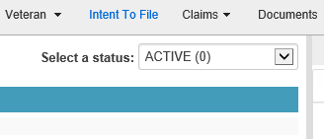
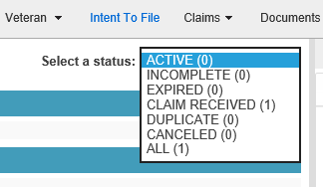
Rating Narrative Review
Check if an Intent to File should have been taken into account
M21-1 III.iv.5.C.2.
Ensure the rating decision does not only deny and defer issues
M21-1 III.iv.6.A.1.c.

Slide 48
Statutory Housebound Benefits (SMC-HB)
Statutory entitlement to Housebound benefits should be taken into consideration if the Veteran:
Has a single disability rated at 100% and
has an additional SC disability, or combination of disabilities, independently evaluated as 60-percent or more disabling or
is permanently housebound due to SC disability
Review the rating decision to determine if SMC-HB should be addressed OR proposed to be removed if the rating is a proposal to reduce and the Veteran will no longer meet the statutory criteria
M21-1 IV.ii.2.H.10.a.

Slide 49
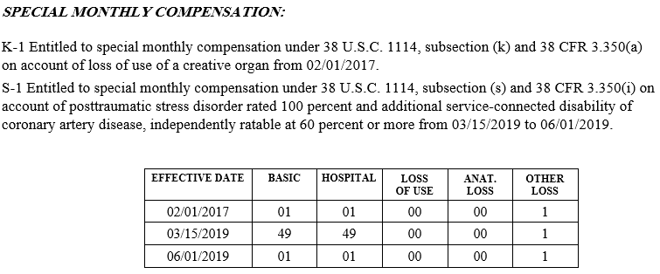
Codesheet Review
Check SMC changes to ensure they are coded correctly

Slide 50
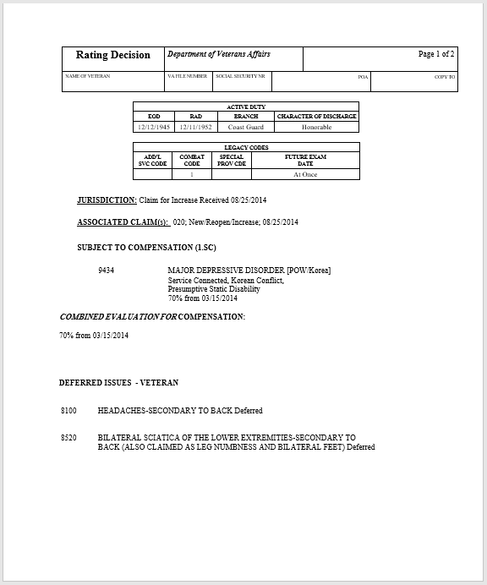
Codesheet Review
Review the codesheet for future exams and deferred Issues

Slide 51
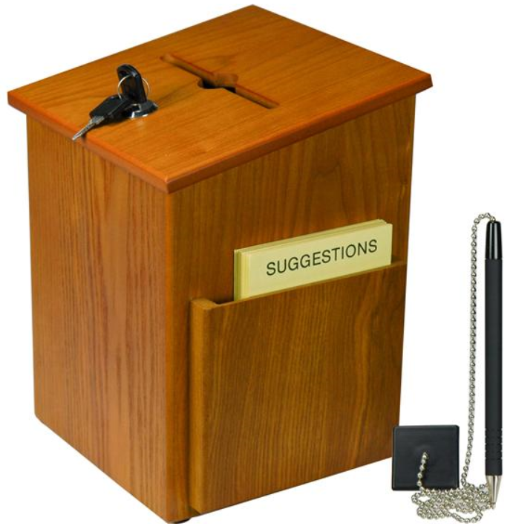
Questions – Suggestions – Next Quality Call
Presented by:
Bonnie Kirby

Slide 52
Would You Like to Present a Topic?
We are offering opportunities for RO SMEs to present topics during Compensation Service Quality Call recording sessions
Peer-to-Peer communication is optimum
Are YOU interested in presenting a topic?
Talk to your Coach or other RO management team member
If okay, have management send your name and topic to:
VAVBAWAS/CO/InternalQRS <InternalQRS.VBAVACO@va.gov>

Slide 53
Questions Relating to Today’s QC Topics
Questions on topics presented must be emailed to the Quality Call Leads at the mailbox InternalQRS.VBAVACO@va.gov
Emails must include Cc to your Coach or other RO management
Emails must contain the name of the topic(s) with your question(s)
Questions must be submitted to the mailbox by COB Friday, February 28th
Questions submitted after Feb 28th will not be accepted for inclusion in the Call Bulletin
Email questions are limited to those pertaining to only the topics presented, and responses will not be provided to any questions that are not related to the topics presented during this Quality Call
Official guidance to the questions will be posted later in the Call Bulletin

Slide 54
Do You Have Suggestions for Topics?
Please feel free to email your topic suggestions to the Quality Call Leads at the mailbox InternalQRS.VBAVACO@va.gov
In your email, be sure to include:
Cc to your Coach or other RO management
Name of the topic
Intended audience (VSR – SVSR – RVSR – DRO – AQRS – RQRS)
Applicable M21-1 and/or 38 CFR citations
Quality Call Bulletins can be found in the STAR Home Page on the Compensation Service Intranet site, TMS, and VBA Learning Catalog
Audio recordings of the Quality Calls with separate copies of the PowerPoint slides can be found in both TMS and VBA Learning Catalog

Slide 55
Next Quality Call
Quality Call recording is usually posted each month in TMS
Next Quality Call will be recorded in March

