Slide 1
Communicating to Upper Management – Part II
THIS EVENT IS BEING RECORDED
VR&E New Division Leaders Training
Briefed by: Participant Presentations
Notes:
Welcome to another session of NDLT. We will record today’s session for training and historical purposes.

Slide 2
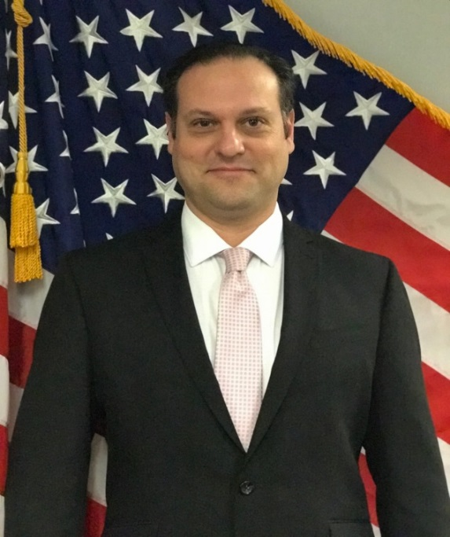
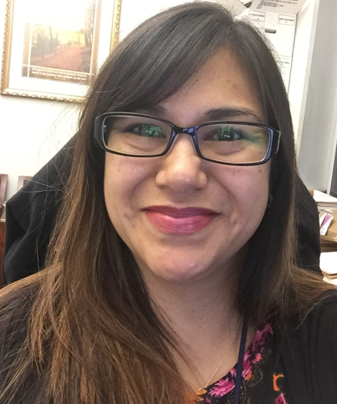
Training Team
Dale Sagotsky VR&E Training Specialist Orlando, FL
Tanya Lunn VR&E Training Specialist Orlando, FL
Notes:
Welcome back to New Division Leaders Training. Last week, you were provided a presentation from our SMEs Linda Steffensmeier and Heather Becker on Communicating with Upper Management/Briefings.

Slide 3
Activity Instructions
Director’s Brief
In your groups, each person will review their own Directors Dashboard and/or VR&E Workload Reports to identify an area of improvement
Once identified, you will consult with your team to identify solutions and an action plan to resolve the issue
Collectively you will work with your team to develop an action plan to present to your Director. Each member will have the opportunity to present. Each group will have 15 minutes to present on the three identified needs areas
In your briefing, you will develop a written paper (MS Word Doc) and/or a slide deck (PowerPoint slide) to share your Action Plan or Strategy to the Directors (submit your documents to VRENMT.VBACO@va.gov by Tuesday, January 18, 2022 @ 9:00AM ET
Note*All group members must participate in the planning meetings and have speaking parts
Notes:
You were given a group activity to complete for this week to review the Director’s Dashboard or VR&E Workload Reports and identify an area of improvement. Each will group will have 15 minutes to present on an action plan on 3 identified needs areas.

Slide 4
Groups Assignment
Group 1 | Group 2 | Group 3
Briefing Time 1/18/2022 @ 11:05 – 11:20am | Briefing Time 1/18/2022 @ 11:25am – 11:40am | Briefing Time 1/18/2022 @ 11:45am – 12:00pm
Trina Brown (VREO) | Roger Otzenberger (VREO) | Charles Curtis (VREO)
Jose “Joe” Vega (VREO) | Charles “Aaron” Wadsworth (SVRC) | Patrice Wilhite (AVREO)
David Dillon (SVRC) | Jacylou Terciano (SVRC) | Artimio Wilson (SVRC)
Notes:
There were a couple of individuals who notified me of a conflict in making today’s presentation, however, were asked to contribute to the development of the presentation. We will start with Group 1 today Joe Vega and David Dillon. Each group will have 15 minutes, then we will pause for feedback, then proceed to the next group. Group 2 will go next with Aaron and Jacylou, and finally Group 3 with Chuck, Patrice and Artimio.
Please plan to share your screen or if you need my assistance in sharing your presentation, I am happy to do so just let me know.

Slide 5
Questions/Discussion
Next NDLT MS Teams Sessions:
e-VA Reports Refresher
Tuesday, January 25, 2022 @ 11-12:30 PM ET
QA: Compliance – Part I
Tuesday, February 1, 2022 @ 11-12:30 PM ET
QA: Compliance– Part II
Thursday, February 3, 2022 @ 11-12:30 PM ET
QA: Preparing for Site Visits
Tuesday, February 8, 2022 @ 11-12:30 PM ET
TMS # 4550333
NDLT Preparing for Briefings Part II
Notes:
You all should now have the February NDLT session invites on your Outlook calendar. Any questions.
TMS Info: Please complete the feedback survey.

