Slide 1
Sound Check
New Manager Training MS Teams Session Call will begin momentarily
A facilitator is currently talking. If you cannot hear, please “raise your hand “
icon in the menu bar at the top of the screen.
Notes:
Narrator – Dale Sagotsky (15 / 7 mins)
Slide Instructions –
Open Lync/slide 15 minutes before call begins
Start Video when call begins (office start time of call)
Place all participants microphones in lecture mode (mute)
Slide Notes – Copy text “A facilitator is currently talking. If you cannot hear, please place a ‘sad face’ emoticon in the chat box.”
Slide Narration –
Hello, Welcome to the New Manager Training Lync Session Call. The call will begin in (15 /7 start time) minutes.
Please remember to mute your microphones when you are not speaking.
If you are calling in by phone, please ensure your microphone and speaker on your computer is muted. This will prevent feedback
Please do not use the Instant Message window for general discussion or commentary as it can be distracting to the audience and presenter.
Please post questions at the end of the call during the Q&A portion. Questions will be answered in the order they are received, within the remaining time of the Hotline call.
The video is currently active and you should see the presenter. If you do not see the presenter, select Video at the top of your window to activate the video. Be sure to pause your video.
(omit at start time) Please stand by until the call begins.

Slide 2
Communicating to Upper Management
THIS EVENT IS BEING RECORDED
Click here to Watch 'NMT: Preparing for Briefings Part I' | Microsoft Stream
VR&E New Manager Training
Briefed by: Heather Becker & Linda Steffensmeier

Slide 3
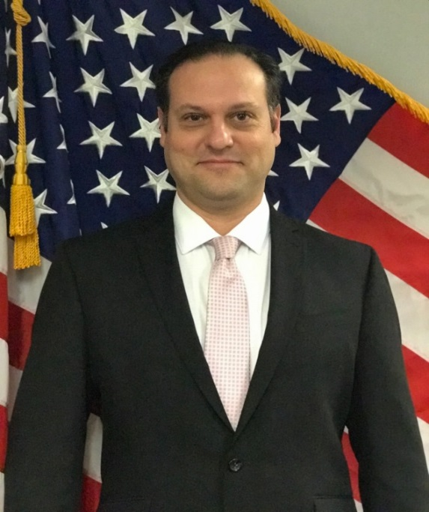
Presenters
Lamoyd Figures VR&E Training Specialist Orlando, FL
Dale Sagotsky VR&E Training Specialist Orlando, FL
Notes:
Welcome to NMT Session 1 for FY 2020. We are your facilitators with the VR&E Central Office Training Team.
Dale – intro – background info
Lamoyd – intro background info

Slide 4
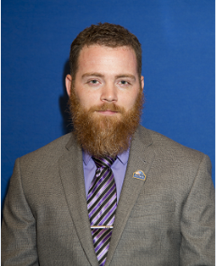
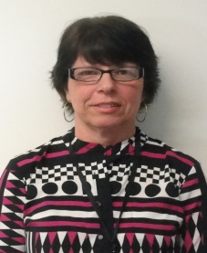
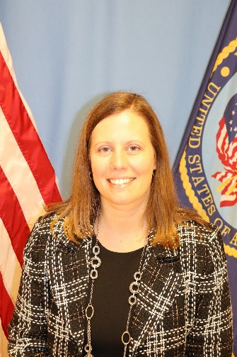
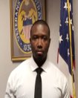
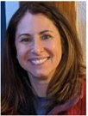
Subject Matter Experts
James Lester
Columbia VREO
Linda Steffensmeier
St. Paul VREO
Heather Becker
Buffalo AVREO
Rodney Hackney Oakland VREO
Will Bethea
Philadelphia/Wilmington VREO
Corliss De La Garza
Albuquerque VREO
Chloe Freeman
Jackson VREO
Kenneth Fisher
Muskogee AVREO
Notes:
Dale
With that being said, I would like to inform you all of our subject matter experts for the NMT Program. (Name and introduce the SMES). These SMEs help to review, develop and facilitate virtual and in-person trainings to the newly hired division leaders. In addition to this, the SMEs also serve as coaches. We greatly applaud and appreciate all their efforts and assistance as we prepare to kick off this year of NMT training.

Slide 5
Objectives
Upon completion of instruction, you will be able to:
Identify an effective briefing
Know the components of the briefing process
Prepare a Regional Office briefing
Notes:
During this time, we will discuss:
What is an effective briefing?
What are the components of the briefing process?
RO briefings
Preparation for weekly briefings, monthly briefings, and quarterly briefings.
Your briefing style and content will depend on who you are briefing as well…this could be the AD, the Director, your Area Director, VR&E Service, or visiting dignitaries.

Slide 6
Key Decision Makers
Regional Office Director
Other RO Management
District Office Director
Central Office
Stake Holders
Notes:
Key decision makers or possible/potental individuals you may have to brief.
District Office: There are 4 districts: Northeast, Southeast, Continental, and Pacific. Northeast District: Thomas Murphy, Southeast District: Al Bocchicchio, Continental District: Sandra Flint, Pacific District: Jonathan Skelly
District Directors generally try to visit offices at least once a year. In addition, they have been at the VREO Conferences to meet with VREO's.
Central Office: Acting Executive Director of VR&E Service: Vacant
Office of Field Operations: Willie Clark: Deputy Under Secretary for Field Operations
Stake Holders-This is going to be folks such as Veteran Service Officers, Congressional leaders and aides, VHA personnel, Dept of Labor, Veteran Community Organizations

Slide 7
Components of Communication
Notes:
Body Language – this can be a powerful tool to be aware of. We can tell a lot about a person when it comes to this. In addition, we can generate a response when our body language is undesirable. Examples of good body language: Smiling, sitting up straight/no slouching, good eye contact. Not only should you be aware of your own body language, watch for body language signs from your audience.
Tone of Voice – I find it interesting that this is lower that body language. This is a strong component of communication. Remember the old saying – It’s all in the delivery. People react to tone and/or make assumptions.
Words – while body language and tone of voice can completely squelch a message…..the words we use to convey the message can either make or break the deal, be damaging or get the results we want. This is where having someone proofread your agenda or message beforehand can help. Use positive words such as can, will, definitely, certainly, great, committed, will accept the challenge; instead of cannot, impossible, never, that is a problem, unfortunately.

Slide 8
Why Brief?
To inform/update
To talk needs
To follow up
Notes:
You have probably asked yourself….Why do we brief? Briefly discuss each.
To inform:
Provide updates on station performance measures and any other pertinent events in your division.
Directors to not like surprises, just as you don’t.
Update director on any potential issues that could become high profile.
Talk Needs
Short and long term types of needs for example staffing, IT needs, general office needs and safety. When at all possible, come to the table with data. If you have an issue that you need guidance on, come to the table with solutions as you may not like the solutions they come up with.
Follow up:
Follow up on previous action items you were assigned or item requested (it is rare to walk out of a meeting without more to do)

Slide 9
What is an Effective Briefing?
Clear
To the Point
Well Structured
Organized
Notes:
An effective briefing is clear, it is to the point, well structured, and organized. Preparing an agenda will help tremendously and keep you on track. Stick to the agenda.
Know how much time you have and allow time for questions. Be prepared to answer questions – over time and as you get to know your director, you will begin to anticipate what they will ask. Anticipate what may be asked of you and bring any documents to answer those questions.
Know what it is that you are trying to convey to management – Read it to someone, if the content generates a lot of questions, then you are not clear.
Be organized. There must be a logical transition and flow of the material.
5. If presenting a problem or issue, show them that you understand the issue. Demonstrate that you know about the entire process- not just about your services or what you are proposing. You may have to talk about finance, IT or other department about the issue on hand. (try to show that you are working on a solution)
6. Your interpretation of the facts should also include recommendations for action.

Slide 10
Components of the Briefing Process
Research
Construct
Refine
Rehearse
Notes:
There are 4 components used to prepare for a briefing. Research, Construct, Refine, and Rehearse. Utilizing these components will help you prepare a more effective briefing.
Research you should thoroughly investigate and understand the issue and how the manager wants the information presented. If it is not relevant –leave it out. Go back to the briefing purpose, then ask yourself if it needs to be in there
Become an expert on the issue or topic. Inadequate preparation annoys the manager because it uses their time ineffectively. Poor preparation also creates doubt about credibility.
Make sure you understand the audience. Ask the administrative assistant or someone that is familiar with the manager's briefing preference. Get a copy of a previous briefing if possible and use it as guide.
You also need to understand the parameters for the briefing. This includes how much time is allotted for the briefing, what kind of briefing the manager wants, is the briefing solely verbal or do you need to prepare text or slides, and any other limits or wants of the manager.
Construct: the rough outline of the presentation.
Remember the key elements and add just the critical information. The critical information is the purpose or situation, the key facts, assumptions, and coordination needed with other Division management or stakeholders.
Make sure to present the information with a smooth, logical progression.
Refine: Remove simple errors, reword items into words familiar to the manager, and remove unnecessary information. Suggestions from others are beneficial.
Format the briefing to use numbers, text, pictures, or simulations, or whatever manner or style best suits the preferences of the manager.
Remove jargon, excess acronyms and reword to make meanings more precise. Also avoid using words that have gained negative connotations within the organization.
Remove information that is not absolutely essential. Place this information in an addendum and bring this to the briefing. This is used just in case the manger requires more detailed information. When deciding what to include… ask yourself. If neither inclusion nor exclusion of the information would change the overall decision, then the information is not essential.
Check for things like capitalizations or punctuation consistency. This is not essential, but managers find inconsistencies very annoying, and may assume that the briefer is less credible because they don’t pay attention to detail.
Rehearse: Practice the briefing and make adjustments
Anticipate possible questions. Develop good, concise answers. It is helpful to have a short, written list of questions to take to the briefing, and refer to.
When practicing, time the briefing.
Ask for feed back.

Slide 11
Briefings to RO Director
Types of Briefings:
Weekly
Monthly
Quarterly
Notes:
Typical briefings are informal but is dependent on the audience.
Weekly, monthly, or quarterly – these could change at any time depending on the topic or HOT, HOT, HOT item that is on everyone’s plate.

Slide 12
Weekly Briefing
Focus more on day-to-day issues:
Contracting – obligated, spent
Personnel Issues – staffing , discipline, losses, extended leave
Training – Classes planned, training status, LMS
Workload – applications, backlogs in offices, average caseloads
Program Issues – GAO, OIG, VR&E Service, white papers
Office Issues – Mold, extended sick leave, furniture, hurricanes, mail, IT, Out-based
Notes:
These will probably be brief because you are updating management more often. Some Directors will do a round robin after a hotline call so that other RO divisions can know what is going on as well.
If you only have weekly meetings with your director, then you are going to want to have performance stats for the previous month (when available) or based on your local tracking mechanisms.

Slide 13
Monthly Briefings
Focus - Performance Standards
Primarily - RO Director Standards
Funds – Travel, GOE, RFA, Office needs
Long Term Office issues- Such as relocating the office or installing T-1 lines
Personnel Issues – Staffing, discipline, losses, extended leave
Notes:
These are the most common and will be a little longer in time and out briefing.
Usually results in Action Items that Directors will want to know the status of at the next briefing.
At the same time, these can also be the beneficial as action items and issues are addressed at a faster pace.

Slide 14
Quarterly Briefings
Strategic in Nature - More Formal
Forecasting – Anticipating potential problems & providing solutions
Trends – Performance, Staffing, Budget, Workload
Internal Controls
Quality Issues
Training
Survey Results and actions
Goals – Short term and Long Term
SAO Results
Contracting Update
Notes:
Usually a narrative and charts, handed in ahead of time for review before you meet.
Usually results in numerous action items.
Usually are lengthy in time and can include individuals that normally would not be there at a weekly or monthly briefing.
May require in depth data mining on your part, lots of research and clarity of what is written.
Quarterly briefings can track trends, where weekly and monthly may not be able to.

Slide 15
Tips for Effective On-line Briefings
Simplify your content
Prepare your technology
Declutter your background
Dress appropriately
Be mindful of your lighting
Remove noisy distractions
Maintain eye contact
Notes:
Agendas, dashboards and other content should be easily legible on the screen if sharing. Make sure you send a copy of your agenda and other materials prior to the meeting
Have a backup plan if something goes wrong with the technology.
Tidy up before presentation time. Try to eliminate as much of the visual clutter in the background as possible. An alternative idea is to make use of some of the virtual backgrounds available on the video conferencing platforms. Just be sure to choose something relatively neutral that won’t distract your audience from what is being said.
Most people who work-from-home won’t dress in a business dress as they would if they were heading to the office. While you don’t necessarily need to wear a suit, avoid anything too bright or patterned that could act as a distraction. Shiny fabrics could also cause an issue if they catch the light at a bad angle. Go for simple solid colors. At the end of the day, you’ll want your audience to focus on the content of your briefing rather than your outfit.
Think of your online briefing as a movie. Lighting matters. To ensure optimal lighting set up a lamp behind your laptop, over the camera so it lights up your face. You can also minimize lighting from other parts of the room using shades. You should also avoid sitting in front of a bright window as this will make you appear as a dark silhouette. Rather turn your laptop around so the window is in front of you instead of behind.
Ideally, you should make sure you do your presentation in a quiet room. However, this is something easier said than done when you are working from home. Controlling background noise is especially difficult if you’ve got kids around or you live in a small apartment where noise from other parts of the building carries through. One solution would be to use a good quality headset with a built-in microphone that can cancel outside sound. Also, remember to remove or mute any noisy computer notifications that pop up.
There are a few things worth noting when it comes to eye contact during an online meeting. Firstly, you should raise your laptop using a box or stack of books so the camera is at eye level. You’ll also need to become accustomed to speaking to the camera rather than watching yourself on the screen. Setting up your laptop in such a way that places you in the center of the frame is also crucial. Sitting too close to your screen won’t provide the most flattering angle either – so play about with positioning till you get it right.
Adapted from an article on SaveDelete by Jasper Singh

Slide 16
Activity Instructions
Director’s Brief
In your groups, each person will review their own Directors Dashboard and/or VR&E Workload Reports to identify an area of improvement
Once identified, you will consult with your team to identify solutions and an action plan to resolve the issue
Collectively you will work with your team to develop an action plan to present to your Director. Each member will have the opportunity to present. Each group will have 15 minutes to present on the three identified needs areas
In your briefing, you will develop a written paper (MS Word Doc) and/or a slide deck (PowerPoint slide) to share your Action Plan or Strategy to the Directors (submit your documents to VRENMT.VBACO@va.gov by Tuesday, January 19, 2021 @ 9:00AM ET
Note*All group members must participate in the planning meetings and have speaking parts

Slide 17
Groups Assignment
Group 1 | Group 2 | Group 3 | Group 4
Briefing Time 1/19/2021 @ 11:05 – 11:20am | Briefing Time 1/19/2021 @ 11:25am – 11:40am | Briefing Time 1/19/2021 @ 11:45am – 12:00pm | Briefing Time 1/19/2021 @ 12:05pm – 12:20pm
Jessica Brazau (VREO) | Francisco Paz (SVRC) | Joshua Pittinger (AVREO) | Gerald “Jerry” Bacon (VREO)
Jeanellie Labrada (SVRC) | Kevin Clayton (AVREO) | Allison Bubier (VREO) | Molly Fazzi (AVREO)
Peter Lopez (SVRC) | Imelda Flores (SVRC) | Ned Evette (SVRC) | Christiana Olaga-Buah (SVRC)
 |  |  | Helen Chan (SVRC)

Slide 18
Questions/Discussion
Next NMT MS Teams Sessions:
NMT Preparing for Briefings Part II
Tuesday, January 19, 2021 @ 11-12:30 PM ET
QA: Modernization and Trends
Tuesday, January 26, 2021 @ 11-12:30 PM ET
QA: Preparing for Site Visits – Part I
Tuesday, February 2, 2021 @ 11-12:30 PM ET
QA: Preparing for Site Visits – Part II
Tuesday, February 9, 2021 @ 11-12:30 PM ET
Remote Management
Tuesday, February 16, 2021 @ 11-12:30 PM ET
TMS # 4550329
NMT Preparing for Briefings Part I
Notes:
Any questions.
TMS Info: Please complete the feedback survey.

