Slide 1
FOR TMS TRAINING CREDIT
To obtain training credit in TMS, there is no need to review these slides at this time – immediately close this box by using your mouse to select the “X” in the upper right-hand corner; select the “Return to Content Structure” button; and, select the next link (Video) to view the edited recording of the Quality Call along with the Call Bulletin
These slides are included here only in case you want to use them later for training purposes or reference
These are the same slides that are shown in the audio-video recording

Slide 2
January 15, 2020
Compensation Service
Quality Call

Slide 3
Welcome to the January 2020 Quality Call
Robert Johnson
Senior Quality Review Specialist
Quality Review Team
Quality Assurance

Slide 4
Agenda
Significant Changes to M21-1
Dependency Effective Dates
Q-Tip – AMA Laws/Regs
Verbiage to Use When Correcting AMA Error Citations
Routing of Radiation Claims and Advisory Requests

Slide 5
Significant Changes to M21-1
Kim Tibbitts
M21-1 Editor
Procedures Maintenance Staff
Policy and Procedures

Slide 6
Changes Necessitated by Update to VAF 21-686c
We have begun making changes to M21-1 that eliminate the requirement to undertake development to obtain evidence/information a claimant fails to provide when submitting VA Form 21-686c, if the version of the form the claimant submitted is September 2018 or later
The detailed instructions that now accompany VA Form 21-686c regarding the evidence/information a claimant must provide justified elimination of this requirement
Important: The provisions of M21-1, Part III, Subpart iii, Chapter 1, Section A, Topic 1, still apply if a claimant is unable to provide documentary evidence of a life event (birth, death, marriage, divorce)

Slide 7
Elimination of Requirement for Quarterly Reports
We have begun making changes to M21-1 that eliminate the requirement to prepare and submit quarterly reports on award adjustments made as a result of computer matching programs
Department of Defense (M21-1, Part X, Chapter 11)
Bureau of Prisons (M21-1, Part X, Chapter 12), and
Social Security Administration (M21-1, Part X, Chapter 15)
The Office of Performance Analysis and Integrity (PA&I) can now provide Compensation Service management with the same data the quarterly reports contained

Slide 8
Increased Frequency for Issuing VAF 21-0538
We have begun making changes to M21-1 to reflect the increased frequency with which the Hines Information Technology Center will soon begin issuing VA Form 21-0538 to Veterans for completion
Frequency will increase from every eight years to every three years
Concerns regarding the number of large overpayments resulting from Veterans’ failure to notify VA of changes in the status of their dependents prompted the change
Information of record regarding the status of a Veteran’s dependents will now be valid for only three years instead of eight, as reflected in a recent change to M21-1 III.iii.5.L.1.b

Slide 9
Dependency Effective Dates
Erin Hawkins
Consultant
Advisory and Special Review Team
Quality Assurance

Slide 10
Dependency Effective Dates

Slide 11
Dependency Sharp v. Shinseki
Effect of Sharp v. Shinseki on the assignment of effective dates is often overlooked – Effective dates for dependents are impacted if the Veteran was at least 30%, and a new decision:
Grants an increase for a condition or establishes service connection for a new disability (even an issue rated 0%) - regardless of whether or not the combined evaluation changes
Grants individual unemployability (IU)
Grants entitlement to special monthly compensation (SMC)
Establishes an earlier effective date for a combined disability evaluation of 30 percent or greater
M21-1 III.iii.5.L.2.b and M21-1 III.iii.5.L.1.c

Slide 12
Dependency Effective Date Timeline
Additional time as a result
Decision Notice
One year preceding receipt of claim
Decision Notice
dated 9-5-19:
Rating granted SMC
effective 3-20-17
Eligibility
(30% or higher)
effective 6-24-14
Birth of
Biological Child
7-5-18
3-20-17
10-16-18
VAF 21-686c
received 10-16-19

Slide 13
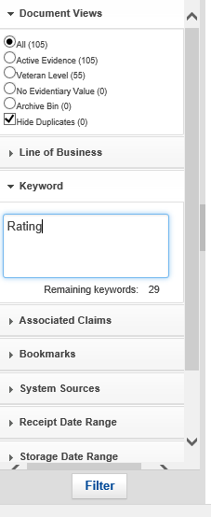
Dependency School Children
The “Keyword” search in VBMS can be a powerful tool for finding potential Rating Decisions and Notifications that may impact a dependency claim – While viewing the documents:
Use the chevron by “Keyword” to open the search box
Enter keyword(s) separated by spaces
Click “Filter”

Slide 14
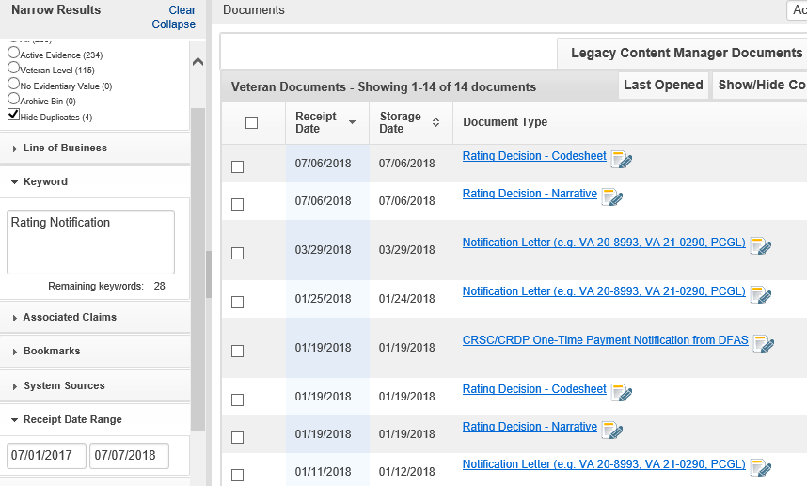
Dependency School Children
Note that the search results can be further filtered by using a date range

Slide 15
Dependency School Children
If the evidence shows that we can convert a minor child to a school child on the 18th birthday, then:
The 18th birthday is the effective date for adding the child, also called the “event” date in VBMS-A
The payment effective date is the first day of the following month
M21-1 III.iii.6.B.1.a
38 CFR 3.31

Slide 16
Dependency VBMS-A Steps
To convert a minor child to a school child on the 18th birthday, promulgating VSRs should note the following in VBMS-A:
The “Event Date” is the child’s 18th birthday
The “Award Eff Date” is automatically filled with the 18th birthday, it must be manually updated to be first day of the following month

Slide 17
Dependency School Children
Promulgators can spot an incorrect school child effective date by reviewing the chart that lists dependents on Draft Award in VBMS-A:
The effective date that “School Attendance Begins” incorrectly shows the 18th birthday
The correct effective date should be 07/01/2017 (first day of the following month)

Slide 18
Dependency VBMS-A Steps
Additionally, the pay chart will incorrectly reflect the following on the Draft Award in VBMS-A:
On the date of the 18th birthday:
The minor child column decreases by 1
The school child column increases by 1
The gross compensation rate will increase

Slide 19
Dependency Reminders
Do not add a stepchild prior to the date of marriage between the biological parent and the Veteran
M21-1III.iii.5.G.6.a
Ensure the effective date for removing a step child is the day after the child left the Veteran’s household
M21-1 III.iii.5.G.6.i
Review the eFolder to determine if evidence is already of record
M21-1 III.iii.5.A.1.f.

Slide 20
Q-Tip – AMA Laws/Regs
David Hannigan
Quality Assurance Officer
Quality Assurance

Slide 21
Fun way to share ideas in a simple tip format
Your Q-Tips are welcome and requested
We will help each other by sharing knowledge
Send your ideas to David Hannigan
david.hannigan@va.gov

Slide 22
AMA – Why Laws/Regs Are Now Included
The Veterans Appeals Improvement and Modernization Act of 2017 (AMA) replaces the Statement of the Case (SOC) and Supplemental Statement of the Case (SSOC)
AMA replaces the SOC/SSOC process by moving it to the rating-level
Pertinent laws/regs in the rating decision are intended to assist the claimant and POA or lawyer with understanding the basis for the decision to assist with the appeal process
This is what the SOC/SSOC used to do!
Reminder: RAMP instruction is not pertinent to non-RAMP AMA ratings

Slide 23
Verbiage to Use When Correcting AMA Citations
Robert Johnson
Senior Quality Review Specialist
Quality Review Team
Quality Assurance

Slide 24
Correcting AMA Error Citations
The following verbiage will be used within the new rating decision and related notification letter:
Providing missed laws and regulations: The purpose of this rating decision is to provide you with additional laws and regulations that are applicable to our decision on your claim but were not included in our previous decision of ____ (date).
Providing favorable findings: The purpose of this rating decision is to explain the favorable findings associated with your claim for ____ (issue) but were not included in our previous decision of ___ (date).

Slide 25
Routing of Radiation Claims & Advisory Requests
Philip Bramlage
Consultant
Advisory and Special Review Team
Quality Assurance

Slide 26
Routing of Radiation Claims to the Jackson RO
In accordance with M21-1 IV.ii.1.C.2.a, Centralized Processing of Claims Based on Radiation Exposure, all radiation claims (excluding legacy appeals) must be transferred to the Jackson VA Regional Office (RO) after the radiogenic disease is confirmed
ROs should not be ordering examinations to determine if a claim is due to radiation prior to sending to Jackson, as the examiner does not have at their disposal the actuals levels of exposure
If an examination is ordered prior to obtaining levels of exposure, this can create an issue because we may receive conflicting opinions once dosage evidence is considered

Slide 27
Routing of Advisory Opinion Requests
We are seeing a trend with BVA directing extra-schedular consideration be given to claims
Although BVA directs such development be conducted, claims processors must still follow the direction given to prepare a memo with a recommendation
M21-1 III.iv.6.B.4.d-e
We have received several claims with Special Issue “Compensation Service Review – Over $25K”
As a reminder, this Special Issue is for reviews of claims involving an overpayment of $25,000 or more due to administrative error, not an award due to the Veteran

Slide 28
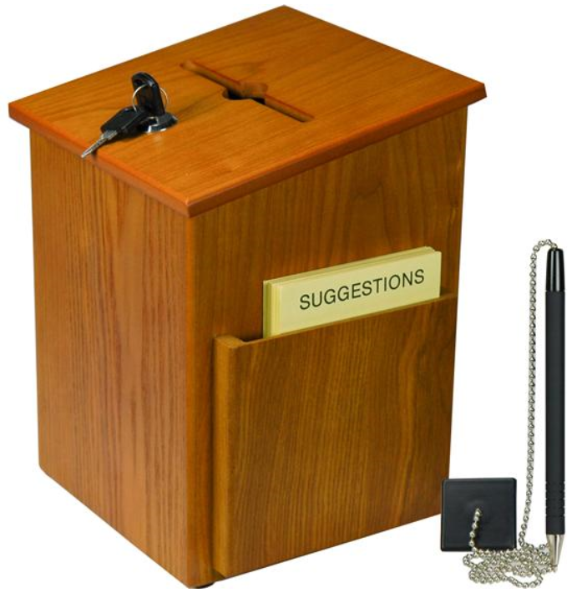
Questions – Suggestions – Next Quality Call
Presented by:
Robert Johnson

Slide 29
Would You Like to Present a Topic?
We are offering opportunities for RO SMEs to present topics during Compensation Service Quality Call recording sessions
Peer-to-Peer communication is optimum
Are YOU interested in presenting a topic?
Talk to your Coach or other RO management team member
If okay, have management send your name and topic to:
VAVBAWAS/CO/InternalQRS <InternalQRS.VBAVACO@va.gov>

Slide 30
Questions Relating to Today’s QC Topics
Questions on topics presented must be emailed to the Quality Call Leads at the mailbox InternalQRS.VBAVACO@va.gov
Emails must include Cc to your Coach or other RO management
Emails must contain the name of the topic(s) with your question(s)
Questions must be submitted to the mailbox by COB Friday, January 31st
Questions submitted after Jan 31st will not be accepted for inclusion in the Call Bulletin
Email questions are limited to those pertaining to only the topics presented, and responses will not be provided to any questions that are not related to the topics presented during this Quality Call
Official guidance to the questions will be posted later in the Call Bulletin

Slide 31
Do You Have Suggestions for Topics?
Please feel free to email your topic suggestions to the Quality Call Leads at the mailbox InternalQRS.VBAVACO@va.gov
In your email, be sure to include:
Cc to your Coach or other RO management
Name of the topic
Intended audience (VSR – SVSR – RVSR – DRO – AQRS – RQRS)
Applicable M21-1 and/or 38 CFR citations
Quality Call Bulletins can be found in the STAR Home Page on the Compensation Service Intranet site, TMS, and VBA Learning Catalog
Audio recordings of the Quality Calls with separate copies of the PowerPoint slides can be found in both TMS and VBA Learning Catalog

Slide 32
Next Quality Call
Quality Call recording is usually posted each month in TMS
Next Quality Call will be recorded in February

