Slide 1
Exam Management System (EMS)
New Functionality Training
Compensation Service
November 2019
This training module contains fictitious Veteran information on various screens for training purposes

Slide 2
Learning Objectives
After Completing this training, users will be able to:
Select New Veteran Priority Issues within Exam Management
Identify updated ESR Request Language
Cancel an ESR while responding to the Clarification Response
Clone ESR data and narrative from an ESR on a cancelled or cleared EP to an existing EP for a new or rework ESR

Slide 3
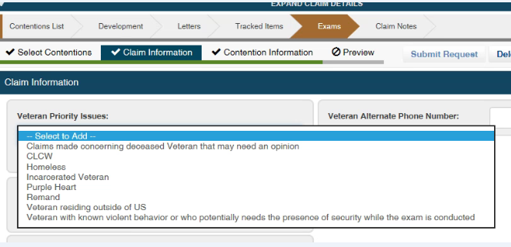
Exam Tab-Claim Information
Veteran Priority Issues
Users must select an applicable priority issue for MDE vendor priority processing
Purple Heart no longer requires ERB-S language to indicate priority

Slide 4
Exam Request Language
ERB-S is no longer needed for:
a medical opinion based on Personal Trauma (non-MST)
Peripheral Nerve (asking the examiner to specify which nerve is affected)
Sharp vs Shulkin
FSAD
Purple Heart

Slide 5
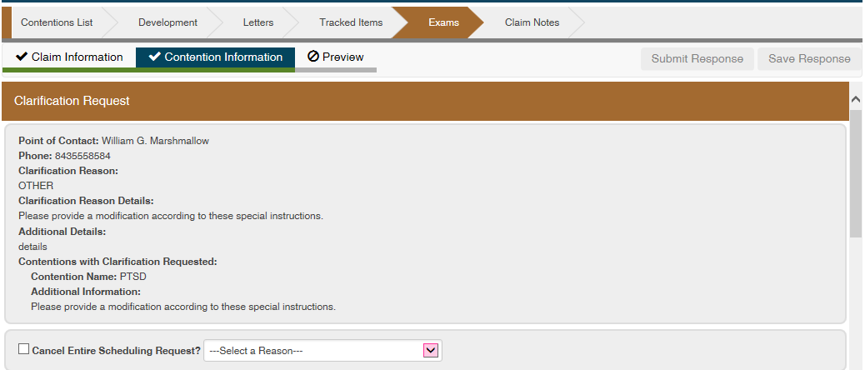
Clarification Request Responses
The Clarification Response to a request to cancel an ESR and the actual action of canceling that ESR used to be two separate user steps.
A separate Modification request to cancel the ESR is no longer needed
User clarification request
ow has the ability to cancel an ESR while responding to a

Slide 6
ESR Cloning Functionality
Users will now be able to clone the data and narrative previously captured from an ESR on a closed or canceled EP, and generate a new or Rework ESR associated to the source ESR under the new EP
Users can regenerate Rework and/or copy an ESR without manual re-keying all of the previous information from a previously closed/canceled EP
Users will now be able to clone an ESR contention information and narrative under a different EP
The data and narrative from the selected contention(s) from the source ESR populates in a 'Draft' Rework ESR
This process will reduce potential errors due to manual data entry and will improve accuracy of data used for contract Exam performance oversight
Note: The previous ESR must be in a completed/canceled state.

Slide 7
ESR Cloning Functionality (cont.)

Slide 8
Questions
Please direct any questions or concerns to the MDEPO Contract Exam Mailbox at:
VAVBAWAS/CO/Contract Examination Inquiries

