Slide 1
FOR TMS TRAINING CREDIT
To obtain training credit in TMS, there is no need to review these slides at this time – immediately close this box by using your mouse to select the “X” in the upper right-hand corner; select the “Return to Content Structure” button; and, select the next link (Video) to view the edited audio-video recording of the Quality Call along with the Call Bulletin
These slides are included here only in case you want to use them later for training purposes or reference
These are the same slides that are shown in the audio-video recording

Slide 2
November 14, 2019
Compensation Service
Quality Call

Slide 3
Welcome to the November 2019 Quality Call
Robert Johnson
Senior Quality Review Specialist
Quality Review Team
Quality Assurance

Slide 4
Agenda
What’s New in M21-1?
VCIP Shipping; and, AEW Adjustments
Ratings for Special Purposes; and, Rating Dental/Oral Conditions
Individual Unemployability Procedures
New and Relevant Evidence Defined
VBMS-R Language and Other Updates
Divorce Effective Date Table
VA Forms Information
Closing Comments

Slide 5
What’s New in M21-1?
Kim Tibbitts
Program Analyst/Manual Editor
Procedures Maintenance Staff
Policy and Procedures

Slide 6
III.ii.1.F – VCIP Shipping
Update abbreviations representing internal Control of Veterans Records System (COVERS) locations for scanning vendors, e.g.
DCSS1 is now ICMHS3
DCSC2 is now ICMHS2
Updated information about and instructions for creating and printing a shipping manifest in VBMS
Replaced the shipping container validation checklist in III.ii.1.F.2.i with a new one
Added a new block (III.ii.1.F.3.b) that contains instructions for resolving shipping exceptions involving source material sent to SMS

Slide 7
III.v.5.E – Processing AEWs
III.v.5.A.8 is now III.v.5.E
Made changes to reflect that AEWs now contain audit data from the Coast Guard
Reorganized and added content to Block f, which contains instructions for performing an initial review of an AEW
Updated instructions in Block j for handling award adjustments that require finance activity action prior to authorization
Corrected information about and the instructions for processing an AEW with a rate change that takes effect on a day other than the first day of the month (Block m)

Slide 8
III.v.5.E – Processing AEWs (Cont’d)
Instructions in Block q for determining whether a Veteran’s military retired pay was based on disability have been replaced with instructions for ensuring a Veteran’s military retired pay is based on length of service

Slide 9
What’s New in M21-1?
Dustin Williams
Program Analyst/Manual Editor
Procedures Maintenance Staff
Policy and Procedures

Slide 10
IX.ii.2 – Ratings for Special Purposes
Relocated the following content to a new section (III.iv.4.P) on rating dental/oral conditions for compensation purposes:
Topic 2, Block a (IX.ii.2.2.a), and
Topic 3 (IX.ii.2.3) (all)
Emphasized, in new Topic 2, Block a (IX.ii.2.2.a), that service connection for dental treatment purposes should be addressed only via rating when requested by VHA

Slide 11
IX.ii.2 – Ratings for Special Purposes (Cont’d)
Updated guidance in the following blocks to better identify the implications of medical evidence on DEA effective date assignment:
Topic 1, Block m (IX.ii.2.1.m), and
Topic 1, Block n (IX.ii.2.1.n)
To clarify, in Topic 5, Block b (IX.ii.2.5.b), that insanity determinations are adjudicative (vs. medical) in nature
To delete Topic 11 (IX.ii.2.11) in favor of cross-reference to M22-4

Slide 12
III.iv.4.P – Rating Dental/Oral Conditions
Created new section to house relocated content on rating dental conditions for compensations purposes, previously found in
IX.ii.2.2.a, and
IX.ii.2.3
Revised Topic 1, Block a (III.iv.4.P.1.a) to
simplify procedures on claim interpretation, and
emphasize that service connection for treatment purposes be rated only when requested by VHA

Slide 13
III.iv.4.P – Rating Dental/Oral Conditions (Cont’d)
Revised Topic 1, Block b (III.iv.4.P.1.b) to
delete the requirement that claims processors notify VHA when a dental disability is granted service connection for compensation purposes, and
add language for inclusion in the rating narrative in such instances
Added a new block (III.iv.4.P.1.c) on dental/oral contentions for which compensation-purpose service connection may not be established

Slide 14
What’s New in M21-1?
Angela Moritz
Program Analyst/Manual Editor
Procedures Maintenance Staff
Policy and Procedures

Slide 15
IV.ii.2.F – Changes to IU Processing Procedures
08/01/2019 Update
Removed sedentary employment language, per Withers holding
Added guidance on effective dates/appeals, per Harper holding
Added Topic 5 for supplemental claims
Clarified procedures for SSA wage data match/4140 processing
10/10/2019 Update
Added guidance on components of IU decisions, per Ray holding
Clarified procedures for SSA wage data match/4140 processing

Slide 16
IV.ii.2.F – IU Procedures (Cont’d)
Recent holdings affecting IU policy/procedures
Withers v. Wilkie
Requires a consistent interpretation of the term sedentary work
Requires application of regulatory criteria when considering sedentary work as a factor in IU determinations
Harper v. Wilkie (IV.ii.2.F.5.k)
IU claim remains in appellate status if IU is not awarded effective from the DOC for the underlying disability rating that is on appeal

Slide 17
IV.ii.2.F – IU Procedures (Cont’d)
Ray v. Wilkie
Standard for referring claims for extra-schedular review
Clarified the information to address when considering non-economic component of IU

Slide 18
IV.ii.2.F – IU Procedures (Cont’d)
IU and Supplemental Claims
Entire new topic added for reviews of IU decisions (IV.ii.2.F.5)
Consolidates IU appeals guidance
Adds supplemental claims guidance
Clarifies that the form drives the process
Discusses multiple form submissions
Discusses which issues have to be addressed in the rating depending on circumstances

Slide 19
IV.ii.2.F – IU Procedures (Cont’d)
Annual SSA Wage Data Match & VA Form 21-4140 Process (IV.ii.2.F.6)
Clarifies that the match identifies family income above poverty level
Process and letters have changed this year
Asks Veterans to provide info about all family income
Requires documentation to explain income source(s)
Tax documents
Pay information
Employer statement
VA Form 21-4138

Slide 20
New and Relevant Evidence Defined
Samuel (Clint) Bass
Rating Quality Review Specialist
Quality Review Team
Wichita VA Regional Office

Slide 21
New and Relevant Evidence References
38 CFR 3.156(d)
38 CFR 3.2501
M21-1 III.iv.2.B.3.d through e
M21-1 III.ii.2.D.1.b
Compensation Service AMA FAQs
Relevant FAQs dated March 3, 2019 and June 6, 2019

Slide 22
M21-1 – New and Relevant Evidence
The M21-1 was extensively updated following the implementation of AMA on 02/19/2019
Specifically, M21-1 III.iv.2.B.3.d was added to define VA’s legal definition of “new and relevant” evidence
New evidence that affirms findings previously deemed favorable, such as a diagnosis of the claimed condition, would be considered relevant evidence

Slide 23
Definition – New and Relevant Evidence
As defined in 38 CFR 3.2501 and M21-1 III.iv.2.B.3.d
New evidence is evidence not previously part of the actual record before agency adjudicators
Relevant evidence is information that tends to prove or disprove a matter at issue in a claim
Relevant evidence also includes evidence that raises a theory of entitlement that was not previously addressed
Note: New evidence that affirms findings previously deemed favorable to the claimant is still relevant
No requirements that relevant evidence prove a previously unsubstantiated matter

Slide 24
AMA FAQ Dated June 6, 2019
Question: It seems as if new and relevant is just a re-wording of new and material - not sure I completely understand the difference?
Answer: New evidence is evidence not previously part of the actual record before the agency. Relevant evidence tends to prove or disprove a matter at issue in a claim or raises a new theory of entitlement that was not previously addressed. See M21-1, Part III, Subpart iv, 2.B.3.d. It is intended to be a lower threshold than the material standard wherein the evidence presented had to relate to an unestablished fact necessary to substantiate the claim.

Slide 25
New and Relevant Evidence Scenario
SC previously denied (direct) for left knee arthritis by rating dated 01/03/2017
STRs show evidence of an in-service left knee injury
VAE shows diagnosis of left knee arthritis with negative direct medical opinion
Presumptive SC under 38 CFR 3.309(a) not shown
Award notification letter dated 01/07/2017
VA received substantially complete VA Form 20-0995 on 07/11/2019
Recent VA treatment records identified and obtained show continued complaints and diagnosis of left knee arthritis since the prior denial was issued
No other evidence was submitted or identified
Question: Does new and relevant evidence exist?

Slide 26
Scenario Answer
Yes – “New and relevant” evidence exists because the recent VA treatment records affirm findings previously deemed favorable (diagnosis), so the claim must be decided on its merits
There were two findings deemed favorable to the Veteran
Incurrence (in-service event) and diagnosis
The unsubstantiated matter (unestablished fact needed to substantiate the claim) was the missing nexus
Unlike the prior new and material standard, there is no requirement that evidence prove a previously unsubstantiated matter in order for it to be considered “relevant”
Since the recent treatment records showing treatment for and diagnosis of left knee arthritis is considered relevant as it affirms the findings previously deemed favorable
Note: When the evidence received is new and relevant, we must not deny as not new and relevant; rather, the claim must be “decided” on its merits (which does not necessarily mean a grant of SC is in order)

Slide 27
AMA FAQ Dated March 3, 2019
Question: If VA previously denied a right knee condition on direct SC, and now the Veteran claims a right knee condition secondary to a SC left hip condition, what is the process?
Answer: This would be considered a supplemental claim and would require submission of the claim on VA Form 20-0995, Decision Review Request: Supplemental Claim. In addition, the mere contention of “secondary service connection” is sufficient to meet the “new and relevant evidence” standard to render the claim complete.

Slide 28
AMA FAQ Dated June 6, 2019
Question: If there is a supplemental claim from a Veteran who missed the exam, and the Veteran doesn’t send in new evidence, is that an incomplete application? If the only reason the Veteran was denied was due to missed exams, and they don’t send in new evidence, do we still administratively deny the claim?
Answer: The Veteran stating on VA Form 20-0995 that he/she will attend the exam is enough evidence to request/reschedule the exam.

Slide 29
VBMS-R Language and Other Updates
Montrica Hoover
Senior Program Analyst
Business Management Staff
Business Process Development

Slide 30
VBMS-R Language Updates
Tool fragment, Deny_NoShow_VAE_S11, has been updated as follows to reflect current policy when a Veteran fails to report for a scheduled VA exam
Old Text: This claim is considered based on the evidence of record as you failed to report for the scheduled VA examination. Evidence expected from this examination which might have been material to the outcome of this claim could not be considered. In order for your claim to be reconsidered, you must submit medical evidence of current treatment or show good cause for missing the examination, while indicating a willingness to report for another VA examination. (38 CFR 3.655)
New Text: This claim is considered based on the evidence of record as you failed to report for the scheduled VA examination. Evidence expected from this examination which might have been material to the outcome of this claim could not be considered. You may submit a supplemental claim with medical evidence of current treatment or evidence showing good cause for missing the examination, while indicating a willingness to report for another VA examination. (38 CFR 3.655)

Slide 31
VBMS-R Language Updates (Cont’d)
Glossary Fragment, BD1, pertaining to “reasonable doubt” has been updated as follows to correctly cite 38 CFR 4.6, not 4.7
Old Text: When, after careful consideration of all procurable and assembled data, a reasonable doubt arises regarding service origin, the degree of disability, or any other point, such doubt will be resolved in favor of the claimant. Reasonable doubt exists because of an approximate balance of positive and negative evidence which does not satisfactorily prove or disprove the claim. (38 CFR 4.7)
New Text: When, after careful consideration of all procurable and assembled data, a reasonable doubt arises regarding service origin, the degree of disability, or any other point, such doubt will be resolved in favor of the claimant. Reasonable doubt exists because of an approximate balance of positive and negative evidence which does not satisfactorily prove or disprove the claim. (38 CFR 3.102; 38 CFR 4.3) Note: The recorded presentation incorrectly shows 4.7 was changed to 4.6 – instead, 4.7 is actually changed to 3.102 & 4.3

Slide 32
VBMS-R Language Updates (Cont’d)
VBMS-R generated, qualification fragment, DENY - ATTRIBUTABLE-38-59, has been updated as follows to change ‘Gulf War’ to ‘Southwest Asia’
Old Text: Service connection is not permitted if there is affirmative evidence that the disability was unrelated to service in the Gulf War.
Service connection for ||DGNSTC TXT|| is denied because evidence established that this disability resulted from {}. (38 CFR 3.317)
New Text: Service connection under this provision is precluded if there is affirmative evidence that the disability was unrelated to service in the Southwest Asia theater of operations.
Service connection for ||DGNSTC TXT|| is denied because evidence established that this disability resulted from {}. (38 CFR 3.317)

Slide 33
VBMS-R Language Updates (Cont’d)
Additional verbiage, such as “Historical 38 CFR 4.88b effective August 30, 1996,” has been added to the parenthetical portion of the decision analysis text where applicable when rating claims for VASRD Infectious Diseases

Slide 34
VBMS-R Language Updates (Cont’d)
Builder fragment, SECTION_4_118_DISFIGUREMENTS, will be updated to correct typographical errors – the update will be implemented with the VBMS 18.0 Release, scheduled for December 15, 2019
Old Text: The eight characteristics of disfigurement, for purposes of evaluation under 38 CFR §4.118 are: scar 5 or more inches 13 or more cm) in length; scar at least one-quarter inch 0.6 cm) wide at widest part; surface contour of scar elevated or depressed on palpation; scar adherent to underlying tissue; skin hypo- or hyper-pigmented in an area exceeding six square inches 39 cm² skin texture abnormal irregular, atrophic, shiny, scaly, etc.) in an area exceeding six square inches 39 cm² underlying soft tissue missing in an area exceeding six square inches 39 cm² and, skin indurated and inflexible in an area exceeding six square inches 39 cm²). The characteristics) of disfigurement may be caused by one scar or by multiple scars; the characteristics) required to assign a particular evaluation need not be caused by a single scar in order to assign that evaluation. A characteristic of disfigurement, even if present in more than one scar, is only counted once for evaluation purposes.
New Text: The eight characteristics of disfigurement, for purposes of evaluation under 38 CFR §4.118 are: scar 5 or more inches (13 or more cm) in length; scar at least one-quarter inch (0.6 cm) wide at widest part; surface contour of scar elevated or depressed on palpation; scar adherent to underlying tissue; skin hypo- or hyper-pigmented in an area exceeding six square inches (39 cm²); skin texture abnormal (irregular, atrophic, shiny, scaly, etc.) in an area exceeding six square inches (39 cm²); underlying soft tissue missing in an area exceeding six square inches (39 cm²); and, skin indurated and inflexible in an area exceeding six square inches (39 cm²). The characteristic(s) of disfigurement may be caused by one scar or by multiple scars; the characteristic(s) required to assign a particular evaluation need not be caused by a single scar in order to assign that evaluation. A characteristic of disfigurement, even if present in more than one scar, is only counted once for evaluation purposes.

Slide 35
Another VBMS-R Update
The asterisk ( * ) indicating that a bilateral factor is required for certain VASD Skin/Scar diagnostic codes has been removed when not required

Slide 36
Divorce Effective Date Table
Melanie Coleman
Consultant
Advisory and Special Review Team
Quality Assurance

Slide 37
Divorce Effective Date Table Purpose
To provide a tool for claims personnel to use when removing dependent spouses from awards based on the information contained in divorce decrees received from beneficiaries
To address issues STAR Authorization Program Review Staff previously identified with claims processors identifying the official date of marital termination when the divorce decree (received by VA) contains different dates
To provide information specific to those states with mandatory post-divorce waiting periods

Slide 38
Table Development and Current Location
Information compiled in the Table has been gleaned from extensive Internet, telephone, and email research
M21-1 is under revision to include references and links to the resource, which has been posted to the STAR Homepage and Compensation Service Job Aids page
In the near future, the Table will be incorporated into the VSR Dependency Effective Dates and Awards training course along with being posted in the VSR Assistant as a Dependency Job Aid

Slide 39
VA Forms Information
Kayce White
Forms Analyst
Part 3 Regulations and Forms
Policy Staff

Slide 40
Quarterly Update: Version Control & Outdated Forms
Though VA encourages the use of the current version of each form because it is the most up-to-date, there are circumstances in which an outdated version of a form may be accepted – these circumstances are listed under M21-1 Part III, Subpart ii, 1.C.8.a – in general, a previous version of a form may be accepted for one year after the current version is released
EXCEPTION: Due to the implementation of Public Law 115-55, Veterans Appeals Improvement and Modernization Act of 2017, VA will continue to accept both ‘September 2015’ and ‘September 2018’ versions of VA Form 21-0958, Notice of Disagreement, until February 19, 2020
Based on this statutory change, VBMS was not updated to include the new ‘September 2018’ version; as such, claimants continued to receive the ‘September 2015’ version until February 19, 2019, when VA discontinued sending VA Form 21-0958 to claimants
For any disagreement with a VBA decision issued prior to February 19, 2019, continue accepting both the previous version, dated September 2015, and the current version, dated September 2018, as valid legacy Notices of Disagreement (NODs)
Both forms will be removed from usage on February 19, 2020, and the current version will be discontinued
Note: This notice corrects the April 2019 VSCM Bulletin stating the previous version of VA Form 21-0958 is acceptable until only September 30, 2019
The table on the next slide provides examples of when a previous version of a form is no longer acceptable

Slide 41
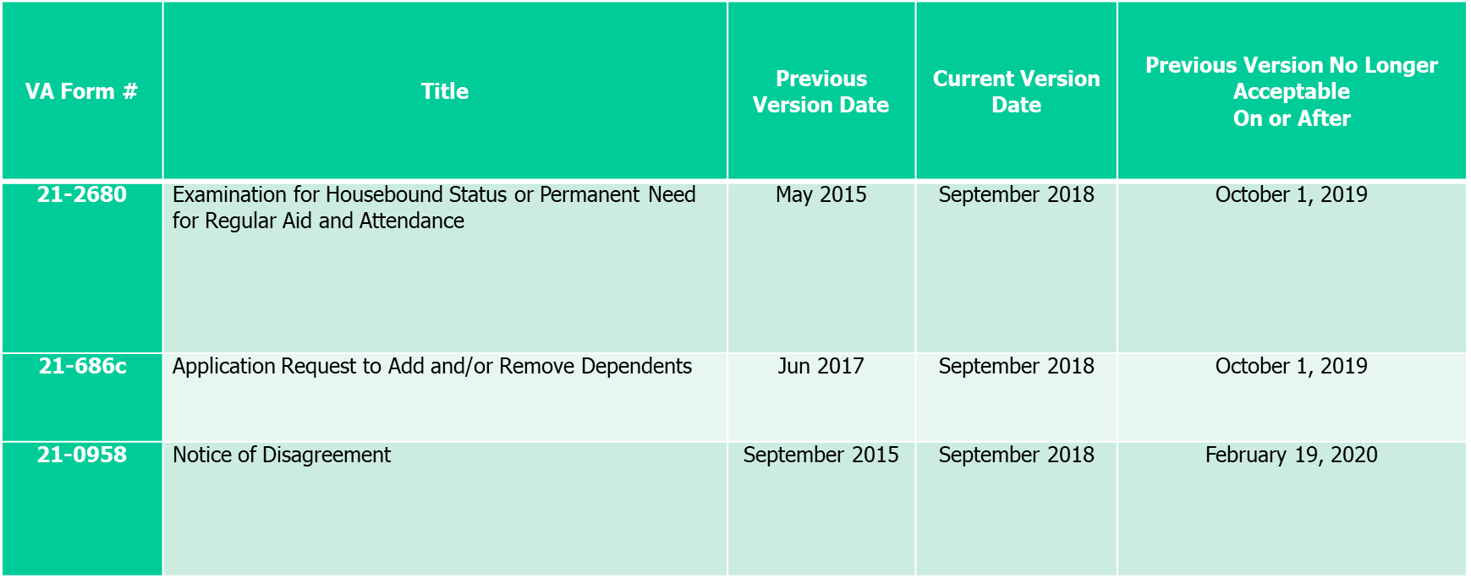
Quarterly Update (Cont’d)

Slide 42
New Version of VA Form 21-526EZ
VBA is releasing a new version (dated September 2019) of VA Form 21-526EZ, Application for Disability Compensation and Related Compensation Benefits, on November 15, 2019
Though the previous version (dated March 2018) of VA Form 21-526EZ is fully legally sufficient, the new version has been updated to provide a more Veteran-friendly format for applying for compensation benefits
Per M21-1 Part III, Subpart ii, 1.C.8.a (procedures for accepting outdated forms), the previous version will be acceptable until September 30, 2020
As of October 1, 2020, it will no longer be accepted

Slide 43
New Version of VA Form 21-526EZ (Cont’d)
The following are enhanced features displayed within the new September 2019 version:
Added a note under Section I: Identification and Claim Information, that explains what is needed for a non-original claim
Only Section I, IV, and a signature is required
Question 17, Section IV, has been reformatted
Only the approximate beginning date of treatment (MM/YYYY) is needed, with an option of a checkbox if the claimant does not have a date
It has also been noted that if treatment occurred from 2005 to present, the claimant does not need to provide dates
In the Note under Question 17, a reference to VA Form 20-0995, Decision Review Request: Supplemental Claim, has been added for the claimant should he/she need to submit a supplemental claim form
Added a note under Section X: Alternate Signer Certification and Signature, that explains this section is required only if the form is not signed by the claimant
Added a note under Section XI: Power of Attorney Signature, that explains a POA cannot sign for an original claim only

Slide 44
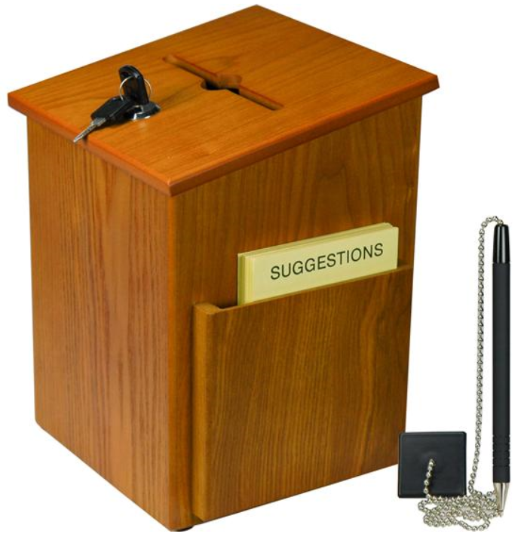
Questions – Suggestions – Next Quality Call
Presented by:
Robert Johnson

Slide 45
Questions Relating to Today’s QC Topics
Questions on topics presented must be emailed to the Quality Call Leads at the mailbox InternalQRS.VBAVACO@va.gov
Emails must include Cc to your Coach or other RO management
Emails must contain the name of the topic(s) with your question(s)
Questions must be submitted to the mailbox by COB Friday, November 22nd
Questions submitted after Nov 22nd will not be accepted for inclusion in the Call Bulletin
Email questions are limited to those pertaining to only the topics presented, and responses will not be provided to any questions that are not related to the topics presented during today’s Quality Call
Official guidance to the questions will be posted later in the Call Bulletin

Slide 46
Do You Have Suggestions for Topics?
Please feel free to email your topic suggestions to the Quality Call Leads at the mailbox InternalQRS.VBAVACO@va.gov
In your email, be sure to include:
Cc to your Coach or other RO management
Name of the topic
Intended audience (VSR – SVSR – RVSR – DRO – AQRS – RQRS)
Applicable M21-1 and/or 38 CFR citations
Quality Call Bulletins can be found in the STAR Home Page on the Compensation Service Intranet site, TMS, and VBA Learning Catalog
Audio recordings of the Quality Calls with separate copies of the PowerPoint slides can be found in both TMS and VBA Learning Catalog

Slide 47
Next Quality Call
A Compensation Service Quality Call is usually presented each month
Next Quality Call will be conducted the second week of December

