Slide 1
VR&E Folder Shipping and Exceptions Training: Refresher for FY 20
Vocational Rehabilitation & Employment Service
Briefed by:
National Program Implementation Team
Notes:
Hello and welcome to the VR&E Folder Shipping and Exceptions Training: A Refresher for FY 20
A few housekeeping items before we begin:
This training is being recorded, so we have muted the audience. We will have a Q&A at the end of the training.
During the Q&A, please keep your questions relevant to the topics in the interest of time. We ask that you type your questions into the chat, and at the end of this training, we will unmute the audience for additional questions.
We also ask that you please keep sidebar conversations out of the Skype chat as it is distracting to the presenters as well as to the audience.

Slide 2
Purpose
The purpose of this refresher training is to assist the Staff to correctly and efficiently create shipments for VR&E and quickly resolve shipping exceptions that may occur.
Notes:
The purpose of this training is to help the shipping points of contact at the ROs stay updated on the most current and correct process of properly creating shipments, sending to scanning, avoid creating mistakes that lead to shipping exceptions, and resolving any shipping exceptions that occur.

Slide 3
Training Objectives
Upon completion of this training, you will be able to:
  Request Access to Data Dimensions Tracker (ddTracker)
  Create Document Control Sheet (DCS) ID
  Generate VR&E Manifests in VBMS
  Add Shipping Information in ddTracker Shipping Portal
  Resolve Shipping Exceptions by Type
Notes:
Today we will cover the topics of how to:
Request Access to Data Dimensions Tracker (ddTracker) – this is needed to track your shipment
Create Document Control Sheet (DCS) ID – this sheet is needed for each Veteran’s folder or file number prior to shipping
Generate VR&E Manifests in VBMS – this is to keep track of your DCS IDs in each shipment
Add Shipping Information in ddTracker Shipping Portal – This is vital communication with the scanning vendor about your shipment
Resolving Shipping Exceptions by Type – While this refresher training is intended to assist with cutting down the number of exceptions, we want to reinforce the importance on avoiding creating shipping exceptions altogether

Slide 4
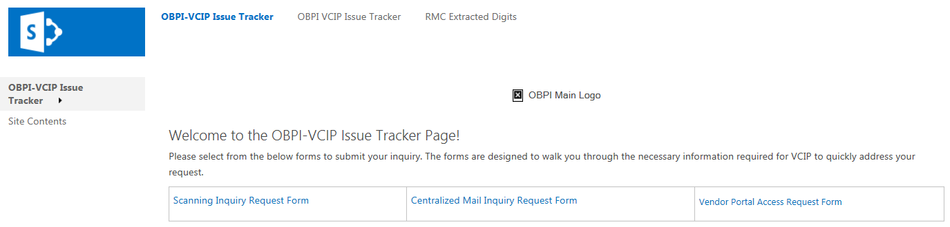

Requesting Access to Data Dimensions Tracker
To request access to the ddTracker, users must complete and submit the Vendor Portal Access Request Form on the VCIP Issue Tracker page.
Notes:
Once someone has been identified as a shipping point of contact for VR&E, they must FIRST request access to the Data Dimensions Tracker shipping portal (or as we refer to as ddTracker) by completing and submitting the Vendor Portal Access Request Form. The user can obtain this access by going to the OBPI-VCIP Issue Tracker Page.
On the VCIP Issue Tracker Page, click on the Vendor Portal Access Request Form link on the right. Once you click on the link, the form will open.

Slide 5
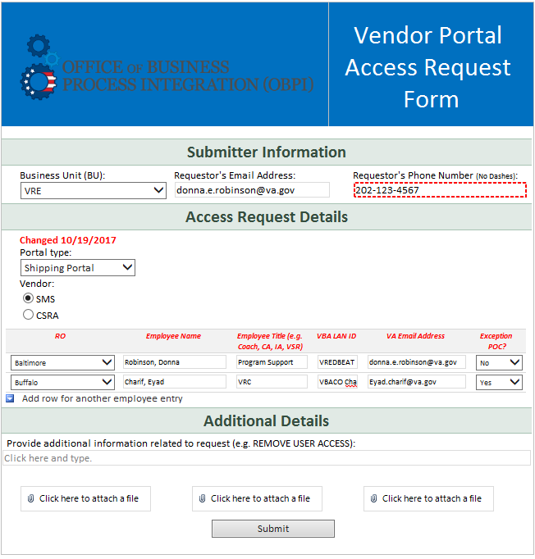
Vendor Portal Access Request Form
In the Vendor Portal Access Request Form, complete the following:
Business Unit (BU)
Requestor’s email address
Requestor’s phone number
Portal Type: Shipping Portal
Vendor: SMS (Systems Made Simple)
Regional Office (RO)
Employee Name
Employee Title
VBA LAN ID
VA Email Address
Exception POC? Select Yes or No
Click Submit button. SMS will contact the requestor by email to provide log-in instructions.
NOTE: The exception POC is responsible for resolving shipment exceptions for the RO.
Notes:
In the Vendor Portal Access Request Form, you need to complete the following fields:
Business Unit: select VRE in the drop down menu
Requestor’s email address
Requestor’s phone number
Portal Type: Shipping Portal
Vendor: SMS (Systems Made Simple) – this is important. We are only shipping to SMS. Please be mindful of this throughout the shipping process.
Regional Office (RO)
Employee Name – person requesting access
Employee Title
VBA LAN ID/VA User ID – If you don’t know this, it is located in the Global Address List under Alias in the last column of the GAL
VA Email Address
Exception POC? Select Yes or No – this is the person who is resolving shipping exceptions
Click on the little blue arrow to add more rows if you have additional POCs that need access
Click Submit button. SMS will contact the requestor by email to provide log-in instructions.

Slide 6
How to Create a Document Control Sheet ID (DCS ID)
Notes:
This portion of our training will provide instructions on how to create a Document Control Sheet ID, or what we commonly refer to as the DCS ID. Remember that the DCS ID is the sheet you create for each Veteran file number, and needs to be secured to that Veteran’s folder before packing and shipping to scanning.

Slide 7
Create Document Control Sheet ID
Log into VBMS
Select the Search drop-down on the upper left corner of the screen.
Type the file number or SSN in the search field.
Select the Open Profile button.
VBMS will display the Veteran’s profile.
Notes:
Begin by logging into VBMS
Select the Search drop-down on the upper left corner of the toolbar
A search box will appear. Type the file number or SSN in the search field
Click on the Open Profile button.
VBMS will display the Veteran’s profile.

Slide 8
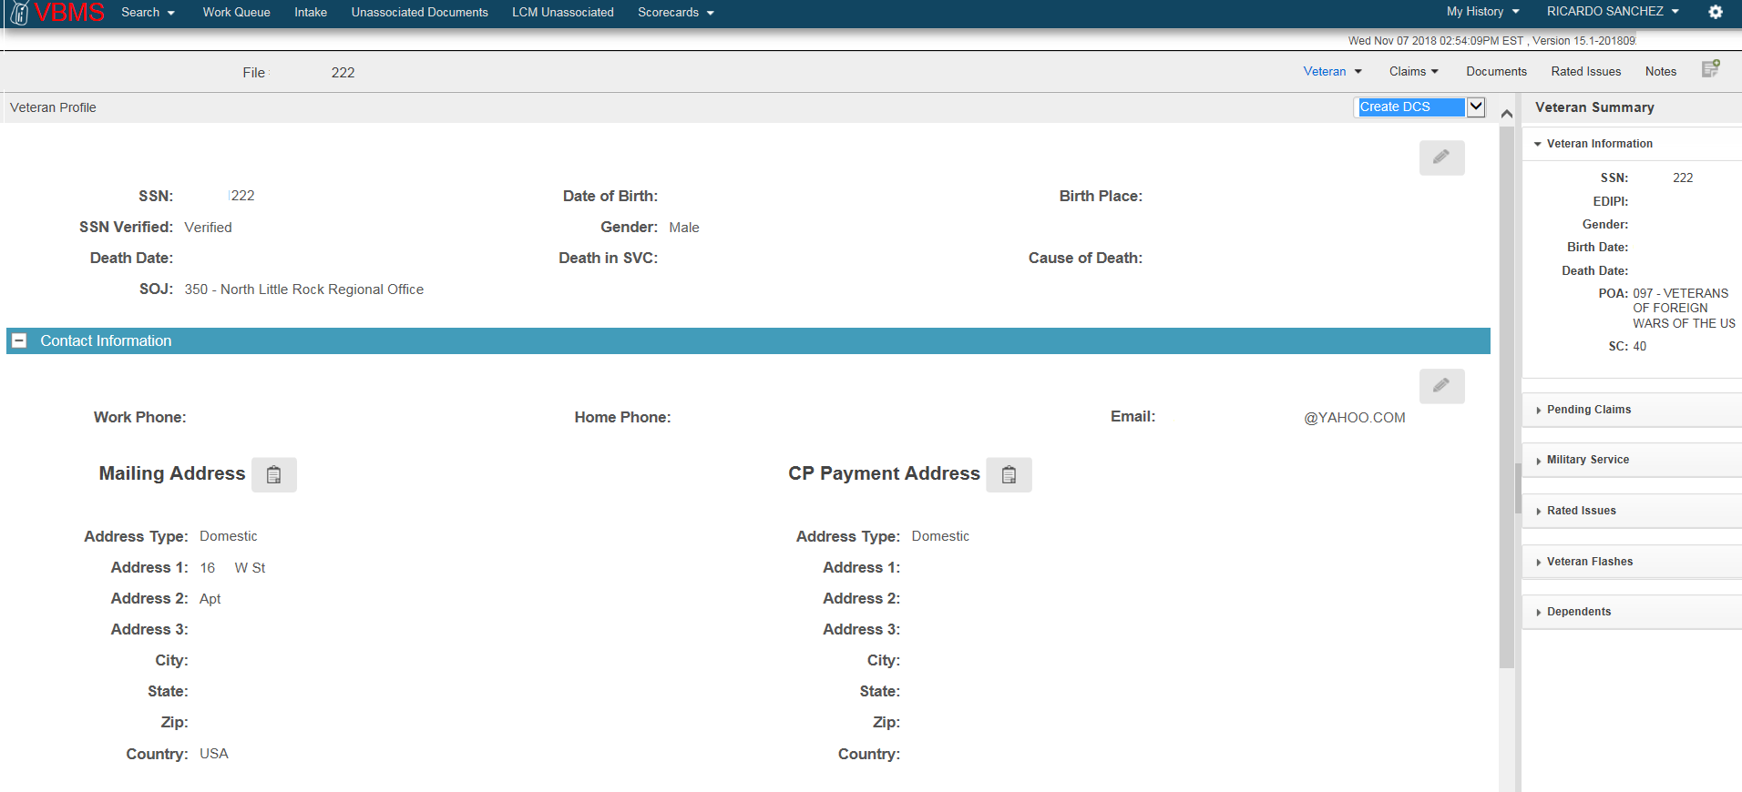
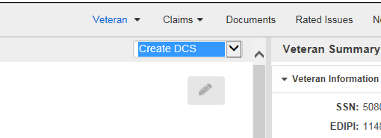
Create Document Control Sheet ID cont’d
5. From the Actions drop-down list, select Create DCS.
Notes:
From the Actions drop-down menu in the upper right hand corner, select the Create DCS option.

Slide 9
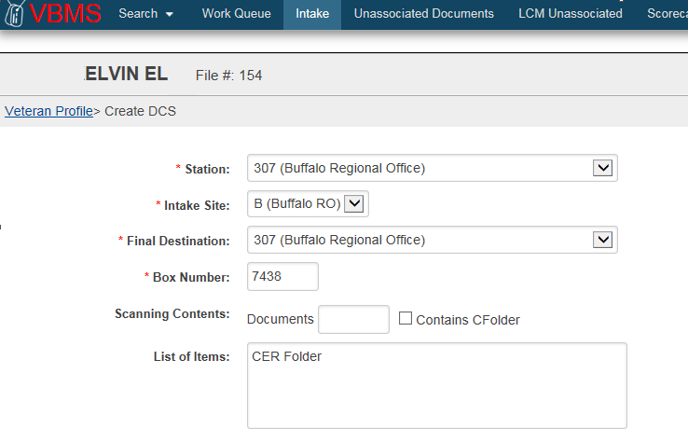

Create Document Control Sheet ID cont’d
From the Create DCS ID screen, select the following from the drop-down menus:
Station: Station from which folders will be shipped
Intake Site: RO location
Final Destination: Same as Station
Box Number: Last four digits of UPS tracking number (i.e., UPS tracking number 1ZA410E40397487438)
Scanning Contents: Leave blank
List of Items: Enter “CER Folder” in text box
Click Submit button to generate the DCS ID
NOTE: Only one UPS tracking number is allowed per shipment. Each box must be issued its own UPS tracking label.
Notes:
From the Create DCS screen, select the following from the drop-down menus:
Your station from which folders will be shipped
Intake Site: Your RO location
Final Destination: Same as Station field
Box Number: Last four digits of UPS tracking number – which should have already been printed for your reference
Scanning Contents: We ask that you leave this area blank
List of Items: Type the words “CER Folder”
Click Submit button to generate the DCS ID
NOTE: You will first need create your UPS shipping label prior to this process of creating a DCS ID. Before creating UPS labels, place folders inside box to be weighed, not to exceed 50 pounds, using the hand rule where you can still fit your hand inside the box – do not overstuff the box. Also, only one UPS tracking number is allowed per shipment. Each box must be issued its own UPS tracking label. Do not use the same UPS tracking number for more than one box. NO CH35 or 36 – only those CH36 that are called up for QA review may be shipped to scanning.

Slide 10
Create Document Control Sheet ID cont’d
After clicking Submit, the message “Do you want to open or save?” will appear at the bottom of the screen
Select Save As to display a PDF view of the DCS ID and to save a copy to the desktop
Don’t forget to save!
NOTE: DCS IDs CANNOT be reprinted from VBMS. Please ensure you print and save DCS IDs before shipping folders to scanning.
Notes:
After clicking Submit, the message “Do you want to open or save?” will appear at the bottom of the screen
Select Save As to display a PDF view of the DCS ID and to save a copy to the desktop

Slide 11
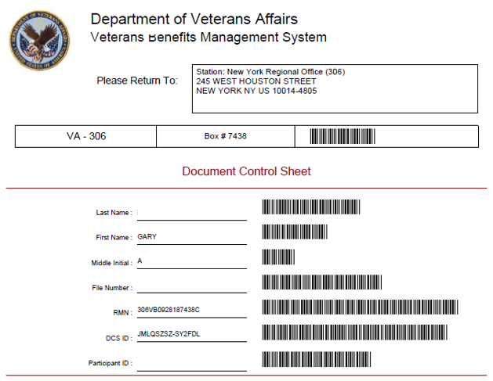
Create Document Control Sheet ID cont’d
Print the DCS ID and place it on top of the associated CER folder, and secure with a rubber band (no staples or clips)
  To avoid Record Management Number (RMN) issues, all DCS IDs and shipping manifests must be created on the same day.
Notes:
Print the DCS ID and place it on top of the associated CER folder, and secure with a rubber band (no staples or clips). If there are multiple volumes, secure them all together.
REMEMBER: To avoid Record Management Number (RMN) issues, all DCS IDs and shipping manifests must be created on the same day.
Introduce Nelly to do the demo

Slide 12
How to Generate VR&E Shipping Manifests in VBMS
Notes:
This portion of our refresher training will review instructions on how to generate VR&E shipping manifests in VBMS. This is an area where we are seeing a lot of errors so we will clearly review this process step by step.
NOTE: It is important to remember that during this process, once you begin processing a box, you must finish it in the same day when creating VR&E shipments in VBMS. The reason is because the date stamp must be consistent with the Records Management number (RMN).

Slide 13
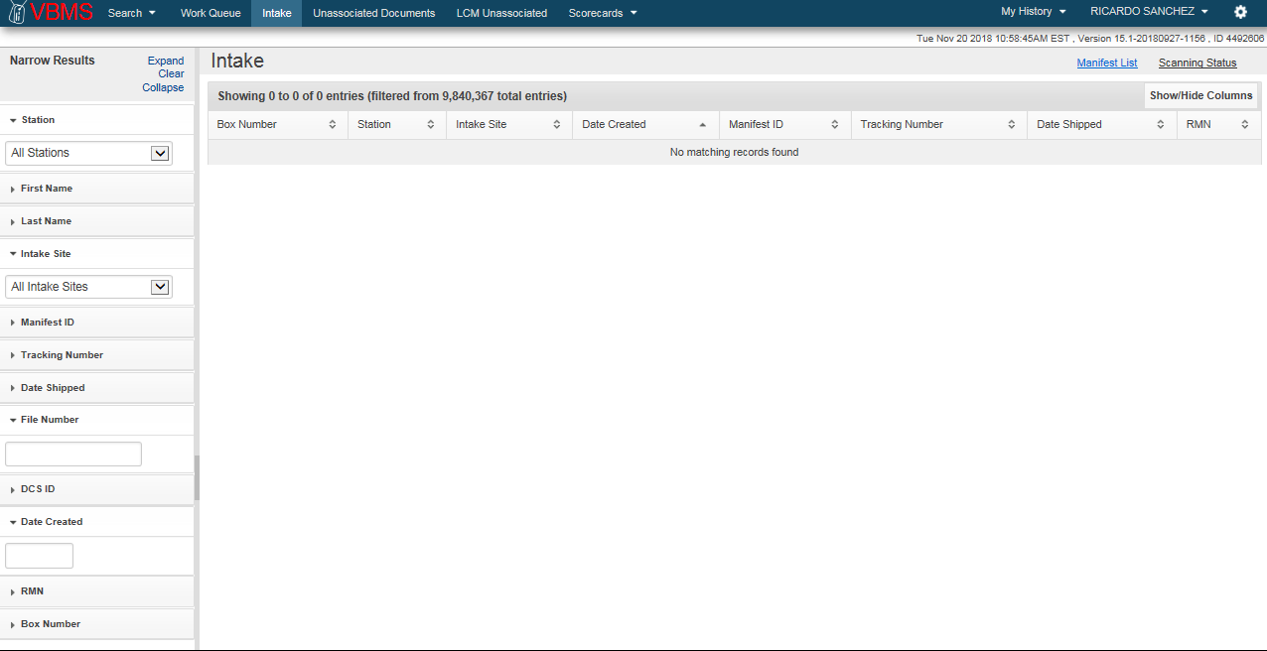

Generate VR&E Manifests in VBMS
Log into VBMS
Select Intake in the upper left corner on the toolbar
Scroll down to File Number: Enter File Number
Click the Filter button
Locate your shipment in the list and click on the hyperlinked Box Number
VBMS will display all the shipments created on the MM/DD/YYY of the search.
Notes:
Begin by logging into VBMS
Select Intake in the upper left corner on the toolbar
Be sure to hit the Clear button at the top of the left navigation pane to clear any data in the fields
Scroll down to File Number – enter the file number
Click the Filter button
Locate your shipment in the list that populates and click on the hyperlinked Box Number
VBMS will display all the shipments created on the date of the search.
NOTE: Searches can also be performed by using Records Management Number (RMN), Tracking Number, and DCS ID

Slide 14
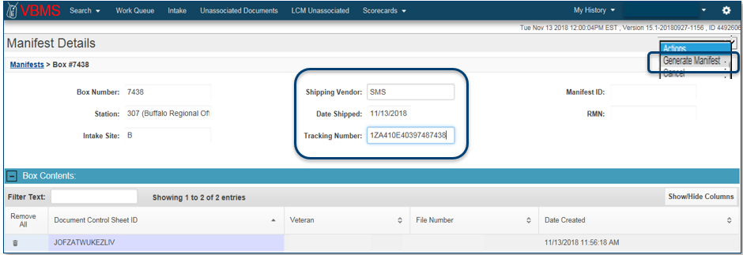
Generate VR&E Manifests in VBMS cont’d
VBMS will display a Manifest Details view listing of all DCS IDs created under the same box number.
In the Shipping Vendor field, type “SMS”
In the Tracking Number field, enter the UPS Tracking number created to ship the box (only one UPS tracking number per box)
From the Actions drop-down menu in the upper right corner of your screen, select Generate Manifest
VBMS will populate the Manifest ID and RMN fields
Notes:
VBMS will display a Manifest Details listing of all DCS IDs created under the same box number
In the Shipping Vendor field, type “SMS” – because remember, we are shipping to SMS and no other vendor.
In the Tracking Number field, enter the UPS Tracking # created to ship the box
From the Actions drop-down menu on the upper right corner of your screen, select Generate Manifest
VBMS will populate the Manifest ID and RMN fields

Slide 15
Generate VR&E Manifests in VBMS cont’d
At the bottom of the screen, VBMS will display the message: Do you want to open or save?
Select Open to display a PDF view of the Shipping Manifest and/or Save As to store a copy to your desktop
Don’t forget to save!
Note: The shipping manifest can be re-printed if needed.
Notes:
After clicking Submit, the message “Do you want to open or save?” will appear at the bottom of the screen
Select Save As to display a PDF view of the manifest and to save a copy to the desktop

Slide 16
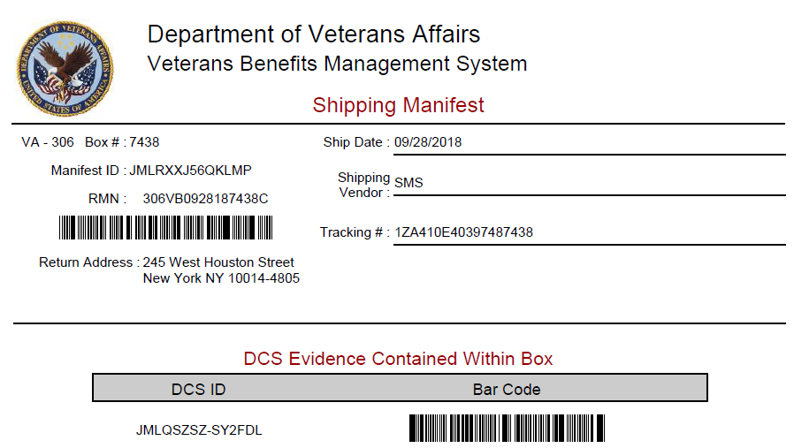
Generate VR&E Manifests in VBMS cont’d
VBMS will display the shipping manifest
Print the shipping manifest and place inside the box prior to shipping
PLEASE: Write your VR&E office location (i.e., 306-VR&E New York) and the RMN in permanent black ink on the outside front of the shipping box
Notes:
VBMS will display the shipping manifest. Above the first barcode, you will see your Office #, Box #, Manifest ID and RMN.
Print the shipping manifest
REMEMBER! Place the manifest inside the box
Please remember to write your VR&E Office location (i.e., 306-VR&E New York) and the RMN in permanent black ink on the outside front of the shipping box
Introduce Nelly to do the demo

Slide 17
How to Add Shipping Information in ddTracker Shipping Portal
Notes:
Now we will discuss How to Add Shipping Information in the ddTracker Shipping Portal which is critical in communicating to the scanning vendor and keeping a track of your Veterans’ folders.

Slide 18
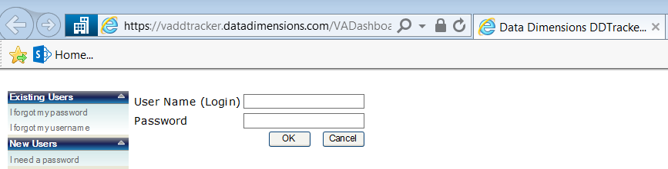
Adding Shipping Information in ddTracker Shipping Portal
Remember! The ddTracker is used to enter shipping information for the scanning vendor.
Log into the DataDimensions ddTracker
Click OK
Notes:
Log into the DataDimensions ddTracker
Click OK

Slide 19
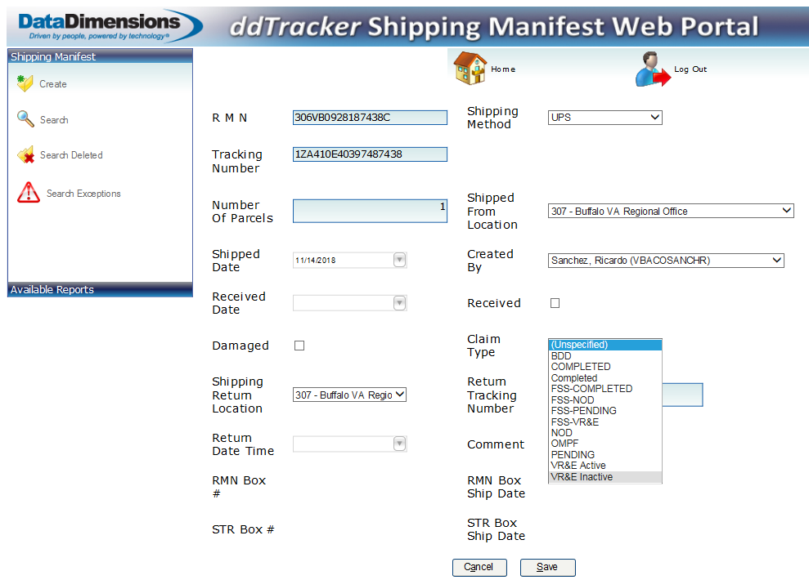
Adding Shipping Information in ddTracker Shipping Portal
From the Home page select Create
Type the RMN and Tracking Number
Shipping Method: Select UPS
Shipped Return Location: Should be the same as Shipped from Location field
From Claim Type drop-down: Select VR&E Active
Click Save
PLEASE NOTE: Step 7 has changed to VR&E Active – This does NOT apply to any folders that are in an open case status (excluding QA folders).
Notes:
From the Home page select Create
Type the RMN and Tracking Number
Shipping Method: Select UPS
Shipped Return Location: Should be the same as Shipped from Location field
From Claim Type drop-down: Select VR&E Active –You may have noticed recently that the VR&E Inactive option is no longer available. This is to ensure that all shipments are being marked properly and as directed by VCIP within the ddTracker
Click Save
PLEASE NOTE: Step 7 has changed to VR&E Active – This does NOT apply to any folders that are in an open case status (excluding QA folders) because VR&E is not yet shipping all other folders in an open case status.
We have been announcing this update on the VRE biweekly shipping calls, but also making you all aware who have not been on these calls, and to ask that you try to join at least one of these calls a month to ensure everyone is up to date on the current news regarding VRE shipping processes. Please reach out to via email to me for this meeting invite. Or let us know in the chat and we can forward you the meeting series.

Slide 20
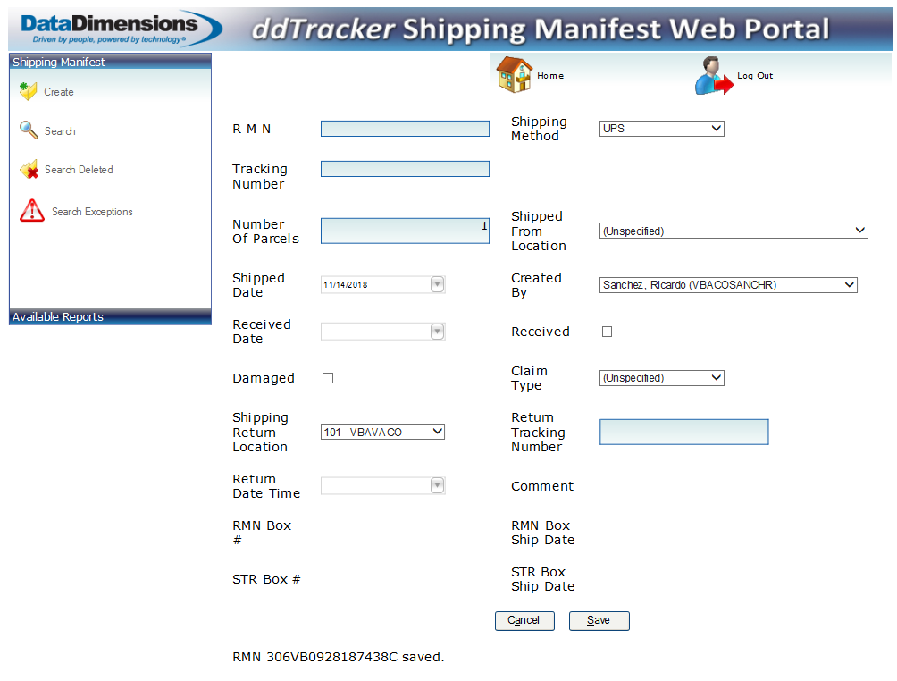
Adding Shipping Information in ddTracker Shipping Portal
The shipping information is saved to ddTracker only when the ‘RMN … saved’ message appears at the bottom of the screen.
To return to the Home page, select Home at the upper right corner of your screen.
Notes:
The shipping information is saved to ddTracker only when you see the ‘RMN … saved’ message which will appear at the bottom of the screen.
To return to the Home page, select Home at the top of the screen with the little house icon.
Introduce Nelly to do the demo

Slide 21
REMEMBER!
Completed VRE material, to include folders called up for QA review, must be shipped only to:
Systems Made Simple (SMS)
432 Midland Road, Mail Stop 195601
Janesville, WI 53546
For additional shipping instructions, follow the steps listed in the M21-1, Part III, subpart ii, Chapter 1, Section F Veterans Claims Intake Program (VCIP) Shipping.
Notes:
Completed material shall be shipped to:
Systems Made Simple (SMS)
432 Midland Road, Mail Stop 195601
Janesville, WI 53546
For additional shipping instructions, follow the steps listed in the M21 manual under the section titled
Veterans Claims Intake Program (VCIP) Shipping.

Slide 22
How to Resolve Shipping Exceptions by Type
Notes:
This portion of our training will provide instructions on how to resolve shipping exceptions. Just a note because we have been seeing this more frequently – once you ship a box to scanning, it can NOT be retuned to the RO. Therefore, it is vital that care and due diligence is taken when creating and shipping any VRE shipments.
The reason that a box cannot be returned back to the RO is that there is no contract requirement for the scan vendor to return the box. Please use job aids such as the shipping checklist that is provided on the VRE biweekly shipping calls – we will discuss the checklist towards the end of this training. It is also attached to this meeting for your use.

Slide 23
RMN/UPS Tracking Missing from Vendor Portal
(Shipping information was not added to the ddTracker Portal)
Notes:
This type of shipping exception involves a missing RMN or UPS tracking number from the vendor portal. In other words, the POC responsible for shipping for the RO neglected to add the shipping information into the portal. This is a required and necessary step.

Slide 24
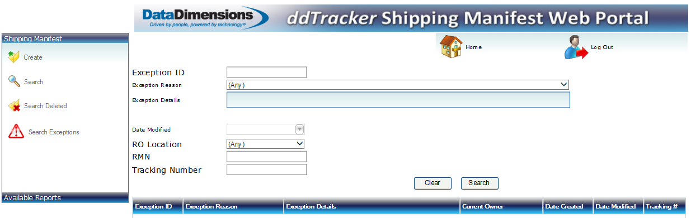
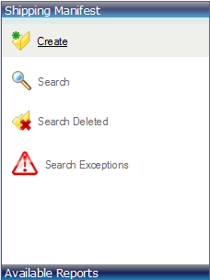
RMN/UPS Tracking Number Missing from Vendor Portal
This shipping exception occurs when the person responsible for shipping does not add the shipping information into the ddTracker portal prior to shipping a box.
To resolve shipping exceptions with a missing RMN and/or UPS Tracking number, sign into the ddTracker
From the Home page select Create
Notes:
This shipping exception occurs when the RO does not add the shipping information into the ddTracker portal prior to shipping a box.
To resolve shipping exceptions with a missing RMN and/or UPS Tracking number, sign into the ddTracker Shipping Manifest Web Portal
From the Home page select Create

Slide 25
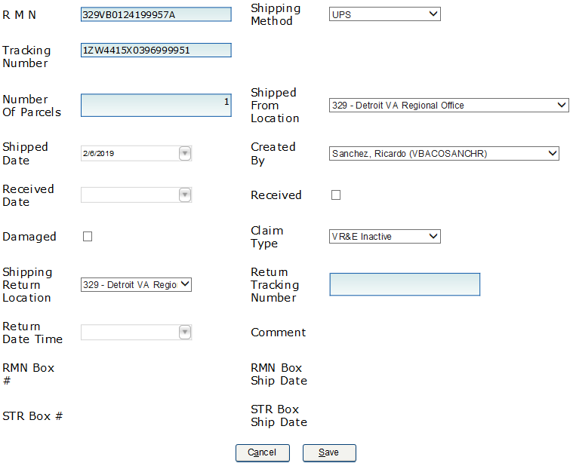
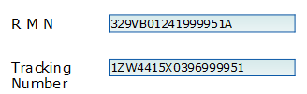
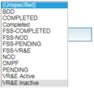

RMN/UPS Tracking Number Missing from Vendor Portal
Type or copy/paste the RMN and Tracking Number
Select UPS for Shipping Method
The Shipped from Location and Shipped Return Location should reflect the shipping station (your RO)
From the Claim Type drop-down list select VR&E Active
Click Save
To return to the Home page, select Home
Note: The shipping information is saved when the RMN … saved message appears at the bottom of your screen
Notes:
Enter or copy and paste the RMN and Tracking Number
Select UPS for Shipping Method
The Shipped from Location and Shipped Return Location should reflect the shipping station (your RO)
From the Claim Type drop-down list select VR&E Active
Click Save
To return to the Home page, select Home
Note: The shipping information is saved when the RMN … saved message appears at the bottom of your screen

Slide 26
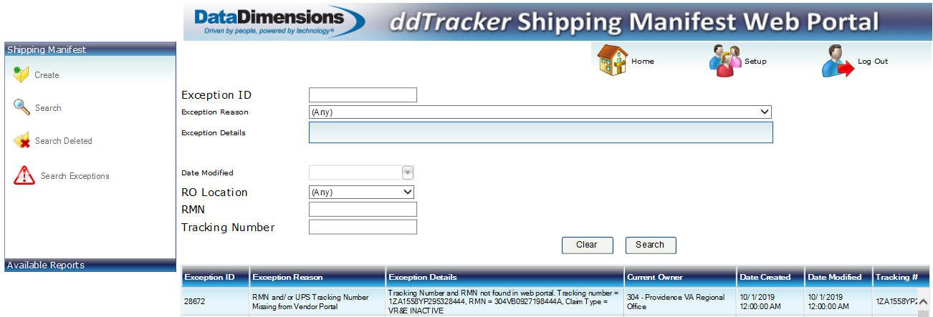
RMN/UPS Tracking Number Missing from Vendor Portal
After the RMN/UPS tracking number are added to the ddTracker, update the shipping exception status. Begin from the ddTracker Home page:
Select Search Exceptions, then click the Search button on the Exception ID page
In the Exception ID page, ddTracker will display unresolved shipping exceptions at the bottom of your screen
Double-click on the Exception ID you wish to resolve
Notes:
After the RMN/UPS tracking number are added to the ddTracker, update the shipping exception status. Begin from the ddTracker Home page:
Select Search Exceptions, then click the Search button on the Exception ID page
On the Exception ID page, ddTracker will display unresolved shipping exceptions at the bottom of your screen
Double-click on the Exception ID you wish to resolve
REMEMBER! Please resolve any identified shipping exceptions as soon as possible to avoid further delay of your Veterans’ folders.

Slide 27
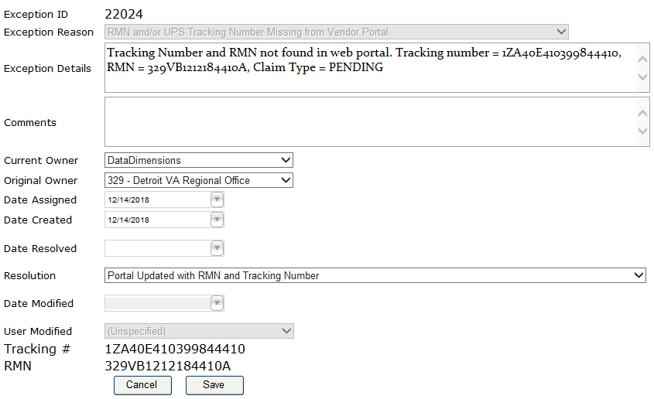
RMN/UPS Tracking Number Missing from Vendor Portal
  From the Current Owner drop-down list, select DataDimensions
  From the Resolution drop-down list, select Portal Updated with RMN and Tracking Number
  Click Save
Notes:
From the Current Owner drop-down list, select DataDimensions
From the Resolution drop-down list, select Portal Updated with RMN and Tracking Number
Click Save
Once you click Save, the system will process that action, but you will not receive a confirmation notification. Please be sure to click Save only once.
Introduce Nelly to do the demo

Slide 28
Missing DCS ID(s) from Manifest
(Extra folders in the box)
Notes:
Now we will discuss how to resolve a shipping exception that involves missing DCS IDs from a manifest. This means that there are extra folders found in a shipping box, but they are not listed on the manifest.

Slide 29
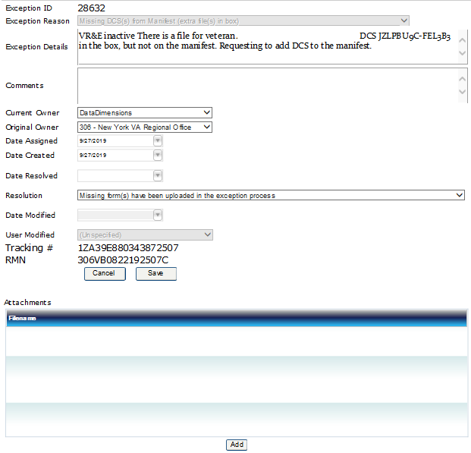
Missing DCS IDs from Manifest (extra folders in box)
From the Home page, click on Search Exceptions, then click Search (or search by Exception ID)
Choose the exception to be resolved by double-clicking the exception
From the exception ID page, displayed here:
Click the Add button at bottom of the page to upload the DCS ID
Next, update the Current Owner field to DataDimensions
From Resolution drop-down select Missing Form(s) have been uploaded in the exception process
Click Save
Notes:
All DCS IDs should have been saved as PDFs, as we have emphasized in trainings. To resolve this type of exception, upload the DCS ID into the ddTracker.
Upload PDF into ddTracker
Update the Current Owner field to DataDimensions
From Resolution drop-down select: Missing Form(s) have been uploaded in the exception process
Click Save

Slide 30
Missing DCS IDs from Manifest (extra folders in box)
  If the missing DCS ID was not saved prior to shipping, please follow these steps:
    In VBMS, search to verify if the missing DCS ID was created
    If the DCS ID was created, but not shipped, remove it from VBMS
    Next, create a new DCS ID and save it
    Generate a new shipping manifest
    In ddTracker, search for the shipping exception
    Next, attach the new DCS ID PDF file
    Update the Current Owner drop-down list to DataDimensions
    Update Resolution drop-down list to Missing Form(s) have been uploaded in the exception process
  Click Save
  REMEMBER! Do not forget to delete DCS IDs that were previously created in VBMS and were not shipped. It's important to avoid Pending Scanning Banners (PSBs).
Notes:
If the DCS ID was not saved as prescribed in the training:
If the missing DCS ID was not saved:
In VBMS, search to verify if the missing DCS ID was created
If the DCS ID was created, but not shipped, remove it from VBMS
Next, create a new DCS ID and save it
Generate a new shipping manifest
In ddTracker, search for the shipping exception
Then attach the new DCS ID PDF file
Update the Current Owner drop-down list to DataDimensions
Update Resolution drop-down list to Missing Form(s) have been uploaded in the exception process
Click Save
Note: Do not forget to delete DCS IDs that were previously created in VBMS but were not shipped. It's important to avoid Pending Scanning Banners (PSBs).
Introduce Nelly to do the demo

Slide 31
Extra DCS ID(s) on Manifest
(Folder not in box)
Notes:
Now we will cover the topic on how to manage extra DCS IDs listed on the manifest. This means that a DCS ID was created in VBMS, but the folder was not shipped.

Slide 32
Extra DCS IDs on Manifest (missing folder from the box)
If the DCS ID was created, but the folder is missing from the box (i.e., folder was not shipped), users must follow these steps:
Log in to VBMS and locate the shipment
Select Intake from the upper ribbon
Search by File Number
Click on the Filter button
Notes:
If the DCS ID was created, but the folder is missing from the box (i.e., folder was not shipped), users must follow these steps:
Log in to VBMS
Select Intake from the upper ribbon
Search by File Number or RMN
Click on the Filter button

Slide 33
Extra DCS IDs on Manifest (missing folder from the box)
VBMS will display the search results
Click on Box Number to display a detailed view of the shipment
Notes:
VBMS will display the search results
Click on the hyperlinked Box Number to display a detailed view of the shipment

Slide 34
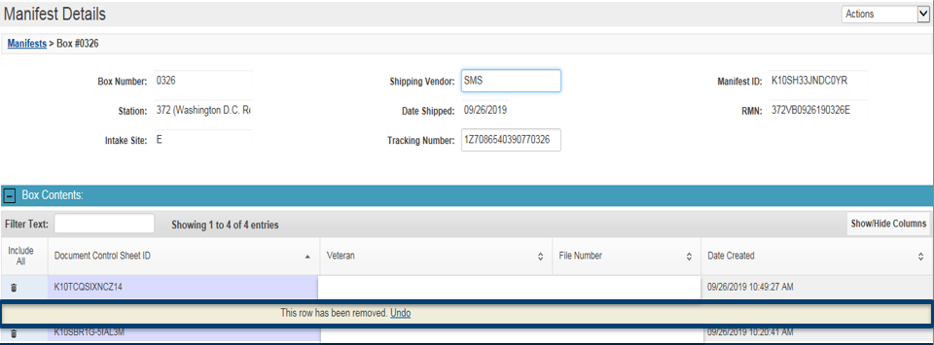
Extra DCS IDs on Manifest (missing folder from the box)
Locate the DCS ID you wish to remove by clicking on the trash can image in the left column
Select Intake to return to the previous view
Notes:
Locate the DCS ID you wish to remove by clicking on the trash can image in the left column
Select Intake to return to the previous view
Now that you have deleted the old DCS ID, you will need to update the ddTracker portal.

Slide 35
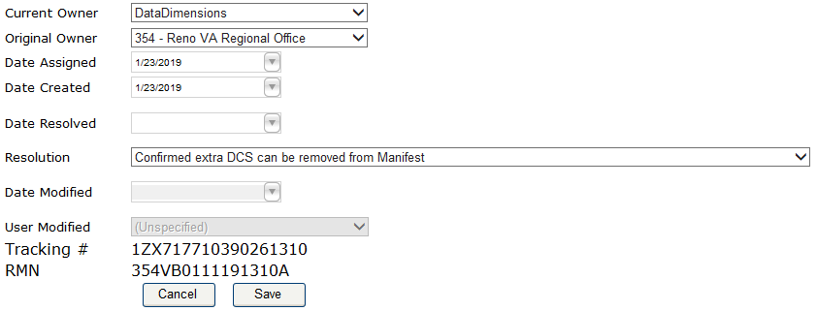
Extra DCS IDs on Manifest (missing folder from the box)
Next, update the information in the ddTracker portal:
Sign into ddTracker and search for shipping exception
Update the Current Owner to DataDimensions
Update the Resolution to reflect Confirmed extra DCS can be removed from Manifest
Click Save
Notes:
Next, update the information in the ddTracker portal:
Sign into ddTracker and search for shipping exception
Update the Current Owner to DataDimensions
Update the Resolution to reflect Confirmed extra DCS can be removed from Manifest
Click Save
Introduce Nelly to do the last demo

Slide 36
IMPORTANT!
Ship ONLY to this scanning vendor:
Systems Made Simple (SMS)
432 Midland Road, Mail Stop 195601
Janesville, WI 53546
Once a box is shipped, it cannot be sent back to the RO
Do NOT ship Chapter 35 folders to scanning
Avoid creating shipping exceptions by following proper protocol
If shipping exceptions do occur, please resolve immediately to avoid scan delays
Remember to delete old DCS IDs once the shipping exception is resolved
Follow the proper protocol for sensitive level folders and work with alternate station
Please respond to VCIP when they send the shipping exceptions report.
Notes:
Ship ONLY to SMS in Janesville – We’re still seeing ROs shipping folders to the old vendor. The guidance VR&E Service & OFO provided since Nov of 2018 is all ROs must ship to SMS. Shipping elsewhere creates a huge issue in delays and lost folders. Please double check your UPS labels before shipping.
We’re finding that once stations have discovered a mistake in a shipment, they request the box be returned. Boxes cannot be returned by the scan vendor. We emphasize the need to be careful when processing and shipping a box. Double check everything before you ship that box
Do NOT ship CH35 or CH36 folders to scanning. Only those CH36 folders called up by QA review may be shipped. Keep in mind, if a CH35 folder gets shipped to scanning, you will not be able to locate it in VBMS, because this is a dependents folder and there is no current infrastructure within VBMS to house CH35. There have been a couple of situations where a CH35 folder was inadvertently sent to shipping. Those ROs must now re-create that CH35 folder to manage on station.
The number of shipping exceptions occurring in the field are becoming significant and causing a huge backlog in the scanning facility. This creates significant delays in the scanning of your folders because of the number of exceptions which are not being resolved timely. There are a couple of stations, which we will not name (you know who you are), who have a very high number of exceptions. These need to be resolved immediately. Please work with us and VCIP if you need assistance.
Again, please resolve exceptions immediately to avoid scan delays
For shipping exceptions that require you to create a new DCS ID, please remember to delete the old DCS ID once the shipping exception is resolved
Guidance has been provided on how to handle sensitive level folders – please work with your alternate station. We go over this process on the VRE Biweekly Shipping calls and we provide access to the slides.
Please respond to VCIP if you receive an email regarding shipping exceptions. They are reaching out to you to assist you.

Slide 37
IMPORTANT!
When packing folders into the shipping box, please use the hand rule. This means you can still slide your hand between the folders and the end of the box so as not to overstuff the box. Remember it should not be more than 50lbs
Please use only the approved, standard white banker boxes for shipping
Be sure to use the shipping checklist that we have provided to you in the attachments of this call
Sensitive level folders – please work with your alternate station to create the DCS ID and manifest. No need to ship the physical folder to the alternate station.
Notes:
Make sure when packing boxes that the hand rule is applied, which means there’s enough room in the box on the end to slide your hand in between the folders and the side of the box. Don’t overstuff the box and check to be sure it’s not over 50lbs
Please continue to use the white, standard banker boxes to ship
Please use the shipping checklist that has been provided. This is a good job aid that we highly recommend is used
Access restricted folders – please continue to work with your alternate stations on creating the DSC IDs and manifests.

Slide 38

Send scanning inquiries or portal assistance to VCIP.VBACO@va.gov
All other VR&E related questions, please contact your Field Liaison Team

