Slide 1
Pension and Fiduciary Service
October
2019
Centralized Benefits Communications Management (CBCM) Phase One - Centralized Printing

Slide 2
Purpose
Centralized Benefits Communications Management (CBCM) is a Veterans Benefits Administration (VBA) initiative designed to provide greater choices for beneficiaries and fiduciaries in how they receive correspondence from VBA. The goal is to centralize and streamline the delivery of outbound communications across all VBA business lines.

Slide 3
Objectives
Upon completion of this training you will be able to:
Explain the new VBMS functionality of Package Manager.
Demonstrate how to create packages in VBMS-Core and VBMS-A
Recognize whether the Package Manager sent the package to centralized printing.

Slide 4
Benefits
Improve the Fiduciary Experience
Provide a more automated and efficient means of generating and delivering letters, and
Reduce the risk of PII violations

Slide 5
Terms
Package Manager – VBMS functionality that allows you to create a package, to add documents, and to track who receives the correspondence.
Package – a group of documents in a particular order (i.e. – Fiduciary Notification Letter, VA Form 21P-4703, and Fiduciary Agreement)
Distribution – electronic information that identifies recipients and mailing location.

Slide 6
CBCM Exemptions
Federal Tax Information
VBMS is not an approved system for storing Federal Tax Information (FTI). Therefore, please do not add any documents to the VBMS eFolder that contains FTI or create a package for Centralized Printing using a document containing FTI.
BFFS Accounting Letters

Slide 7
Creating packages in VBMS-Core
There are three ways you can create packages in VBMS-Core.
1. Letter chevron in the Claim Details
2. Veteran’s eFolder
3. Package Manager

Slide 8
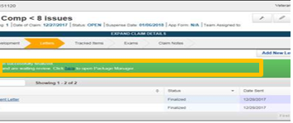
Creating Packages in Letter Chevron
VBMS-Core will automatically create a package in the Letter Chevron after you finalize a letter.
Once the green Success Banner appears, click the link.

Slide 9
Creating Packages in the Letter Chevron
Next, select the name of the package you just created.
*Note: Package name will be based on letter name and date of letter. The package will also be in “Draft” status.

Slide 10
Creating Packages in Letter Chevron
Add document(s) from the efolder or standard enclosures by clicking the “+Document(s)” button.
Note: Only use standard forms in the Package Manager.

Slide 11
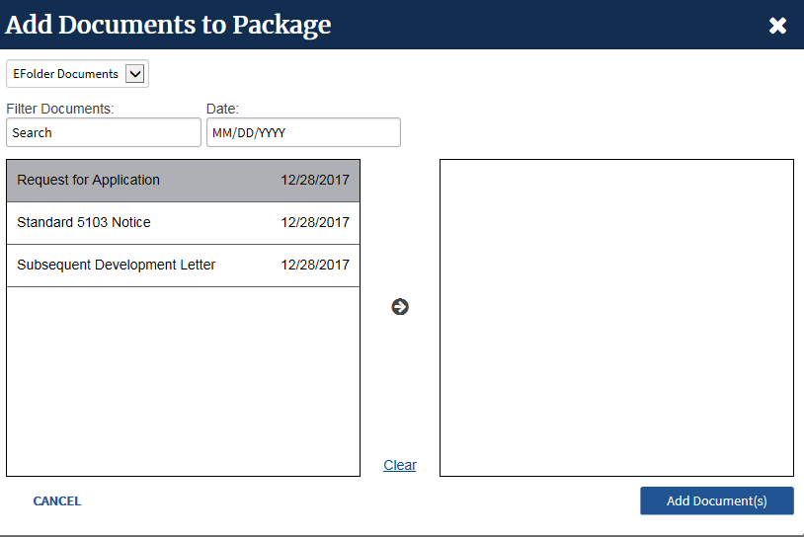
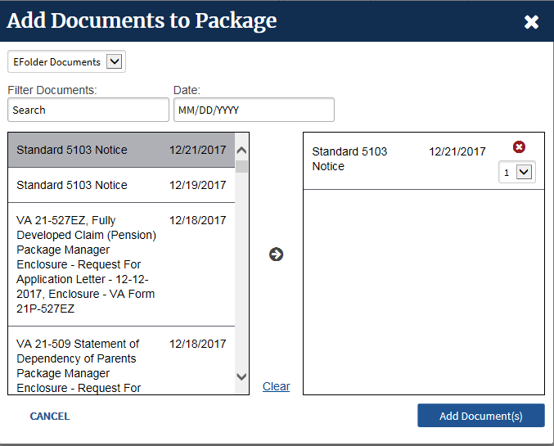
Creating Packages in Letter Chevron
To add eFolder document(s):
Select the document(s)
Select the arrow to move the document(s), then select Add Document(s).

Slide 12
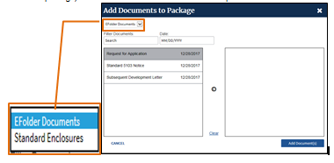
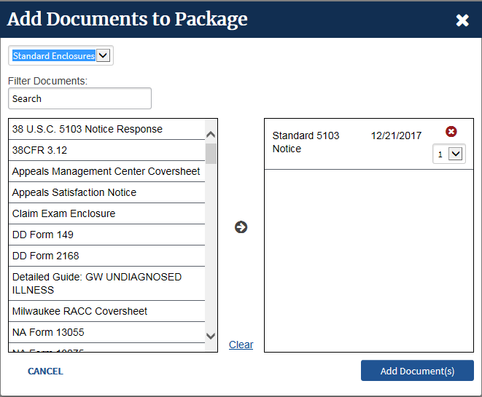
Creating Packages in Letter Chevron
To add standard enclosures, such as, VA Form 24-0296,
Click the Drop-Down Menu
Select the standard enclosure(s)
Use the arrow to move the enclosure(s) and select “Add Document(s).”

Slide 13
Creating Packages in Letter Chevron
Verify the address.
Select the “Add Recipient” button if needed.
Indicate if the recipient is an “Individual” or “Organization.”
Verify all information indicated by an asterisk.
Save
Send Package for each recipient

Slide 14
Creating Packages in Letter Chevron
You will know the package was sent to Centralized Printing when:
The circle icon becomes an envelope.
The status changes to “FINALIZED.”
Close this window to return to VBMS-Core.

Slide 15
Additional Ways to View Package Status: Distributions Tab
You will see the following “Distributions Tab” status messages:
Draft, circle; The package is not finalized. This status means the user must finalize the package to be sent.
In Progress, envelope; The package is finalized and sent to Centralized Printing. No action is needed.
Success, checkmark; Centralized Printing received and accepted the package. No action is needed.
Fail, exclamation point; Centralized Printing received the package, but unable to print it. User should contact VAVBAWAS/CO/VCIP

Slide 16
Additional Ways to View Package Status: Package Tab
You will see the following “Packages” status messages:
New, blue circle; The package has not been finalized and sent. User needs to finalize and send package.
Finalized, green circle; The package has been sent to Centralized Printing. No further action is needed.

Slide 17
Creating Packages in the eFolder
Packages can be manually created from the eFolder by selecting the applicable document(s), then selecting “Add to Package” from the Action Drop Down menu.
*Note: Letters created using PC Generated Letters (PCGL) and BFFS will be sent after the letter has been uploaded to the eFolder.

Slide 18
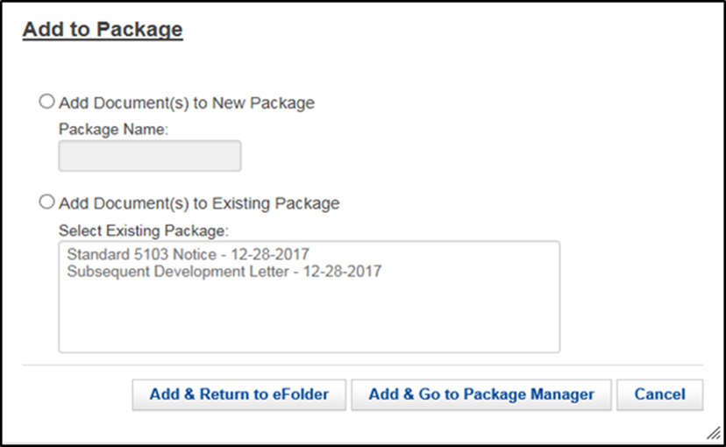
Creating Packages in the eFolder
After you select, “Add to Package,” chose one of the following:
add the document(s) to a new package, or
add the document(s) to an existing package.
Note: All new packages will require you to
create a package name.
Example, “Successor Initial Appointment Letter ” as a Package name (correspondence date).

Slide 19
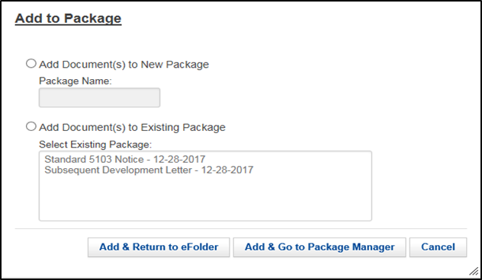
Creating Packages in the eFolder
If you select either “Add and Return to eFolder,” or “Add & Go to Package Manager,” you will have the option of adding additional documents to your package.

Slide 20
Creating Packages in Package Manager
You can create a new or an existing package by just clicking on the Package Manager from the Veteran’s Drop Down menu.

Slide 21
Creating Packages in Package Manager
Next, click create and build your package. Once you are done, it will be in a “NEW” status.

Slide 22
Deleting a Package Created in Error
You can delete a package in “New” status by selecting Delete (trash can icon).

Slide 23
Creating Packages in VBMS-Awards
After generating an award, navigate to the “Award Letter Interview” and select “Gen Letter.”
Click “Enclosures”
Note: Package Manager sends the documents you indicate. You should only add documents that are not already in the Letter Preview.

Slide 24
Creating Packages in VBMS-Awards
To send additional enclosures, specify the recipients, using the “Enclosures” tab:
Select “N” under “Part of Award Ltr,” if it is not a part of the normal award package.
Select the recipient(s) using the pencil scratchpad icon.
Enter the “Enclosure Order.” For example, if this enclosure goes first, then place a 1 in the space.

Slide 25
Creating Packages in VBMS-Awards
After building the package, navigate to “Recipients” tab and ensure recipients’ addresses are correct.
- You can add an additional recipient by selecting the “Add” button.
If there is not a predefined address for the VSO, then manually input the address fields and save. Note, it should be the claimant’s SOJ.

Slide 26
Creating Packages in VBMS-Awards
After all recipients have been identified, click on the arrow under “Delivery Method.”
*Note: If the Award requires concurrence, the delivery method and recipient information will continue from the Authorizer’s changes.

Slide 27
Creating Packages in VBMS-Awards
The promulgator will select “Print Central.”
Once all the recipients are added and the delivery method of “Print Central” is complete, select “Accept”

Slide 28
Creating Packages in VBMS-Awards Authorization Review
Navigate to the Correspondence Summary to review a snapshot of both “Recipients” and “Enclosures” tabs.
Authorizer can make edits to either recipients or enclosures in their respective tabs

Slide 29
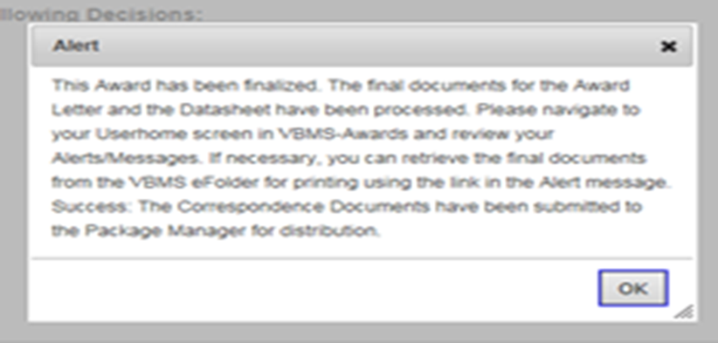
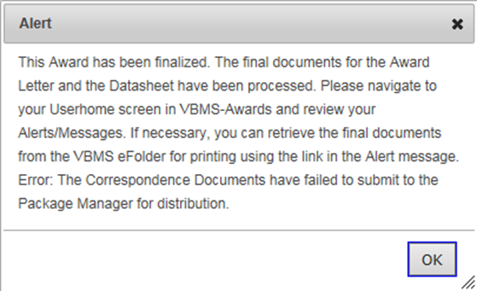
Creating Packages in VBMS-Awards Authorization Review
Authorizers will receive the following message when a “Print Central” letter is authorized and successfully sent to Package Manager.
If the package failed to submit, the message will refer the user to the Package Manager.

Slide 30
Creating Packages in VBMS-Awards Authorization Review
You can verify that packages sent from VBMS Awards were received by Package Manager and sent to Centralized Printing by navigating to the Package Manager for that Veteran in VBMS Core.
The “Recipient tab” status should show, “In Progress” for successful submission

Slide 31
VSO Copies of Correspondence
Copies of communications (letters) for VSO Representatives will be printed along with the claimant’s copy and mailed to the SOJ. The SOJ will disseminate VSO copies to co-located organizations.

Slide 32
Review
Understand the new VBMS functionality of Package Manager.
Create packages in VBMS-Core and VBMS-Awards.
Recognize whether the Package Manager sent the package to centralized printing.
Improve the overall experience for our internal and external stakeholders.

Slide 33
Questions

