Slide 1
FOR TMS TRAINING CREDIT
To obtain training credit in TMS, there is no need to review these slides at this time – immediately close this box by using your mouse to select the “X” in the upper right-hand corner; select the “Return to Content Structure” button; and, select the next link (Video) to view the edited audio-video recording of the Quality Call along with the Call Bulletin
These slides are included here only in case you want to use them later for training purposes or reference
These are the same slides that are shown in the audio-video recording

Slide 2
October 9, 2019
Compensation Service
Quality Call

Slide 3
Welcome to the October 2019 Quality Call
Bonnie Kirby
Senior Quality Review Specialist
Quality Review Team
Quality Assurance

Slide 4
Agenda
Deferred Ratings
What’s New in the M21-1?
M21-5, Appeals and Reviews
Previously Denied Issues Within the Scope of the Claim
Accrued Claim Processing
Q-Tips
EP 930 Establishment and VBMS Notes
Selecting Increase Exams in CAPRI
Effective Date for Schoolchildren Turning 18

Slide 5
Agenda (Cont’d)
Dependency Special Focused Review (SFR)
EP Cancellations SFR Results and Recommendations
Proper Use of Compensation Service Over $25K Special Issue
Requirements for Extra-Schedular Requests to Compensation Service
Closing Comments

Slide 6
Deferred Ratings
Jessica Flannery
Analyst
Program Operations Staff
Quality Assurance

Slide 7
Generating Deferrals
Over 980,000 deferrals created in FY19
40% of those deferrals did not contain a manual reference
Reminder: M21-4, 6.8.e requires deferrals to outline all relevant details to include a manual reference(s).
Manual references provide guidance on required claim processing procedures.
Manual references help ensure everyone across the nation is consistent in the rework actions being requested.
When generating a deferral, if you determine there is no applicable reference for the requested action, then you must analyze whether the deferral is truly necessary.
Notes:
980,000 deferrals means nearly (if not more than) 1 million actions were needed to relook/rework a claim. How many more Veterans could we have assisted last FY if we didn’t have those nearly 1 million deferrals.

Slide 8
Generating Deferrals
A deferral should not be used unless returning a claim to an earlier place within the claims cycle to correct an erroneous or incomplete action.
Missed actions associated with systems compliance, such as service verification, are the responsibility of all claims processors and are not a valid reason for deferrals (unless it requires additional development or an updated rating decision).
Prior to generating a deferral, ask yourself if there were erroneous or incomplete actions that requires the claim to return to an earlier place in the claim cycle. If your answer is NO, you could be generating unnecessary rework.

Slide 9
What’s New in the M21-1?
Melissa Milenkovic
Acting Chief
Procedures Maintenance
Policy and Procedures

Slide 10
Policy Letter 20-19-08
On September 4, 2019, the USB signed the Policy Letter 20-19-08 on the stay of pending claims under the Blue Water Navy Vietnam Veterans Act of 2019.
Components of the new law
New development procedures
Updated stay procedures for end products 040 (supplemental claims)

Slide 11
Policy Letter 20-19-08
New development procedures:
Concede exposure for Da Nang Harbor service.
Do not request US Army and Joint Services Records Research Center or JSRRC research in Navy Vietnam service cases.
New EP 040 stay procedures
Continue EP 040 and establish EP 335

Slide 12
M21-5, Appeals and Reviews
Rob Gordon
Management and Program Analyst
Quality Assurance, Training, and Site Visits
Appeals Management Office

Slide 13
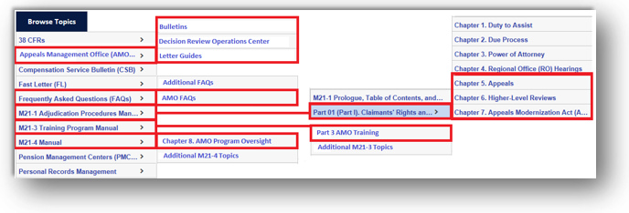
AMO – M21-5, Appeals and Reviews
The Compensation Pension Knowledge Management houses AMO-related guidance in numerous locations

Slide 14
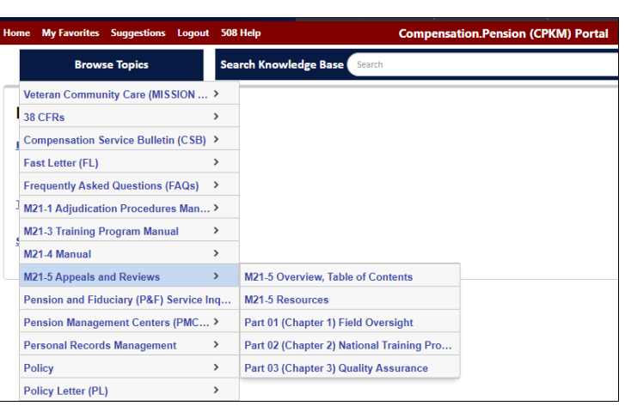
AMO – M21-5, Appeals and Reviews
The new M21-5 structure stores all AMO-related information and guidance in one centralized location
Publishing dates:
Quality Assurance, Training and Oversight Chapters published October 1, 2019
Procedural migration from M21-1 to M21-5 in FY20

Slide 15
Previously Denied Issues Within the Scope of the Claim
Jennifer Monville
Rating Quality Review Specialist
Quality Review Team
Nashville Regional Office

Slide 16
Previously Denied Issues Within the Scope of the Claim
References
38 CFR 3.155(d)
M21-1 III.ii.2.B
M21-1 III.iv.6.B
AMA FAQ Compensation Services dated September 24, 2019

Slide 17
Previously Denied Issues Within the Scope of the Claim
The ability to consider a claim reasonably raised or within scope is essentially unchanged by new regulations and procedures pertaining to supplemental claims.
If, prior to February 19, 2019, we could consider an issue reasonably raised or within scope, continue to do so per the guidance in M21-1, Part III, Subpart iv, 6.B.
This includes any/all inferred issues or other ancillary benefits that are required per M21-1.

Slide 18
Previously Denied Issues Within the Scope of the Claim
Example 1:
The veteran was denied service connection for right lower extremity radiculopathy in rating dated 12/10/15.
He files a claim for increase on a VA Form 21-526EZ in his S/C’d lumbar spine degenerative arthritis. The VA exam reveals bilateral lower extremity radiculopathy as a progression of the lumbar spine condition.

Slide 19
Previously Denied Issues Within the Scope of the Claim
Example 1 Cont’d:
The radiculopathy is considered within the scope of the claim for increase in the lumbar spine condition, and both extremities should be raised and granted.
There is no requirement to solicit a 20-0995 for the previously denied right lower extremity radiculopathy. The valid claim for increase in the back allows for neurological complications to be addressed within the scope of the claim.
38 CFR 3.400(o)(2) controls the effective date.

Slide 20
Previously Denied Issues Within the Scope of the Claim
Example 2:
The veteran was previously denied service connection for unspecified kidney disease in VBA rating dated May 5, 2010. He files an initial claim for service connection for diabetes mellitus.
Service connection for diabetes is warranted. The VA exam also diagnoses diabetic nephropathy (a diabetic complication).

Slide 21
Previously Denied Issues Within the Scope of the Claim
Example 2 Cont’d:
The rating decision should raise and grant the diabetic nephropathy as within the scope of the claim for diabetes mellitus.
There is no need to solicit a 20-0995 for the kidney disease, as issue is part of the valid claim for the diabetes (which includes any diabetic complications).
38 CFR 3.400 would be the controlling effective date regulation

Slide 22
Previously Denied Issues Within the Scope of the Claim
Example 3:
The veteran was denied entitlement to automotive and adaptive equipment in VBA rating dated February 13, 2015
He has filed a claim for increase in his diabetes mellitus. The evidence now shows a right below-the-knee amputation due to the diabetes, which is being service connected in the rating.
The rating should also raise and grant entitlement to the automotive and adaptive equipment as an ancillary benefit within the scope of the current claim.

Slide 23
Accrued Claim Processing
Andrew Gray
Lead Training Analyst
Certification Staff
Training

Slide 24
Accrued Routing Changes
Beginning Wednesday, October 2, NWQ began routing accrued claims back to the VSCs for processing
VSCs now have jurisdiction over accrued claims and requests for substitution resulting from disability compensation claims
PMCs have retained jurisdiction over accrued claims where an accrued issue is the cause of the Veteran’s death and a claim for cause of death is pending

Slide 25
Accrued Submission Requirements
Claims for accrued benefits are required to be submitted on the following prescribed forms:
21P-534
21P-534a
21P-534EZ
21P-535 (Surviving Parents)
21P-601

Slide 26
Accrued Processing Reminders
Address accrued claims in a rating decision when, after the original claimant’s death, there is an accrued claim filed and an issue within the jurisdiction of the rating activity was pending at the time of death
If a request for substitution has been granted, then base the rating decision on the evidence contained within the file at the time of death and additional evidence submitted by the claimant
The claimant for accrued claims has the same rights as the Veteran

Slide 27
Fun way to share ideas in a simple tip format
Your Q-Tips are welcome and requested
We will help each other by sharing knowledge
Send your ideas to VACO’s Quality Review Team
VAVBAWAS/CO/InternalQRS

Slide 28
Q-Tip #1 – EP 930 Establishment and VBMS Notes
Bonnie Kirby

Slide 29
Q-Tip #1 – EP 930 Establishment and VBMS Notes
Per M21-4 Appendix B, a VBMS permanent claim associated note MUST be added for:
An explanation for establishing an EP 930
An explanation for canceling an EP 930
The rationale for changing the date of claim (DOC) for an EP 930
and/ or
The corrective action taken, date of action taken, and station number of the station that completed the corrective action for all EP 930 corrections.

Slide 30
Q-Tip #2 – Selecting Increase Exams in CAPRI
Angela Childers-Conner
Veterans Claims Examiner
Disability Examination Program Management
Medical Disability Exam Quality & Program Management Office

Slide 31
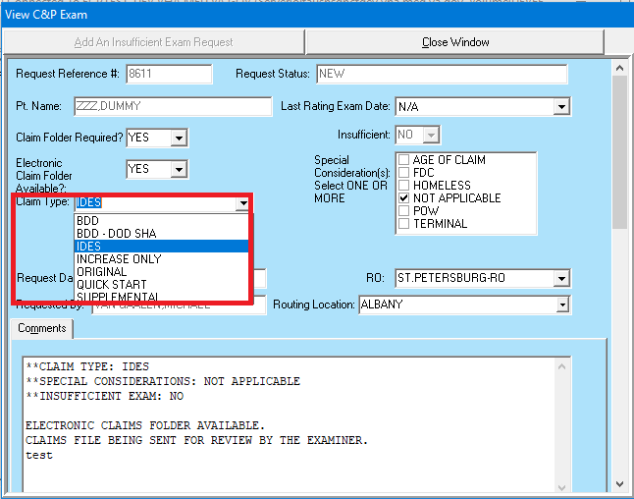
Choosing the Correct Claim Type for CAPRI Exam Requests
FY19 showed almost 400 INCREASE exam requests in CAPRI incorrectly identified as IDES
VHA will begin requesting corrective action for these requests in FY20
The requestor must quickly amend the original request to avoid VHA cancellation

Slide 32
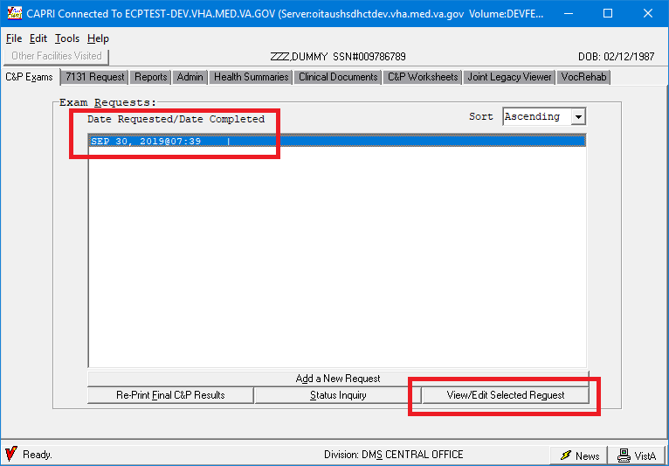
Choosing the Correct Claim Type for CAPRI Exam Requests
To update a request, begin with the C&P Exams tab, select the date of the exam, select View/Edit, select “INCREASE” from the Claim Type drop-down menu.

Slide 33
Choosing the Correct Claim Type for CAPRI Exam Requests
The correct request will appear as follows:
Thank you for your attention to detail regarding all exam requests.

Slide 34
Q-Tip #3 – Adding Schoolchild from His/Her 18th Birthday
Isabelle Brisendine
Consultant
Program Review – STAR Staff
Quality Assurance

Slide 35
Q-Tip #3 – Effective Date for Schoolchildren Turning 18
There has been an increase in errors due to making improper adjustments for schoolchild claims. Please remember the following when making award adjustments:
When adding a schoolchild from the 18th birthday, the Veteran should continue to be paid at the minor child rate from the child’s 18th birthday through the end of the month, and then receive the higher schoolchild rate the first of the following month.
M21-1 III.iii.6.B.1.a; 38 CFR 3.31; and, VETSNET Awards User Guide

Slide 36
Q-Tip #3 – Effective Date for Schoolchildren Turning 18
Notice the change date is not the first of the month.
The school child adjustment should be effective 7/1/19.

Slide 37
Q-Tip #3 – Effective Date for Schoolchildren Turning 18
School Aged Child should begin on the first of the month, 7/1/19.

Slide 38
Dependency Special Focused Review (SFR)
George Boyd
Consultant
Advisory and Special Review Team
Quality Assurance

Slide 39
Dependency SFR
Quality Assurance (214D) is conducting a Dependency Special Focused Review (SFR) to:
Check the accuracy of dependency issues
Identify error trends
Provide recommendations to improve quality
Discover areas for which additional training may be needed
National random sample of cases:
Veterans in receipt of monetary benefits
Assigned an initial or increased overall evaluation of 30% or greater
FY 2018 through June 30, 2019

Slide 40
Dependency SFR
Employees responsible for an error, as well as their Coaches, will be notified using the Error Notification process, via the Quality Management System (QMS).
Corrective action may be required on errors found during this review. Although errors will be cited (when applicable) and routed to the appropriate RO for corrective action, the station’s quality will not be affected.

Slide 41
EP Cancellations SFR Results and Recommendations
Christine Alford
Chief
Advisory and Special Review Team
Quality Assurance

Slide 42
EP Cancellations SFR
In August 2019, Quality Assurance (QA) completed a Special Focused Review (SFR) of Cancelled End Products (EPs):
No process in place to measure the accuracy of cancelled claims
Improper cancellations negatively impact outcome of the EP system
Affects service to the beneficiary
Purpose:
Confirm compliance and proper usage of the current EP system
Determine the accuracy of EP cancellations
Identify error trends
Discover areas for which additional training is needed

Slide 43
EP Cancellations SFR
National random sample of 261 cases:
Pending over 60 days before cancellation
Including both rating and non-rating EPs
EPs cancelled during FY 2018 and in FY 2019 through 3/31/19
Rating EPs | 81
Non-Rating EPs | 180
TOTALS: | 261

Slide 44
EP Cancellations SFR
93 cases contained errors, some of which contained multiple errors.
72 of the 93 cases were improperly cancelled, resulting in a 72.4% accuracy.
16 of the 93 cases had one or more benefit entitlement (BE) errors impacting the Veteran’s benefits, while the remaining 77 cases contained non-BE errors. This amounted to a 93.87% error rate.
Rating EPs | 29
Non-Rating EPs | 64
Rating EPs | 2
Non-Rating EPs | 14

Slide 45
EP Cancellations SFR
Multiple error trends:
Cancellation of EP when award/rating required
Development action necessary
Work credit warranted
EP cancellation to change station jurisdiction or to change claim label
EP cancellation errors separated into five categories:
Requires award action
Requires development
Requires rating review
EP should have been changed to another EP and cleared
EP should have been cleared

Slide 46
EP Cancellations SFR
Reminders:
Pending Issue File Cancellation (PCAN) command is to be used to cancel the pending issue when credit is not appropriate. Using the PCAN command will result in no work credit being applied to the employee or to the station.
Follow guidance in the NWQ Playbook for requesting jurisdiction of an actionable, concurrent EP when not assigned to your station.

Slide 47
EP Cancellations SFR
Reminders (continued):
Consider use of the Pending Issue File Change (PCHG) command when the EP is not properly established. This command can be used to change the claim label/type or date of claim without the need for cancelling or reestablishing the EP, as delineated in M21-1 III.ii.1.A.2.b.
EPs 030 and 040 are NOT subject to the above guidance and should NOT be changed for data integrity reasons.

Slide 48
Proper Use of Compensation Service Over $25K Special Issue
Christine Alford

Slide 49
Compensation Service - Over $25K Special Issue
The Compensation Service Review (CS)-Over 25K Special Issue applies only to cases requiring CS review of administrative decisions involving erroneous payments of $25,000 or greater (M21 III.v.1.I.3.g).
To prevent claims processing delays due to misrouting of claims and misallocation of resources, please do not select the Over $25K Special Issue unless the claim falls within the parameters of M21 III.v.1.I.3.g.

Slide 50
Compensation Service - Over $25K Special Issue

Slide 51
Compensation Service - Over $25K Special Issue System Compliance Error
M21-4, Chp. 6, Appendix A, Section “e”
Special Issues (SI) in this table are considered system compliance errors
Among these is “CS Review – Over $25K”
Requests for approvals of administrative decisions involving overpayments at least $25K due to administrative error

Slide 52
Compensation Service - Over $25K Special Issue
Reminder:
M21-4, Chp. 6, Appendix A
Table in Section “e”
Other Resources:
Portions of VBMS User Guides referencing Contentions
July 2017 CS Bulletin
November 2017 CS Quality Call
February 2018 CS Quality Call

Slide 53
Requirements for Extra-Schedular Requests to Compensation Service
Christine Alford

Slide 54
Compensation Service – Extra-Schedular
Please follow the steps in the tables in M21-1 III.iv.6.B.4.d when referring claims for Extra-Schedular consideration to Compensation Service under either 38 CFR 3.321(b)(1) or
38 CFR 4.16.
Follow the steps in the tables in M21-1 III.iv.6.B.4.d i referring claims for Extra-Schedular consideration under either 38 CFR 3.321(b)(1) or 38 CFR 4.16(b).

Slide 55
Compensation Service – Extra-Schedular

Slide 56
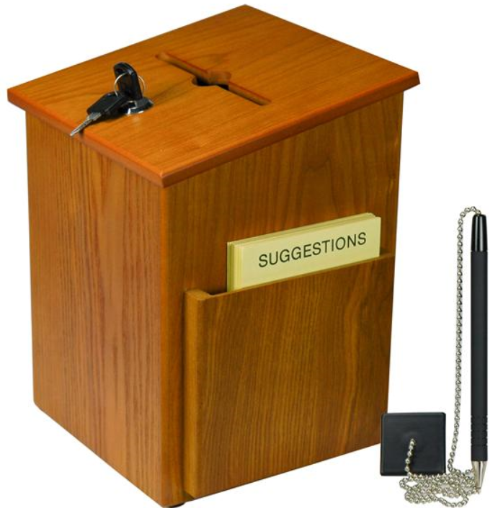
Questions – Suggestions – Next Quality Call
Presented by:
Bonnie Kirby

Slide 57
Questions Relating to Today’s QC Topics
Questions on topics presented must be emailed to the Compensation Service Quality Review Team at InternalQRS.VBAVACO@va.gov
Emails must include Cc to your Coach or other RO management
Emails must contain the name of the topic(s) with your question(s)
Questions must be submitted to the mailbox by COB Friday, October 11th
Questions submitted after COB Friday will not be accepted for inclusion in the Call Bulletin
Email questions are limited to those pertaining to only the topics presented, and responses will not be provided to any questions that are not related to the topics presented during today’s Quality Call
Official guidance to the questions will be posted later in the Call Bulletin

Slide 58
Do You Have Suggestions for Topics?
Please feel free to email your topic suggestions to the Compensation Service Quality Review Team at InternalQRS.VBAVACO@va.gov
In your email, be sure to include:
Cc to your Coach or other RO management
Name of the topic
Intended audience (VSR – SVSR – RVSR – DRO – AQRS – RQRS)
Applicable M21-1 and/or 38 CFR citations
Quality Call Bulletins can be found in the STAR Home Page on the Compensation Service Intranet site, TMS, and VBA Learning Catalog
Audio recordings of the Quality Calls with separate copies of the PowerPoint slides can be found in both TMS and VBA Learning Catalog

Slide 59
Next Quality Call
A Compensation Service Quality Call is usually presented each month
Next Quality Call will be conducted on November 13, 2019

