Slide 1
Enhancing Positive Outcomes
Briefed by:
VR&E Service

Slide 2
Objectives
After this training, participants will be able to:
Identify the different plan types that can lead to positive outcomes
Recognize challenges that could delay plan development
Identify services to previous program participants
Implement techniques to improve positive outcomes

Slide 3
Plan Development Gap
Plan of Services
Evaluation & Planning

Slide 4
Duty to Assist
Grant If You Can, Deny If You MUST
We have a duty to assist each and every claimant throughout the life of their program
This includes offering services to the claimant that may not have been requested
Veterans Claims Assistance Act (VCAA)
Public Law 112-154
M28R.III.C.2.08

Slide 5
Untapped Resources
Program Percentage of Total Cases
Decrease in use of IL Services
2.74% of cases in Rapid Access
Re-Employment
Self-Employment
Rapid Access
Independent Living
Long-Term
Services

Slide 6
Decreasing Time – Increasing Outcomes
Employment Through Long Term Services
4-6
years
Re-Employment
Self-Employment
Rapid Access
Independent Living
< 6
1-3
1-2
< 1
years
years
year
Months

Slide 7
Questions
Statistics
Duty to Assist
Bridging Gaps between Evaluation and Planning and Plan Development

Slide 8
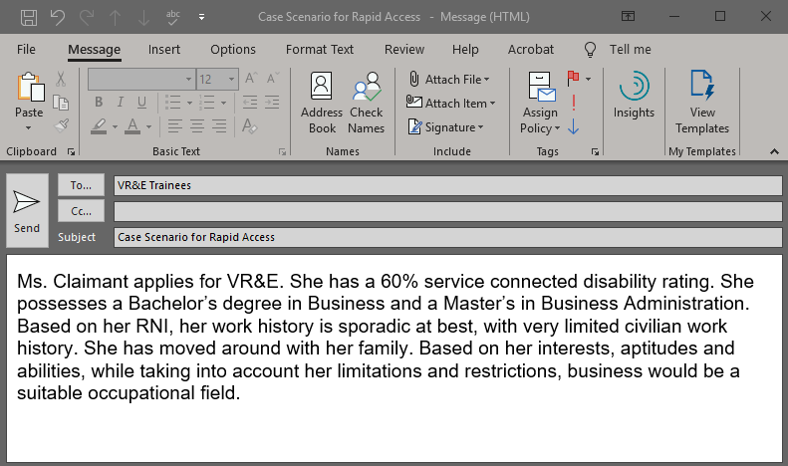
Case Scenario for Rapid Access
VR&E Trainees

Slide 9
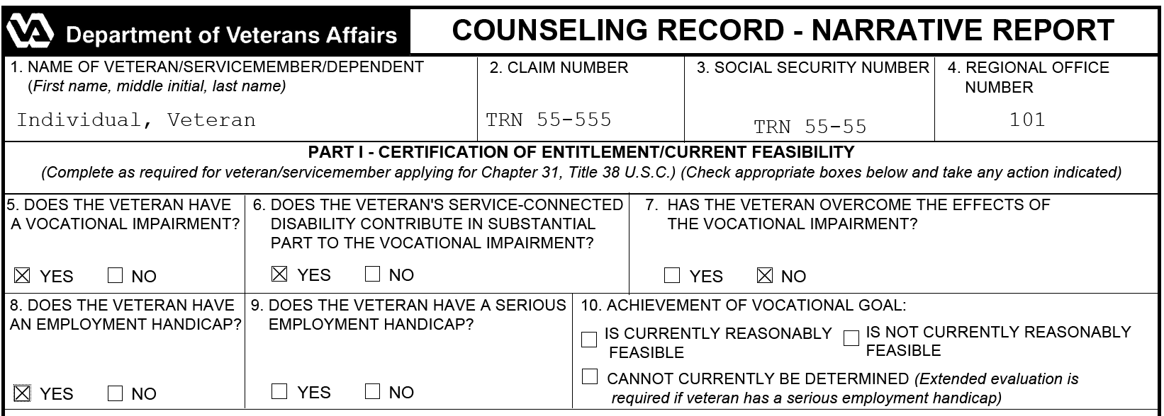
Determining Entitlement
Ms. Claimant has a vocational impairment, Ms. Claimant’s SCD contributes in substantial part, but has she overcome since she qualifies for a suitable employment, since she has not obtained or maintained employment.

Slide 10
Analyzing Vocational Impairment
Checklist for analyzing and determining if the claimant has overcome the vocational impairment:
Currently suitably employed
Qualified for suitable employment based on current labor market information (gainful employment status consistent with a claimant's abilities, aptitudes and interests) and/or reasons beyond his or her control
Currently unemployed and/or not in suitable employment
Medical and psychological limitations in combination with his/her job description
This Photo by Unknown Author is licensed under CC BY-SA

Slide 11
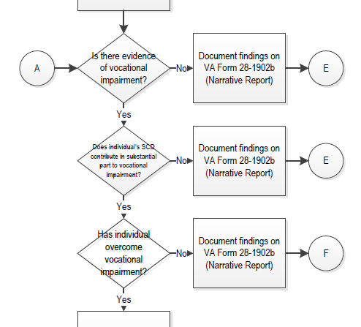
Vocational Impairment Determination
If the employment ... | Then the Claimant…
Aggravates the disability/disabilities, or Is unstable, or Is not consistent with the claimant’s pattern of abilities, aptitudes, and interests | Not suitably employed and has not overcome the effects of the impairment
Requires reasonably developed skills, and Does not aggravate the disability/disabilities Is stable and continuing, and Is consistent with the claimant's pattern of abilities, aptitudes, and interests | Suitably employed, and has overcome the effects of the impairment

Slide 12
Reasons Beyond Their Control
What factors might contribute to reasons beyond their control? (38 U.S.C. 3102 and 38 CFR 21.51)
Lack of job seeking/resume skills in civilian job market
Understanding transferrable skills to determine what the claimant qualifies for in the job market
Competitive job market or changes in the job market
Lack of understanding of how and when to discuss disability(ies)
Discriminating factors in the workplace (age, legal, etc.)
Lack of work experience or lacking current skills in the field they are trained
In need of workplace accommodations

Slide 13
Rapid Access to Employment
Rapid Access to Employment Services could include but not limited to:
Vocational Counseling and Guidance
Job Development and Placement Services
Resume Development
Information on Special Hiring Authorities
Direct job leads
Transferable Skills Analysis
Certificate or Short Term Training
EAA payments for Improvement of Rehabilitation Potential as per PA-19-05

Slide 14
Rapid Access to Employment
Consider developing a combined IWRP/IEAP
The plan could include Job Seeking Skills training to be provided by:
Employment Coordinator
Vocational Rehabilitation Counselor
Department of Labor/DVOP
Contractor via the National Contract
Best case practice: Offices should follow up with cases closed RC 25 (further education) to reengage in services.

Slide 15
Questions
Entitlement
Vocational Impairments
Rapid Access to Employment

Slide 16
Reasonable Accommodations
The ADA requires reasonable accommodations as they relate to these three aspects of employment:
Ensuring equal opportunity in the application process
Enabling a qualified individual with a disability to perform the essential functions of a job
Making it possible for an employee with a disability to enjoy equal benefits and privileges of employment

Slide 17
Accommodations
Things to consider:
Workplace job analysis
Discuss job functions with claimant and request a job description
Identify what specific symptoms and functional limitations are creating barriers to accessing the workplace or performing job tasks
Review medical documentation and request input from medical service providers if necessary
Use Job Accommodations Network (JAN) for additional resource to identify appropriate accommodations

Slide 18
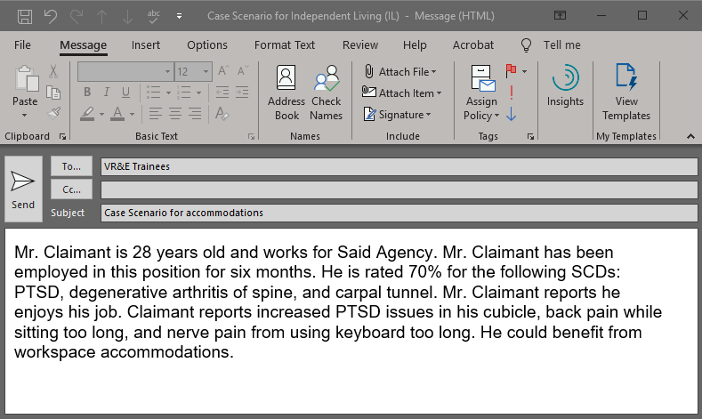
Case Scenario for Accommodations

Slide 19
Case Scenario Accommodations
Accommodations Provided to Mr. Claimant:
Cubicle with low walls so claimant can see out over the cubicle
A mirror so he can see people from all angles in his desk space
Ergonomic chair
Ergonomic keyboard
Dragon speak
Sit/Stand Desk

Slide 20
Questions
Accommodations

Slide 21
Limited Employment Services (Eligibility)
Under 38 U.S.C. 3117, VR&E has the authority to provide limited employment services to claimants with at least a 10% service-connected disability rating. To qualify for these services, the claimant must:
Previously participated a rehabilitation program with either VR&E, a State vocational rehabilitation program, or a similar program under the Rehabilitation Act of 1973
Be employable. This means the claimant will not meet VR&E entitlement criteria

Slide 22
Limited Employment Services: Available Services
If the claimant meets the eligibility criteria under 38 U.S.C. 3117, then VR&E may provide services and assistance needed to obtain employment. Examples of those include, but are not limited to:
Purchase of or reimbursement for required items
Understanding of special hiring authorities and/or laws that provide preference in hiring for claimants
Direct placement in employment
Coordination of services with the Department of Labor, via the use of Disabled Veterans Outreach Program (DVOP) Specialists or Local Veterans Employment Representatives (LVER)
Job development and placement services

Slide 23
Limited Employment Services: Self-Employment
38 U.S.C. 3117 provides additional services for claimants who have completed a rehabilitation program for self-employment. These services include:
Coordination with the Small Business Administration to assist the claimant in obtaining a business loan to purchase equipment needed to establish a business
Information on special considerations provided to Veteran-owned businesses provided in the Small Business Act
If the claimant completed a State rehabilitation program with a self-employment objective, VR&E may provide supplementary equipment and initial stocks and supplies, or assistance in acquiring such, if this is not available through the State rehabilitation program or another source

Slide 24
Questions
Limited Employment Services

Slide 25
Independent Living
If a determination of a vocational goal is found infeasible and the claimant has a serious employment handicap with a rating 20% or higher, evaluate for independent living (IL) needs:
Discuss the types of activities the claimant engages in such as any social, spiritual pursuits or past work activities, and
When possible, ask open ended questions to evaluate how the claimant might spend time, such as describing a day or week to include a discussion about routine activities

Slide 26
Independent Living
Required activities to conduct a full assessment of independent living needs involve the following:
Complete the preliminary IL assessment
Ask open ended questions during the assessment about the claimant’s current activities of daily living
Review housing situation
Discuss prior community and social activities
Explore how the service connected disability(ies) impact the claimant’s activities of daily living
Discuss emotional, personal and spiritual needs
Secure necessary services to conduct an in-home comprehensive IL assessment

Slide 27
Independent Living
Other considerations for services:
Services may jointly be provided and identified from an occupational therapist with VHA
VHA Prosthetics provides a range of durable medical equipment to assist with safely accessing their home
Support and assistance may be provided for one avocational goal
The majority of IL cases do not involve home adaptation but when necessary, we partner with Specially Adapted Housing (SAH) to assist in coordinating construction
The goal of IL services is to help the claimant to achieve maximum independence in daily living and whenever possible, increase the claimant’s ability to return to work.

Slide 28
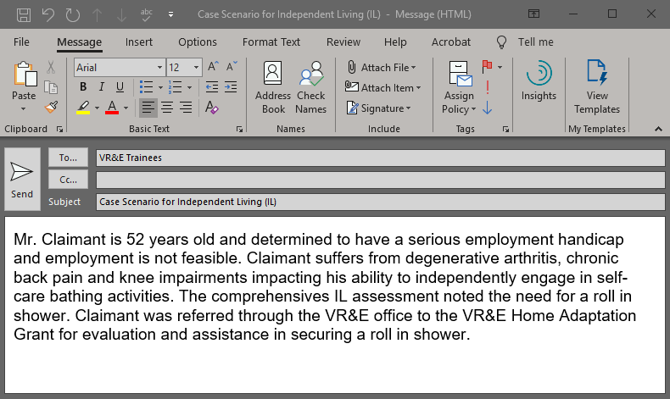
Case Scenario Independent Living

Slide 29
Before Independent Living Construction

Slide 30
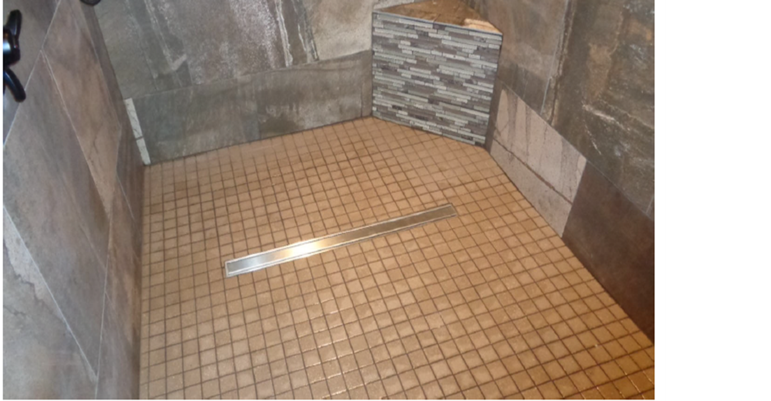
IL Construction-Interior of New Shower

Slide 31
Questions
Independent Living

Slide 32
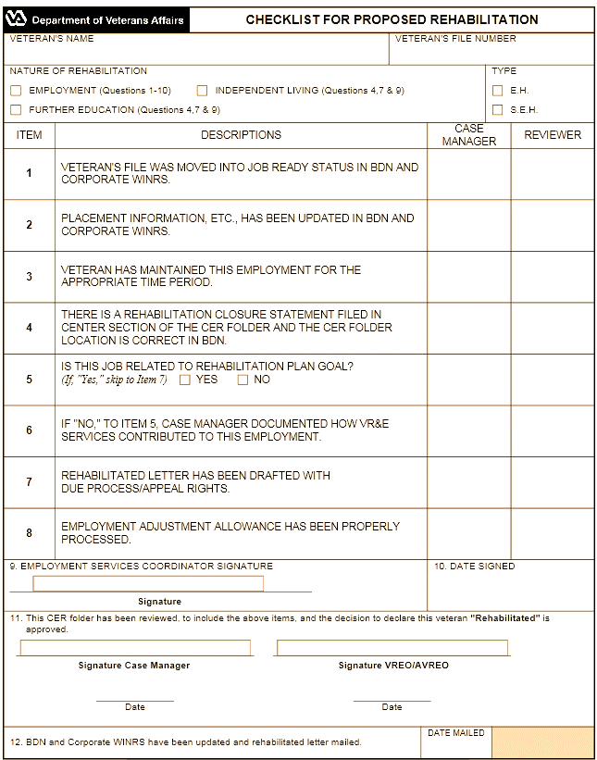
Criteria for RC 35 (MRG-1)
The use of RC 35 (MRG-1) is appropriate when:
The claimant is employed, and
VR&E services contributed to the claimant obtaining or maintaining current employment, and
Current employment benefits the claimant but does not meet the criteria for closure as “rehabilitated” in accordance with 38 CFR 21.283

Slide 33
Criteria for RC 34 (MRG-2)
The use of RC 34 (MRG-2) is appropriate when:
The claimant completed all or some of the planned services leading towards a vocational goal, and is currently employable in a suitable job, and
The services provided enabled the claimant to qualify for suitable employment, yet case does not meet the criteria for closure as “rehabilitated”

Slide 34
Questions to consider for RC 34 (MRG-2)
Is the claimant currently qualified and capable of obtaining employment in a suitable occupation, defined as employment that is consistent with interests, aptitudes and abilities that does not aggravate his/her disability condition(s)?
Did the services provided by VR&E contribute to the claimant’s employability?
Has the claimant overcome the impairments to employment noted during the initial evaluation?
Have the claimant’s circumstances in the period following application for services improved?
Did services provided contribute to the improvement in the claimant’s circumstance?

Slide 35
RC 34 (MRG-2) Services
Examples of services that could assist a claimant become employable:
Vocational Counseling and Guidance
Reduction of barriers to employment
Services provided towards education or training
Tools and equipment to assist in obtaining employment
Referrals to resources such as VAMC, DOL, Career Services, etc.
Resume development, internship resources, development of job seeking skills

Slide 36
Training Objectives Review
You should now be able to:
Identify the different plan types that can lead to positive outcomes
Recognize challenges that could delay plan development
Identify services to previous program participants
Implement techniques to improve positive outcomes

Slide 37
Questions

