Slide 1
Identifying Contentions and Classifications
Compensation Service
August 2019
Notes:
Welcome to the Introduction to Medical Electronic Performance Support System (E P S S) course. To advance each slide, click anywhere on the screen.

Slide 2
Lesson Objectives
Given the handout and all available references, the Claims Assistant (CA) will:
Determine and identify contention(s) made by the claimant.
Recognize how to enter a contention appropriately.
Determine the most appropriate contention classification.
Recognize how to enter the classification appropriately.
Notes:
Lesson Objectives
Upon completion of this lesson, you will be able to:
Identify how to access Medical EPSS
Identify how to access the Help Menu
Determine how to access the menu tabs at the top of the Medical EPSS
Determine how to utilize the Search function box on the main menu
Identify other reference tools
Locate elements within the Medical EPSS in a practical activity

Slide 3
References
M21-1, Part III, Subpart iii, 1.F, Record Maintenance During the Development Process
M21-1 Part III, Subpart iii, 5.L, EP Control When Requesting Evidence/Information Required to Add a Dependent in a Decision Notice
M21-1, Part III, Subpart v, 10.A, 800 Series Work Items and Cost-of-Living Allowance (COLA) Adjustments
Medical EPSS
DBQ Switchboard
Index of DBQ/Exams by Disability
Notes:
Reference
The references for this course are listed on the screen. You may click any hyperlinked references for further details.
Compensation Service Intranet Home Page
Rating Job Aids
http://epss.vba.va.gov/Medical EPSS

Slide 4
Overview
Listing contentions for each claim is mandatory and should be entered as soon as they are identified.
The contention classification is also a required system components when entering a contention.
The contention list is available via eBenefits and are transparent for the Veteran.
Classifications are used for the exam management functionality. For both of these reasons contentions are imperative to the accuracy of data, claims processing and reporting purposes.
Notes:
What is the Medical E P S S?
Tutorial information related to medical terminology and issues, using graphics and visual aids to illustrate various medical definitions and concepts
Information regarding the function of the body system and common conditions
Links to obtain more information on specific diseases, body parts, and medical terms

Slide 5
Topic 1: The Contention
Enter issues as contentions when they are:
Expressly claimed by the claimant/Veteran/authorized representative and/or
Put at issue and requires development.
They should be entered as soon as they are identified and should be easy to understand and in “the claimant’s own words”, as appropriate.
Notes:
What is the Medical E P S S?
Tutorial information related to medical terminology and issues, using graphics and visual aids to illustrate various medical definitions and concepts
Information regarding the function of the body system and common conditions
Links to obtain more information on specific diseases, body parts, and medical terms

Slide 6
Contention Types
Rating contentions should be entered in the claimants own words, and listed separately within VBMS.
Example 1: Veteran claims diabetes mellitus to include heart, depression and numbness in hands. The contentions should be entered as:
diabetes
heart condition
depression and
numbness in hands.
Notes:
What is the Medical E P S S?
Tutorial information related to medical terminology and issues, using graphics and visual aids to illustrate various medical definitions and concepts
Information regarding the function of the body system and common conditions
Links to obtain more information on specific diseases, body parts, and medical terms

Slide 7
Contention Types
Non-Rating contentions should relate to the specific benefit being claimed.
Dependency contentions should follow specific language and format.
Example 3: A Veteran submits a claim to add a spouse and a child to a running award.
Create separate contentions for the spouse and child as follows:
Dependency claim for [name of spouse]
Dependency claim for [name of child]
Notes:
What is the Medical E P S S?
Tutorial information related to medical terminology and issues, using graphics and visual aids to illustrate various medical definitions and concepts
Information regarding the function of the body system and common conditions
Links to obtain more information on specific diseases, body parts, and medical terms

Slide 8
Contention Types
When establishing End Products derived from Work Items, contentions are mandatory.
Example 4: VA receives a Work Item 840: Combat-Related Special Compensation (CRSC)/Concurrent Retirement and Disability Payments (CRDP) Audit Error Worksheet.
VA would establish an End Product (298), CRSC/CRDP Processing,
add special issue Potential Under/Overpayment,
add contention...at a minimum should list the type of Work Item.
Minimum: “Audit Error Worksheet”
Notes:
What is the Medical E P S S?
Tutorial information related to medical terminology and issues, using graphics and visual aids to illustrate various medical definitions and concepts
Information regarding the function of the body system and common conditions
Links to obtain more information on specific diseases, body parts, and medical terms

Slide 9
Contention Types
Best practice to use specific information when categorizing Work Items.
From this example best practice:
“Audit Error Worksheet – CRSC/CRDP”
M21-1, Part III.v.10.A hyperlinks are provided directing specific actions when establishing End Products from Work Items.
Notes:
What is the Medical E P S S?
Tutorial information related to medical terminology and issues, using graphics and visual aids to illustrate various medical definitions and concepts
Information regarding the function of the body system and common conditions
Links to obtain more information on specific diseases, body parts, and medical terms

Slide 10
Contentions
When establishing claims, a review of any prior rating decision should be reviewed through SHARE corporate record, the last rating decision within the eFolder, or the Rated Issues + icon within the VBMS contention page.
Notes:
What is the Medical E P S S?
Tutorial information related to medical terminology and issues, using graphics and visual aids to illustrate various medical definitions and concepts
Information regarding the function of the body system and common conditions
Links to obtain more information on specific diseases, body parts, and medical terms

Slide 11
Contentions
Example 5: A Veteran submits a claim for "bilateral knee condition". A review of the corporate record indicates the Veteran is service connected for right knee patellofemoral pain syndrome and was previously denied for a left knee strain.
The contentions should be entered as follows:
right knee patellofemoral pain syndrome (claimed as bilateral knees), and
left knee strain (claimed as bilateral knees).
Notes:
What is the Medical E P S S?
Tutorial information related to medical terminology and issues, using graphics and visual aids to illustrate various medical definitions and concepts
Information regarding the function of the body system and common conditions
Links to obtain more information on specific diseases, body parts, and medical terms

Slide 12
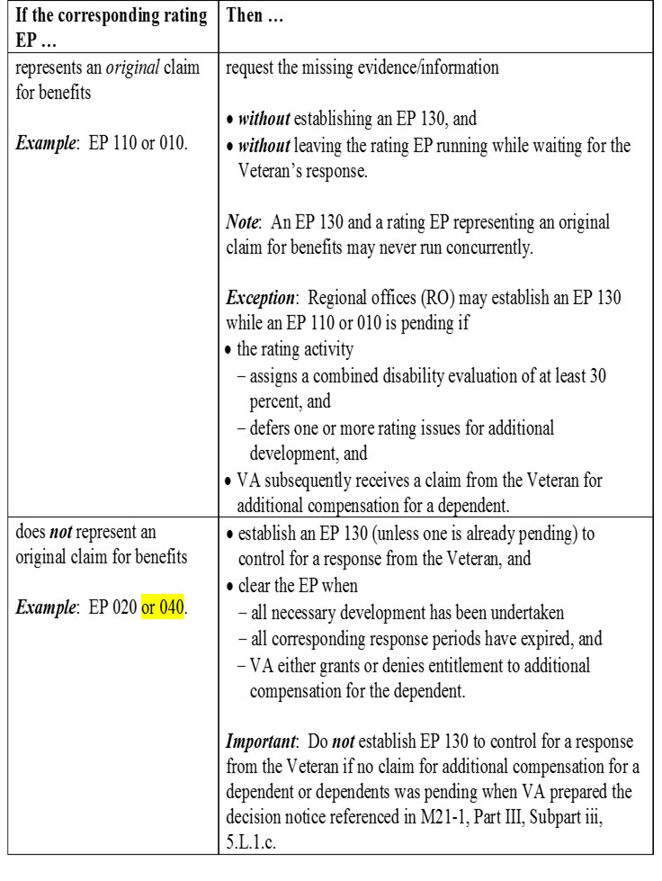
Contentions
When an original claim for benefits (EP 110 or EP 010) is received with a VA Form 21-686c, Declaration of Status of Dependents, we must add the dependents noted as contentions.
When a VA Form 21-686c, Declaration of Status of Dependents, is received and it is a non-original claim, then a separate EP 130 will need to be established.
Notes:
What is the Medical E P S S?
Tutorial information related to medical terminology and issues, using graphics and visual aids to illustrate various medical definitions and concepts
Information regarding the function of the body system and common conditions
Links to obtain more information on specific diseases, body parts, and medical terms

Slide 13
Verifying the Contentions
Contentions automatically entered by the system that are missing critical information, such as the contention classification, will be marked unverified. The claims processor must update the missing/incorrect information and select SAVE. The contention will then be marked as verified and viewable in eBenefits.
All employees reviewing a claim are responsible for ensuring all contentions are correct and verified.
Notes:
What is the Medical E P S S?
Tutorial information related to medical terminology and issues, using graphics and visual aids to illustrate various medical definitions and concepts
Information regarding the function of the body system and common conditions
Links to obtain more information on specific diseases, body parts, and medical terms

Slide 14
Topic 2: Classification
The CLASSIFICATION and MEDICAL fields are required components when entering a contention. The classification is associated with the contention being entered, you are associating the medical condition. This information is used in the exam management functionality and it is imperative the classification is correct.
Notes:
What is the Medical E P S S?
Tutorial information related to medical terminology and issues, using graphics and visual aids to illustrate various medical definitions and concepts
Information regarding the function of the body system and common conditions
Links to obtain more information on specific diseases, body parts, and medical terms

Slide 15
Medical Field
This yes or no field should be completed for every contention. If the contention has the potential of getting an examination it should be updated to “yes”.
“Administrative Issue” is to be used from this point forward for only non-rating issues, such as dependency or drill pay. Administrative conditions and should be updated to “no”.
Notes:
What is the Medical E P S S?
Tutorial information related to medical terminology and issues, using graphics and visual aids to illustrate various medical definitions and concepts
Information regarding the function of the body system and common conditions
Links to obtain more information on specific diseases, body parts, and medical terms

Slide 16
How do I choose the Classification?
Select the appropriate medical verbiage that corresponds to the claimed medical condition. This is different than the plain language contention entered previously.
Non-Rating issues should be updated to “administrative”.
Notes:
What is the Medical E P S S?
Tutorial information related to medical terminology and issues, using graphics and visual aids to illustrate various medical definitions and concepts
Information regarding the function of the body system and common conditions
Links to obtain more information on specific diseases, body parts, and medical terms

Slide 17
Medical Terminology Resources
Resources to assist with classification:
Index of DBQ/Exams by Disability
Medical EPSS
DBQ Switchboard
Notes:
What is the Medical E P S S?
Tutorial information related to medical terminology and issues, using graphics and visual aids to illustrate various medical definitions and concepts
Information regarding the function of the body system and common conditions
Links to obtain more information on specific diseases, body parts, and medical terms

Slide 18
Index of DBQ/Exams by Disability
Example 6: Veteran submits a claim for service connection for diabetes mellitus. The claimed condition of “diabetes” can be typed into the search criteria.
Reviewing the results provided, you know to choose “Endocrine” as the classification for the claimed condition.
Notes:
What is the Medical E P S S?
Tutorial information related to medical terminology and issues, using graphics and visual aids to illustrate various medical definitions and concepts
Information regarding the function of the body system and common conditions
Links to obtain more information on specific diseases, body parts, and medical terms

Slide 19
Medical EPSS
Example 6: Veteran submits a claim for service connection for diabetes mellitus. The claimed condition of “diabetes” can be typed into the search criteria.
Reviewing the results provided, you know to choose “Endocrine” as the classification for the claimed condition.
Notes:
What is the Medical E P S S?
Tutorial information related to medical terminology and issues, using graphics and visual aids to illustrate various medical definitions and concepts
Information regarding the function of the body system and common conditions
Links to obtain more information on specific diseases, body parts, and medical terms

Slide 20
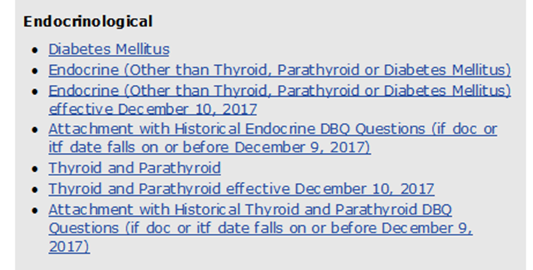
DBQ Switchboard
Example 6: Veteran submits a claim for service connection for diabetes mellitus. The claimed condition of “diabetes” can be typed into the Control + F (find function).
Reviewing the results provided, you know to choose “Endocrine” as the classification for the claimed condition.
Notes:
What is the Medical E P S S?
Tutorial information related to medical terminology and issues, using graphics and visual aids to illustrate various medical definitions and concepts
Information regarding the function of the body system and common conditions
Links to obtain more information on specific diseases, body parts, and medical terms

Slide 21
Index of DBQ/Exams by Disability
Example 7: The Veteran claimed “erectile disfunction” on the VA Form 21-526EZ. A search of “erectile disfunction” produced no results within the Index of DBQ/Exams by Disability page. A new search of “erec” produced a result of “erectile dysfunction” and “hysterectomy”.
Notes:
What is the Medical E P S S?
Tutorial information related to medical terminology and issues, using graphics and visual aids to illustrate various medical definitions and concepts
Information regarding the function of the body system and common conditions
Links to obtain more information on specific diseases, body parts, and medical terms

Slide 22
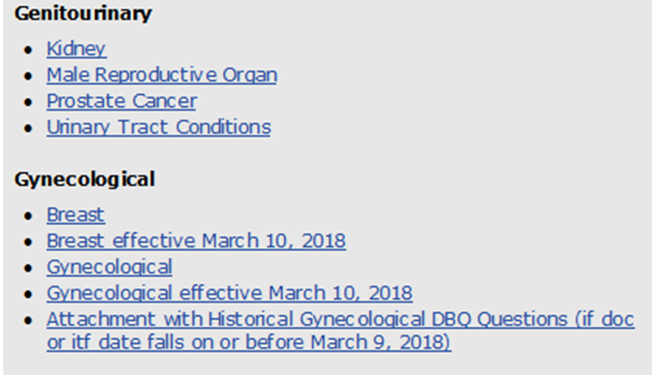
DBQ Switchboard
By looking at the results from the initial search table it produced two results. If uncertain arose, then utilizing the DBQ Switchboard would produce the following:
Further investigation within “Male Reproductive Organ” worksheet by using the Control + F (for find key word “erectile”) would yield erectile dysfunction located on page 2. Male Reproductive Organ was listed under the “Genitourinary” header.
Notes:
What is the Medical E P S S?
Tutorial information related to medical terminology and issues, using graphics and visual aids to illustrate various medical definitions and concepts
Information regarding the function of the body system and common conditions
Links to obtain more information on specific diseases, body parts, and medical terms

Slide 23
Medical EPSS
Example 7: The Veteran claimed “erectile disfunction” on the VA Form 21-526EZ. A search of “erectile disfunction” produced no results. A new search of “erectile” produced a result of “erectile dysfunction”.
Reviewing the results provided, you know to choose “Endocrine” as the classification for the claimed condition.
Notes:
What is the Medical E P S S?
Tutorial information related to medical terminology and issues, using graphics and visual aids to illustrate various medical definitions and concepts
Information regarding the function of the body system and common conditions
Links to obtain more information on specific diseases, body parts, and medical terms

Slide 24
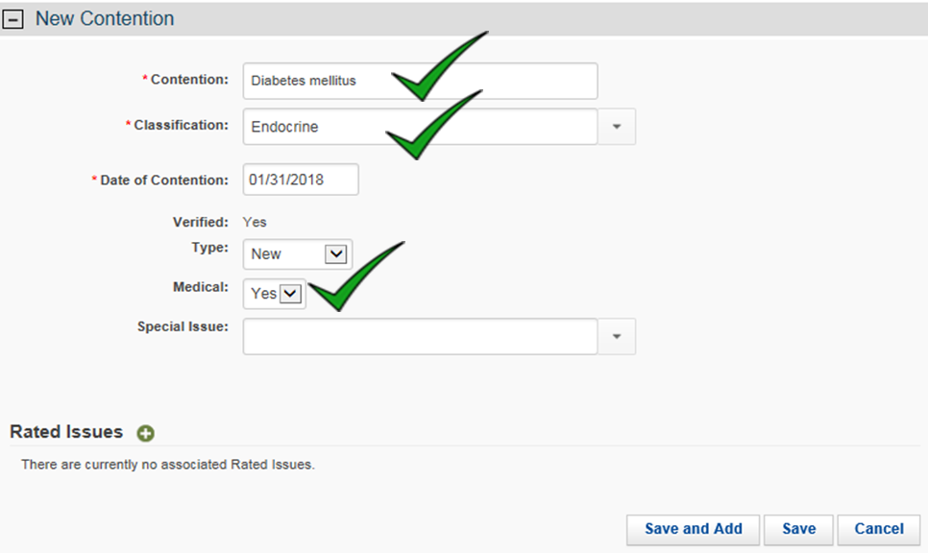
VBMS Input
Example 6: You received a claim from a Veteran claiming service connection for diabetes mellitus.
Notes:
What is the Medical E P S S?
Tutorial information related to medical terminology and issues, using graphics and visual aids to illustrate various medical definitions and concepts
Information regarding the function of the body system and common conditions
Links to obtain more information on specific diseases, body parts, and medical terms

Slide 25
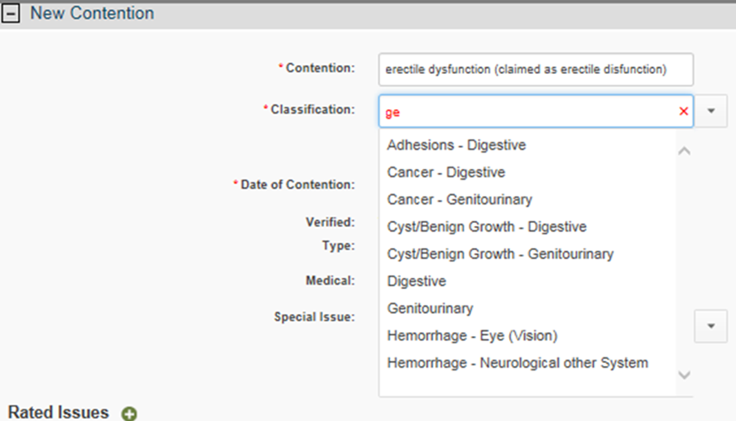
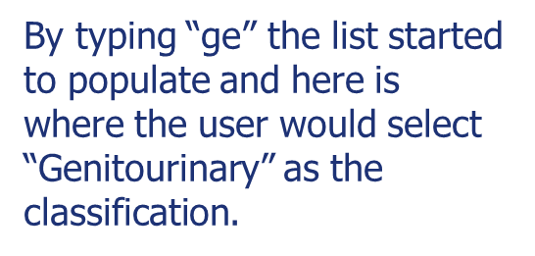
VBMS Input
Example 6: The Veteran claimed “erectile disfunction” on the VA Form 21-526EZ.
Notes:
What is the Medical E P S S?
Tutorial information related to medical terminology and issues, using graphics and visual aids to illustrate various medical definitions and concepts
Information regarding the function of the body system and common conditions
Links to obtain more information on specific diseases, body parts, and medical terms

Slide 26
Putting It All Together
Notes:
What is the Medical E P S S?
Tutorial information related to medical terminology and issues, using graphics and visual aids to illustrate various medical definitions and concepts
Information regarding the function of the body system and common conditions
Links to obtain more information on specific diseases, body parts, and medical terms

Slide 27
Review
Questions
Notes:
Questions?

