Slide 1
Post-Initial Exam Scheduling Request (ESR) Training
June 2019
Compensation Services

Slide 2
Objectives
Enhance the users’ understanding of different Exam Management System (EMS) statuses and how they affect the claim suspense.
Understand the current functionality of the ESR process (post submission).
Understand when an IT ticket is warranted.
Understand EMS known issues.

Slide 3
VBMS EMS Current State
Office of Information and Technology (OIT) is actively working on issues known to be affecting EMS.
Contract Exam Staff is continuously working with MDE vendors to identify defects or issues affecting the ESR and responses.
Current focus is to enhance users’ ability to keep claims moving and avoid opening unnecessary IT trouble tickets.

Slide 4
EMS State
EMS states exist at the following levels:
ESR Level Status-reflects the status of the overall exam request
Contention Level Status-reflects the status of the individual contentions
Appointment Level Status-reflects the status of each appointment associated with contentions

Slide 5
ESR Status
Draft: The request has been saved but not submitted. You can edit and delete draft requests using the edit request option from the “actions menu”.
Processing: The request has been sent to the vendor to acknowledge receipt.
Triage: Occurs after the vendor acknowledgement and prior to the first appointment scheduled.
Clarification Requested: A request for clarification has been received for the contention. A request for clarification indicator will also show next to the request in the Summary table view. Once you submit a response, the contention status returns to what it was before the request for clarification.

Slide 6
ESR Status (cont.)
Open: The request has been successfully submitted. You can cancel or modify an open ESR using the “Create Modification” option from the “Actions” dropdown menu.
Completed: At least one contention has been completed, and all contentions are either completed or cancelled. If results have been received for all exams, you can request more detail regarding a completed exam using the rework option from the “Actions” dropdown menu.
Cancelled: The entire request has been cancelled, or all contentions have been cancelled.
Error: A transmission error may occur when attempting to deliver an exam scheduling request, rework request, modification request, or clarification request response through EMS.

Slide 7
ESR Level Status Workflow
Draft Status
Preparing ESR to submit
Processing Status
Open Status
MDE vendor processing ESR
Complete Status
MDE vendor completes ESR
ESR submission
Ready for CR or Appointment information
Triage Status

Slide 8
ESR Level Status Information
Processing Status
An “Exam Request-Processing” tracked item with a two day suspense is created.
An “Exam Request-[Contention]” tracked item is created with a 30 day suspense at the time of the ESR submission.
If VBMS does not receive acknowledgement from the vendor, the ESR will remain in “Processing” status.
If an ESR remains in “Processing Status” it cannot be modified.
Contact MDE vendor and verify if the ESR was received.
If the ESR was not received a IT trouble ticket must be completed.
Open Status
Allows users to modify ESR.
Cancel or modify, ESR or individual contentions up to 24 hours prior to scheduled appointment.

Slide 9
Contention Level Status
Draft: The contention is included in a draft request.
Queued: The contention is included in a request that has been sent for submission (in processing status).
Triage: The contention is included in a request that has been successfully submitted (in open status).
Scheduled: An appointment for a medical examination has been scheduled, or DBQs will be completed through the ACE process.
Pending Results: Medical examination appointments have been completed, or at least one examination for the contention was completed and all others were either completed or cancelled. All results (DBQ(s), diagnostics) have not been received. The “Results Available Package” has not been received.

Slide 10
Contention Level Status (cont.)
Completed: All actions by the MDE vendor has been completed and corresponding “Results Available Package” is received.
Cancelled: The contention has been cancelled by EMS or via a modification request. When all contentions are cancelled, the request will also be cancelled.
Removed: The contention can be removed during the clarification response process

Slide 11
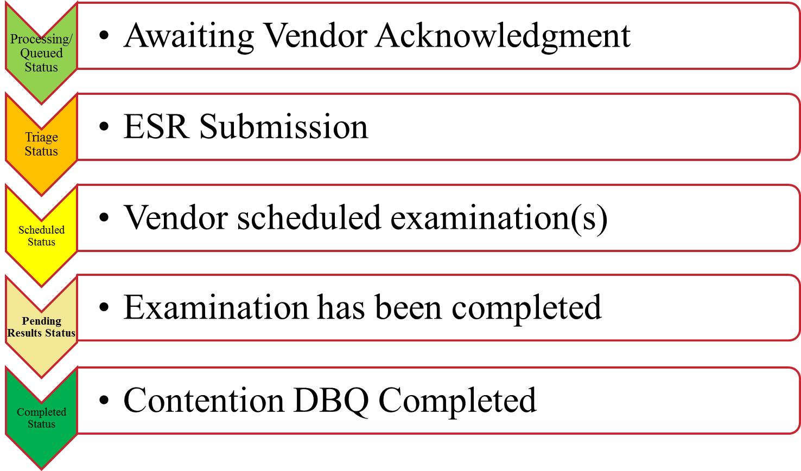
Contention Level Status Workflow

Slide 12
Contention Level Status Information
Triage Status
If the claim is in “Triage” status and the exam tracked item is past due, check the appropriate vendor portal for exam status information. If NOT found, update the tracked item to five days past the appointment date.
If the vendor portal is absent of any information, please contact the vendor to ensure no ESR was received.
The user will need to cancel ESR and resubmit.
Pending Results Status
Recently added to reflect when the MDE vendor has completed the examination but is still finalizing the results.
Completed Status
Indicates MDE vendor has finished all necessary elements of the examination and DBQ and all associated diagnostics results are available.

Slide 13
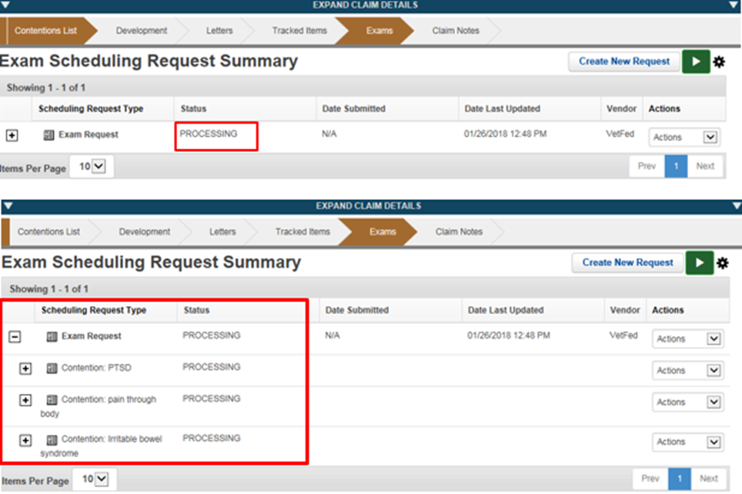
EMS Status Snapshot
ESR
Contention

Slide 14
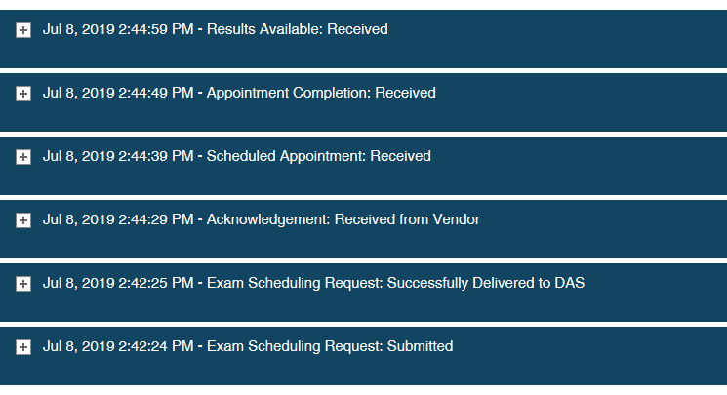
ESR Packages
Selecting “History” in the "Actions" drop down menu from either the ESR or contention level, EMS will display all packages that have been Submitted, Received, or Delivered.

Slide 15
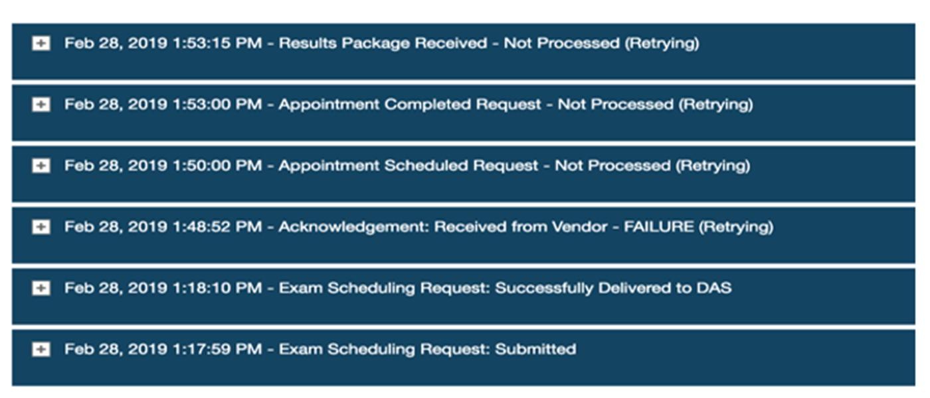
ESR Package Messaging
ESR package messaging indicates the current status of the inbound and outbound messages from the MDE vendor and EMS.

Slide 16
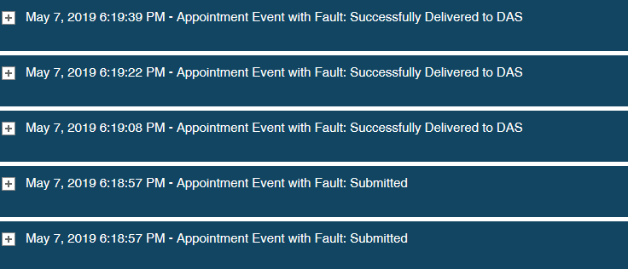
ESR Package Fault Messaging
ESR “Fault” messaging indicates an out of order action was sent by the MDE vendor.
Example: Contention cancellation received prior to appointment cancellation. The “Fault” message is an automatic response to the MDE vendor from EMS.

Slide 17
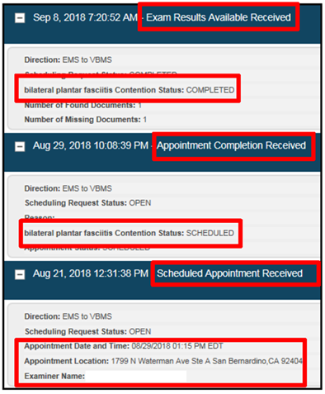
ESR Package Expansion
By expanding ESR package, users are able to review additional details concerning ESR.

Slide 18
Clarification Request Responses
If an MDE vendor requires additional information for an ESR, a request for clarification will be sent.
The CR function is only available prior to the first scheduled appointment.
The ESR level status will reflect “Clarification Requested” and the contention level status will remain in “Triage” status.
The user must respond to the CR in order for the MDE vendor to continue the scheduling process.
If a user is unable to respond to a CR, an IT ticket will need to be opened and submitted.

Slide 19
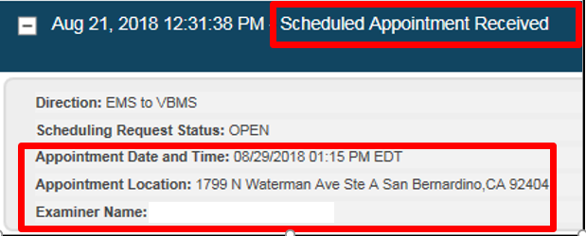
Appointment Packages
The appointment package information can be found by selecting “History” under the “Actions” drop down menu for each contention.
Notes:
“Scheduled Appointment Received” means the packet was received by a doctor.

Slide 20
Appointment Packages
The appointment package provides details including status, location, time, and provider for each appointment.
A user can request a modification of the appointment up to two full calendar days prior to the examination.
Once the claimant reports for the appointment and the vendor sends the “Appointment Completed” package, the contention status will indicate “Pending Results”.
Note: ESR’s ordered prior to VBMS EMS 17.0 release will not display the “Pending Results” status they will default to “Complete” status.

Slide 21
Modification Request
A modification request is created to change the Address or submit additional instructions on an exam request, once an ESR has been submitted; or it can be used to submit Cancellations.
Modifications allow users to have flexibility to ensure that the exam process is successfully completed.
Modification requests are only available when an ESR is an triage or open status.

Slide 22
Cancellations
Vendors can request contention cancellations that the EMS will automatically complete. (no appointments scheduled)
Vendors can modify or cancel appointments.
Vendors cannot cancel an ESR.
Vendors will initiate an ESR cancellation through a CR and a user must respond to the CR and then “Create Modification” to cancel the ESR.
Note: Users should select “View Details” under the “Actions” dropdown menu to review vendor message for additional information regarding the cancellation request.

Slide 23
Cancellation Due to a No Show
The MDE vendor will send an appointment cancellation followed by a request to cancel contentions when the Veteran fails to report for the appointment. The system will automatically send a response and simultaneously cancels the contention. User should verify the vendor has sent an appointment cancellation(s) prior to requesting the contention cancellation.
If the Veteran fails to report for all appointments, the ESR level status will show “Cancel”. If the Veteran shows for at least one examination the ESR level status will show “Completed” and user will have to review individual contentions and review the detail screen to find the reason the Veteran did not report.

Slide 24
Exam Results Received Package
Users should not expect examination results until at least five days, after the last scheduled appointment has been completed.
If the “Results Available” package has not been received after five days, or the corresponding DBQ(s) and diagnostics are not in the VBMS, extend the tracked items accordingly.
Please review the vendor portal to ensure all DBQ(s) have been completed. The vendor should be asked to resend the results available package if it is missing in the history of the ESR. The results available package is the MDE Vendor’s certification that they have completed all actions on a contention and no further appointments are being scheduled.
Note: Do Not open a ticket for missing DBQ’s.

Slide 25
Helpful Tips
Review the History and Details screens for each contention.
Use the vendor portal when expected results are not found and contact the vendor directly to ensure all DBQ’s have been finalized.
Review Documents in VBMS completely as DBQ(s) could be mislabeled.
Close corresponding tracked items when applicable. EMS creates all necessary tracked items for the ESR’s. EMS will open or close these tracked items accordingly.

Slide 26
Questions

