Slide 1
Enhanced ESR Rework Submission Training
June 2019 Compensation Services

Slide 2
Objectives
In order to accomplish the purpose of this lesson, the user will be required to accomplish the following lesson objectives.
Understanding System Details when entering a “Rework” ESR
Successfully creating a “Rework” ESR
Understanding steps to take when Rework option is not available

Slide 3
Terminology
Rework has two categories in EMS. The rework category for each contention must be selected.
EMS Insufficient- Missing information on DBQ requested needed for rating purposes
EMS Clarification- Information on the DBQ provided needs additional information for rating purposes

Slide 4
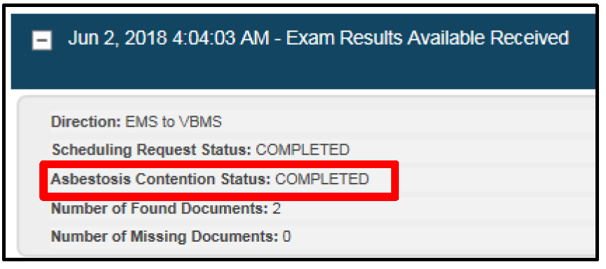
Initiating Exam Rework
The user may initiate a “Rework” request when it has been determined the exam results are insufficient or in need of clarification.
“Rework” functionality is found in the “Actions” drop down for the “Completed” ESR.
The ESR must be in a “Completed” status and all EMS packages for the contention(s) are required to request the “Rework”.

Slide 5
Initiating Exam Rework (cont.)
Prior to ordering the “Rework” exam request, the user must ensure that the ESR is in a “Completed” status.
Additionally, the following messaging must be reflected in the ESR history:
• ESR Acknowledgement
• Appointment Completed
• Results available package for the ESR requiring the “Rework”

Slide 6
Inability to Create a Rework Request
If EMS “Rework” functionality is not available, the user must submit a new request. The following language must be inserted into the special instruction field of the new request:
“This is a rework request for the UUID shown. This is being submitted as a new request because the rework functionality is not currently available for this claim.”
Note: Do not submit an IT ticket if “Rework” is not available.

Slide 7
Unique Universal Identifier (UUID)
The Request UUID can be found on the previously completed examination on the ESR “History” by using the “Actions” drop down.

Slide 8
Exam Rework-Select Contentions
Selecting “Rework” will bring the user to the Select Contentions tab in VBMS.

Slide 9
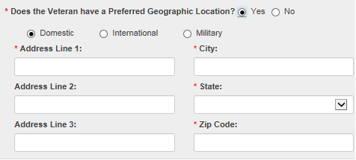
Exam Rework-Claim Information
In the Claim Information screen the user must verify that the Veterans address is correct.
If the Veteran has relocated since the completion of the previously scheduled examination, the user must select “The Preferred Geographic Location” and enter the address where the previous examination was referred to. This process allows the system generate the correct MDE vendor options.
Rework ESR should always be returned to the MDE vendor that previously completed the original examination.

Slide 10
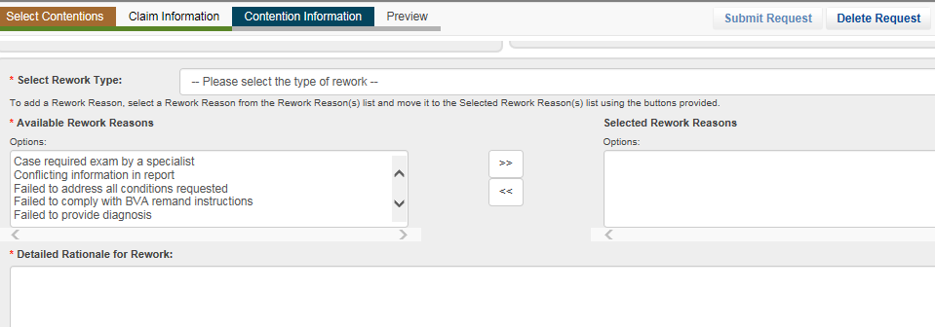
Rework Request-Contention Information
The user must select rework type, rework reasons and rationale for rework.

Slide 11
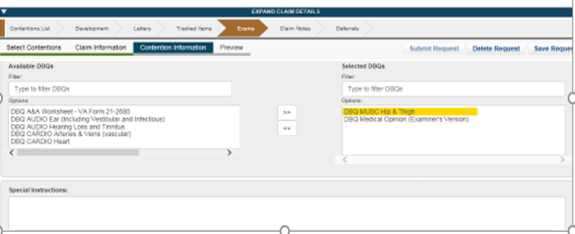
Rework Request-Contention Information (cont.)
User will select the appropriate DBQ and provide any special instructions if necessary.

Slide 12
Exam Rework-Preview
Once user selects the preview tab, a PDF of the examination request is generated for review.
–The system automatically populates language from the previous ESR so additional language should only pertain to the reason for the “Rework” request. Information entered incorrectly will require the user to make the appropriate revisions.
Note: Once “Rework” is submitted changes cannot be made

Slide 13
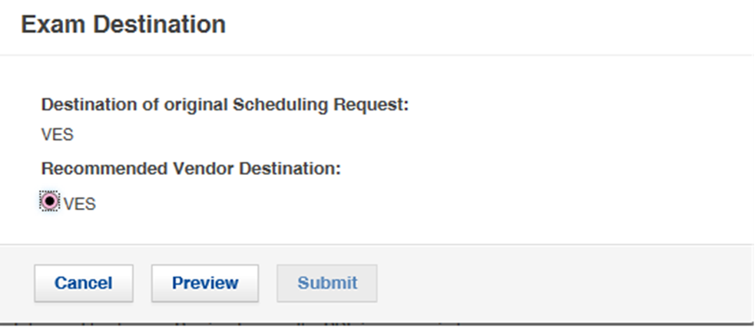
Rework Request-Submit
EMS will automatically select the MDE Vendor who previously completed the examination.

Slide 14
ESR-Rework Status
Once “Rework” ESR has been submitted the exam summary screen will show the details of ESR
The status will indicate “Processing”
The Rework ESR cannot be modified while in “Processing”
Note: The “Rework” ESR will have the same EMS messaging.

Slide 15
Copy ESR function for Rework
If EMS rework functionality is not available and you are needing to submit as new exam, you can use the clone function to avoid re-entering the ESR.

Slide 16
Questions

