Slide 1
FOR TMS TRAINING CREDIT
To obtain training credit in TMS, there is no need to review these slides at this time – immediately close this box by using your mouse to select the “X” in the upper right-hand corner; select the “Return to Content Structure” button; and, select the next link (Video) to view the edited audio-video recording of the Quality Call along with the Call Bulletin
These slides are included here only in case you want to use them later for training purposes or reference
These are the same slides that are shown in the audio-video recording

Slide 2
July 10, 2019
Compensation Service
Quality Call

Slide 3
Welcome to the July 2019 Quality Call
Bonnie Kirby
Senior Quality Review Specialist
Quality Review Team
Quality Assurance

Slide 4
Agenda
June 2019 Quality Call Quiz
What’s New in the M21-1?
ERB-S Retirement
Mandatory Use of the Military Sexual Trauma (MST) Checklist
Q-Tip
Clarification Requests for CAPRI Exams
Drill Pay and Active Duty Dates
New Quality Assurance Team 214D
Poll Questions and Closing Comments

Slide 5
QUIZ – June 2019 Topics – QUIZ

Slide 6
Quiz Question Guidance
Three (3) Quiz Questions will be shown on the following slides
Interactive Quiz Screen will be displayed after each question slide
Using your mouse , please select your response
Please do NOT type your answer into the Chat Box
Note: If you are in a group setting using only one computer, poll the group and have somebody use the mouse at the computer to select the group’s response
Quiz results will be discussed after everybody has responded

Slide 7
Quiz Question #1 – Use Mouse to Select Answer
You are performing a Rating Quality Review on a rating denying SC for PTSD due to MST (Military Sexual Trauma). You’re not sure if the RVSR that completed the rating has demonstrated an accuracy rate of 90% or greater on MST cases, and there is no second signature on the codesheet.
QUESTION: What action should you take?
E-mail the rating station’s QRT coach for this information.
Assume the RVSR is authorized to complete single signature MST ratings and proceed with the review.
Cite an 11e error under the task based checklist.
Put the case on hold in QMS and e-mail your coach.

Slide 8
Quiz Answer #1
Assume the RVSR is authorized to complete single signature MST ratings and proceed with the review.
Currently there is no national repository to show which employees have demonstrated a 90% accuracy rate on 10 or more MST cases. Additionally, verifying the credentials of the person that worked the MST case is not within the scope of the quality review process. Therefore, proceed with the review and only cite a task-based error if there is a critical error otherwise present.
M21-1 III.iv.6.D.7.d

Slide 9
Quiz Question #2 – Use Mouse to Select Answer
A Veteran claims increased compensation for CAD after undergoing bypass surgery the month prior. A Heart DBQ was completed with the claim, and a stable, linear, non-painful scar of 8 inches on the chest was noted.
QUESTION: How should the scar be handled on the rating decision?
No action necessary; the Veteran did not claim the scar.
Send an RFA letter for the scar.
Grant SC for the scar since it is within the scope of the claim.

Slide 10
Quiz Answer #2
Grant SC for the scar since it is within the scope of the claim.
The Veteran’s claim for increase for his CAD encompasses the scar since it was related to his surgery for the SC condition. Therefore, this issue must be addressed (and granted) on the rating decision.
M21-1 III.iv.6.B.2.c

Slide 11
Quiz Question #3 – Use Mouse to Select Answer
If a claim is in open status and needs additional development, it is acceptable to create a deferral and keep the claim in open status.
QUESTION: Is this statement true or false?
True
False

Slide 12
Quiz Answer #3
False
Effective June 1, 2019, employees must not create deferrals on claims in the open status. VSRs are instructed to complete all necessary work on any claim in open status to continue the claim moving forward.
M21-4 Appendix D

Slide 13
What’s New in the M21-1?
Dustin Williams
Program Analyst
Procedures and Program Implementation Staff
Policy and Procedures

Slide 14
Obtaining Service Records
General overarching update – Updating the section to account for the extraction of STRs from RMC and the utilization of the RMC Source Material Tracking System (SMTS) Portal to request STRs / check status of requests.
III.iii.2.B.2.e – Added a note describing the rare situation in which a PIES M04 request would be warranted for records that would have been expected to be stored at RMC.
III.iii.2.B.3.a – Block now discusses all methods of automated STR requests, no longer specific to records (previously) housed by RMC.

Slide 15
Obtaining Service Records
M21-1 III.iii.2.B.3.b – Add new information and clarify existing information to make it easier to determine what actions needs to be taken to obtain STRs for members of the National Guard or Reserves that are currently serving or were serving as of January 1, 2014.
MAJOR DETAIL: It matters if STRs that are located in JLV are certified (as described in III.iii.2.B.2.a and b) or not. This determines the course of action. Certified STRs need to be requested via HAIMS to ensure that an information flow is established and future STRs will automatically transfer over to the eFolder, reducing overall claims processing time.

Slide 16
Obtaining Service Records
Reminders: Veterans receiving post-service treatment as a dependent or a retiree will appear in JLV. Those are not STRs. Look closely before you decide course of action! Do not manipulate service information to force a HAIMS request unless criteria in the Step/Action table is met.
The PIES NG1/RV1 request to Code 07 (when uncertified STRs are found, or otherwise not found after following the directions in the table) will prompt the VA Liaison Office (VALO) to work with the service department to get a certified copy of STRs sent to VA.

Slide 17
Obtaining Service Records
M21-1 III.iii.2.B.3.l – Updated based on updates to VBMS functionality with HAIMS and STR requests.
MAJOR DETAIL: VBMS STR auto-request parameters now include the brief transition period when the service departments may have sent records for scanning/uploading to HAIMS instead of shipping to RMC. While the number of effected claims is small, it’s a notable process improvement.

Slide 18
Obtaining Service Records
The Step/Action table was updated to account for the extraction of STRs from RMC – directions now require use of the RMC SMTS Portal. This necessitated a reformatting/restructuring of the table, in particular, Steps 2 and 3.
Restructured table also makes the distinction between certified and uncertified STRs and the corresponding actions to take. When certified STRs are available in JLV but the HAIMS request failed to transfer the records, it’s important to contact the PIES Help Desk. An issue is preventing proper transfer of the records which will affect all future attempts by the system to auto-request (and obtain) STRs. This must be resolve by the PIES Help Desk/DoD to ensure smooth operation.

Slide 19
Obtaining Service Records – Misc.
M21-1 III.iii.2.B.5.b (Army) /M21-1 III.iii.2.B.8.a (Marine Corps) – Updated instructions for obtaining personnel records for Army and Marine Corps Veterans via PIES.
PIES is hard-coded to allow records requests only when the Veteran’s service falls within a certain date range – to prevent erroneous requests delaying claims and delaying search efforts.

Slide 20
Obtaining Service Records – Misc.
However, based on information provided by both service departments, there is some overlap in which records may not have been scanned (therefore, accessible by DPRIS) and were instead sent to NPRC. To request the records, a special PIES O99 request is required. We’ve identified this scenarios and provided the proper request code/language to use to ensure proper processing

Slide 21
What’s New in the M21-1?
Melissa Milenkovic
Program Analyst
Procedures and Program Implementation Staff
Policy and Procedures

Slide 22
Reference Laws Tab – VBMS-R
The Reference Laws tab in VBMS-Rating was released in the 17.0 update in May 2019.
Use of this tool is not mandatory for VSC employees.
38 CFR 3.103(f) and M21-1, Part III, Subpart iv, 6.C: rating decisions/decision notices must provide the claimant a list of statutes and regulations applicable to the claim.

Slide 23
Reference Laws Tab – VBMS-R
Using Law tab
Inserts header and list of regs after favorable findings (if any)
Free text parenthetically
User adds relevant law(s)/reg(s) after system or free text analysis fragments

Slide 24
ERB-S Retirement
John Brandt
Business Applications Analyst
Ratings, Exam Management, Quality Management, and Development Staff
Business Management

Slide 25
ERB-S Retirement
Exam Request Builder Simplified (ERB-S) contains additional exam language required for exam requests submitted through Exam Management System (EMS) in VBMS.
ERB-S was only intended to be a temporary repository for exam request language
Current exam request language found in ERB-S will be incorporated into EMS with VBMS 18.0 in December

Slide 26
ERB-S Retirement
ERB-S is difficult to update when exam request language needs to be added, modified, or removed
ERB-S will be retired as of August 1, 2019.
In the interim, exam request language will be moved to M21-1 III.iv.3.A
Users can copy required language and paste into their exam request.

Slide 27
ERB-S Retirement
New EMS exam request language not included in VBMS 18.0 will be maintained in the M21-1 until it can be added to a future release of VBMS
Incorporating the language into the M21-1 will allow for updating language changes more quickly and easily
Exam Request Builder (ERB), found on the Job Aids page on the Compensation Service Intranet page, will continue to be used for exams requested through CAPRI

Slide 28
ERB-S Retirement
A hyperlink to EMS exam request language in the M21-1 will be provided on the Job Aids page next to the link for ERB.

Slide 29
Military Sexual Trauma (MST) Checklist
Esther Adefope
Chief
STAR Program Review Staff
Quality Assurance

Slide 30
Military Sexual Trauma (MST) Checklist
The updated training provided to all MST Coordinators and Claims Processor in December 2018, stated the use of the three checklists is required for claims processors and MST Coordinators.
However, the manual notes use of these checklists is only “recommended” and not required. As a result, many MST claims are being received without the appropriate checklists uploaded to the Veteran’s eFolder in VBMS. This causes a delay in claims processing as employees must review, complete, and upload checklists.

Slide 31
Military Sexual Trauma (MST) Checklist
M21-1 IV.ii.1.D.5.l. MST Claim Processing Requirements
Important: To ensure accurate claims processing, the following checklists/worksheet are recommended for completion and uploading to the claims folder:
MST Outreach Coordinator Checklist
Personal Trauma Development Checklist, and
Personal Trauma Incident/Marker Worksheet
The word “recommended” will be removed from the manual and will show the worksheets are “required” for completion and uploading to the claims folder.

Slide 32
Military Sexual Trauma (MST) Checklist
Failing to use the checklist and uploading into the claims folder will not constitute a critical error/BE error for national STAR reviews or local IQRs. However, a corrective action comment will be cited so that corrective action is taken.

Slide 33
Q-Tip
Bonnie Kirby

Slide 34
Fun way to share ideas in a simple tip format
Your Q-Tips are welcome and requested
We will help each other by sharing knowledge
Send your ideas to VACO’s Quality Review Team
VAVBAWAS/CO/InternalQRS

Slide 35
Q-Tip – Clarification Requests For CAPRI Exams
Clarification requests via Skype Instant Messenger are not acceptable
HIPAA training advises that “Skype should not be used for communicating patient information that is required to be maintained within CPRS… Skype is not part of a VA System of records”
M21-1 III.iv.3.D.3.c Clarification of Examination Reports states that if clarification is needed, the examiner should be contacted to discuss it or it should be returned to the examiner

Slide 36
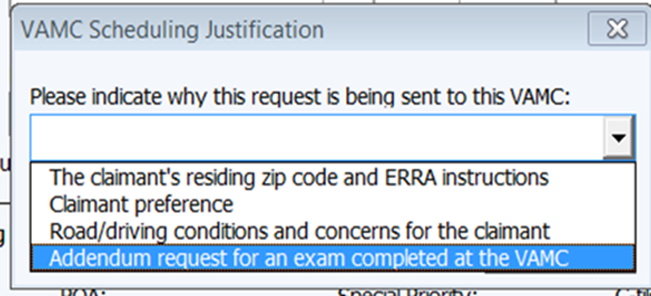
Q-Tip – Clarification Requests For CAPRI Exams
M21-1 III.iv.3.D.3.e Returning Examination Reports Requested through CAPRI currently advises that a phone call or email are the preferred methods of seeking clarification
For tracking purposes, all clarification requests should be submitted through CAPRI with a 2507 request created in the ERB. Select the “addendum request for an exam completed at the VAMC” option as shown in the screenshot below:
If the exam is sufficient,
do not state that the exam
is insufficient.

Slide 37
Drill Pay and Active Duty Dates
Christine Alford
Chief
Advisory and Special Review Team
Quality Assurance

Slide 38
Drill Pay & Active Duty Dates
M21-1 III.v.4.C.3
VA Form 21-8951 shows the combined amount of days for drill(s) and active duty during the same fiscal year, when applicable
Drill/ Training for FY 2017: 150 days
Active Duty for FY 2017: - 50 days
= 100 days used for the drill pay adjustment

Slide 39
New Quality Assurance Team 214D
George Boyd
Consultant
Advisory and Special Review Team
Quality Assurance

Slide 40
New Quality Assurance Team 214D
Advisory & Special Review Team
Established June 1, 2019
Quality Improvement
Personnel
Management
Consultants with knowledge of:
Both Pre & Post VSR tasks
Rating and Appeals functions

Slide 41
New Quality Assurance Team 214D
Responsibilities & Functions
Special Focus Reviews (SFRs)
Consistency Studies
FY19 Site Visits
Response to Office of Inspector General Reports
Work in tandem with the Training Staff (213)
Advisory Opinions from the Advisory and CAVC Staff (211B)

Slide 42
Poll Questions
Presented by:
Bonnie Kirby

Slide 43
Interactive Poll Question Guidance
Three (3) Poll Questions will be shown on the following slides
Interactive Poll Screen will be displayed after each question slide
Using your mouse , please select your response
Please do NOT type your answer into the Chat Box
Note: If you are in a group setting using only one computer, poll the group and have somebody use the mouse at the computer to select the group’s response
Poll results will be discussed after everybody has responded

Slide 44
Poll Question #1 – Use Mouse to Select Answer
You are developing an original claim from a Veteran and ready to enter a request for a contract examination in EMS.
QUESTION: Where do you find additional exam language after 8/1/19?
The Exam Management System (EMS) in VBMS
38 CFR 3.159(c)(4)(i)
The Exam Management System Simplified (ERB-S)
M21-1 III.iv.3.A

Slide 45
Poll Question Answer #1
M21-1 III.iv.3.A
The ERB-S will be retired effective August 1, 2019. Its function was intended to be temporary, and it is not easily updated in a timely fashion. EMS will be updated with exam language in December with the VBMS 18.0 update. In the interim (and for some cases afterwards), this verbiage will be available in the manual since it can be updated both quickly and easily.
M21-1 III.iv.3.A

Slide 46
Poll Question #2 – Use Mouse to Select Answer
You are reviewing a DBQ completed through CAPRI. It is sufficient for rating purposes, but you need clarification of a statement the examiner made.
QUESTION: How should you contact the examiner for clarification?
Request a new DBQ through CAPRI
Create the request in ERB by selecting the “addendum request for an exam completed at the VAMC” option, then submit via CAPRI
Send the examiner a message via Skype; it’s the fastest and easiest way to receive your answer
Submit the request through CAPRI and state that the exam is insufficient

Slide 47
Poll Question Answer #2
Submit the request through CAPRI selecting the “addendum request for an exam completed at the VAMC” option
For tracking purposes, all clarification requests should be submitted through CAPRI with a 2507 request. If clarification only is needed, do not state that the exam is insufficient.
M21-1 III.iv.3.D.3.c & e

Slide 48
Poll Question #3 – Use Mouse to Select Answer
A Veteran has both been on active duty and received drill pay during the same fiscal year. The VA Form 21-8951 shows 185 training days. Personnel records from DPRIS show that the Veteran was on active duty from June 25, 2011 through August 31, 2011.
QUESTION: What is the total amount of days for which the Veteran received drill pay?
117
120
115

Slide 49
Poll Question Answer #3
117
The Veteran was on active duty for 68 days (6 days in June, 31 days in July, and 31 days in August). Therefore:
Drill/ Training for FY 2017: 185 days
Active Duty for FY 2017: - 68 days
= 117 days used for the drill pay adjustment
M21-1 III.v.4.C.3

Slide 50
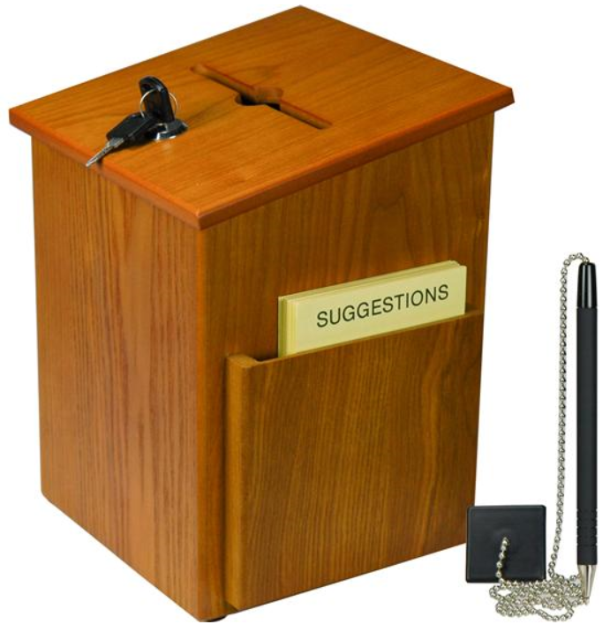
Questions – Suggestions – Next Quality Call
Presented by:
Bonnie Kirby

Slide 51
Questions Relating to Today’s QC Topics
Questions on topics presented must be emailed to the Compensation Service Quality Review Team at InternalQRS.VBAVACO@va.gov
Emails must include Cc to your Coach or other RO management
Emails must contain the name of the topic(s) with your question(s)
Questions must be submitted to the mailbox by COB Friday, July 12th
Questions submitted after COB Friday will not be accepted for inclusion in the Call Bulletin
Email questions are limited to those pertaining to only the topics presented, and responses will not be provided to any questions that are not related to the topics presented during today’s Quality Call
Official guidance to the questions will be posted later in the Call Bulletin

Slide 52
Do You Have Suggestions for Topics?
Please feel free to email your topic suggestions to the Compensation Service Quality Review Team at InternalQRS.VBAVACO@va.gov
In your email, be sure to include:
Cc to your Coach or other RO management
Name of the topic
Intended audience (VSR – SVSR – RVSR – DRO – AQRS – RQRS)
Applicable M21-1 and/or 38 CFR citations
Quality Call Bulletins can be found in the STAR Home Page on the Compensation Service Intranet site, TMS, and VBA Learning Catalog
Audio recordings of the Quality Calls with separate copies of the PowerPoint slides can be found in both TMS and VBA Learning Catalog

Slide 53
Next Quality Call
A Compensation Service Quality Call is usually presented each month
This is the last Quality Call for Fiscal Year 2019
Next Quality Call will be conducted in Fiscal Year 2020

