Slide 1
FOR TMS TRAINING CREDIT
To obtain training credit in TMS, there is no need to review these slides at this time – immediately close this box by using your mouse to select the “X” in the upper right-hand corner; select the “Return to Content Structure” button; and, select the next link (Video) to view the edited audio-video recording of the Quality Call along with the Call Bulletin
These slides are included here only in case you want to use them later for training purposes or reference
These are the same slides that are shown in the audio-video recording

Slide 2
June 12, 2019
Compensation Service
Quality Call

Slide 3
Welcome to the June 2019 Quality Call
Robert Johnson
Senior Quality Review Specialist
Quality Review Team
Quality Assurance

Slide 4
Agenda
May 2019 Quality Call Quiz
Change to STAR Sample Size
Appeals Modernization Act (AMA) Reminders
Creating Deferrals in Open Status
What’s New in the M21-1?
Military Sexual Trauma (MST) Updates
Amyotrophic Lateral Sclerosis (ALS) Special Focused Review (SFR)
Q-Tips
Scars
Due Process
The References, Episode 2: Lyles and the Pyramid(ing) of Doom
VASRD Infectious Diseases, Immune Disorders, and Nutritional Deficiencies
Poll Questions and Closing Comments

Slide 5
QUIZ – May 2019 Topics – QUIZ

Slide 6
Quiz Question Guidance
Three (3) Quiz Questions will be shown on the following slides
Interactive Quiz Screen will be displayed after each question slide
Using your mouse , please select your response
Please do NOT type your answer into the Chat Box
Note: If you are in a group setting using only one computer, poll the group and have somebody use the mouse at the computer to select the group’s response
Quiz results will be discussed after everybody has responded

Slide 7
Quiz Question #1 – Use Mouse to Select Answer
One of the first steps to take upon receipt of a claim based on military sexual trauma (MST) is for the MST Outreach Coordinator to contact the Veteran via telephone to ask if he/she completed DD Form 2910, DD Form 2911, or a similar form following the incident.
QUESTION: Is a second attempt necessary if the Coordinator is unable to contact the Veteran by telephone on the first attempt?
Yes
No

Slide 8
Quiz Answer #1
No
If the MST Outreach Coordinator is unable to contact the Veteran by telephone on the first attempt, a second attempt is not necessary. Instead, the Coordinator will document the unsuccessful attempt as a permanent VBMS note, and follow the remaining procedures in M21-1 IV.ii.1.D.5.d to obtain and review all relevant credible supporting evidence.
M21-1 IV.ii.1.D.5.f

Slide 9
Quiz Question #2 – Use Mouse to Select Answer
Comp ITF received on 01/07/2019. 526EZ for hearing loss received on 03/01/2019. You are granting direct service connection for hearing loss with a 10% evaluation effective 01/07/2019.
QUESTION: What are the laws and regulations applicable to this claim?
38 CFR 3.310; 38 CFR 3.155; 38 CFR 3.400; and, 38 CFR 4.87
38 CFR Part 3 and 38 CFR Part 4
38 CFR 3.303; 38 CFR 3.155; 38 CFR 3.400; and, 38 CFR 4.85
38 CFR 3.303; 38 CFR 3.400; and, 38 CFR 4.124a

Slide 10
Quiz Answer #2
38 CFR 3.303; 38 CFR 3.155; 38 CFR 3.400; and, 38 CFR 4.85
You must list:
3.303 – Regulation governing the type service connection (direct)
3.155 – Regulation governing ITF acceptance and impact (provisions of ITF)
3.400 – Regulation governing the effective date assigned (effective date assignment)
4.85 – Regulation governing the evaluation assigned (hearing loss)
Every decision often contains many “mini-decisions” based on different laws and regulations, so any of those mini-decisions each require the corresponding law (effective date, evaluation, reasonable doubt, FTR, etc.)
CFR 3.103(f) & M21-1 III.iv.6.C.5.a & e

Slide 11
Quiz Question #3 – Use Mouse to Select Answer
When a Field Examiner recommends review of competency status, a medical examination must be routinely requested.
QUESTION: Is this statement true or false?
True
False

Slide 12
Quiz Answer #3
False
Do not routinely request an examination of the beneficiary when evidence indicates that competency has been regained. When recommendations from a Field Examiner suggest restoration of competency is warranted, and evidence is otherwise consistent with or does not conflict with the recommendation, no additional evidence is required to restore competency.
M21-1 III.iv.8.A.4.d

Slide 13
Quality Assurance Update
Robert Johnson
Senior Quality Review Specialist
Quality Review Team
Quality Assurance

Slide 14
Change in STAR Sample Size
To better align the STAR process with the current claims routing environment, the sample methodology is restructured
Previously, over 22,000 STAR assessments were conducted annually
Effective immediately, approximately 11,700 STAR assessments will be conducted annually – one pull per month
~ 5,500 authorization claims
~ 6,200 rating claims
Resulting national metrics will have a margin of error of no more than 1.1 percent with a 95 percent confidence level
The national score is the emphasis for STAR accuracy
Any STAR errors will still need to be corrected by the EP clearing station

Slide 15
Appeals Modernization Act (AMA) Reminders
Mike Jones
Authorization Quality Review Specialist
Quality Review Team
Milwaukee VA Regional Office

Slide 16
Reconsideration & Reopened Claims
Reconsideration and reopened claims received prior to the implementation of AMA on February 19, 2019
Do not treat as a request for application
Do not return to the claimant for submission on a valid AMA form
Work the claim under EP 020
Claim Label – use the most approximate label, such as New or Increase
38 CFR 3.160(e)
FAQ March 3, 2019 – AMA Claims Establishment/ End Products (EPs)

Slide 17
AMA Errors Cited During the Grace Period
AMA errors cited during the grace period still need to be corrected
38 CFR 3.103(f)
M21-4, Chapter 6, 6.4.d

Slide 18
Creating Deferrals in Open Status
Daniel Buzhardt
Lead Operations Analyst
Program Operations
Quality Assurance

Slide 19
Creating Deferrals in Open Status
Effective June 1, 2019, employees may not create deferrals on claims in the open status
VSRs are instructed to complete all necessary work on any claim in open status, to continue the claim moving forward
Rather than doing a deferral on claims in the open status, it is more efficient and better service to our Veterans to perform all appropriate actions needed on the claim

Slide 20
Creating Deferrals in Open Status
The deferral functionality will not be removed from VBMS
Compensation Service and Pension & Fiduciary Service may designate exceptions and create policy for its use for specific needs in the future, where directed development is appropriate
M21-4, Appendix D has been updated to reflect this guidance

Slide 21
What’s New in the M21-1?
Matthew Hof
Manual Editor
Procedures and Program Implementation Staff
Policy and Procedures

Slide 22
Private Medical Record (PMR) Retrieval Program
M21-1 III.i.4.A.3.c – New VA.gov claims submission functionality
VA.gov completes and routes VA Forms 21-4142 and 21-4142a to the PMR contractor after a compensation claim is finalized and submitted
VA Form 21-526EZ overflow page is annotated to indicate the completed VA Forms 21-4142 and 21-4142a have been sent to the PMR contractor
Completed forms will not be uploaded into the eFolder until the PMR contractor completes development
Important to look at the overflow page to determine if a request is pending

Slide 23
PMR Retrieval Program (Cont’d)
III.iii.1.D.2.d
RO leadership must communicate changes to PMR Super Users (including contact information) to the PMR Program Management Office
Corporate mailbox is PMR.VBACO@va.gov
IIII.iii.1.D.2.e
Updated block to include the existing requirement for PMR Super Users to check the PMR portal for returned requests that need additional information or development

Slide 24
PMR Retrieval Program (Cont’d)
III.iii.1.D.2.g
Added a new method for identifying VA Forms 21-4142/a that have been referred to the contractor, based on the new VA.gov functionality described in III.i.4.A.3.c
Also changed the maximum suspense period for the PMR VBMS tracked item from 35 days to 10 days due to improved processing times by the PMR contractor
III.iii.1.D.2.h
Add instructions for handling a PMR request returned by the PMR contractor

Slide 25
Military Sexual Trauma (MST) Updates
Esther Adefope
Chief
STAR Program Review Staff
Quality Assurance

Slide 26
MST Claims Assistance Reminder
Quality Assurance is here as a resource and will respond to your case-specific MST questions that cannot be resolved locally by your QRT
We recognize these are complex claims and can be difficult to process
When all local efforts have been exhausted to resolve an MST question related to a specific case being adjudicated, please email the claim number and question(s) to the CS Quality Assurance MST POC
Esther.adefope@va.gov, or
VAVBAWAS/CO/214B (214B.VBACO@va.gov)

Slide 27
May 2019 Quality Call MST Question #1
Any issue adjudicated involving MST require second-signatures until a decision maker has demonstrated an accuracy rate of 90% or greater on a minimum of 10 MST cases per M21-1 III.iv.6.D.7.d
Question: In the NWQ, how is each RO aware that single-signature MST ratings are completed by individuals who demonstrated this requirement?
It appears each RO has its own listing showing who is authorized to adjudicate single-signature MST rating decisions
RO QRT Coaches should coordinate with their leadership for a solution
Not within scope of quality reviewer to verify credentials at this time – assume the employee is authorized to process the work

Slide 28
May 2019 Quality Call MST Question #2
Some ROs have designated MST Outreach Coordinators that are not listed in http://www.benefits.va.gov/benefits/mstcoordinators.asp
Concern: STAR and ROs will cite errors and avoidable deferrals because the coordinators who performed the work are not listed on the website
STAR error will not be cited since such action does not rise to the level of CUE
Deferrals and local quality errors should not be cited based on employee not currently listed as an MST Coordinator on the website
Not within scope of quality reviewer to verify credentials at this time – assume the employee is authorized to process the work

Slide 29
M21-1 Needs Updates for MST Processing?
If employees at your RO have suggested edits, questions, comments, or concerns regarding M21-1 content
Each RO, through its designated leadership/coordinator, can submit them via the M21-1 mailbox using the format and text outlined in the February 2019 Compensation Service Quality Call Bulletin
VAVBAWAS/CO/M21-1 (M21-1.VBAVACO@va.gov)

Slide 30
Amyotrophic Lateral Sclerosis (ALS) – Special Focused Review (SFR) –
Vanessa Carr
Consultant
STAR Program Review Staff
Quality Assurance

Slide 31
ALS SFR Background
Special focused review was initiated based upon recommendation related to the Office of Inspector General (OIG) Review of Accuracy of Claims Involving Service-Connected ALS Report dated September 6, 2018
Quality Assurance’s STAR Program Review Staff conducted a review during November 2018 on 200 randomly selected cases involving ALS entitlement

Slide 32
ALS SFR Results
200 cases were randomly selected
4 cases were excluded
41 of the 196 cases were noted to have errors
Overall accuracy = 79%
Errors noted in 4 areas:
Evaluation of ALS and complications
Evaluation of SMC
Incorrect effective date
Ancillary benefits

Slide 33
ALS Reminders
Review any medical records that are submitted for evidence of possible complications
Check SMC Calculator input for accuracy
Reduce A&A when the Veteran is hospitalized at VA expense
On May 15, 2019, the M21-1 was updated to reflect the change in ALS claims processing authority
M21-1 III.iv.4.N.6.f

Slide 34
Q-Tips
Vanessa Carr
Consultant
STAR Program Review Staff
Quality Assurance

Slide 35
Fun way to share ideas in a simple tip format
Your Q-Tips are welcome and requested
We will help each other by sharing knowledge
Send your ideas to VACO’s Quality Review Team
VAVBAWAS/CO/InternalQRS

Slide 36
Q-Tip #1 – Inferring Scars
Throwback: This was previously a March 2017 Quality Call Q-Tip
Sixteen (16) national A2 errors cited in February 2019 for failure to infer (and grant) a scar
Reminder: When evaluating an SC disability, infer and grant scars that are within the scope of the claim
M21-1 III.iv.6.B.1.c

Slide 37
Q-Tip #2 – Due Process Scenario
Due Process letter contains the correct proposed rate(s) based on dependency information at the time the letter is sent
Subsequently, dependents on the Veteran’s award are removed
Divorce
School child
Child turns 18, etc.
As such, rate is now less than proposed when final action is taken
A new Due Process letter is not needed
Initial Due Process letter was correct at the time it was issued, so a new notice of proposed adverse action is not required
M21-1 I.2.B.3.e

Slide 38
The References, Episode 2
Andrew Latham
Consultant
Denver Rating Instruction Staff
Training

Slide 39
Lyles and the Pyramid(ing) of Doom
Release date: May 29, 2019
Topic: Lyles Holding, Meniscal Evaluations
How to View/Listen: Adobe Captivate Prime (4507185)
https://captivateprime.adobe.com/app/learner?accountId=27356#/course/1185400

Slide 40
VASRD Infectious Diseases, Immune Disorders, and Nutritional Deficiencies
Janel Keyes
Regulations Chief
Policy

Slide 41
VA Schedule for Rating Disabilities (VASRD)
Federal regulations used by claims processors to evaluate the severity of Veterans’ disabilities
Reflects outdated medical terminology and evaluation criteria
Last complete update in 1945
Currently comprised of 15 body systems
Comprehensive effort to update all body systems
Incorporate medical, scientific, and economic data/advances
Update to combine Respiratory System with Impairment of Auditory Acuity (14 body systems)

Slide 42
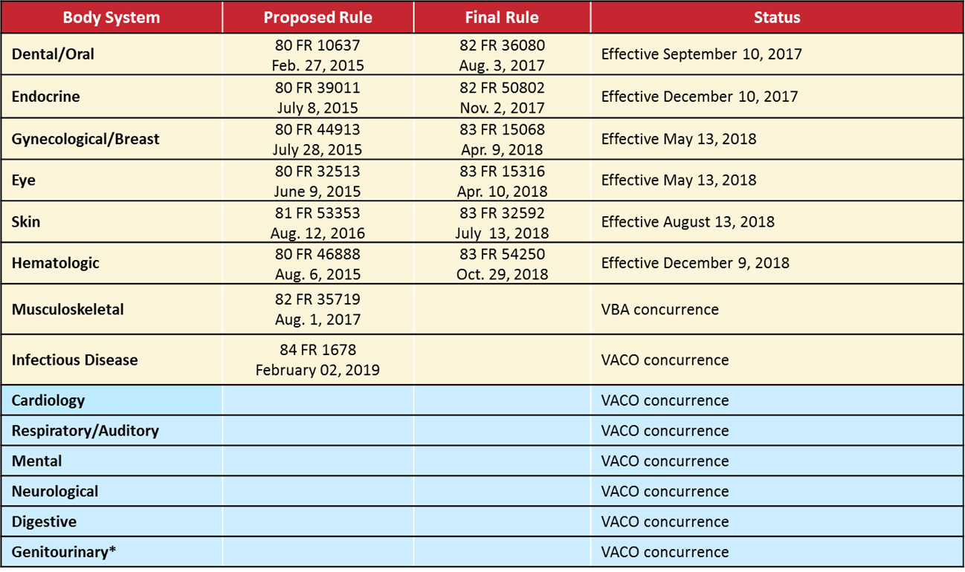
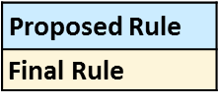
Status by Body System (as of April 2019)

Slide 43
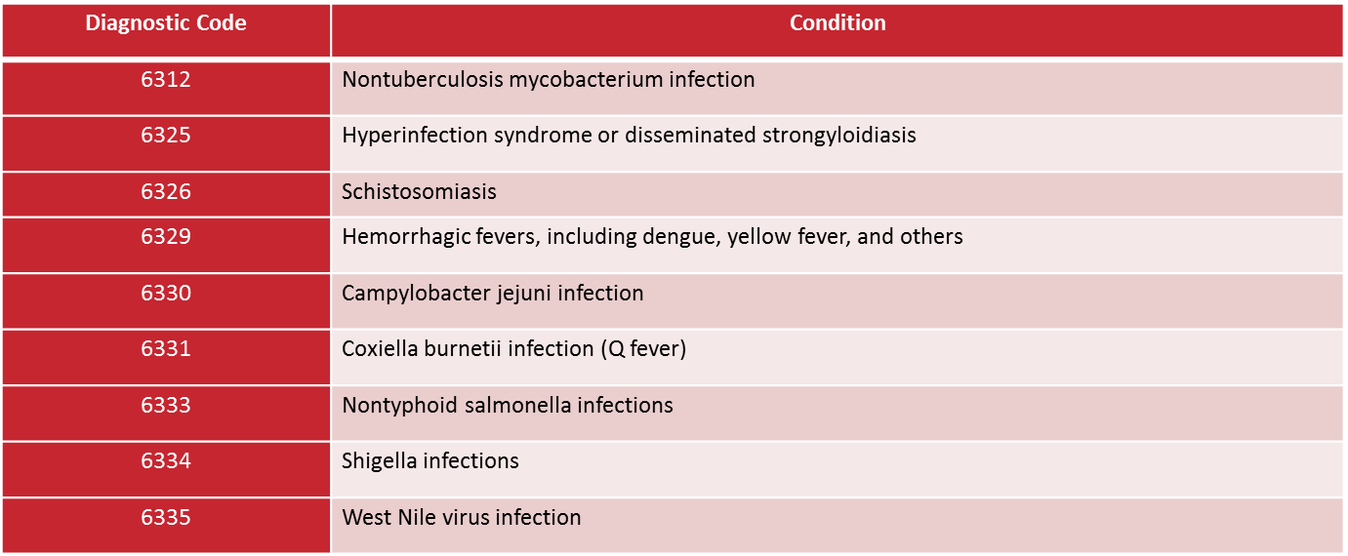
Highlights: Infectious Diseases, Immune Disorders, and Nutritional Deficiencies
Final rule target effective date is August 11, 2019
Added 9 diagnostic codes (DC)

Slide 44
Highlights (Cont’d)
Revised 18 DCs
Created the following General Rating Formula:
General Rating Formula for Infectious Diseases:
For active disease........ 100
After active disease has resolved, rate at 0 percent for infection. Rate any residual disability of infection within the appropriate body system.

Slide 45
Highlights (Cont’d)

Slide 46
VASRD Implementation
In addition to publishing the final rule, VBA must develop, coordinate, and deliver:
Communications information to outreach personnel
Procedural guidance (via M21 updates)
Updated training materials in TMS
VBMS system updates
Disability Benefit Questionnaires (DBQs) for use by VHA and VBA-contracted examiners

Slide 47
VASRD Implementation (Cont’d)
Once final rule is effective, rating personnel must apply both old and new VASRD rating criteria
To ensure accurate and timely decisions, Compensation Service must align final rule publication with VBMS-R releases

Slide 48
Poll Questions
Presented by:
Robert Johnson

Slide 49
Interactive Poll Question Guidance
Four (4) Poll Questions will be shown on the following slides
Interactive Poll Screen will be displayed after each question slide
Using your mouse , please select your response
Please do NOT type your answer into the Chat Box
Note: If you are in a group setting using only one computer, poll the group and have somebody use the mouse at the computer to select the group’s response
Poll results will be discussed after everybody has responded

Slide 50
Poll Question #1 – Use Mouse to Select Answer
VA Form 21-526EZ for service connection for hearing loss was received on February 5, 2019. A review of the file shows that hearing loss was previously denied and the appeal period has expired. The Veteran has submitted new and relevant evidence.
QUESTION: What is the correct action you should take?
Accept the reopened claim, work under EP 020, and complete any necessary development
Send the Veteran a Request for Application for AMA Review letter and clear EP 400

Slide 51
Poll Question Answer #1
Accept the reopened claim, work under EP 020, and complete any necessary development
Do not return to the claimant for submission on a valid AMA form. An AMA review form is not required when the claim to reopen or reconsider is received prior to the AMA implementation date (02/19/2019).
38 CFR 3.160(e)
FAQ March 3, 2019 – AMA Claims Establishment/ End Products (EPs)

Slide 52
Poll Question #2 – Use Mouse to Select Answer
VSRs are no longer allowed to create deferrals on claims in the open status (development).
QUESTION: Is this statement true or false?
True
False

Slide 53
Poll Question Answer #2
True
Effective June 1, 2019, employees may not create deferrals on claims in the open status. VSRs are instructed to complete all necessary work on any claim in open status to continue moving the claim forward.
M21-4, Appendix D

Slide 54
Poll Question #3 – Use Mouse to Select Answer
You are conducting a local quality review on an MST case and notice the VA Form 27-0820 documenting the attempt to contact the Veteran to ask if she completed DD Form 2910, DD Form 2911, or a similar form is signed by a person who is not listed on VBA’s MST Coordinator website. (https://www.benefits.va.gov/benefits/mstcoordinators.asp)
QUESTION: Should you cite an error?
Yes
No

Slide 55
Poll Question Answer #3
No
Local Quality Review Teams and STAR should not be citing this as an error. Quality Assurance has never provided such guidance, the checklist provides no way to support this as an error, and the manual explaining the checklists do not show this as an error.
Reminder: All employees developing and adjudicating MST cases must be those designated as specialized to process these types of claims!

Slide 56
Poll Question #4 – Use Mouse to Select Answer
Veteran submits new claim for SC for only right knee strain. Evidence of record, including the VA exam, shows SC for the right knee strain is warranted. Exam reveals a right knee scar that resulted from a post-service arthroscopy procedure, the procedure was associated with the SC right knee strain, the scar is not painful or unstable, and the scar is less than 6 square inches.
QUESTION: What action, if any, should be taken on the unclaimed scar?
Invite a claim for right knee scar on a prescribed form
No action is necessary on the right knee scar because it was not claimed
Infer right knee scar within scope of claim and grant service connection

Slide 57
Poll Question Answer #4
Infer right knee scar within scope of claim and grant SC
In the event that the examination is otherwise sufficient for rating purposes, the decision maker awards service connection (SC) for the right knee strain and separate SC for the noncompensable right knee scar as within the scope of the claim for SC for right knee strain.
M21-1 III.iv.4.L.3.e
M21-1 III.iv.6.B.1.c
M21-1 IV.ii.2.B.3.c

Slide 58
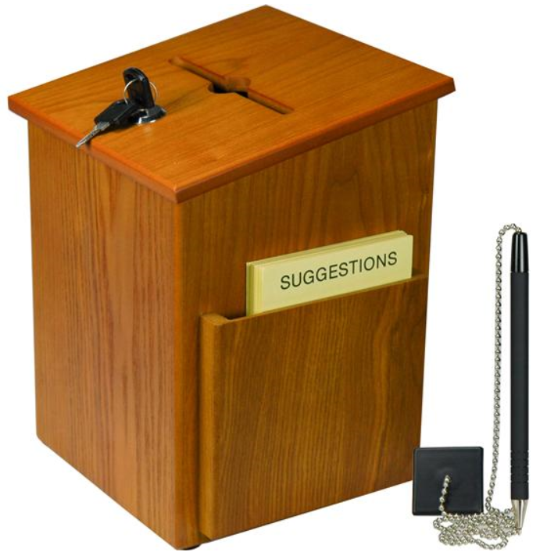
Questions – Suggestions – Next Quality Call
Presented by:
Robert Johnson

Slide 59
Questions Relating to Today’s QC Topics
Questions on topics presented must be emailed to the Compensation Service Quality Review Team at InternalQRS.VBAVACO@va.gov
Emails must include Cc to your Coach or other RO management
Emails must contain the name of the topic(s) with your question(s)
Questions must be submitted to the mailbox by COB Friday, June 14th
Questions submitted after COB Friday will not be accepted for inclusion in the Call Bulletin
Email questions are limited to those pertaining to only the topics presented, and responses will not be provided to any questions that are not related to the topics presented during today’s Quality Call
Official guidance to the questions will be posted later in the Call Bulletin

Slide 60
Do You Have Suggestions for Topics?
Please feel free to email your topic suggestions to the Compensation Service Quality Review Team at InternalQRS.VBAVACO@va.gov
In your email, be sure to include:
Cc to your Coach or other RO management
Name of the topic
Intended audience (VSR – SVSR – RVSR – DRO – AQRS – RQRS)
Applicable M21-1 and/or 38 CFR citations
Quality Call Bulletins can be found in the STAR Home Page on the Compensation Service Intranet site, TMS, and VBA Learning Catalog
Audio recordings of the Quality Calls with separate copies of the PowerPoint slides can be found in both TMS and VBA Learning Catalog

Slide 61
Next Quality Call
A Compensation Service Quality Call is usually presented each month
Next Quality Call will be conducted on July 10, 2019

