Slide 1

Compensation Service Benefits Delivery at Discharge (BDD) and Integrated Disability Evaluation System (IDES) Conference Call
Briefed by: 212A
Name/Title: 212A Staff
Date: June 11, 2019

Slide 2
Agenda (1 of 4)
Introduction
Topics for Discussion
  Contract Examination Exclusions List
  ExamTrack not Showing Delivered Exams by MTF
  Exam Request Builder (version 4.5)
  Intake Sites not showing in EMS
  BDD In-Service Ratings when SM referred to IDES

Slide 3
Agenda (2 of 4)
IDES Specific Topics
  Dependency Claims from IDES Participants and Required
  Use of EP 130
  Claim Status of EP 689 when Brokering
  Closing Exam Tracked Items in VBMS
  Indicating Required Specialist Examination in CAPRI Requests
  Providing Required Contact Information in CAPRI Requests
  Receiving Electronic Documents from PEBLOs
  and/or IDES Participants
  Current IDES Program Timeliness
  Deferment Status Check
  IDES SM Satisfaction Survey Report
  (October 2018 to March 2019)

Slide 4
Agenda (3 of 4)
VTA Reminders
  VTA Access
  VTA Version 2.4.3
  VTA Training
  VTA Addendum
BDD Specific Topics
  Routing In-Service Ratings for BDD Claims
  BDD Claims Establishment
  Current Program Timeliness
  Questions from the Pre-Discharge BDD Mailbox

Slide 5
Agenda (4 of 4)
TMS #
BDD/IDES Coaches Call
Next Teleconference
Open Floor

Slide 6
Reminder: Slides are used to show the Topic, and start discussion, however, slides do not show all the information associated with the topic. The Read Ahead is the official document.

Slide 7
Topics for Discussion

Slide 8
Contract Examination Exclusions List
The following four claim types have been removed from the Contract Examination Exclusions List:
  Initial claim for disability based on Gulf War undiagnosed illness (follow-up examinations may be ordered through contract examination providers)
  Examination is for a Veteran's dependent or survivor
  Veteran is deceased, and an opinion is required
  Veteran is claiming pension
If the Servicemember is claiming Gulf War undiagnosed illness or pension, these conditions can be examined by a VBA contractor. Questions should be directed to ContractExam.VBAVACO@va.gov

Slide 9
ExamTrack not Showing Delivered Exams by MTF
A recent VBMS release removed the ability for MSCs to search for exams by MTF. The issue is being worked, but in the meantime, the only way to search for exams is by the Servicemembers SS#. We realize this is time consuming and hope to have the issue resolved soon

Slide 10
Exam Request Builder (version 4.5)
A new version of Exam Request Builder has been published on the Job Aids page. This new version has the following change
  Language related to Sharp v. Shulkin, 29 Vet.App. 26 (2017) was added to the examination request wording for the Temporomandibular Disorders DBQ
  A bug that allowed empty values for RAD date when Special Priority was set to BDD was fixed
Please be sure to always launch the Exam Request Builder from the Rating Job Aids page to insure you have the current version.

Slide 11
Intake Sites not showing in EMS
Recently, it was brought to our attention that the intake site data in VBMS is not being transferred to EMS for Pre-Discharge exams. Without this information, MSCs will not be able to run batch reports or download batch documents from the vendor portals. A recent VBMS update contributed to this issue; however, the VBMS team has been notified and is actively working to correct the issue
Until the issue is resolved, MSCs will have to search and track each case individually. We realize this process is labor intense and time consuming, however, without proper tracking, notification letters, no shows, and other valuable information regarding the Servicemembers exams could cause delays

Slide 12
BDD In-Service Ratings when Servicemember
Referred to IDES
We were informed that some BDD claims have not been administratively denied when the SM was referred into the IDES process. Per M21-1 III.i.2.D.8.c, the MSC is required to establish a 689 EP and notify the Station of Jurisdiction (SOJ) that the BDD claim needs to be administratively denied, because the SM is no longer eligible for BDD due to no known discharge date
However, these actions are not being taken. On the most recent case, the BDD claim was rated. The SM is still on active duty and asking us what to do now that she is going to start receiving benefits. If you have encountered this issue as well, please let us know today on the call or contact us at the Pre-Discharge mailbox

Slide 13
IDES Specific Topics

Slide 14
Dependency Claims from IDES Participants and
Required Use of EP 130
When Veterans with evaluations of at least 30% submit dependency claims, VA will take immediate action to add dependents
When processing IDES claims from Non-AD Veterans with running VA awards, the MSC must consider the Veteran’s current evaluation
If the participant is currently receiving compensation at 30% or higher, the MSC must:
  Ensure all dependency related documents have been uploaded into the Veteran’s eFolder or have been shipped to the scanning vendor,
  Establish an EP 130, using:
  the date the VAF 21-686c (or VAF 21-674) was received as the date of claim, and
  a standard (non-IDES) dependency claim label, and
List the claimed dependents as contentions under the EP 130 (not under the EP 689)

Slide 15
Dependency Claims from IDES Participants and
Required Use of EP 130 (continued)
An EP 130 should not be established when:
  the participant has a combined rating of less than 30 percent, and/or
  the participant is on active duty, without regard to any current disability rate (as any VA payment should be suspended)
In these instances above, dependency issues should be controlled under the EP 689 and addressed within the IDES rating award action
EP 130s established by MSCs will be routed by NWQ to non DRAS stations and will be generally worked outside of IDES. However, if any EP 130 remains pending at the time of the IDES award DRAS will resolve the dependency claim when dependency is established by the evidence of record

Slide 16
Claim Status of EP 689 when Brokering
During the May IDES/BDD Teleconference a question was raised about the need to update the claim status of the EP 689 when the claim is brokered to DRAS. At this time there, MSCs are not required to update the status of this EP
Providence DRAS indicated that if the MSC has the ability to update the status to RFD (i.e., the 689 is in the MSC’s work queue, and they are already using Complete Work Item to send the 689) tit would be appreciated if the MSC was to update the claim status to Ready for Decision (RFD) when brokering cases to Providence
However, MSCs must not change the claim status of the 689 to RFD in any Army case as doing so may disrupt processes currently in place at Seattle DRAS. All 689s brokered to Seattle DRAS must be left open (or in Ready to Work status)

Slide 17
Closing Exam Tracked Items in VBMS
MSCs are must enter tracked items for exams requested outside of VBMS Exam management
MSCs must enter a tracked item, for each type of examination (i.e., the SHA, and any required specialist exam)
Each tracked items must be closed out to reflect the date that the related examination was returned from VHA
It would not be appropriate to close out exam tracked items simply using the date that the last examination from the provider was returned (as done in VTA)
VTA data captures only the time it takes for a provider to return all the exams that were requested from that provider; whereas the tracked items in VBMS are tracking the time it takes to return each requested exam individually

Slide 18

Indicating Required Specialist Examination in CAPRI Requests (1 of 4)
MSCs must request specialist exams per M21-1 III.i.2.D.6.c and M21-1 III.iv.3.A.6.
In exams requested from VHA, MSCs must indicate the SHA and any required specialist exams by selecting the specific DBQs needed from the List of Exams dropdown shown on the Add New C&P Exam Screen in CAPRI

Slide 19

Indicating Required Specialist Examination in CAPRI Requests (2 of 4)
If an MSC inadvertently clicks submit before selecting all required exams, the MSC can add the DBQ to the request (provided that the exam is still pending and has not yet been scheduled)
To update an existing CAPRI request:
Click the View/Edit Selected Request Button on the C&P Exam Screen…

Slide 20
Indicating Required Specialist Examination in CAPRI Requests (3 of 4)
from View C&P Exam screen, click Add Exam to Request Button…

Slide 21
Indicating Required Specialist Examination in CAPRI Requests (4 of 4)
Select the required exams from List of Exams Dropdown, and…
In all cases, all specialist exams and SHA must be selected from the options shown in CAPRI. It is not sufficient to indicate the need for these exams in the remarks section of the request

Slide 22
Providing Required Contact Information in CAPRI Requests
MSCs are reminded of the requirement (M21-1 III.i.2.D.6.h) to provide their contact information (name, title, complete mailing address, phone and fax number, and e-mail address), as well as that of the PEBLO assigned, in the remarks of any exam request submitted to VHA
In requests submitted via EMS, the system will prompt users for these details. However, in requests submitted via CAPRI, MSCs must remember to provide this information in the remarks section of the request

Slide 23
Receiving Electronic Documents from
PEBLOs and/or IDES Participants
MSCs are reminded that digitally received forms should not be printed out, dated and re-scanned to load into VBMS. See M21-1, lll.i.2.D.3.e (Uploading Electronic Documents to the eFolder)

Slide 24
Current IDES Program Timeliness
As outreach specialists and VA’s frontline contact with SMs and Veterans, it is vital that we are realistic in our communications regarding claims processing times. Below is the current program timeliness data (ADC) as of June 4, 2019
Stage/Phase | IDES
Claim Dev (AD/NAD) | 5/18
Exams to PEBLO | 4
Medical Stage | 44
Proposed Ratings | 45/49
Recon Ratings | 10
Exit Interviews | 9
Final Ratings (AD) | 41

Slide 25
Deferment Status Check
MSCs and DRAS personnel are reminded to check the deferment status for each case in VTA before processing
The Case Deferment function is intended to capture elapsed time for cases that cannot move forward in IDES due to external delays lasting a minimum of 30 days. Data should not be entered into cases that are in deferment
If you feel data input is required while the case is in deferment, contact the IDES Mailbox

Slide 26
IDES SM Satisfaction Survey Report
(October 2018 to March 2019)
Each quarter, DHA provides reports on SM satisfaction with IDES. For this report, data was collected between October 2018 and March 2019. SMs completed 5,917 surveys via the web and phone. 39 % of SM responded to the survey
During the 6 months, 93% of respondents expressed overall satisfaction with the IDES. Active and Reserve component SMs overall satisfaction rates were 95% and 89%, respectively. This rate continues to exceed the goal of 80%
  Satisfaction with VA MSCs
The report summarized SM feedback on their satisfaction with the MEB and PEB Phases. SMs indicated 89% satisfaction with MSC customer service. MSCs are commended for their dedicated service. Thank you for your exceptional service to our wounded, ill and injured Servicemembers!

Slide 27
VTA Reminders

Slide 28
VTA Access, VTA Version 2.4.3 and VTA Training
Access to VTA is scheduled to move from the Veterans Information Portal to AccessVA on June 19, 2019. Other than going through AccessVA, the procedure is the same (PIV and Pin). New instructions will be provided via an email from OFO, and posted on VTA
VTA v.2.4.3 was released on June 9, 2019. A complete list of changes/updates is in Appendix 1. VA specific items are highlighted in yellow
The live VTA Training that occurs on the third Tuesday and Wednesday of each month has ended. An on-line course has been created at https://jkodirect.jten.mil/Atlas2/page/login/Login.jsf. The course number is US426

Slide 29
IDES Processing Changes
Related to VTA 2.4.3 Updates
(Addendum to RA)

Slide 30
MSC Change: Total Claimed Conditions Field (1 of 3)
Effective immediately, MSCs must enter the Number of Claimed Conditions Field in VTA to reflect the total number of issues to be considered for VA purposes
This guidance applies point forward; is not necessary for MSC update/change any previous data entered in VTA

Slide 31
MSC Change: Total Claimed Conditions Field (2 of 3)
If the participant submits a 21-526EZ…
The MSC must update the VTA to:
  include the conditions that were referred by the Service Department on the VA Form 21-0819, and
  reflect the total number of all medical contentions listed in VBMS under the 689 (at the completion of the exit interview)
This field should not be updated to include new conditions that a participant may add after the initial interview
Reminder: MSCs should advise IDES participants to list the referred conditions on the VA Form 21-526Z. However, when a participant submits a 21-526EZ at the initial IDES interview, all referred conditions listed on the 21-0819 will be considered claimed for VA purposes

Slide 32
MSC Change: Total Claimed Conditions Field (3 of 3)
If the participant declines to file a VA claim:
The MSC must enter “0” in the Number of Claimed Conditions Field in VTA
This field should reflect “0” only when the participant specifically declines to file a VA Claim
A zero indication in this field will generally serve as an indication to DRAS that a Decline to File Letter should be prepared along with the proposed rating (and no final rating will be prepared)
Reminder: when an IDES participant declines to file a VA claim, the MSCs must ensure that the participant’s decision is documented on a VA Form 21-4138 or 27-0820 (as required by M21-1 III.i.2.D.4.a, Step 5)

Slide 33
DRAS Change: Decline to File Letter Date Field
When IDES Participants decline to file a VA claim, M21-1 III.i.2.F.10 requires DRAS to:
  Prepare a proposed rating for PEB purposes only,
  Prepare a notification letter acknowledging the participant’s decision to decline to file a VA claim and
  clear the EP 689
  Effective immediately, the DRAS must additionally:
    enter the date the of Decline to File Letter in the Decline to File Letter Date field in VTA.
    This entry must made when the letter as sent--at the same time the proposed rating is provided to the PEB

Slide 34
DRAS Change: Decline to File Letter Date Field
An entry in the Decline to File Letter Date field will now prevent these cases from appearing on the Pending Final Rating Report
In cases in which the DRAS had prepared the decline to file letter prior to this VTA update (and/or cases in which the DRAS inadvertently fails to enter the date the letter is prepared), the case will appear on the final pending reports. In these instances, the DRAS must:
  must not enter a VA Benefits Date in VTA;
  enter the Decline to File Letter Date in VTA to reflect date of the Decline to File Letter
  Use the Request DoD Research for Possible Disenrollment function in VTA to send an email to VTA administrators explaining that the participant declined to file a VA claim and that no final rating will be sent
Important: If the participant submits an application after the initial interview, but before the DRAS prepares the proposed rating, the DRAS must not send the decline to file letter or clear the EP 689

Slide 35
Removal of Servicemember Filing VA Claim Field
The Servicemember Filing VA Claim Field has been removed by VTA
  MSCs are no longer required to enter a Yes/No response in the field (the indication in the Number of Claimed Conditions Field now serves this purpose)
  This field will no longer determine whether cases appear on the Pending Final Rating Reports (all active duty cases will appear on the final rating report, unless/until the DRAS enters a Decline to File Letter Date
Update to Guidance from April 2019 Teleconference
  Handling applications from IDES participants who VA decline to file claims at the initial interview was discussed on the April 2019 IDES/BDD Teleconference
  The April guidance has been updated (in the June Read Ahead) to remove all references to the Service Member Filing VA Claim field; however, all other requirements remain applicable

Slide 36
BDD Topics for Discussion

Slide 37
Routing In-Service Ratings for BDD Claims
In-service rating decisions are routed by NWQ the day following discharge (which should also be the date of claim in VBMS) for award action. We have received several inquiries regarding BDD claims being prematurely routed to ROs. Premature routing is a result of the claim being in the incorrect life cycle and/or having an incorrect DOC (should be RAD+1). For the claim to be properly routed when the only pending action left is promulgation, the lifecycle must show Awaiting Award and the DOC must show RAD +1
This lifecycle is automatically generated upon completion of the rating decision. Placing a tracked item after the rating decision has been completed (such as waiting for DD214/service verification) will place the claim back into development status which will result in premature routing. BDD claims processors are reminded to not create additional tracked items after the in-service rating decision has been completed. If a claim is received in error, check for the correct DOC and ensure the claim is placed back into the correct life cycle

Slide 38
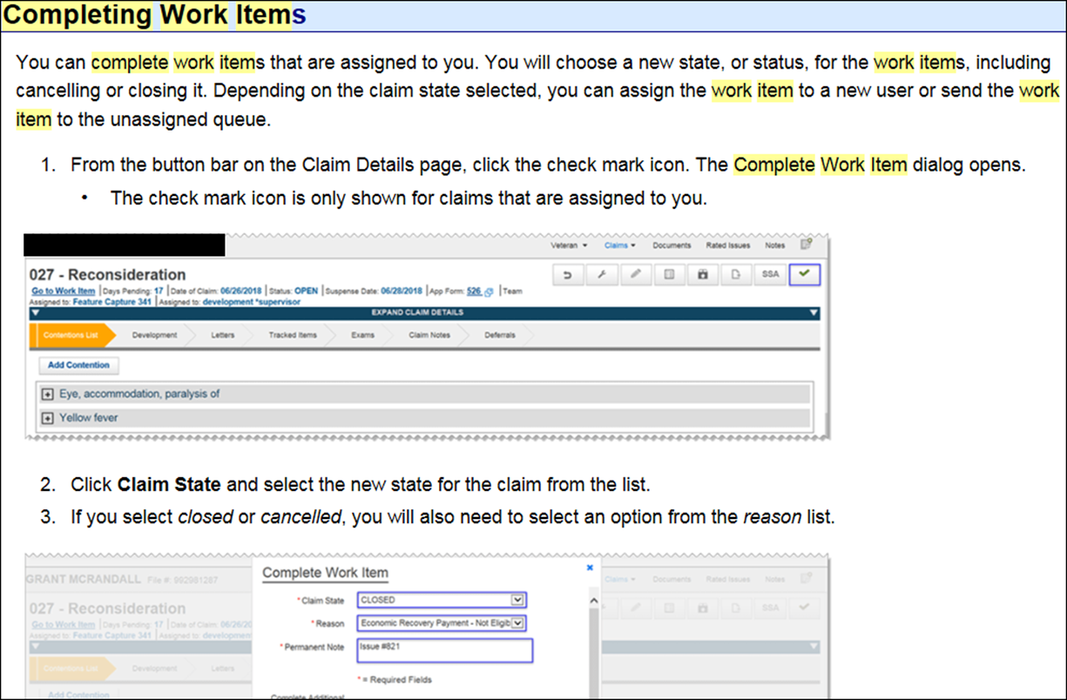
Routing In-Service Ratings for BDD Claims
Below is further information from NWQ. In order to update the lifecycle, the user needs to complete the work item, see the screenshot below for reference

Slide 39
BDD Claims Establishment
We have received reports about BDD claims being incorrectly established and developed. As a reminder, all claims meeting the BDD requirements per M21-1 III.i.2.A.1.d should be established as an EP 336 with a BDD claim label per M21-1 III.i.2.A.2.c.
The intake site must change the diary 336 EP to the proper EP and claim label as shown in the table below after all development actions have been taken per M21-1 III.i.2.A.2.d.
Claim Type | BDD EP - Claim Label
Original | 110 - BDD-Initial, or 010 - BDD-Initial 8+ issues
new SC reopened, or increased evaluation | 020 - BDD-Supplemental
Note: If the diary 336 EP has matured to a pending EP (i.e. the suspense date of RAD+1 has been reached), the pending EP must also be changed to the proper EP and claim label in the table above.

Slide 40
Current Program Timeliness
As outreach specialists and VA’s frontline contact with SMs and
Veterans, it is vital that we are realistic in our communications regarding claims processing times. Below is the current program timeliness data as of June 5, 2019
June 5, 2019 | BDD
Completed FYTD | 7,380
Receipts FYTD | 24,157
Pending | 4,330
% Pending >125 Days | 4,537
# Pending >125 Days | 61.5%
Average Days Pending | 75.1
Avg. Days to Complete FYTD | 35.90

Slide 41
Questions from the Pre-D/BDD Mailbox
3 Questions and Answers

Slide 42
Misc and Open Floor
TMS # VA 4518493
Coaches Call (Thursday at 2pm)
Next Teleconference: July 9, 2019
Open Floor/Questions

