Slide 1
Vocational Rehabilitation and Employment (VR&E)
Quality Assurance Transformation
Notes:
Hello, I am Aimee Speers, QA and Site Visit Supervisor, we are very excited to bring you training on the VR&E, Vocational Rehabilitation and Employment QA Transformation Initiative, part of the VR&E Modernization Program.

Slide 2
Introductions
Derek Brown
Senior VRC for Site Visits
Mandy Showalter
QA Reviewer
Jennifer Snyder
Senior VRC for QA Reviews
Aimee Speers
QA & Site Visit Supervisor
Notes:
Presenting the training today is Derek Brown, Senior VRC for Site Visits, Mandy Showalter, QA Reviewer and Jennifer Snyder, Senior VRC for QA Reviews and myself, Aimee Speers, QA & Site Visit Supervisor.

Slide 3
Agenda
Purpose of QA Transformation
Sampling Methodology
Selection Criteria and Scope
Reviews
SOPs
Scoring Methodology
Metrics
QAWeb
Notes:
We have a lot of information to cover today in the training including the purpose of QA transformation, the sampling methodology, selection criteria and scope, revised instruments and SOPs for each of the five types, scoring methodology, metrics and the QAWeb. We will cover each of these topics and give you a chance to ask questions, if needed.

Slide 4
Purpose
The purpose of Quality Assurance (QA) Transformation is to increase the effectiveness and efficiency of the QA process. To do this, we have:
Developed a statistically valid sampling methodology.
Revised the QA review instruments with specific questions to better evaluate compliance and performance.
Revised the scoring methodology.
Developed a Local QAWeb module so that both the Local QA and National STAR reviews will be completed in the same system, which will allow for comparison and promote consistency.
We will now get a truer picture of the performance of our program and the areas needed for targeted training of staff at the national, Regional Office, and individual level. This will translate into better services for our Veterans.
Notes:
Let's start by talking about the purpose of the QA transformation. There's not been much difference in the last 15 years. We work to modernize the QA program to increase the effectiveness and efficiency of the process. To do this we have developed a statistically valid sampling methodology. Revised the QA review instruments with specific questions to better evaluate compliance and performance. Revised the scoring methodology. Developed a Local QAWeb module so that both the Local QA and National STAR reviews will be completed in the same system, which will allow for comparison and promote consistency. These changes will give us a truer picture of the performance of our program and to help identify areas where we need more training at the national, regional office, and individual level. The ultimate goal is to provide better services for our Veterans.

Slide 5
Sampling Methodology
Collaboration with Performance Analysis and Integrity (PA&I) to revise the sampling methodology
Ensures we are in line with VBA’s Quality Assurance Sampling Methodology
Each month, PA&I will pull extra cases to use as substitutions
Factors used to determine sample size for each RO:
Workload
Accuracy Scores for the Past Two Fiscal Years
Confidence Level
Margin of Error
Confidence Levels and Margin of Error
90% Confidence Level with a 5% Margin of Error
Increase the Confidence Level as resources allow
A sample is pulled for each of the 5 review types
Most cases selected for review will be in EE, IL, RTE, JR, or INT status
National STAR sample size
Increase current average of 730 reviews monthly to approximately 816 reviews monthly
Local QA random sample changes
August 2019 case pull
Stratified by Case Manager
A case may be selected for more than one review type in a single session if it meets the criteria for both (for example RSDA and FA).
Notes:
During the transformation process we worked with the office of performance analysis and integrity statisticians to revise the sampling methodology. This was done to reflect industry standard and bring them in line. The statistical formula used to determine the sample size includes Workload and Accuracy Scores for the Past Two Fiscal Years. Confidence Level. Margin of Error. Confidence Levels and Margin of Error. 90% Confidence Level with a 5% Margin of Error. We will work and reevaluate the sample size each year. A sample is pulled for each of the five review types. As many of you have noticed, the samples have changed and most cases that are selected for review will be in a rehab plan, extended eval, or interrupted status. That is the with the majority of the workload is. These cases will be selected for rehab service delivery, or a physical actual review. Due to the changes in the selection methodology, the national STAR sample size increases. They will pull additional cases for each review type and it will serve as a substitution. So, if the cases aren't used they go back into the pod and they will be eligible to be selected for future reviews. A case will not be selected for the same review type in a 12-month period, but it may be selected for other review types. Due to the way the new sampling methodology works the case may be selected for more than one review type in a single session if it meets the criteria for both. So, there won't be any changes to the local QA review until August 2019, and at that point all of this will be implemented for local QA.

Slide 6
Selection Criteria and Scope
Entitlement Determination/ Rehabilitation Planning Accuracy (EDRPA)
Selection Criteria: An entitlement determination has been made and the case exited Evaluation and Planning (EP) status in the month prior to selection.
Scope: All activity from receipt of Application until the case exits EP status.
Selection Criteria: The case is currently in Extended Evaluation (EE), Independent Living (IL), Rehabilitation to the Point of Employability (RTE), or Job Ready (JR) status, or Interrupted (INT) after having been in one of those statuses. The case must have been in one or more of those statuses for at least 10 months.
Scope: All activity, except fiscal payments, for the 12-month period prior to the date selected for review.
Rehabilitation Service Delivery Accuracy (RSDA)
Fiscal Accuracy (FA)
Selection Criteria: A Subsistence Allowance or Employment Adjustment Allowance (EAA) award must have been paid in the month prior to selection for review.
Scope: Fiscal activity (awards, purchases, beneficiary travel, etc.) during the 6-month period prior to the date selected for review.
Notes:
Now we will look at the selection criteria and review period for each type.
Entitlement Determination/Rehabilitation Planning Accuracy (EDRPA). Selection Criteria: An entitlement determination has been made and the case exited Evaluation and Planning (EP) status in the month prior to selection. For example, only cases that exit status in April were selected from a review. And those reviews are done in June and scored in July.
Rehabilitation Service Delivery Accuracy (RSDA). To be selected for review here the case must be an extended eval --Selection Criteria: The case is currently in Extended Evaluation (EE), Independent Living (IL), Rehabilitation to the Point of Employability (RTE), or Job Ready (JR) status, or Interrupted (INT) after having been in one of those statuses. The case must have been in one or more of those statuses for at least 10 months. Scope: All activity, except fiscal payments, for the 12-month period prior to the date selected for review.
Fiscal Accuracy (FA). This used to be part of other reviews but now it is its own separate review type. Selection Criteria: A Subsistence Allowance or Employment Adjustment Allowance (EAA) award must have been paid in the month prior to selection for review. Scope: Fiscal activity (awards, purchases, beneficiary travel, etc.) during the 6-month period prior to the date selected for review. They must receive payment in the prior month to be selected. The entire reward is reviewable even if it began outside the six-month period.

Slide 7
Selection Criteria and Scope
Selection Criteria: The case must have entered Rehabilitated or Discontinued status in the month prior to selection for review.
Scope: The CCA review includes all case closure activities. The review period begins when the Veteran:
Obtains employment and is in Job Ready status.
Receives 18 months of employment services (review period begins 2 months prior to reaching 18 months).
Determines they will pursue further education rather than seeking employment.
Is placed in Interrupted status with no planned date of reentrance.
Does not reenter planned services from interruption as planned, leading to case closure.
Successfully completes Independent Living services.
Case Closure Accuracy (CCA)
Chapter 36 Accuracy
(CH-36A)
Selection Criteria: The case entered Completed with Counseling or Closed without Counseling in the month prior to selection for review.
Scope: All activity from receipt of application until case closure.
Notes:
Case Closure Accuracy (CCA). Selection Criteria: The case must have entered Rehabilitated or Discontinued status in the month prior to selection for review. The review period begins when the veteran obtains employment and is in job ready status. Receives 18 months of employment services (review period begins 2 months prior to reaching 18 months). Or they are determined that they will pursue further education rather than seeking employment. Or they could be placed in interrupted status with no plan date of re-entrance. Or they do not reenter services as planned leading to case closure. So, these are activities related to the closure.
Chapter 36 Accuracy (CH-36A) Selection Criteria: The case entered Completed with Counseling or Closed without Counseling in the month prior to selection for review. Scope: All activity from receipt of application until case closure. To be selected for review the case must have been completed with counseling or closed without counseling status in the month prior to the selection review.

Slide 8
Reviews
Local QA and National STAR reviews will be completed in QAWeb using the same review instruments.
Enables comparison of Local QA and STAR reviews.
Promotes consistency.
Number of questions on each review instrument has increased.
Old instruments had 4-6 questions.
Revised instruments have 15-33 questions.
The revised instruments look at the same issues as the previous instruments.
This helps give credit for work that is done correctly, rather than having multiple issues included under one question.
Example, under the old instruments, if a 28-1905 is not documented and signed, the fiscal score for the review was 0%. Under the revised instruments, this is only one of 27 possible questions that are used to calculate the score.
If all 27 questions are applicable, and there is one error, then the score would be 96.3%.
Questions on each instrument are more specific.
Training needs are more easily identifiable.
Errors and trends are more easily tracked.
Notes:
As mentioned previously, Local QA and National STAR reviews will be completed in QAWeb using the same review instruments. It allows local QA and STAR reviews in the same system. It also enables comparison of local QA and STAR reviews. If there is 100% on the score and the other says 80%, why is that? Are we looking at issues differently? Is training or policy clarification needed? This process will also help promote consistency. Number of questions on each review instrument has increased. Old instruments had 4-6 questions. There were multiple reasons for questions and multiple standard comments. Revised instruments have 15-33 questions. The revised instruments look at the same issues as the previous instruments. The questions here more specific. This helps give credit for work that is done correctly, rather than having multiple issues included under one question. Example, under the old instruments, if a 28-1905 is not documented and signed, the fiscal score for the review was 0%. Under the revised instruments, this is only one of 27 possible questions that are used to calculate the score. If all 27 questions are applicable, and there is one error, then the score would be 96.3%. That's the number of correct, 26, divided by the total 27 and that comes out to the percentage.

Slide 9
Reviews
Case reviews are based on guidance that was in effect at the time of the service:
United States Code (USC) – Title 38, Part III
Code of Federal Regulations (CFR) – Title 38, Chapter I, Part 21
VR&E Procedural Manual (M28R)
Other guidance (Policy Advisories, Circulars, Letters, and Emails).
Due to the nature of the services provided by VR&E, professional judgement must be used in some instances.
Tracking:
All review types include one question about Higher-Level Reviews (HLR) and one question about Supplemental Claim Reviews (SCR). ******
The Fiscal Accuracy (FA) review instrument also includes one question to assist with tracking improper payments. ******
****** Please note: Tracking questions are not included in the accuracy scores.
Notes:
When reviewing a case for STAR review or local QA it is based on the law or policy that was in effect at the time of the service. VR&E must comply with United States Code (USC) Title 38, Part III. Code of Federal Regulations (CFR) Title 38, Chapter I, Part 21. VR&E Procedural Manual (M28R). Other guidance (Policy Advisories, Circulars, Letters, and Emails). Clarification is sometimes found in hotline bulletins, education manuals, compensation manuals. And note there are times when professional judgment must also be used when reviewing cases for quality. This is why it is important to clearly document anything that happens or why a specific decision was made. We can speculate but if it isn't documented we can only go by what is seen in the case. For tracking purposes each review type includes a question about the type of review and supplemental claim reviews. The Fiscal Accuracy (FA) review instrument also includes one question to assist with tracking improper payments. That's also for tracking purposes. It's important to note these tracking questions do not affect accuracy scores.

Slide 10
Reviews
Some questions may have multiple reasons for which an error could be cited.
Example:
5. Did the 28-1902b contain all the required elements to document entitlement determination?
28-1902b was not present in the record.
28-1902b was not signed by the VRC.
28-1902b did not document the entitlement decision.
Automatic entitlement under NDAA was not documented for the Servicemember.
Existence of a vocational impairment was not documented, justified, and/or consistent with evidence.
Contribution of the SCD to the vocational impairment was not documented, justified, and/or consistent with evidence.
Overcoming the effects of the impairment was not documented, justified, and/or consistent with evidence.
EH determination was not documented, justified, and/or consistent with evidence.
SEH determination (including how SCD contributes in substantial part) was not documented, justified, and/or consistent with evidence.
Listing reasons:
Enables tracking of more specific issues.
Identifies why specific errors are cited.
Helps identify training needs.
Notes:
Some questions may have multiple reasons for which an error could be cited. This assessment process is to help track specific trends, identify why specific errors are cited and identify training needs for possible policy clarification. Example: Did the 28-1902b contain all the required elements to document entitlement determination? A. 28-1902b was not present in the record. B. 28-1902b was not signed by the VRC. C. 28-1902b did not document the entitlement decision. D. Automatic entitlement under NDAA was not documented for the Servicemember. Etc...

Slide 11
EDRPA Reviews
Application, Initial Evaluation, and Entitlement Determination
Evaluation and Planning
Plan Development
Fast Track
Extended Evaluation
Independent Living
Self Employment
Reviews
General Comments
Entitlement Determination/ Rehabilitation Planning Accuracy
Data
Accurate
Consistent
Entitlement Determination
Correct decision
Documented
Explained/justified
Written notification of decision
Clearly explained
Feasibility decision
Documented
Clearly explained
Evaluation and Vocational Exploration activities
Documented
Sufficient evaluation
Results support plan development
Plan Development
Services needed to reach the vocational goal
Addresses identified needs
Concurrence documented
Plan is signed by Veteran and VRC
Notes:
Now let's look closer at each review type. The revised instruments and SOPs are available on the STAR SharePoint site. Remember for EDRPA review the case exited the status in the month prior to selection for review. The review consists of all activity from receipt of application until the case exits EP status. Questions on each of the revised review instruments are divided into categories. On the EDRPA instrument these categories are Application, Initial Evaluation and Entitlement Determination, Evaluation and Planning, Plan Development, Fast Track, Extended Evaluation, Independent Living, Self-Employment Reviews. General Comments. Some of the specific issues reviewed include, was the data entered correctly and consistently? Was entitlement determination correct? Was entitlement determination documented? Was each component of entitlement determination correctly explained and justified? Was the servicemember given a written notification of the decision? Was the feasibility decision documented? Were evaluation and vocational activities documented? Were all required activities completed and documented?

Slide 12
RSDA Reviews
Rehabilitation Service Delivery Accuracy
General
Extended Evaluation Status
Independent Living Status
Job Ready Status
Reviews
General Comments
Data
Accurate
Consistent
Required documents
Signed, dated, and filed correctly
Regulatory limits
Concurrence documented
Case management
Frequency
Documentation quality
Documentation of progress
Annual review
Plan amended when required
Referrals
Interruption documentation
Notes:
RSDA Reviews. The case is currently in extended evaluation independent living, job ready status. If it's been in one of the statuses for at least 10 months. These reviews focus on case management and service delivery. Categories of questions are General. Extended Evaluation Status. Independent Living Status. Job Ready Status. Reviews. General Comments. In the RSDA reviews we look at the data and is it accurate and consistent? Are the required documents signed, dated and filed correctly? Does the case comply with regulatory limits? Are all required concurrences documented? Are the case management appointments and contacts maintained and documented at the required frequency and do they show the veteran's progress? With the annual view is the plant documented? Was the plan amended when required? Were referrals made when needed? Was a documentation of interruption? For specific statuses, we will look at extended evaluation. Were services designed to resolve feasibility of achievement of a vocational goal? Was their collaboration with other VA entities when needed? Was referral made to SAH when needed? Was the developed 60 days prior to completion of training? Was the job ready declaration documented?

Slide 13
FA Reviews
Supporting Documentation
Subsistence Allowance
Employment Adjustment Allowance
Other Expenditures
Reviews
IPERA
General Comments
Fiscal Accuracy
Required documents
Signed, dated, and filed correctly
Concurrence
Documented when required
Rate election and effective date
Documentation supports enrollment
Rehab plan lists each facility
Enrollment period
Rate of pursuit
Dependents
P911SA rate
Awards amended correctly
Reductions
Withdrawals
6-credit hour exclusions
Mitigating circumstances
Punitive grades assigned
Eligible for EAA payment
Correct amount paid for each EAA award
Notes:
To be selected for a fiscal accuracy review there must be a payment in the month prior to selection for review. All fiscal activity limited not limited to awards, purchases, beneficiary travel etc. during the six-month period prior to the date selected for review will be included in the review. Categories for questions for the FA Reviews. Supporting Documentation. Subsistence Allowance. Employment Adjustment Allowance. Other Expenditures. Reviews. IPERA. General Comments. fiscal accuracy reviews look at required documents, are they signed, dated and filed correctly? Is concurrence documented when required? Is the rate election and effective date documented? Does documentation support enrollment? Is each facility listed in the rehab plan? Is the enrollment period correct? Was the rate of pursuit correct for standard, nonstandard, overlapping terms, etc.? Does the award reflect the correct number of dependents? Was the correct P911SA rate used? Was the award amended correctly when needed? Was the correct amount paid for each award? Other expenditures are also reviewed to include retroactive inductions, retroactive reimbursements, revolving fund loans and beneficiary travel.

Slide 14
CCA Reviews
All Case Closures
Rehabilitated
Discontinued
Maximum Rehabilitation Gain
Reviews
General Comments
Case Closure Accuracy
Data
Closure decision
Documentation
Present, signed, and dated
Appropriate services provided
Adequate follow-up
Documentation, duration, and frequency
Closure statement
Concurrence documentation Correct Reason Codes
Due Process
Closure letter
Notes:
CCA Reviews. Case Closure Accuracy. These cases must have entered, rehabilitated or discontinued status in the month prior to selection for review. Categories of questions in the case closure accuracy instrument are all Case Closures. Rehabilitated. Discontinued. Maximum Rehabilitation Gain. Reviews. General Comments. case closure accuracy reviews look at was the data accurate and consistent in the eFolder? Is required documentation present? Does the case comply with regulatory limits? Were appropriate services provided so the veteran could participate in the plan and/or maintain simple employment? Was there adequate file but -- follow-up documented? Did it include all the required information? Is documented prior to closure using the appropriate checklist? Was the correct reason code used? Was the veteran provided with appropriate due process? Was a closure letter sent with the correct date and decision?

Slide 15
CH-36A Reviews
Chapter 36 Accuracy
All Chapter 36 Cases
CH36A – Completed With Counseling
CH36B – Closed without Counseling
Reviews
General Comments
Eligibility determined prior to opening record
Application included in the file/eFolder
Completed with Counseling
Servicemember/Veteran (SM/V) provided with an individual counseling session
SM/V provided with an assessment
Results of assessment summarized into a comprehensive report
CH36 Checklist Job Aid, Notes from Counseling and Next Steps, Vocational Assessment Summary, etc. are documented in the file/eFolder
Closed without Counseling
10-day letter sent when the SM/V misses the appointment and contact is not established
If the SM/V declined services via phone or email, was the contact documented in a case note prior to closing the case
Notes:
CH-36A Reviews. These are cases completed with counseling or closed without counseling the month prior to review. The review includes all activity from receipt of application until case closure. Categories of questions in the Chapter 36 Accuracy. All Chapter 36 Cases. CH36A Completed with Counseling. CH36B Closed without Counseling. Reviews. General Comments. Eligibility determined prior to opening record. Is the Application included in the file/eFolder? Was this closed as completed with counseling? Was the Servicemember/Veteran (SM/V) provided with an individual counseling session. SM/V provided with an assessment. Results of assessment summarized into a comprehensive report. CH36 Checklist Job Aid, Notes from Counseling and Next Steps, Vocational Assessment Summary, etc. are documented in the file/eFolder. for those cases Closed without Counseling. was a 10-day letter sent when the SM/V misses the appointment and contact is not established. If the SM/V declined services via phone or email, was the contact documented in a case note prior to closing the case.

Slide 16
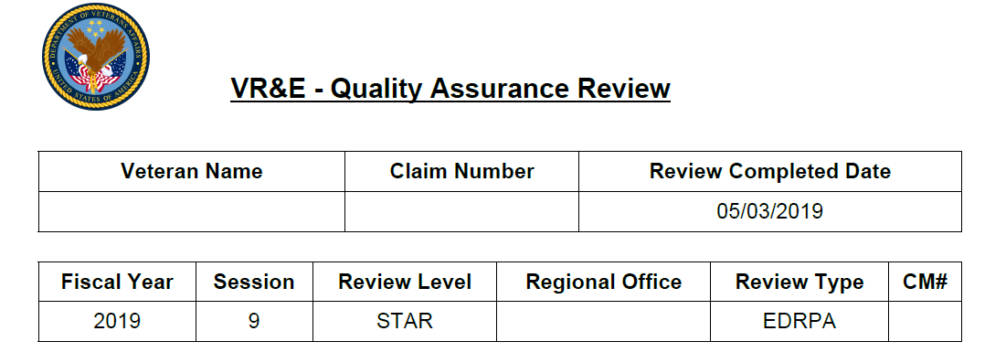
Review Results
Review Level:
STAR or Local QA
Case Manager at the time of selection
Notes:
There have been changes to the document showing the review results. The review completed date is now at the top of the page instead of the bottom. The review level is now included for national reviews and it will say STAR. And for local QA it does say local QA. The case management number will also be listed in this identifies the case manager at the time of the selection.

Slide 17
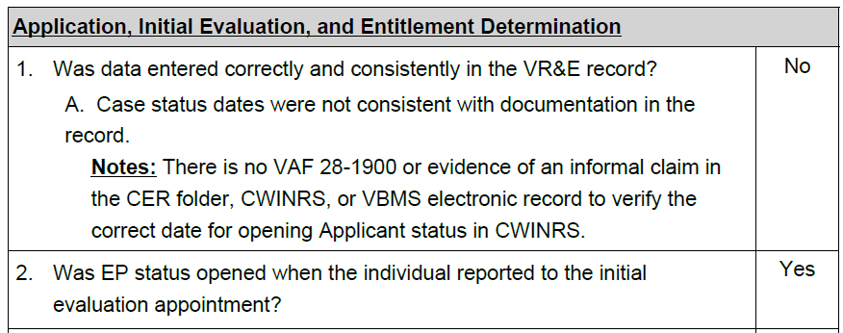
Review Results
“Notes” further explain specifics of an error cited.
“No” indicates an error.
“Yes” indicates there is no error.
“NA” indicates the question is not applicable
Notes:
This slide shows the different types of responses you will see. Question one has a no response and that means there is no air. In this instance a note was added. You will notice there's no citation listed. All citations are listed in the corresponded question or reason on the SOP and this is done to ensure the most updated citations are provided. Questions with a yes response means there is no air. In this case the EP status was opened when the individual reported to the initial evaluation. Question seven has a NA response. Which indicates the question was not applicable.

Slide 18
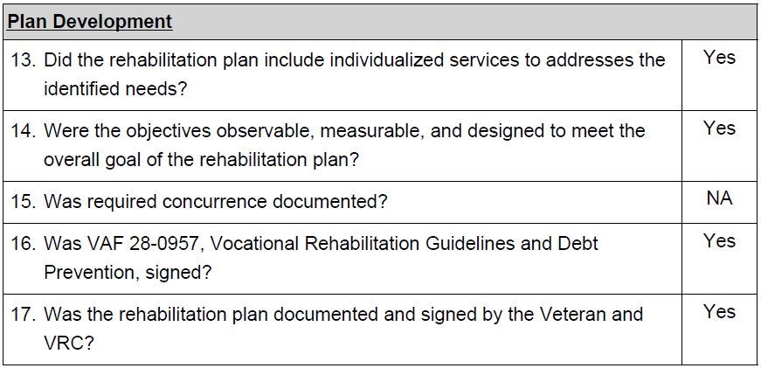
Review Results
In this example from an EDRPA review, the following categories were not applicable to the case:
Fast Track,
Extended Evaluation,
Independent Living,
Self Employment
You will notice the numbering goes from 17 to 34 because questions under those categories were not included in the review.
Notes:
In this example from an EDRPA review, the following categories were not applicable to the case: Fast Track, Extended Evaluation, Independent Living, Self-Employment. You will notice the numbering goes from 17 to 34 because questions under those categories were not included in the review.

Slide 19
Review Results
In the example above, a Comment Only was cited in an RSDA review.
The “Yes” response indicates no error was cited.
The “Comments Only” is cited to provide feedback when an issue is outside the scope of the review or does not warrant an error, but was noted by the QA Reviewer.
A question could have both an error and a “Comment Only.” If that occurs, the response would be “No.”
Notes:
This yes response indicates no error was cited. This comment is to provide feedback because the issue is outside the scope of the review or does not warrant an error but was noted by the reviewer. It can have both the question and comment. If that occurs the response would be no. Most comments will be included in the general comments section of the review instrument.

Slide 20
Standard Operating Procedures (SOP)
An SOP has been developed for each type of review. The SOPs include an explanation of the following:
Selection criteria.
Scope
Scoring for each review type.
For each question, the SOPs provide an explanation of what should be considered and the applicable regulation or policy citation.
These can be updated as policy is updated.
SOPs are available on the Knowledge Management Portal (KMP) and on the STAR SharePoint site.
Notes:
An SOP has been developed for each type of review. The SOPs include an explanation of the following: Selection criteria. Scope Scoring for each review type. For each question, the SOPs provide an explanation of what should be considered and the applicable regulation or policy citation. These can be updated as policy is updated. When there is an error cited, they may or may not include the citation. The citations are listed in the SOPs which should be reviewed to ascertain further understanding of the error. SOPs are available on the Knowledge Management Portal (KMP) and on the STAR SharePoint site. They are designed to assist in completing a review and understanding why the error was cited. They go through each question and refer to the SOP for more information about what should be considered. As you review the results you should review the SOP to obtain further understanding of the error and policy.

Slide 21
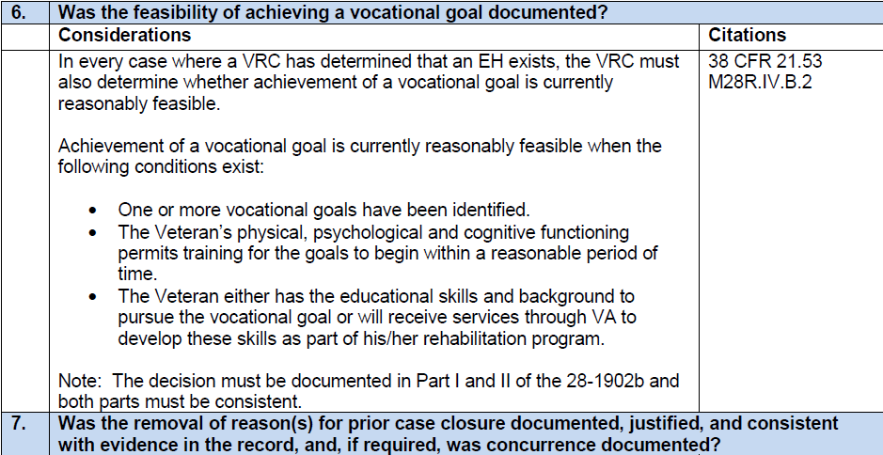
SOPs
The SOP lists each question. The “Considerations” section discusses the policy reviewed and included under the question. The “Citations” section gives the citations for the regulation, policy and/or guidance.
Notes:
The SOP lists each question. The "Considerations" section discusses the policy reviewed and included under the question. The "Citations" section gives the citations for the regulation, policy and/or guidance. These will be updated as policy changes are identified, or necessary changes are needed.

Slide 22
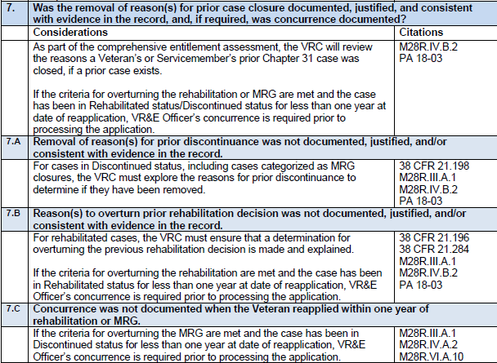
SOPs
When a question lists reasons, these appear as in Question 7 below.
Notes:
Some of the questions on the revised review instruments may have multiple reasons for which an error could be cited, and this is to help track specific trends. And they can identify training needs are possible policy clarifications. For example, on this slide it shows question number 7, was the removal of reasons for prior case closure documented, justified, and consistent with evidence in the record and, if required, was concurrence documented? And they have the listed reasons. A. Removal of reasons for prior discontinuance was not documented justified and/or consistent with evidence in the record. B. Peak reasons to overturn prior rehabilitation decision was not documented justified. The appropriate citations are listed next to each reason.

Slide 23
Scoring Methodology
3 Possible Responses for Each Question
Yes = No Error
No = Error
NA = Not Applicable
Formula: Y / Y+ N = Accuracy Score
Example: 27 questions. 16 Yes, 1 No, 10 NA
16 (Yes) / 17 (Yes + No) = 94.1%
*Under previous reviews, which had only 1 question this would be 0%
The number of Yes responses divided by the total number of responses (Yes + No), gives the Accuracy Score.
Not Applicable (NA) responses are not included in the scores.
The same formula is used for all Accuracy Scores.
Notes:
In response to the previous question this is the section that we are covering, scoring methodology. As we mentioned, there are three possible responses for each individual question. Yes = no error. No = error. NA = not applicable. This is the formula and how it works. Formula: Y/Y+N = Accuracy Score. This is a review instrument example for you to look at. Example: 27 questions. 16 Yes, 1 No, 10 NA. 16 (Yes) / 17 (Yes + No) = 94.1%. That is how the scores would be calculated. Under the previous review we only have one question potentially and it could have potentially have been a 0 for that question. And that is how that works.

Slide 24
Rolling 12-Month Accuracy Scores
June 2019
July 2019
June 2019
August 2019
July 2019
June 2019
September 2019
August 2019
July 2019
June 2019
May 2020
April 2020
March 2020
February 2020
January 2020
December 2019
November 2019
October 2019
September 2019
August 2019
July 2019
June 2019
Build up to 12 months
Director’s Dashboard shows Rolling 12-Month Scores
Summary of Scores Report shows Individual Session Scores
The Rolling 12-Month period starts over with June 2019 scores
October – May scores – old instruments, scoring, and sampling methodology.
May FY19 scores are an average of June FY18 – May FY19 scores
June – September scores – revised instruments, scoring, and sampling methodology
September FY19 scores are an average of June FY19 – September FY19
OFO will provide guidance on how Director Performance will be assessed for FY19.
Notes:
Another issue that comes up is the QA scores are posted on the Director's Dashboard shows Rolling 12-Month Scores. Summary of Scores Report shows Individual Session Scores. that comes back after we complete the review session and it is just for that individual review session. So how does this work? The Rolling 12-Month period starts over with June 2019 scores. We are finishing this up in the month of May. These will be posted in June. How will this work? The reviews that were done October May scores old instruments, scoring, and sampling methodology. May FY19 scores are an average of June FY18 May FY19 scores. and then we look at the June September scores revised instruments, scoring, and sampling methodology. September FY19 scores are an average of June FY19 September FY19. OFO will provide guidance on how Director Performance will be assessed for FY19. we are transitioning from old instruments to new instruments and sampling methodology and that is yet to come.

Slide 25
Rolling 12-Month Accuracy Scores
As a new month is added to the scores
September 2020
August 2020
July 2020
June 2020
May 2020
April 2020
March 2020
February 2020
January 2020
December 2019
November 2019
October 2019
EXAMPLE
If the score is 100% every month, except September FY19, when the score is 75% for that one session, then the Rolling 12-Month Score is 97.9% until September FY19 (Session 12) is no longer included.
If no other errors are cited, the September FY20 score will be 100%.
August 2020
July 2020
June 2020
May 2020
April 2020
March 2020
February 2020
January 2020
December 2019
November 2019
October 2019
September 2019
July 2020
June 2020
May 2020
April 2020
March 2020
February 2020
January 2020
December 2019
November 2019
October 2019
September 2019
August 2019
June 2020
May 2020
April 2020
March 2020
February 2020
January 2020
December 2019
November 2019
October 2019
September 2019
August 2019
July 2019
May 2020
April 2020
March 2020
February 2020
January 2020
December 2019
November 2019
October 2019
September 2019
August 2019
July 2019
June 2019
September 2019
Session Score:
75%
Rolling 12-Month Score: 97.9%
All 12 Session Scores: 100%
Rolling 12-Month Score: 100%
An older month is removed.
Notes:
Rolling 12-Month Accuracy Scores. We get this question quite often. Here is the example. If the score is 100% every month, except September FY19, when the score is 75% for that one session, then the Rolling 12-Month Score is 97.9% until September FY19 (Session 12) is no longer included. People often ask why their scores are not improving it. Scores of been 100% for eight months. Remember again the dashboard is a rolling 12-month average. If 11 of the months were at 100% but one month was 75%, then those scores when you put them together is 97.9%. 100% x 11. If no other errors are cited, the September FY20 score will be 100%. September 2019 Session Score: 75%. Rolling 12-Month Score: 97.9%. as you move forward another month will drop off and another month will drop off. Eventually the 75% will drop off once you hit September 2020. So, of maintained 100% in the subsequent months you will have 100% when you reach September 2020.

Slide 26
Metrics
Entitlement Determination Accuracy (EDA)
Measures: Accuracy of the Entitlement Decision
Source: Question 10 in EDRPA reviews.
Fiscal Accuracy (FA)
Measures: Accuracy of fiscal activity.
Source: All Applicable Questions in FA reviews.
Program Outcome Accuracy (POA)
Measures: Accuracy of the Outcome Decision.
Source: Questions 13, 14, or 15 in CCA reviews.
= On the Director’s Dashboard
Notes:
Quality review metrics will be provided. There is a total of six and three will be on the director's dashboard beginning with the June 2019 scores. The 12-month rolling period will start over and let me repeat that. Beginning June FY 19 scores the 12-month rolling average for all accuracy scores will start over. So, what are the metrics we will be looking at? Entitlement Determination Accuracy (EDA). Measures: Accuracy of the Entitlement Decision. Source: Question 10 in EDRPA reviews. Fiscal Accuracy (FA). Measures: Accuracy of fiscal activity. Source: All Applicable Question in FA reviews. Program Outcome Accuracy (POA). Measures: Accuracy of the Outcome Decision. Source: Questions 13, 14, or 15 in CCA reviews. Those are the closure decisions. Three possible questions can give us the score. One related to rehabs, one related to regular disk on and one for MRG. So that could be 13, 14 or 15 for the outcome accuracy. Those scores will be posted on the director's dashboard as indicated by the star on the slide.

Slide 27
Metrics
Evaluation, Planning, Rehabilitation Services Accuracy (EPRSA)
Measures: Accuracy of Chapter 31 services.
Source: All Applicable Questions from All CH31 reviews
Chapter 36 Accuracy
(CH-36A)
Measures: Accuracy of Chapter 36 services.
Source: All Applicable Questions from all CH36 reviews
Overall Accuracy
Measures: Overall accuracy of VR&E services.
Source: All Applicable Questions from all CH31 & CH36 reviews
= On the Director’s Dashboard
Notes:
Evaluation, Planning, Rehabilitation Services Accuracy (EPRSA). Measures: Accuracy of Chapter 31 services. Source: All Applicable Questions from All CH31 reviews. That means all applicable questions will be the composite for the score for this particular accuracy score. Chapter 36 Accuracy (CH-36A). Measures: Accuracy of Chapter 36 services. Source: All Applicable Questions from all CH36 reviews. And we have a new accuracy score which won't be on the dashboard. Overall Accuracy. Measures: Overall accuracy of VR&E services. Source: All Applicable Questions from all CH31 & CH36 reviews.

Slide 28
Instruments and Metrics
Instruments
Entitlement Determination/ Rehabilitation Planning Accuracy (EDRPA)
Entitlement Determination Accuracy (EDA)
Question 10 in the EDRPA review.
VRC Performance Standard
Rehabilitation Service Delivery Accuracy (RSDA)
All applicable questions in all CH31 reviews.
Dashboard, VREO, VRC, & EC Performance Standard
Evaluation, Planning, Rehabilitation Services Accuracy (EPRSA)
Fiscal Accuracy (FA)
Fiscal Accuracy
All applicable questions in the FA review.
Dashboard, VREO, VRC, & EC Performance Standard
Case Closure Accuracy (CCA)
Program Outcome Accuracy (POA)
Questions 13, 14, and 15 in the CCA review.
Dashboard & VREO Performance Standard
All applicable questions in all CH31 & CH36
reviews.
Overall Accuracy
Chapter 36 Accuracy
(CH-36A)
CH-36A
All applicable questions in the CH-36A review.
VRC Performance Standard
= On the Director’s Dashboard
Notes:
This is a more visual representation of how the scores come together now. As you can see you have the entitlement determination and rehab planning accuracy. You have rehab services delivery, fiscal accuracy and case closure accuracy. Those will all be comprising for this score as you can see listed in the red box. These are all applicable questions. Again, this will be on the director's dashboard. It is the EPRSA. looking at the overall accuracy which will be adding into that is the accuracy results for the chapter 36 reviews, so all applicable questions that were answered for 31 and 36. Going out to the right you have question 10 from the EDRPA instrument. And the fiscal accuracy which is all applicable questions under the FA review. Fiscal accuracy is based solely on the fiscal accuracy instrument which is on the Director's Dashboard and the performance standard. And the program outcome accuracy will be based on question number 13, 14, or 15. And those are on the Director's Dashboard as part of the VREO performance standards. And finally, the CH-36 review which is all the applicable questions and accuracy score. That is for the VRE performance standards. That is the scoring and methodology.

Slide 29
QAWeb
QAWeb
Used to record results of STAR reviews since 2014
Local QA reviews will be recorded in QAWeb as of September 2019
Cases will be loaded into QAWeb by the STAR Team
ROs will have access to reports
Local reports for individual case managers
National reports on completed review sessions
Training in the use of QAWeb
Will be provided for those who complete Local QA reviews
QAWeb training will be held in July 2019
Access will be requested through Common Security Employee Manager (CSEM)
Notes:
QAWeb is the system used to record results of STAR reviews since 2014. In 2018 received funding to build a local QA module. And so, we worked with a group of officers and assistance and selected managers from two offices from each district to determine the requirements for the system. This was completed, and the pilot has begun. The training for the pilot stations are tomorrow. That will be done for one station for each district. The QAWeb has supporting capability that old systems have not. This is available at both the national and local levels. Locally the VRE officers can run reports for their station and individual case managers. In September 2019, we will begin using QAWeb for QA reviews based on cases selected in August. Training will be provided in July 2019, for those involved in completing the local QA reviews. Access to the system will be through the common security employee manager.

Slide 30
QA Process Overview
Business Rules for QA Sampling
Revised as needed, each Fiscal Year
Monthly case selection
National STAR
Local QA
Lists are posted to the VR&E STAR SharePoint
Email notification is sent to the ROs
Cases are randomly assigned to QA Reviewers
Results posted, end of each month, on STAR SharePoint
CER folders are returned to RO
Scores are provided to PA&I for posting to Dashboard
Cases with paper CER folders must be sent to the STAR Office by the Due Date
Please include a list of all cases that are included in the box.
If cases have been closed and scanned, please include these on the list as well, annotating the case is in VBMS.
If there will be a delay, please email the reason and expected arrival date to the QA Mailbox.
Notes:
Each year the STAR team will update the role with PA&I. Business Rules for QA Sampling. Revised as needed, each Fiscal Year. PA&I will use a statistical formula to select a random sample of cases for each RO and that determines the caseload. The local QA poll uses the same business rules, but the number of cases reviewed are based on the number required by the individual standards. Beginning with the pole in August it will be stratified by the case manager. PA&I generates the case pull each month and we generate it to the STAR SharePoint and send out an e-mail notification to the ROs. They have to be sent to the STAR office by due date and please include a list of cases in the shipment and name and claim number in the cases. If a case is not available if it is being shipped for scanning and not yet scanned or transferred to another office, please let us know so we can provide a substitute if needed. If cases are delayed, please email the reason and expected arrival date to the QA Mailbox. please list the reason and expected date of arrival. We need cases to arrive on time to plan for the month. Once a case is received in the STAR office we will check them in and load them into the QAWeb system and randomly assigned them to QA reviewers on the STAR team. At the end of the session the results are posted to the STAR SharePoint and that includes individual reports and summary reports which give you the individual session scores. The QA accuracy score report which was previously the valid scorecard report, gives you the rolling 12-month scores and also the corrective actions report.

Slide 31
Reminder Regarding Changes to Cases
Once notification of case selection is received:
Absolutely no additions or deletions may be made related to work or activities that were, or should have been, completed prior to the date selected for review.
Case management and service delivery should continue
VR&E Staff should continue to provide services, process awards, record notes in CWINRS, etc. from the date of request forward
For cases that need to be moved to Discontinued or Rehabilitated status while undergoing a STAR review:
The VREO must review prior to closure
Email the QA mailbox to request an expedited review
CER folder will be returned to the RO
NOTE
Notes:
Once notification of case selection is received: When the list is posted, after that absolutely no additions or deletions may be made related to work or activities that were, or should have been, completed prior to the date selected for review. Case management and service delivery should continue. you can still continue to provide services and notes and all of that. That from the date of request forward. If the case with the papers STAR folder is at the STAR office for review and it needs to be discontinued or rehabilitated, you can e-mail the QA mailbox and requested expedited review. The review will be expedited, and the role returned to CER for review prior to closure. Since we are reviewing more cases in VBMS we have questions about what to do with the paper copy. QA reviews are done as part of the internal process and there's no requirements to file the results. Reviews are completed in QAWeb which is the VA system of record for STAR reviews. Most case managers don't have access to QAWeb or the SharePoint so review results are printed. They are duplicated, and these can be destroyed as such if they are no longer needed.

