Slide 1
Compensation Service Benefits Delivery at Discharge (BDD) and Integrated Disability Evaluation System (IDES) Conference Call
Briefed by: 212A
Name/Title: 212A Staff
Date: May 14, 2019

Slide 2
Agenda (1 of 4)
Introduction
Topics for Discussion
MSC’s and Time Management
MSC (BDD/IDES) Consistency Study for May 2019
MSC Training Conference Index Card Questions
Applicability of General VBA Policy/Procedures in
BDD and IDES Claims

Slide 3
Agenda (2 of 4)
IDES Specific Topics
Stressor Development in Active Duty IDES Cases
Broker EP 689 to DRAS when all Development is Complete
Transfer of Pending Rating EPs after Final IDES Ratings
Including Dependents on BEL
MSC Notes in VTA to confirm SM not filing a VA Claim
Air Force IDES PEBLO Conference
Current IDES Program Timeliness

Slide 4
Agenda (3 of 4)
VTA Reminders
Returning Exam Results to PEBLO, Exam End and
Medical Evaluation End Dates
SHA and Other Exam Fields
VTA Training
BDD Specific Topics
BDD Rating EP Cancellations
Current Program Timeliness
Questions from the Pre-Discharge BDD Mailbox

Slide 5
Agenda (4 of 4)
TMS #
BDD/IDES Coaches Call
Next Teleconference
Open Floor

Slide 6
Reminder: Slides are used to show the Topic, and start discussion, however, slides do not show all the information associated with the topic. The Read Ahead is the official document.

Slide 7
Topics for Discussion

Slide 8
MSC’s and Time Management
MSCS are reminded of the importance of working their BDD and/or IDES cases and updating systems in a timely manner
If your site has a heavy Veteran population and you have a lot of walk-in traffic, we recommend that you establish and post-office hours in order to set aside certain days/hours to perform BDD/IDES duties (interviews, database updates, etc.) to avoid interruptions
All MSCs should also set their schedule to attend the monthly BDD/IDES Call

Slide 9
MSC (BDD/IDES Programs) Consistency Study for May 2019
The Quality Review and Consistency Staff (214C) has scheduled the following MSC (BDD/IDES Programs) Consistency Study:
Topic: System Compliance – Contentions and Corporate Flashes (TMS# 4500122)
Date: Tuesday, May 14-Thursday, May 16, 2019
Audience: MSCs Only
The study will be assigned Tuesday the 14th no later than (NLT) 9am ET and will remain open until 9am Thursday the 16th

Slide 10
MSC Training Conference Index Card Questions
We realized that some of the index card questions and answers from the last MSC training conference were missed on the document posted to the IDES Intranet site
These questions have been added to the document and will be posted to both the IDES and BDD Intranet sites as soon as they are approved for release

Slide 11
Applicability of General VBA Policy/Procedures in BDD and IDES Claims (1 of 2)
All BDD/IDES specific processing requirements are currently specified in M21-1 III.i.2, however, BDD/IDES are generally subject to broader VBA rules and requirements
To the extent possible, the BDD/IDES sections of the M21-1 include references to applicable general claim processing requirements.
It is not feasible to restate all applicable VBA requirements within the BDD/IDES sections of the M21-1.
BDD and IDES claim processors must consider the wider M21-1 when processing BDD and IDES claims, particularly when handling uncommon or irregular situations

Slide 12
Applicability of General VBA Policy/Procedures in BDD and IDES Claims (2 of 2)
Clearly, there are important procedural differences between the general claim process and the BDD/IDES processes; and there are several BDD/IDES specific requirements that are not applicable to non-IDES/BDD claims
When no BDD or IDES specific requirement or procedure exists, general VBA policy should be considered applicable to compensation claims submitted by BDD/IDES participants
These concepts are also discussed in M21-1 Prologue
Questions should be directed to IDES or Pre-Discharge Mailboxes

Slide 13
IDES Specific Topics

Slide 14
Stressor Development in Active Duty IDES Cases
Development for stressors is unnecessary when evidence shows an initial diagnosis of PTSD in service. (M21-1 III.i.2.D.4.c)
In-service exam providing diagnosis of PTSD would be sufficient to support a grant of service-connection on a direct basis
Alternatively, exams showing no PTSD diagnosis would also make stressor development unnecessary
Duty Status (not component) should be considered when determining the need for stressor development. If the participant is serving on AD, even as a member of the NG/R
There are potential circumstances that might complicate granting PTSD diagnoses that exist prior to AD service may complicate grant on direct basis (aggravation may need to be considered)

Slide 15
Broker EP 689 to DRAS when all Development is Complete
MSCs are reminded of the requirement to broker the EP 689 to DRAS when development is complete
MSCs must ensure that all VBMS tracked items have been resolved and updated to reflect the appropriate disposition
These actions are specifically required by M21-1 III.i.2.D.7.d and must be completed in all IDES cases
It is highly recommended that MSCs supporting the IDES program have a VBMS user role that allows brokering (such as Intake Analyst)
Any MSC without the capability to broker must coordinate with their supervisor or another employee with brokering access

Slide 16
Transfer of Pending Rating EPs after Final IDES Rating
When non-IDES issues are deferred in final ratings, the rating EPs must be continued at authorization in accordance with M21-1 III.i.2.E.4.d.
These EPs/issues will be managed by NWQ and worked outside of the IDES program
To ensure these EPs are routed to an appropriate VSC (and not directly back to the DRAS), the DRAS must change the claim label to the appropriate non-IDES claim label
Important: DRAS must not broker these EPs to other stations

Slide 17
Including Dependents on BEL
M21-1 III.i.2.E.3.l. stipulates the BEL must indicate:
any eligible dependents, and
additional language (if no 21-686c is or record)
The Letter Creator Tool (LCT) is now being updated to include dependency information
At this time, LCT BELs indicate that all participants will be paid at the rate for a single Veteran with no dependents
Until the BEL is updated DRAS personnel must manually
update the dependency status in the BEL to indicate the accurate dependency status of the participant, and
Add the language specified by M21-1 lll.i.2.E.3.l (if no 21-686c is of record)

Slide 18
MSC Notes in VTA when SM not filing a VA Claim
MSCs must select NO for the Servicemember Filing VA claim in VTA when a participant specifically declines to file a VA claim as documented by M21-1 lll.i.D.4.a (step 5)
Compensation Service is working changes for this field which will e implemented with the next VTA release
Until the release is in production, and NO is selected, please add a note in VTA and confirm the selection is correct before brokering to DRAS

Slide 19
Air Force IDES PEBLO Conference
From April 23 to April 26, 2019, VBA representatives from Compensation Service IDES Staff and the Providence DRAS participated in the Air Force (AF) IDES PEBLO Conference in San Antonio, TX.
VBA provided an Overview of Compensation Service Benefits, as well as MSC and DRAS Roles and Responsibilities. VBA also participated in a Q&A panel to address any questions that arose during the week. Several PEBLOs expressed a great working relationship with their AF MSCs
All MSCs are commended for their dedicated service

Slide 20
Current IDES Program Timeliness
As outreach specialists and VA’s frontline contact with SMs and Veterans, it is vital that we are realistic in our communications regarding claims processing times. Below is the current program timeliness data (ADC) as of May 5, 2019
April 2019 | IDES
Claim Dev (AD/NAD) | 6/15
Exams to PEBLO | 2
Medical Stage | 44
Proposed Ratings | 46/49
Recon Ratings | 10
Exit Interviews | 8
Final Ratings (AD) | 45

Slide 21
VTA Reminders

Slide 22
Returning Exam Results to PEBLO, Exam End and Medical Evaluation End Dates
We are seeing an uptick in cases where VTA is updated with the Medical Evaluation End Date (MEED) (which is the signal to PEBLOs that exams are complete), then the MSC discovers an exam was not completed, and the MEB has completed the NARSUM
MSCs are reminded that they should wait until all exams are complete and verified before entering the MEED. If for some reason, exams were provided to the PEBLO, and it is then determined a requested exam was not completed, the MSC should immediately inform the PEBLO that an exam is forthcoming so the MTF has all exams for the NARSUM
Exam End Date: Date the provider(s) released ALL exams (SHA/GM/Specialty) and the complete medical evaluation report(s).
Medical Evaluation End Date: Date medical evaluation report delivered or made available to PEBLO

Slide 23
SHA and Other Exam Fields (1 of 2)
We are seeing cases where the following fields are being populated incorrectly
The fields and their definitions are shown on the Read Ahead
If you need to ensure the data you are inputting is correct, hover over the question mark next to the data field name.

Slide 24
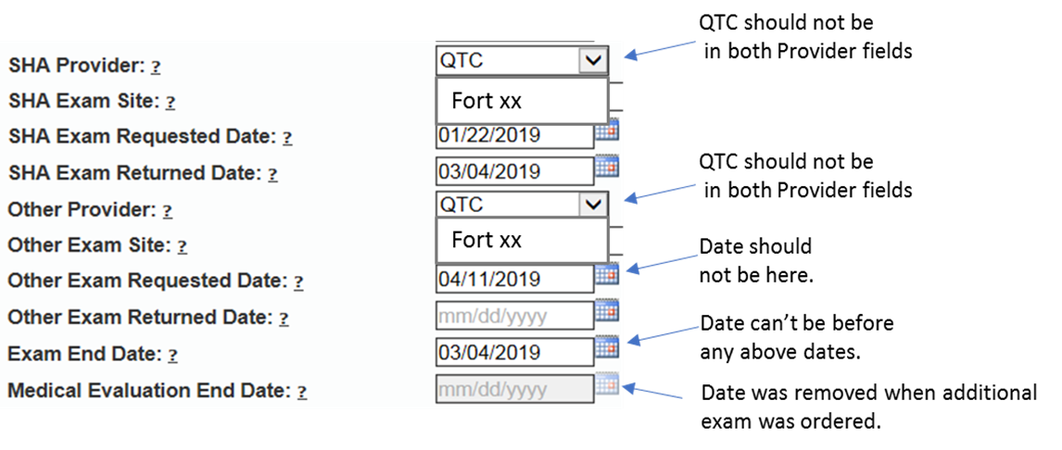
SHA and Other Exam Fields (2 of 2)

Slide 25
VTA Training
Live VTA Training that occurs on the 3rd Tues/Wed of each month has ended. An on-line course has been created, and an announcement on how to access is forthcoming

Slide 26
BDD Topics for Discussion

Slide 27
BDD Rating EP Cancellations
We have been informed by the Winston-Salem RO intake sites that they have noticed some BDD rating EPs have been cancelled by other ROs while they are waiting for the documents to be scanned into VBMS by VCIP
Do not cancel any EP if documents are missing from the VBMS eFolder without first contacting the MSC that established the EP
An examination request should already be in the eFolder since the EP 336 has already been changed to a rating EP
If you have any EPs cancelled in error by another RO, please send all the details including the claim number to the Pre-Discharge mailbox

Slide 28
Current Program Timeliness
As outreach specialists and VA’s frontline contact with SMs and
Veterans, it is vital that we are realistic in our communications regarding claims processing times. Below is the current program timeliness data as of May 8, 2019.
May #, 2019 | BDD
Completed FYTD | 20,219
Receipts FYTD | 21,444
Pending | 4,438
% Pending >125 Days | 10,318
# Pending >125 Days | 51%
Average Days Pending | 84.4
Avg. Days to Complete FYTD | 54.71

Slide 29
Questions from the Pre-D/BDD Mailbox
5 Questions and Answers

Slide 30
Misc and Open Floor
TMS # VA 4507358
Coaches Call (Thursday at 2pm)
Next Teleconference: June 11, 2019
Open Floor/Questions

