Slide 1
FOR TMS TRAINING CREDIT
To obtain training credit in TMS, there is no need to review these slides at this time – immediately close this box by using your mouse to select the “X” in the upper right-hand corner; select the “Return to Content Structure” button; and, select the next link (Video) to view the edited audio-video recording of the Quality Call along with the Call Bulletin
These slides are included here only in case you want to use them later for training purposes or reference
These are the same slides that are shown in the audio-video recording

Slide 2
May 8, 2019
Compensation Service
Quality Call

Slide 3
Welcome to the May 2019 Quality Call
Robert Johnson
Senior Quality Review Specialist
Quality Review Team
Quality Assurance

Slide 4
Agenda
April 2019 Quality Call Quiz
Blue Water Navy (BWN) / Procopio Information
Military Sexual Trauma (MST) Review
AMA – Including Applicable Laws & Regulations
STAR Reconsideration Request Reminders
What’s New in M21-1?
Incompetency Determinations
Propriety of Providing Notice by Telephone
VA Forms Information
Initial PTSD DBQ and Medical Opinion DBQ
National STAR Authorization Checklist Update – Question 11 “Data Integrity”
Nashville VARO Authorization Quality Improvement Plan
Poll Questions and Closing Comments

Slide 5
QUIZ – April 2019 Topics – QUIZ

Slide 6
Quiz Question Guidance
Three (3) Quiz Questions will be shown on the following slides
Interactive Quiz Screen will be displayed after each question slide
Using your mouse , please select your response
Please do NOT type your answer into the Chat Box
Note: If you are in a group setting using only one computer, poll the group and have somebody use the mouse at the computer to select the group’s response
Quiz results will be discussed after everybody has responded

Slide 7
Quiz Question #1 – Use Mouse to Select Answer
“My review of the Veteran’s Tampa VAMC medical reports, including the reports dated 3/29/19, 4/11/19, and 4/29/19, showing treatment for left shoulder pain during repeated use over time and flare-up events reveal there was no left shoulder joint loss of motion during these occasions; only pain. During today’s examination, the Veteran did not complain of any left shoulder functional loss, other than pain, during repeated use over time and flare-ups.”
QUESTION: Is this a Sharp-compliant Mitchell rationale?
Yes
No

Slide 8
Quiz Answer # 1
Yes
The examiner discussed specific facts of the case by noting a review of VAMC records by date. The examiner discussed the procurable VAMC evidence and the Veteran’s testimony; in other words, the examiner personalized to the Veteran’s specific case facts.
M21-1 III.iv.3.D.2.r

Slide 9
Quiz Question #2 – Use Mouse to Select Answer
Veteran, age 54, is SC for PTSD @ 70% for 8 years and HEARING LOSS @ 10% for 9 years with an overall, combined evaluation of 70%. Claim for increase for hearing loss received, and current VAE shows 0% is warranted. You are adjudicating the claim today.
QUESTION: Should you schedule a future Audio examination to monitor for anticipated improvement in hearing loss?
Yes
No

Slide 10
Quiz Answer # 2
No
Do not establish a future examination control in cases when the evaluation is 10% or less, or when the combined evaluation would not change even if the reexamination resulted in a reduced evaluation for one or more disabilities. In addition, the Veteran will have reached age 55 by the time the reexamination is conducted.
M21-1 III.iv.3.B.2.c-d-e

Slide 11
Quiz Question #3 – Use Mouse to Select Answer
Shirley Mae, a female GW Era Veteran, submitted a claim for service connection for Diabetes Mellitus. STRs show normal upon entrance into service and a diagnosis of diabetes during active duty. Shirley submits evidence showing only a current diagnosis along with her statement of suffering with DM since service.
QUESTION: When requesting a Diabetes Mellitus DBQ for Shirley, which of the following language do you have to add to the examination request?
Does the Veteran have Ketoacidosis?
Does the Veteran have FSAD?

Slide 12
Quiz Answer # 3
Does the Veteran have FSAD?
Since some DBQs have not yet been updated, when requesting a Diabetes Mellitus DBQ, you need to add the following language: “Does the Veteran have female sexual arousal disorder (FSAD) that is at least as likely as not attributable to diabetes mellitus? If yes, please complete the Gynecological Conditions DBQ.”
This guidance currently applies to Diabetes Mellitus, Parkinson’s Disease, ALS, Central Nervous System and Neuromuscular Diseases, and MS DBQs
M21-1 III.iv.4.J.1.b

Slide 13
Blue Water Navy (BWN) / Procopio Information
Dr. Nilijah Carter
Acting Deputy Executive Director Operations
Office of the Director
VA Central Office

Slide 14
Procopio Decision
On January 29, 2019, the Federal Circuit held that it was Congress’ intent to extend presumptive service connection due to herbicide exposure to those Veterans who served in the territorial sea of the Republic of Vietnam (RVN)
This population of Veterans is generally known as “blue water” Navy Veterans
The decision will require VBA to extend the presumption of service connection where the claimant can establish
Service in the territorial seas of Vietnam, i.e., within the 12-nautical mile territorial sea of RVN during the time period specified in 38 USC 1116(a); and
that he or she suffers (or suffered, in the case of death claims) from one of the diseases listed in 38 CFR 3.309(e)

Slide 15
Stay on Processing Procopio Claims
On February 15, 2019, VA issued VBA Letter 20-19-05 which provided the interim procedures for controlling claims affected by the Procopio decision
This policy letter provided interim guidance on holding these claims for processing and adjudication
During that time, VA filed a motion to stay implementation, which would suspend final action on claims potentially affected by the Procopio decision while VA evaluated the Court’s decision
On March 22, 2019, the Court denied VA’s motion to stay, meaning the case became precedent that binds the VA claims adjudication system, and VA must take action to adjudicate claims

Slide 16
Procopio Claims – Current Status
To implement the Procopio decision, VBA will make evidence-based determinations that involve:
Whether a claimant was present, during the specified period of time, and on a Navy vessel
Whether that vessel traveled within the 12-nautical mile territorial sea of Vietnam

Slide 17
Procopio Claims – Current Status (Cont’d)
To ensure consistency in decision making, VBA created a “12-Mile Team” to make the evidence-based determination for placement in the 12-nautical mile territorial sea of RVN
Serves as a temporary stop gap until VBA develops a ship locator tool, which will consist of data transcribed from deck logs located at NARA
Uses VBA-approved tools to make evidence-based determinations
Upon determination by the 12-Mile Team, cases will be routed to stations for any additional actions pursuant to current claims processing policies and procedures

Slide 18
Procopio Claims – Current Status (Cont’d)
VBA is also working on drafting a robust Standard Operating Procedure (SOP) for the 12-Mile Team which will eventually be used for updating the M21-1
VBA has a drafted a post-stay Policy Letter that outlines this policy and description of the 12-Mile Team
The issue of whether Nehmer (or liberalizing effective date) will apply to these Procopio cases is still pending with OGC

Slide 19
Military Sexual Trauma (MST) Claims Review
Esther Adefope
Chief
Program Review Staff
Quality Assurance

Slide 20
OIG MST Review
VBA is committed to serving our Nation’s Veterans by processing claims related to MST in an accurate and caring manner
OIG conducted a review of VA’s processing of Posttraumatic Stress Disorder (PTSD) claims related to MST
VBA concurred with OIG’s findings of inadequate processing of these sensitive issue claims and has taken immediate steps to improve this process which includes a special claims review

Slide 21
VBA Action on MST Claims
VBA has issued guidance reminding all ROs of the processing requirements and procedures related to MST-related claims by email and during national calls
VBA takes seriously the issues OIG raised in its report and is committed to reviewing the claims of Veterans’ that were previously denied, and take corrective action on those claims that were not properly processed according to VBA policy

Slide 22
VBA Action on MST Claims (Cont’d)
VBA implemented a plan to conduct a review of denied MST-related claims decided between 10/01/2016 through 06/30/2018, and take corrective action on claims determined to have been improperly denied
Currently, 5 ROs are reviewing a total of 9,700 denied MST claims
A total of 3,311 claims have been reviewed

Slide 23
Common Findings
Three common mistakes have been identified so far:
Development letters did not have appropriate MST language
MST Coordinator did not attempt to contact the Veteran
Veteran was not asked if either a DD Form 2910 or 2911 was completed
VBA will closely monitor the progress of this review and is on track to finish the review by the end of September 2019
VBA will conduct a national SFR of MST claims
This review will be conducted by the Quality Assurance Program Review Staff during 4th Quarter FY19

Slide 24
MST Claims Processing Requirements
The MST Outreach Coordinator must contact the Veteran via telephone to ask if he/she completed the DD Form 2910/2911 or a similar form following the incident
Send the proper development letter to the Veteran to include the development for VA Form 21-0781a, and include the language for MST restricted report or the MST unrestricted report
Be sure to include the specific language shown in the manual
Restricted guidance can be found M21-1 IV.ii.1.D.5.g
Unrestricted guidance can be found M21-1 IV.ii.1.D.5.h

Slide 25
MST Claims Processing Requirements (Cont’d)
Review the claim and all attached documents
Request STRs and the entire personnel folder
VSRs must work closely with RVSRs when developing MST cases
A marker refers to evidentiary signs, events, or circumstances indicating a possibility that the claimed stressor occurred, such as reports, lay statements, or behavioral changes that may be associated with the approximate timeframe of the claimed stressor

Slide 26
MST Claims Processing Requirements (Cont’d)
After all required development has been satisfied and the evidence obtained is credible evidence that supports the Veterans assertion that the stressful event occurred, the next step is to get an exam
The threshold for getting an exam is low
In compliance with 38 CFR 3.159(c)(4), an examination will always be needed when a thorough review shows
A medical diagnosis of PTSD or the Veteran’s lay statement describing PTSD symptoms

Slide 27
MST Claims Processing Requirements (Cont’d)
In compliance with 38 CFR 3.159(c)(4), an examination will always be needed when a thorough review shows (Cont’d)
Circumstantial evidence of a marker in the in-service or post-service records
Indication that PTSD symptoms may be associated with the claimed MST stressor (established by applying a low threshold and liberal approach satisfied by virtue of a current diagnosis or symptoms and the presence of a marker)
The evidence is insufficient to make an informed decision on the claim without examination

Slide 28
MST Examination Outcome
A current diagnosis and a stressor linked to service by the VA examiner, or a current diagnosis and evidence that the event happened in service, should lead to granting service connection
M21-1 IV.ii.1.D.6.a

Slide 29
MST Claims Assistance
As a reminder to all ROs and employees processing MST claims, please reach out to Quality Assurance for assistance if you have questions on specific MST claims that you cannot resolve locally
We are here as a resource and will respond to your questions
We recognize these are complex claims and can be difficult to process
You can send questions to the CS Quality Assurance MST POC
Esther.adefope@va.gov, or
VAVBAWAS/CO/214B (214B.VBACO@va.gov)

Slide 30
AMA – Including Applicable Laws & Regulations
David Hannigan
Quality Assurance Officer
Quality Assurance
VA Central Office

Slide 31
Including Applicable Laws & Regulations
Decision makers have always been required to accurately and appropriately apply all laws & regulations pertinent to every decision made
AMA guidance simply tells us to list those applicable laws & regulations in each rating decision
System-generated language will typically be sufficient to satisfy the requirement for inclusion of any laws & regulations applicable to the claim
If the applicable laws & regulations are not cited via system automation, use free-text parenthetical annotations to identify the ones you need
M21-1 III.iv.6.C.5.a & e

Slide 32
Example
You are granting service connection for right knee strain with a 10% evaluation from the date of claim; April 8, 2019
You must list:
Regulation governing the type of SC (direct, presumptive, secondary, etc.)
Just the one pertinent to the actual issue as decided
Regulation governing the effective date as assigned, and
Regulation governing the evaluation assigned
Typically the pertinent section of the rating schedule

Slide 33
VACO Guidance
So long as the law and/or regulation provided speaks to the nature of the claimed issue(s), the rating should be found as sufficient for IQR purposes in regard to the laws & regulations
Listing a single reference, so long as it speaks to all the issues decided, would be sufficient for IQR purposes
At this time, VACO Quality Review and Consistency advises to not cite errors based upon the inclusion of too many laws and/or regulations

Slide 34
STAR Reconsideration Request Reminders
David Hannigan

Slide 35
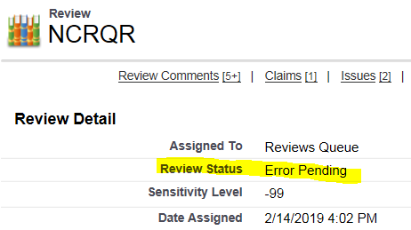
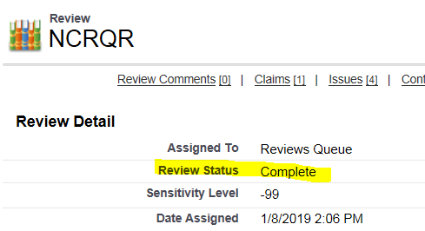
“Final” STAR Assessments in QMS
Do not submit a national STAR reconsideration request until QMS shows a final peer review was conducted by Quality Assurance QRT
Review Detail – Review Status – Must show “Error Pending” or “Complete”

Slide 36
Routing Recons in QMS to Quality Assurance
Per the National Quality Error Corrections SOP released to all ROs on November 20, 2017, follow these two steps
Step 1: The clearing RO’s QRT Coach or designee will select the “Initiate Recon” button within the QMS Error Correction Record
Rationale for removing the error(s) with supporting citations must be entered into the free text field – then select the “Next” button
Step 2: Select the “Recon Decision” button, select “STAR CS Team,” and then the “Next” button to complete the submission of the case
If this button is not selected, the case is never routed to Quality Assurance

Slide 37
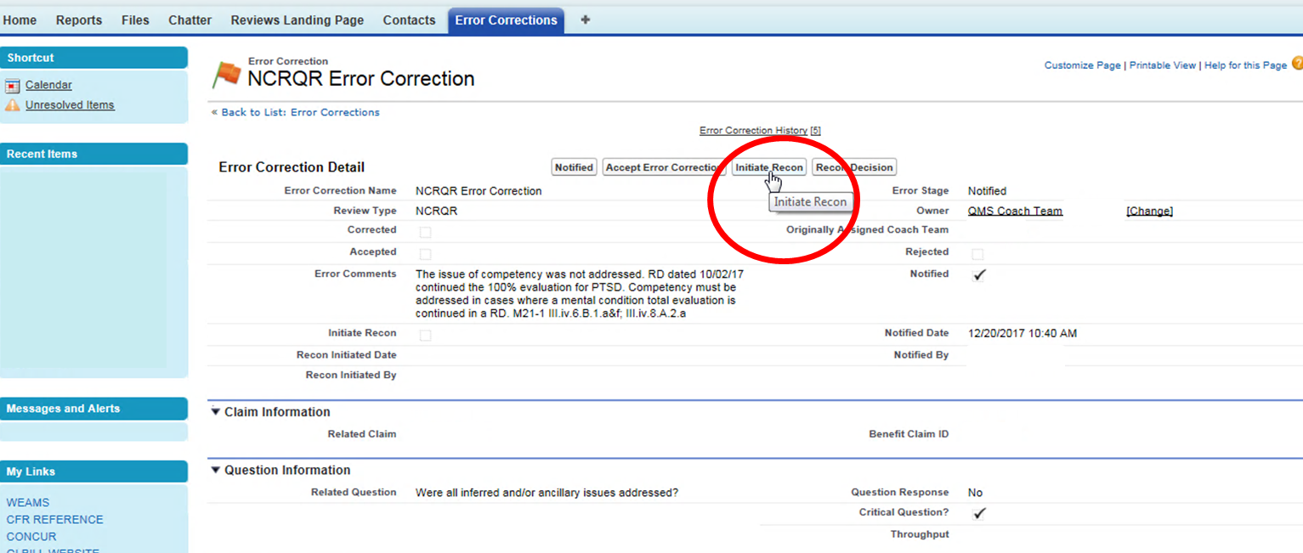
Step 1
Select “Initiate Recon” button on Error Correction Detail screen

Slide 38
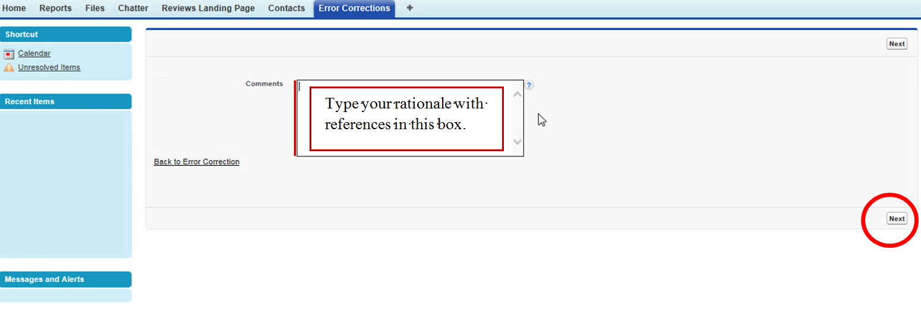
Step 1 (Cont’d)
Type your rationale and references into the Comments box and then select “Next”

Slide 39
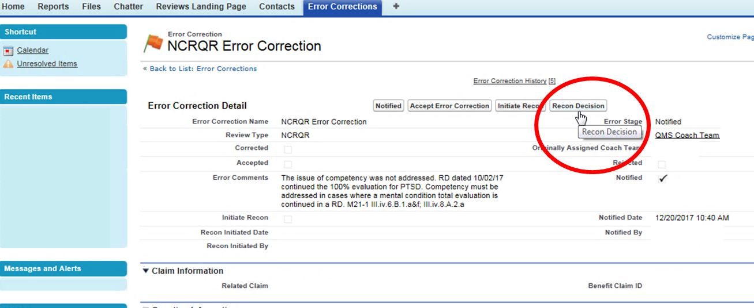
Step 2 – This is Important !
Select “Recon Decision”

Slide 40
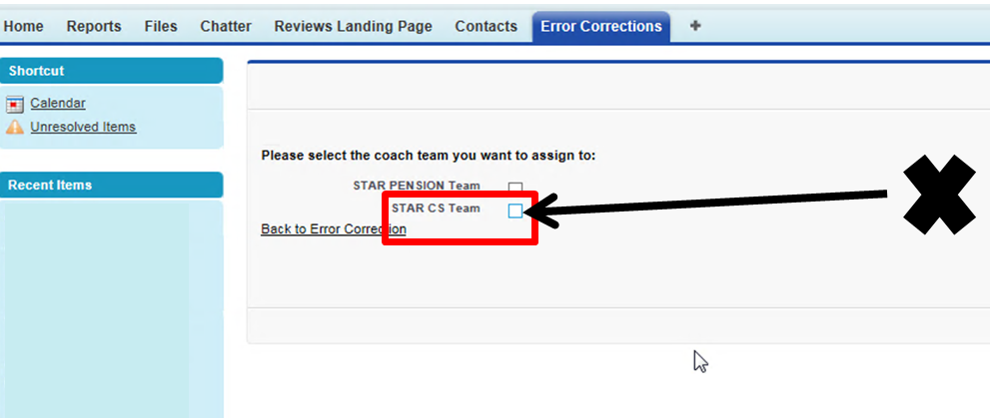
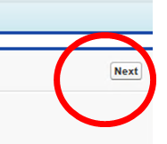
Step 2 (Cont’d)
Select “STAR CS Team” and then select “Next”
Only now is the reconsideration request routed to Quality Assurance

Slide 41
What’s New in M21-1
Angela Hiller & Kim Tibbitts
Manual Editors
Procedures and Program Implementation Staff
Policy and Procedures

Slide 42
Incompetency Determinations
Angela Hiller
Manual Editor

Slide 43
Incompetency Determinations
Collaborative project
Compensation Service
Southeast District
Fiduciary Service
Goals
Identify problem areas
Identify and implement solutions
Short-term
Long-term

Slide 44
Incompetency Determinations
Communicating & Maintaining Control between Fid Hubs and VSCs
Currently rely on
EPs
Emails

Slide 45
Incompetency Determinations
Ensure Proposal Process is Complete
Brady Bill notification documentation (M21-1 III.v.9.B.3)
Letter uploaded
VA Form 27-0820 documenting phone call
Successful
Unsuccessful
Auto-establishment of EP 590
Ensure it occurs
Ensure proper payee
Problems resolved with VBMS 16.1 released February 2019
Future state: auto-establishing of BFFS work item based on EP 590

Slide 46
Incompetency Determinations
Withdrawing Incompetency Proposals
Final rating at RO
Release withheld retro benefits
III.v.9.B.2.b
III.v.9.B.3.i

Slide 47
Incompetency Determinations
Restoration of Competency
Evidentiary Burden
38 CFR 3.353(b)(3)
Medical evidence not required—based on all evidence
Reasonable doubt resolved in favor of competency
Field examinations may be sufficient to restore competency without exam
Do not routinely request examination
M21-1 III.iv.8.A.4.d
Updates to NICS database
M21-1 III.v.9.B.4.d & III.v.9.B.6.a were updated (November 2018), and this process is now automated

Slide 48
Incompetency Determinations
Additional Information/Training
Fiduciary End Products and Processing Notification (TMS 4437812) in the VBA Learning Catalog
This training aims to teach the learner to:
Understand how EP controls affect claim management, productivity, and staffing,
Identify EPs and responsibilities associated with fiduciary promulgation activities,
Understand the proper date of claim for fiduciary EP’s,
Identify situations requiring jurisdictional transfers,
List the situations that are excluded from fiduciary processing, and
Understanding the basic processing of judicial determinations

Slide 49
Propriety of Providing Notice by Telephone
Kim Tibbitts
Manual Editor

Slide 50
Propriety of Providing Notice by Telephone
Recent updates to III.iii.5.K clarify the circumstance under which it is appropriate to notify a Veteran of a VA decision by telephone:
Veteran fails to return VA Form 21-0538, Mandatory Status of Dependents
Claims processor calls Veteran and obtains all the information that VA Form 21-0538 requires, and
the information the Veteran provides requires no adjustment to his/her award

Slide 51
Propriety of Providing Notice by Telephone
Important:
Notification by telephone is not appropriate once VA has issued a notice of proposed adverse action because the Veteran failed to return VA Form 21-0538

Slide 52
VA Forms Information
Kayce White
Publication Control Officer
Part 3 Regulations and Forms
Policy Staff

Slide 53
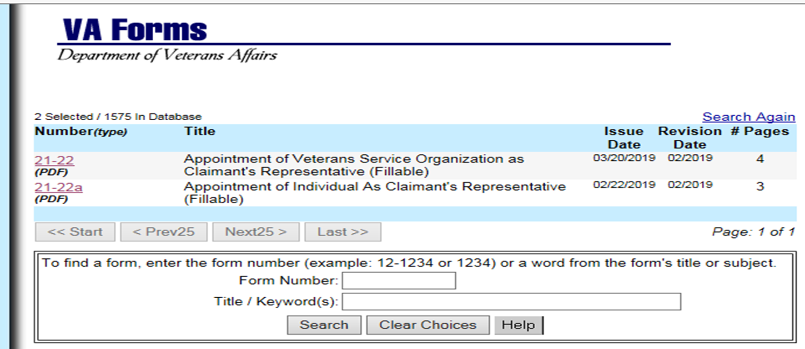
Issue Date vs Revision Date

Slide 54
Issue Date vs Revision Date (Cont’d)
The REVISION DATE field on the VA Forms Website or the Publications Index from the ‘Compensation Service Intranet Home Page’ shows the current version of a form
This date matches the form version found on the bottom left corner of the form itself
This date is updated only when a new version date is uploaded to these websites
Do not confuse this date with the ISSUE DATE field listed on these websites
This field is not relevant to determining the date of the current version or when it became outdated
Further guidance can be found in the M21-1 Part III, Subpart ii, 1.C.8.b

Slide 55
Form Discontinuance Reminder
M21-1, Part III, Subpart ii, 1.C.8.e was recently updated to include a section on the procedures for handling discontinued forms
A form becomes discontinued when its creation and distribution is stopped without a replacement under the same form number and/or name
When a form is discontinued, its use must cease effective on the date of discontinuance
This effective date will be communicated prior to the date specified
Do not apply the outdated forms procedures listed in M21-1 III.ii.1.C.8.a to discontinued forms

Slide 56
Form Discontinuance Example
VA Form 21-526c, Pre-Discharge Compensation Claim (version dated June 2016), was discontinued from use on May 1, 2019
It was removed from the VA Forms websites and cannot be accepted by VA’s intake centers
If the form is received on or after May 1, 2019, send a VA Form 21-526EZ, Application for Disability Compensation and Related Compensation Benefits, to the claimant to be completed and returned

Slide 57
Outdated Forms Reminder: VAF 21-0958
As stated in M21-1, Part III, Subpart ii, 1.C.8.a, the previous version of VA Form 21-0958, Notice of Disagreement, may still be accepted for up to one year after the newest version
The newest version of VA Form 21-0958 is dated September 2018 so the previous version dated September 2015 is still usable until September 30, 2019
As of October 1, 2019, the previous version is no longer acceptable
Note: The Appeals Modernization Act of 2017, Public Law 115-55, was implemented on February 19, 2019, but this does not limit the usage of the previous version of this form
VA Form 21-0958 is still used for decisions made prior to February 19, 2019 – Do not confuse the reasoning behind the use of the form with the outdated forms issue because they are not related

Slide 58
Initial PTSD DBQ and Medical Opinion DBQ
Jack Glandon
Veterans Claims Examiner
Medical Disability Exam (MDE) Staff
Program Management Office

Slide 59
Background
Issue # 1: There are differences of opinion among claims processors and examiners on whether the Initial PTSD DBQ has an embedded medical opinion
Issue #2: Inconsistencies with exam requests have been observed
Language in examination request is inconsistent
Separate Medical Opinion DBQ being requested

Slide 60
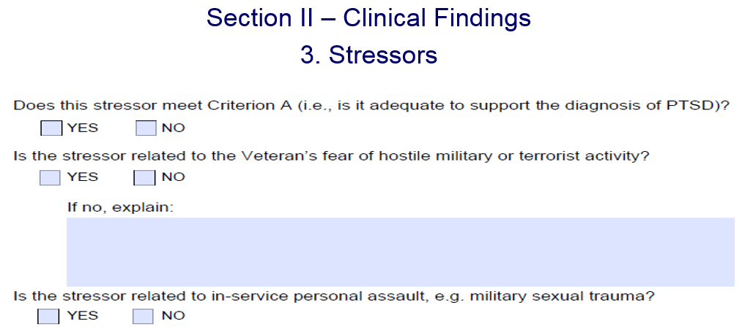
Initial PTSD DBQ Embedded Medical Opinion
Compensation Service would like to emphasize that there is an embedded medical opinion contained in the Initial PTSD DBQ

Slide 61
Initial PTSD Exam Requests
When requesting an Initial PTSD exam:
Exam Request Builder (ERB) – Select Service connection w/o MO (see slide 63)
Exam Management System (EMS) – Select correct contention classification (see slide 64)
Do not request a separate Medical Opinion DBQ
A rare circumstance may exist that would warrant a separate Medical Opinion DBQ, but this would be determined on a case by case basis

Slide 62
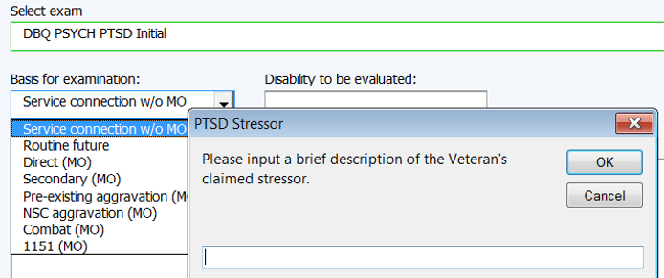
ERB Screenshot

Slide 63
EMS Contention Classifications
It is important that claims processors select the appropriate contention classification for the reported stressor
PTSD Combat or Personal Trauma will display the following in the Contention Information tab in EMS:
Mental Disorders will not display this in EMS

Slide 64
Updates
Initial PTSD DBQ
M21-1 (manual)
Training
EMS

Slide 65
National STAR Authorization Checklist Update
Isabelle Brisendine
Consultant
Program Review Staff
Quality Assurance

Slide 66
Data Integrity Issue vs Comment Verbiage
Since April 2018, STAR citations for End Product and Date of Claim errors under Question 11 of the National STAR Authorization Checklist have been categorized as comments
Effective April 9, 2019, Quality Assurance began inputting “Data Integrity Issue” rather than “Comment” at the beginning of the error narrative when citing STAR errors for End Product and/or Date of Claim issues under Question 11
This will remind ROs these are data integrity issues and also assist STAR in tracking these deficiencies

Slide 67
Kudos to the Nashville Regional Office
Christine Alford
Chief
Program Review Staff
Quality Assurance

Slide 68
RO Quality Improvement Initiatives
Quality Improvement Initiatives Based on Positive Impact
Measuring and Improving Outcomes and Internal Processes
Wide Dissemination of Proven RO Best Practices
User-Friendly and Effective Resources
Effective Communication Practices Regarding Procedural, Legislative, and Regulatory Changes

Slide 69
Nashville RO Quality Improvement
Leonard (Ray) Wilson
Coach
Quality Review Team
Nashville VA Regional Office

Slide 70
Nashville Authorization Quality Improvement
National Authorization Quality Target, 91.5%
Nashville Authorization Quality:
80.9% - December 2017
79.2% - January 2018
76.9% - February 2018
Nashville QRT Conducted Authorization Quality Trend Analyses in February 2018 to Identify Improvement Opportunities
Key areas of deficiency were identified
Initial training in deficient areas was completed (primarily non-rating and non-rating special mission teams)
Live Veteran claims were utilized to provide practical application

Slide 71
Nashville Authorization Quality
Follow-up Training
Reinforcement of initial training conducted during weekly team huddles
Additional training areas identified by VSRs and team managers with training provided as needed
“Peer to Peer” review days instituted
Training and Quality Review Teams provide continuous oversight and assistance
Nashville Authorization quality in February 2018, 76.9%
Nashville Authorization quality in February 2019, 94.0%

Slide 72
Nashville Authorization Quality (Cont’d)
Collaborative Effort
Quality Review Team
Training Team
Non-Rating, Non-Rating Special Mission, and Rating Bundle VSR Team Coaches
Individual VSR employees

Slide 73
RO Quality Improvement
Christine Alford

Slide 74
Quality Improvement at Your RO!
All offices are encouraged to utilize tools and strategies featured on previous Quality Calls to communicate information vital to quality improvement
Does your office currently have a similar quality-focused practice?
Please let us know so we can feature your best practice during an upcoming Quality Call for everyone’s benefit!

Slide 75
Poll Questions
Presented by:
Robert Johnson

Slide 76
Interactive Poll Question Guidance
Four (4) Poll Questions will be shown on the following slides
Interactive Poll Screen will be displayed after each question slide
Using your mouse , please select your response
Please do NOT type your answer into the Chat Box
Note: If you are in a group setting using only one computer, poll the group and have somebody use the mouse at the computer to select the group’s response
Poll results will be discussed after everybody has responded

Slide 77
Poll Question # 1 – Use Mouse to Select Answer
One of the first steps to take upon receipt of a claim based on military sexual trauma (MST) is for the MST Outreach Coordinator to contact the Veteran via telephone to ask if he/she completed DD Form 2910, DD Form 2911, or a similar form following the incident.
QUESTION: Is this statement true or false?
True
False

Slide 78
Poll Question Answer # 1
True
Upon receipt of a claim based on MST, VA’s ‘Step 1’ is for the RO’s MST Outreach Coordinator to contact the Veteran via telephone to ask if he/she completed DD Form 2910, DD Form 2911, or a similar form following the incident.
M21-1 IV.ii.1.D.5.f

Slide 79
Poll Question # 2 – Use Mouse to Select Answer
You are granting direct service connection for hearing loss with a 10% evaluation from the date of claim; March 1, 2019.
QUESTION: What are the laws and regulations applicable to this claim?
38 CFR 3.310; 38 CFR 3.155; and, 38 CFR 4.87
38 CFR Part 3 and 38 CFR Part 4
38 CFR 3.303; 38 CFR 3.400; and, 38 CFR 4.85
38 CFR 3.303; 38 CFR 3.400; and, 38 CFR 4.124a

Slide 80
Poll Question Answer # 2
38 CFR 3.303; 38 CFR 3.400; and, 38 CFR 4.85
You must list:
3.303 – Regulation governing the type service connection (direct)
3.400 – Regulation governing the effective date assigned (date of claim)
4.85 – Regulation governing the evaluation assigned (hearing loss)
Every decision often contains many “mini-decisions” based on different laws and regulations, so any of those mini-decisions each require the corresponding law (SC, effective date, evaluation, FTR, etc.)
CFR 3.103(f) & M21-1 III.iv.6.C.5.a & e

Slide 81
Poll Question # 3 – Use Mouse to Select Answer
Following a proposal of incompetency, Brady Bill notification must be completed at the regional office before fiduciary actions occur.
QUESTION: Is this statement true or false?
True
False

Slide 82
Poll Question Answer # 3
True
The letter must be sent and uploaded in VBMS, and the phone call must be made and documented on VA Form 27-0820.
M21-1 III.v.9.B.3

Slide 83
Poll Question # 4 – Use Mouse to Select Answer
A GW Era Veteran has submitted an original claim for SC for PTSD. Records show he served as an Armor Crewman and earned an Iraq Campaign Medal. DD214 confirms service in an imminent danger area in Iraq. You are scheduling an exam at the Tampa VAMC.
QUESTION: Which DBQ(s) should you request?
Mental Disorders DBQ and Medical Opinion DBQ
Initial PTSD DBQ
Mental Disorders DBQ
Initial PTSD DBQ and Medical Opinion DBQ

Slide 84
Poll Question Answer # 4
Initial PTSD DBQ
The receipt of the Iraq Campaign Medal is considered evidence of service in an area of potential hostile military or terrorist activity. Concede a stressor when the DD214 shows service in an area of potential military or terrorist activity. The Initial PTSD DBQ contains an embedded medical opinion that is sufficient for this scenario.

Slide 85
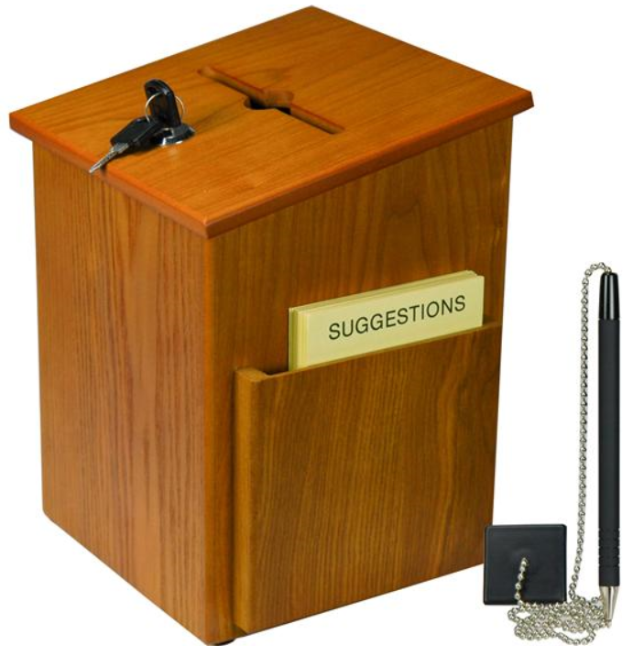
Questions – Suggestions – Next Quality Call
Presented by:
Robert Johnson

Slide 86
Questions Relating to Today’s QC Topics
Questions on topics presented must be emailed to the Compensation Service Quality Review Team at InternalQRS.VBAVACO@va.gov
Emails must include Cc to your Coach or other RO management
Emails must contain the name of the topic(s) with your question(s)
Questions must be submitted to the mailbox by COB Friday, May 10th
Questions submitted after COB Friday will not be accepted for inclusion in the Call Bulletin
Email questions are limited to those pertaining to only the topics presented, and responses will not be provided to any questions that are not related to the topics presented during today’s Quality Call
Official guidance to the questions will be posted later in the Call Bulletin

Slide 87
Do You Have Suggestions for Topics?
Please feel free to email your topic suggestions to the Compensation Service Quality Review Team at InternalQRS.VBAVACO@va.gov
In your email, be sure to include:
Cc to your Coach or other RO management
Name of the topic
Intended audience (VSR – SVSR – RVSR – DRO – AQRS – RQRS)
Applicable M21-1 and/or 38 CFR citations
Quality Call Bulletins can be found in the STAR Home Page on the Compensation Service Intranet site, TMS, and VBA Learning Catalog
Audio recordings of the Quality Calls with separate copies of the PowerPoint slides can be found in both TMS and VBA Learning Catalog

Slide 88
Next Quality Call
A Compensation Service Quality Call is usually presented each month
Next Quality Call will be conducted on June 12, 2019

