Slide 1
FOR TMS TRAINING CREDIT
To obtain training credit in TMS, there is no need to review these slides at this time – immediately close this box by using your mouse to select the “X” in the upper right-hand corner; select the “Return to Content Structure” button; and, select the next link (Video) to view the edited audio-video recording of the Quality Call along with the Call Bulletin
These slides are included here only in case you want to use them later for training purposes or reference
These are the same slides that are shown in the audio-video recording

Slide 2
April 10, 2019
Compensation Service
Quality Call

Slide 3
Welcome to the April 2019 Quality Call
Robert Johnson
Senior Quality Review Specialist
Quality Review Team
Quality Assurance

Slide 4
Agenda
March 2019 Quality Call Quiz
Purple Heart Priority Initiative
Appeals Modernization Act (AMA) FAQs
RVSR VBMS AMA Q-Tips
How to Correct AMA Cited Errors
Deferrals
Online Self-Service Disability Compensation Claims Tool
December 2018/January 2019 Consistency Study Results
Sharp-Compliant Mitchell Rationale Examples & STAR Grace Period
Routine Future Examinations
Final Notification Letters for VAMC Records
ERB-S to EMS Language Integration
Poll Questions and Closing Comments

Slide 5
QUIZ – March 2019 Topics – QUIZ

Slide 6
Quiz Question Guidance
Three (3) Quiz Questions will be shown on the following slides
Interactive Quiz Screen will be displayed after each question slide
Using your mouse , please select your response
Please do NOT type your answer into the Chat Box
Note: If you are in a group setting using only one computer, poll the group and have somebody use the mouse at the computer to select the group’s response
Quiz results will be discussed after everybody has responded

Slide 7
Quiz Question #1 – Use Mouse to Select Answer
QUESTION: For claims received on and after February 19, 2019, do you need to include a declaration of “Favorable Findings identified in this rating: None” in the rating decision narrative or place that declaration on the codesheet?
Yes
No

Slide 8
Quiz Answer # 1
No
There are no requirements in the manual that direct decision makers to input “None”, “N/A”, or any other notation when there are no favorable findings. 38 CFR 3.103(f) requires “a listing of any findings…that are favorable to the claimant.” M21-1 III.iv.6.C.5.a tells us that denials of claims should include “findings favorable to the claimant…if any.” Neither require a statement to the claimant that there were no favorable findings identified.
M21-1 III.iv.6.C.5.f – Addressing “Favorable” Findings in the Rating

Slide 9
Quiz Question #2 – Use Mouse to Select Answer
As a decision maker, there is evidence of record showing you can grant SC @ 10% for RIGHT KNEE OSTEOARTHRITIS; however, the examiner has provided an insufficient Sharp-compliant Mitchell rationale, and the basis for the opinion is not otherwise apparent in your review of the evidence.
QUESTION: Can you grant the right knee disability @ 10% and defer the same issue for clarification of the insufficient Mitchell rationale?
Yes
No

Slide 10
Quiz Answer # 2
Yes
Make a partial rating decision when one or more issues require additional development before they can be decided, but the record otherwise contains sufficient evidence to grant any claim at issue, including SC @ 0%.
M21-1 III.iv.6.A.1.b

Slide 11
Quiz Question #3 – Use Mouse to Select Answer
You are a VSR promulgating a rating decision today. The claim was received by VA on February 9, 2019. Your review of the VBMS eFolder shows the Veteran mailed the claim by herself to VA using an old VA Form 21-526 (version dated November 2014).
QUESTION: What action should you take?
Generate a deferral because that VA Form 21-526 is discontinued
Promulgate the rating decision and generate an award

Slide 12
Quiz Answer # 3
Promulgate the rating decision and generate an award
VA Form 21-526 (version dated November 2014) and VA Form 21-526b (version dated June 2014) were discontinued on February 19, 2019. Any usage of these two forms in unacceptable on or after February 19, 2019*. Since the 21-526 was mailed and received by VA on February 9, 2019, in this example, use of the form is acceptable.
M21-1 III.ii.2.B.1.d
M21-1 III.ii.1.C.8.a – Exceptions on Accepting Outdated Versions (*)

Slide 13
Purple Heart Priority Initiative
Aaron Cantrell
Training Consultant
Denver Instruction Staff
Training

Slide 14
Prioritizing Purple Heart Medal Recipients
On February 26, 2019, Secretary Robert Wilkie announced that VA would start prioritizing claims for Veterans with a Purple Heart
This prioritization started on April 1, 2019
Manual Updated
M21-1 III.ii.1.D.1.a
M21-1 III.ii.1.D.7
M21-1 III.iii.2.I.1.b
Updated and mandatory training due April 30, 2019
TMS # 4500942

Slide 15
Purple Heart Medal
The Purple Heart is awarded to members of the Armed Forces of the United States who have been wounded, killed, or died of wounds received during combat or combat-related service
The Purple Heart is awarded in the name of the President of the United States
If receipt of the Purple Heart is documented, add the Purple Heart corporate record flash in SHARE

Slide 16
Prioritization
The following claims are prioritized for service members who have earned a Purple Heart medal:
original compensation
original pension
original DIC
Character of Discharge (COD) determinations will not be prioritized

Slide 17
Medal of Honor
Claims from Veterans with a Medal of Honor have always been priority; however, no corporate record flash existed in SHARE
If the Veteran has a Medal of Honor, add the new Medal of Honor corporate record flash to SHARE

Slide 18
Managing Priority Claims
Upon receipt of a claim that requires priority processing, the claims processor must take any and all necessary development actions before taking action on any other non-priority claim
If the claims processor has multiple claims that require priority processing in his/her work queue, they should use their best judgement on which claim to process first

Slide 19
Managing Priority Claims (Cont’d)
The claims processor should do the following to expedite the processing of priority claims:
use the appropriate corporate record flash or special issue
frequently follow up on all development actions
utilize issue-specific coordinators (i.e., Military Records Specialists), where applicable
use the telephone to contact the Veteran and conduct development activities, whenever possible
collaborate with the Veterans Health Administration (VHA) and other involved counterparts

Slide 20
Managing Priority Claims (Cont’d)
review all evidence early in the claims process to determine if the claim can be rated without further development
sympathetically consider the claimant’s level of impairment so as to:
solicit for DBQs completed by their primary care provider in lieu of an examination
request medical opinions based solely a folder review when evidence is available to assign an evaluation
Another effective technique is to soft-transfer the claim from person-to-person
Ready for Decision: Pre VSR to RVSR
Rating Decision Complete: RVSR to Promulgator
Awaiting Authorization: Promulgator to Authorizer

Slide 21
Summary – Managing Priority Claims
This is not an all-inclusive list
Think outside the box
Be Creative
Don’t do anything:
Illegal
Unethical
Inappropriate
VBMS Notes

Slide 22
Appeals Modernization Act (AMA) FAQs
Andrew Gray
Lead Training Analyst
Certification Staff
Training

Slide 23
AMA Training Announcements
Answering Your Questions: AMA Supplemental Training (TMS 4500996) is now available for employees
This course is inactive in TMS and must be completed in Adobe Prime via the Learning Catalog or a search in Prime

Slide 24
AMA FAQs
Are favorable findings required in a rating decision when confirming and continuing the current evaluation (CCEVAL)?
Confirmed and continued evaluation decisions are denials of a claim for increased evaluation; however, findings favorable to the claimant will be covered by the system generated language, assuming all symptoms are considered and input by the adjudicator.

Slide 25
AMA FAQs (Cont’d)
Is a complaint of pain without evidence of a diagnosed disability sufficient to warrant a favorable finding in a rating decision, pursuant to the holding of the Federal Circuit in Saunders v. Wilkie?
The Court’s holding is limited to pain resulting in functional impairment of earning capacity. With evidence of functional impairment of earning capacity, a favorable finding would be appropriate.

Slide 26
AMA FAQs (Cont’d)
If correspondence is received with a VA Form 20-0995 (for example a VA Form 21-4138) that lists additional supplemental contentions, can we accept the listed issues on the correspondence as part of the supplemental claim, as we do for initial claims filed on the VA Form 21-526EZ?
Yes, contentions that relate to the prescribed form submitted at the same time as the prescribed form on a VA Form 21-4138 should be established with the contentions from the prescribed form.

Slide 27
AMA FAQs (Cont’d)
If a Veteran’s claim was denied in January of 2019 (notification sent the same month), and submits a claim for the same contentions on February 25, 2019, should the claim be filed and processed as a supplemental claim or as a reconsideration claim?
Claims of this nature received after February 19, 2019, will be processed as supplemental claims and must be received on the appropriate form (VA Form 20-0995).

Slide 28
AMA FAQs (Cont’d)
If a Veteran does not identify treatment at a specific VA Medical Center (VAMC), adjudicators must perform an enterprise search in CAPRI and associate any relevant records with the eFolder. If this procedure results in new evidence being uploaded, would this be considered new and relevant evidence?
It is likely that this would rise to the level of new and relevant. The evidence is certainly new and, if the claim is a rating claim, would require review by the rating activity with a rating decision to determine whether the evidence is also relevant. Adjudicators should continue to follow procedural guidance regarding enterprise searches and upload of records.

Slide 29
AMA FAQs (Cont’d)
With the new lower standard of relevancy, would new treatment records always be relevant to a prior denial (warranting a review on merits), even if the denial was for lack of an in-service event?
Insofar as they relate to treatment for the disability claimed, then “Yes.” "Relevant" evidence is evidence that tends to prove or disprove a matter at issue in the claim – not just the particular matter whose resolution would result in a grant.

Slide 30
AMA FAQs (Cont’d)
If a Veteran submits private treatment records showing a diagnosis of a claimed condition, and we request and receive a VA examination that shows no current diagnosis, should we use the private evidence to support a favorable finding of a diagnosis?
Favorable findings are conclusions of fact specific to the case. If you have multiple pieces of evidence relevant to an element of entitlement, then consider them all, weigh the evidence, and reach a conclusion. If, in your scenario, your conclusion is that the unfavorable evidence has more probative value, then you are not conceding that the Veteran has a diagnosis and thus there would be no favorable finding of one.

Slide 31
AMA FAQs (Cont’d)
Is there any time a regulation would not need to be cited for an assigned effective date?
There is not. Effective dates for grants are assigned based on regulatory requirements – the applicable regulation should be cited in all instances.
Will a VA Form 20-0995 be required for previously denied auto allowance and/or housing claims, in addition to receipt of their respective claim forms?
Yes.

Slide 32
AMA FAQs (Cont’d)
In situations where an adjudicator denies a claim where exposure was considered but not specifically claimed (for instance, Veterans who claim conditions consistent with disabilities under 38 CFR 3.317 where we order exams and the results are unfavorable), are we required to enter favorable findings speaking to exposure in our denials?
If you conclude that the evidence raises a theory of entitlement, your decision must address relevant reasons for denying and any favorable findings for all theories of entitlement considered.

Slide 33
RVSR VBMS AMA Q-Tips
Jennifer Monville
Rating Quality Review Specialist
Quality Review Team
VARO Nashville

Slide 34
AMA Rating Decision Tips and Tricks
A number of VBMS-R embedded tool issues have been identified since the release of AMA on 02/19/2019, such as:
Effective Date Builder
Evaluation Builder – VASRD
Evaluation Builder – Next Higher
Some relevant references are:
38 CFR 3.103(f)
M21-1 III.iv.6.C.5.a

Slide 35
Effective Date Builder
38 CFR 3.400 (effective date) is only auto-populated when the effective date is generated via the embedded VBMS-R Effective Date Builder
If the user bypasses the VBMS-R embedded Effective Date Builder, then “(38 CFR 3.400)” (and/or other relevant effective date regulations) must be manually entered in the rating narrative/effective date paragraph via free text
Note: This is not a VBMS-R defect, and there is no anticipated “fix” – the user needs to be aware of when free-text regulatory citations are required!

Slide 36
Evaluation Builder – VASRD
38 CFR 4.124a (neurological rating schedule) is generated for nearly every disability evaluation when using the embedded VBMS-R Evaluation Builder
If 38 CFR 4.124a is not accurate, the decision maker must manually update the auto-generated ‘38 CFR 4.124a’ citation to the correct VASRD body system reflective of the disability being evaluated
Note: This is a known VBMS-R defect and is expected to be fixed in a future update
Compensation Services Calendar Blast was sent to the Field on 02/19/2019

Slide 37
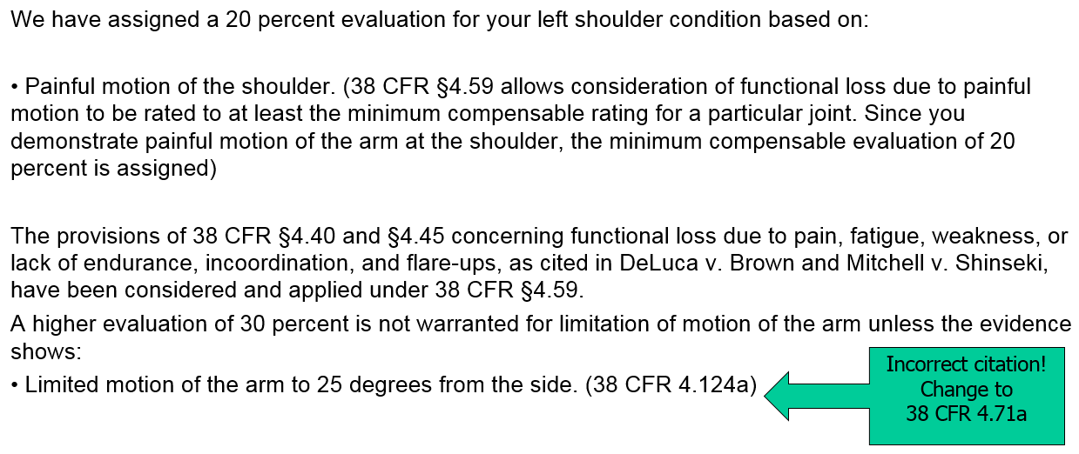
Example of Incorrect VASRD Evaluation Text

Slide 38
Evaluation Builder – Next Higher
If the evaluation is at the scheduler maximum (i.e., Tinnitus – 10%), the VBMS-R embedded Evaluation Builder is not adding a VASRD body system citation at all, so the decision maker will need to manually add the appropriate VASRD body system citation relevant to the disability evaluation (in this example, “38 CFR 4.87”)
Note: This is a known VBMS-R defect and is expected to be fixed in a future update
Compensation Service Calendar Blast was sent to the Field on 03/22/2019

Slide 39
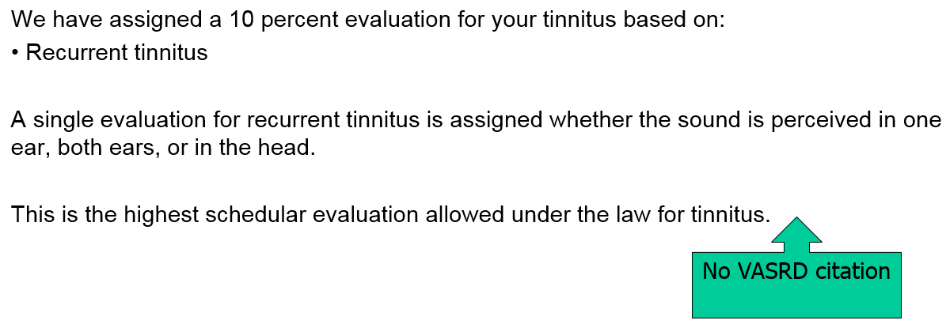
Example of Incorrect Next Higher Evaluation Text

Slide 40
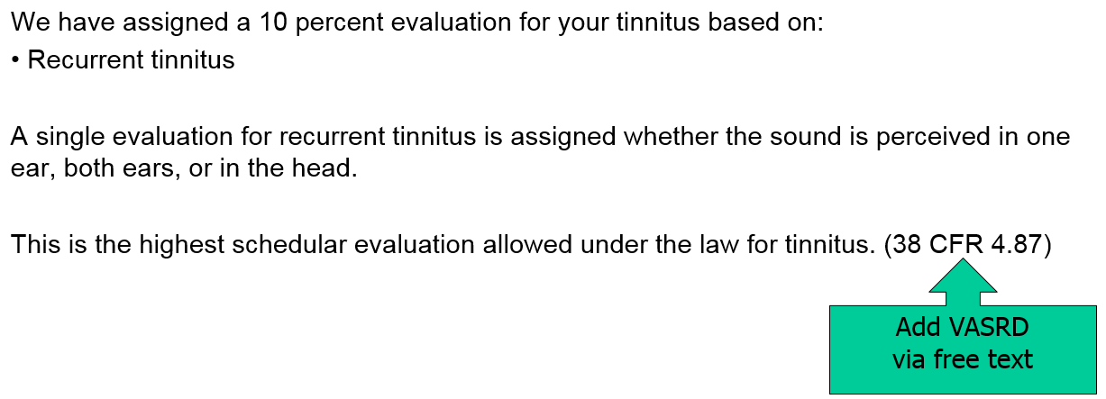
Example of Correct Next Higher Evaluation Text
Free text VASRD citation needs to be added as shown:

Slide 41
How to Correct AMA Cited Comments/ Errors
Bonnie Kirby
Senior Rating Quality Review Specialist
Quality Review Team
Quality Assurance

Slide 42
Correcting AMA Related Errors/ Comments
Task-based rating checklist
Question 9: critical error task when laws and regulations applicable to the claim are not provided
Question 12: a corrective comment task when applicable favorable findings are not identified and properly documented
How should these be corrected?
A new rating decision should be completed to provide the Veteran/ beneficiary legally sufficient notice
Favorable findings must be documented in VBMS for retention

Slide 43
Suggested Verbiage for AMA Related Citations
Suggested verbiage for providing missed laws and regulations:
The purpose of this rating decision is to provide you with additional laws and regulations that are applicable to our decision on your claim, but were not included in our previous decision of ____ (date).
Suggested verbiage for providing favorable findings:
The purpose of this rating decision is to explain the favorable findings associated with your claim for ____ (issue), but were not included in our previous decision of ___ (date).

Slide 44
Deferrals
Bonnie Kirby
Senior Rating Quality Review Specialist
Quality Review Team
Quality Assurance

Slide 45
Selecting Deferral Reasons
In December of 2018, VBMS deferral functionality expanded
VBMS Deferral Guide released by the NWQ on January 24, 2019
Initiating and Finalizing Draft Deferrals
Deferral Reasons
Deferral Status
Deferral Resolution

Slide 46
Selecting Deferral Reasons (Cont’d)
Select all applicable deferral reasons
Example: If an exam has already been completed, but requires clarification, etc., select one of the following detailed reasons:
Clarification Needed
Insufficient Exam
Opinion Needed
Refer to M21-1 III.iv.3.A.7.a for complex medical opinion requests that must be prepared by the rating activity

Slide 47
Selecting Deferral Reasons (Cont’d)
Exception: When all rework actions are associated with late flowing evidence/ new evidence/ documents that were not associated with the eFolder at the time of the previous action, only select one of the following reasons:
Primary Deferral Reason | Secondary Deferral Reason
Development | New Records/ Needs Review
RVSR – Rating Correction | Late flowing documents/ scanning issues
VSR – Notification Correction | Late flowing documents/ scanning issues
VSR – Incorrect Payment | Late flowing documents/ scanning issues
VSR – EP Errors | Late flowing documents/ scanning issues

Slide 48
New Self-Service Disability Compensation Claim Tool on VA.gov
Paul Shute
Chief
Operational Innovation
Office of the Director

Slide 49
Background
On March 20, 2019, VA launched the new Self-Service Disability Compensation Claim Tool on VA.gov
The new tool allows for Veterans to file non-original claims for disability compensation
This capability represents an expansion of the digital modernization happening throughout VA

Slide 50
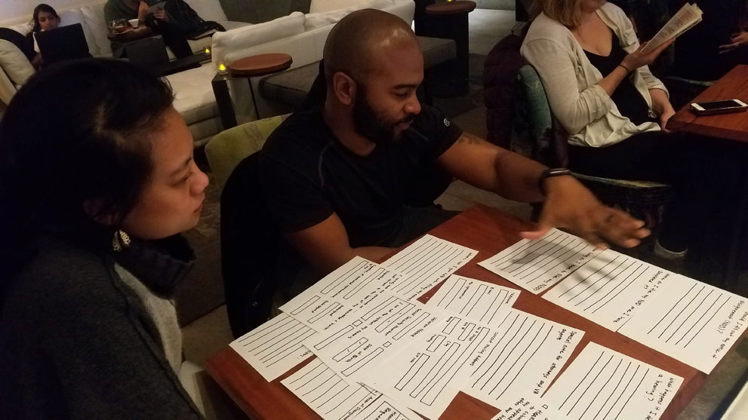
Key Features for Veterans
The content, structure, and terminology used within the tool was developed based on extensive usability testing with Veterans
Veterans don’t see forms, they see customized questions

Slide 51
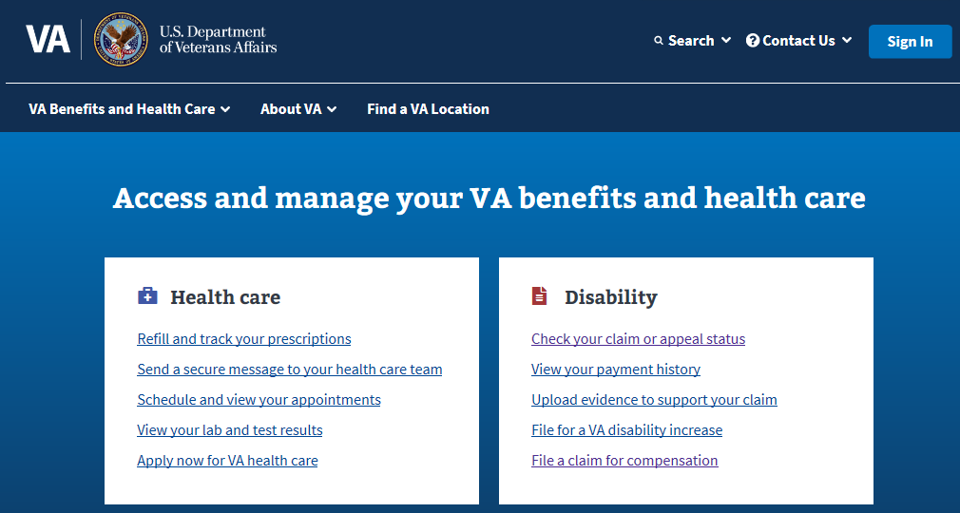
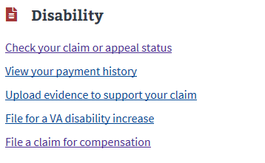
Key Features for Veterans (Cont’d)
This online claim submission capability can be accessed directly from the VA.gov website
Claims are established instantly, and the Veteran can check his/her claim status on the ‘Check your claim or appeal status’ page

Slide 52
Key Features for Adjudicators
Enhanced Intent to File (ITF) functionality
VA Forms 21-4142 and 4142a direct-to-PMR vendor routing
Current version of VA Form 21-526EZ (March 2018) provided
Information display on VA Form 21-526EZ overflow page
Automated claims establishment

Slide 53
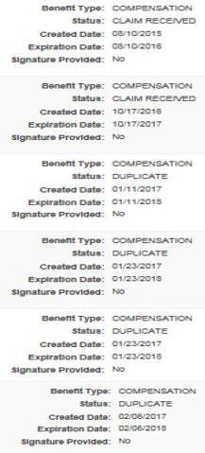
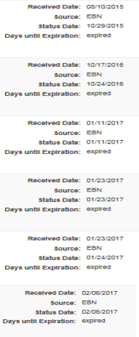
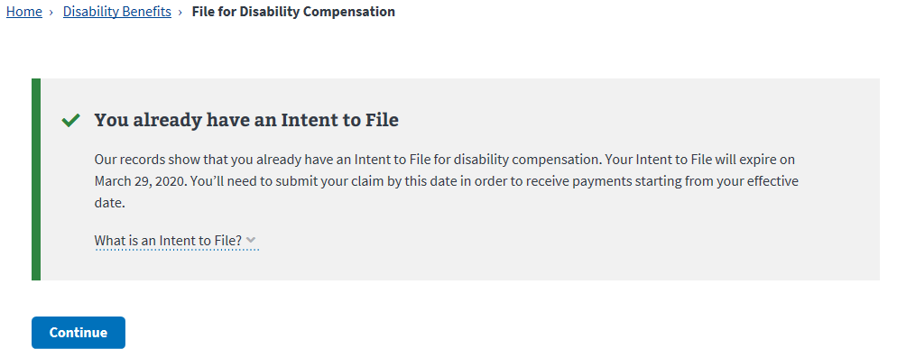
Enhanced Intent to File (ITF) Functionality
eBenefits produced duplicate ITFs, resulting in confusion for the Veteran and difficulty for the adjudicator
VA.gov queries the Veterans record to determine whether an ITF is already pending

Slide 54
VA Forms 21-4142 and 4142a Direct-to-PMR Vendor Routing
M21-1III.iii.1.D.2.f - Uploading VA Forms 21-4142 and 21-4142a to the PMR Vault
PMR Vault
PMR Vendor
PMR Vendor

Slide 55
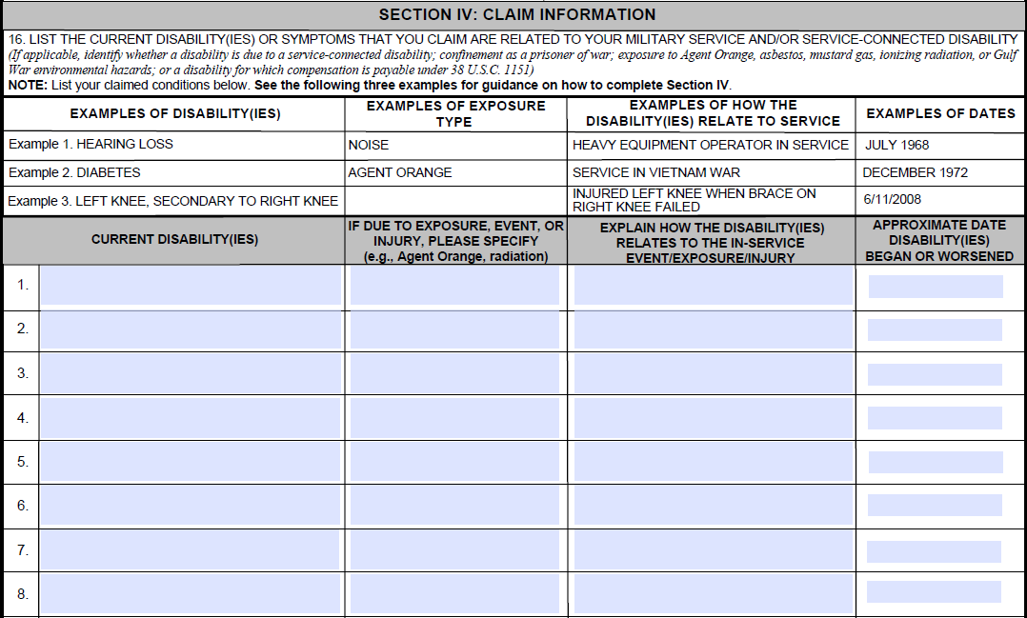
Current Version of VA Form 21-526EZ (March 2018) Provided

Slide 56
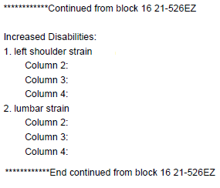
Information Display On VA Form 21-526EZ Overflow Page

Slide 57
Information Display On VA Form 21-526EZ Overflow Page (Cont’d)
PMR Vendor

Slide 58
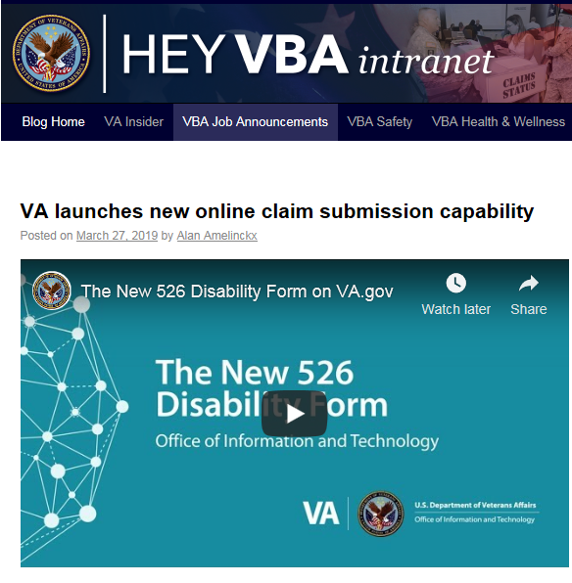
Additional Resources
Hey VBA and VA Insider
OFO Communications
DUSB Calls
District and RO Email Notices
Public Affairs Officer (PAO) Call
Compensation Service Bulletin and Quality Calls

Slide 59
December/January Consistency Study Results
Bryan Yost
Consultant
Program Review Staff
Quality Assurance

Slide 60
December 2018 VSR/AQRS Consistency Study
Topic: Usage of the Exam Management System (EMS) regarding clarification, modification, and rework of examination requests
Format: Pre-Test, Training, Post-Test
Time: December 11th to December 13th, 2018
Learning objectives:
Identify the steps required to respond to a request for clarification, complete a modification request, and complete a rework request
Differentiate and define types of modification, clarification, and rework requests

Slide 61
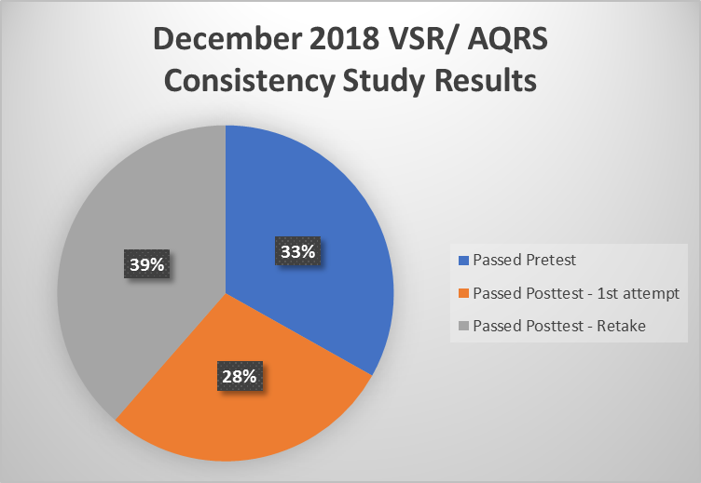
Dec 2018 VSR/AQRS Consistency Study Results
Deployment Dates:
12/11 – 12/13/2018
Pass Rates:
Passed Pretest – (33.15%)
1406 of 4241
Passed Posttest – (28.25%)
First Attempt following Training
1198 of 4241
Passed Posttest – (38.60%)
Retake (Two or More Attempts
following Training)
1637 of 4241

Slide 62
January 2019 VSR/AQRS Consistency Study
Topic: Claim Development Actions
Format: Case Study
Time: January 8th to January 10th, 2019
Learning objectives:
Demonstrate competence regarding proper case processing and review procedures
Demonstrate competence regarding the sufficiency of medical opinions and procedures for ordering examinations and medical opinions

Slide 63
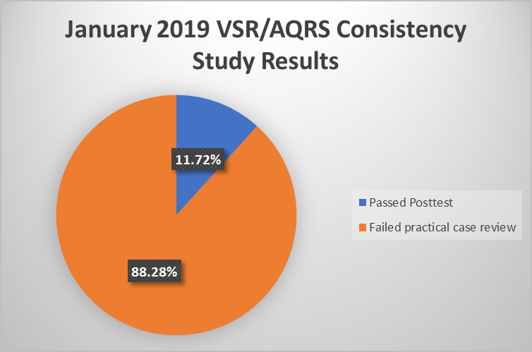
Jan 2019 VSR/AQRS Consistency Study Results
Deployment Dates:
01/08 – 01/10/2019
Pass Rate:
Passed Posttest – (11.72%)
Single Attempt
526 of 4487

Slide 64
December 2018 Rating Consistency Study
Topic: Initiating Deferrals, Part I
Format: Pre-Test, Training, Post-Test
Time: December 18th to December 20th, 2018
Learning objectives:
Determine claim progression
Identify deferral components, claim lifecycle phase, and claim status
Identify differences between avoidable and unavoidable deferrals
Identify actions that resolve deferrals

Slide 65
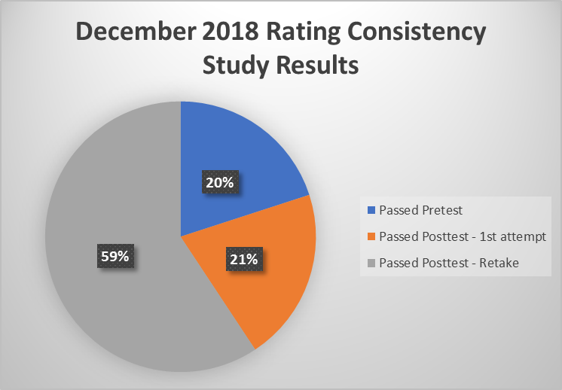
Dec 2018 Rating Consistency Study Results
Deployment Dates:
12/18 – 12/20/18
Pass Rates:
Passed Pre-test – (20.0%)
568 of 2840
Passed Post-test – (20.7%)
First Attempt following Training
588 of 2840
Passed Post-test – (59.3%)
Retake (Two or More Attempts
following Training)
1684 of 2840

Slide 66
January 2019 Rating Consistency Study
Topic: Initiating Deferrals, Part II
Format: Pre-Test, Training, Post-Test
Time: January 22nd to January 24th, 2019
Learning objectives:
Identify actions that resolve deferrals
Identify and apply appropriate primary and secondary deferral reasons

Slide 67
Jan 2019 Rating Consistency Study Results
Deployment Dates:
01/22 - 01/24/2019
Pass Rates:
Passed Pretest – (68.84%)
2028 of 2946
Passed Posttest – (15.17%)
First Attempt following Training
447 of 2946
Passed Posttest – (15.98%)
Retake (Two or More Attempts
following Training)
471 of 2946

Slide 68
Recommendations
Consider conducting local training on the following topics:
Control and follow-up of exam requests in EMS
For EMS, including links to TMS courses, see the VBMS EMS Information page
Sufficiency of private medical opinions
For information on when to request medical opinions, refer to
M21-1 I.1.C.3.c
TMS # 4201874

Slide 69
Sharp-Compliant Mitchell Rationale – Examples & STAR Grace Period –
Robert Johnson
Senior Quality Review Specialist
Quality Review Team
Quality Assurance

Slide 70
Sufficiency – Mitchell Rationales
The rationale is usually sufficient when it is:
specific to the case,
based on the procurable evidence, and
does not rely solely on an aversion to opining on matters beyond direct observation
Any rationale for the inability to opine without speculating should be based on the specific facts of the case, rather than a generic, canned statement that could apply to multiple cases
Missing discussion of the specific facts of the case in the rationale with generic, canned statements should be a red flag for decision makers

Slide 71
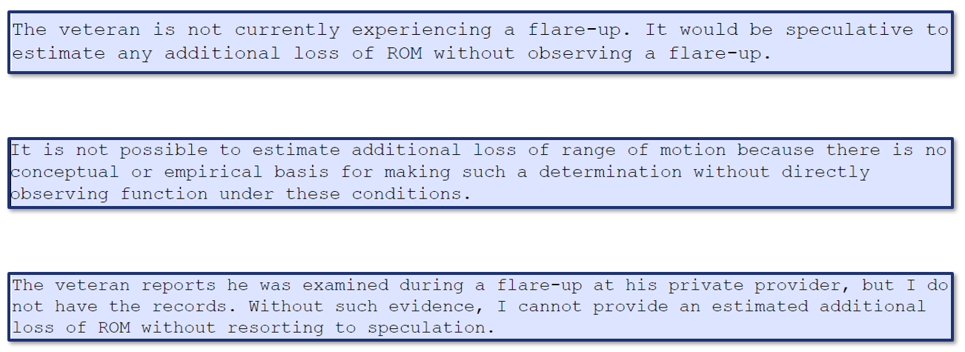
Examples – Insufficient Rationales

Slide 72
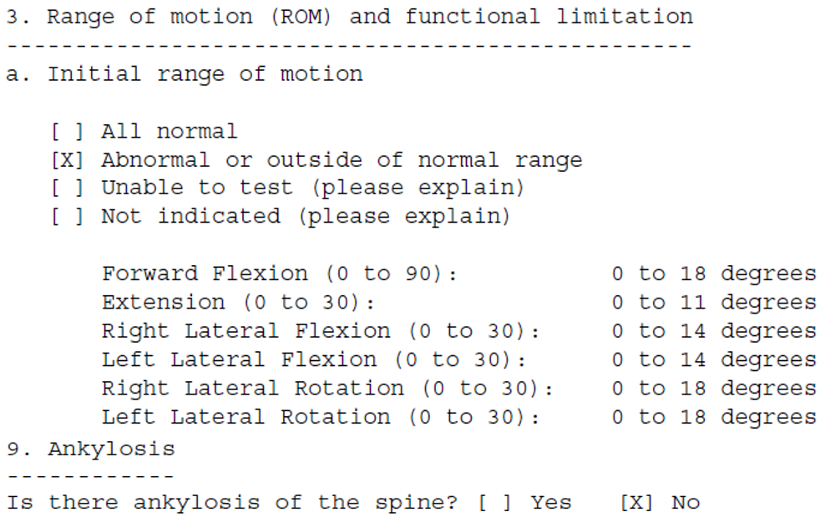
Example # 1 – Sufficient to Adjudicate
The insufficient rationale is moot

Slide 73
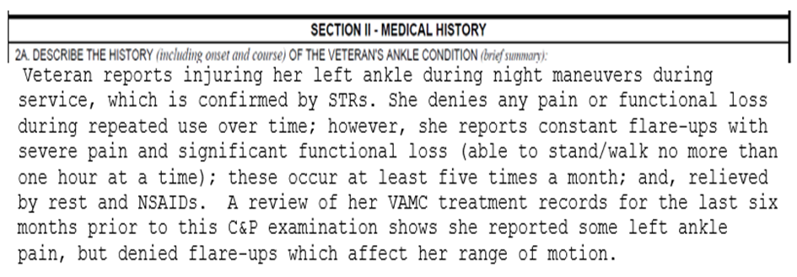
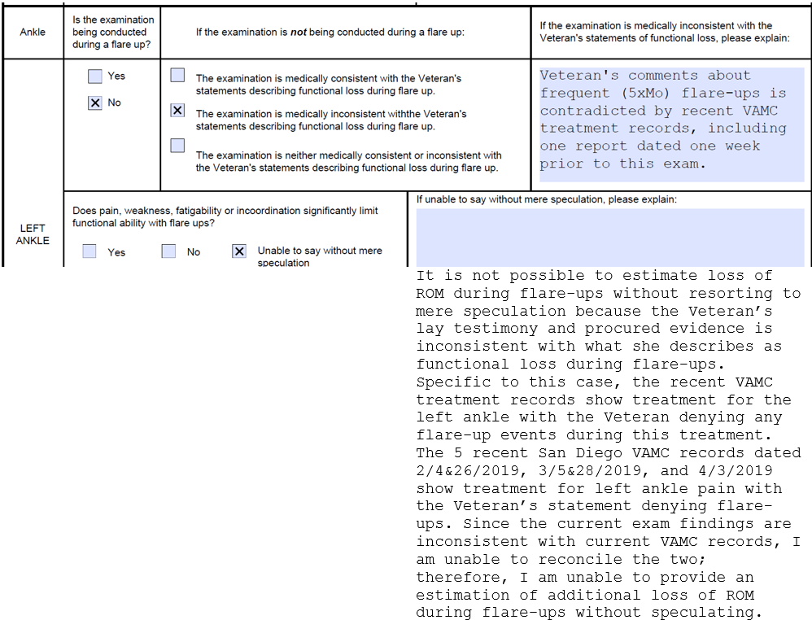
Example # 2 – Sufficient to Adjudicate
Examiner has personalized the case

Slide 74
Expiration – STAR Grace Period
On 03/13/2019, Quality Assurance initiated a 30-day grace period for STAR assessments on insufficient Mitchell rationales
Previous STAR errors cited have been corrected in QMS to show only corrective action comments
ROs need to take action, but comments will not count against station accuracy
STAR BE errors on insufficient Mitchell rationales will be cited with cleared EPs on and after 04/12/2019
Questions on the grace period can be sent to VAVBAWAS/CO/214B

Slide 75
Routine Future Examinations
Kelly Kennedy
Consultant
Program Review Staff
Quality Assurance

Slide 76
RFE Errors on National Quality Reviews
Two new subcategories were added under Question # 13 of the National Compensation Rating Quality Review Checklist on 10/1/18
To date, 18 errors have been cited in the new subcategories

Slide 77
Thirteen (13) H7 Errors Cited to Date
Veteran age 55, now or by time RFE control expires
4 errors
Overall combined evaluation would not change
3 errors
RFE not warranted as Veteran already rated permanent and total
2 errors
Improvement not likely based on evidence of record
2 errors
Evaluation of condition only 10%
1 error
Evaluation will be protected under 38 CFR 3.951(b) when RFE comes due
1 error

Slide 78
Five (5) H8 Errors Cited to Date
RFE scheduled at 3-year (or other unwarranted) interval when should have been 18, 24, or 30 months to review for sustained improvement
4 errors
Prior 5-year interval should have been changed to 3 years
1 error

Slide 79
RFE Reminders
References:
38 CFR 3.327(b)
38 CFR 3.344
M21-1 III.iv.3.B.2
Remember, it is the policy of VBA to request future examinations only when absolutely necessary, and every effort should be made to limit cases where future examinations are requested

Slide 80
RFE Reminders: Preventing H7 Errors
Do not establish a future examination control in cases when:
the disability is static, without material improvement over five years
the disability is permanent in character and of such nature that there is no likelihood of improvement
the Veteran is over 55 years of age (except under unusual circumstances or where required by regulation)
the evaluation is the prescribed schedular minimum within its DC
the evaluation is 10 percent or less, or
the combined evaluation would not change even if the reexamination resulted in a reduced evaluation for one or more disabilities
(38 CFR 3.327(b)(2) and M21-1 III.iv.3.B.2.d)

Slide 81
RFE Reminders: Preventing H8 Errors
When a routine future examination is warranted, pay attention to special circumstances that warrant a different timeframe than 3 years after the date of rating (M21-1 III.iv.3.B.2.c)
Reexaminations for sustained improvement under 38 CFR 3.344
Examination to evaluate residuals of service-connected malignancy
Reexamination for prestabilization rating under 38 CFR 4.28
Reexamination of mental disorder rated in accordance with 38 CFR 4.129
Mandatory examination/reexamination in connection with a specific diagnostic code as required by regulation
Change previously established 5 year RFE intervals to 3 year intervals, or request immediate examination as appropriate (M21-1 III.iv.3.B.2.i)

Slide 82
Medical Disability Examination Program Management Office Reminders
Angela Childers-Conner
Veterans Claims Examiner
Medical Disability Examination Program Review Staff

Slide 83
Final Notification Letters for VAMC Records
M21-1 Part III.Subpart iii.1.C.2

Slide 84
Concerns
We have received several reports from Veterans and VHA expressing concern regarding letters sent to Veterans from ROs stating that VA treatment records cannot be located
Instances in which VAMC treatment records after 2005 are not available in CAPRI will be rare, if ever, occurrences
ROs are urged to ensure employees are following the manual guidance on Final Notification Letters, and when a Final Notification Letter needs to be sent, and that good customer service practices are followed, including clear letter language and telephone contact with the Veteran, when possible

Slide 85
Results of Review
A review of several files with reported treatment dates after 2005 showed the following:
VAMC records that covered the reported treatment date ranges were already uploaded to the eFolder’s prior to or at the time the Final Notification Letters were generated
The letters being sent addressed such things as gaps in treatment dates that fall within a larger date range during which Veteran has reported treatment and mentioned entire date ranges of treatment not being available when in fact they were
These letters are very misleading and upsetting to Veterans, and are causing additional work and frustration, as well as safety concerns, for the Release of Information (ROI) offices at the VAMCs

Slide 86
Reminders
Claims processors are reminded that M21-1 III.iii.1.C contains information on requesting federal records, to include VA medical records
When relevant treatment is reported at a VA facility, ROs must attempt to obtain the records, unless the RO concludes that it is reasonably certain the records do not exist
As noted in M21-1 III.iii.1.C.2.i, a final notification letter would not need to be sent if gaps in treatment during a date range provided by the claimant are seen, nor if VBA has relevant reports of treatment approximately close to the starting date of treatment provided by the claimant

Slide 87
Example # 1
The Veteran submitted a claim electronically and reported treatment at a VAMC beginning on 01/01/2017. A review of CAPRI shows the Veteran registered for treatment on 01/12/2017 and was first seen at the VAMC for treatment on 01/18/2017. As the first treatment record is approximately close to the starting date of treatment provided by the claimant, it can reasonably be concluded that we have all records that were identified by the Veteran.
A Final Notice letter is not needed in this case for the records from January 1 to January 11, 2017.

Slide 88
Example # 2
The Veteran reported treatment at a VAMC from 01/01/2012 to 12/31/2018. A review of CAPRI shows that the Veteran received treatment from 12/2011 through to the present date, with some gaps in treatment that span from several weeks to several months.
A Final Notice letter is not needed in this case as this situation would not necessitate the documentation of unavailability or non-existence of treatment records.

Slide 89
Example # 3
A claim is received 11/29/2018. The Veteran reported treatment from 01/01/2017 to 11/19/2018. The VSR uploads CAPRI records from 2009 to 2018. No records are shown in CAPRI from 01/01/2017 to 01/21/2017 and 11/18/2018 to 12/04/2018.
A Final Notification Letter for records from 01/01/2017 to 01/21/2017 and 11/18/2018 to 12/04/2018 is not needed, as the records show there is a gap in treatment dates; the records are not missing.

Slide 90
Example # 4
A claim is received 02/10/2018. The Veteran reported treatment from 01/2016 to 11/2018. CAPRI shows the Veteran enrolled in the VA Healthcare System on 02/02/2016. The earliest treatment in CAPRI is dated 05/05/2016.
A Final Notification Letter is not required for records from 01/01/2016 to 05/04/2016. It can be assumed that there are no records from 01/01/2016 to 02/02/2016, as this is prior to enrollment in the VA Healthcare System. It can also be reasonably concluded that there are no records between the Veteran’s enrollment date of 02/02/2016, and the date the treatment reports begin on 05/05/2016, as treatment records do not exist in CAPRI.

Slide 91
ERB-S
M21-1 Part III.Subpart iv.3.A.10

Slide 92
ERB-S to EMS Language Integration
Exam Request Builder - Supplemental (ERB-S) is a tool for claims processors to use while the Exam Management System is being updated with current language based on changes in the claims adjudication process
M21-1 III.iv.3.A.10 provides guidance for claims processors regarding ordering contract exams in VBMS, and how and when to use ERB-S

Slide 93
Usage Matrix
Recent manual guidance only addressed FSAD and MST medical opinions; current guidance now utilizes a Usage Matrix to address the following issues:
Veterans in receipt of the Purple Heart medal
Musculoskeletal claims involving joints (Sharp v Shulkin)
Peripheral nerves
Medical opinion based on non-MST personal trauma
Female veterans claiming DM, MS, PD, ALS, or any CNS/Neuromuscular Disease

Slide 94
Important FSAD Reminder
Please be aware that exams for female Veterans claiming diabetes mellitus, Parkinson’s disease, Amyotrophic Lateral Sclerosis (ALS), any Central Nervous System or Neuromuscular Disease, or Multiple Sclerosis (MS) must include the language from the ERB-S button for FSAD
See M21-1, Part III, Subpart iv, Chapter 4, Section J. 1 – Female Sexual Arousal Disorder (FSAD)

Slide 95
Poll Questions
Presented by:
Robert Johnson

Slide 96
Interactive Poll Question Guidance
Four (4) Poll Questions will be shown on the following slides
Interactive Poll Screen will be displayed after each question slide
Using your mouse , please select your response
Please do NOT type your answer into the Chat Box
Note: If you are in a group setting using only one computer, poll the group and have somebody use the mouse at the computer to select the group’s response
Poll results will be discussed after everybody has responded

Slide 97
Poll Question # 1 – Use Mouse to Select Answer
Original compensation, pension, and DIC claims are prioritized for service members who have earned the Purple Heart medal.
QUESTION: Are Character of Discharge (COD) determinations prioritized for service members who earned the Purple Heart medal?
Yes
No

Slide 98
Poll Question Answer # 1
No
Only original compensation, pension, and DIC claims are prioritized for service members who have earned a Purple Heart medal. Character of Discharge (DOC) determinations will not be prioritized.
M21-1 III.ii.1.D.7.c

Slide 99
Poll Question # 2 – Use Mouse to Select Answer
“It is not possible to determine, without resorting to mere speculation, to estimate loss of range of motion of the knee joint as there is no conceptual empirical basis for making such a determination without directly observing function under these conditions and directly measuring the ROM with a goniometer. Additionally, my review of the Veteran’s VAMC medical reports, including the CAPRI reports dated 2/14/19, 2/27/19, 3/4/19, and 4/2/19 showing treatment for knee pain during repeated use over time and flare-up events show there was no knee joint loss of motion during these occasions; only pain. During today’s examination, the Veteran did not complain of any functional loss, other than pain, during repeated use over time and flare-ups.”
QUESTION: Is this Mitchell rationale Sharp-compliant?
Yes
No

Slide 100
Poll Question Answer # 2
Yes
Although the examiner used a generic statement, the examiner also discussed specific facts of the case by noting a review of VAMC records by date. Even though part of the rationale is based on an aversion to opining on matters beyond direct observation, the examiner discussed the procurable VAMC evidence and the Veteran’s testimony; in other words, the examiner personalized to the Veteran’s specific case facts.
M21-1 III.iv.3.D.2.r

Slide 101
Poll Question # 3 – Use Mouse to Select Answer
Veteran, age 52, is SC for PTSD @ 70% for 8 years and HEARING LOSS @ 10% for 9 years with an overall, combined evaluation of 70%. Claim for increase for hearing loss received, and current VAE shows 0% is warranted. You are adjudicating the claim today.
QUESTION: Should you schedule a future Audio examination to monitor for anticipated improvement in hearing loss?
Yes
No

Slide 102
Poll Question Answer # 3
No
Do not establish a future examination control in cases when the evaluation is 10% or less, or when the combined evaluation would not change even if the reexamination resulted in a reduced evaluation for one or more disabilities. In addition, the Veteran will have reached age 55 by the time the reexamination is conducted.
M21-1 III.iv.3.B.2.d & e

Slide 103
Poll Question # 4 – Use Mouse to Select Answer
Shirley Mae, a female GW Veteran, has submitted a claim for service connection for DIABETES MELLITUS. STRs show normal upon entrance into service, and a diagnosis of DM during active duty. Shirley submits evidence showing a current diagnosis along with a statement of suffering with DM from service until now.
QUESTION: When requesting a Diabetes Mellitus DBQ for female Veterans, do you need to add any language to address the presence of Female Sexual Arousal Disorder (FSAD)?
Yes
No

Slide 104
Poll Question Answer # 4
Yes
Since some DBQs have not yet been updated, when requesting a Diabetes Mellitus DBQ, you need to add the following language: “Does the Veteran have female sexual arousal disorder (FSAD) that is at least as likely as not attributable to diabetes mellitus? If yes, please complete the Gynecological Conditions DBQ.”
This guidance currently applies to Diabetes Mellitus, Parkinson’s Disease, ALS, Central Nervous System and Neuromuscular Diseases, and MS DBQs
M21-1 III.iv.4.J.1.b

Slide 105
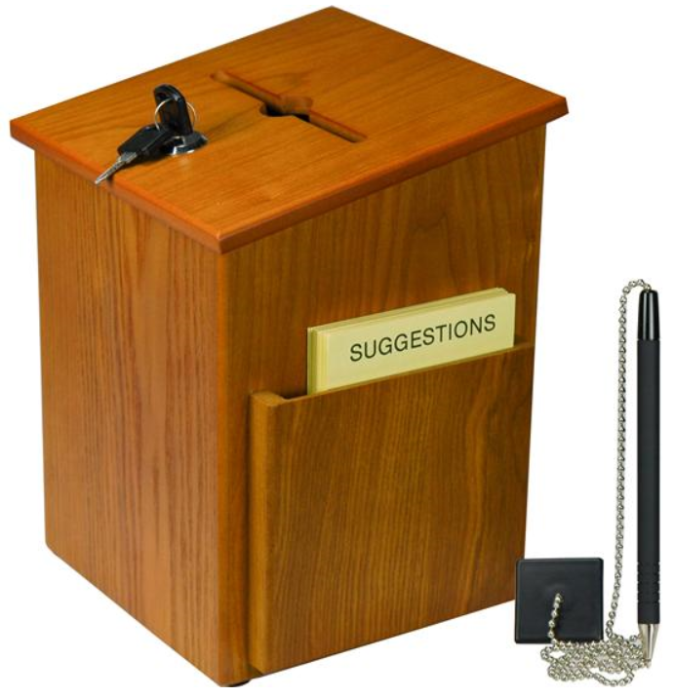
Questions – Suggestions – Next Quality Call
Presented by:
Robert Johnson

Slide 106
Questions Relating to Today’s QC Topics
Questions on topics presented must be emailed to the Compensation Service Quality Review Team at InternalQRS.VBAVACO@va.gov
Emails must include Cc to your Coach or other RO management
Emails must contain the name of the topic(s) with your question(s)
Questions must be submitted to the mailbox by COB Friday, April 12th
Questions submitted after COB Friday will not be accepted for inclusion in the Call Bulletin
Email questions are limited to those pertaining to only the topics presented, and responses will not be provided to any questions that are not related to the topics presented during today’s Quality Call
Official guidance to the questions will be posted later in the Call Bulletin

Slide 107
Do You Have Suggestions for Topics?
Please feel free to email your topic suggestions to the Compensation Service Quality Review Team at InternalQRS.VBAVACO@va.gov
In your email, be sure to include:
Cc to your Coach or other RO management
Name of the topic
Intended audience (VSR – SVSR – RVSR – DRO – AQRS – RQRS)
Applicable M21-1 and/or 38 CFR citations
Quality Call Bulletins can be found in the STAR Home Page on the Compensation Service Intranet site, TMS, and VBA Learning Catalog
Audio recordings of the Quality Calls with separate copies of the PowerPoint slides can be found in both TMS and VBA Learning Catalog

Slide 108
Next Quality Call
A Compensation Service Quality Call is usually presented each month
Next Quality Call will be conducted on May 15, 2019

