Slide 1
Review of Service Treatment Records (STRs) for Integrated Disability Evaluation System (IDES)
Compensation Service
March 2019
Notes:
Welcome to Introduction to Reviewing Service Treatment Records (STRs) course. To advance each slide, click anywhere on the screen.

Slide 2
Lesson Objectives
Define STRs
Explain the organization of STRs
Know how to locate x-rays, medical history forms, and other parts of STRs
Identify the entrance and separation physical examinations and tab/annotate them for future reference
Understand the Subjective Objective Assessment Plan (SOAP) format
Identify methods for the IDES review of STRs
Notes:
Lesson Objectives
Upon completion of this lesson, you will be able to:
Define STRs
Explain the organization of STRs
Know how to locate x-rays, medical history forms, and other parts of STRs
Identify the entrance and separation physical examinations and tab/annotate them for future reference
Review STRs efficiently to establish that the claimed condition/symptoms did/did not occur during service
Understand the Subjective Objective Assessment Plan (SOAP) format

Slide 3
References
M21-1 Part III, Subpart iii, 2.A, General Information on Service Records
M21-1, Part III, Subpart iii, Chapter.2.B, Migration of Service Records and the Procedures for Obtaining Them
M21-1 Part IV, Subpart ii, Chapter 2.A, Deciding Claims for Disability Compensation
M21-1, Part III, Subpart i, Chapter 2, Section D - Overview the Integrated Disability Evaluation System (IDES) and Initial Claims Development
M21-1, Part III, Subpart i, Chapter 2, Section E - Department of Veterans Affairs (VA) Responsibilities Based on Medical Evaluation Board (MEB) and Physical Evaluation Board (PEB) Outcomes
M21-1, Part III, Subpart i, Chapter 2, Section F - Special Situations Related to the Integrated Disability Evaluation System (IDES
Notes:
References
The references for this course are listed on the screen.

Slide 4
Definition
STRs are the chronological records (electronic or paper) documenting the medical and/or dental care and treatment received primarily outside of a hospital (i.e. – outpatient) during service for each service member. For many years, they were referred to as Service Medical Records (SMRs).
Notes:
Definition
STRs are the in-service health records that service departments collect for each service member. For many years, they were referred to as Service Medical Records (SMRs).

Slide 5
Obtaining STRs
STRs will be uploaded into VBMS from or can be requested from:
Records Management Center (RMC)
Automatically when claim folder is established in VBMS
National Personnel Records Center (NPRC)
via Personnel Information Exchange System (PIES) O50 request
Healthcare Artifact and Image Management Solution (HAIMS)
Automatically when a Veteran whose service ended on or after January 1, 2014, files a claim for VA benefits, and
the RO that received the claim begins processing it in VBMS.
Joint Legacy Viewer (JLV)
M21-1, Part III, Subpart iii, Chapter 2, Section B - Migration of Service Records and the Procedures for Obtaining Them
Notes:
Obtaining STRs
STRs will be uploaded into VBMS from:
National Personnel Records Center (NPRC) via Personnel Information Exchange System (PIES)
Records Management Center (RMC)
Healthcare Artifact and Image Management Solution (HAIMS)

Slide 6
General Information Found in STRs
Physical examination reports, including reports from entrance and discharge physical examinations, if performed
Service member’s medical history and dental records
Clinical record cover sheets and summaries
Physical profiles and Medical board proceedings
Notes:
General Information Found in STRs
Physical examination reports, including reports from entrance and discharge physical examinations, if performed
Service member’s medical history and dental records
Clinical record cover sheets and summaries
Physical profiles and Medical board proceedings
On January 1, 2013 individual service departments included a letter of certification of completeness of a member’s STRs
Note:
See handout for complete list

Slide 7
General Information Not Found in STRs
Inpatient treatment records (clinical records)
Finance records
Mental health records, or
The Military Personnel Record Jacket (MPRJ), which may contain physical profiles and medical board proceedings
Notes:
General Information Not Found in STRs
Inpatient treatment records (clinical records)
Finance records
Mental health records, or
The Military Personnel Record Jacket (MPRJ), which may contain physical profiles and medical board proceedings

Slide 8
General Information Not Found in STRs (cont.)
If a Service member obtains treatment at an "off-base" civilian facility on their own, medical or mental health records created during the course of treatment are not automatically associated with the STRs.
These records are never forwarded for long-term storage to the NPRC, they are destroyed after a period of inactivity (five years for mental health records).
Notes:
General Information Not Found in STRs (continued)
If a Service member obtains treatment at an "off-base" civilian facility on their own, medical or mental health records created during the course of treatment are not automatically associated with the STRs.
These records are never forwarded for long-term storage to the NPRC, they are destroyed after a period of inactivity (five years for mental health records).

Slide 9
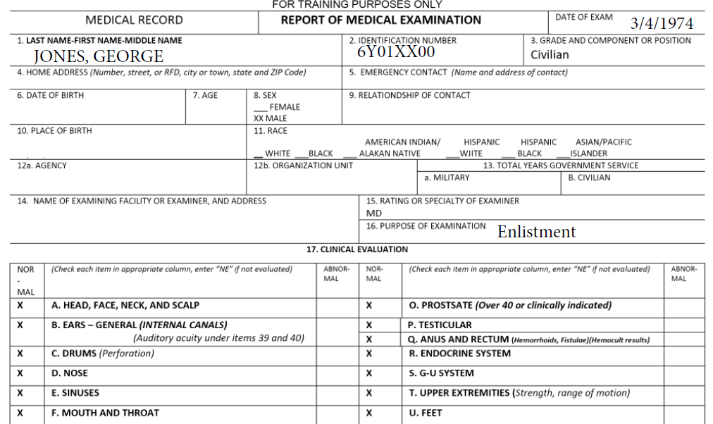
Enlistment Exam
Notes:
Enlistment Exam

Slide 10
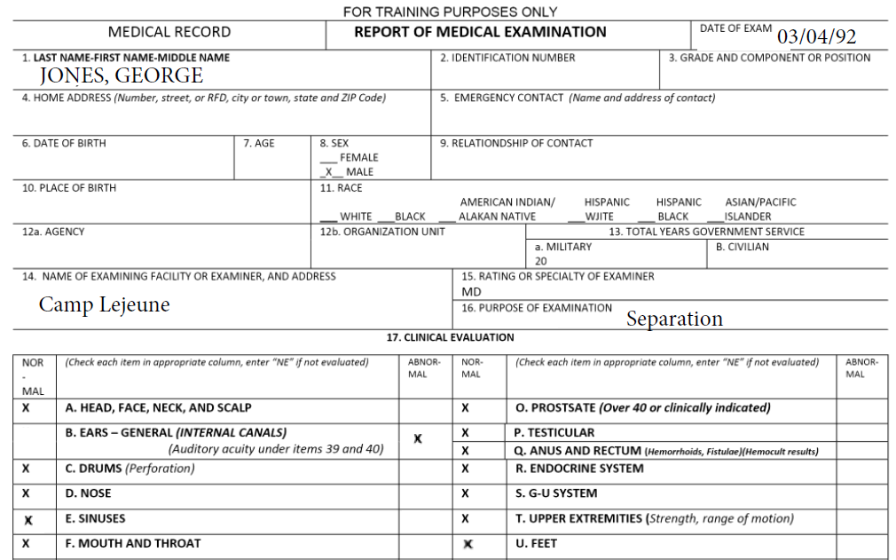
Separation Exam
Notes:
Separation Exam

Slide 11
SOAP
Subjective, Objective, Assessment, Plan (SOAP)
The SOAP format is used by many medical professionals, not just military medical professionals
Many treatment records will use different abbreviations, or possibly none at all, to signify each section
Notes:
SOAP
Subjective, Objective, Assessment, Plan (SOAP)
The SOAP format is used by many medical professionals, not just military medical professionals.
Many treatment records will use different abbreviations, or possibly none at all, to signify each section

Slide 12
Examples of SOAP
Notes:
Examples of SOAP

Slide 13
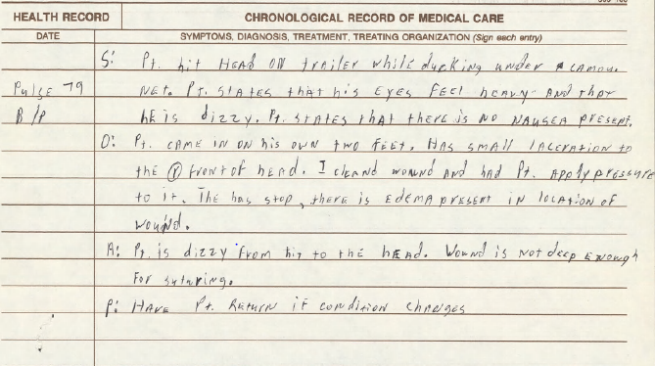
Examples of SOAP

Slide 14
Examples of SOAP

Slide 15
STR Review for IDES
An MSC must be able to review STRs effectively to find and explain information to the Servicemember:
Limit review as much as possible
Locate and tab or bookmark the entrance and separation physical exams in the STRs
Tab/bookmark where a potential claimed condition is located if it is not mentioned on the separation physical exam
Write down a list of the potentially claimed conditions to use during the initial interview for a reference

Slide 16
Initial Interview Preparation
Prior to the initial interview, the MSC should review the STRs and identify potential service-connected disabilities that:
May not potentially unfitting, and are
Chronic disabilities or symptoms, and
In need of ongoing treatment

Slide 17
Initial Interview
During the initial interview the:
Service member identifies issues
MSC provides suggestions for claiming additional disabilities
Claims are ultimately the Service Member’s decision

Slide 18
Tabbing Records in Paper Claims Folders
It is helpful to tab Entrance and Separation Physical Exams for future reference.
Note: All tabs must be removed prior to sending the information to the scanning contractor.

Slide 19
Bookmarking STRs in VBMS
Regional Offices must follow the standardized steps in the table found in M21-1 III.iv.3.A.15.e to bookmark documents in the claims folder for the examiner’s review.
Important: While there are multiple bookmark types available in VBMS, when bookmarking evidence for an examiner’s review, ROs must use the medical bookmark.

Slide 20
Practical exercise Topic 1 & 2

Slide 21
Questions

