Slide 1
Rating Decisions for the Integrated Disability Evaluation Systems (IDES)
Compensation
Service
November
2020

Slide 2
Motivation
The Military Service Coordinator (MSC) is responsible for explaining the proposed and final rating decision(s) to the Veteran or Service member enrolled in the IDES system.
The MSC’s comprehensive understanding of the elements of a rating decision allows the MSC to effectively explain the proposed and final rating decision(s) to Veterans or Service members enrolled in the IDES system.
Notes:
Instructor remind audience, the MSC is not responsible for verifying the accuracy of a proposed rating decision.

Slide 3
Lesson Objectives
Recognize evidence a Rating Veteran Service Representative (RVSR) needs to consider in the rating decision
Explain which Veterans Administration System is used to create a rating
Identify the components of a proposed and final rating decision
Explain the difference between the IDES proposed rating vs the final rating
Describe the Benefit Estimate Letter (BEL)

Slide 4
References
38 C.F.R 3.306 Aggravation of preservice disability
38 C.F.R 3.350 - Special monthly compensation ratings.
38 C.F.R Part 4 - Schedule for rating disabilities
M21-1, Part III,i,2,D - Overview of the Integrated Disability Evaluation System (IDES) and Initial Claims Development
M21-1, Part III,i,2,F - Special Situations Related to the Integrated Disability Evaluation System (IDES)
M21-1, Part III.i,2,C - Ancillary Benefits and Other Issues Involving Pre-Discharge Claims
M21-1, Part III,i,2,E - Department of Veterans Affairs (VA) Responsibilities Based on Medical Evaluation Board (MEB) and Physical Evaluation Board (PEB) Outcomes
M21-1, Part III, i,2,E.3 Proposed Ratings
M21-1 Part III. iv - General Rating Process

Slide 5

Topic 1: Rating Decision Preparation

Slide 6
Topic 1: Objectives
Recognize information the RVSR considers in preparing a rating.
Identify what Veteran Benefits Administration's (VBA’s) system the RVSR uses to create a rating.

Slide 7
Rating Decision Preparation
The Rating Veterans Service Representative (RVSR) must consider the following when preparing the rating decision.
  Provisions of all pertinent laws and regulations
  1945 Schedule for Rating Disabilities
  Policy statements
  Procedures
  Administrators and Secretaries decisions
  Court of Appeals for Veterans Claims (CAVC) precedent opinions
  Other legal precedents governing the Department of Veterans Affairs (VA)

Slide 8
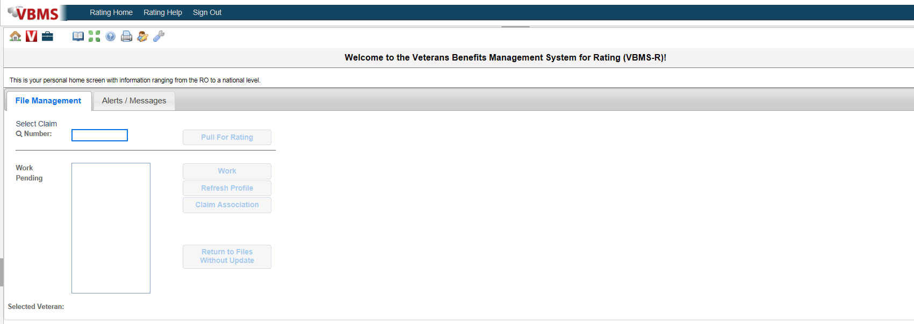
Rating Decision Preparation (Cont.)
A Rating Veterans Service Representative (RVSR) assigned to the Disability Rating Activity Site (DRAS) considers all the evidence and laws to produce the IDES rating in the Veteran Benefits Management System-Rating (VBMS-R).

Slide 9

Knowledge Check

Slide 10
Questions
1. Who at the DRAS prepares the rating decision?
A. The IDES VSR
C. The RVSR
D. Not prepared at the DRAS
RVSR’s need to consider laws, rules and VA guidance in
their rating decisions. Name something a RVSR may need to
consider in their rating decision.
    Provisions of all pertinent laws and regulations
    1945 Schedule for Rating Disabilities
    Policy statements
    Procedures
    Administrators and Secretaries decisions
    Court of Appeals for Veterans Claims (CAVC) precedent opinions
    Other legal precedents governing the Department of Veterans Affairs (VA)
The RVSR uses what VBA system to create the IDES rating.
  VBMS-R

Slide 11

Topic 2: Components Of A Rating Decision

Slide 12
Topic 2: Objectives
Identify the components of a rating decision.
Explain the difference between a proposed rating and the final rating.
Recognize and explain the difference between a short form and long form

Slide 13
Components of a Rating Decision
A rating decision consists of two sections, the:
  Rating Narrative
  Code Sheet
There are two types of IDES rating decisions:
  Proposed ratings
  Final ratings

Slide 14
Rating Narrative
The first major part of a rating decision is the Rating Narrative, the Rating Narrative is composed of a narrative explanation of the determination on benefit entitlement which includes the following subparts:
  Introduction
  Decision
  Evidence
  Reasons for Decision
  References

Slide 15
Proposed Rating Decision Introduction
On a proposed rating decision, the Introduction Section:
  Includes the Servicemember’s name and branch of service
  Informs the Servicemember that the rating decision is produced in order to help DoD determine a final disposition for unfit conditions
  Instructs the Servicemember that the proposed rating decision determines potential entitlement to VA disability compensation
  Explains to the Servicemember that the rating decision would be null and void for VA benefits purposes if they are later shown to lack the requisite character of discharge, and
  Notes that if the Servicemember is found fit for duty, the rating decision would be null and void for VA benefits entitlement

Slide 16
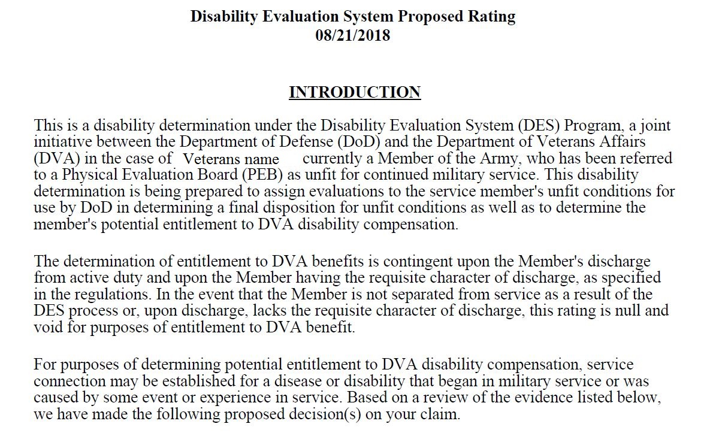
Proposed Introduction Example

Slide 17
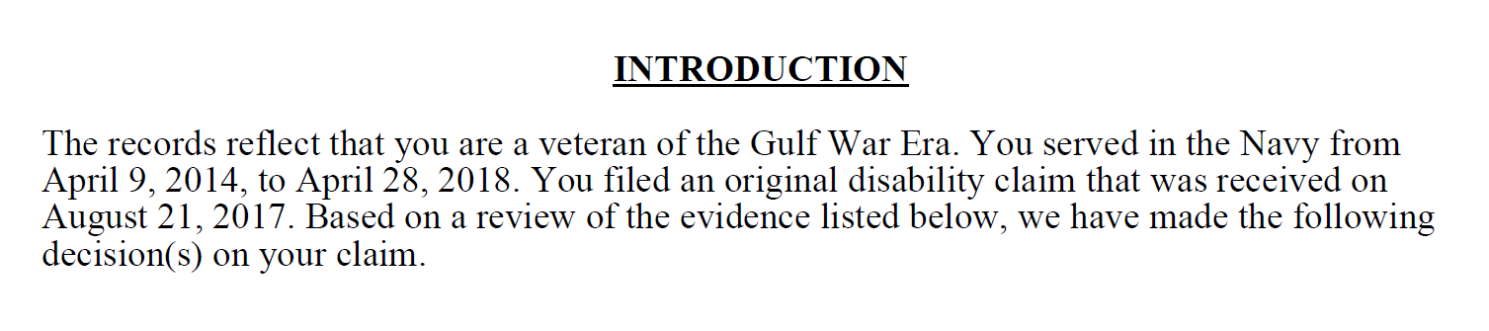
Final Rating Decision Introduction
On a final rating decision, the Introduction section identifies:
  The claimant
  Veteran’s qualifying periods of service
  Any special considerations such as Former Prisoner of War(POW) status
  Date the claim was received
  Type of claim received

Slide 18
Decision
The Decision section lists the specific outcome for each issue addressed, such as the award or denial of:
service connection (SC), conditions referred, claimed or found on exam
an increased evaluation, or
an ancillary benefit, such as special monthly compensation (SMC).
Decision will be listed in a logical manner, ensuring to accomplish the following:
Address all issues.
Awards before denials.
Awarded evaluations in descending order of evaluation.
Group together similar decisions, such as awards and denials, and
Related conditions, such as injuries from a single accident.

Slide 19
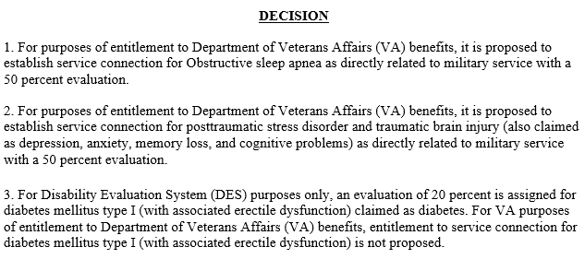
Decision Example
Note: DRAS is required to propose an evaluation for all unfitting (PEB-referred) conditions even if VA will not be granting service connection of the condition for disability compensation purposes.

Slide 20
Overview of the Evidence Section
The Evidence section is a listing of all evidence considered in arriving at the decision, which may include but is not limited to
  Service treatment records (STRs)
  Service personnel records
  Private and VA treatment records
  VA or contract examination reports, to include Disability Benefits Questionnaires (DBQs)
  Lay statements, and/or
  Written or oral testimony, to include court related transcripts.

Slide 21
Evidence Section
If the evidence section identifies ... | Then it will list the evidence type and ...
service records, such as STRs or personnel records | the date of receipt [MM-DD-YYYY], and the period of service associated with the records [MM-YYYY to MM-YYYY]. Example: STRs received on June 20, 2017, for the period October 2006 to November 2010.
VA treatment records | the name of the facility, and dates covered by the records [MM-DD-YYYY to MM-DD-YYYY].
private medical records | the name of the facility or physician date of receipt, and dates covered by the records [MM-YYYY to MM-YYYY]. Example: Medical records, Dr. Jones, received February 1, 2017, for the period May 2012 to Feb 2016.

Slide 22
Evidence Section
If the Evidence section identifies ... | Then it will list the evidence type and ...
VA or contract examination(s) | identify the examining facility/contractor, and date the exam was conducted.
other government, including Federal and State records | the name of the source (agency, facility, etc.), and date of receipt. Example: Social Security Administration records received on March 8, 2017.
lay statement(s) | the source of the statement, and date of receipt.
forms | the full name of the form, and date of receipt.
evidence requested, but not received | in the following format: Private medical records requested from [provider’s or facility’s name], but not received.

Slide 23
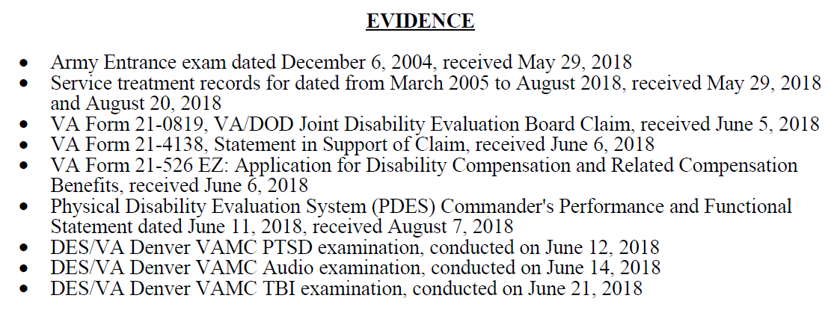
Evidence Section
If the Evidence section identifies ... | Then it will list the evidence type and ...
evidence considered in a prior VA decision | by separately stating each piece of evidence considered, including the prior decision.
any medical evidence that is confidential under 38 U.S.C 7332 (certain medical records relating to human immunodeficiency virus (HIV) infection, substance abuse, or sickle cell anemia) | by specifying only the relevant date and name of the medical facility.
non-relevant records not requested | follow the documentation requirements specified in M21-1, Part I, 1.C.4.f.

Slide 24
Narrative
There are two distinct types of narratives created in a rating decision:
Short Form
  A short form rating narrative does not have to contain the entire explanation of the analysis or specifically cite each piece of the evidence; it is characterized by standard automated language and limited free text. However, each element of the decision should be adequately explained.
Long Form
  A long form rating narrative must be used in decisions involving specific claims. to thoroughly and adequately discuss the reason a decision was made. A few examples are, legacy appeals, higher-level reviews (HLR), and Nehmer claims. For the complete list see M21-1 III.iv.6.C.7.a
Notes:
Instructor: let the audience know in the following slides they will see examples of a short form

Slide 25
Reasons for Decision - Grant
If ... | Then the Reasons for Decision must address ...
awarding the claim | benefit being awarded and legal basis for the award (for example, secondary SC) assigned evaluation, if applicable effective date basis for the current evaluation, if applicable requirements for the next higher evaluation, if applicable routine future examination notice, if applicable, and reason for the effective date. Applicable regulations
Exception: An effective date explanation is not required when the assigned effective date is the date of the claim's receipt, or the day following discharge from active-duty service.

Slide 26
Example: Short Form Award
Notes:
Instructor: You may want to open and share the long form example job aid. This would be a good time to review the long form example discuss and compare the detail for the long form versus the short form.

Slide 27

Reasons for Decision
Confirm and Continue (C&C) rating
If ... | Then the reasons for decision must address ...
confirming and continuing an existing evaluation | basis for the current evaluation requirements for the next higher evaluation absence of evidence demonstrating sustained improvement, if applicable, and potential for routine future examination, if applicable.
Note: C&C decisions may be appropriate for Reserve or National Guard members.

Slide 28
Reasons for Decision
Rating Denial
If ... | Then the Reasons for Decision will address ...
denying the claim | theory of SC being addressed in the decision (for example, direct SC), if applicable all of the claimant’s contentions benefit denied, and reason for denial. Favorable Findings identified in the issue/decision Laws and Regulations applicable to this issue
Note: If there are multiple bases of SC being considered and/or multiple denial reasons, the relevant text will be added to the rating Narrative.
Example: A Veteran alleges hypertension due to burn pit exposure. The denial must address SC on a direct basis, as well as the contention that the disability was due to burn pit exposure.

Slide 29
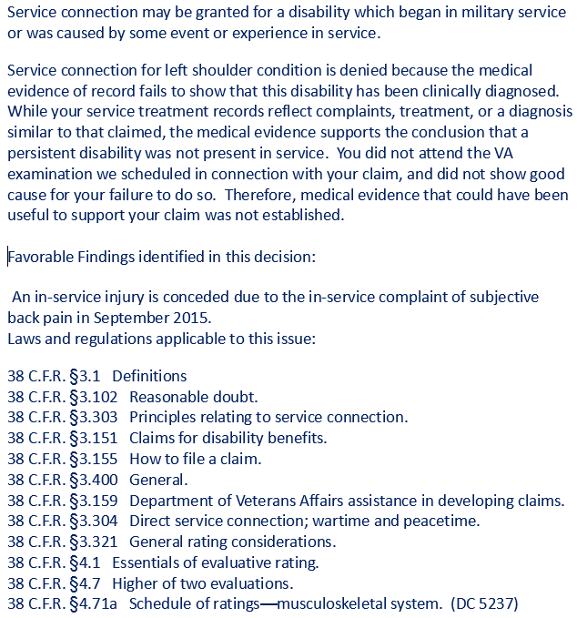
Example: Traditional Short Form Denial

Slide 30
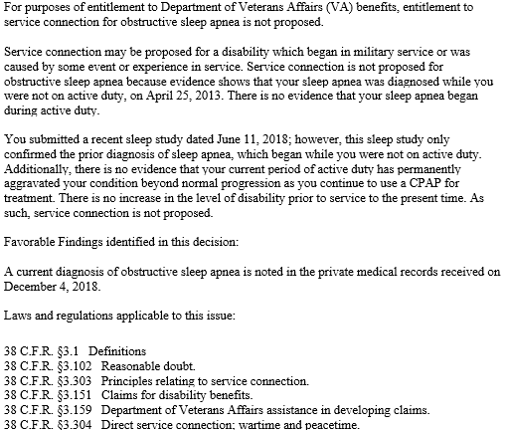
Example: IDES Long Form Denial
Note: Long form narratives are required for adverse action in IDES ratings.

Slide 31
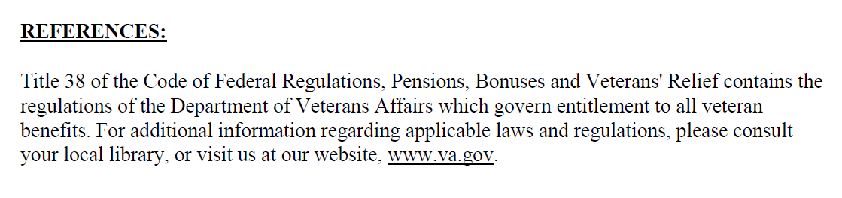
References
The References section is automatically generated by VBMS-R to note which laws and regulations govern entitlement to veteran benefits.

Slide 32
Knowledge Check

Slide 33
Questions
1. What are the two (2) sections of a rating decision?
Rating Narrative and Code Sheet
2. Detail the parts of a Rating Narrative.
Introduction, Decision, Evidence, Reasons for Decision & Evidence.
What are the two distinct forms of Narratives?
  Short form and Long form
What type of IDES rating decisions would a DRAS RVSR prepare?
  Proposed and Final Ratings
Notes:
Instructor notes: The questions and answers will reveal as you click through.

Slide 34

Topic 3: The Code Sheet

Slide 35
Topic 3: Objectives
Define the sections of a rating codes sheet.
Describe the lay out of the Data Table.
Identify the difference(s) between an IDES proposed code sheet and the final rating code sheet.

Slide 36
Rating Code Sheet
The second component of the rating decision is the code sheet, which is broken down into the following subparts:
Data Table
Jurisdiction
Associated Claim(s)
Coded Conclusions
Special Notations and Template Fields
Signature(s)

Slide 37
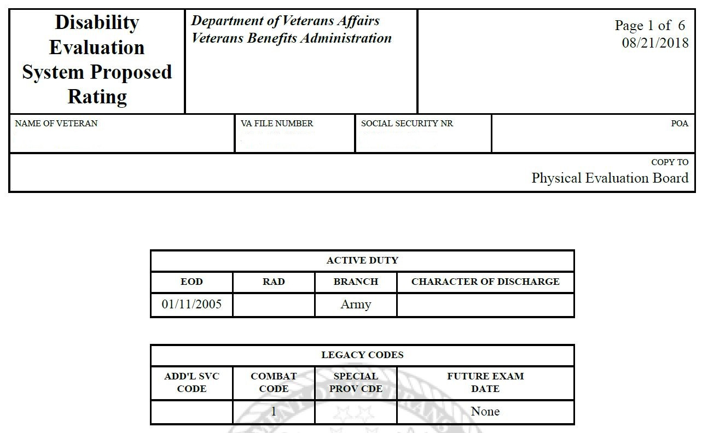
Data Table
The Data Table includes:
Personal Identifying Information such as name, Social Security Number, Period of Service (POS), POA, file number, and date of rating
Any future exam date(s)
SMC Code(s)
Combat Status Code
Additional service code
Note: On IDES proposed ratings for Service members who are still serving on active duty, there should be an Entered on Active Duty (EOD) date listed without a Release from Active Duty (RAD) date in the data table. Future exam date coding shows up as “None” on all proposed rating code sheets, even in cases where a future exam would be necessary. The actual future exam indicators only show up on final rating decisions.

Slide 38
Jurisdiction
The Jurisdiction of the Code sheet,
        appears below the heading section
        explains why the case is before the rating activity
        refers to the claim at issue, and
        cites the pertinent jurisdictional date.
The Jurisdiction section describes the type of claim that was decided and the date that it was received. It also shows the associated Pending Issue File (PIF).

Slide 39
Associated Claims
The Associated Claim(s) section
appears below the Jurisdiction
includes 689 end product(s) (EP) associated with the contentions/claims be processed along with the DOC(s) of the claim(s)
cites the type of claim(s)
Associated Claim(s): 689; Disability Evaluation System; 06/05/2018

Slide 40
The Proposed Rating Code Sheet
On proposed IDES rating decisions, the Coded Sheet is organized in the following manner:
  Proposed Disability Evaluation Rating System (DES) Service Connected, for proposed grants of SC, or
  Proposed DES Not Service Connected, for proposed denials of SC.
  Proposed SMC entitlement
  Ancillary benefit entitlement
Note: Proposed rating decision code sheets for active-duty members only list the issues being addressed in connection with the pending IDES claim. Any prior SC or NSC decisions will be carried forward on the final DES rating.

Slide 41
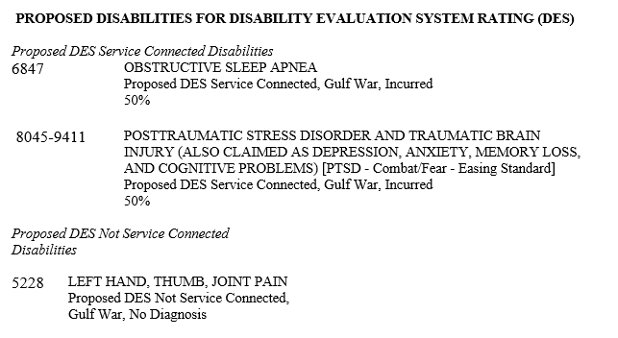
IDES Proposed Coded Conclusion
The Coded Conclusions section provides the list of conditions that are proposed DES service connected or proposed not DES service connected. This section may also include all previous rating for Reserve or National Guard members.
38 CFR Part 4, Rating Schedule for Disabilities, is used to determine disability codes and percentages of evaluation.

Slide 42
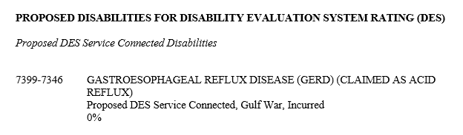
Analogous Codes
When a condition unlisted in the rating schedule is encountered, it is permissible to rate it under a closely related disease or injury, in which not only the functions affected, but the anatomical localization and symptoms are closely analogous.
Two diagnostic codes are shown on the code sheet. The first code begins with two number representing the rating schedule body system and ends in “99” to indicate it is an analogous rating. The second code is the one used to rate the claimed condition.
Notes:
A

Slide 43

Combined Evaluations
The percentage of disabilities is not added together but is determined based on the combined rating table and bilateral factor located in 38 C.F.R. §4.25.
Exception: Proposed evaluations, such as under the IDES program or proposed reductions, are not reflected in the combined evaluation.
Notes:
Instructor Note(s): For additional information; demonstrating combined evaluations and the bilateral factor using the Disability Rating Calculator is helpful. Also VBMS-R automatically calculates each combined evaluation effective date based on the issues established and effective dates entered. VA Disability Rating Calculator

Slide 44
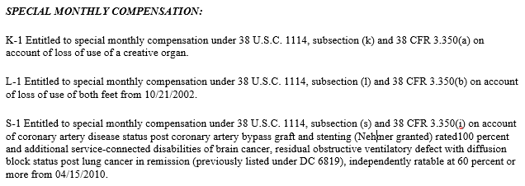
Special Monthly Compensation (SMC)
Special Monthly Compensation (SMC) recognizes the severity of certain disabilities or combinations of disabilities by adding an additional compensation to the basic rate. The most common Special Monthly Compensation (SMC) grants are:
  Loss/Loss of use of (SMC K)
  Aid and attendance (SMC L)
  Statutory Housebound (SMC S)
  .

Slide 45

Special Notations
Occasionally, the RVSR will input comments in the Special Notations box, which can include:
interpretation of the rating schedule on the claim (Reviewer notes)
special instructions to authorization (such as soliciting a claim for an issue found on exam)
Reminders for the final rating
Entitlement to ancillary benefits
Notes:
Instructor: tell the audience that they should look for any special notations on the code sheet. It would be located at the bottom of the Codesheet above the signature(s)

Slide 46
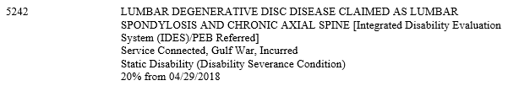
The Final Rating Code Sheet
On final IDES rating decisions (post separation and Reserve/NG members) the coded conclusion will;
identify the PEB-referred disabilities with special issue coding following the disability name
any condition for which disability severance pay was received
combat or non-combat

Slide 47
Knowledge Check

Slide 48
Questions
1. What are the parts of the Rating Code Sheet?
Data table, Jurisdiction, Associated claims(s), Coded conclusions,
Special notations and Template fields and Signature(s)
Which of the decisions below would you see on a Proposed Rating Code
Sheet? Choose all that apply.
A. Identify the PEB-referred disabilities with special issue coding following the
disability name.
B. Proposed DES Service Connection for proposed grants of service
connection (SC)
C. Proposed Special Monthly Compensation (SMC) entitlement
D. Combat or Non-combat
What is the SMC code for statutory housebound status?
SMC S – Statutory Housebound
Notes:
Instructor notes: The questions and answers will reveal as you click through.

Slide 49

Topic 4: Ancillary Benefits and the Benefits Estimate Letter (BEL)

Slide 50
Topic 4: Objectives
Identify ancillary benefits which may be applicable to the rating.
Identify the information in a Benefits Estimate Letter (BEL) and,
Recognize if a BEL should be provided to or included in the Veteran’s file.

Slide 51
Ancillary Benefits
The following are more commonly seen ancillary benefits that may be addressed on the rating, if applicable:
  Eligible for Civil Service Preference
  Entitled to Adaptive Equipment Only
  Entitled to Automobile and Adaptive Equipment
  Entitled to Loan Guaranty Benefits
DEA under 38 U.S.C. Chapter 35
SAH under 38 CFR 3.809
Special housing adaptation (SHA) awards under 38 CFR 3.809a
Automobile and adaptive equipment under 38 CFR 3.808
Vocational rehabilitation and employment, and
Loan guaranty for surviving spouses under 38 CFR 3.805

Slide 52
Ancillary Benefits (Cont.)
Active-duty IDES participants are eligible for and automatically entitled to Vocational Rehabilitation and Employment (VR&E) services. MSC’s must direct the participant to an IDES Vocational Rehabilitation Counselor(VRC) when the service member expresses interest in VR&E services.
Veterans who have a compensable SC disability maybe eligible for a waiver of the VA home loan funding fee, if VA Form 26-1880, Request for a Certificate of Eligibility is received, MSC’s must act by forwarding the form to the appropriate regional loan center (RLC) as well as ascertain if the service member plans to use VA’s home loan program and advise the service member to let his/her lender know a pre-discharge claim is pending.
Notes:
Instructor: remind the audience that understanding what the Veteran/Servicemember could be eligible for allows them to review the rating and any associated documents of the claim and relay accurate information as well as provide excellent customer service ensuring the Veteran/Servicemember receives all entitled benefits.

Slide 53
Benefits Estimate Letter (BEL)
The purpose of the BEL is to provide the participant with a proposed estimate of VA benefits to assist him/her with financial planning following discharge from active duty.
The BEL contains;
Salutation and gratitude for the SMs service
Overview of the MEB finding and notification that eligibility to VA benefits is contingent on the requisite character of service on discharge
Purpose of the BEL
What the VA is proposing, and
What the SM may be entitled to if separated
Note: The DRAS must include dependents on the BEL when VA Form 21-686c, Declaration of Status of Dependents, is of record and complete.
See M21-1, Part III, Subpart I, 2.E.6.Exhibit: Benefits Estimate Letter (BEL) for IDES Participants
Notes:
Instructor: Explain to the audience that the DRAS must prepare a notification letter in conjunction with proposed rating decisions. There is guidance for participants who are on active duty and not on active duty. III.i.2.E.3.k. Notification Letter to Accompany Proposed Rating Decisions.

Slide 54
Knowledge Check

Slide 55
Questions
Active-duty participants are eligible for and automatically entitled to what ancillary benefit?
  Vocational Rehabilitation and Employment (VR&E) services
Name are 3 of the more common ancillary benefits seen on a rating decision?
  Eligible for Civil Service Preference, Entitled to Adaptive Equipment Only, Entitled
  to Automobile and Adaptive Equipment, Entitled to Loan Guaranty Benefits, DEA
  under 38 U.S.C. Chapter 35, SAH under 38 CFR 3.809, Special housing adaptation
  (SHA) awards under 38 CFR 3.809a, Automobile and adaptive equipment under
  38 CFR 3.808, Vocational rehabilitation and employment, and Loan guaranty for
  surviving spouses under 38 CFR 3.805
  What is the purpose of the BEL?
    The purpose of the BEL is to provide the participant with a proposed estimate of VA benefits to assist him/her with financial planning following discharge from
    active duty.
Notes:
Instructor notes: The questions and answers will reveal as you click through.

Slide 56
Questions

