Slide 1
VA Appeals Modernization Act Appeals Modernization Mail Routing Denver Training Facility
Briefed by:
Tessa Koob
March 2019

Slide 2
Lesson Objectives
Become familiarized with the Appeals Modernization Act Decision Review process
Recognize VA Forms 20-0995 and 20-0996
Understand routing requirements for Decision Review requests
Demonstrate mail routing procedures for Decision Review documentation

Slide 3
References
Public Law 115-55, Veterans Appeals Improvement and Modernization Act of 2017
38 CFR 3.2500 Review of Decisions
M21-1 I.7.2. Mail Intake Procedures
M21-1 III.ii.1.E.5.c. Processing CM packets
M21-1 III.ii.2.B. Claims for Disability Compensation and/or Pension, and Claims for Survivors Benefits
M21-1 III.ii.2.C.6. Requests for Application
M21-1 III.iv.2.B.3. Readjudicating a Previously Decided Claim After February 19, 2019
Caseflow User Guide
CM Portal Superuser and Basic User Manuals

Slide 4
VBA Workload Distribution
RO VSCs
New Process Supplemental Claims
DROC St. Pete
DROC Seattle
New Process HLR
New Process Full Grants
New Process Remands
DROC D.C.
RO Appeals Teams
Legacy Appeals & Full Grants
Receipts
Legacy Remands
RAMP HLR & Supp.
New Process HLR Returns
VBA distributes AMA claims and legacy appeals to ROs for processing based on policy guidance outlined in VBA Letter 20-18-05.
VBA established new Decision Review Operations Centers (DROCs) in FY2018 to process AMA Higher-Level Reviews (HLRs) and Board decisions.
4

Slide 5
Decision Review Operations Center (DROC)
DROCs are responsible for processing AMA related mail and Decision Review Request forms for Supplemental Claims and Higher-Level Reviews:
AMA Related Mail Receipts
St Petersburg RO DROC
Seattle RO DROC
The Centralized Mail Portal (CMP) has automatic routing rules for AMA related forms and mail packets will be evenly distributed between each DROC.
DROC jurisdiction is based on workflow, not geographical location.
Notes:
All appeals-related mail will be routed to a Decision Review Operations Center (DROC) for intake processing. Appeals mail packets will be automatically routed and evenly distributed between the SeaTac, Washington and St. Petersburg, Florida DROCs using Centralize Mail (CM) portal routing rules. However, some mail may inevitably “slip through the cracks” and be routed to the Veterans Service Center’s (VSC) CM portal queue.

Slide 6
End Product Controls
Intake personnel at the DROCs use Caseflow to establish AMA Supplemental Claims and Higher-Level Reviews.
The following end products (EPs) and claim labels are used for tracking of this work:
*Note: Compensation Service is aware of the removal of EP Label Reconsideration with the update on February 19, 2019. This issue is being addressed by the appropriate staffs for a solution.
AMA EPs | EP 040 Series | EP 030 Series
Claim Labels | Supplemental Claim – Rating Supplemental Claim– Non-Rating HLR DTA Error – Rating HLR DTA Error – Non-Rating PMC Supplemental Claim – Rating PMC Supplemental Claim– Non-Rating PMC HLR DTA Error – Rating PMC HLR DTA Error – Non-Rating | Higher Level Review – Rating Higher Level Review – Non-Rating Board Grant Rating Board Grant Non-Rating
Notes:
EXPLAIN RAMP Higher-Level Reviews are tracked under end product (EP) 682 for rating and non-rating as well as EP 683 for duty to assist error corrective actions.
EXPLAIN AMA Higher-Level Reviews are tracked under end product (EP) 030 series for rating and non-rating as well as 040 series for duty to assist error corrective actions.

Slide 7
Decision Review Forms
Claimants must use the following prescribed forms when requesting a decision review:
VA Form 20-0995, Decision Review Request: Supplemental Claim
VA Form 20-0996, Decision Review Request: Higher-Level Review
VA Form 10182, Decision Review Request: Board Appeal
VA will not process the VA Form 10182 as these forms should be routed directly to the Board of Veterans’ Appeals.
Note: Requests based on Clear and Unmistakable Error (CUE) do not fall under AMA and will continue to be processed as normal by the VSC. Do NOT route CUE allegations to a DROC for intake processing
Notes:
The AMA Decision Review process retires use of the VA Form 4107, Your Rights to Appeal our Decision and VA Form 21-0958, Notice of Disagreement. Now each Decision Review process has it’s own prescribed form, the only exception being a CUE.
Supplemental Claims, which may be submitted at any time after a decision has been made on a given issue, must be submitted using VA Form 20-0995, Decision Review Request: Supplemental Claim. Supplemental claims will be processed at the DROC of jurisdiction.
A request for a Higher-Level Review must be submitted using VA Form 20-0996, Decision Review Request: Higher-Level Review and received within one year of the notice of the decision being reviewed. Higher-Level Reviews may be processed at the DROC of jurisdiction, however the claimant has the option to elect that the original station that made the decision conduct the review.
A request for a Board Appeal must also be received within one year of the notice of the decision being reviewed and must be submitted using VA Form 10182, Decision Review Request: Board Appeal. Board Appeals will be processed by the BVA.
CUE’s do not require a prescribed form, however they must be submitted in writing and bare the claimant’s signature, or that of their designated representative. There is no time limitation on submitting a request for review based on a CUE – CUEs may be alleged by a claimant or discovered by VA during the adjudication of a claim. CUEs may be processed at either a VSC or DROC.
Refer CAs to the Appeals Modernization Mail Routing – VSC Job Aid for instructions on routing these forms.

Slide 8
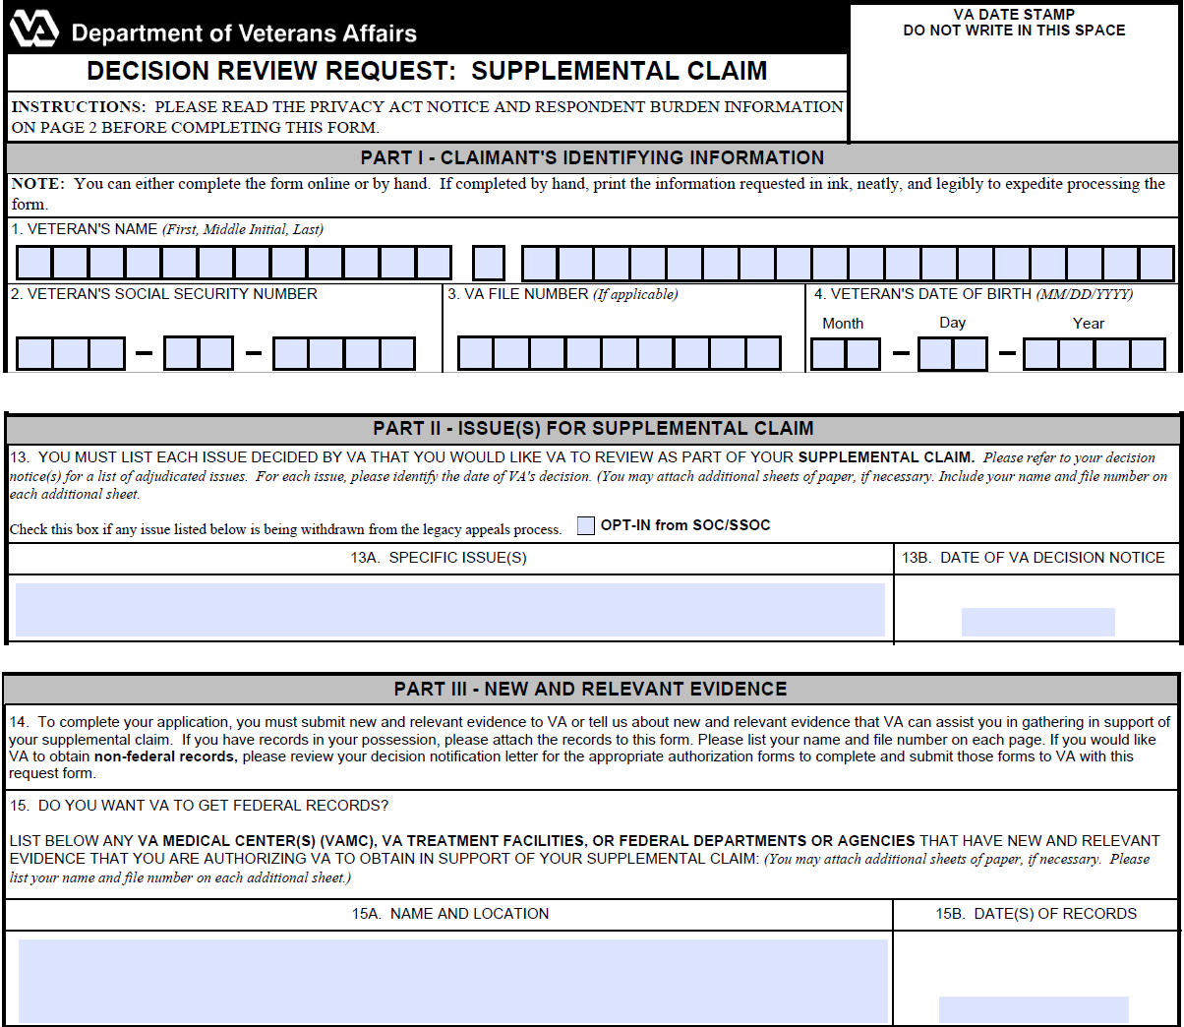
VA Form 20-0995, Decision Review Request: Supplemental Claim
Notes:
Review the VA Form 20-0995, Decision Review Request: Supplemental Claim with the trainees. Point out Part II is where the claimant must list the issue(s) they want to be part of their supplemental claim. Part III discusses the importance of New and Relevant Evidence (historically called new and material evidence).

Slide 9
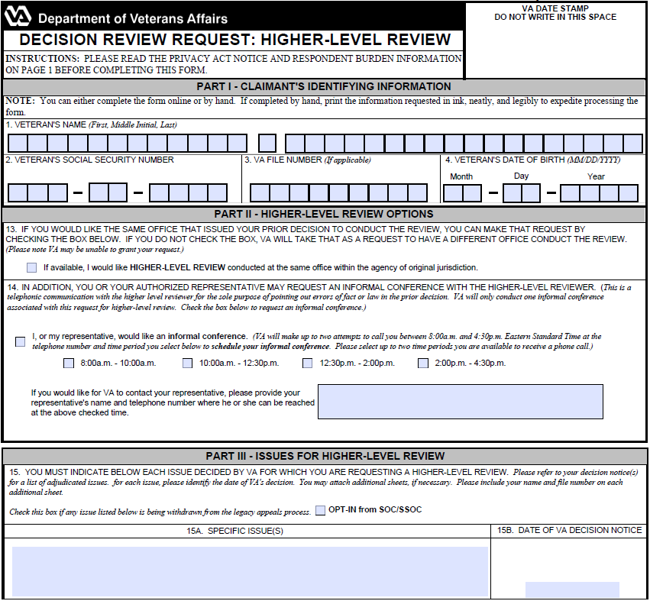
VA Form 20-0996, Decision Review Request: Higher-Level Review
Notes:
Review VA Form 20-0996, Decision Review Request: Higher-Level Review with the trainees. Discuss how Part II has the Higher-Level Review Options, including how a claimant can request a Higher-Level Review conducted a the same office within the agency of original jurisdiction, Question 13. Part III should be reviewed for the issues that are related to the Higher-Level Review and also for any issue that is being withdrawn from the legacy appeals process.

Slide 10
AMA Mail Packets
CMP users must transfer all mail packets containing AMA Decision Review documents (i.e. VA Forms 20-0995 and 20-0996) to a DROC mail portal for intake processing. When manually transferring AMA related mail packets, choose either DROC (Seattle or St. Petersburg).
If a request for a Supplemental Claim or Higher-Level Review is not received on the prescribed form (such as on a 21-526EZ), transfer the mail packet to a DROC for intake processing. DROC claims processors will send the Veteran a Request for Application AMA Review letter and process any VSC claims identified on the form.
If a CMP user sees a mail packet containing only VA Form 10182, Decision Review Request: Board Appeal, forward to the Board of Veterans’ Appeals mail portal.
Notes:
All Decision Review related mail should be automatically routed to the DROC of jurisdiction – however some forms or documents may inevitably be overlooked and assigned to a VSC claims assistant for intake processing. When reviewing mail packets in the CMP containing either VA Form 20-0995 or 20-0996, transfer the form and any associated documentation to a DROC CM queue for intake processing. This includes requests for a Decision Review not submitted on the prescribed form. Do not CEST, do not upload – just transfer the mail packet.
Advise CAs not to confuse VA Form 20-0996, Decision Review: Higher-Level Review with VA Form 21-0966, Intent to File, which have similar form numbers.

Slide 11
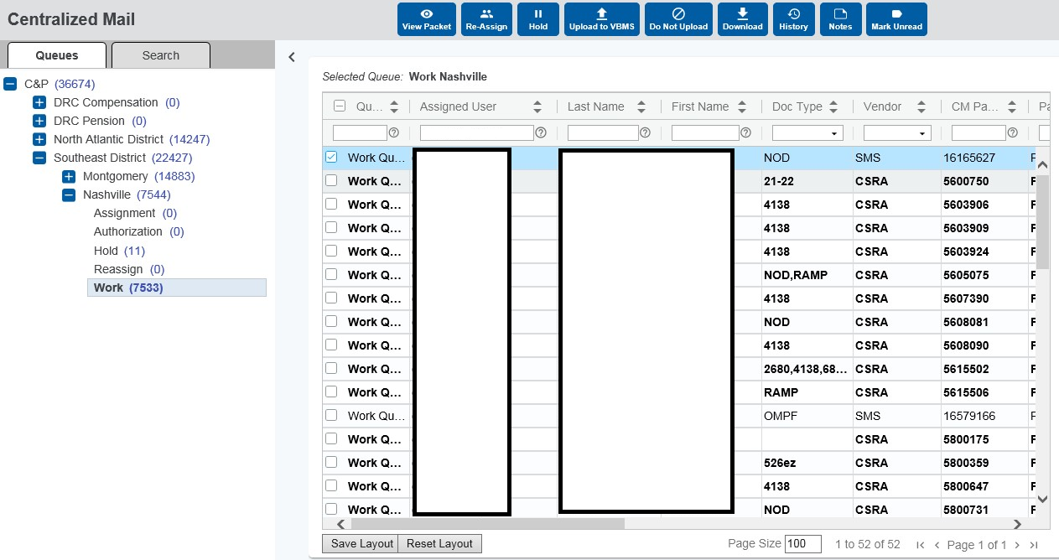
Transferring CM Mail Packets
Notes:
The CM portal user must send a mail packet to the Reassign Queue, where the Super User may route the mail packet to a DROC mail queue for intake processing.
The user must select the mail packet they wish to route to a DROC in the Results Grid display and the Packet Actions Task Bar will appear above the grid. The user must then select the “Re-Assign” button in the actions task bar to move the mail packet to the Reassign queue.
The CM portal Super User will navigate to the Reassign queue, select the mail packet, then click the “Re-Assign” action button in the task bar and select either the SeaTac or St. Petersburgrsburg DROC mail queue from the drop-down list.

Slide 12
Questions?
12

