Slide 1
Favorable Findings For Dependency
Compensation Service
March 2019

Slide 2
Lesson Objectives
Define favorable findings
Explain when to use and input favorable findings
Overturning favorable findings

Slide 3
References
Public Law 115-55, Veterans Appeals Improvement and Modernization Act 2017
38 CFR 3.103(f), Decision Notices
M21-1, Part III, Subpart v, 2. B, Decision Notices
Appeals Modernization Act Letter Guide, March 2019
Approved Language for Favorable Findings – Dependency, February 6, 2019
AMA Approved Text for PCGL Letters, February 12, 2019

Slide 4
Define Favorable Finding
A favorable finding is a determination of fact, based on applicable laws and regulations, made by the adjudicator on an issue under review. Favorable findings should relate to a material element that would be required to grant the benefit sought.

Slide 5
AMA Notice Requirements
Favorable Findings DO NOT apply to award adjustments (drill pay adjustments, military retired pay adjustments, incarceration adjustments or return to active duty)
Favorable Findings DO apply to dependency, character of discharge determinations, line of duty determinations, and other benefit entitlement issues in non-rating claims
AMA notice requirements (with exception of favorable findings noted above) DO apply to all non-rating decision

Slide 6
Required Elements of a Decision Notice
Each decision notice (rating and non-rating issues) must:
inform the claimant of the issues adjudicated
summarize the
  − evidence VA considered
  − laws and regulations applicable to the claim, and
  − applicable review options the claimant may use to seek further review
  of the decision
explain how to obtain or access evidence used in making the decision
identify
  − for denied claims, the element(s) required to grant the claim that were
  not met, and
  − a listing of findings that are favorable to the claimant under 38 CFR
  3.104(c), if any

Slide 7
Favorable Findings Requirement
Each notice of a decision affecting benefits must address any findings made by the adjudicator that are favorable to the claimant.
  Not all claims will have favorable findings
  Element selection generates favorable finding language
  Elements specific to dependent type...for example:
    Spouse
    Minor Child
    Foster child
    School child

Slide 8
Favorable Findings Requirement
For example: If we denied a claim to add a dependent spouse the decision notice would identify the element(s) not met with a summary of applicable laws and regulations. Then list the element(s) met that are favorable to the veteran. The decision notice will state:
“We couldn’t pay for <Dependent’s Name> as a dependent, because not all required elements were met. The following list contains an explanation of the elements required to establish entitlement to additional compensation for your dependent:”
“You failed to provide the date and place of the marriage. (38 CFR 3.204).”

Slide 9
Favorable Findings: Examples
“Even though we aren’t able to pay additional compensation for your dependent, the following findings were favorable to your claim:”
You are rated 30% or greater service connected
You provided < Dependent’s Name>’s social security number.
Your relationship with < Dependent’s Name> has been established.
You provided your spouse's name.
You provided < Dependent’s Name>’s social security number.
You provided marital history, as requested.
You provided your spouse’s date of birth.

Slide 10
PCGL/Letter Templates
VSRs will continue to use PCGL or other templates to generate non-rating decision notification letters, when necessary
The following sections must be amended when providing notice:
“What We Decided”
  Include any favorable findings, if applicable, for each issue decided
  Include applicable laws and regulations for each issue decided
“What You Should Do If You Disagree With Our Decision”
  Include approved text that explains AMA review options
  Include text that explains how to access or obtain evidence

Slide 11
PCGL/Letter Templates (cont.)
“Issue(s) Adjudicated/Evidence Considered”
  Decisionmakers will follow existing guidance on listing the issues adjudicated and the evidence considered
“Enclosures”
  Include VA Form 20-0998, Your Rights to Seek Further Review of Our Decision
  DO NOT include VA Form 4107 or any application forms

Slide 12
VBMS-A: Non-Rating Decisions
VBMS-Awards was updated to include functionality related to:
Documenting dependency decisions
  Favorable findings,
  Elements met/not met
  Laws and regulations
Overturning favorable findings indicated in a prior dependency decision
  Documenting justifications for overturning the decision
  Notice to the claimant
Notifying claimants of AMA review options
  Updated text under the “What to Do if You Disagree” section
  Updated enclosures (i.e. 20-0998, no longer provides application forms)

Slide 13
Inputting Favorable Findings
Automatically included in the decision notice
  Based upon VSR selecting required decision elements.
Proper selection of decision elements as “met” or “not met”
  Determines favorable finding text listed in decision notice.

Slide 14
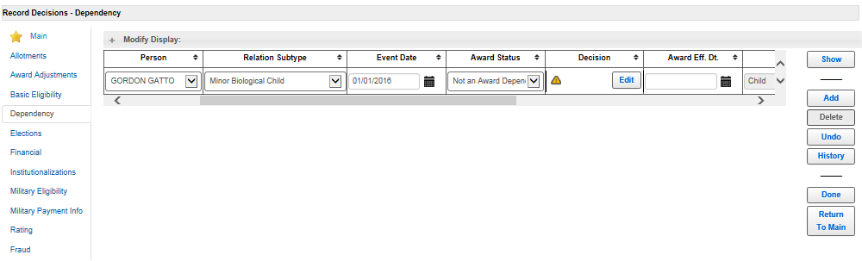
Inputting Favorable Findings (cont.)

Slide 15
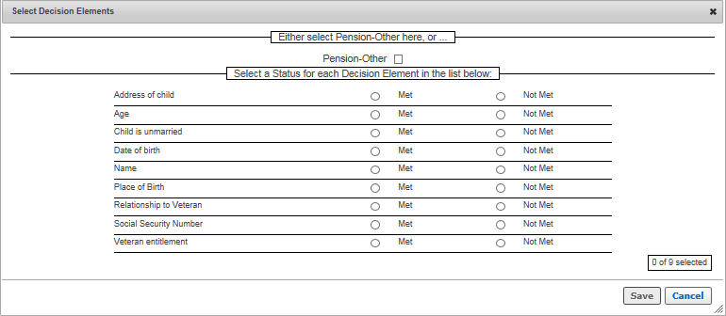
Inputting Favorable Findings (cont.)

Slide 16
Dependency Denial Example
John Smith a service connected veteran submits a VA Form 21-686c wishing to add minor child Larry Smith to his award. A review of the file show’s he is rated at 30% for sleep apnea. All information to add the minor child is present on the 686c except the minor child’s social security number.
All attempts to contact the veteran by phone have been unsuccessful. The veteran fails to respond within 30-days with requested information.

Slide 17
Dependency Denial Example (Cont...)

Slide 18
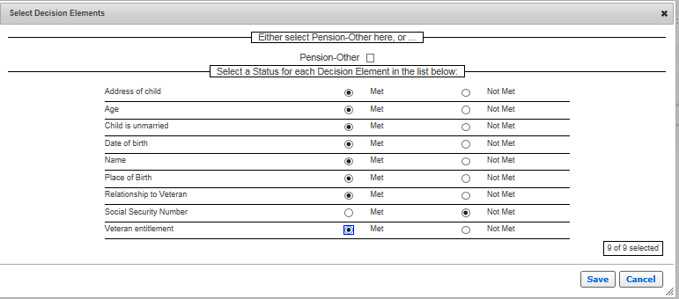
Dependency Denial Example (Cont...)

Slide 19
Dependency Denial Example (Cont...)

Slide 20
Generated Favorable Finding Text
"The following text displays in the letter:
Even though we aren’t able to pay additional compensation for your dependent, the following findings were favorable to your claim:
  You are rated 30% or greater service connected.
  You provided < Dependent’s Name>’s age.
  Your relationship with < Dependent’s Name> has been established.
  You provided your child’s name.

Slide 21
Generated Favorable Finding Text (cont.)
  You provided < Dependent’s Name's> place of birth.
  < Dependent’s Name> is unmarried.
  You provided <Dependent> address.
  You provided < Dependent’s Name>’s date of birth.

Slide 22
Generated Favorable Finding Text (Cont...)

Slide 23
Overturning Favorable Findings
The veteran may file a new claim to add a previously denied dependent that calls into question a prior favorable finding.
Once it is determined that a prior favorable finding is no longer favorable we must overturn that favorable finding and notify the veteran of the reason why the prior finding was overturned.
We take the same approach as inputting favorable findings to overturn a favorable finding. The only difference is we now take the “met” element that was previously favorable and change to “not met”.
Once you change the element you will be prompted with the following message:
"You are electing to overturn a prior favorable finding. Please provide a justification that meets the clear and unmistakable evidence standard necessary to overturn a favorable finding.”

Slide 24
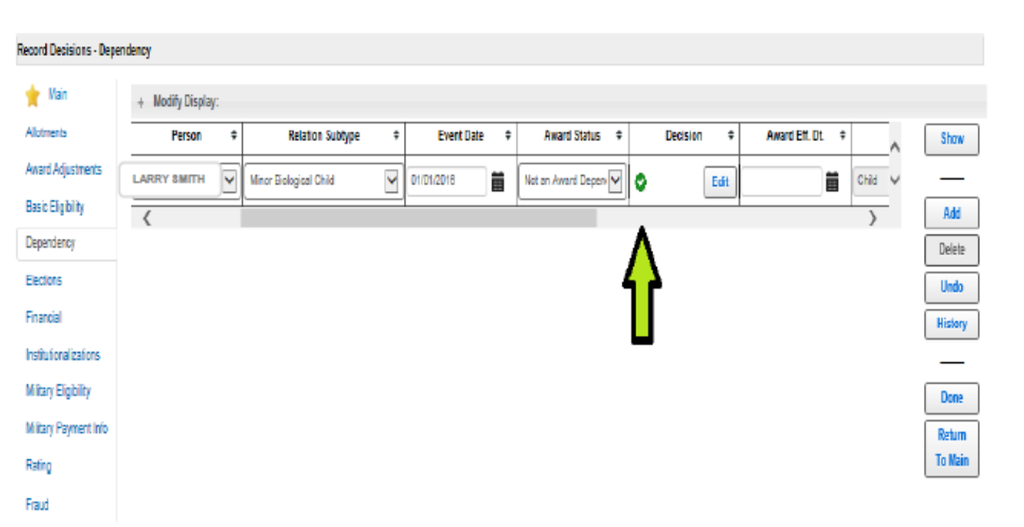
Overturning Favorable Findings (cont.)

Slide 25
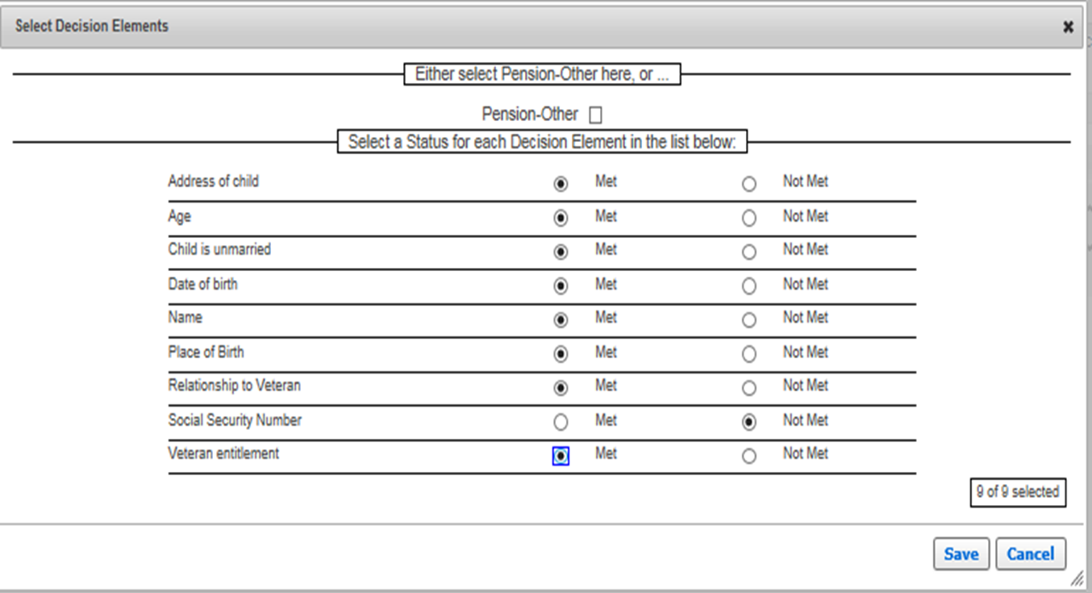
Overturning Favorable Findings (cont.)

Slide 26
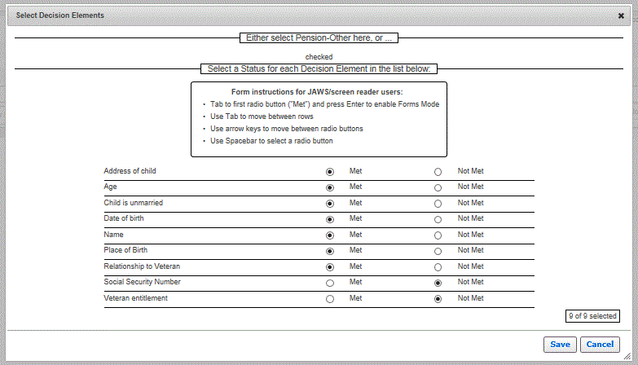
Overturning Favorable Findings (Cont...)

Slide 27
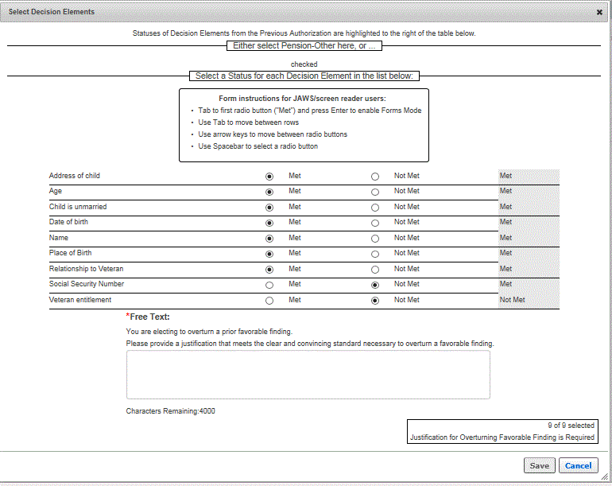
Overturning Favorable Findings (cont.)
Please provide a justification that meets the clear and unmistakable evidence standard necessary to overturn a favorable finding.

Slide 28
Overturned Favorable Finding Generated Text
“The following text displays in the letter:
Favorable Findings Overturned (Header)
“Based on evidence of record, we have overturned the following finding(s) that we had originally decided in favor of your claim:
In the text box you will list the prior favorable finding that is being overturned and then provide justification for overturning.
<You are rated 30% or greater service connected.>”
“The overturned issue's explanation appears in the letter:
“The rating decision dated 2/1/2019 reduced your service connection percentage from 30% to 20% therefore you are no longer eligible for the benefit sought. (38 CFR 3.4)”

Slide 29
Overturned Favorable Finding Generated Text

Slide 30
Review
Questions?

