Slide 1
Appointment Reminder to Text
Vocational Rehabilitation & Employment Service
Briefed by: National Program Implementation Team
Date: 12/19/2018
Notes:
Hello and welcome to the training on Appointment Reminder to Text.

Slide 2
Purpose
Provide instructions on how to send an appointment reminder
To increase the rate of Veteran attendance for scheduled VR&E appointments
Leverage existing technology to assist VR&E accomplish work more efficiently
Increase communication between VRC and Veteran
Note: There is currently no enterprise solution. This is an interim process while VR&E works on a long term solution.
Notes:
VR&E is currently looking into providing additional tools to leverage existing technology to assist VR&E field staff in accomplishing work more effectively. One such tool is sending reminders to Veterans through text message as a way to increase the rate of Veteran attendance for scheduled VR&E appointments.
The purpose of this training is to:
Provide Regional Offices with step-by-step instructions on how to send appointment reminders to Veterans using readily available technology
Help increase the rate of Veteran attendance for scheduled VR&E appointments by utilizing Appointment Reminder to Text
Assist VR&E field staff in accomplishing administrative work more efficiently
And, to increase communication with the Veteran

Slide 3
Appointment Reminder to Text
VR&E Staff will use an existing recipient list by exporting it to Excel and learn to customize it for their utilization
VR&E Staff will use a template to send an appointment reminder to Veterans’ cell phones
Recipient list includes the four major SMS (short-message service) gateway domains
VR&E Staff will follow the step-by-step Mail Merge Wizard in Microsoft Word to set up the email reminders
Veteran will receive an text reminding them of their appointment
Notes:
In this training, we will show VR&E Staff how to use an existing recipient list, which will be the Appointment to Reminder Text Report now located in OBIEE in the VR&E workload management reports dashboard, and customize it for their use. This report pulls data from the CWINRS Scheduler.
In addition to the recipient list, there is a Word template that contains a brief appointment reminder message. Both the recipient list and template are needed to send appointment reminders to Veterans’ cell phones.
The Appointment Reminder to Text report includes the four major SMS gateway domains (which are Verizon, T-Mobile, Sprint and AT&T). An SMS is a Short-Message Service, or more commonly known as a text. An SMS gateway domain is the 10-digit cellular number with the service provider’s gateway address. For example: for Verizon carriers it would be the 10-digit cell number@vtext.com, or for T-Mobile carriers it would be the 10-digit cell number@tmomail.net
VR&E Staff will use the Mail Merge Wizard in Microsoft Word to set up the e-mail reminders following the step-by-step process
The result will be the Veteran receiving an text reminding them of their appointment

Slide 4
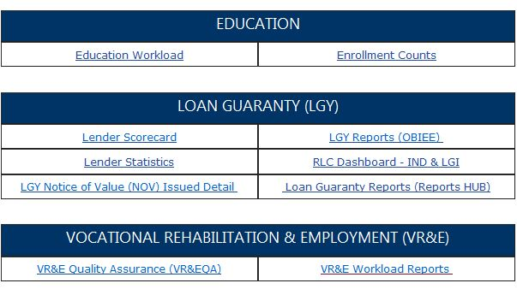
Appointment Reminder to Text cont.
Go to the Office of Performance Analysis & Integrity (PA&I) Reports page: https://vbaw.vba.va.gov/PAI/ReportsList.asp
Scroll down to Vocational Rehabilitation & Employment
Click on VR&E Workload Reports
Notes:
VR&E field staff may already have a method for accessing the VR&E Workload Reports. We will discuss how to access these reports from the PA&I home page.
Go to the Office of Performance Analysis & Integrity (PA&I) Reports page: https://vbaw.vba.va.gov/PAI/ReportsList.asp
Once on the PA&I home page, scroll down the page to Vocational Rehabilitation & Employment
Click on the VR&E Workload Reports hyperlink

Slide 5
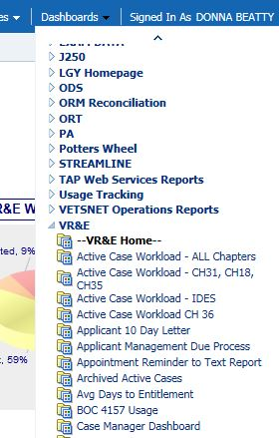
Appointment Reminder to Text cont.
Sign in using your PIV credentials
Once logged into OBIEE, click Dashboards, scroll down the menu to VR&E Home
Select Appointment Reminder to Text Report
NOTE: Please click the link once and allow the page to load as OBIEE may take a few minutes to populate all the data
Notes:
When prompted, sign in using your PIV credentials
Once logged into OBIEE, click on Dashboards from the toolbar, and scroll down to VR&E Home
Select the Appointment Reminder to Text Report
NOTE: Please click the link once and allow the page to load as OBIEE sometimes takes a few minutes to populate all the data

Slide 6
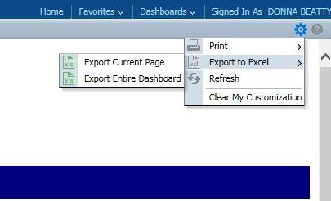
Appointment Reminder to Text cont.
Click on Page Options in upper right corner of page (cog wheel icon)
Select Export to Excel in the drop-down menu, then Export Current Page (this step usually takes a few minutes to retrieve)
Save Excel report locally with the current date (i.e., Appointment Reminder to Text Report 2018 11 28)
Notes:
Once the report loads, click on Page Options in upper right corner of page (the cog-wheel icon, to the left of the help icon) located under your name
Select Export to Excel in the drop-down menu, then Export Current Page (this step usually takes a few minutes to retrieve)
Save Excel report locally using the current date in the naming convention. (Example: Appointment Reminder to Text Report 2018 11 28)
Note: To lift the administrative burden for VR&E staff from having to obtain mobile carrier information, each Veteran’s phone number will be sent to the four major SMS gateway domains (AT&T, Verizon, Sprint, T-Mobile) and is incorporated into the report. This means that you will see four duplications for every Veteran with the four different SMS gateway addresses. This is intentional and VR&E Staff should not delete these duplications.
This will soon be your recipient list. But first, you need to customize it.

Slide 7
Appointment Reminder to Text cont.
Delete all headers, rows 1 through 7, on the Excel report
11. Scroll all the way to the bottom and delete the last rows on the
Excel report that contain the words “VR&E Intranet”, “VR&E
Knowledge Management Portal”, “PA&I Data & Information
Services”
Notes:
Before you use this list for your appointment reminders using mail merge, you must first edit it by filtering by your Regional Office, the correct days you are sending it for, and the correct case manager, and deleting all other ROs, days and case managers you do not want to send to. This will ensure that Mail Merge is able to utilize the report correctly, and more importantly, it is ensuring that your appointment reminders are not being inadvertently sent to all Veterans, to all ROs, and from all case managers nationwide.
Begin by deleting the headers on your report, rows 1 through 7
Scroll all the way to the bottom of the report and delete the last rows on the report that contain the words “VR&E Intranet”, “VR&E Knowledge Management Portal”, “PA&I Data & Information Services”. This extra information was included when the report was exported from OBIEE and it is not needed.

Slide 8
Appointment Reminder to Text cont.
12. Adjust columns A, B & C on the Excel report to make the
columns smaller. (Columns can be aligned quickly by double-
clicking on the lines of each column on the top row)
13. Highlight all column headings in the first row and select the
Sort & Filter, then Filter in the top right corner of the Excel
toolbar
Notes:
12. Adjust columns A, B & C on the Excel report to make the columns smaller. (Columns can be aligned quickly by double-clicking on the lines of each column on the top row)
13. Highlight all column headings in the first row (you can simply click on the row number on the far left), and select the Sort & Filter in the top right corner of the Excel toolbar, then
choose Filter in the drop-down menu. Notice there are now filter options in each column marked by an arrow. Clicking on the arrows will display a drop-down menu and from
there you can specify the data you want to keep and what you need to delete.
NEXT ARE IMPORTANT REMINDERS FOR CUSTOMIZING YOUR EXCEL REPORT

Slide 9
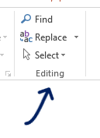
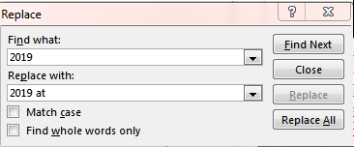
Appointment Reminder to Text cont.
NEW STEP:
Select the column labeled APPT DT.
Select the “Replace” feature from the “Editing” section.
Using the “Replace” feature enter 2019 in the “Find what” field and “2019 at” in the “Replace with field. Click “Find Next” and “Replace” or “Replace All”.
Notes:
The report from OBIEE is formatted slightly different from the previous report provided for you. The time and date for appointments are included in the same data field. For this reason, it is necessary to add the word “at” between the date and time in the field. Doing so in the spreadsheet edits the message Veterans receive.
To add “at” between the date and time, in the spreadsheet, select the column labeled “APPT DT”. Next select the “Replace” feature from the “Editing” section in the far right hand corner of the “Home” tab of the command ribbon.
Once the “Replace” box opens, enter “2019” in the “Find what” box and “2019 at” in the “Replace with” box. Click “Find Next” to locate applicable fields and replace each line individually by clicking “Replace” each time or click “Replace All” to replace all applicable text at one time.
NEXT ARE ADDITIONAL IMPORTANT REMINDERS FOR CUSTOMIZING YOUR EXCEL REPORT

Slide 10
Carrier Gateways
To lift the administrative burden for VR&E staff to obtain carrier information, each Veteran’s phone number will be sent to the four major SMS gateway domains (AT&T, Verizon, Sprint, T-Mobile) and is incorporated into the report. A Veteran will appear on the list four times, one for each gateway.
Notes:
The four gateways were chosen because they account for the largest part of the market and are least likely to charge for text messaging. To eliminate the burden of VR&E staff seeking carrier information, the email message will be sent to the Veteran’s phone number at each gateway (AT&T, Verizon, Sprint, T-Mobile). This is why each individual is listed four times in the report.

Slide 11
Important Reminders
When applying the filter to the Excel report, it is important to remember the following rules:
Be sure to DELETE the ROs that you do not want. Do not use the “hide” feature
Be sure to DELETE the Dates that you do not want. Do not use the “hide” feature
Since it is recommended that text reminders be sent out on specific days, be sure to filter the Appointment column to list only those days you are sending:
Monday report for Tues-Wed appointments
Wednesday report for Thurs-Fri appointments
Friday report for Monday appointments
When filtering by Regional Office, Case Manager, and Date, please ensure you DELETE the rows that you do not want. Do not use the “hide” function. The mail merge function does not recognize the “hide” function and will therefore send a text to all ROs, case managers, and dates if these unwanted rows are not deleted.
Notes:
When applying the filter to the Excel report, it is important to remember the following rules:
Be sure to DELETE the ROs that you do not want. Do not use the “hide” feature
Be sure to DELETE the Dates that you do not want. Do not use the “hide” feature
Since it is recommended that text reminders be sent out on specific days, be sure to filter the Appointment column to list only those days you are sending:
Monday report for Tues-Wed appointments
Wednesday report for Thurs-Fri appointments
Friday report for Monday appointments
When filtering by Regional Office, Case Manager, and Date, please ensure you DELETE the rows that you do not want. Do not use the “hide” function. The mail merge function does not recognize the “hide” function and will therefore send a text to all ROs, case managers, and dates if these unwanted rows are not deleted.
Remember, you will see each Veteran listed four times. One time for each carrier gateway.
We will now show you how to create the Word template for the appointment message.

Slide 12
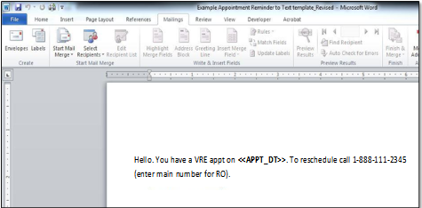
Mail Merge
Open the Word template that was provided with predefined merge fields. Using this template will ensure uniform, deliverable messages. Or, create your own using this language: Hello. You have a VRE appt on <<APPT_DT>>. To reschedule call 1-888-111-2345.
Click on the Mailings tab on the toolbar
Notes:
*Remember that your recipient list is now done and saved locally to your machine. Here is where you will begin the mail merge.
Open the Word template that was provided with predefined merge fields. This template can also be created using a blank Word document and using similar verbiage. Please ensure you are including the main number for your RO or out-based location.
Click on the Mailings tab at the top, middle portion of the toolbar.
NOTE: For out-based offices, a separate mail merge template must be created and updated to display the main office telephone number associated to that location.

Slide 13
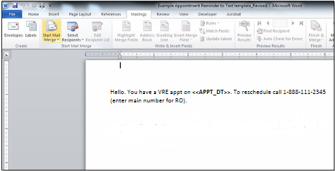
Mail Merge cont.
Click on Start Mail Merge
Notes:
Next, click on Start Mail Merge on the left side of the toolbar

Slide 14
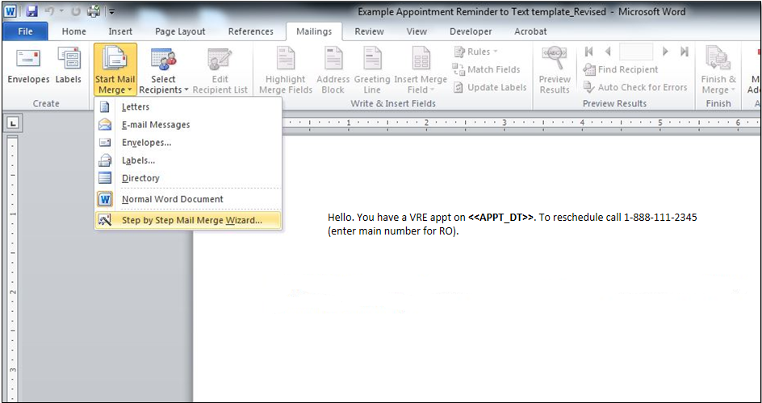
Mail Merge cont.
In the drop-down menu, click on Step by Step Mail Merge Wizard
Notes:
In the drop-down menu, click on Step by Step Mail Merge Wizard.
A Mail Merge navigation pane will appear on the right side of the screen, beginning with Step 1 of 6.

Slide 15
Mail Merge cont.
Select E-mail messages from the pick list
Then click Next
Notes:
Select E-mail messages from the pick list
Then click Next.

Slide 16
Mail Merge cont.
Next, select Use current document
Then click Next
NOTE: This step is applicable when first establishing a link to an Excel spreadsheet.
Notes:
Next, select Use current document
Then click Next
NOTE: This step is applicable when first establishing a link to an Excel spreadsheet.

Slide 17
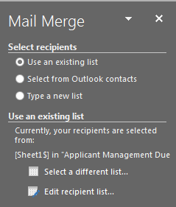
Mail Merge cont.
Select Use an Existing list
Click Browse
NOTE: This screenshot displaying Browse will be displayed with your first mail merge distribution ONLY. Subsequent mail merge distributions will display Select a different list (see figure above).
Notes:
Select Use an existing list. This is the Excel report you have just customized and saved locally.
Then click Browse.
NOTE: This first screen shot displaying “Browse” will be displayed with your 1st mail merge distribution ONLY. Subsequent mail merge distributions will display Select a different list.

Slide 18
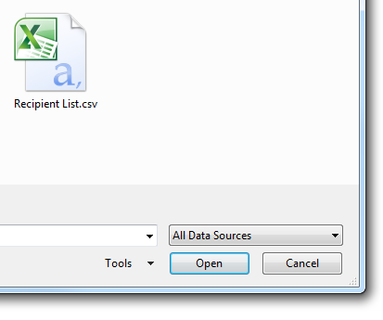
Mail Merge cont.
Once the browse window opens, select your Excel report
Click Open
Notes:
Once the browse window opens, select your Excel report from your desktop or local folder.
Then click Open

Slide 19
Mail Merge cont.
Select your list
Click OK
Notes:
Click on Open, then click OK

Slide 20
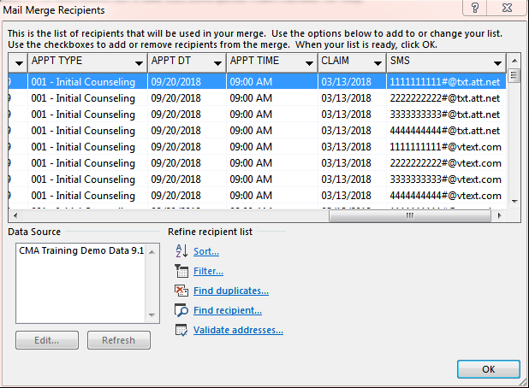
Mail Merge cont.
A box displaying all of the mail merge recipients will appear AFTER selecting a sheet and clicking okay. Double check to ensure the correct recipients are listed. Click OK.

Slide 21
Mail Merge cont.
Hello. You have a VRE appt on <<APPT_DT>>. To reschedule call 1-888-000-0000
In this step of the Mail Merge Wizard, you already have the Word template with the predefined merge fields in a generic message, shown above.
This message is intended to be short. If message verbiage is customized locally, please ensure to keep it under 160 characters, including spaces. Do not include any PII.
Click Next to preview the messages
NOTE: Enter main number for RO or out-based location
Notes:
In this step of the Mail Merge Wizard, you already have the Word template with the predefined merge fields in a generic message, shown above.
This message is intended to be short. If message verbiage is customized locally, please ensure to keep it under 160 characters, including spaces. Anything longer may be truncated due to the limited amount of characters allowed by the mobile carrier. Do not include any PII.
Click Next to preview the messages
NOTE: Enter main number for RO or out-based location

Slide 22
Mail Merge cont.
Preview the e-mail messages
Click Next to complete the mail merge
Notes:
Preview the e-mail messages
Click Next to complete the mail merge

Slide 23
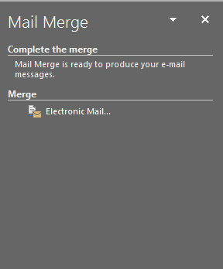
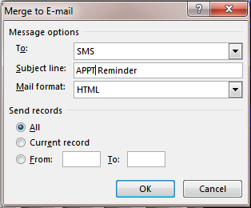
Mail Merge cont.
Click on Electronic Mail…
Choose fields in Message Options:
To: drop-down menu – select SMS
Populate the Subject Line as shown
Choose HTML in Mail Format
Click OK
Notes:
Click on Electronic Mail…
Choose fields in Message Options:
To: drop-down menu – select SMS
Populate the Subject Line as shown.
NOTE: Consistency in populating the subject line is important. We will come back to this in a couple of slides.
Choose HTML in Mail Format
Click OK

Slide 24
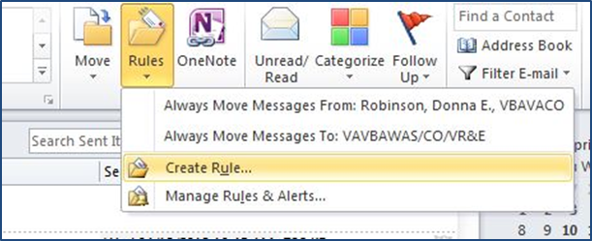
Set up Outlook Rule
Once Mail Merge is complete, set up a rule in Outlook for returned messages and responses. To set up a rule, do the following:
In Outlook mailbox, select Rules on the toolbar and then on Create Rule…
24
Notes:
Once Mail Merge is complete, you will want to set up a rule in Outlook to handle returned messages and responses.
As we mentioned earlier in the training, since the recipient report will have incorporated the four major SMS gateway domains (AT&T, Verizon, Sprint, T-Mobile), there will be email messages returned as undeliverable.
So setting up a rule in Outlook to manage these returned emails will keep your inbox from being overloaded.
To set up a rule, do the following:
In your Outlook mailbox, select Rules on the Outlook toolbar and then select Create Rule… in the drop-down menu

Slide 25
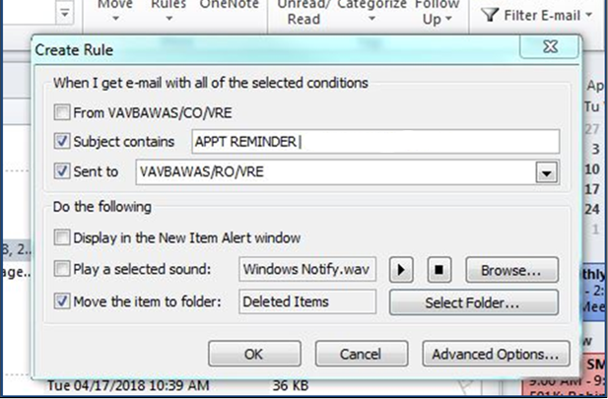
Set up Outlook Rule cont.
Check the Subject contains box and enter subject title - ensure it is the same as the subject line from your mail merge (refer to slide 19)
Check the Sent to box
Check the Move the item to folder box
Click on Select Folder…
2
3
3
4
Notes:
Check the Subject contains checkbox and enter the subject title, ensuring that it is consistent with the same as the subject line from your mail merge (refer to slide 19)
Check the Sent to checkbox and choose the option that reflects the name of your Inbox where the message was sent
Check the Move the item to folder checkbox
Click on Select Folder…

Slide 26
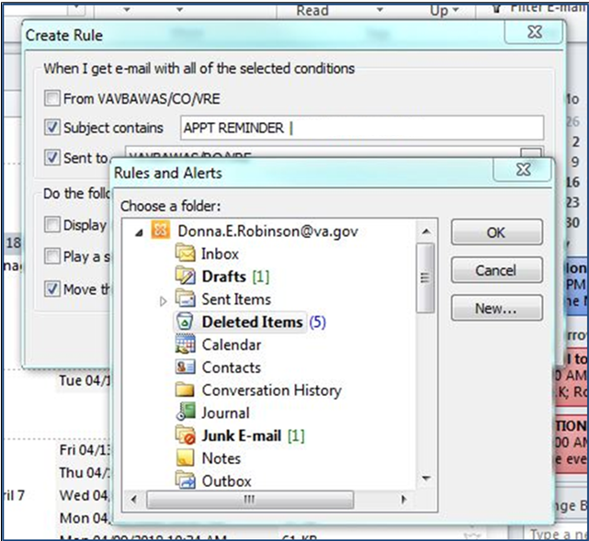
Set up Outlook Rule cont.
Choose your Deleted Items folder in the next dialogue box. Then click OK.
Notes:
This will open a new dialogue box. Select the Deleted Items folder. Then click on OK.

Slide 27
Important Reminders
Reminder it is recommended that text reminders be sent at least 3 times a week:
Send on Monday (for Tuesday & Wednesday appointments)
Send on Wednesday (for Thursday & Friday appointments)
Send on Friday (for Monday appointments)
Be sure to set up “rule” in Outlook for messages and responses that are returned undeliverable
SAFEGUARD PII (DO NOT include: Name, DOB, SSN, Disability information in the text messaging)
If message verbiage is customized locally, keep the message short (under 160 characters including spaces)
Notes:
And now for some important reminders:
It is recommended that text reminders be sent at least 3 times a week.
Remember to set up your Outlook rule to manager undeliverable messages.
Never include personally identifiable information in the messaging.
If you customize the message, ensure it is kept under 160 characters including spaces to ensure the message does not get truncated.

Slide 28
Important Reminders cont.
Provide correct the office phone number so the Veteran can call with questions, to confirm, or to reschedule the appointment in advance
Remember to turn off Preview Results function in Mail Merge before saving the template to preserve the prescribed merge fields
Notes:
Be sure to include the office phone number of either the Regional Office or the associated out-based office so the Veteran can call if they have questions.
Remember to turn off the Preview Results function in mail merge before you save your message template to keep the prescribed merge fields in the document.

Slide 29
Important Reminders cont.
Final checklist items before starting Mail Merge:
Ensure Outlook is open and running
Have Word template open
Have Excel spreadsheet (recipient list) saved in accessible location (i.e., desktop)
Notes:
And some final checklist items to remember before starting mail merge:
Make sure your Outlook is open
Have your Word template open
Be sure you have your recipient list easily accessible.

Slide 30
Appt Reminder to Text Demo
Demonstration

Slide 31
Questions?
Notes:
We have reached the end of our training for today. We will now open it up for any questions you have.

