Slide 1
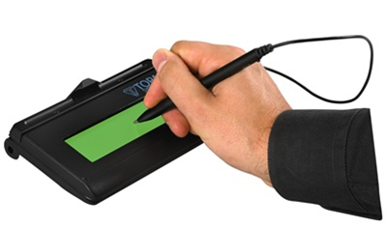
VR&E Signature Pad Training
Briefed by:
VR&E Training Team
Notes:
Welcome. My name is ______________ and I will be presenting today’s training on Signature Pads to capture Veterans’/Servicemembers’/Dependents’ signatures electronically. This is part of VR&E Service’s transition to a digital and paperless environment. It is expected that electronic signature pads will streamline the process of capturing and storing signed documents within VR&E. Electronic signature pads will only be used to capture VR&E participants’ signatures, VR&E employees will continue to use the PIV enabled signature to sign documents.

Slide 2
Training Objectives
Upon completion of this training, participants will understand:
Topaz Signature Pad capabilities
How to use the Topaz Signature Pad with a PDF document
How to use the Topaz Signature Pad with a Word document
Notes:
The goal at the end of this training is for you to understand what some of the Topaz Signature Pad capabilities are and to understand how to create digital signatures on pdf and word documents.

Slide 3
Topaz Signature Pad Icon
Adobe Acrobat DC must be loaded
before Topaz software
Notes:
When you download the Topaz software from the Software Center, you should now have both Adobe DC and Topaz signature software installed on your PC. By installing the signature pad software, you will have the pDoc Signer installed as well. This application offers an alternate way from using Adobe DC for an employee to use the signature pad for PDF documents. Since VR&E is using Adobe DC as the program of choice to view and edit PDFs, please use Adobe Acrobat DC.
To verify the Adobe software on your PC, go to your Start menu. You should see the applications for Adobe Acrobat DC as well as Adobe Reader DC. Make sure that Adobe Acrobat DC is amongst the available software to use. If you do not see it, return to the Software Center and install it.

Slide 4
Signature Pad - Selection
Notes:
You may recognize this image from the install instructions that were sent out. When you completed the install and followed the configuration instructions, you should have chosen the option to ask for the method (e.g. PIV enabled for VRC or to use the signature pad) each time you sign. The screen shows the two methods. Make sure you do not choose a specific method for signing as a default as you will need both options depending on whether you are using your PIV or the Topaz signature pad to sign the document.
VRCs will select Adobe Default Security to use their PIV card for their digital signature. In order for the Veteran or Servicemember to sign using the signature pad, Topaz Gem Sign Plus must be selected under menu options.

Slide 5
Topaz Signature Pad
The Topaz Signature Pad is a device used to securely sign PDF documents with electronic signatures using an electronic signature pad.
With the Topaz Signature Pad you can:
Create and sign new digital signature fields in PDF and Microsoft Word documents
Sign existing digital signature fields in PDF and Microsoft Word documents
Notes:
Listed on the screen are things you can do with the Topaz Signature Pad. Today, we will discuss capturing signatures in existing digital signature fields and creating and signing new digital signature fields in PDF and Word documents.

Slide 6
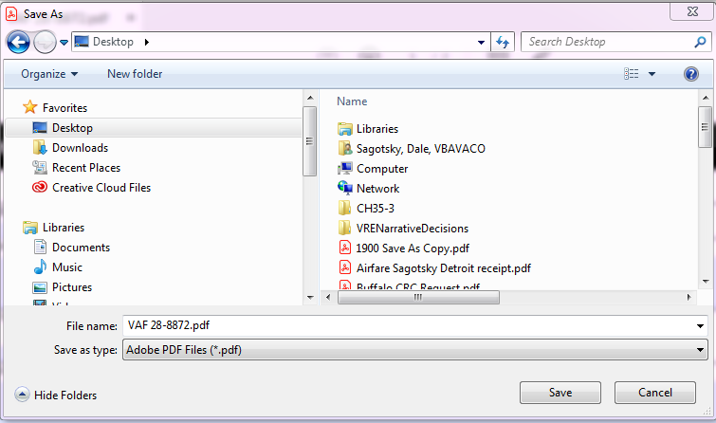
Opening Adobe PDF
Opens in Adobe Reader
Save file on your PC
Select File and right click for shortcut menu
Open with Adobe Acrobat DC
Notes:
You may have PDF documents open in Adobe Acrobat or Adobe Reader. Follow the steps outlined here to ensure that the PDF document opens with Adobe Acrobat.

Slide 7
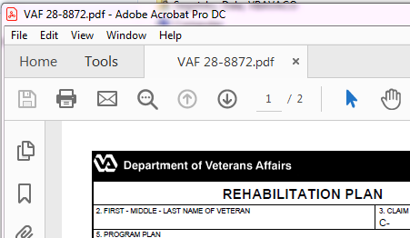
Opening Adobe PDF
Document opens in Adobe Acrobat DC
Notes:
Make sure to be using Adobe Acrobat DC and not Adobe Reader when using your signature pad.

Slide 8
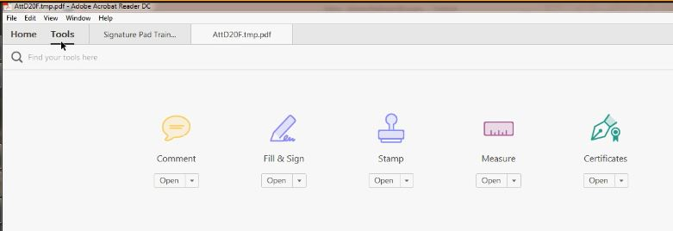
Signature Pad with PDF cont’d
Select “Tools” then choose Certificates. Click on the image or Open to access the signature toolbar. Then click on the icon for Digitally Sign.
1
2
3
Notes:
At this stage, a document needs to be open to use the signature pad.
Select Tools, then choose Certificates. You may open certificates. If you receive a yellow banner indicating enabling all features, make sure to select Enable Features.
You should have access to an icon to Digitally Sign the document. Click on the icon for Digitally Sign.

Slide 9
Capturing Veteran Signature
Select Topaz Gem Sign Plus to capture the Veteran or Servicemember signature
Notes:
After choosing to Digitally Sign, you will see the option to pick the method.

Slide 10
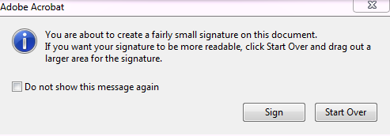
Signature Pad with PDF cont’d
Follow the instructions as displayed
Cross-hair cursor starts at top left of Signature
Field to bottom right.
If you select a small area to sign, the following message appears:
Notes:
Once you click on the digitally sign icon, a window will appear instructing you to click and drag the mouse to the area you would like your signature to display. Click Ok. You will see your mouse cursor turn into a cross-hair. At this stage, you will click, then drag and drop to the right and down to select the area you wish for the signature to appear.
If you select too small of a space you will be informed with the option to Sign, and proceed with the signature, or Start Over.

Slide 11
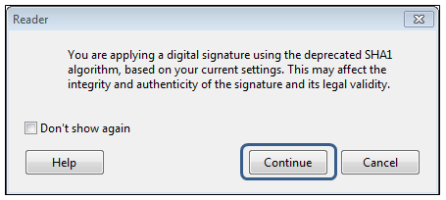
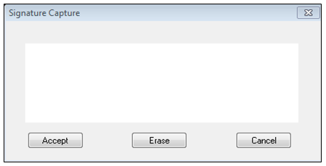
Signature Pad with PDF cont’d
Select “Continue”
“Signature Capture” screen appears.
Notes:
After you have created a signature box, select the “Continue” option.
After clicking continue, it will ask you how you want to sign it. Be sure to choose the Topaz.Gem.Plus when asked which method you would like to use to sign.
The orange tab shows you where the signature will be applied. Once you select Continue, the “Signature Capture” screen appears.

Slide 12
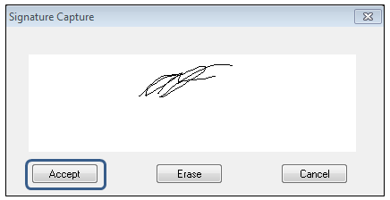
Signature Pad with PDF cont’d
Using the Topaz Signature Pad, allow the Veteran to sign his/her name onto the signature pad.
The Veteran’s signature appears on the “Signature Capture” screen displayed on your desktop. Select “Accept.”
Notes:
Using your signature pad have the Veteran, Servicemember, or Dependent sign his/her name onto the pad. Their signature should appear on your computer screen. Once that occurs, select the “Accept” option.

Slide 13
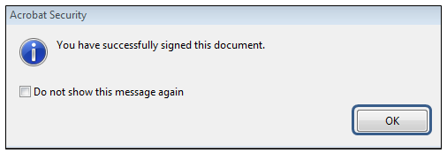
Signature Pad with PDF cont’d
In the “Acrobat Security” box select “OK.” The Veteran’s signature now appears on the PDF document.
Notes:
To accept the signature select the option “OK”.

Slide 14
Signature Pad with PDF cont’d
You now have your electronic signature embedded into the document in the signature area

Slide 15
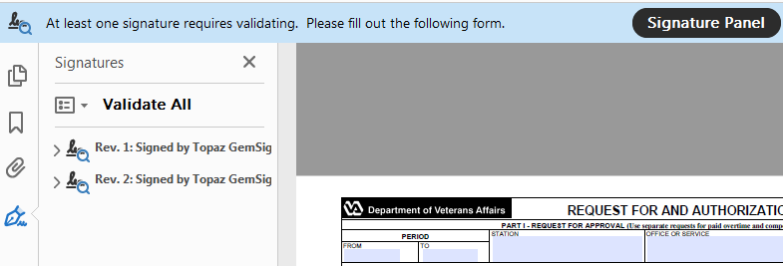
Previously Signed Docs in PDF
Notes:
What if you have previously signed a document using the signature pad, and would like to make an edit to the document? When you open the document the blue banner will appear letting you know that the document has been signed and the signatures validated. As soon as you edit the document, the signatures are no longer validated. Once you complete editing the document, you may check the signature validation by clicking on Signature Panel which will require validation. When you are done with document, you may click on Validate All or you can validate one signature at a time To Validate all signatures, click on Validate All Signatures.

Slide 16
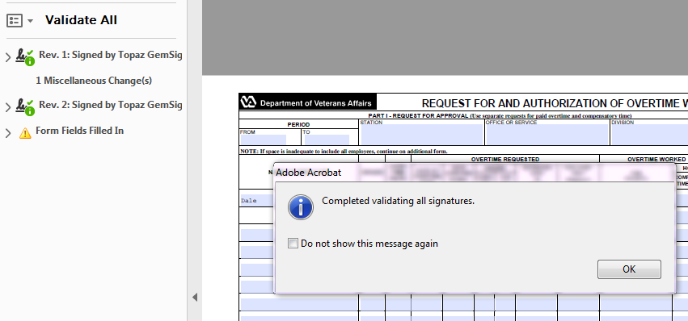
Validating Signature
Notes:
Adobe will ask if you want to validate all signatures. Click Ok. All signatures will be validated. Note each valid signature now has a green checkmark next to it. You can save the document at this point.

Slide 17
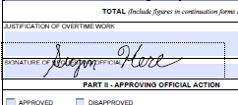
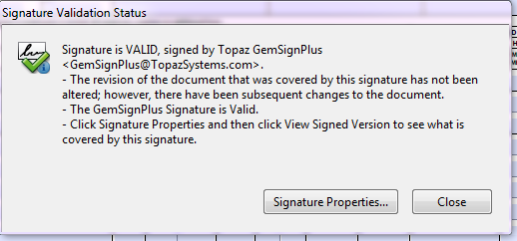
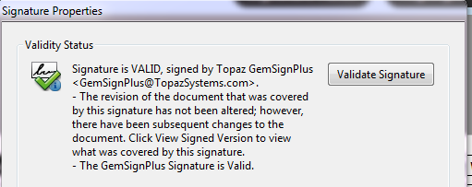
Validating Signature
Double-click signature
Signature Validation Status
Validate Signature
Notes:
You may also validate signatures by double clicking on the actual electronic signature. Choose Signature Properties. Choose Validate Signature.

Slide 18
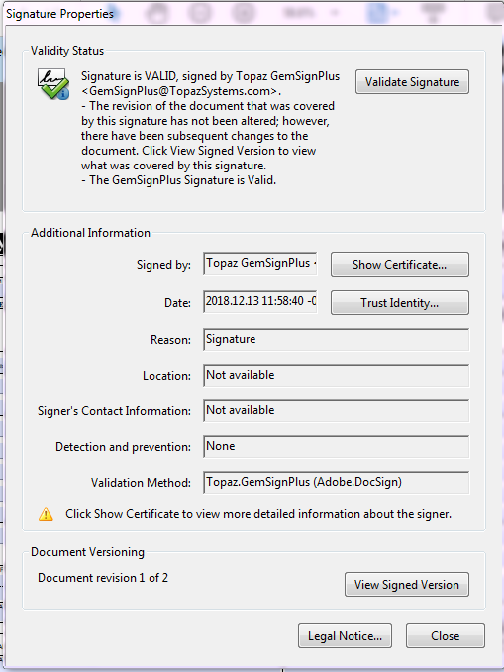
Validating Signature
Notes:
Click Close. Now the signature is validated.

Slide 19
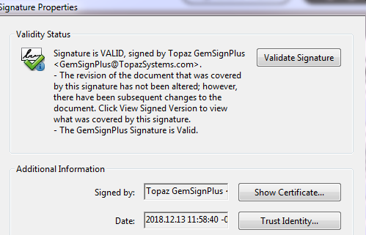
Verifying Date and Time Stamp
Notes:
To see the date and timestamp for your signature in Adobe Acrobat, complete the following steps. Double Click the Signature you want to see. A Signature Properties window will appear. The field Date has the date and time stamp of the signature.
As the VA employee, when you use your PIV to sign the document, the date/time will appear in the signature box based on PIV enabled settings.

Slide 20
Capturing Counselor Signature
Select Adobe Default Security to capture VRC’s PIV enabled digital signature
Notes:
After choosing to Digitally Sign, you will see the option to pick the method.

Slide 21
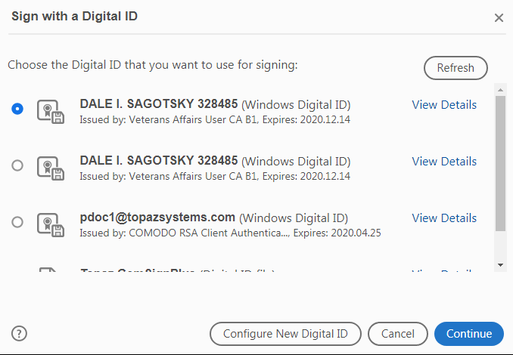
Capturing Counselor Signature
Notes:
Choose the active certificate and Continue.

Slide 22
Samples of PIV enabled signature
Notes:
Then you see a preview of your digital signature appear. Click Sign. Save the document. This completes signature options with PDF.

Slide 23
Using Signature Pads with Word
Select a Word Document. Once the document is opened, place your mouse insertion point in the signature field where the Veteran will sign. If you receive a Security Warning, you may have to Enable Content be selecting the button.
Select “Add-Ins” tab from the tool bar.
Notes:
I will now instruct on using the Topaz signature pad with MS Word. When placing an electronic signature on a Word document, open a Word document and on the above tool bar select the “Add-Ins” option.

Slide 24
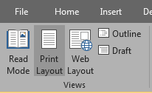
Signature Pads with Word
Ensure that you are in Print Layout Mode
Print Layout
Notes:
From the View menu of the open document, select Print Layout. The document you plan on having the Veteran sign will need to be in Print Layout mode.

Slide 25
Signature Pads with Word
Once the “Add-Ins” tab is selected, two options will appear in the custom tool bar:
Select the pencil icon: (Topaz Sig Doc)
Notes:
After selecting the “Add-Ins” option, select the pencil icon. If you get the yellow banner, Enable Content, click on that button.

Slide 26
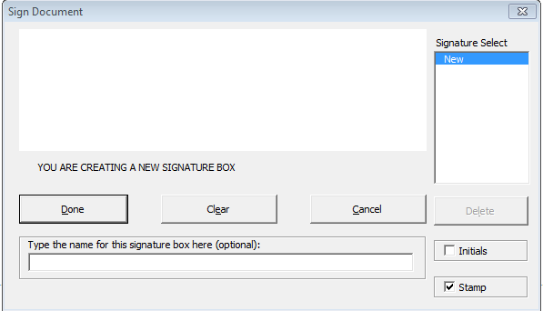
Signature Pads with Word cont’d
The “Sign Document” dialogue box appears.
Using the Topaz Signature Pad, allow the Veteran to sign his/her name. The Veteran’s signature appears on the Topaz Signature Pad and on the Signature Capture screen displayed on your desktop.
Notes:
Using your signature pad have the Veteran, Servicemember, or Dependent to sign his/her name onto the pad. They can clear the signature and start over if needed. Once they have signed, click Done.

Slide 27
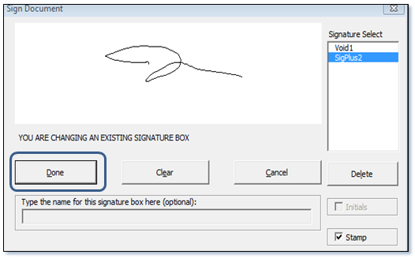
Signature Pads with Word cont’d
After the Veteran’s signature appears in the signature box, select “Done.” The Veteran’s signature appears on the document.
Notes:
The Veteran, Servicemember, or Dependent signature appears on your computer screen. Once that occurs, select the “Done” option.

Slide 28
Questions/Discussion
VA Pulse Page - VR&E Service Modernization Program
Notes:
Thank you for attending today’s training. For any additional questions please inquire through the VR&E Modernization Initiatives VA Pulse Page. A notification will be sent to VR&E employees in the coming days notifying them of this training certification completion requirement in TMS.

