Slide 1
VA Appeals Modernization Act and Impacts to Legacy Appeals
August 2022
Notes:
Course Description:
This course provides an overview of the Appeals Modernization Act (AMA) and the impacts to legacy appeals. It identifies the key changes resulting from AMA and explains the opt-in opportunities into the modernized review system.

Slide 2
The Bottom Line
A Veteran filed a notice of disagreement (NOD) in January 2015. He received a statement of the case (SOC) in April 2017 and submitted additional private medical evidence. In March 2019, he received a supplemental statement of the case (SSOC). After learning about the Appeals Modernization Act (AMA), the Veteran opted into the AMA process.
In this training, we will learn the differences between legacy appeals and AMA and how Veterans can opt-in to the new modernized review system.
Notes:
Instructor Notes:
So, what is the bottom line with VA Appeals Modernization Act and Impacts to Legacy Appeals?
Consider the following scenario: A Veteran received a decision notice denying his claim in February 2014 and filed a notice of disagreement (NOD) in January 2015. He received the statement of the case (SOC) in April 2017, more than three years after the original denial letter and two years after the NOD. In response, he submitted additional private medical evidence. In March 2019, he received a supplemental statement of the case (SSOC). After learning about the new Appeals Modernization Act (AMA) that went into effect in February 2019, he opts to put his legacy appeal into the new modernized review system under AMA.
In this training, we will learn the differences between legacy appeals and AMA and how Veterans can opt-in to the new system.

Slide 3
Objectives
Identify the key changes resulting from AMA
Identify the three review options and their attributes
Explain the opportunities to opt-in to the modernized review system
Notes:
Instructor Notes:
At the end of this training, given the training and handouts, learners will be able to successfully complete knowledge checks through instruction of the following objectives:
identify the key changes resulting from AMA
identify the three review options and their attributes, and
explain the opportunities to opt-in to the modernized review system

Slide 4
References
P.L. 115-55, Veterans Appeals Improvement and Modernization Act of 2017
38 C.F.R. § 3.2400, Applicability of Modernized Review System
M21-5, Chapter 4, Appeals Modernization Act (AMA) Control and Other Activities
M21-5, 7.D, Documenting Appeal Decisions
Notes:
Instructor Notes:
Here are our references for today’s training:
P.L. 115-55, Veterans Appeals Improvement and Modernization Act of 2017
38 C.F.R. § 3.2400, Applicability of Modernized Review System
M21-5, Chapter 4, Appeals Modernization Act (AMA) Control and Other Activities
M21-5, 7.D, Documenting Appeal Decisions

Slide 5
Objective
Identify the key changes resulting from AMA
Notes:
Instructor Notes:
Let’s jump-in to today’s training by identifying the key changes resulting from AMA.

Slide 6
What Is Appeals Modernization Act (AMA)?
The Veterans Appeals and Improvement and Modernization Act of 2017 was signed into law on August 23, 2017
Took effect February 19, 2019
Changed claims and appeals processes and decision notification requirements
Affects all VA administrations, VBA claimants, VBA business lines, and claims and appeals personnel
Notes:
Learning Objective: Identify the key changes resulting from AMA
Instructor Notes:
The Veterans Appeals and Improvement and Modernization Act of 2017 was signed into law on August 23, 2017. It took effect on February 19, 2019.
The AMA changed the claims and appeals processes and decision notification requirements. It affects all VA administrations (VBA, VHA, and NCA), all VBA claimants (Veterans, survivors, and other beneficiaries), all VBA business lines (Compensation Service, Pension and Fiduciary, Loan Guaranty, Vocational Rehabilitation and Employment Service, Insurance Service, and Education Service), and all VBA claims and appeals personnel.

Slide 7
Key Amendments
New review options (three lanes)
Improved Decision Notice
Eight-point decision notice requirements
Favorable findings
Duty to assist
Effective date protections
Filing requirements
Evidentiary record
New and relevant standard
Supplemental Claim
Higher-Level Review
Board Appeal
Notes:
Learning Objective: Identify the key changes resulting from AMA
Instructor Notes:
VA made several key amendments to the Code of Federal Regulations (CFR) in response to the AMA. These topics will be addressed throughout the training. In addition, please refer to the Job Aid attached to this training which includes more in-depth information about each of these topics.
The key amendments include:
New review options: 38 C.F.R. §§ 3.156, 3.160, 3.400, 3.2501, 3.2500, 3.2400, 3.2601, 3.2502
The AMA had multiple provisions and effects. It provided three choices for claimants dissatisfied with VA’s decisions, including authorizing two new decision review options, or lanes, such as higher-level reviews (HLR), and supplemental claims, and creating new appeals options, or reviews, within the Board of Veterans’ Appeals (Board).
Improved decision notice: 38 C.F.R. § 3.103(f)
Favorable findings: 38 C.F.R. § 3.104(c)
Duty to assist: 38 C.F.R. §§ 3.159, 3.2601, 3.103
Effective date provisions: 38 C.F.R. §§ 3.400, 3.2500
Filing requirements: 38 CFR §§ 3.151, 3.155
Evidentiary record: 38 CFR §§ 3.103, 3.104(c), 3.151(d), 3.159
New and relevant standard: 38 CFR §§ 3.156, 3.2501

Slide 8
New Improved Notice Requirements
VA discontinued VA Form 4107, Your Right to Appeal, and VA Form 21-0958, Notice of Disagreement, for all decisions (claims or appeals) issued on/after February 19, 2019
Claimants and appellants now receive VA Form 20-0998, Your Right to Seek Review of Our Decision, and are directed to the VA website to obtain applicable application forms
8
Notes:
Learning Objective: Identify the key changes resulting from AMA
Instructor Notes:
With the implementation of AMA, VA discontinued use of VA Form 4107, Your Right to Appeal, and VA Form 21-0958, Notice of Disagreement, for all decisions (claims or appeals) issued on or after February 19, 2019. VBA updated VBMS-Awards and PCGL systems to remove the discontinued forms and include the proper AMA enclosures and text explaining the new decision review options.
Claimants and appellants now receive VA Form 20-0998, Your Right to Seek Review of Our Decision, and are directed to the www.va.gov/decision-reviews website to obtain applicable forms.

Slide 9
Knowledge Check #1
Question: On what date was the Veterans Appeals and Improvement Modernization Act of 2017 (AMA) implemented?
Answer: The Veterans Appeals and Improvement Modernization Act of 2017 (AMA) was signed into law on August 23, 2017, and implemented on February 19, 2019.
Notes:
Learning Objective: Identify the key changes resulting from AMA
Instructor Notes:
**IMPORTANT: Slide contains animations. Click to reveal the scenario, question and answer to students.**
Question: On what date was the Veterans Appeals and Improvement Modernization Act of 2017 (AMA) implemented?
Answer: The Veterans Appeals and Improvement Modernization Act of 2017 (AMA) was signed into law on August 23, 2017, and implemented on February 19, 2019.

Slide 10
Objective Identify the three review options and their attributes
Notes:
Instructor Notes:
Next, let’s identify the three review options and their attributes.

Slide 11
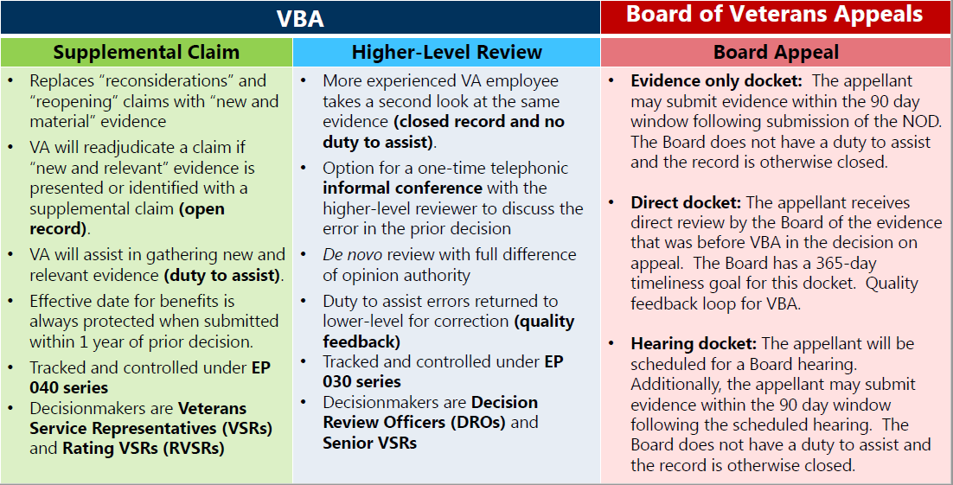
Three Review Options
Notes:
Learning Objective: Identify the three review options and their attributes
Instructor Notes:
The AMA created three new review options for claimants who disagree with the decisions they receive from VA: supplemental claim; higher-level review; and Board appeal. Each lane has its own attributes and characteristics.
Supplemental claims replace reconsiderations and reopened claims with new and material evidence. VA will readjudicate a claim if new and relevant evidence is presented or identified with a supplemental claim (open record). VA will assist in gather new and relevant evidence (duty to assist). Effective date for benefits is always protected when submitted within one year of the prior decision. These claims are tracked and controlled under EP 040 series. Decisionmakers for these claims are Veterans Service Representatives (VSR) and Rating VSRs (RVSR).
Higher-level review claims are for more experienced VA employees to take a look at the same evidence (closed record and no duty to assist). Claimants have the option for a one-time telephonic informal conference with the higher-level reviewer to discuss the error in the prior decision. The HLR is a de novo review where decisionmakers have full difference of opinion authority. Duty to assist errors are returned to lower-level for correction (quality feedback loop). HLRs are tracked and controlled under EP 030 series. Decisionmakers are Decision Review Officers (DRO) for rating issues and Senior VSRs (GS-11 or GS-12 VSRs and Authorization Quality Review Specialists (AQRS)) for non-rating issues.
Board appeals are sent to the Board of Veterans Appeals with three docket choices. Claimants can choose the evidence only docket, where the appellant may submit evidence within the 90-day window following submission of the Notice of Disagreement (NOD). The Board does not have a duty to assist, and the record is otherwise closed. Claimants can choose the direct docket, where the appellant receives direct review by the Board of the evidence that was before VBA in the decision on appeal. The Board has a 365-day timeliness goal for this docket with a quality feedback loop for VBA. Finally, claimants can choose the hearing docket, where the appellant is scheduled for a Board hearing. Additionally, the appellant may submit evidence within the 90-day window following the scheduled hearing. The Board does not have a duty to assist, and the record is otherwise closed.

Slide 12
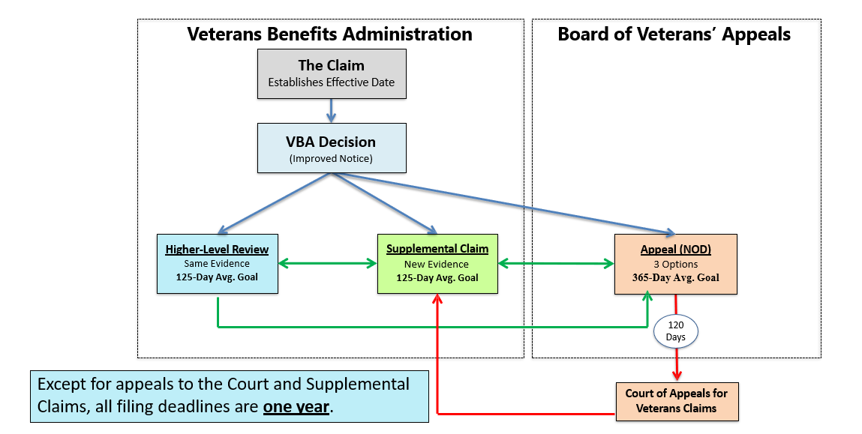
New Decision Review Process
Notes:
Learning Objective: Identify the three review options and their attributes
Instructor Notes:
The chart here explains the new decision review process. The first step is that the Veterans Benefits Administration (VBA) establishes a claim and issues a decision. Once the claimant receives the notice from VBA, if the claimant disagrees with the decision, the claimant has three review options.
The claimant can select the higher-level review with the same evidence, a supplemental claim with new evidence, or a Board appeal with three evidentiary options. The choice of the initial review lane can also be determinative of any following review lanes. If a claimant selects the higher-level review lane but then disagrees with the decision on the HLR, the claimant cannot ask for another HLR of the same issue immediately following the decision; the claimant would have to select a supplemental claim review or a Board appeal.
If a claimant selects a Board appeal and disagrees with the decision, the claimant can only go to the Court of Appeals for Veterans Claims (CAVC) for review. After a CAVC decision, the claimant can only seek review under a supplemental claim if there is new evidence.
If a claimant selects supplemental review and disagrees with the decision, the claimant can seek another supplemental review, if there is new evidence; if there is no new evidence, the claimant can request a higher-level review or a Board appeal.
Except for appeals to the Court and supplemental claims, all filing deadlines are one year from date of notification letter of a decision.

Slide 13
AMA Forms
Claimants must use specific VA forms to file for decision review:
VA Form 20-0995, Decision Review Request: Supplemental Claim
VA Form 20-0996, Decision Review Request: Higher-Level Review
VA Form 10182, Decision Review Request: Board Appeal (Notice of Disagreement)
VA Form 20-0998, Your Right to Seek Review of Our Decision included in all decision notices
Notes:
Learning Objective: Identify the three review options and their attributes
Instructor Notes:
With the development of the AMA, VA created new forms for applicants to complete based on the lane chosen.
Claimants who choose the
supplemental lane file VA Form 20-0995, Decision Review Request: Supplemental Claim
higher-level review lane file VA Form 20-0996, Decision Review Request: Higher-Level Review, and
Board lane file VA Form 10182, Decision Review Request: Board Appeal (Notice of Disagreement).
In addition, all decision notices sent by VA now include VA Form 20-0998, Your Right to Seek Review of Our Decision, which explains the new decision review options.

Slide 14
Knowledge Check #2
Scenario: Veteran wants VBA to review the denial of service connection for hearing loss. He has no new evidence and does not want VA to develop for any new evidence. In addition, he wishes to have an informal conference.
Question: Which VBA review option includes a closed evidentiary record, an informal conference, and no duty to assist?
Answer: Higher-level reviews include a closed evidentiary record and no duty to assist. Claimants who wish to seek VBA review and have additional evidence should file a supplemental claim.
Notes:
Learning Objective: Identify the three review options and their attributes
Instructor Notes:
**IMPORTANT: Slide contains animations. Click to reveal the scenario, question and answer to students.**
Scenario: Veteran wants VBA to review the denial of service connection for hearing loss. He has no new evidence and does not want VA to develop for any new evidence. In addition, he wishes to have an informal conference.
Question: Which VBA review option includes a closed evidentiary record and no duty to assist?
Answer: Higher-level reviews include a closed evidentiary record and no duty to assist. Claimants who wish to seek VBA review and have additional evidence should file a supplemental claim.

Slide 15
Objective Explain the opportunities to opt-in to the modernized review system
Notes:
Instructor Notes:
Let’s jump-in to today’s training by identifying the key changes resulting from AMA.

Slide 16
“Opt-in” Opportunities for Legacy Appeals
Test Programs
Concluded with the implementation of the new law
Rapid Appeals Modernization Program (RAMP) and Board Early Applicability of Appeals Modernization (BEAAM)
Opt-in from an SOC/SSOC
Available after the effective date of the new law
Must be filed within 60 days of receipt of SOC/SSOC, or within the one-year appeal period of the contested decision*
*Note: The one-year legacy appeal period for decisions made prior to AMA implementation expired in February 2020
16
Notes:
Learning Objective: Explain the opt-in opportunities for legacy appeals
Instructor Notes:
With the implementation of the AMA, claimants who receive a notification decision dated February 19, 2019, or later, can choose one of the three new review options. However, there are also two opportunities for some claimants with pending legacy appeals to “opt-in” to the new modernized review system.
TEST PROGRAMS
First, VA implemented test programs prior to the full implementation of the AMA. These test programs, Rapid Appeals Modernization Program (RAMP) and the Board Early Applicability of Appeals Modernization (BEAAM), concluded prior to February 19, 2019.
RAMP operated from November 1, 2017, to February 15, 2019. It was open to Veterans with a pending legacy appeal in an eligible stage. The program allowed participants to request review under either the higher-level review or supplemental claim lanes.
BEAAM was a test program open to a select group of Veterans and allowed them to request review in the Board appeal lane. Some of these decisions resulted in grants or remands that were processed by VBA.
OPT-IN FROM SOC/SSOC
Second, claimants who receive a statement of the case (SOC) or supplemental statement of the case (SSOC) after the effective date of the new law can opt-in to the new system. They must file the opt-in within 60 days of receipt of the SOC/SSOC, or within the one-year appeal period of the contested decision.
*Note: The one-year legacy appeal period for decisions made prior to AMA implementation expired in February 2020

Slide 17
SOC/SSOC Opt-in to the Modernized System
Statement of the Case (SOC) or Supplemental Statement of the Case (SSOC) on or after February 19, 2019
Issue based, not claim based
Must be filed within 60 days of SOC/SSOC
VA will include the following enclosures:
VA Modernized Decision Review System - SOC/SSOC Opt-in Fact Sheet
VA Form 20-0998, Your Right to Seek Review of Our Decision
17
Notes:
Learning Objective: Explain the opt-in opportunities for legacy appeals
Instructor Notes:
Now that the test programs have concluded, claimants who receive a Statement of the Case (SOC) or Supplemental Statement of the Case (SSOC) on or after February 19, 2019, can opt-in to the modernized system.
Opt-in to the modernized system is issue-based, not claim-based. For example, if a claimant receives an SOC for three issues, they can opt-in to the modernized system for one, two, or all three issues. The issues that the claimant does not opt-in to modernized system remain in the legacy system.
VA must receive the opt-in within 60 days of the date of the SOC or SSOC.
To ensure claimants are aware of this opportunity, with every SOC/SSOC issued on or after February 19, 2019, VA will include the following enclosures:
VA Modernized Decision Review System - SOC/SSOC Opt-in Fact Sheet
VA Form 20-0998, Your Rights to Seek Review of Our Decision
VBA will no longer provide the application forms to claimants with notice letters. Claimants will access the new forms on the VA.gov forms page.

Slide 18
How To Opt-in From an SOC/SSOC
Claimants must check the “OPT-IN from SOC/SSOC” box on the applicable form (VA Form 20-0995 or VA Form 20-0996) to opt-in
Withdraws the issues listed from the legacy appeals process and withdraws any associated hearing requests
Claimant cannot return to the legacy appeals process for the issue(s)
Notes:
Learning Objective: Explain the opt-in opportunities for legacy appeals
Instructor Notes:
Claimants must check the “OPT-IN from SOC/SSOC” box on the applicable form to opt-in. By checking the box, the claimant is electing to withdraw the issues listed from the legacy appeals process and are withdrawing any associated hearing requests.
The claimant cannot return to the legacy appeals process for the issue(s).
The images are examples of the opt-in box that is available on higher-level review claim form (top box) and supplemental claim form (bottom box).

Slide 19
Knowledge Check #3
Question: A Veteran has a legacy appeal pending for service connection for tinnitus and hearing loss and evaluation of posttraumatic stress disorder (PTSD) and receives an SSOC for all three issues. What options are available to the Veteran if they wish to opt-in to the modernized system? What options are available if the Veteran wishes to return to the legacy system after opt-in?
Answer: The Veteran can opt-in to the modernized system for any of the issues on the SSOC. They can choose to opt-in the tinnitus, hearing loss, and/or PTSD. Once an issue is in the modernized system, however, the Veteran cannot return to the legacy appeal system.
Notes:
Learning Objective: Explain the opt-in opportunities for legacy appeals
Instructor Notes:
**IMPORTANT: Slide contains animations. Click to reveal the scenario, question and answer to students.**
Question: A Veteran has a legacy appeal pending for service connection for tinnitus and hearing loss and evaluation of posttraumatic stress disorder (PTSD) and receives an SSOC for all three issues. What options are available to the Veteran if they wish to opt-in to the modernized system? What options are available if the Veteran wishes to return to the legacy system after opt-in?
Answer: The Veteran can opt-in to the modernized system for any of the issues on the SSOC. They can choose to opt-in the tinnitus, hearing loss, and/or PTSD. Once an issue is in the modernized system, however, the Veteran cannot return to the legacy appeal system.

Slide 20
Course Summary
AMA Impacts to Legacy
Identifying the key changes with AMA
Identifying the new review options
Explaining the opt-in opportunities from legacy appeals
Notes:
Instructor Notes:
As stated in the beginning of the training, the lesson objectives were to:
Identifying the key changes with AMA
Identifying the new review options
Explaining the opt-in opportunities from legacy appeals
We discussed each of these objectives through the topics in each slide today.

Slide 21
Questions?
Discuss any additional questions after today’s training locally with experts, quality staff, and/or management. Management may route any additional questions requiring OAR assistance to OARADMIN.VBAWAS@va.gov
21
Notes:
Instructor Notes:
What other questions do you have today?
Please discuss any additional questions after today’s training locally with experts, quality staff, and/or management. Management may route any questions requiring OAR assistance to OARADMIN.VBAWAS@va.gov.

Slide 22
Next Steps
An assessment and satisfaction survey have been assigned to you in TMS
You have unlimited attempts to complete the assessment and may answer one question incorrectly to achieve a passing score
Be sure to complete the survey and assessment to receive credit for this training
Notes:
Instructor Notes:
An assessment and satisfaction survey have been assigned to you in TMS. You have unlimited attempts to complete the assessment and may answer one question incorrectly to achieve a passing score. Completing both will allow you to receive credit for this training.

